Slide 1
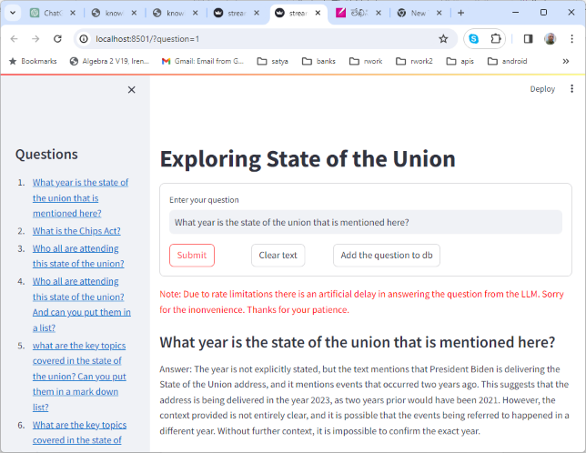
A Trivial RAG

Slide 2
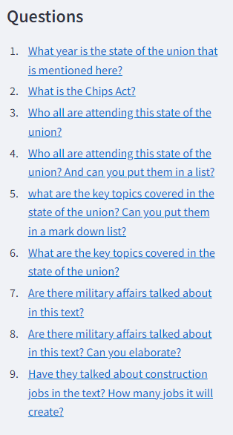
Questions

Slide 3
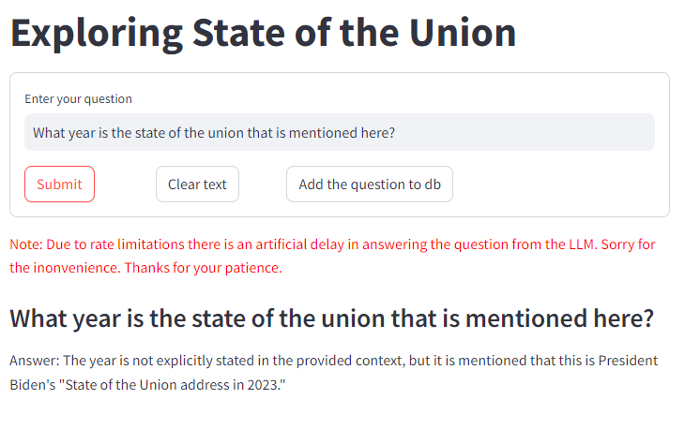
Answers
What year is the state of the union that is mentioned here?
Answer: The year is not explicitly stated in the provided context, but it is mentioned that this is President Biden's "State of the Union address in 2023."

Slide 4
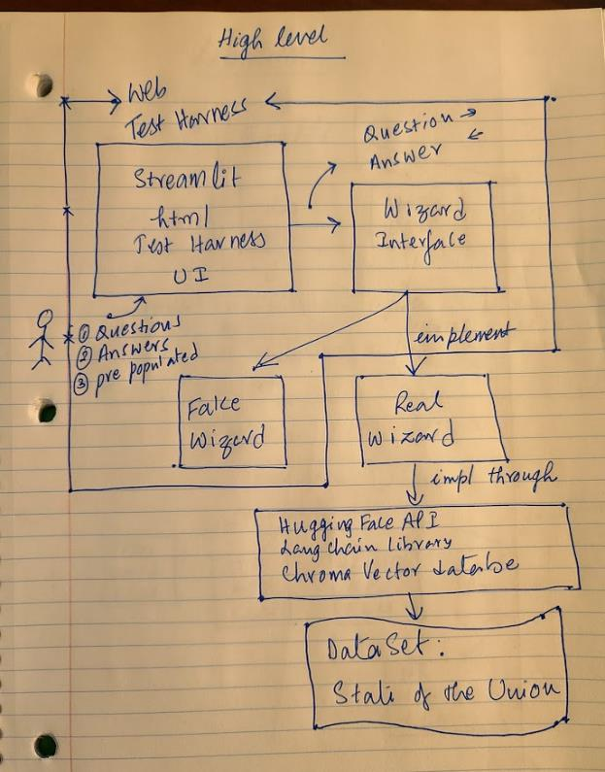
High level Architecture

Slide 5
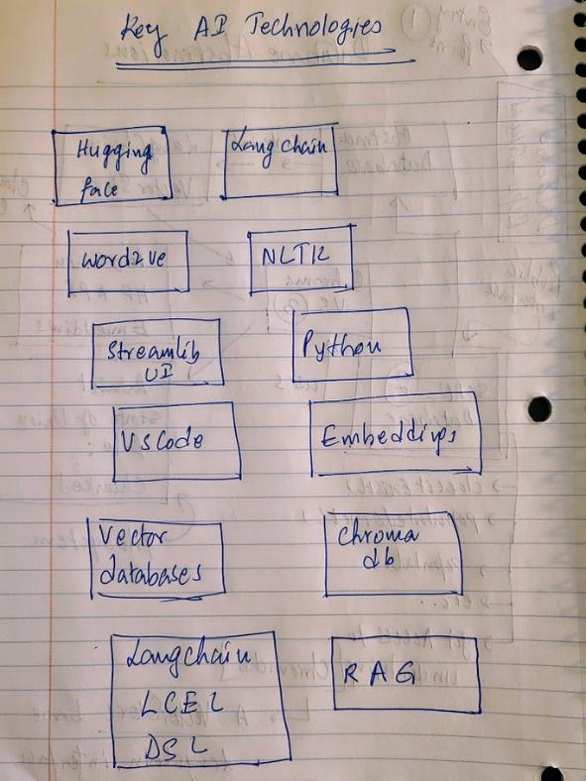
What did I learn

Slide 6
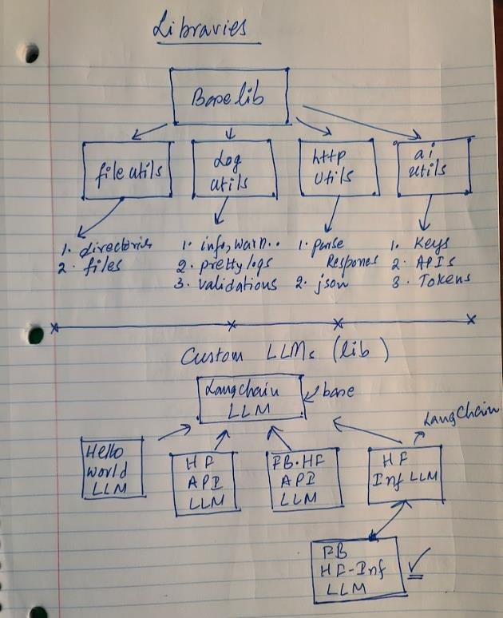
Base Libs, HF, LangChain

Slide 7
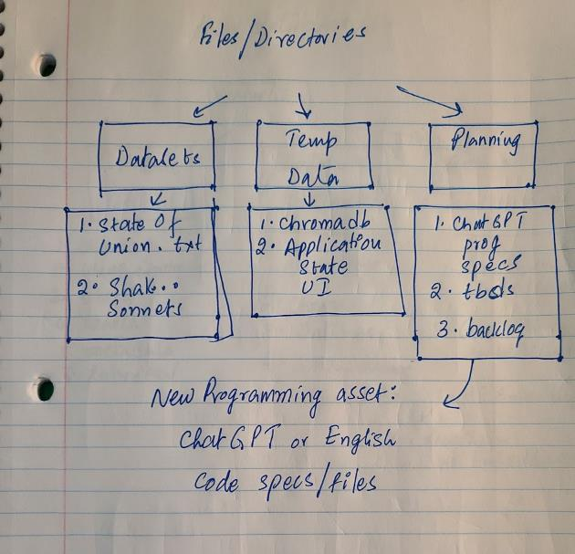
Files, Datasets, Miscellaneous

Slide 8
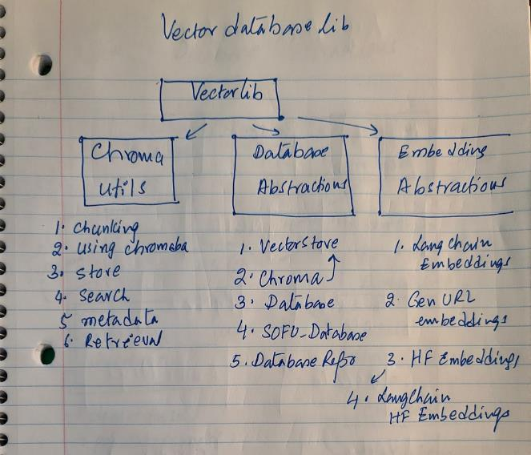
Vector Databases

Slide 9
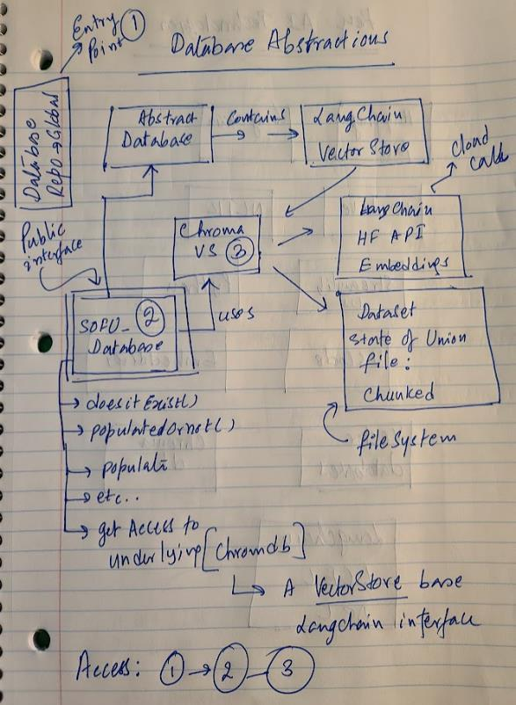
Vector Database Abstractions

Slide 10
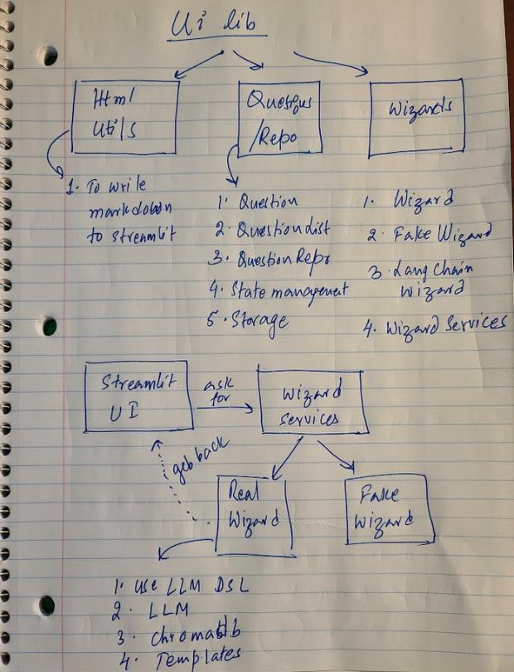
UI Design/libs

Slide 11
Key References [More to come]
GitHub Projects
https://github.com/SatyaKomatineni/langchaindemo [Main one]
https://github.com/SatyaKomatineni/articles-repo
https://github.com/SatyaKomatineni/llmragdemo-repo
Hugging Face
https://huggingface.co/ (home)
https://huggingface.co/docs/api-inference/detailed_parameters (How to use their API – Most useful)
https://github.com/huggingface (on github)
LangChain
https://chat.langchain.com/ [Great ai help on langchain]
https://python.langchain.com/docs/modules/model_io/llms/custom_llm (how to write custom LLMs)
LangChain Vector Stores/Embeddings/github
https://python.langchain.com/docs/integrations/retrievers/self_query/chroma_self_query (how to use Chroma, an interface to ChromaDB)
Understanding vetcor stores: Docs/Integrations/Components/Vector stores/Chroma
https://python.langchain.com/docs/modules/data_connection/text_embedding/ (Embeddings in langchain world)
They are at: /docs/integrations/text-embedding
https://python.langchain.com/docs/integrations/text_embedding/sentence_transformers
https://github.com/langchain-ai/langchain/blob/a210a8bc53f9c5c4820f45abdb2cc3200d52b1e2/libs/core/langchain_core/embeddings.py#L7 (base class embeddings)
https://github.com/langchain-ai/langchain/tree/00a09e1b7117f3bde14a44748510fcccc95f9de5/libs/community/langchain_community/embeddings (all available ones)
Embedding Basics
https://docs.trychroma.com/embeddings (Chromadb take on them)
https://platform.openai.com/docs/guides/embeddings/what-are-embeddings (Open ai take on them)
https://www.sbert.net/docs/pretrained_models.html (Deeper read)

Slide 12
Next Steps
Lit Survey for LCEL
LCEL Architecture
Output parsers
Use Pine cone
Agents
Data preparation

