Slide 1
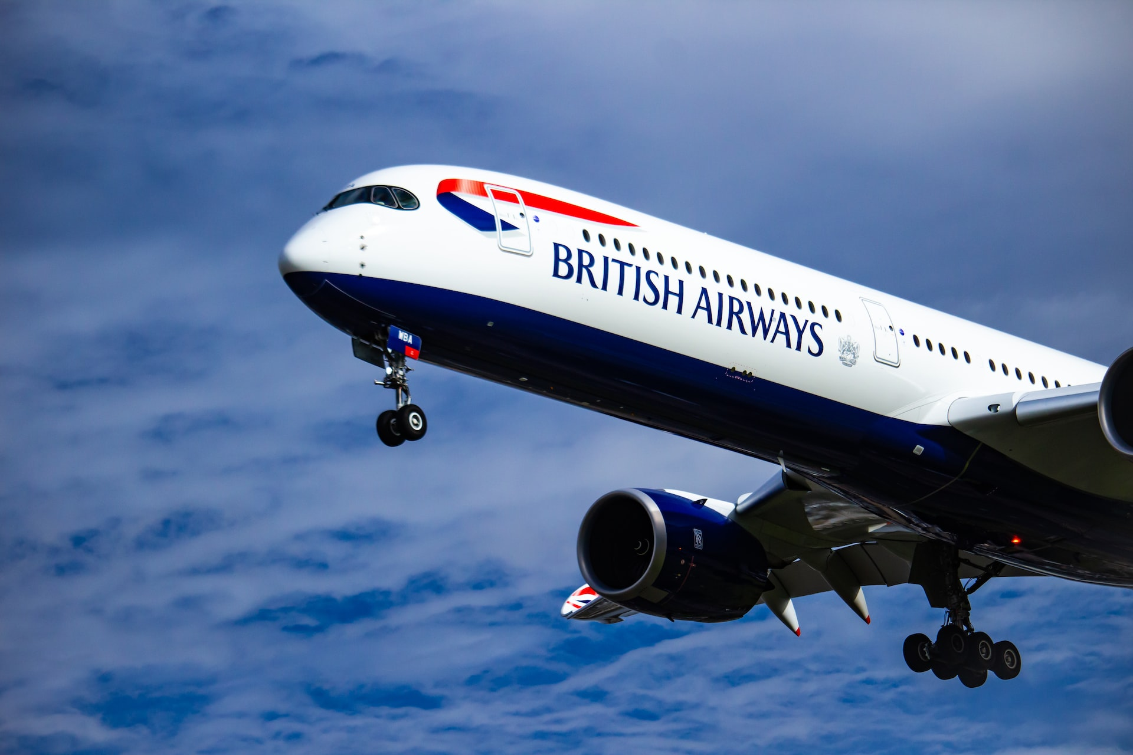
BRITISH AIRWAYS
SOLELY FOR PURPOSES OF FORAGE WORK EXPERIENCE
Insights on customer feedback
INSIGHTS ON CONSUMER FEEDBACKS

Slide 2
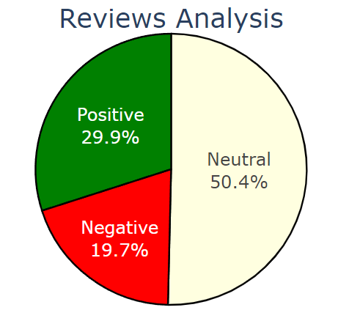
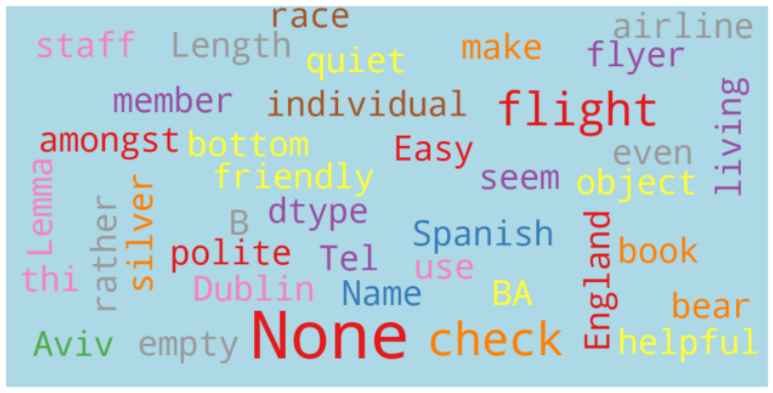
Consumer reviews
We have successfully collected 3460 consumer reviews.
Positive Reviews: 1036
Negative Reviews: 681
Neutral Reviews: 1743

