Slide 1
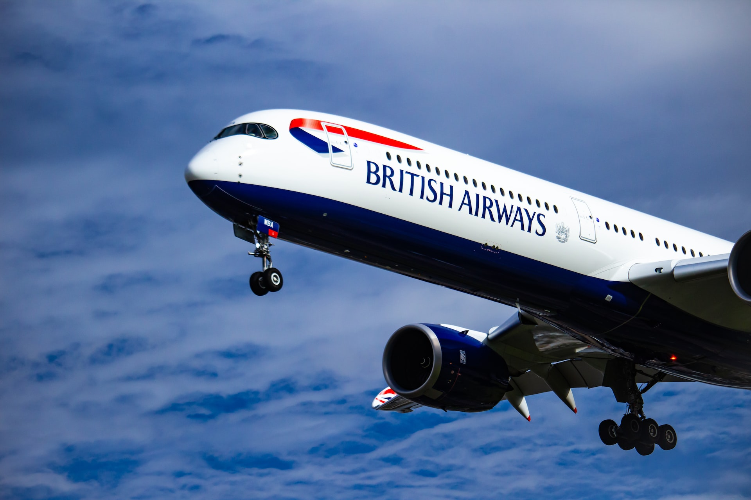
BRITISH AIRWAYS
SOLELY FOR PURPOSES OF FORAGE WORK EXPERIENCE
Insights on customer feedback
INSIGHTS ON CONSUMER FEEDBACKS

Slide 2
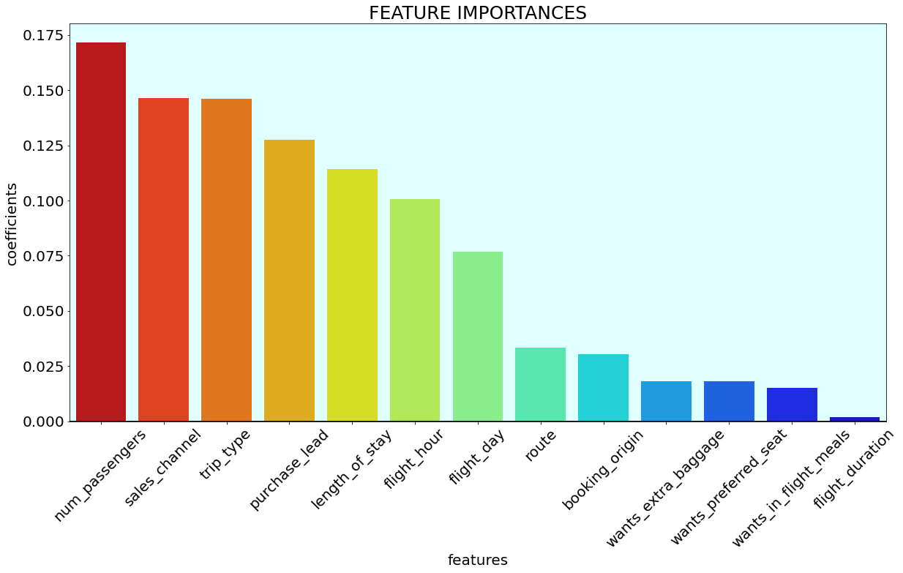
Consumers purchasing behavior
We gathered consumers booking data and trained predictive model.
Accuracy of model: 87.83 %
Factors that influence consumers
Purchasing behaviors:
Number of passengers travelling
Sales channel booking was made on
Trip Type (Round Trip, One Way, Circle Trip)
Number of days between
travel date and booking date
Day of week of flight departure
Flight route

