Slide 1
Interactive
Voice Driven Document

Slide 2
Mini Project by:
N161316 K. Madhavi
N160052 V. Anji Babu
N160955 S. Sathya Sri
N160805 K. Mamatha
N160011 B. Bhanu Prasad
N160295 P. Harish

Slide 3
INTRODUCTION
Speech recognition is one of the fastest growing technologies.
In the past-paced world, working with machines would come handy to edit documents, to send mails, etc using voice recognition.
Besides that, visually impaired people and people with hand problems can find it hard typing in document, so our project aimed at helping those. They can interact with voice assistant, share information by operating computer through voice. Our project is capable of recognizing the speech and converting the audio to text for editing the Documents, sending Mails, browsing information from Net, to open & print Documents etc.

Slide 4
Continued...
The purpose of our project is to set up a Voice Recognition Environment and mapping the voice commands to do tasks like adding paragraphs, applying styles to text,creating tables etc.
We are trying to extend the functioning and efficiency of voice commands that helps persons who are visually impaired and physically challenged.
To setup a Voice Recognition Environment,we are using the python programming language and Speech Recognition library to recognize and for text to speech pyttsx 3 library and functions to perform commands.

Slide 5
TECHNOLOGY
Our Interactive voice driven document is designed in a efficient speech recognition software that can understand multiple accents and a Natural language processing algorithm to convert speech to text and vice versa.
Speech recognition is a system that translates the language being spoken into text format. To do this, a deep learning model is used that takes in audio signals, analyses them and converts them into the corresponding text.

Slide 6
Continued…
Microphone takes in the voice input from the user.
Internal processes like converting the audio input into signals and preprocessing them in its next step will get to be happens.
Then, it is sent to the speech to text API which applies a deep learning model and understands what the user is trying to say and finally displays the output it analyzed and extracted.
Speech recognition is mainly of two kinds 1)Acoustic model 2)Language model

Slide 7
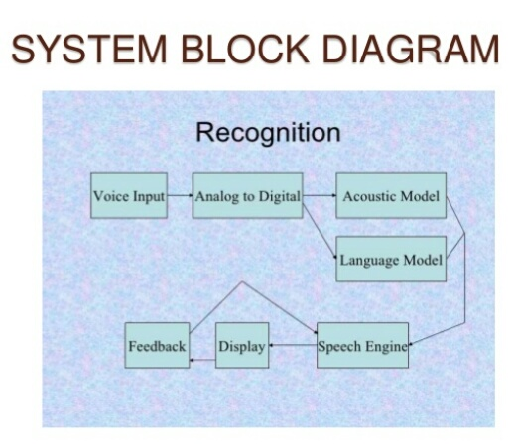

Slide 8
Popular Voice assistants like Google, Amazon Alexa, Apple Siri are already existed. They are limited to searching, playing songs and reading weather updates.
EXISTING PROPOSED
Compared to existing ones,we made a project that performs actions through commands. It can enable us to enter into a document, give input through voice and we can save, print and convert to pdf that from voice commands. We can send emails as well to others through voice commands.

Slide 9
ADVANTAGES
Saves a lot of time.
Comes handy to busy people.
Provide significant help for the people with disabilities.
Lower operational costs.
Able to write the text both through keyboard and voice input.
Voice recognition of different notepad commands such as open save and Clear.
Requires less consumption of time in writing text.

Slide 10
DISADVANTAGES
Offline:
Similar to existing to voice assistants, this project needs internet connection.
Synonyms:
Are the words that are differently spelled and have the different meaning but acquires the same meaning, for example "there" "their ","be" and "bee". This is a challenge for computer machine to distinguish between such types of phrases that sound alike.
Noise factor:
The program requires hearing the words uttered by a human distinctly and clearly. Any extra sound can create interference, first you need to place system away from noisy environments and then speak clearly else the machine will confuse and will mix up the words.

Slide 11
APPLICATIONS
Access information online from google, wikipedia etc,
Open any kind of document and edit that document through voice commands.
Reads daily updates like Date, Time,Weather reports etc.
Open Music Player and play songs as well as Youtube.
Sends e-Mails.
Interact with us like a virtual personal assistant and it can crack jokes.

Slide 12
FUTURE SCOPE
In future with this technology, accuracy will become better.
Dictation speech recognition will gradually become accepted.
Greater use will be made of "intelligent system" which will attempt to guess what the speaker intended to say, rather than what was actually said, as people often misspeak and make unintentional mistakes.
Microphone and sound system will be designed to adapt more quickly to changing background noise levels, different environments, with better recognition of extraneous material to be discarded.

Slide 13

Requirements
Software Requirements
Packages like speech recognition, pyttsx 3, webbrowser, docx, time, requests, ecapture, BeautifulSoup, docx2pdf and some inbuilt python packages.
Hardware Requirements
PC having 8gb RAM with processor Intel(R) Core(™) i5.
We installed Pycharm having interpreter Anaconda with python version 3.8.
Systems inbuilt Microphone.

Slide 14
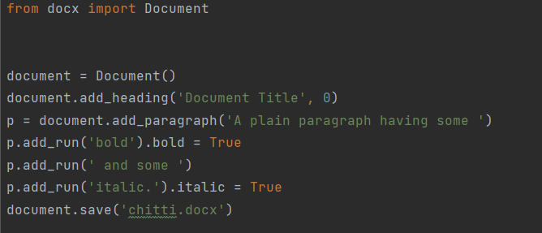
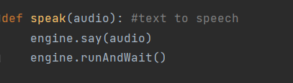
We are importing pyttsx 3
pyttsx3 is a text-to-speech conversion library in Python. Unlike alternative libraries, it works offline.
Here we use a function called speak(audio) to increase efficiency and reduce time complexity & space complexity and no of lines in code.
Whenever we want our system to give output in speaker (or talk) we use this function.
||
||
We import Docx here, to open a document, to map commands like applying styles, saving a document.
We can add paragraphs, headings, page breaks, tables and finally we can convert it into pdf also.

Slide 15
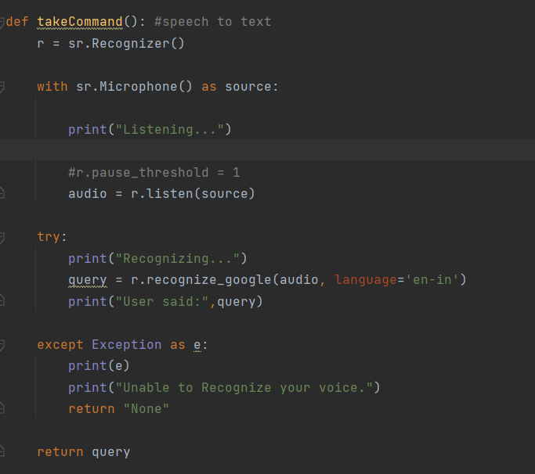
Function : takeCommand
We are importing Speech recognition here
Speech to Text
Whenever we want to give input to the system this function will take care of it.
It will record our voice through our voice and forward it into further function to perform

Slide 16
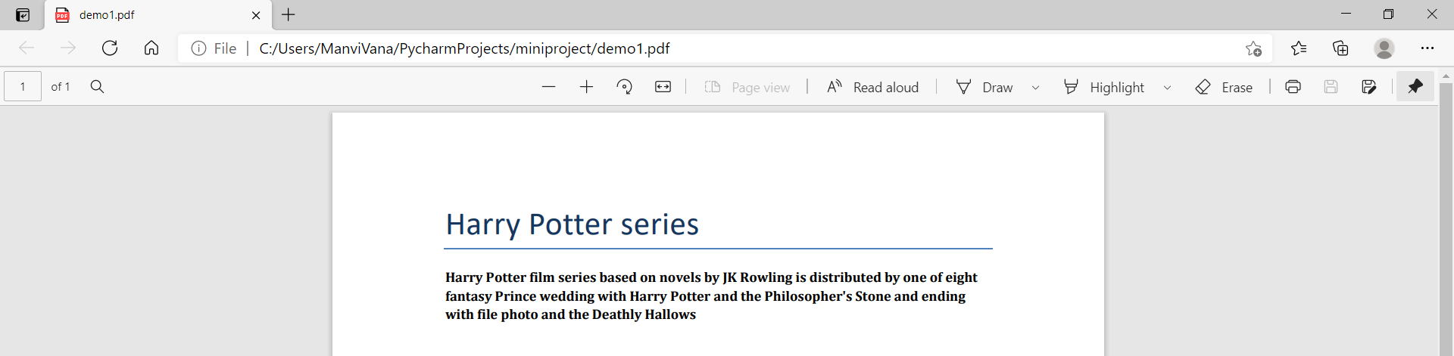
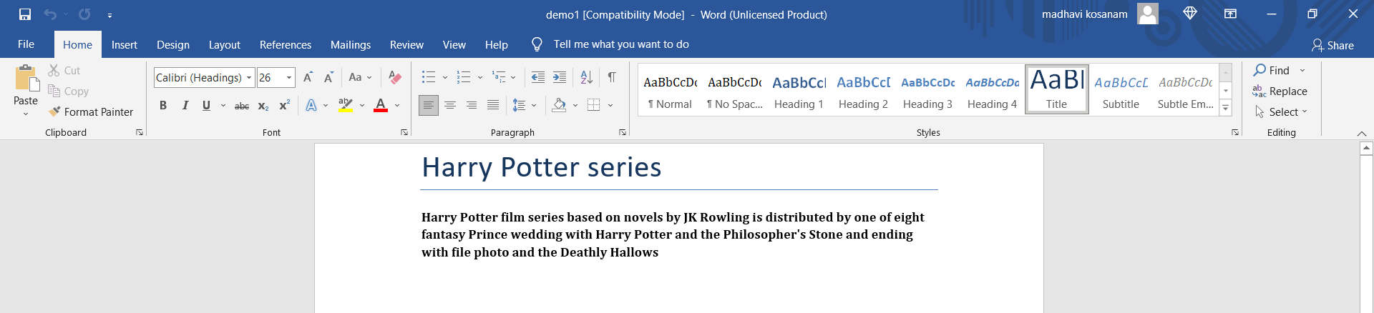

Slide 17
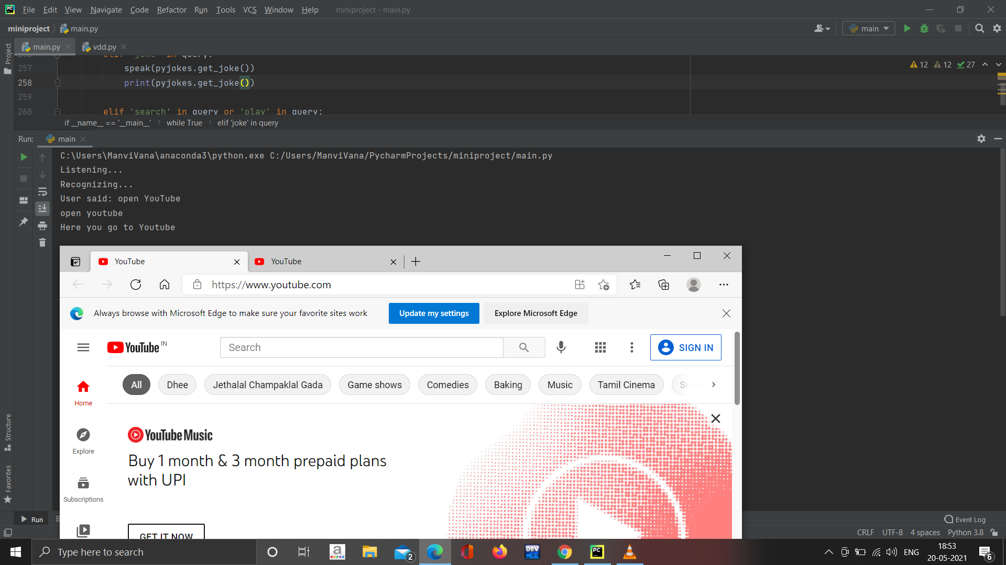

Slide 18
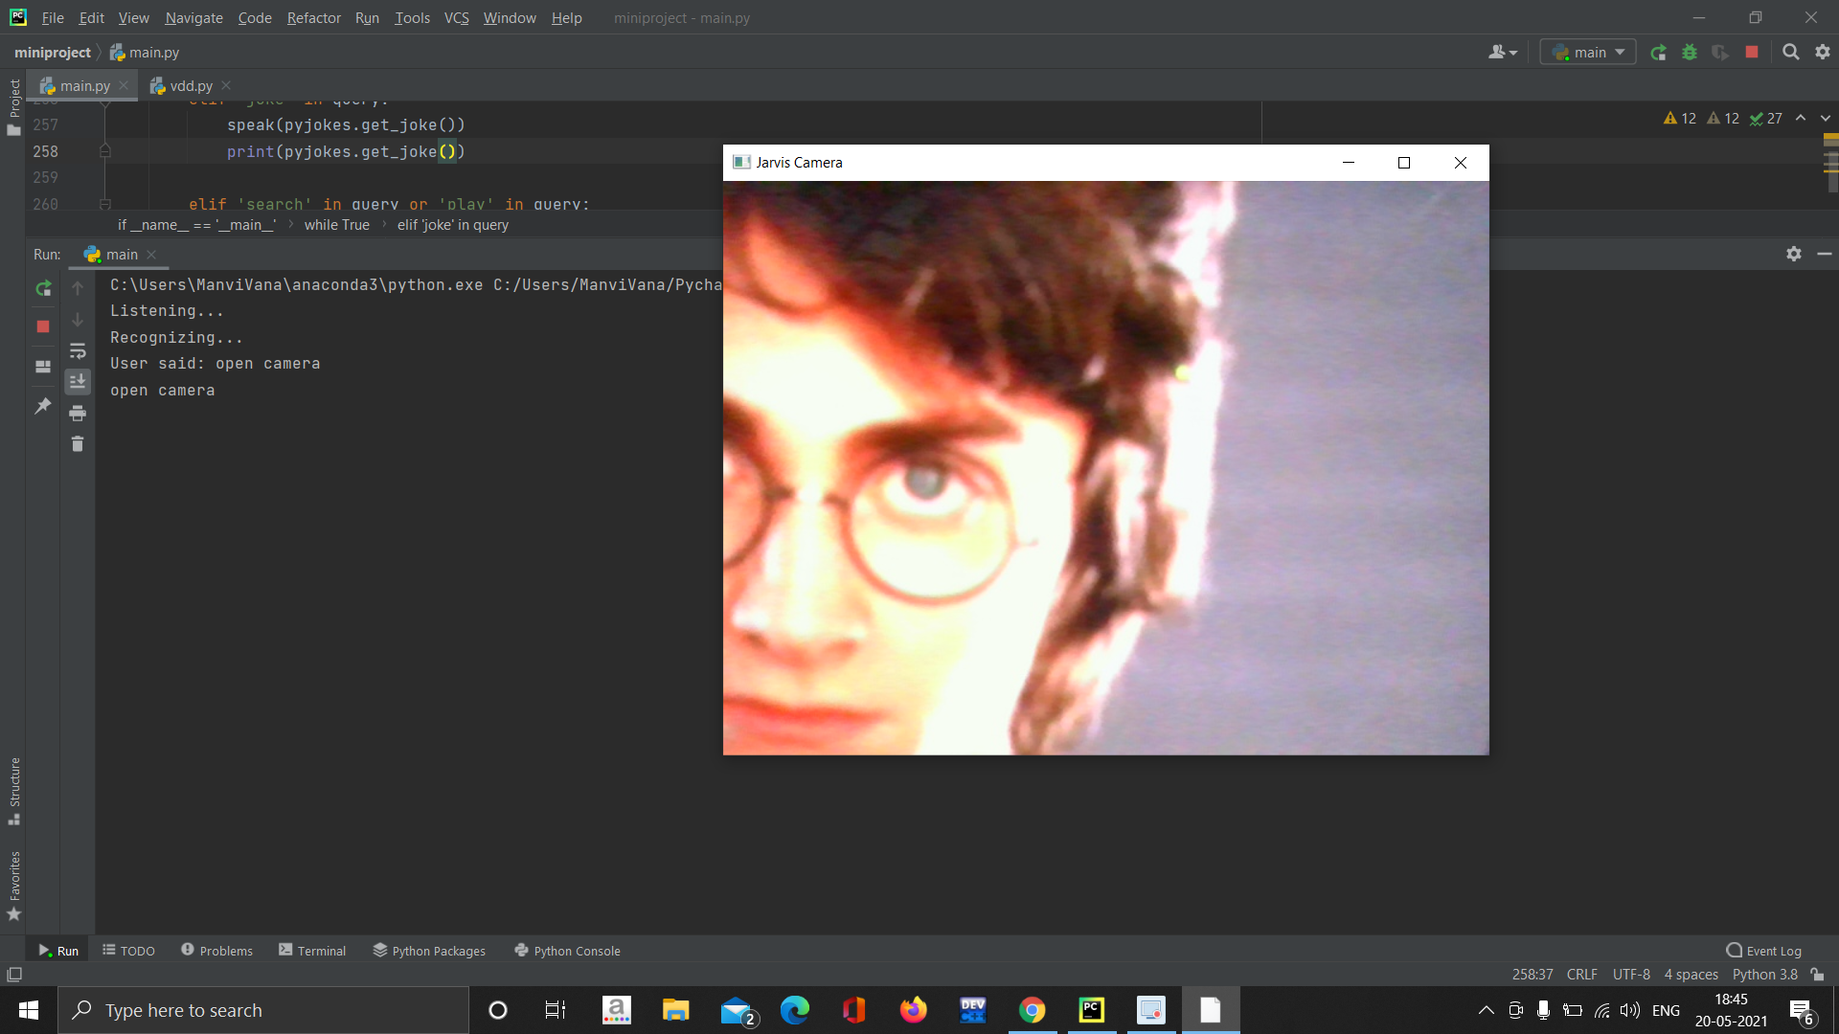
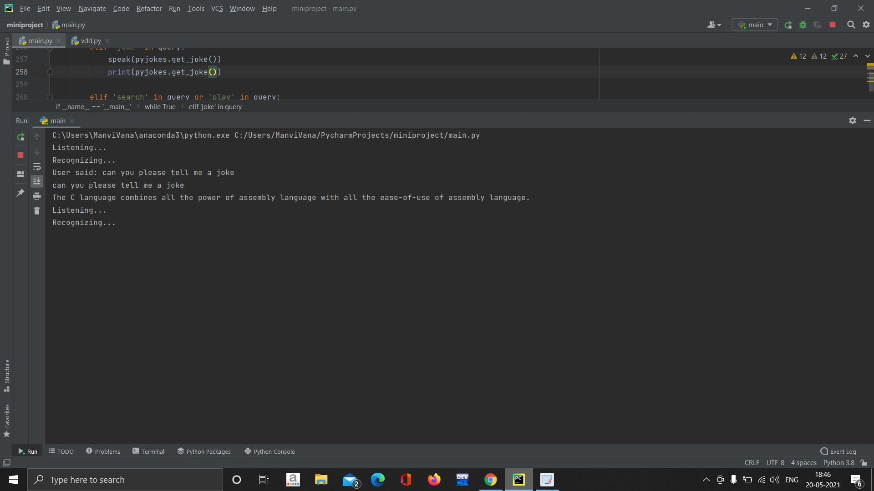

Slide 19
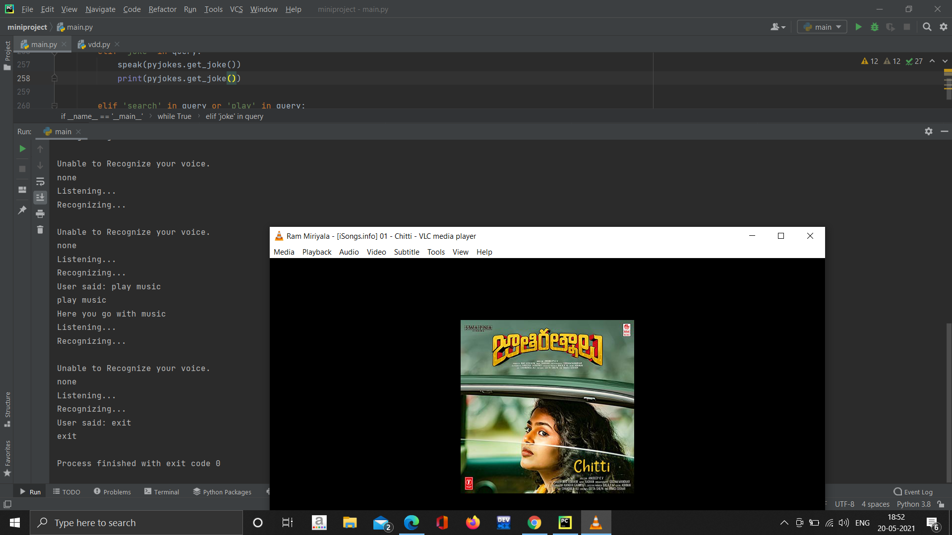

Slide 21
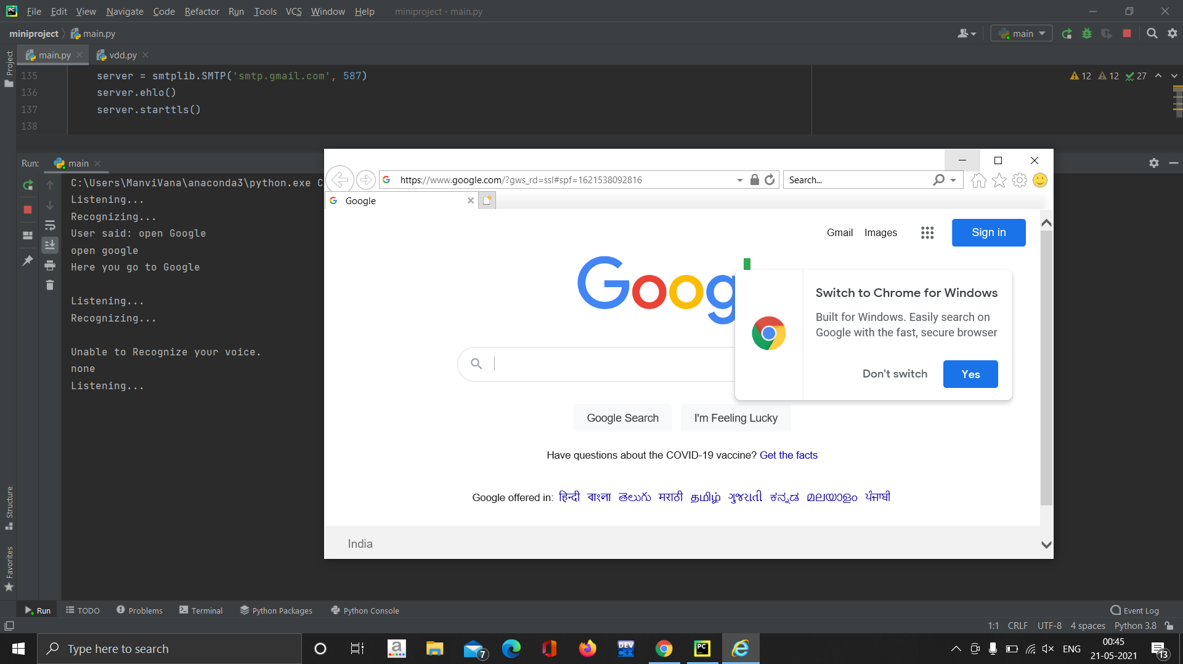

Slide 22
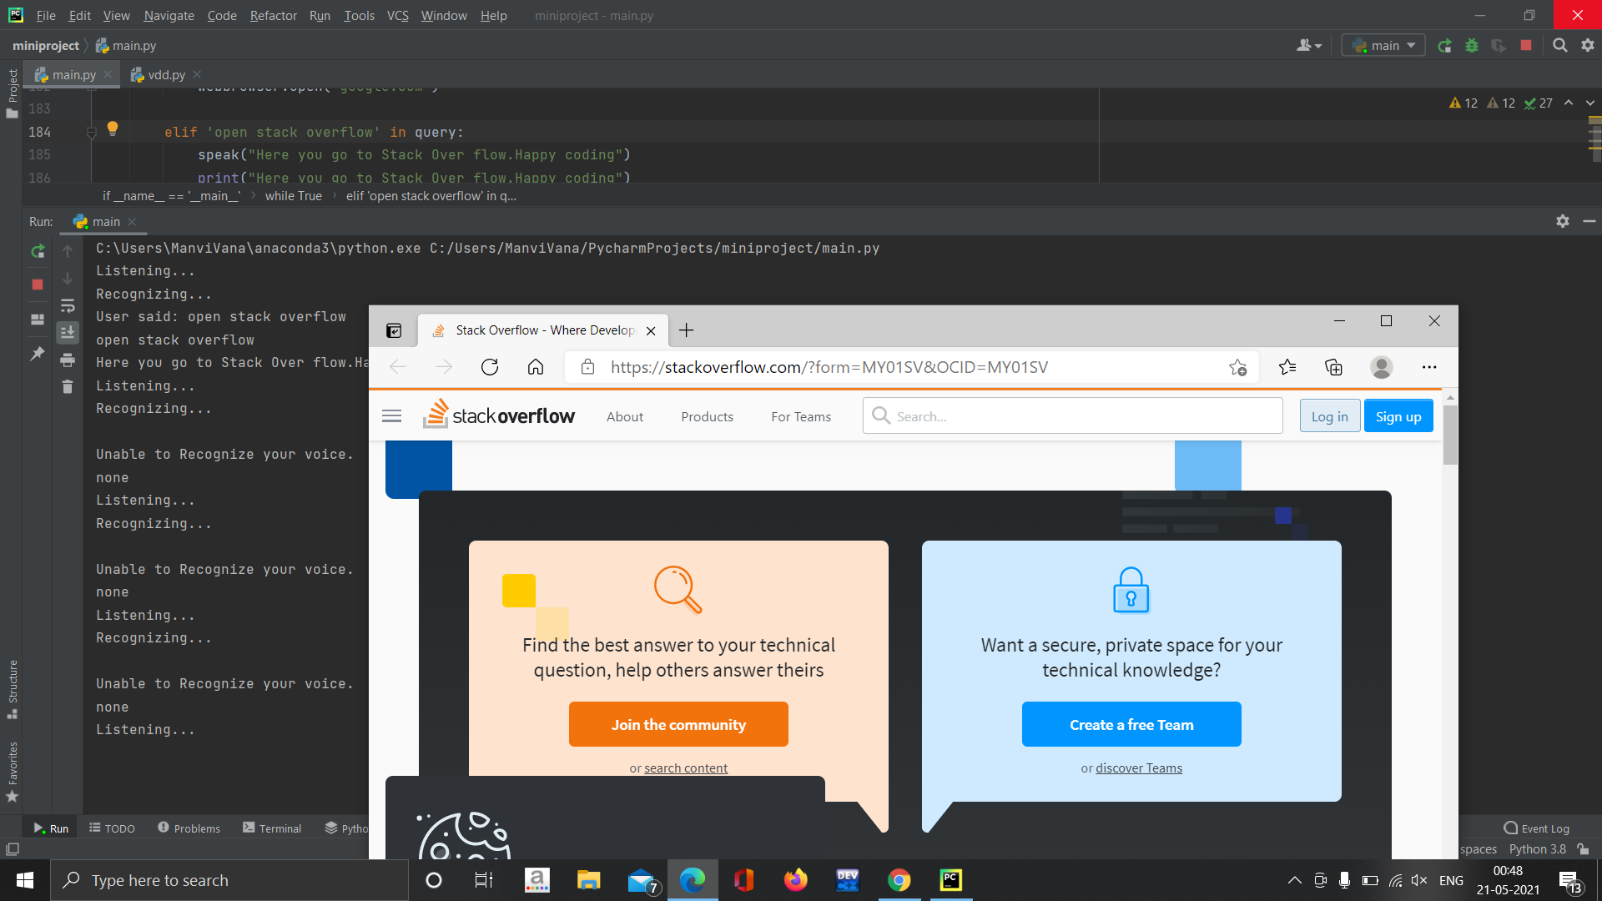

Slide 23
Conclusion
The primary concern of our project i,e enabling working with document through voice commands has been achieved.

