Slide 1

Tuned Mass Damper
SATYA SRIKANTH 22117075
JAYENDRA 22117001
POOJA 22117094
NIKHIL 22119036
Lab Based Project MIN-300 (Design)
Supervisor: Dhanashri M . Joglekar

Slide 2


Objectives
To develop and analyze a Pendulum-based Tuned Mass Damper (TMD) prototype by:
Recording real-time acceleration and energy fluctuations of a vibrating system in two cases (with and without TMD).
Deriving theoretical values using MATLAB simulations and comparing experimental results with theoretical outcomes.
Tuning pendulum length and base mass to optimize natural frequency and mass ratio for effective vibration reduction and energy absorption.
Implementing Julia code to simulate the setup for various initial conditions.
Developing a virtual model interface allowing users to modify system parameters for enhanced experimentation.
METHODOLOGY
PROTOTYPE DEVELOPMENT DESIGNED CAD MODELS IN SOLIDWORKS, 3D PRINTED PARTS, AND SOURCED METAL COMPONENTS. ASSEMBLED THE PENDULUM-BASED TMD AND INTEGRATED AN ACCELEROMETER. | EXPERIMENTAL VALIDATION CONDUCTED TESTS IN TWO SCENARIOS: WITH AND WITHOUT TMD. RECORDED REAL-TIME ACCELERATION AND ENERGY FLUCTUATIONS USING SENSORS. | THEORETICAL IMPLEMENTATION Studied TMD mechanics, damping effects, and energy dissipation principles. Developed MATLAB simulations to derive theoretical acceleration and energy fluctuations. Wrote Arduino IDE code for real-time data acquisition. | DATA ANALYSIS & COMPARISON Analyzed experimental data and compared it with MATLAB-simulated theoretical values. Evaluated the effectiveness of the pendulum-based TMD in vibration control.
PROTOTYPE DEVELOPMENT DESIGNED CAD MODELS IN SOLIDWORKS, 3D PRINTED PARTS, AND SOURCED METAL COMPONENTS. ASSEMBLED THE PENDULUM-BASED TMD AND INTEGRATED AN ACCELEROMETER. | EXPERIMENTAL VALIDATION CONDUCTED TESTS IN TWO SCENARIOS: WITH AND WITHOUT TMD. RECORDED REAL-TIME ACCELERATION AND ENERGY FLUCTUATIONS USING SENSORS. | THEORETICAL IMPLEMENTATION Studied TMD mechanics, damping effects, and energy dissipation principles. Developed MATLAB simulations to derive theoretical acceleration and energy fluctuations. Wrote Arduino IDE code for real-time data acquisition. | DATA ANALYSIS & COMPARISON Analyzed experimental data and compared it with MATLAB-simulated theoretical values. Evaluated the effectiveness of the pendulum-based TMD in vibration control.

Slide 3
TIMELINE
1
2
3
4
5
6
WEEK 1-2
WEEK 3-4
WEEK 5
WEEK 6
WEEK 7-9
WEEK 10-13
Research on TMD, Formulation,
Handle Software(Arduino IDE, Matlab)
Design CAD Models
Prototype Development
Design Arduino Codes
and record all analysis
Design Matlab codes
Real time Analysis & Comparison
System Optimisation
Optmised system parameters
Interface design
Designed User-friendly interface

Slide 4

MEMPHIS DESIGN A brief history of a quirky design
Phase 1:
Results &Discussions
Designed all CAD models and 3D printed parts using
Solid works and bought all the metal items for the prototype .
Phase 2:
Mounted accelerometer sensor on the prototype, connected it to
Arduino and assembled the prototype.
Phase 3&4:
Learned how TMD works, how acceleration, frequencies, Energies
vary with time due to damping
and learned how matlab and Arduino softwares works. MATLAB to obtain theoretical values for acceleration, mechanical energy variations and
analysed with experimental data.

Slide 5
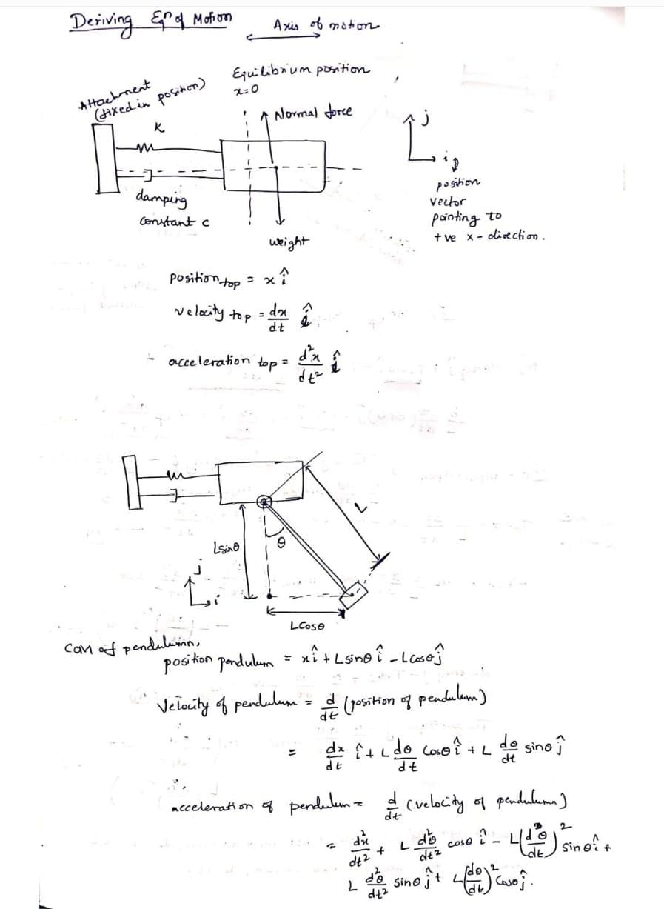
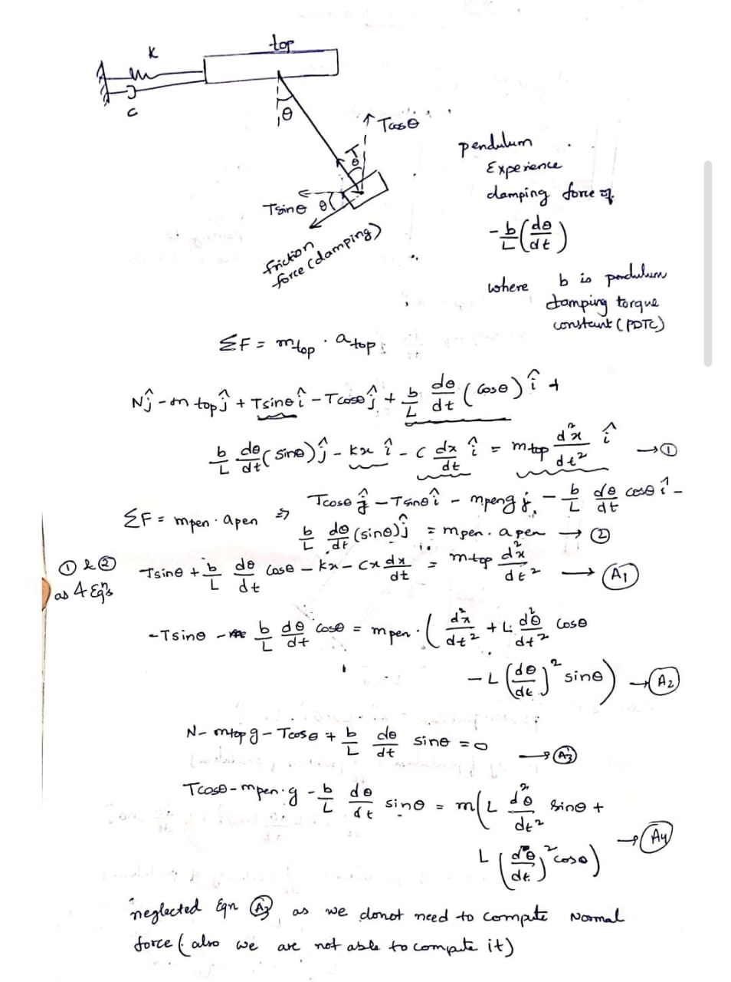
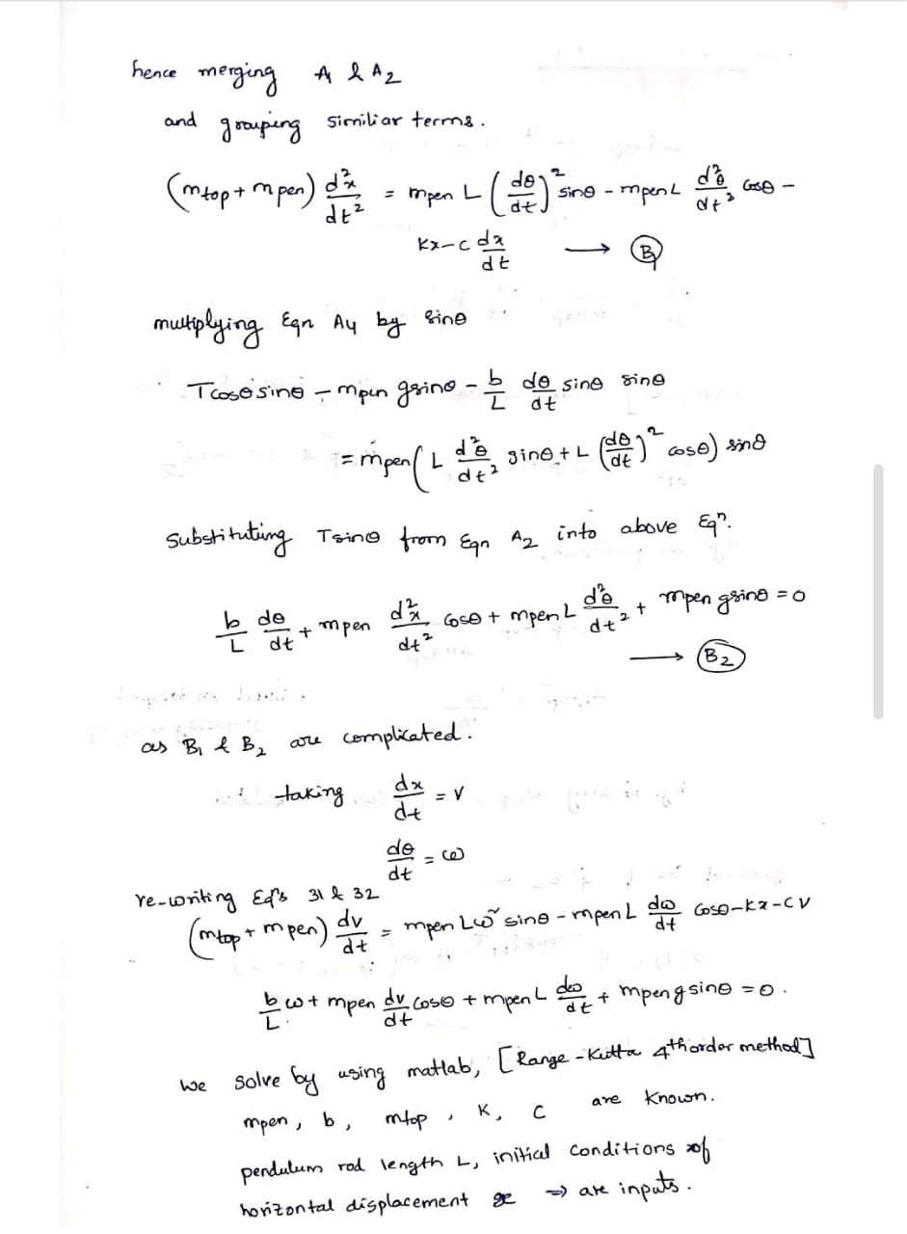
Analysis of system-Deriving Equation of Motion

Slide 6
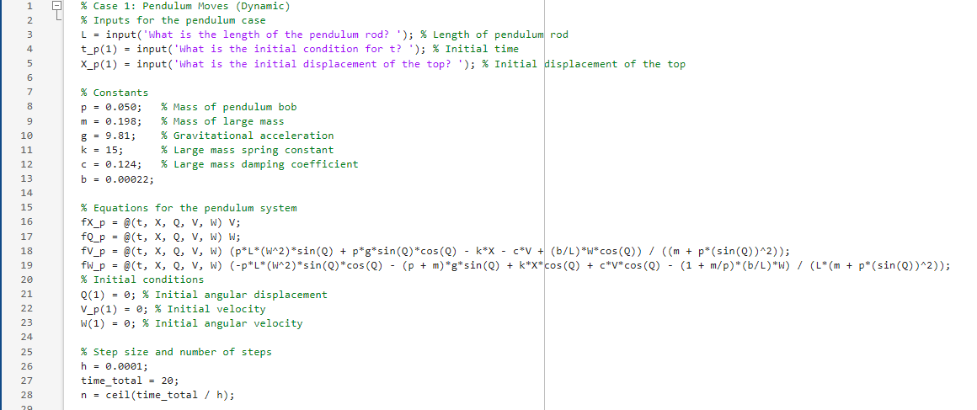
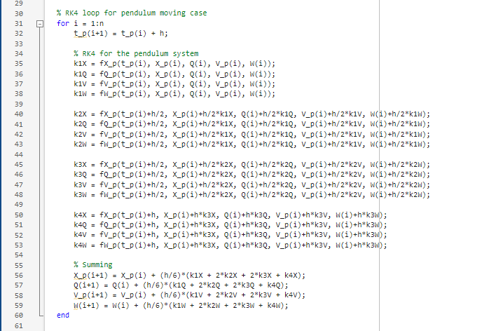
Matlab Code

Slide 7
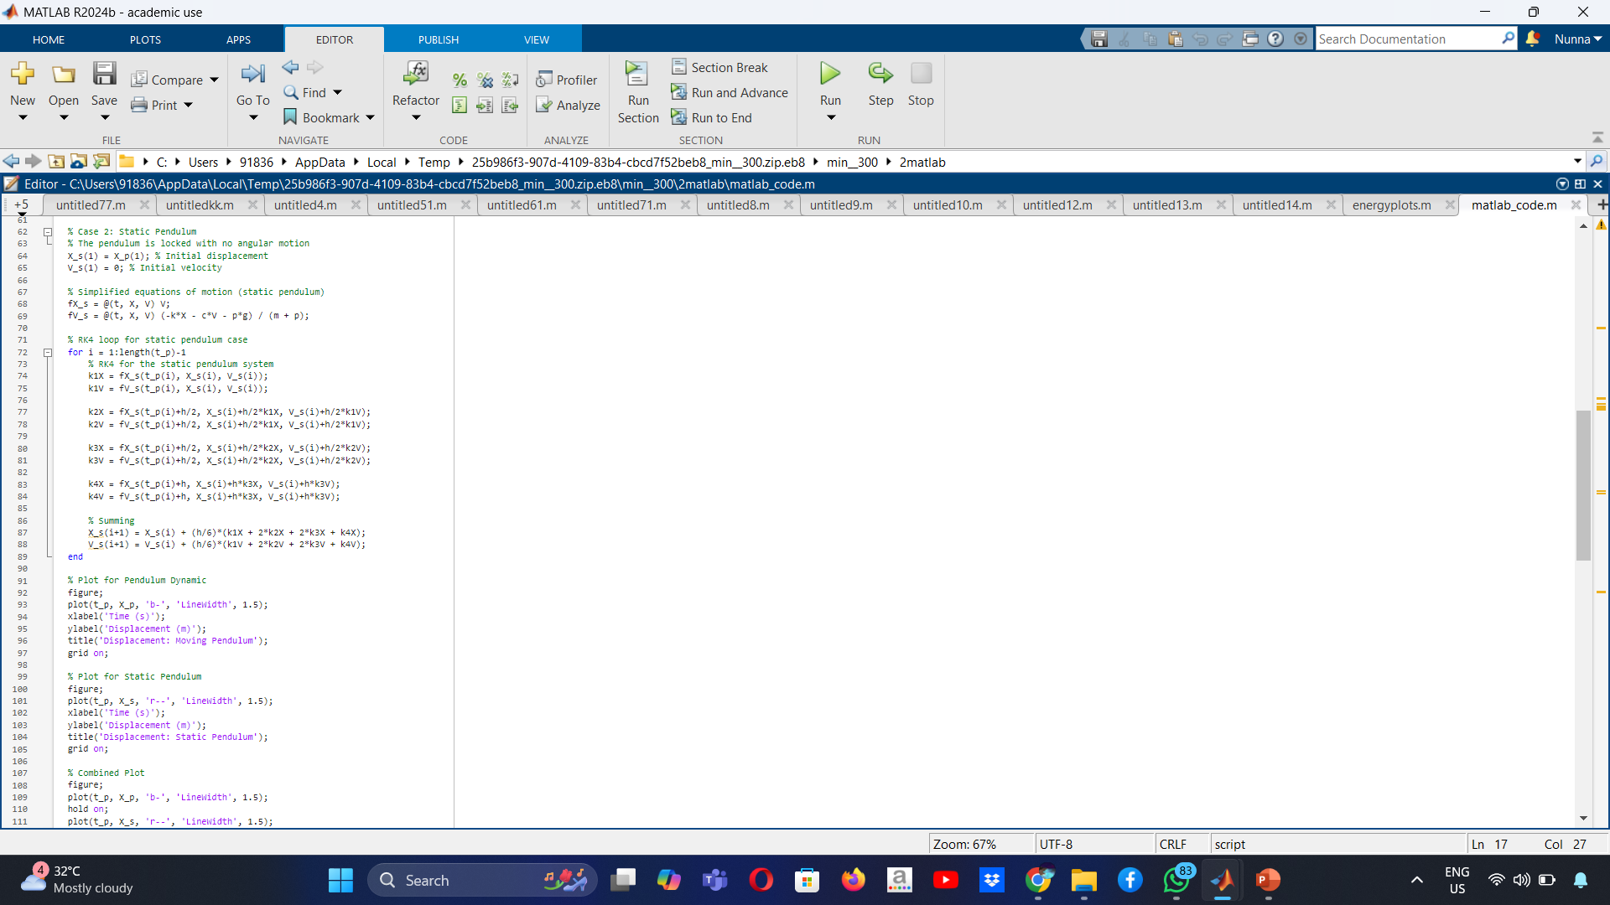
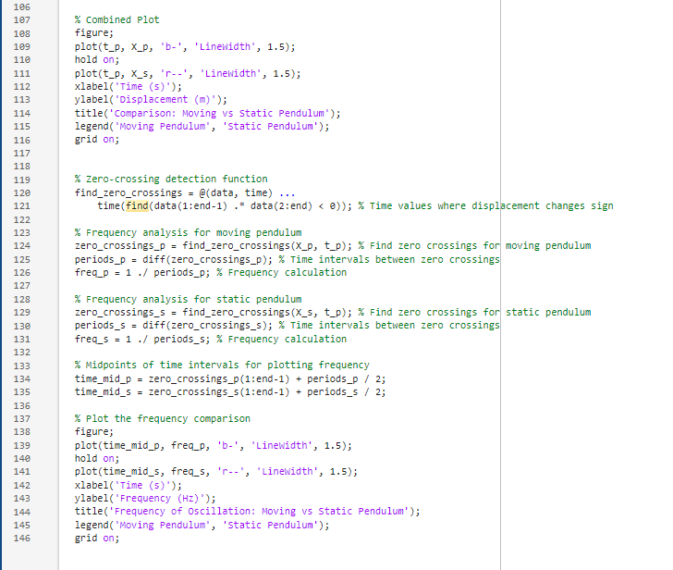
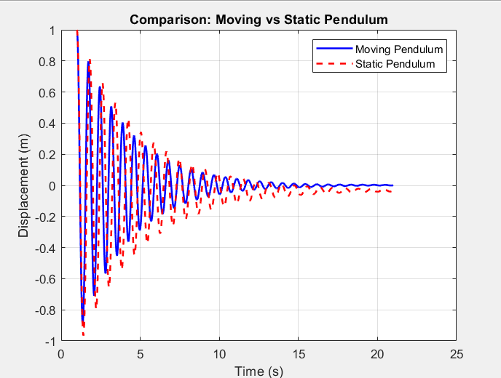
Matlab Code
Output
Absorption of energy by Moving Pendulumn

Slide 8
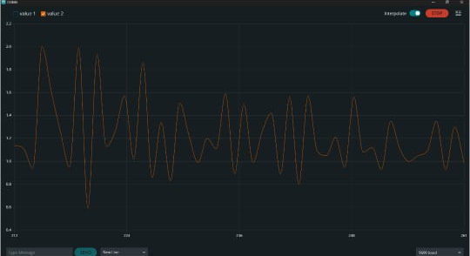
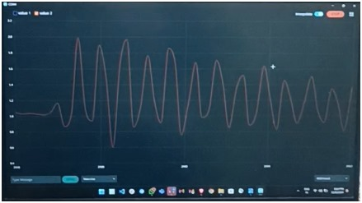
MEMPHIS DESIGN A brief history of a quirky design
Phase 5:
Results &Discussions
We tuned the pendulum length and base mass—key parameters influencing the natural frequency and mass ratio of the TMD—to effectively reduce vibration fluctuations and maximize energy absorption along with Julia code to simulate setup and give output for different initial values
Before
After
Phase 6:
Developed a virtual model interface of the
prototype, where users can modify all
system parameters.

Slide 9
MEMPHIS DESIGN A brief history of a quirky design
Conclusion
Conclusion for Tuned Mass Damper System Analysis
Effectiveness: The TMD system effectively reduces vibrations by transferring energy from the primary structure to the damper, with moving pendulums showing superior energy absorption compared to static ones.
Optimization: Parameter tuning—specifically the natural frequency, damping ratio, and mass ratio—significantly enhances vibration reduction and energy dissipation, achieving optimal performance.
Performance: The optimized TMD reduced peak displacement and stabilized vibrations across a wide frequency range, demonstrating its practicality for applications like buildings, bridges, and machinery.
Future Scope: Further exploration of multi-degree-of-freedom systems, nonlinear effects, and adaptive control strategies can enhance the design and performance of TMDs.
This study highlights the critical role of TMDs in improving structural stability and energy dissipation efficiency

