Slide 1

Tuned Mass Damper
SATYA SRIKANTH 22117075
JAYENDRA 22117001
POOJA 22117094
NIKHIL 22119036
Lab Based Project MIN-300 (Design)
Supervisor: Dhanashri M . Joglekar

Slide 2
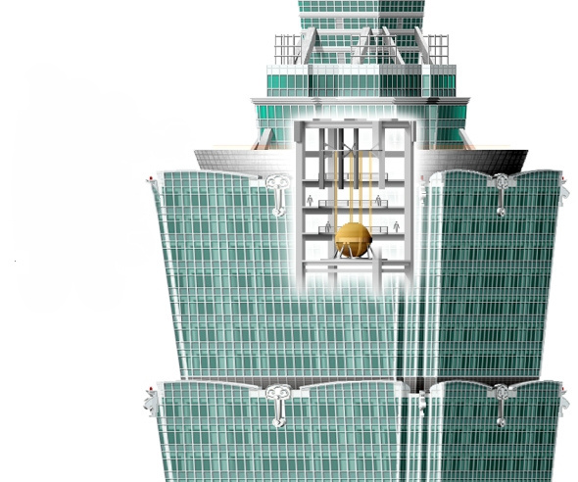
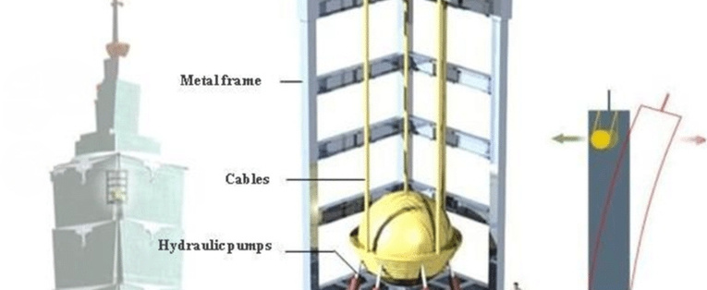
Objectives
1.Build Pendulum based Tuned Mass Damper prototype.
2.Record Realtime acceleration and energy fluctuations of a point in the vibrating system in two cases: 1.With no TMD2.With TMD
3.Derive theoretical values using MATLAB simulations and analyse all experimental results from prototype with theoretical values.

Slide 3



METHODOLOGY
PROTOTYPE DEVELOPMENT DESIGNED CAD MODELS IN SOLIDWORKS, 3D PRINTED PARTS, AND SOURCED METAL COMPONENTS. ASSEMBLED THE PENDULUM-BASED TMD AND INTEGRATED AN ACCELEROMETER. | EXPERIMENTAL VALIDATION CONDUCTED TESTS IN TWO SCENARIOS: WITH AND WITHOUT TMD. RECORDED REAL-TIME ACCELERATION AND ENERGY FLUCTUATIONS USING SENSORS. | THEORETICAL IMPLEMENTATION Studied TMD mechanics, damping effects, and energy dissipation principles. Developed MATLAB simulations to derive theoretical acceleration and energy fluctuations. Wrote Arduino IDE code for real-time data acquisition. | DATA ANALYSIS & COMPARISON Analyzed experimental data and compared it with MATLAB-simulated theoretical values. Evaluated the effectiveness of the pendulum-based TMD in vibration control.
PROTOTYPE DEVELOPMENT DESIGNED CAD MODELS IN SOLIDWORKS, 3D PRINTED PARTS, AND SOURCED METAL COMPONENTS. ASSEMBLED THE PENDULUM-BASED TMD AND INTEGRATED AN ACCELEROMETER. | EXPERIMENTAL VALIDATION CONDUCTED TESTS IN TWO SCENARIOS: WITH AND WITHOUT TMD. RECORDED REAL-TIME ACCELERATION AND ENERGY FLUCTUATIONS USING SENSORS. | THEORETICAL IMPLEMENTATION Studied TMD mechanics, damping effects, and energy dissipation principles. Developed MATLAB simulations to derive theoretical acceleration and energy fluctuations. Wrote Arduino IDE code for real-time data acquisition. | DATA ANALYSIS & COMPARISON Analyzed experimental data and compared it with MATLAB-simulated theoretical values. Evaluated the effectiveness of the pendulum-based TMD in vibration control.

Slide 4
TIMELINE
1
2
3
4
WEEK 1-2
WEEK 3-4
WEEK 5
WEEK 6
Research on TMD, Formulation,
Handle Software(Arduino IDE, Matlab)
Design CAD Models
Prototype Development
Design Arduino Codes
and record all analysis
Design Matlab codes
Real time Analysis & Comparison

Slide 5

MEMPHIS DESIGN A brief history of a quirky design
Phase 1:
Work so far
Designed all CAD models and 3D printed parts using
Solid works and bought all the metal items for the prototype .
Phase 2:
Mounted accelerometer sensor on the prototype, connected it to
Arduino and assembled the prototype.
Phase 3:
Phase 3:Learned how TMD works, how acceleration, frequencies, Energies
vary with time due to damping
and learned how matlab and Arduino softwares works

Slide 6
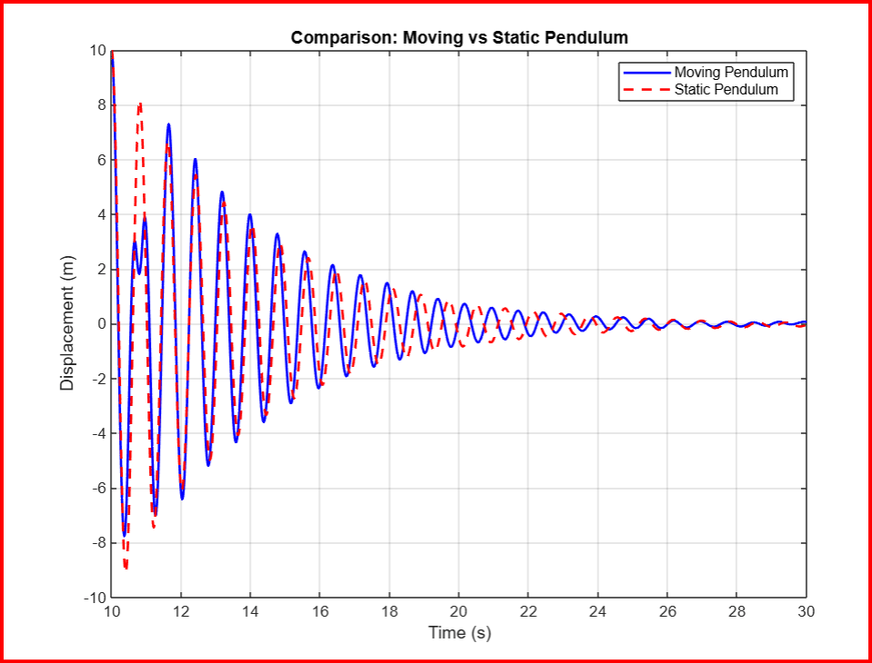
MEMPHIS DESIGN A brief history of a quirky design
Thank You
Phase 4:
MATLAB to obtain theoretical values for acceleration, mechanical energy variations and
analysed with experimental data.
Future Work:
1. Developing a virtual model interface of the
prototype, where users can modify all
system parameters.
2.Utilize machine learning models to
predict acceleration and energy variations
based on input parameters, enabling
data-driven insights into vibration mitigation.

