Slide 1
FitManagr for ERPNext
Complete gym management inside your Frappe / ERPNext system: members, billing, attendance, training and automation
Works with Frappe / ERPNext v14 · v15 · v16
Notes:
Opening: FitManagr turns any ERPNext into a gym management system. Same login, same server, no extra licences for the ERP.

Slide 2



Gyms still run on registers, spreadsheets and WhatsApp
Paper registers
Manual follow-ups
Disconnected tools
Renewals are missed, dues go unnoticed, and nobody knows who actually visits.
Staff chase members one by one on personal phones, with no record of who was called.
Gym software in one place, accounts in ERPNext, and nothing matches at month end.
FitManagr — runs the whole gym on the same Frappe / ERPNext server the business already trusts
One login — owners, managers, front desk and trainers each see only what their role allows
Notes:
The pain we solve for gym owners who already use, or want, ERPNext.

Slide 3
What you get
36
100
3
6
Gym doctypes: members to payroll
REST API endpoints for any UI
Frappe / ERPNext versions: v14, v15, v16
Built-in roles with row-level security
Multi-gym and multi-branch — one server can host many gyms, each fully isolated
Automation built in — expiry, reminders, dues, payroll and daily summaries run on their own every night
No ERPNext changes — FitManagr adds its own doctypes and never modifies ERPNext

Slide 4



Three ways to deploy it
ERPNext Desk only
Desk + FitManagr apps
Your own custom UI
Gym runs inside ERPNext's own screens. Click Set Up Gym and you are live, with every module on, no expiry and no limits.
Add the owner, staff, member and kiosk apps (web, Android, iOS) on top of the same backend.
Build a branded website or app on the REST API. Security and gym isolation are enforced by the backend.
Same backend in all three — start in the desk, add the apps or your own UI later, with nothing to migrate
Mix them freely — accounts team in the desk, front desk on a tablet, members on the phone app
Upgrade any time — add the apps or a custom UI later, on the same data
Notes:
This is the core sales slide: one backend, three ways to sell it.

Slide 5
Inside the ERPNext desk
Everything a gym needs, as normal Frappe forms, lists and reports

Slide 6
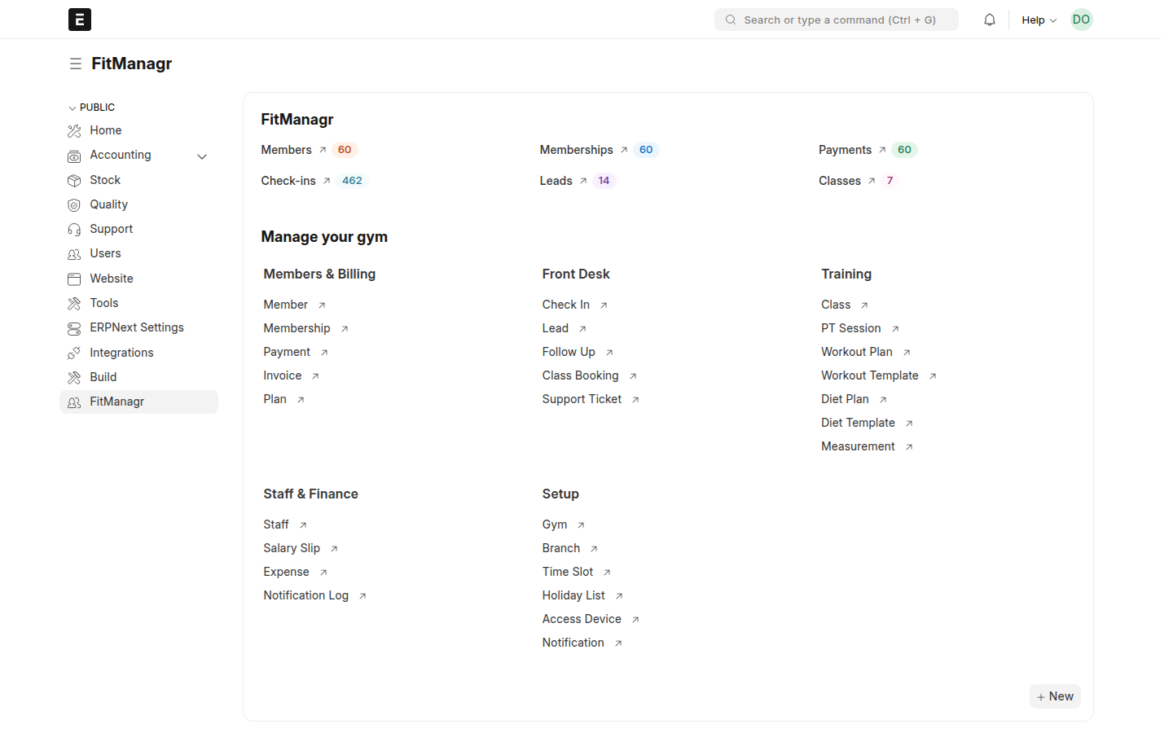
A FitManagr workspace for every gym role
One click from the sidebar — members, memberships, payments, check-ins, leads and classes
Grouped by job — Members & Billing, Front Desk, Training, Staff & Finance, Setup
Role-aware — trainers never see salaries; front desk can't delete payments
Standard Frappe — list filters, group-by, report view, Excel export and print formats

Slide 7
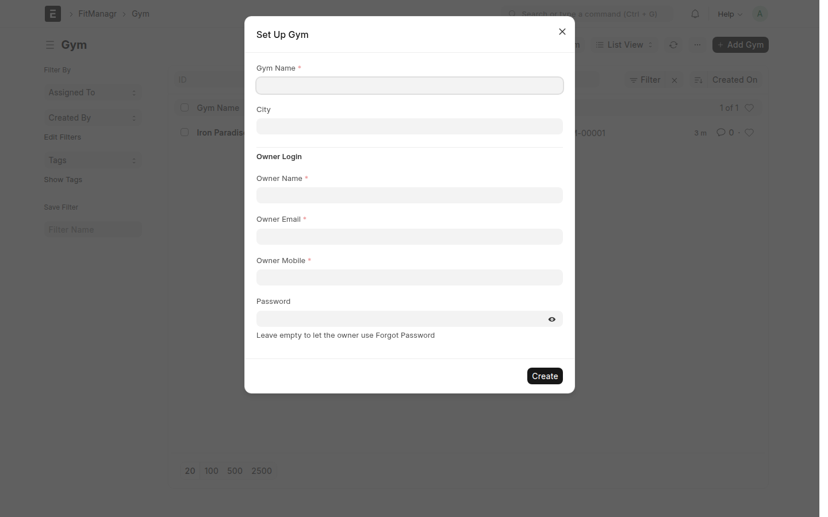
Set up a gym in one step
Set Up Gym — gym name, owner and mobile; FitManagr creates the rest
Created for you — owner login, Main branch, staff record, plans, time slots, workout and diet templates
Self-hosted licence — all modules on, no expiry, no member or branch limits
Many gyms — run it once per gym; each gym's users see only their own data

Slide 8
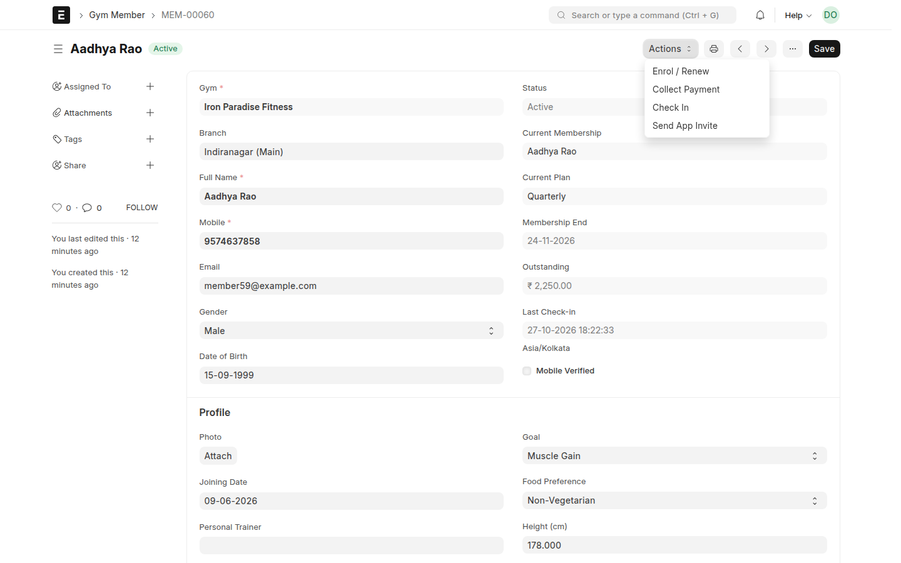
Members and memberships
Member profile — photo, contact, emergency details, status, validity, dues and last visit
Enrol / Renew — plan, discount and payment in one step; renewals start the day after the current plan ends
Freeze, unfreeze, cancel — freezing pushes the end date out automatically
Plans — general, PT, couple, class pack, off-peak slot, day pass, with a joining fee charged only the first time

Slide 9






Billing that never loses a rupee
Dues per membership
Auto-allocation
GST invoices
Every membership tracks its own balance, and the member shows the total.
A payment goes to the oldest unpaid membership first. Overpayment is blocked.
PDF invoice on every payment, sent by email and WhatsApp. Rate and SAC per gym.
Any payment mode
Expenses & P&L
Payroll
Cash, UPI, card, bank transfer or Razorpay online, with reference numbers.
Expense categories and a profit-and-loss for any date range.
Staff salary, PT commission and monthly salary slips.

Slide 10






Attendance, access and training
QR check-in
Access rules
Access devices
Member QR, gym entrance QR and kiosk mode. Repeat scans within 30 minutes are ignored.
Expired, frozen or out-of-slot members are blocked at the door (configurable).
Register turnstiles and biometric machines per branch.
Classes
Personal training
Diet & workout
Timetable, capacity, bookings, waitlist and attendance, with no double booking.
Trainers, PT packs, session calendar and sessions used.
Indian diet templates and workout splits, assigned to members.

Slide 11



Leads and follow-up calls (CRM)
Lead pipeline
Auto call list
One-tap conversion
New → Contacted → Trial → Converted or Lost, with source and assignment.
Renewals, dues, members absent 7+ days and expiring trials land on today's list.
Convert a lead into a member with plan and payment in one step.
Every call is logged — outcome and callback date, so managers see who followed up and who didn't
Branch-aware — front desk at each branch sees only their branch's list

Slide 12
Automation that runs every night
When | What happens | Channels
Midnight (gym time) | Memberships move Upcoming → Active → Expired; freezes end; dues refresh | System
07:00 | Today's follow-up call list is built for front desk | App, email
08:00 | Renewal reminders (7/3/1 days), expiry notices, birthday wishes | WhatsApp, SMS, email, push
Every 3 days | Dues reminder to members with a balance | WhatsApp, SMS, push
Daily | Owner's daily summary: collections, check-ins, renewals due | Email, push
Monthly | Payroll day: salary slips generated and sent | Email
1 hour before | Class and PT session reminders | Push, WhatsApp
Notes:
The scheduler runs everything below on each gym's own clock.

Slide 13



Secure by design, multi-gym by default
Tenant isolation
Roles & branches
Protected fields
Every row carries its gym. Lists, forms, links and the REST API are filtered to the user's gym automatically.
Owner, Manager, Front Desk, Trainer and Member roles. Front desk and trainers can be locked to one branch.
Status, licence limits, dues and logins can't be forged through the API.
Tested on every push — automated tests check that one gym can never read or link another gym's data
Full audit trail — Frappe keeps the version history of every record and who changed it
Your server, your data — self-hosted clients keep all member data on their own ERPNext

Slide 14



A REST API for any UI
POST /api/method/fitmanagr.api.v1.members.check_in
Authorization: token <api_key>:<api_secret>
{ "member": "MEM-00012", "method": "Manual" }
Branded website
Members book classes and pay online.
Flutter / React Native
About 100 endpoints — session, members, check-in, billing, classes, PT, plans, finance, insights, member app, notifications
Standard Frappe REST too — /api/resource on every gym doctype, with the same security
Auth — API key/secret, session cookie, or a Firebase token in SaaS mode
A custom app per franchise.
Kiosk screen
A door tablet that only checks members in.

Slide 15
Install in four commands
Frappe / ERPNext | Branch | Python | Node
v14 | version-14 | 3.10 | 16 / 18
v15 | version-15 | 3.11 / 3.12 | 18 / 20
v16 | version-16 | 3.14 | 24
bench get-app <repo> --branch version-15
bench --site erp.example.com install-app fitmanagr
bench --site erp.example.com enable-scheduler
# Desk → Gym → Set Up Gym
Frappe Cloud — install on a private bench from the private GitHub repo
Own server — any Ubuntu server with a production bench
Tested on all three versions — CI tests every branch on every push
Notes:
Branch = Frappe version. ERPNext is optional.

Slide 16



Licensing options
Self-hosted licence
SaaS subscription
Custom build
One-time or annual licence on the client's own ERPNext. All modules, no member limits, no expiry.
We host it. Starter, Growth and Pro plans with a base price plus a per-member price, and a free trial.
Your own UI, ERPNext accounting posting, integrations and white-label apps.
Self-hosted never expires — the daily licence check skips gyms without an expiry date
SaaS prices are editable — base price, per-member price and modules per plan, plus custom deals per gym
Apps on top — owner, member and kiosk apps can be added to any option

Slide 17
Run your gym on ERPNext, starting today
Setup guide: satyabrata12017.github.io/fitmanagr-setup
Contact: Satya · satyabrata12017@gmail.com
See the Frontend deck for the owner, staff and member apps

