Slide 1
FitManagr Apps
Run the gym from a phone or tablet. Members get their own app.
Web · Android · iOS · Tablet kiosk
Notes:
The frontend works on top of the FitManagr backend: our server or the client's own ERPNext.

Slide 2

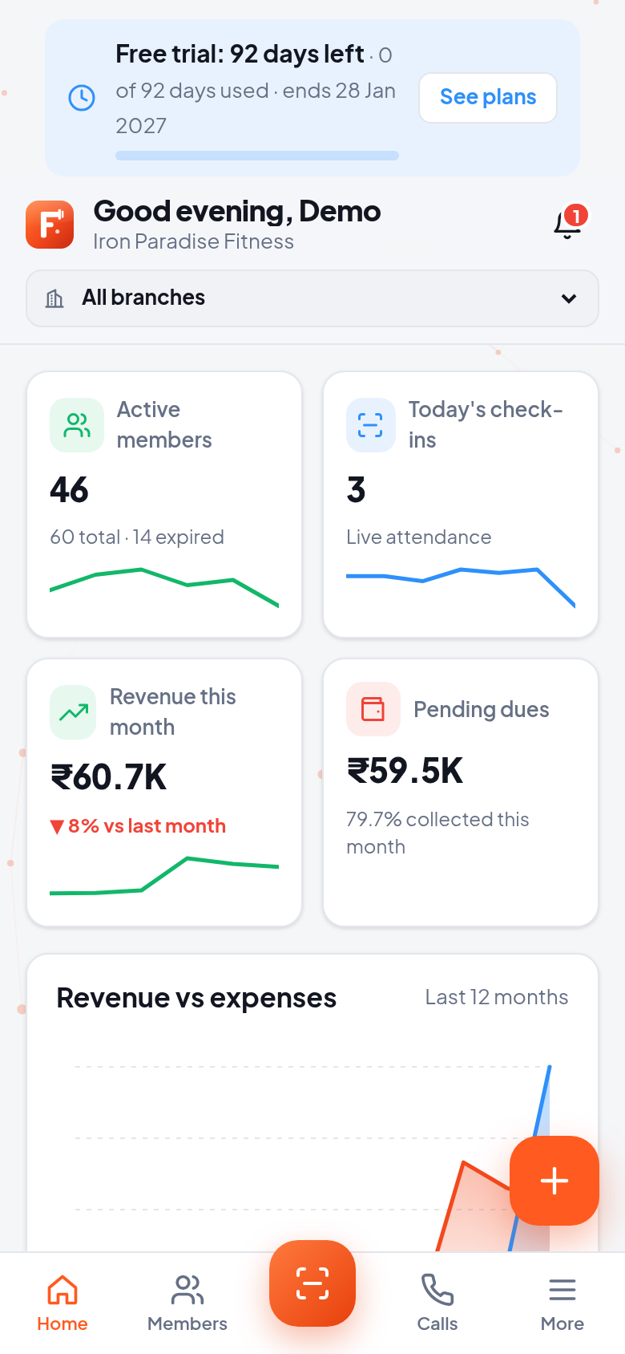
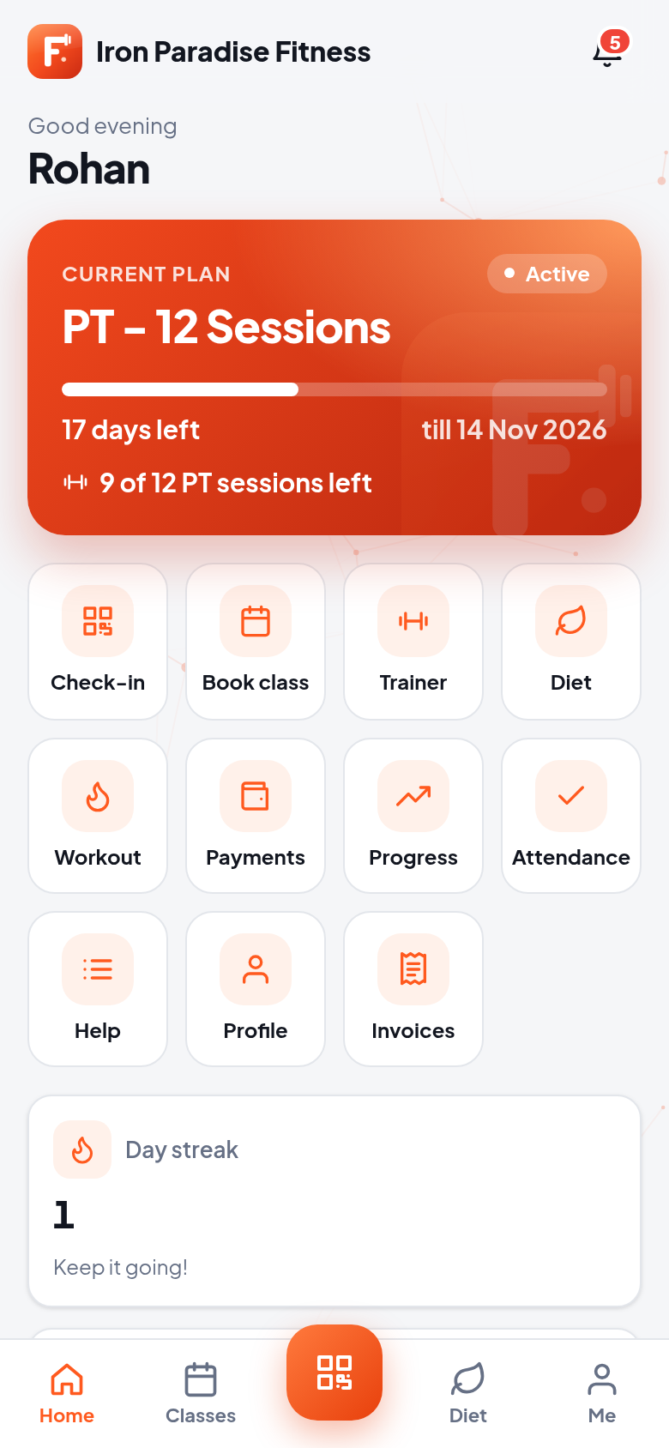
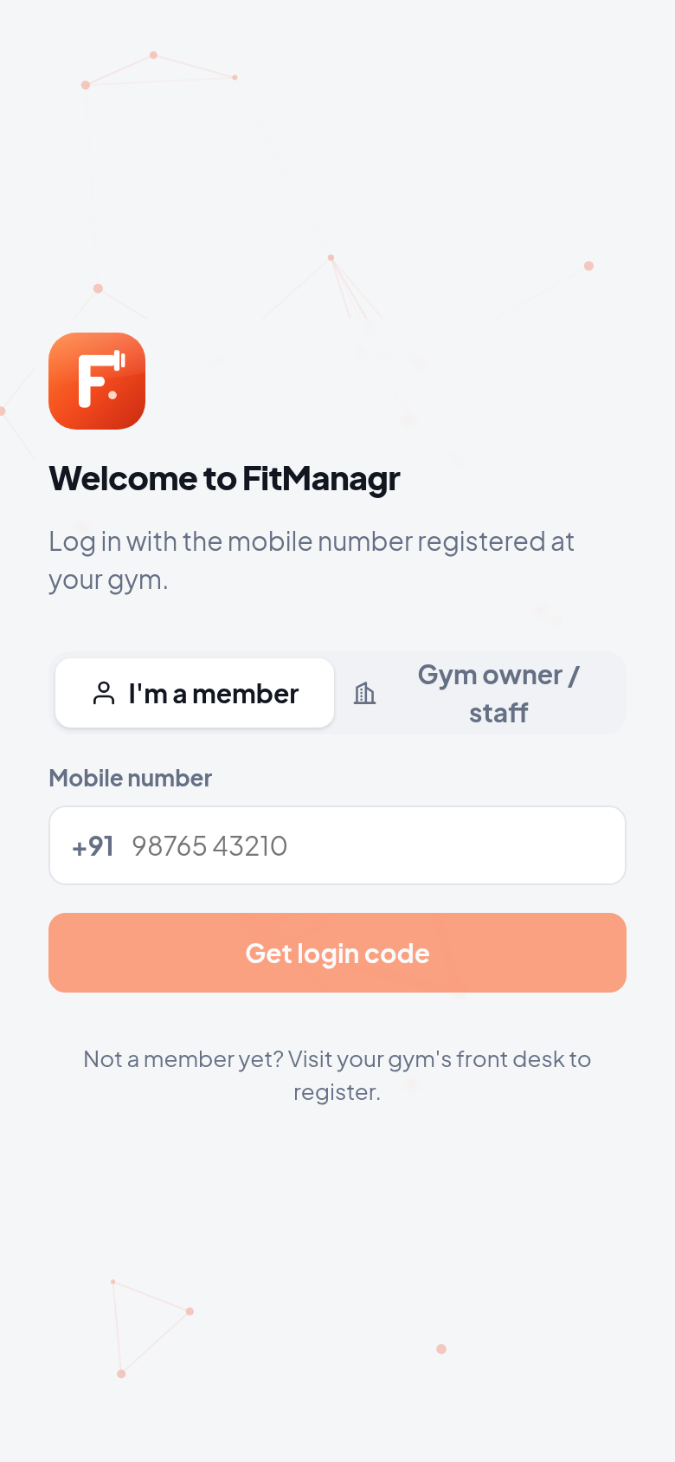


One app, three experiences
Owner & staff app
Dashboard, members, billing, check-in, kiosk, leads, classes, PT, staff, expenses and reports. Menus follow each role.
Member app
Login with mobile + OTP. Plan card, QR check-in, class booking, diet and workout plans, payments and progress.
Admin console
For the platform owner: all gyms, plans and pricing, trials, invoices and support tickets.

Slide 3
Owner & staff app
Everything the front desk and the owner do in a day, on phone or tablet

Slide 4
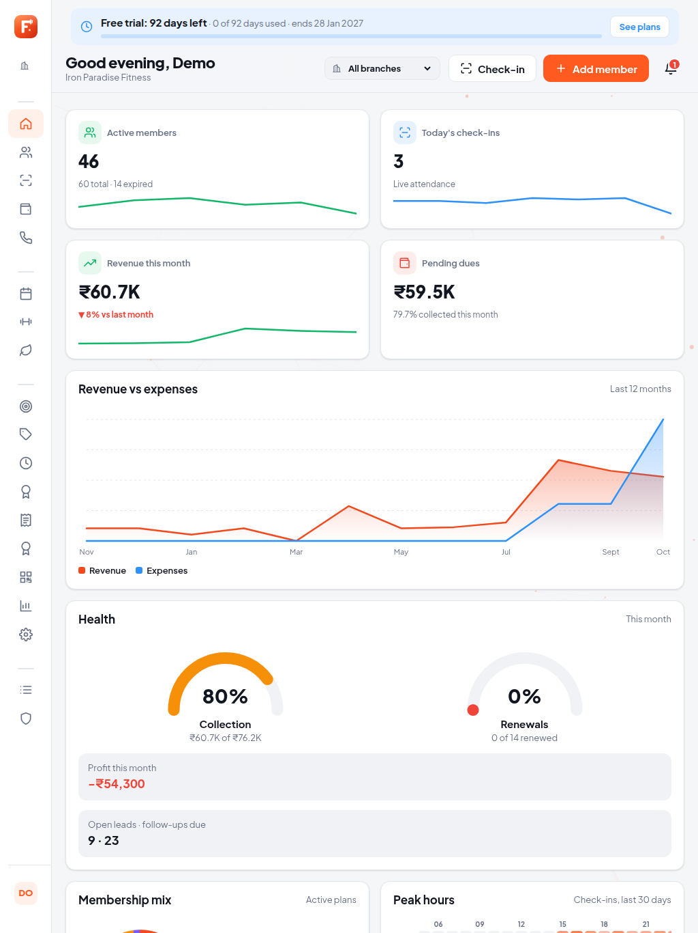
The owner's dashboard
Today at a glance — active members, today's check-ins, monthly revenue and growth, pending dues
Charts — 6-month revenue, 7-day check-ins, this month's P&L
Act now — renewals due with call and WhatsApp buttons, birthdays, lead follow-ups

Slide 5
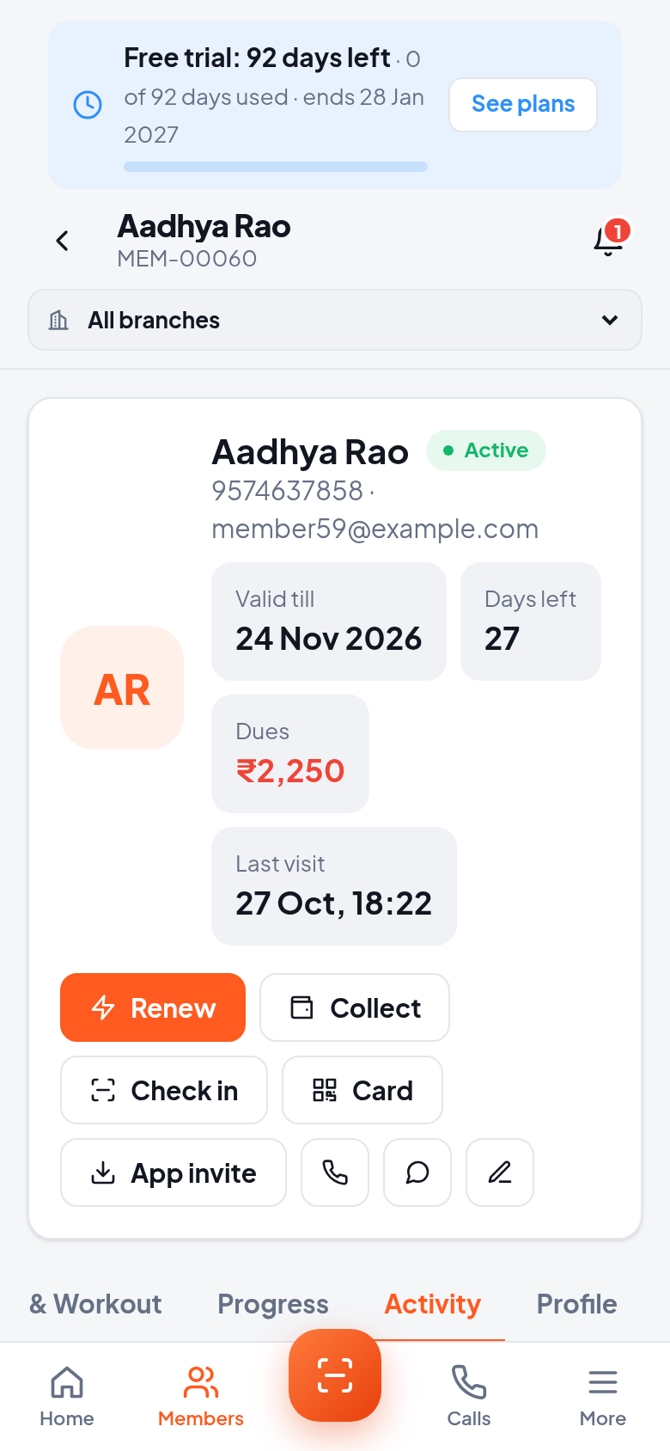
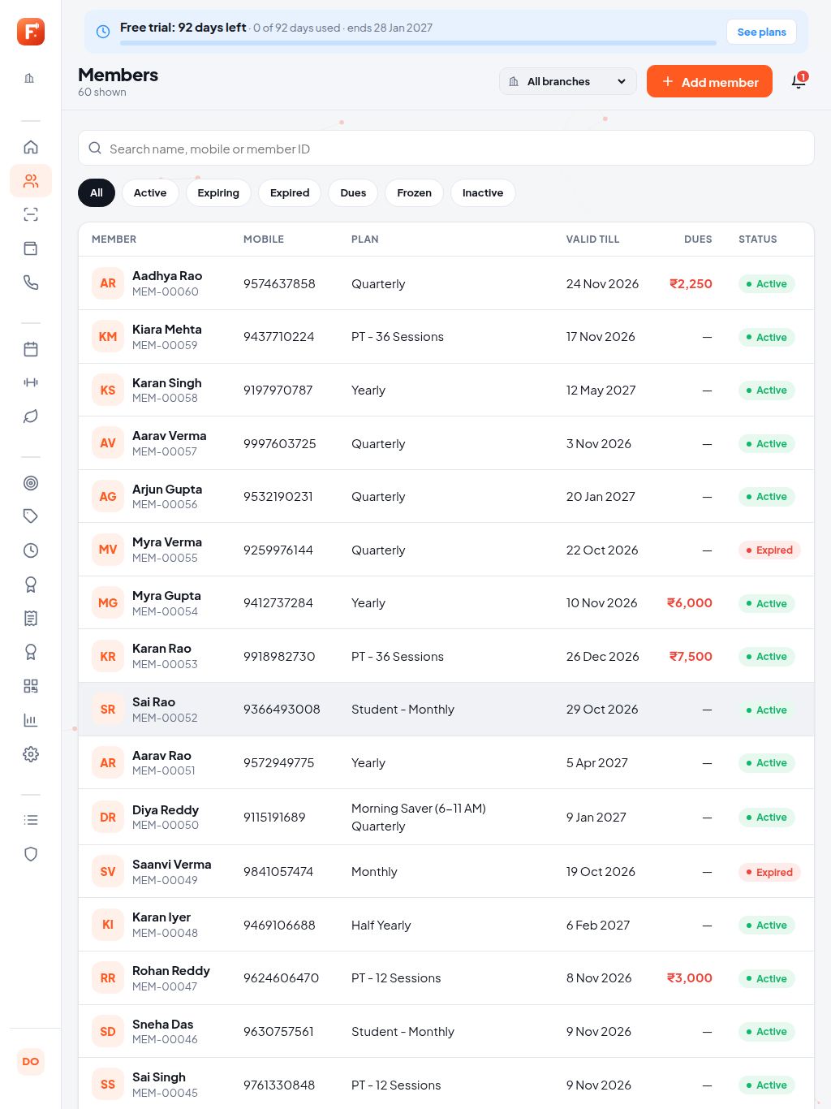
Members, with the full picture
Search and filter — by name, mobile or ID; Active, Expiring, Expired, Dues, Frozen
Member 360 — memberships, payments, attendance, progress, workout and diet, invoices
Digital card — a QR membership card to share on WhatsApp
Add with a camera photo — straight from the phone

Slide 6
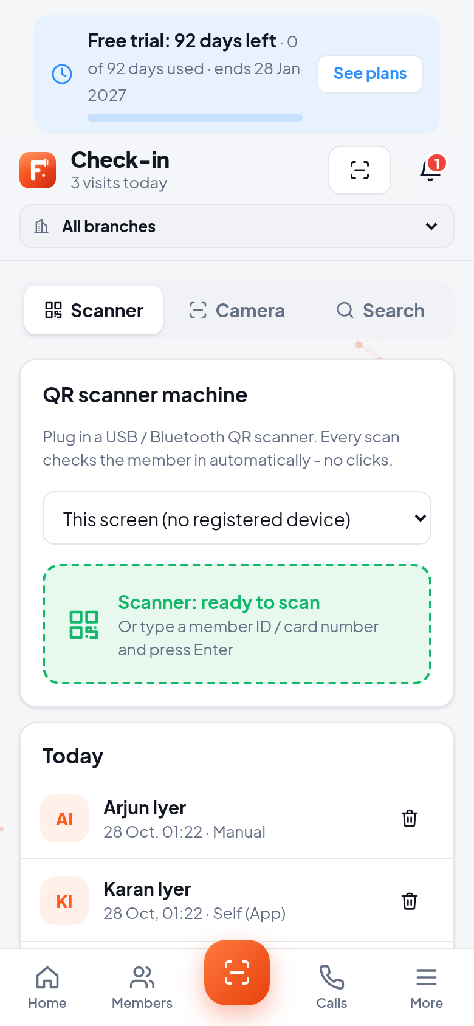
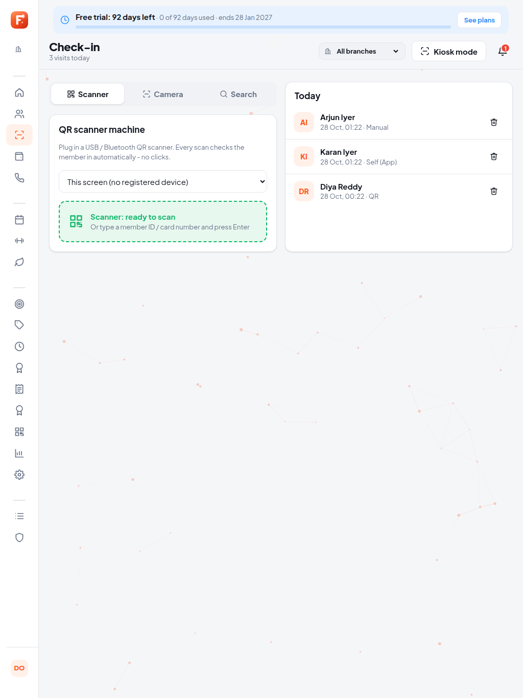
Check-in at the door
Camera QR scanner — scan the member's card
Gym entrance QR — members scan it themselves
Kiosk mode — a full-screen tablet at the entrance
Rules applied — expired, frozen and out-of-slot members are blocked; repeat scans ignored

Slide 7
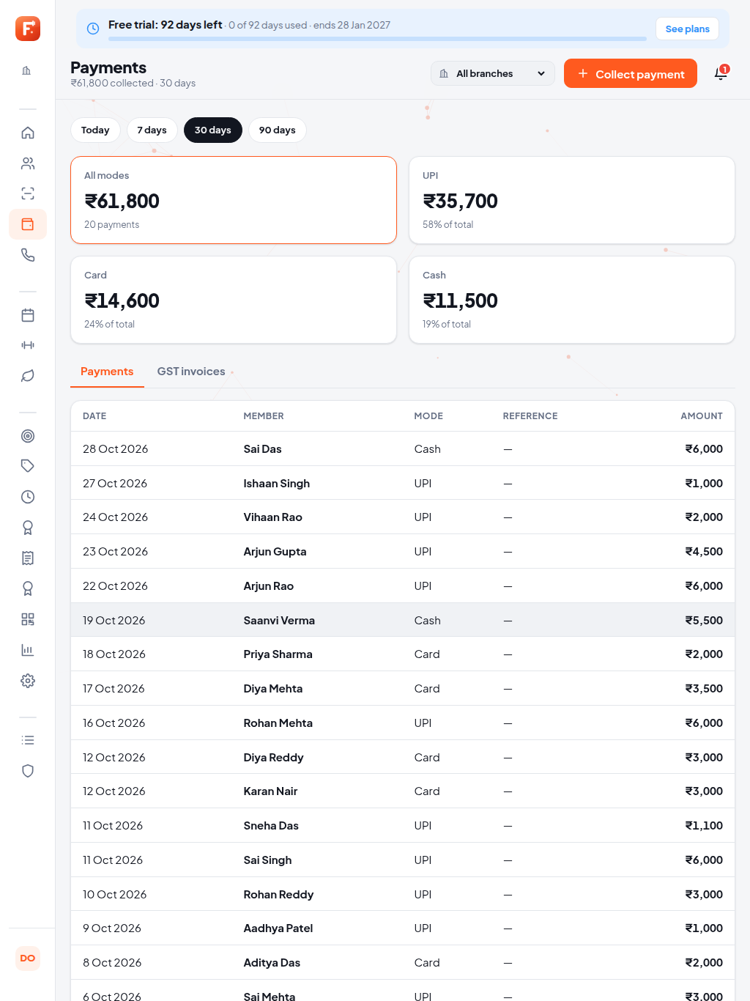
Payments and GST invoices
Collect in seconds — cash, UPI, card or online, with partial payments
Automatic invoice — GST PDF sent on WhatsApp and email
Dues list — who owes what, with one-tap reminders

Slide 8
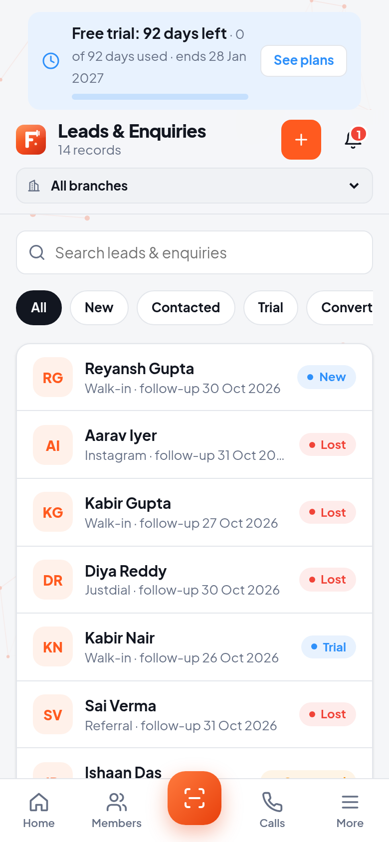
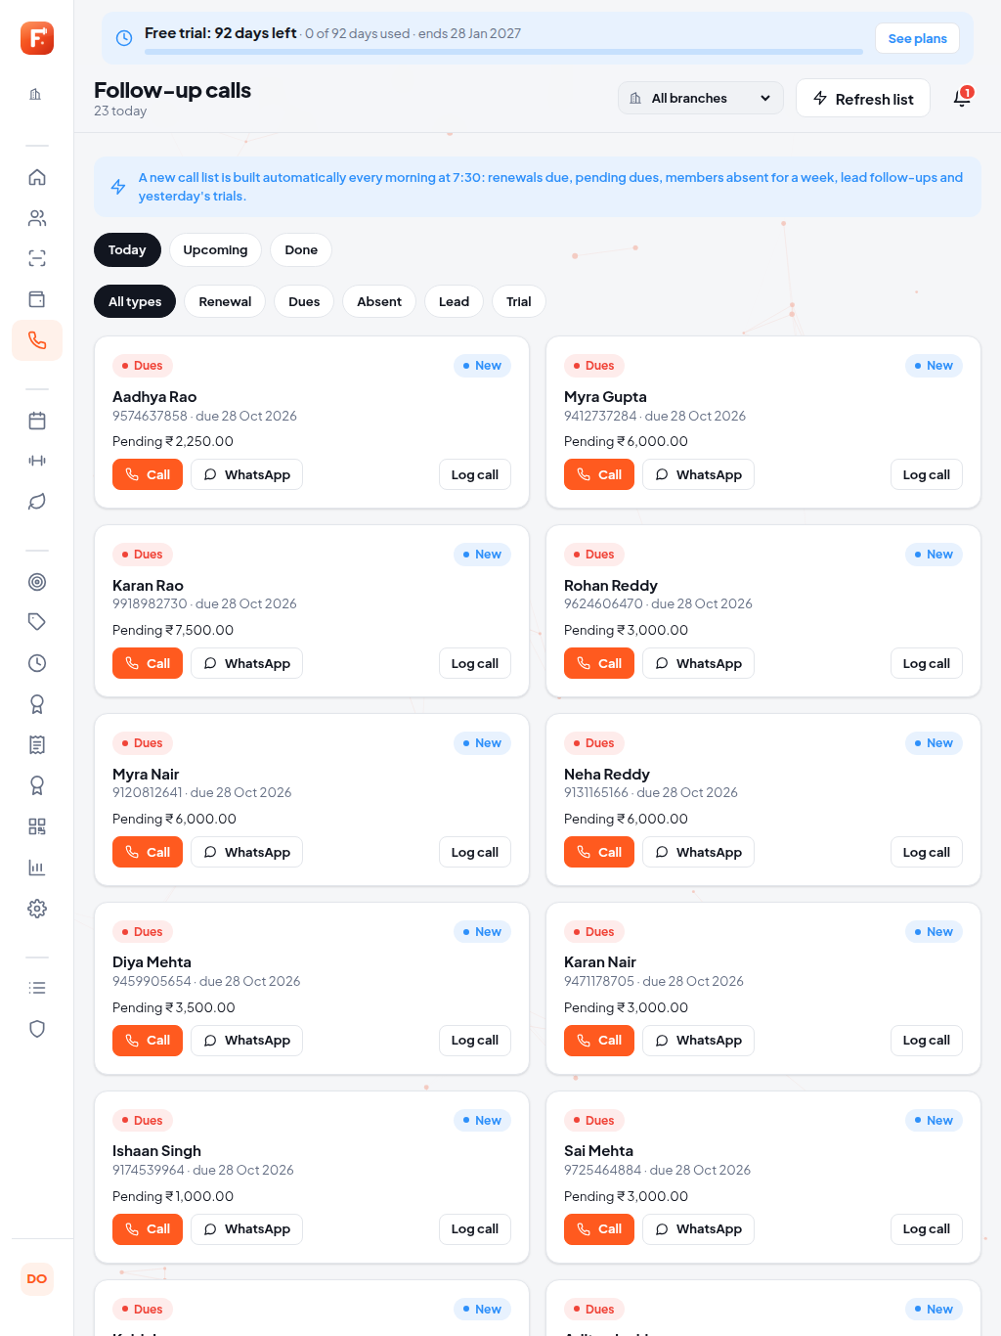
Follow-up calls and leads
Today's call list — renewals, dues, absent members and expiring trials, built automatically
Tap to call or WhatsApp — log the outcome and set a callback
Lead pipeline — New → Contacted → Trial → Converted, with one-tap conversion

Slide 9
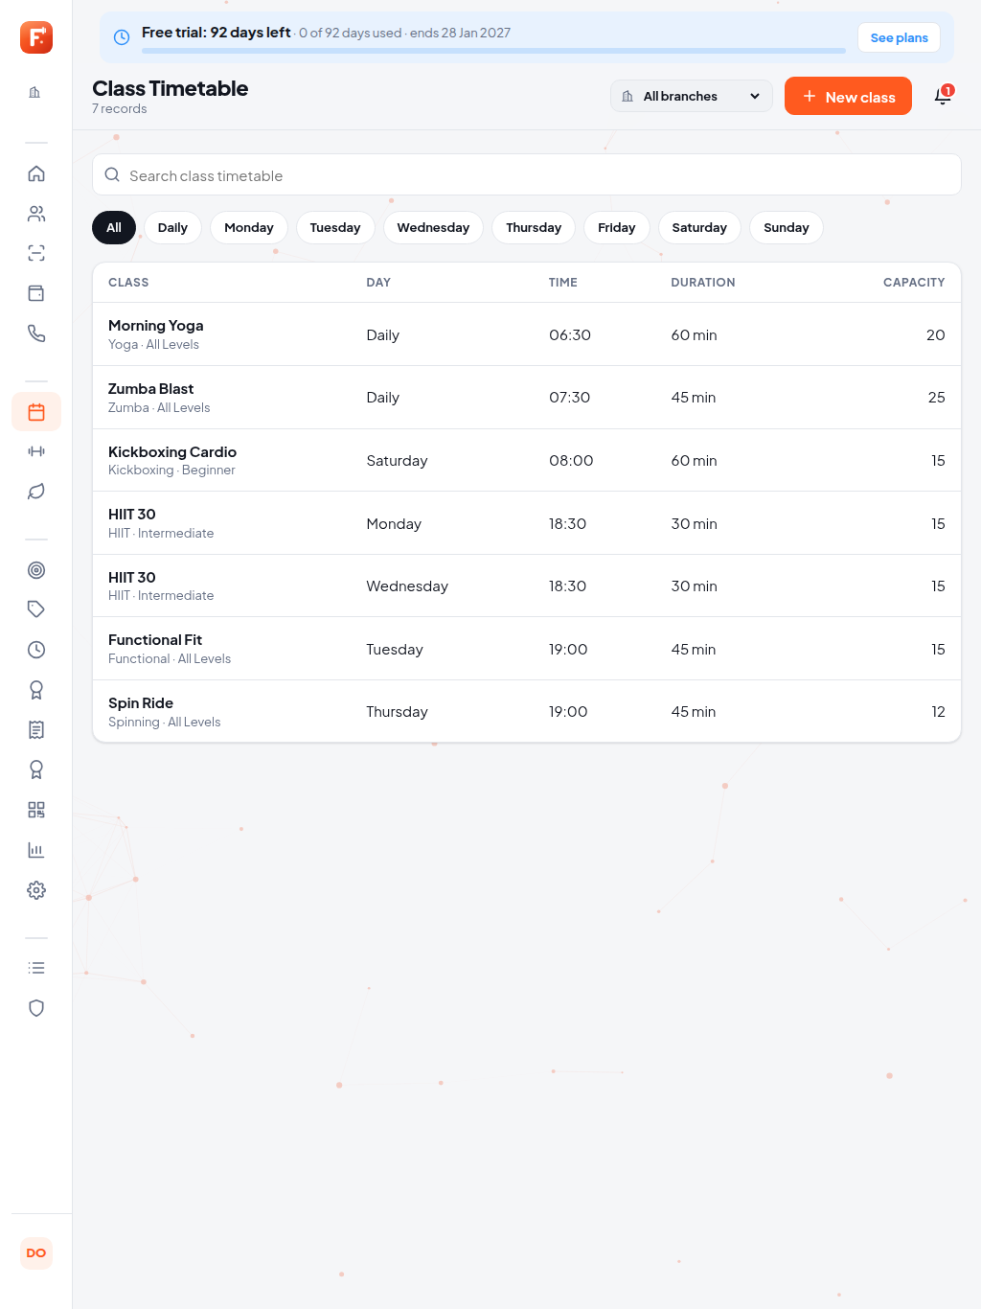
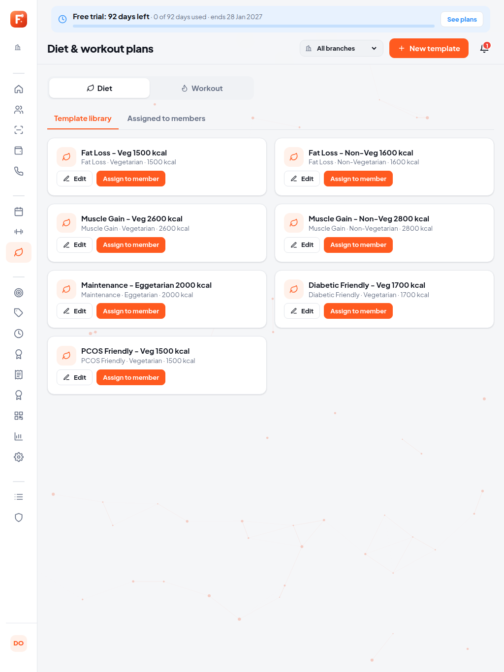
Classes, PT, diet and workout
Class timetable — capacity, bookings, waitlist, attendance
Personal training — trainers, sessions, member requests to approve
Plans library — Indian diet templates and workout splits, assigned in a tap

Slide 10
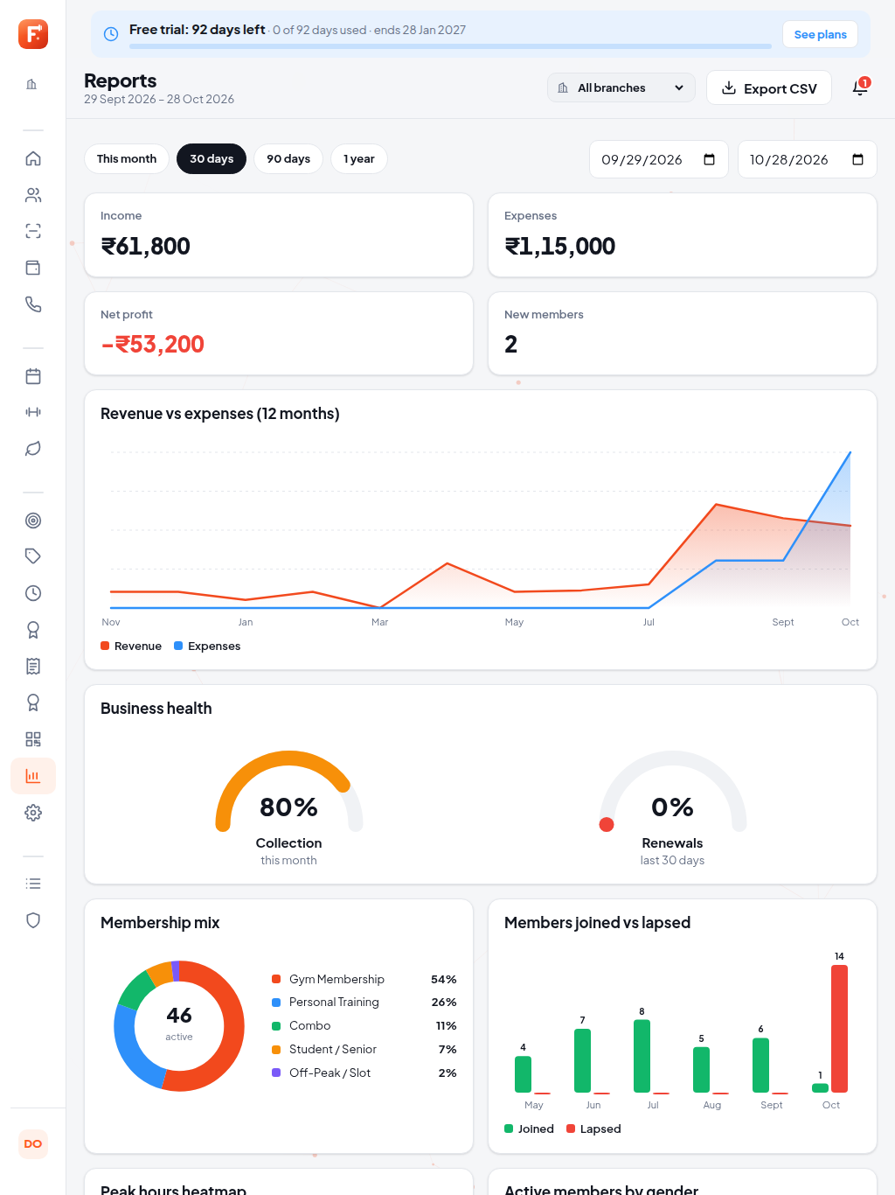
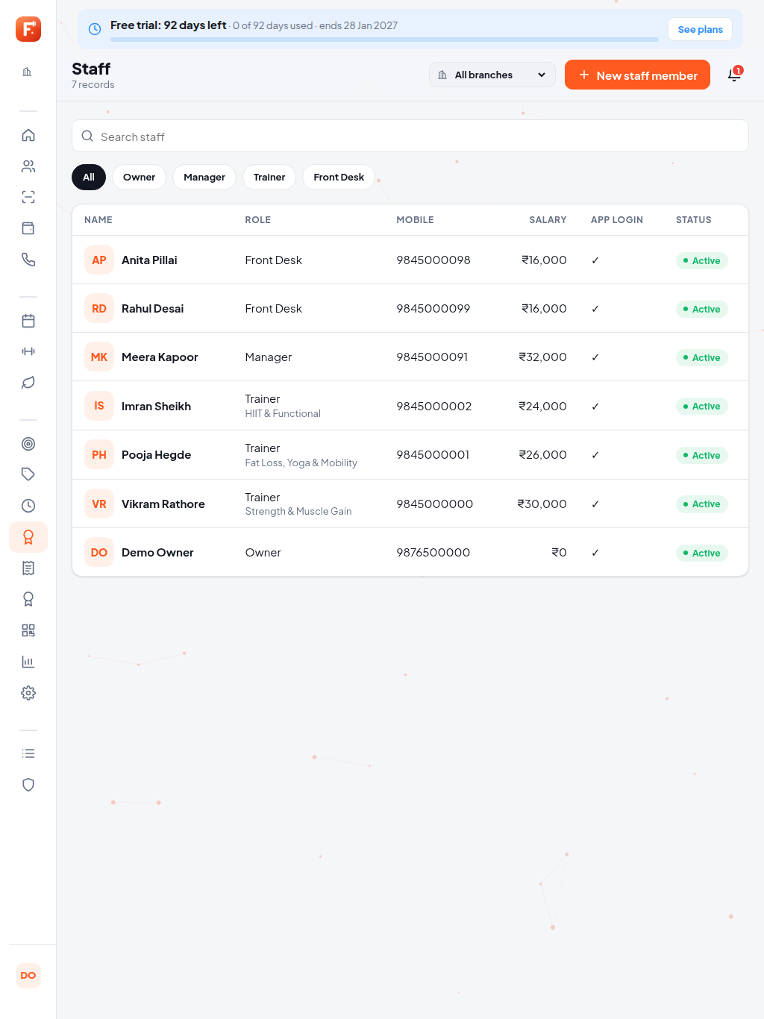
Staff, payroll, expenses and reports
Staff & trainers — roles, logins, trainer profiles shown to members
Payroll — salary, PT commission, monthly slips
Reports — P&L, collections by mode, revenue by plan, peak hours, lead funnel, trainer load, CSV export

Slide 11
The member app
Members manage their own membership: fewer calls to the front desk

Slide 12
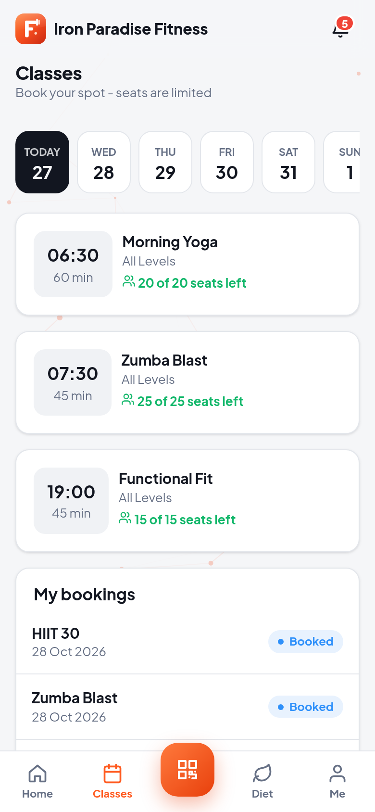
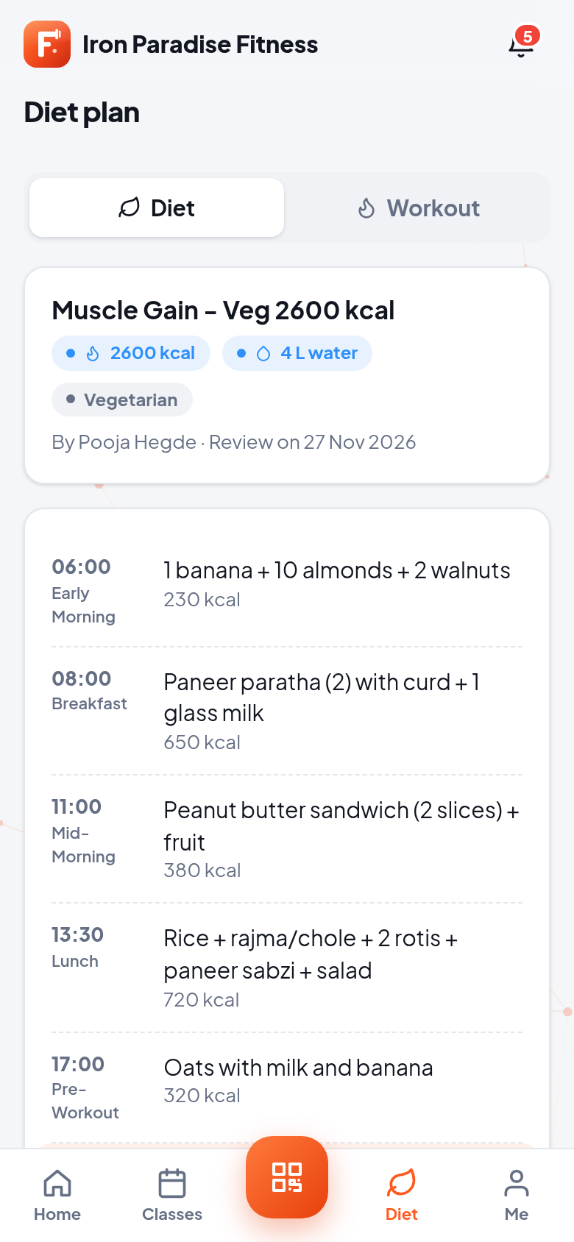
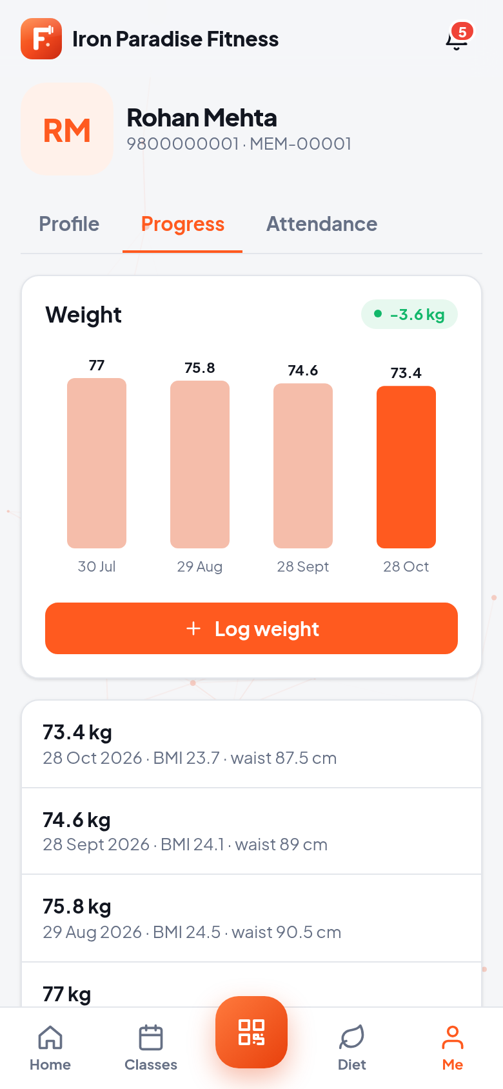
Members do it themselves
Login with mobile + OTP — over WhatsApp or SMS; no passwords
Home — plan card, days left, PT sessions left, today's class and diet, streak
Check-in — personal QR, or scan the gym's entrance QR
Classes and trainers — book, cancel, waitlist, request PT
Pay online — renew or clear dues with UPI or card; download invoices
Progress — weight chart, BMI, measurements, attendance calendar

Slide 13
Every message, on the right channel
Event | In-app | Push | WhatsApp | SMS | Email
Payment → GST invoice PDF | ✔ | ✔ | ✔ | ✔ | ✔
Renewal due (7 / 3 / 1 days) | ✔ | ✔ | ✔ | ✔ | ✔
Membership expired | ✔ | ✔ | ✔ | ✔ | ✔
Dues pending | ✔ | ✔ | ✔ | ✔
Class / PT reminders | ✔ | ✔ | ✔
Birthday, we-miss-you (7 days absent) | ✔ | ✔ | ✔
Owner daily summary | ✔ | ✔ |  |  | ✔
Each gym switches every channel on or off, and every send is logged.

Slide 14






Phone, tablet, desktop: web and store apps
Installable web app
Android (Play Store)
iOS (App Store)
Add to the home screen on Android, iPhone, tablet or PC. It updates itself.
Native push, camera QR, haptics and share. Signed .aab built by one script.
Built on GitHub's macOS runners, so no Mac is needed. Sent to TestFlight automatically.
Light and dark mode
Tablet layouts
White-label
Follows the system or the user's choice, with safe areas for notches.
Wide tables and side panels on tablets; cards on phones.
Your brand name, logo and app id per customer, from the same code.

Slide 15
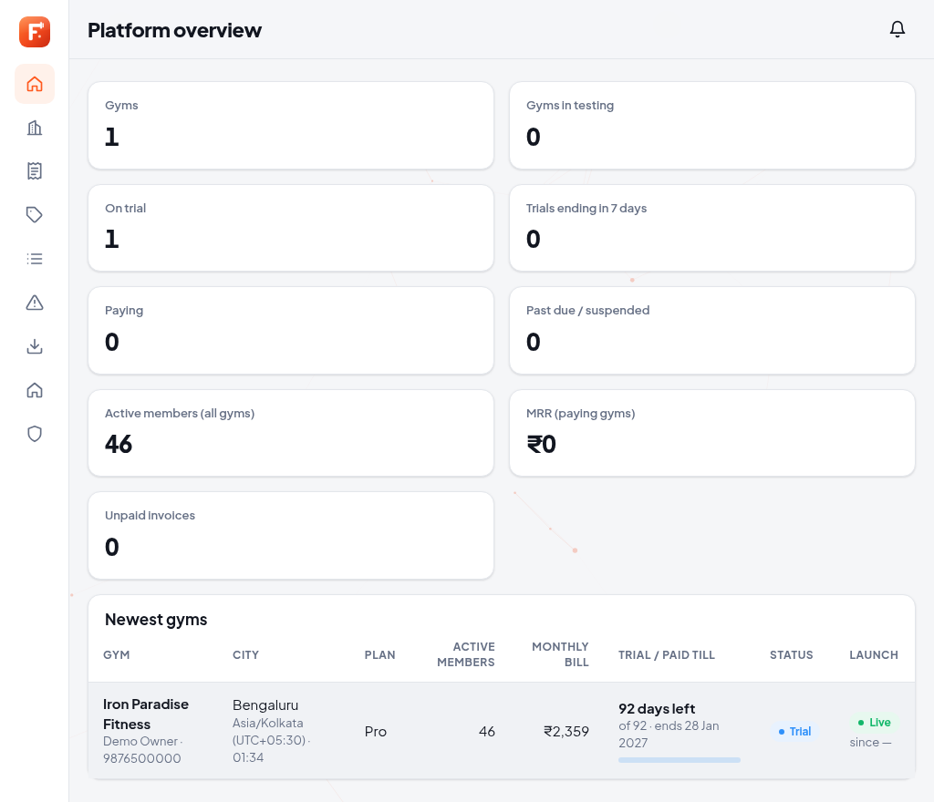
Admin console for SaaS
All gyms — status, plan, members and this month's bill
Plans and pricing — base price plus per-member price, custom deals per gym
Trials and licences — extend, suspend or activate in a click
Support — tickets from gyms and app error logs in one place

Slide 16



Works on any FitManagr backend
Our cloud (SaaS)
Client's own ERPNext
Custom UI
Gyms sign up and start a free trial. We host and bill monthly.
Point the app at the client's ERPNext with FitManagr installed. Nothing to migrate.
Prefer a different design? Build on the same REST API.
One setting — the app's API address decides which server it talks to
Same features everywhere — desk users and app users see the same members, payments and check-ins in real time
White-label per client — build the store apps under the client's own name and logo

Slide 17
Give every gym an app its members love
Setup guide: satyabrata12017.github.io/fitmanagr-setup
Contact: Satya · satyabrata12017@gmail.com
See the Backend deck for ERPNext deployment and licensing

