Slide 1
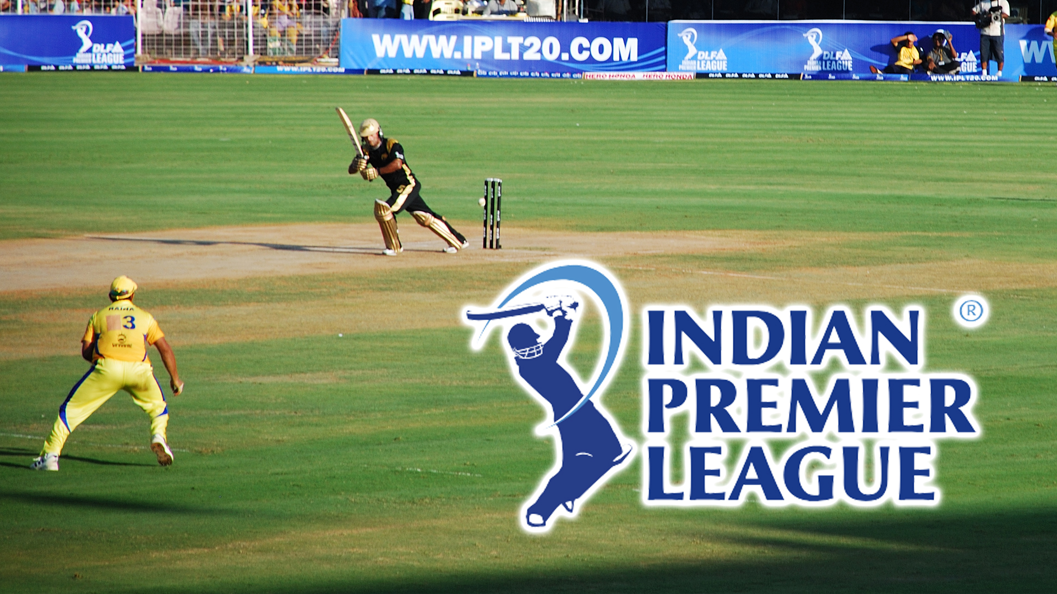
IPL Match Analysis

Slide 2
DELIVERIES
278,205
Across the dataset
1,169 matches reveal a league shaped by small edges
278,205 deliveries across 1,169 unique matches.
QUESTIONS
The analysis asks where advantage actually comes from: toss value, chasing advantage, team strength, venue effect, and player impact.
5
02

Slide 3
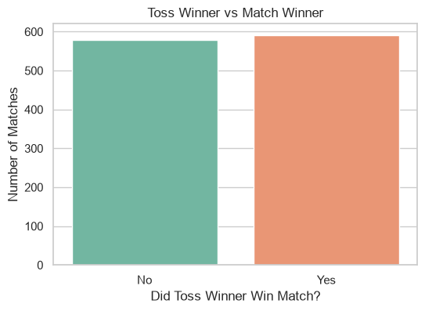
TOSS VALUE
The toss winner also won the match in 50.56% of matches.
The toss creates a decision point, but not a reliable outcome.
Toss winners win only slightly more often than they lose.
03

Slide 4
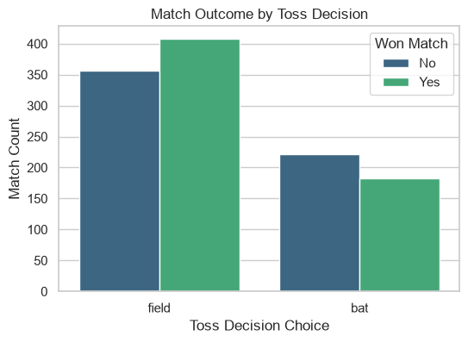
TOSS DECISION
Fielding first was chosen in 764 tosses versus 405 decisions to bat. Captains field first in about two of every three matches, and those sides win more often.
When teams chose to field, the toss winner won 53.40% of matches. When teams chose to bat, that figure fell to 45.19%.
Choosing to field aligns with a higher toss-winner win rate.
05

Slide 5
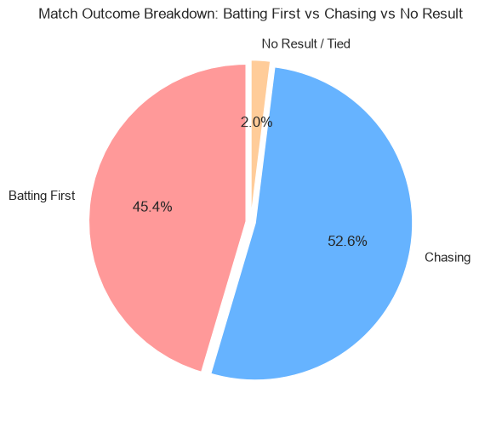
Batting first vs chasing
Chasing wins 615 matches, or 52.6%. Batting first wins 531 matches, or 45.4%. No result or tied: 23 matches, or 2.0%.
Chasing wins a modest majority of completed matches.
04

Slide 6
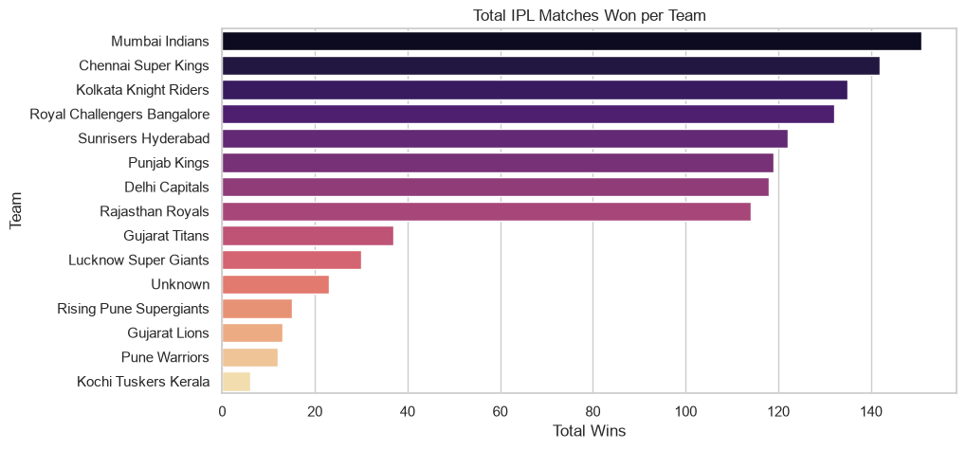
Total wins per franchise
Mumbai Indians led total wins at approximately 150; Chennai Super Kings followed at approximately 141; Kolkata Knight Riders were next at approximately 135 wins.
07

Slide 7
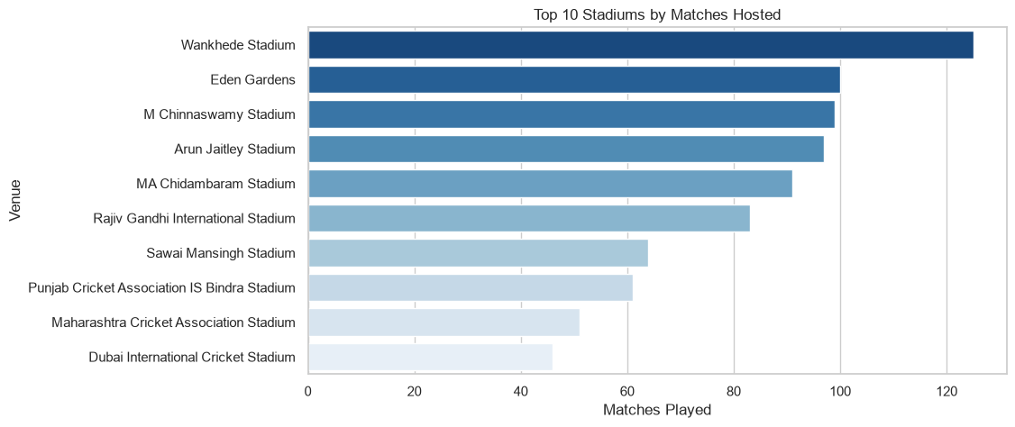
Top 10 stadiums by matches hosted
≈125matches at Wankhede, the busiest ground.

Slide 8
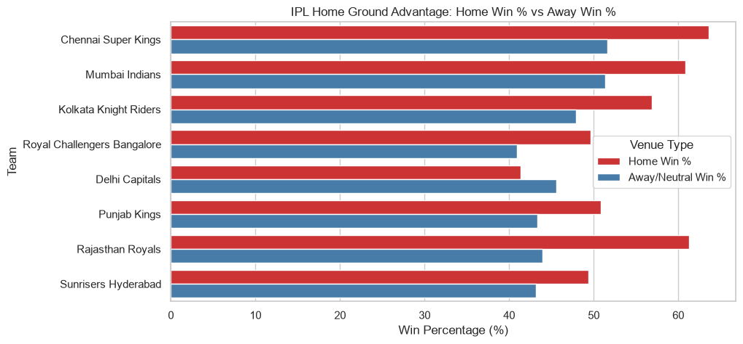
Home advantage is real, but it is not universal
06

Slide 9
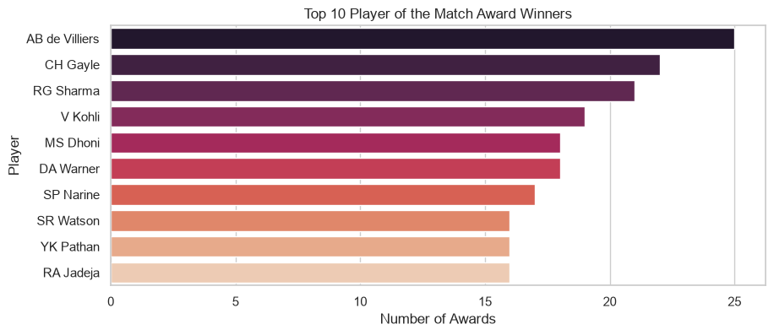
Player of the match awards
AB de Villiers led the Player of the Match count with 25 awards. CH Gayle followed with approximately 22, then Rohit Sharma with approximately 21.
Virat Kohli, MS Dhoni, David Warner, and Sunil Narine also sit among the leading award winners.
08

Slide 10
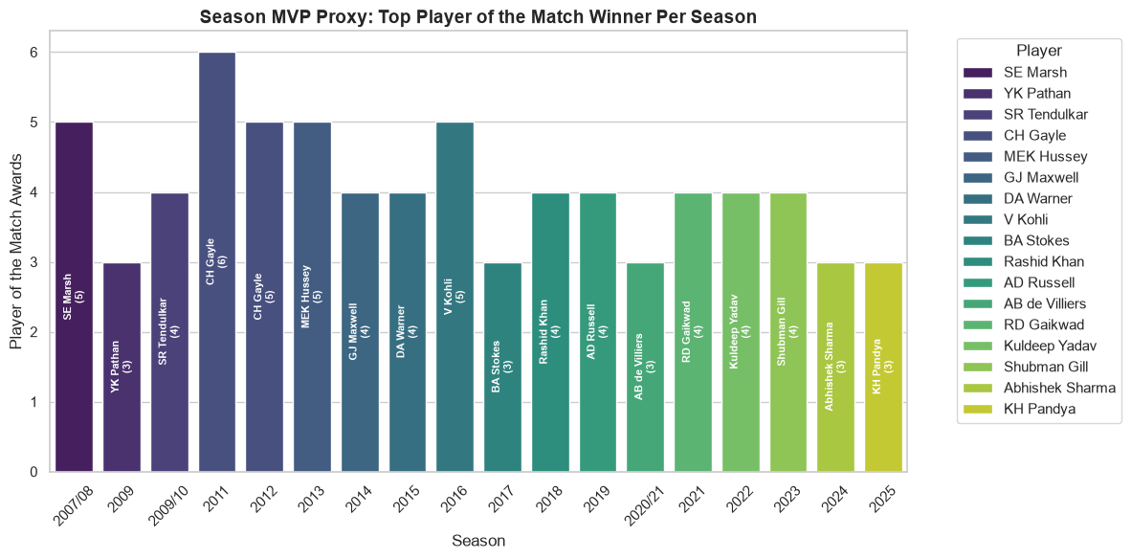
Top award winner per season

Slide 11
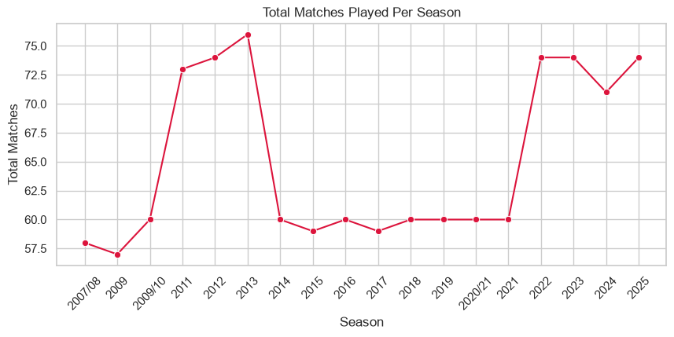
Matches per season
Season volume rose from roughly 58 matches in 2007/08 to roughly 76 in 2013; from 2014 through 2021, most seasons clustered around 59–60 matches; by 2022–2025, the competition returned to roughly 71–74 matches per season.
IPL season volume has settled near the mid-70s after a long 60-match phase.
09

Slide 12
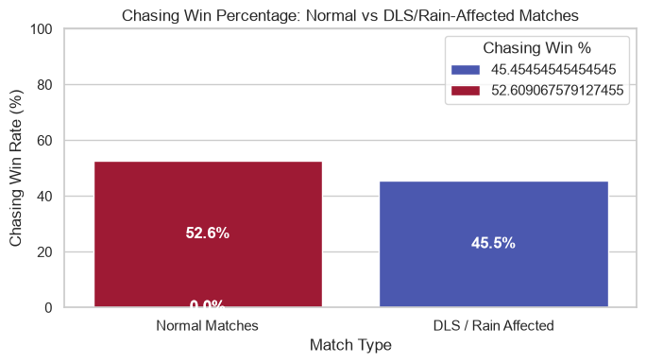
Rain-affected matches
22 matches were settled by the D/L method, under 2% of all matches. Chasing sides won fewer of them than usual.
With 22 matches, a gap of about seven points is within random variation, so it is a pattern to watch and not a finding.

Slide 13
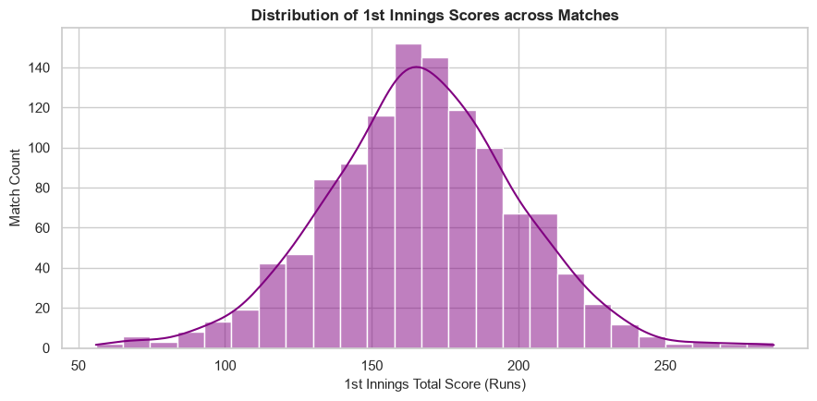
First-innings totals
Across 1,169 matches, the mean first-innings score was 167.0 runs. The middle 50% of scores fell between 147 and 188 runs. The observed range stretched from 56 to 287 runs.
The scoring center of gravity is in the high 160s, with meaningful variation around it.
10

Slide 14
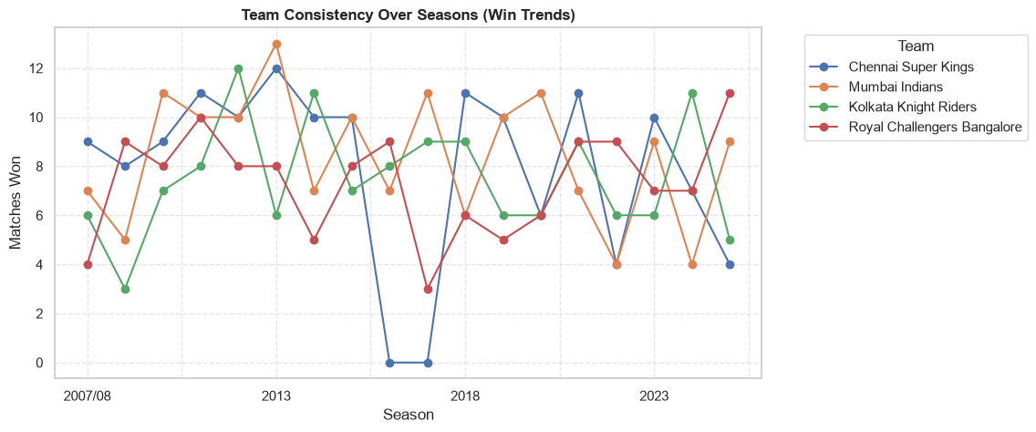
Team consistency over seasons
Top 5 Teams
Mumbai Indians reached about 13 wins around 2013, the highest of the four lines. The flat stretch matches Chennai’s two-season suspension from the league. Outside those gaps, all four teams swing between about 3 and 13 wins a year, with no franchise holding the top spot for long.

Slide 15
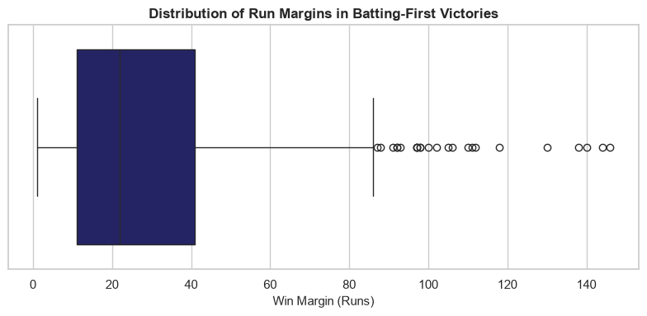
Runs margin in batting-first wins
Most wins by the side batting first are decided by 11 to 41 runs; a few blowouts run past 100.
531 batting-first wins ≈22 median margin , in runs
≈11–41 middle half of margins ≈146 largest margin, in runs

