Slide 1
Capstone Project
Foundations of Data Science
------------------------------------------
Satya Dalai
January 2016

Slide 2
Capstone Project : Customer Churn in the Telecom Industry
Customer Churn
Customer Churn is the number of customers who leave or stop a service within a defined period.
It is important because
analyzing customer churn can help us understand product and service deficiencies
can also help understand customer acquisition and retention metrics for the future
the costs of customer acquisition outweigh customer retention.
Customer Data
Data Analyzed was of 3333 individual accounts of a Telecom Company based in the USA
The dataset had information such as Account Length, State, Area Code, VoiceMail and International Plan Status, minutes, calls and charges during different times of the day as well as customer service calls made.
SpringBoard Foundations of Data Science
Satya Dalai

Slide 3
Capstone Project : Customer Churn in the Telecom Industry
Data Analysis
The data was analyzed to establish relationships between Churn and other attributes
The objective is to use the available data to help us predict and identify customers at risk of churn
Offering these customers with incentives and customized offers could reduce churn
Currently ~14.5% of customers are Churners in the data
SpringBoard Foundations of Data Science
Satya Dalai

Slide 4
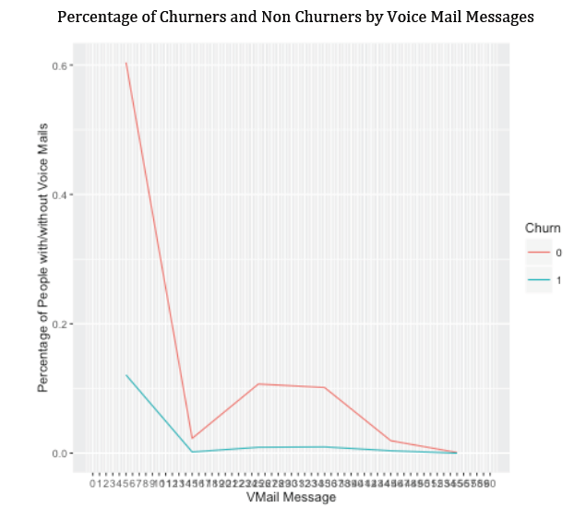
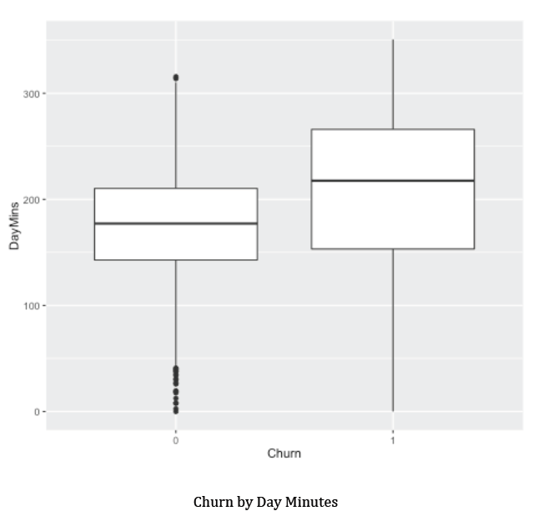
Capstone Project : Customer Churn in the Telecom Industry
Exploratory Data Analysis
Some findings during the EDA process are listed below.
The boxplots to the left represent Churn by Day Minutes.
The higher day minutes attributed to Churners could possibly mean that frequent users of the telecom service encountered more issues increasing their churn rate.
50% of both churners and non churners have 0 voice mail messages.
The frequency plot shows the spread of both, which doesn’t appear to have a pattern.
Churn by Voice Mail Messages
Churn by Day Minutes
SpringBoard Foundations of Data Science
Satya Dalai

Slide 5
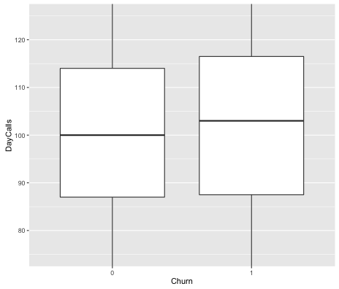
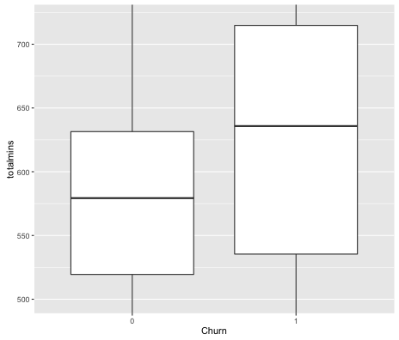
Capstone Project : Customer Churn in the Telecom Industry
Exploratory Data Analysis
Some findings during the EDA process are listed below.
Total Minutes is the sum of Morning, Evening and Night minutes. Since it is a factor of day minutes, it is not surprising to see a larger median for Churners.
As the plots show, there doesn’t appear to be a marked difference between churners and non churners.
However, we know that Churners use more minutes than non churners, and so although they’re making slightly more calls, their calls last longer.
Churn by Day Calls
Churn by Total Minutes
SpringBoard Foundations of Data Science
Satya Dalai

Slide 6
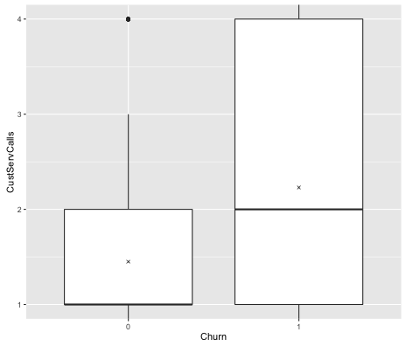
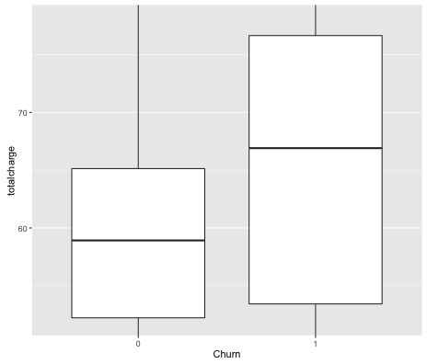
Capstone Project : Customer Churn in the Telecom Industry
Exploratory Data Analysis
Some findings during the EDA process are listed below.
50% of Churners appear between 1 to 4 customer calls, half of whom made between 2 to 4 calls to Customer Service.
Compared to non churners, 75% of whom made 3 or less calls, it seems like Churners made several customer calls before they moved on.
This is expected and I would think most calls made by Churners remained largely unresolved
There seems to be a significant difference between churners and non churners when dealing with total charges
We expected to see higher values in the boxplots for churners because day charges displayed the same behavior.
Churn by Customer Service Calls
Churn by Total Charges
SpringBoard Foundations of Data Science
Satya Dalai

Slide 7
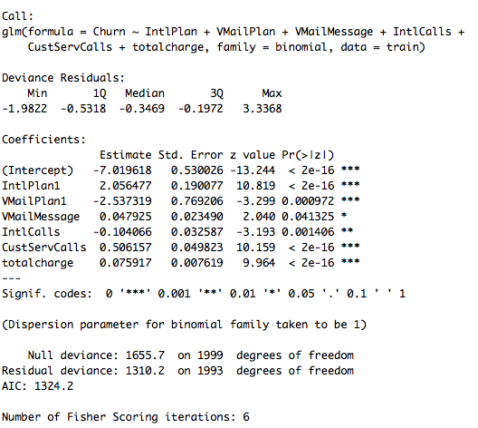

Capstone Project : Customer Churn in the Telecom Industry
Methodologies
Presented here are brief outputs of the methodologies employed
to facilitate analysis
Logistic Regression Modeling
Logistic Regression Modelling Output
The table on the right displays the Logistic Regression Model’s output.
We can see Voice Mail Plans and International Calls have negative values indicating an inverse relationship with Churn. Churn goes down as customers sign up for Voice Mail Plans and increase their international calls usage.
Other variables are detrimental to churn.
The AIC Value is 1324.2
The Confusion Matrix is shared here
The accuracy of the model is 0.8582146
SpringBoard Foundations of Data Science
Satya Dalai

Slide 8
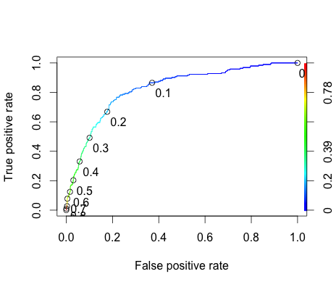
Capstone Project : Customer Churn in the Telecom Industry
Methodologies
Presented here are brief outputs of the methodologies employed
to facilitate analysis
Receiver Operating Characteristic Curve
ROC Curve
The value for AUC is 0.8239433. The ROC Curve shows the tradeoff between sensitivity on the Y axis and specificity on X axis.
SpringBoard Foundations of Data Science
Satya Dalai

Slide 9
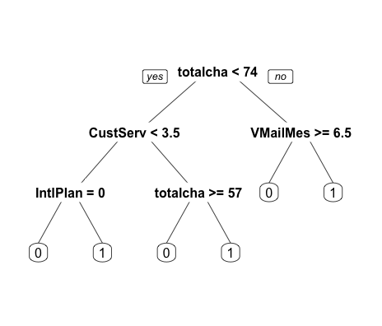

Capstone Project : Customer Churn in the Telecom Industry
Methodologies
Presented here are brief outputs of the methodologies employed
to facilitate analysis
Decision Trees
Decision Tree Plot
The Confusion Matrix for the Decision Tree
The accuracy of the model is 0.9234809
SpringBoard Foundations of Data Science
Satya Dalai

Slide 10
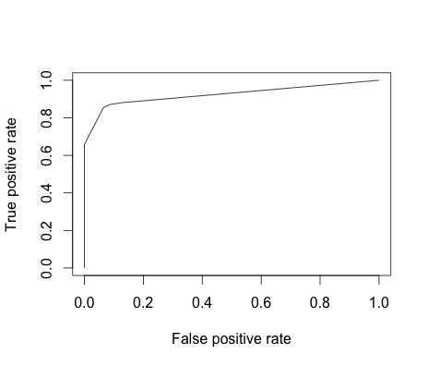
Capstone Project : Customer Churn in the Telecom Industry
Methodologies
Presented here are brief outputs of the methodologies employed
to facilitate analysis
Receiver Operating Characteristic Curve for the Decision Tree
ROC Curve
The AUC value has already been established to be 0.9241
SpringBoard Foundations of Data Science
Satya Dalai

Slide 11
Capstone Project : Customer Churn in the Telecom Industry
Data Findings and Recommendations
Our most important findings :
Customer Churn increased with International Plans, Voice Mail Messages, Customer Service Calls and Total Charges.
Customer Service Calls
This seems like an acceptable find. Increased customer service calls likely indicate dissatisfaction with the service leading to churn.
Recommendations
Increased calls are leading to churn, and finding out why is an important step towards retention. The company should first focus on the most common problems and slowly tackle a wider range. Customer Service should also be toll free and any calls that are left unresolved after defined timelines should be escalated to bring the median for churners down.
SpringBoard Foundations of Data Science
Satya Dalai

Slide 12
Capstone Project : Customer Churn in the Telecom Industry
Data Findings and Recommendations
Our most important findings :
Customer Churn increased with International Plans, Voice Mail Messages, Customer Service Calls and Total Charges.
Total Charges
I don’t think this is restricted to this particular telecom provider, and could be an industry trend. It seems like this could be a customer going over budget on their plans or being billed for services they did not accept, and decided to move.
Recommendations
I recommend communicating warnings when a customer exceeds their minutes or unfamiliar activity is detected on their usage. However, this may have limited impact and a spillover of pending charges to other telecom providers will be a larger deterrent. The nature of competition may not allow that though and something akin to a credit score may be the middle path.
SpringBoard Foundations of Data Science
Satya Dalai

Slide 13
Capstone Project : Customer Churn in the Telecom Industry
Thank you
End.

