Slide 1
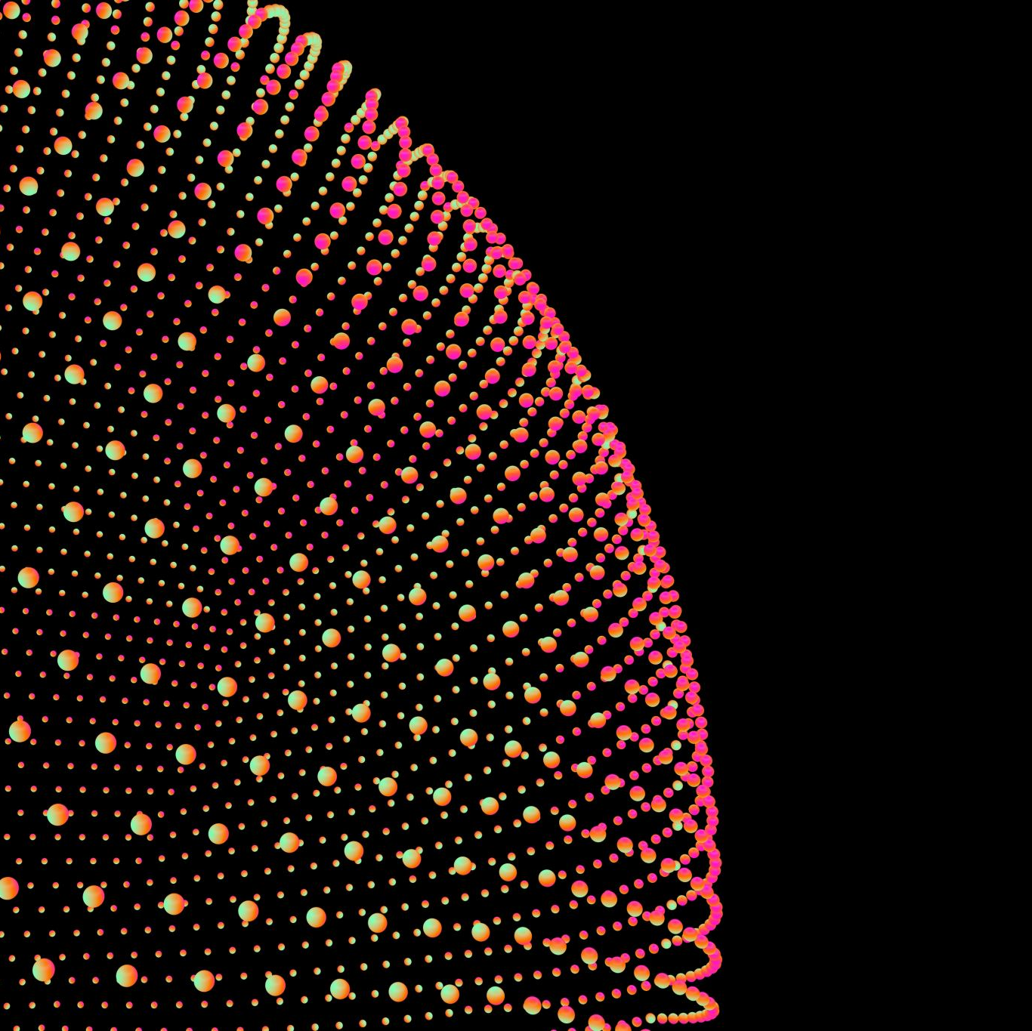
Facial Emotion Detector
IE406-MACHINE LEARNING
DA-IICT, GANDHINAGAR

Slide 2






Primary Objective
The aim of the project is to mirror the facial expression of any image and give an emoji as an output which corresponds to the expression in the image.
Building the model using CNN where each pixel will behave as feature for that training example
Optimizing it using different approaches for model structure and algorithms

Slide 3
An insight about the dataset…
FER-2013
The dataset consists of 28k training examples and 5k testing examples.
Each training example is a 48x48 b/w image.
Dataset size is
28000 x 48 x 48
Angry
Disgust
Fear
Happy
Neutral
Sad
Surprise
7 target classes:

Slide 4
Common CNN model for image classification
(LeNet,AlexNet,VGG)
Applying different optimizing methods
(Dropout, ADAM)
Normalized input data
Optimizing in terms of Computational-power, time,
structure
Building a different model on our own and adding functionalities of ResNet, Inception Model along with hyperparameter tuning and other optimization methods
Testing the Models and comparing the results

Slide 5
References
Raheja, Jagdish Lal, and Umesh Kumar. "HUM AN FACIAL EXPRESSION DETECTION FROM DETECTED IN CAPTURED IM AGE USING BACK PROPAGATION NEURAL NETW ORK." (2010).
N. Song, H. Yang and P. Wu, "A Gesture-to-Emotional Speech Conversion by Combining Gesture Recognition and Facial Expression Recognition," 2018 First Asian Conference on Affective Computing and Intelligent Interaction (ACII Asia), 2018, pp. 1-6, doi: 10.1109/ACIIAsia.2018.8470350.
Dataset - FER-2013 | Kaggle

Slide 6
Team
201901202 – Aditya Zala
201901227 – Satyadev Patel
201901228 – Nirmit Ghughu
201901247 – Darsh Rank
201901472 – Adtiya Arya
Thanks …

