Slide 1
anomaly Detection in network activities
TEAM Name
Satyadhar kumar (e18cse163)
Saish gopishetty (e18cse157)
Ravula praveen (e18cse146)
ravi chowdary (e18cse145)
Computer Science Engineering Department
Bennett University, Greater Noida, U.P.
Date 16.6.20

Slide 2
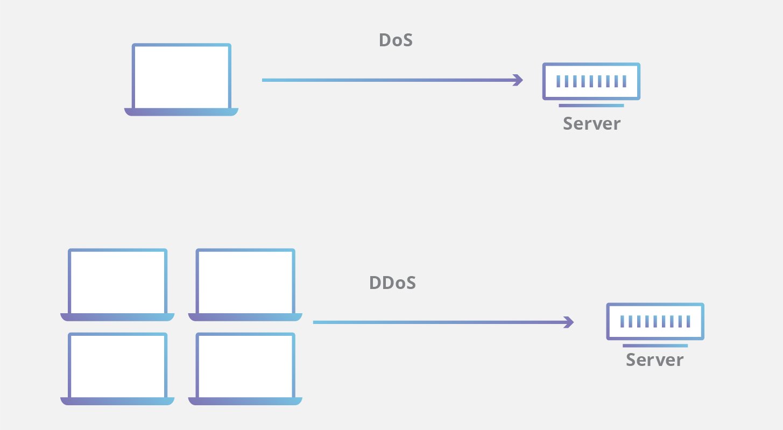
Introduction
Our project concerns the field of Cyber Security and aims at detecting DOS or DDOS attacks.
The main aim of our team was to build a software from scratch that is light, gives the user real time information about the said network and could work independently.
Our project helps users to keep track of their live internet traffic and detect an anomaly whenever there is a DOS attack

Slide 3
Objectives
Analalysis of Network packets
Showing statistics of different protocols.
In this project we are sniffing packets with respect to six protocols namely: TCP, UDP, DNS, IP, FTP, and HTTP
After updating the count for each protocol, the program plots the pie chart,bar graph and timeslot
Detecting DOS and DDOS ATTACKS.

Slide 4
Data resoUrces Used
We have used the Anaconda Installation of Python since it comes pre-installed with most of the basic python libraries such as Pandas, Matplotlib, NumPy, etc.
The Python libraries used in this project are:
1. The Scapy Library
2. The Tkinter Library
3. The Matplotlib Library
4. The Math Library
5. The Time Library

Slide 5
Methodology
When we run the code,a GUI gets popped up which consists of three 3 options,we need to select a time option from it.
Then, the program runs the start function. In each execution of the loop, the sniff function that has been imported from the Scapy Library captures a single network packet .
Then searches for the protocols that are present in that packet and increases the number of packets in that protocol by one if that protocol is present in the packet. In this project we are sniffing packets with respect to six protocols namely: TCP, UDP, DNS, IP, FTP, and HTTP.

Slide 6
Methodology
After updating the count for each protocol, the program plots the pie chart,bar graph and timeslot
Then,we open Switchblade GUI and artificially generate DOS attack by typing our IP address.
For finding IP address ,we used ifconfig function in terminal.
Finally our project recognises the attack and displays an alert message

Slide 7
Results Achieved
In our project, the pie chart indicates the percentage of the total number of packets that belong to each protocol.
The bar graph gives us information about the total number of packets with respect to each protocol.
The time plot gives us information about the total number of packets belonging to each protocol with respect to time spent after starting the evaluation.
Thus, our project helps users to keep track of their live internet traffic and detect an anomaly whenever there is a DOS attack.

Slide 8

Performance evaluation
Presently, there are many software which can detect a DOS attack. Most of the software available are actually packet sniffers.(Ex. Wire Shark, Tcp dump, SolarWinds)
Microsoft has very recently come up with its Microsoft Azure DDOS Protection services which monitors as well as detects prevalent DOS or DDOS attacks.
As compared to other existing technologies, our software is much lighter, much faster and gives users the real time information about the network traffic in their computer

Slide 9
Conclusion
As of now our project is tailored to perform only those tasks that have been discussed above. The primary aspects of the project which we have decided to work upon are:
Faster computation speeds.
Lighter and more efficient software.
Ability to detect the name of the protocol that had been used to launch the attack.

Slide 10
References
[1] Petersen, B. and Chung, E., Broadcom Corp, 2009. Network activity anomaly detection. U.S. Patent Application 12/015,387.
[2] Garcia-Teodoro, P., Diaz-Verdejo, J., Maciá-Fernández, G. and Vázquez, E., 2009. Anomaly-based network intrusion detection: Techniques, systems and challenges. computers & security, 28(1-2), pp.18-28.
[3] Krügel, C., Toth, T. and Kirda, E., 2002, March. Service specific anomaly detection for network intrusion detection. In Proceedings of the 2002 ACM symposium on Applied computing (pp. 201-208).
[4] Simmross-Wattenberg, F., Asensio-Perez, J.I., Casaseca-De-La-Higuera, P., Martin-Fernandez, M., Dimitriadis, I.A. and Alberola-Lopez, C., 2011. Anomaly detection in network traffic based on statistical inference and\alpha-stable modeling. IEEE Transactions on Dependable and Secure Computing, 8(4), pp.494-509.
[5] Gao, J., Hu, G., Yao, X. and Chang, R.K., 2006, August. Anomaly detection of network traffic based on wavelet packet. In 2006 Asia-Pacific Conference on Communications (pp. 1-5). IEEE.
[6] Chan, P.K., Mahoney, M.V. and Arshad, M.H., 2005. Learning rules and clusters for anomaly detection in network traffic. In Managing Cyber Threats (pp. 81-99). Springer, Boston, MA.
[7] Noble, C.C. and Cook, D.J., 2003, August. Graph-based anomaly detection. In Proceedings of the ninth ACM SIGKDD international conference on Knowledge discovery and data mining (pp. 631-636).
[8] Pavithirakini, S., Bandara, D.D.M.M., Gunawardhana, C.N., Perera, K.K.S., Abeyrathne, B.G.M.M. and Dhammearatchi, D., 2016. Improve the Capabilities of Wireshark as a tool for Intrusion Detection in DOS Attacks. International Journal of Scientific and Research Publications, 6(4), pp.378-384.
[9] Othman, Z.A. and Eljadi, E.E., 2011, July. Network anomaly detection tools based on association rules. In Proceedings of the 2011 International Conference on Electrical Engineering and Informatics (pp. 1-7). IEEE.
[10] Mantere, M., Sailio, M. and Noponen, S., 2014, April. A module for anomaly detection in ICS networks. In Proceedings of the 3rd international conference on High confidence networked systems (pp. 49-56).
[11] Mahoney, M.V., 2003, March. Network traffic anomaly detection based on packet bytes. In Proceedings of the 2003 ACM symposium on Applied computing (pp. 346-350).
[12] Gao, J., Hu, G., Yao, X. and Chang, R.K., 2006, August. Anomaly detection of network traffic based on wavelet packet. In 2006 Asia-Pacific Conference on Communications (pp. 1-5). IEEE.

Slide 11

Thank You

