Slide 1
Overview of a Computational Models
Dr. Anand Bihari
SJT Annex- 203N
anand.bihari@vit.ac.in

Slide 2
TOC
In theoretical computer science, the theory of computation is the branch that deals with whether and how efficiently problems can be solved on a model of computation, using an algorithm.
The field is divided into three major branches:
Automata theory,
Computability theory
and computational complexity theory.
In order to perform a rigorous study of computation, computer scientists work with a mathematical abstraction of computers called a model of computation.
There are several models in use, but the most commonly examined is the Turing machine.

Slide 3
Automata theory
In theoretical computer science, automata theory is the study of abstract machines (or more appropriately, abstract 'mathematical' machines or systems) and the computational problems that can be solved using these machines. These abstract machines are called automata.
This automaton consists of
states (represented in the figure by circles),
and transitions (represented by arrows).
As the automaton sees a symbol of input, it makes a transition (or jump) to another state, according to its transition function (which takes the current state and the recent symbol as its inputs)

Slide 4
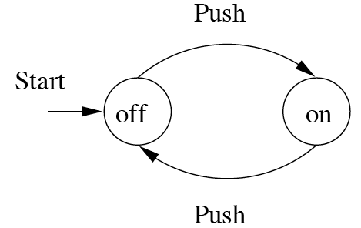
Ex: FA modeling of on/off switch
Finite Automata : Examples
Push
Start
off
on
Push
action
state

Slide 5
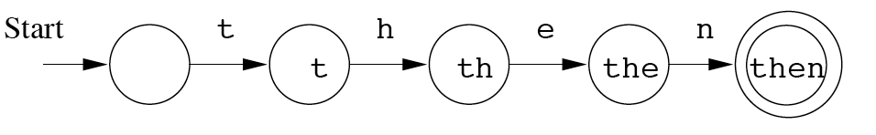
Modeling recognition of the word “then”
Start state
Transition
Intermediate state
Final state

Slide 6
Introduction to formal proof:
Basic Symbols used :
U – Union
∩- Conjunction
ϵ - Empty String
Φ – NULL set
“~” or “¬”- negation
‘ – compliment
= > implies

Slide 7
Additive inverse: a+(-a)=0
Multiplicative inverse: a*1/a=1
Universal set U={1,2,3,4,5}
Subset A={1,3}
A’ ={2,4,5}
Absorption law: AU(A ∩B) = A, A∩(AUB) = A
De Morgan’s Law:
(AUB)’ =A’ ∩ B’ (A∩B)’ = A’ U B’
Double compliment
(A’)’ =A
A ∩ A’ = Φ

Slide 8
Relations:
Let a and b be two sets a relation R contains aXb.
Relations used in TOC:
Reflexive: a = a
Symmetric: aRb = > bRa
Transition: aRb, bRc = > aRc
If a given relation is reflexive, symmetric and transitive then the relation is called equivalence relation.

Slide 9
Example
Reflexive Relation: A relation R on set A is said to be a reflexive if (a, a) ∈ R for every a ∈ A.
Example: If A = {1, 2, 3, 4} then R = {(1, 1) (2, 2), (1, 3), (2, 4), (3, 3), (3, 4), (4, 4)}. Is a relation reflexive?
Solution: The relation is reflexive as for every a ∈ A. (a, a) ∈ R, i.e. (1, 1), (2, 2), (3, 3), (4, 4) ∈ R.
Symmetric Relation: A relation R on set A is said to be symmetric iff (a, b) ∈ R ⟺ (b, a) ∈ R.
Example: Let A = {1, 2, 3} and R = {(1, 1), (2, 2), (1, 2), (2, 1), (2, 3), (3, 2)}. Is a relation R symmetric or not?
Solution: The relation is symmetric as for every (a, b) ∈ R, we have (b, a) ∈ R, i.e., (1, 2), (2, 1), (2, 3), (3, 2) ∈ R but not reflexive because (3, 3) ∉ R.

Slide 10
Transitive Relations: A Relation R on set A is said to be transitive iff (a, b) ∈ R and (b, c) ∈ R ⟺ (a, c) ∈ R.
Example1: Let A = {1, 2, 3} and R = {(1, 2), (2, 1), (1, 1), (2, 2)}. Is the relation transitive?
Solution: The relation R is transitive as for every (a, b) (b, c) belong to R, we have (a, c) ∈ R i.e, (1, 2) (2, 1) ∈ R ⇒ (1, 1) ∈ R.
Other relation type (HW)
Irreflexive Relation
Asymmetric Relation
Identity Relation
Void Relation
Universal Relation

Slide 11
Introduction to Formal Proof
Types of Proof
Deductive proof:
A sequence of justified steps
Inductive proof:
Recursive proofs of a parameterized statements

Slide 12
Deductive proof
Consists of a sequence of statements whose truth lead us from some initial statement called the hypothesis / given statement to a conclusion statement.
Hypothesis may be true / false, typically depending on the values of its parameters.
When we go from hypothesis H to conclusion C, “If H Then C “. We call the C is deduced from H.
Ex:
If x >=4, then 2^{x} >=x²
If x is the sum of squares of four positive integers, then 2^{x} >= x²

Slide 13
Another example
If p is true then q is true
Eg: if a and b are odd numbers then product is also an odd number.
Odd number can be represented as 2n+1
a=2x+1, b=2y+1
product of a X b = (2x+1) X (2y+1)
= 2(2xy+x+y)+1 = 2z+1 (odd number)

Slide 14
Additional Forms of Proof
Proofs about sets
Proofs by contradiction
Proofs by counter example

Slide 15
Proofs about sets
If A and B are two expression representing sets, the statement A = B means that the two sets representation are the same.
We can prove the equivalence of sets A = B in the following ways:
By commutative law of union of two sets E and F as E U F = F U E.
Where A is the expression for E U F and B is the expression for F U E.
So A = B by the commutative law of union.
We can prove the set equality A = B by if and only if statement that is “ an element x is in A iff x is in B”.
The set of equation A=B can be proved by two if statement as follows:
(i) if x is in A then x is in B
(ii) if x is in B then x is in A.

Slide 16
Proof by contrapositive:
The contrapositive o the statement “if H then C” is “if not C then not H.”
A statement and its contrapositive are either both true or both false, so we can prove either to prove the other.
To prove that “If H then C” and “I not C then not H” are logically equivalent, first observe that there are four cases to consider:
H and C both true
H true and C false
C true and H false
H and C both false

Slide 17
Proofs by contradiction
Another way to prove the statement “if H then C” by the from H and not C implies falsehood.
We assume that the hypothesis H and the negation of the conclusion C as true and then we compute the proof by showing that something known to be false follows logically from H and not C. This form of proof is called proof by contradiction.

Slide 18
Example:
Proposition Suppose x ∈ Z. If 7x + 9 is even, then x is odd.
Proof. (Direct) Suppose 7x + 9 is even.
Thus 7x + 9 = 2a for some integer a.
Subtracting 6x + 9 from both sides, we get x = 2a − 6x − 9.
Thus x = 2a − 6x − 9 = 2a − 6x − 10 + 1 = 2(a − 3x − 5) + 1.
Consequently x = 2b + 1, where b = a − 3x − 5 ∈ Z.
Therefore x is odd.
Here is a contrapositive proof of the same statement:

Slide 19
Example:
Proposition Suppose x ∈ Z. If x² − 6x + 5 is even, then x is odd.
Proof. (Contrapositive) Suppose x is not odd.
Thus x is even, so x = 2a for some integer a.
So x²−6x+5 = (2a)²−6(2a)+5 = 4a²−12a+5 = 4a²−12a+4+1 = 2(2a²−6a+2)+1.
Therefore x² − 6x + 5 = 2b + 1, where b is the integer 2a² − 6a + 2.
Consequently x² − 6x + 5 is odd.
Therefore x² − 6x + 5 is not even.

Slide 20
Counter Example
To prove theorem itself is true or false.
To solve this problem, we try to prove the theorem else if we are unable to prove the theorem then try to prove the statement is false.
It is easy to prove that a statement is not a theorem than to prove it is a theorem.

Slide 21
Consider the statement, "All even numbers are multiples of ‍4." What are two counterexamples that show that the statement is false?
We need to find two numbers that satisfy the condition of the statement, but not its conclusion.
Condition: is an even number
Conclusion: is a multiple of 4
Let's consider some example numbers that satisfy the condition: ‍2, 4 , 6, and 8.
Next, let's check to see if any aren't multiples of
2/4 = 0.5, 4/4= 1, 6/4= 1.5 and 8/4=2
‍2 and 6‍ do not divide evenly by ‍4, so these are numbers for which the statement's conclusion isn't true.
2 and ‍6 are counter examples that show the statement is false.

Slide 22
Inductive Proofs
Deals with recursively defined objects like trees and expressions of various kinds such as regular expression
Inductive proof includes the following:
Induction on Integers
Structural Induction
Mutual Induction

Slide 23
a) Induction on Integers
Suppose we are given a statement S(n) about an integer n to prove. One common approach is to prove two things:
The basis where we show S(i) for a particular integer i Usually i =0 or i =1 but there are examples where we want to start at some higher i perhaps because the statement S is false for a few small integers
The inductive step where we assume n >= i where i is the basis integer and we show that “if S(n) then S(n +1)
The Induction Principle: If we prove S(i) and we prove that for all n >=i, S(n) implies S(n+1) then we may conclude S(n) for all n >= i.

Slide 24


Prove the induction
Prove the following by induction for all n>=0.
The proof is in two parts the basis and the inductive step we prove each in turn.
Basis:
Let n= 0, then
= 0 x (0+1) x (2x0 + 1) = 0
=> 0 = 0

Slide 25
Let n=1, then
1² = 1 x (1 +1) x (2 x 1 + 1)/6 = 6/ 6 =1
=> 1=1
Similarly Let n=2, then
1² + 2² = 2 x (2 +1) x (2 x 2 + 1)/6 = 30/ 6 =5
=> 5=5
Induction:
S(n) = 1² + 2² +3² +………+ n² = n(n+1)(2n+1)/6 is true for all n values.
S(n) is true for all n>=i.
Now we have to prove S(n+1) is also true.
S(n+1) = 1² + 2² +3² +………+ (n+1)² =(n+1)(n+2)(2(n+1)+1)/6

Slide 26
LHS:
S(n+1) = 1² + 2² +3² +………+ (n+1)²
= 1² + 2² +3² +………n²+ (n+1)²
= n(n+1)(2n+1)/6 + (n+1)² = n(n+1)(2n+1) + 6(n+1)² /6
= (n+1) [n (2n+1) + 6 (n+1)]/6
= (n+1) [ 2n² + n + 6n + 6]/6
= (n+1) [ 2n² + 7n + 6]/6
= (n+1) [(n+2) (2n+3)]/6
= (n+1) [((n+1)+1)(2(n+1)+1)]/6
= RHS.
Hence LHS = RHS.
So, it is proved S(n+1) is also true.

Slide 27
b) Structural Induction
It deals with the recursively defined structure.
all recursive definitions have a basis case where one or more elementary structures are defined and an inductive step where more complex structures are defined in terms of previously defined structures.
Structural induction is a technique that allows us to apply induction on recursive definitions even if there is no integer.
Structural induction is also no more powerful than regular induction, but can make proofs much easier.

Slide 28
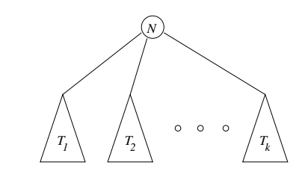
BASIS: A single node is a tree and that node is the root of the tree.
INDUCTION: If T₁, T2, ………., T_{k} are trees then we can form a new tree as follows:
Begin with a new node N which is the root of the tree
Add copies of all the trees T₁, T2, ………., T_{k}
Add edges from node N to the roots of each of the trees T₁, T2, ………., T_{k}

Slide 29
c) Mutual Inductions
Sometimes we cannot prove a single statement by induction but rather need to prove a group of statements S₁(n), S₂(n), ……. , S_{k}(n) together by induction on n.
Strictly speaking proving a group of statements is no different from proving the conjunction (logical AND) of all the statements.
For instance the group of statements S₁(n), S₂(n), ……. , S_{k}(n) could be replaced by the single statement S₁(n) AND S₂(n)AND ……. AND S_{k}(n).
However when there are really several independent statements to prove it is generally less confusing to keep the statements separate and to prove them all in their own parts of the basis and inductive steps We call this sort of proof mutual induction.

Slide 30
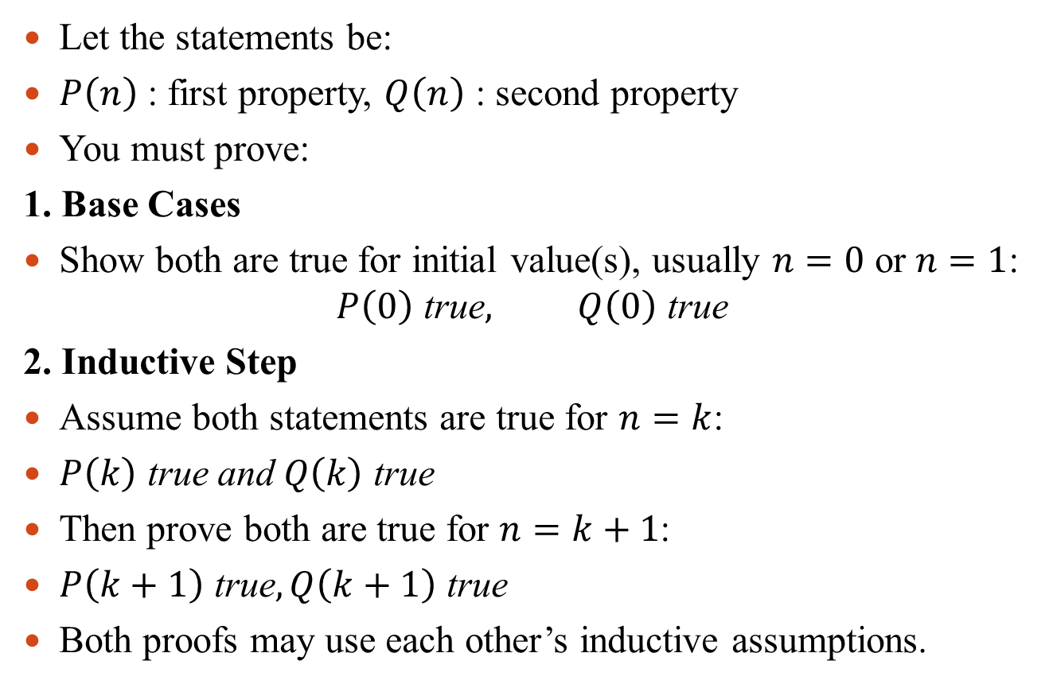
Structure of Mutual Induction
Let the statements be:
$P\left(n\right)$: first property, $Q\left(n\right)$: second property
You must prove:
1. Base Cases
Show both are true for initial value(s), usually $n=0$ or $n=1$:
$$P\left(0\right) \text{true}, Q\left(0\right) \text{true}$$
2. Inductive Step
Assume both statements are true for $n=k$:
$P\left(k\right) \text{true} \text{and} Q\left(k\right) \text{true}$
Then prove both are true for $n=k+1$:
$P\left(k+1\right) \text{true}, Q\left(k+1\right) \text{true}$
Both proofs may use each other’s inductive assumptions.

Slide 31
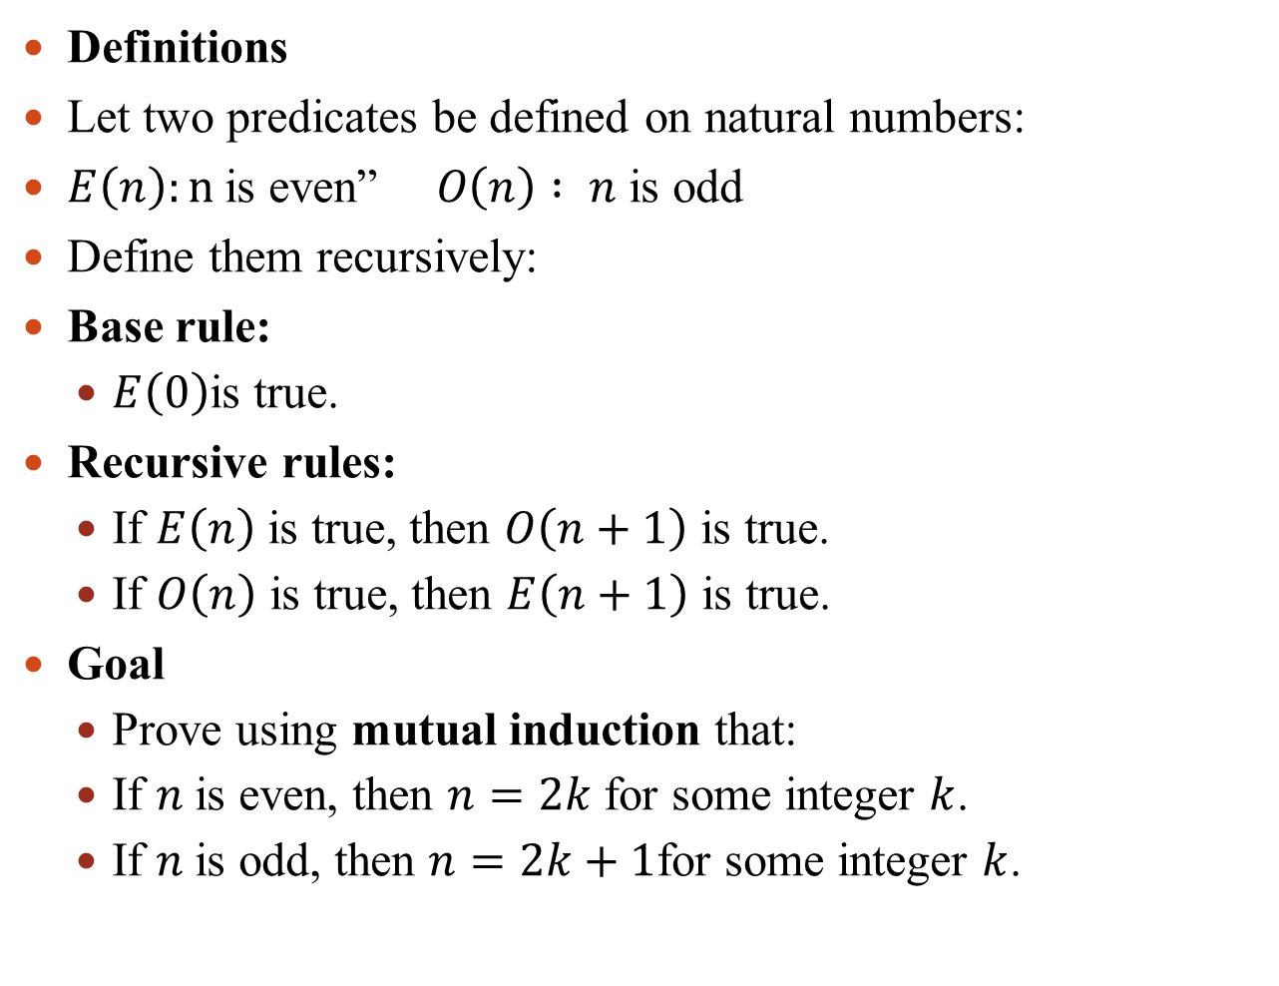
Example of Mutual Induction (Even & Odd Functions)
Definitions
Let two predicates be defined on natural numbers:
$E\left(n\right):n$is even” $O\left(n\right) : n$ is odd
Define them recursively:
Base rule:
$E\left(0\right)$is true.
Recursive rules:
If $E\left(n\right)$ is true, then $O\left(n+1\right)$ is true.
If $O\left(n\right)$ is true, then $E\left(n+1\right)$ is true.
Goal
Prove using mutual induction that:
If $n$is even, then $n=2k$ for some integer $k$.
If $n$is odd, then $n=2k+1$for some integer $k$.

Slide 32
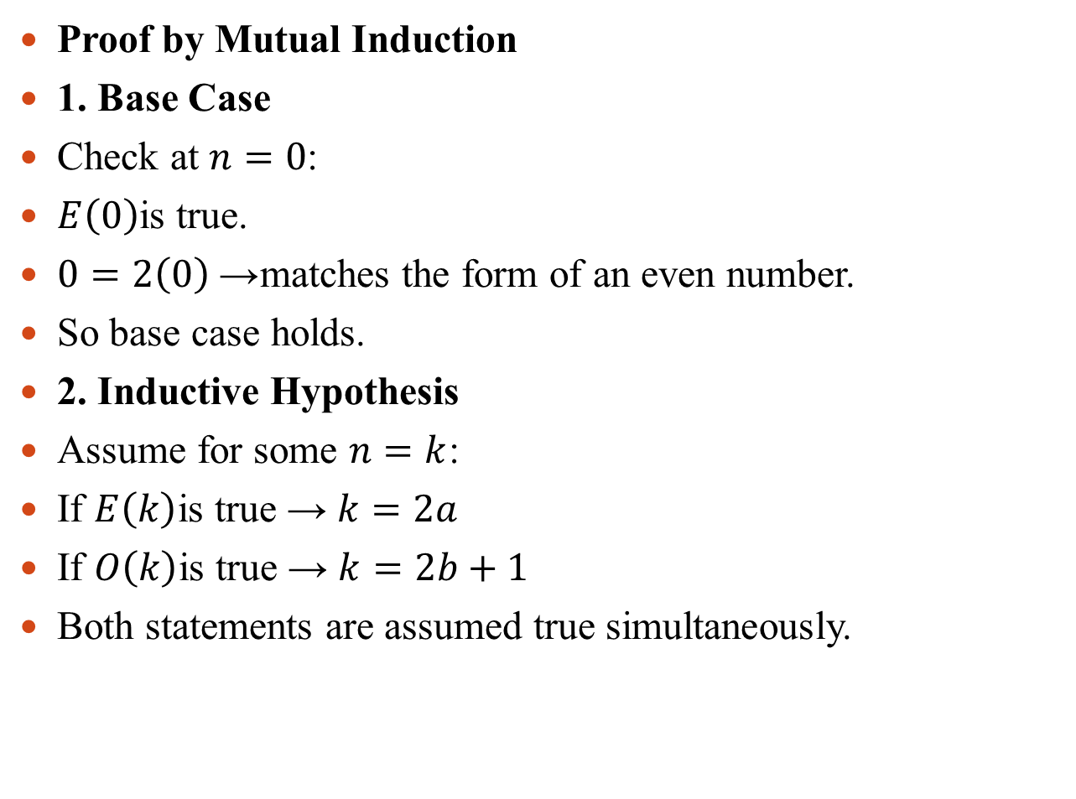
Proof by Mutual Induction
1. Base Case
Check at $n=0$:
$E\left(0\right)$is true.
$0=2\left(0\right)$→ matches the form of an even number.
So base case holds.
2. Inductive Hypothesis
Assume for some $n=k$:
If $E\left(k\right)$is true → $k=2a$
If $O\left(k\right)$is true → $k=2b+1$
Both statements are assumed true simultaneously.

Slide 33
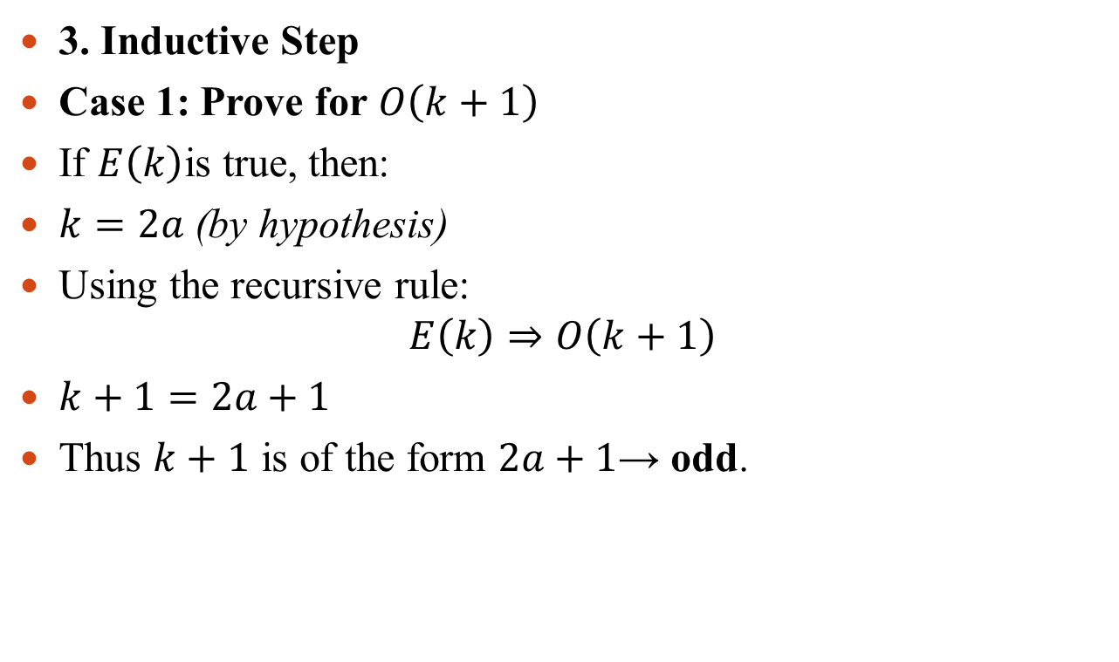
3. Inductive Step
Case 1: Prove for $O\left(k+1\right)$
If $E\left(k\right)$is true, then:
$k=2a \text{(}\text{by} \text{hypothesis}\text{)}$
Using the recursive rule: $E\left(k\right)⇒O\left(k+1\right)$
$k+1=2a+1$
Thus $k+1$ is of the form $2a+1$→ odd.

Slide 34
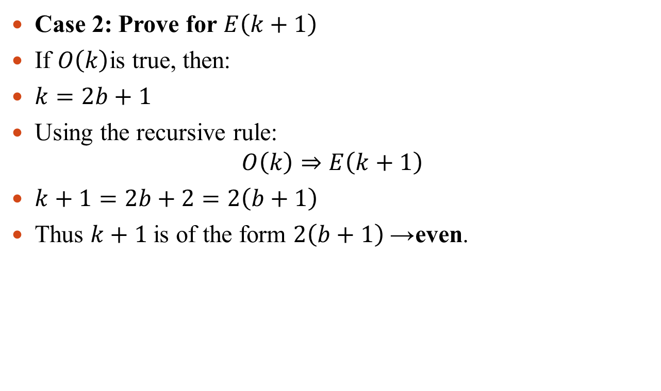
Case 2: Prove for $E\left(k+1\right)$
If $O\left(k\right)$is true, then:
$k=2b+1$
Using the recursive rule: $O\left(k\right)⇒E\left(k+1\right)$
$k+1=2b+2=2\left(b+1\right)$
Thus $k+1$is of the form $2\left(b+1\right)$→ even.

