Slide 1
Introduction
BCSE304L
Dr. Adrija Bhattacharya
VIT, Vellore

Slide 2
Methods of proof
A theorem is a statement that can be shown to be true.
A proof is to demonstrate that a theorem is true with a sequence of statements that form an argument.
An axiom or postulate is the underlying assumption about mathematical structures, the hypothesis of the theorem to be proved, and previously proved theorems.
The rules of inference are the means used to draw conclusion from other assertions which tie together the steps of a proof.
A lemma is a simple theorem used in the proof of other theorems.
A corollary is a proposition that can be established directly from a theorem that has been proved.
A conjecture is a statement whose truth is unknown. When its proof is found, it becomes a theorem.

Slide 3
On Theorems, Lemmas and Corollaries
We typically refer to:
A major result as a “theorem”
An intermediate result that we show to prove a larger result as a “lemma”
A result that follows from an already proven result as a “corollary”
An example:
Theorem: The height of an n-node binary tree is at least floor(lg n)
Lemma: Level i of a perfect binary tree has 2^{i} nodes.
Corollary: A perfect binary tree of height h has 2^{h+1}-1 nodes.

Slide 4
Deductive Proofs
From the given statement(s) to a conclusion statement (what we want to prove)
Logical progression by direct implications
Example for parsing a statement:
“If y≥4, then 2^{y}≥y².”
(there are other ways of writing this).
given
conclusion

Slide 5
Example: Deductive proof
Let Claim 1: If y≥4, then 2^{y}≥y².
Let x be any number which is obtained by adding the squares of 4 positive integers.
Claim 2:
Given x and assuming that Claim 1 is true, prove that 2^{x}≥x²
Proof:
Given: x = a² + b² + c² + d²
Given: a≥1, b≥1, c≥1, d≥1
➔ a²≥1, b²≥1, c²≥1, d²≥1 (by 2)
➔ x ≥ 4 (by 1 & 3)
➔ 2^{x} ≥ x² (by 4 and Claim 1)
“implies” or “follows”

Slide 6
Quantifiers
“For all” or “For every”
Universal proofs
Notation=
“There exists”
Used in existential proofs
Notation=
Implication is denoted by =>
E.g., “IF A THEN B” can also be written as “A=>B”

Slide 7
Different ways of saying the same thing
“If H then C”:
H implies C
H => C
C if H
H only if C
Whenever H holds, C follows

Slide 8
“If-and-Only-If” statements
“A if and only if B” (A <==> B)
(if part) if B then A ( <= )
(only if part) A only if B ( => ) (same as “if A then B”)
“If and only if” is abbreviated as “iff”
i.e., “A iff B”
Example:
Theorem: Let x be a real number. Then floor of x = ceiling of x if and only if x is an integer.
Proofs for iff have two parts
One for the “if part” & another for the “only if part”

Slide 9
Rules of Inference
The rules of inference provide the justification of the steps used to show that a conclusion follows logically from a set of hypotheses.
Basis of the rule of inference: the law of detachment
hypotheses
conclusion
Example 1
It is snowing today.
If it snows today, then we will go skiing.
We will go skiing.

Slide 10
Rules of Inference
Rules of Inference | Tautology | Name
 |  | Addition
 |  | Simplification
 |  | Conjunction
 |  | Modus ponens (detachment law)
 |  | Modus tollens
 |  | Hypothetical syllogism
 |  | Disjunctive syllogism

Slide 11
Example 2
Example 3
Solution
Example 4
Solution

Slide 12
Example 5
Solution
Example 6
p: It is sunny this afternoon.
q
Show the following hypotheses :
(1) It is not sunny this afternoon and it is colder than yesterday.
(2)We will go swimming only if it is sunny.
(3) If we do not go swimming, then we will take a canoe trip.
(4) If we take a canoe trip, then we will be home by sunset.
lead to the conclusion “We will be home by sunset”.
r
s
t

Slide 13
Example 7
p
Show that the hypotheses
If you send me an e-mail message,
then I will finish writing the program,
(2) If you do not send me an e-mail massage, then I will go to sleep early,
(3) If I go to sleep early, then I will wake up feeling refreshed
lead to the conclusion “If I do not finish
writing program, then I will wake up
feeling refreshed”.
q
r
s

Slide 14
Proving techniques
By induction
(3 steps) Basis, inductive hypothesis, inductive step
By contradiction
Start with the statement contradictory to the given statement
E.g., To prove (A => B), we start with:
(A and ~B)
… and then show that could never happen What if you want to prove that “(A and B => C or D)”?
By contrapositive statement
If A then B ≡ If ~B then ~A

Slide 15
Proving techniques…
By counter-example
Show an example that disproves the claim
Note: There is no such thing called a “proof by example”!
So when asked to prove a claim, an example that satisfied that claim is not a proof

Slide 16
Induction
If we have a propositional function P(n), and we want to prove that P(n) is true for any natural number n, we do the following:
Show that P(0) is true. (basis step)
Show that if P(n) then P(n + 1) for any n∈N. (inductive step)
Then P(n) must be true for any n∈N. (conclusion)

Slide 17
Induction
Example: Show that n < 2^{n} for all positive integers n.
Let P(n) be the proposition “n < 2^{n}.”
1. Show that P(1) is true. (basis step)
P(1) is true, because 1 < 2¹ = 2.

Slide 18
Induction
2. Show that if P(n) is true, then P(n + 1) is true. (inductive step)
Assume that n < 2^{n} is true.
We need to show that P(n + 1) is true, i.e.
n + 1 < 2^{n+1}
We start from n < 2^{n}:
n + 1 < 2^{n} + 1 ≤ 2^{n} + 2^{n} = 2^{n+1}
Therefore, if n < 2^{n} then n + 1 < 2^{n+1}

Slide 19
Induction
Then P(n) must be true for any positive integer. (conclusion)
n < 2^{n} is true for any positive integer.
End of proof.

Slide 20
Induction
Another Example (“Gauss”): 1 + 2 + … + n = n (n + 1)/2
Show that P(0) is true. (basis step)
For n = 0 we get 0 = 0. True.

Slide 21
Induction
Show that if P(n) then P(n + 1) for any n∈N. (inductive step)
1 + 2 + … + n = n (n + 1)/2
1 + 2 + … + n + (n + 1) = n (n + 1)/2 + (n + 1)
= (2n + 2 + n (n + 1))/2
= (2n + 2 + n² + n)/2
= (2 + 3n + n² )/2
= (n + 1) (n + 2)/2
= (n + 1) ((n + 1) + 1)/2

Slide 22
Induction
Then P(n) must be true for any n∈N. (conclusion)
1 + 2 + … + n = n (n + 1)/2 is true for all n∈N.
End of proof.

Slide 23
Induction
There is another proof technique that is very similar to the principle of mathematical induction.
It is called the second principle of mathematical induction.
It can be used to prove that a propositional function P(n) is true for any natural number n.

Slide 24
Induction
The second principle of mathematical induction:
Show that P(0) is true. (basis step)
Show that if P(0) and P(1) and … and P(n), then P(n + 1) for any n∈N. (inductive step)
Then P(n) must be true for any n∈N. (conclusion)

Slide 25
Induction
Example: Show that every integer greater than 1 can be written as the product of primes.
Show that P(2) is true. (basis step)
2 is the product of one prime: itself.

Slide 26
Induction
Show that if P(2) and P(3) and … and P(n), then P(n + 1) for any n∈N. (inductive step)
Two possible cases:
If (n + 1) is prime, then obviously P(n + 1) is true.
If (n + 1) is composite, it can be written as the product of two integers a and b such that 2 ≤ a ≤ b < n + 1.
By the induction hypothesis, both a and b can be written as the product of primes.
Therefore, n + 1 = a⋅b can be written as the product of primes.

Slide 27
Induction
Then P(n) must be true for any n∈N. (conclusion)
End of proof.
We have shown that every integer greater than 1 can be written as the product of primes.

Slide 28
Why does Mathematical induction work?
P(1)
Law of detachment

Slide 29
Example 1
P(n)
Basis step
=
2
:
We
prove
P(1)
is
true.
1
1
.
Therefore,
P(1)
is
true.
Inductive
step
:
Assuming
P(k)
is
true,
we
prove
P(k
+
1
)
is
true.
1
+
+
+
+
−
+
+
3
5
(
2
k
1
)
(
2
k
1
L
)
=
2
+
+
=
+
2
k
(
2
k
1
)
(
k
1
)
Therefore,
for
any
+
k
if
P(k)
is
true
then
P(k
1
)
is
true.

Slide 30
Example 2
P(n)
Use Mathematical induction to prove the inequality

Slide 31
Mathematical induction is used to prove the form
Where the universe of discourse is the set of contiguous integers: m,m+1,m+2,….
Basis step. The proposition P(m) is shown to be true.
Inductive step. The implication
Example 3
P(n)
Use Mathematical induction to prove that

Slide 32
Example 4 Sums of Geometric Progressions
Use Mathematical induction to prove the following formula:
P(n)

Slide 33
Example 5 Inequality for Harmonic Numbers.
Use Mathematical induction to prove that
P(n)

Slide 34
Example 6 The numbers of Subsets of a Finite Set
Use Mathematical induction to prove that
P(n)
X
X

Slide 35
Form of Proof by Contraposition
Theorem: p → q.
This is logically equivalent to ∼q → ∼p.
Outline of the proof of the theorem:
Assume ∼q.
Prove ∼p.
Conclude that p → q.
This is a direct proof of the contrapositive.

Slide 36
Benefit of Proof by Contraposition
If p and q are negative statements, then ∼p and ∼q are positive statements.
We may be able to give a direct proof that ∼q → ∼p more easily that we could give a direct proof that p → q.

Slide 37
Example: Proof by Contraposition
Theorem: The sum of a rational and an irrational is irrational.
Restate the theorem: Let r be a rational number and let α be a number. If α is irrational, then r + α is irrational.
Restate again: Let r be a rational number and let α be a number. If r + α is rational, then α is rational.

Slide 38
The Proof
Proof:
Let r be rational and α be a number.
Suppose that r + α is rational.
Let s = r + α. Then α = s – r, which is rational.
Therefore, if r + α is rational, then α is rational.
It follows that if α is irrational, then r + α is irrational.

Slide 39
Example
To prove
we can prove the equivalent statement in contrapositive form:
or

Slide 40
Rationale
Why?

Slide 41
Recall: Negation
Statement: n is odd
Negation of the statement: n is not odd
Or: n is even

Slide 42
Recall: Negation
Notations

Slide 43
Contrapositive
The contrapositive form of
is

Slide 44
Example 4
Analysis | Proof: We prove the contrapositive:

Slide 45
Contrapositive
Analysis | Proof by Contrapositive of If-then Theorem Restate the statement in its equivalent contrapositive form. Use direct proof on the contrapositive form. State the origin statement as the conclusion.

Slide 46
Contraposition and Compound Hypotheses
Often a theorem has the form
(p ∧ q) → r.
This is logically equivalent to
∼r → ∼(p ∧ q).
However, it is also equivalent to
p → (q → r).
so it is also equivalent to
p → (∼r → ∼q).

Slide 47
Form of Proof by Contradiction
Theorem: p → q.
Outline of the proof of the theorem :
Assume ∼(p → q).
This is equivalent to assuming p ∧ ∼q.
Derive a contradiction, i.e., conclude r ∧ ∼r for some statement r.
Conclude that p → q.

Slide 48
Benefit of Proof by Contradiction
The statement r may be any statement whatsoever because any contradiction
r ∧ ∼r
will suffice.

Slide 49
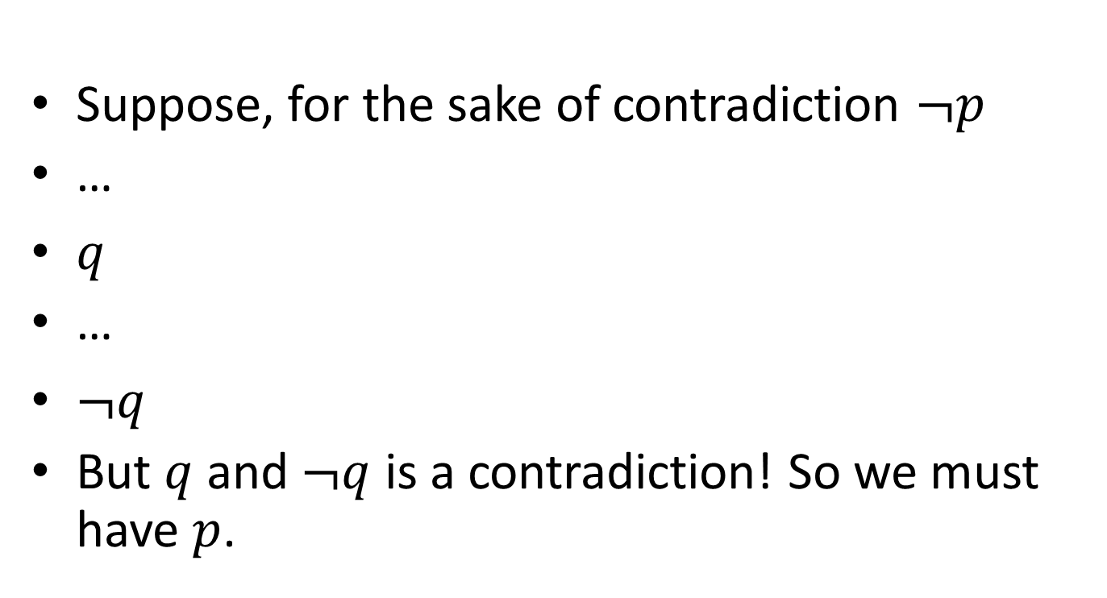
Proof By Contradiction Skeleton
Suppose, for the sake of contradiction $¬p$
…
$q$
…
$¬q$
But $q$ and $¬q$ is a contradiction! So we must have $p$.

Slide 50
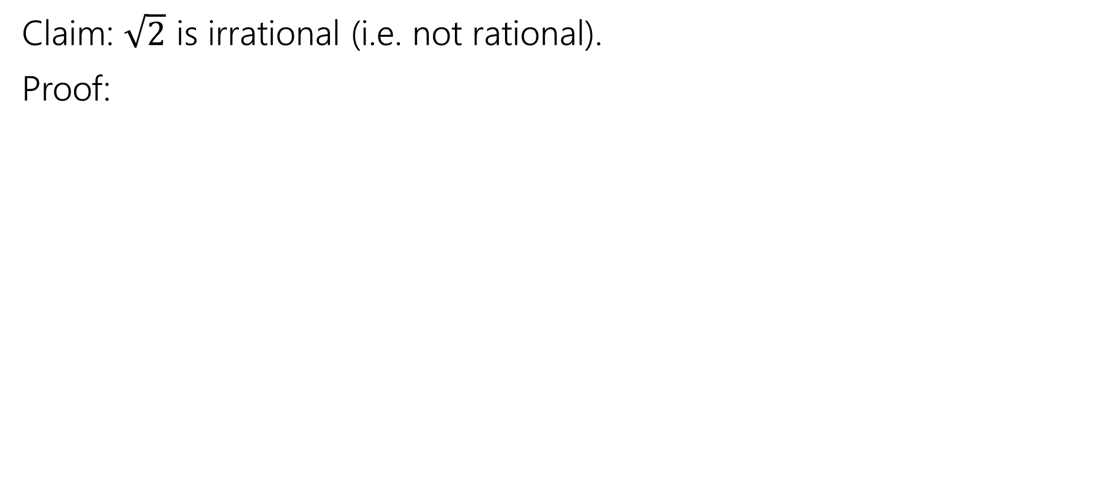
Proof By Contradiction
Claim: $\sqrt{2}$ is irrational (i.e. not rational).
Proof:

Slide 51
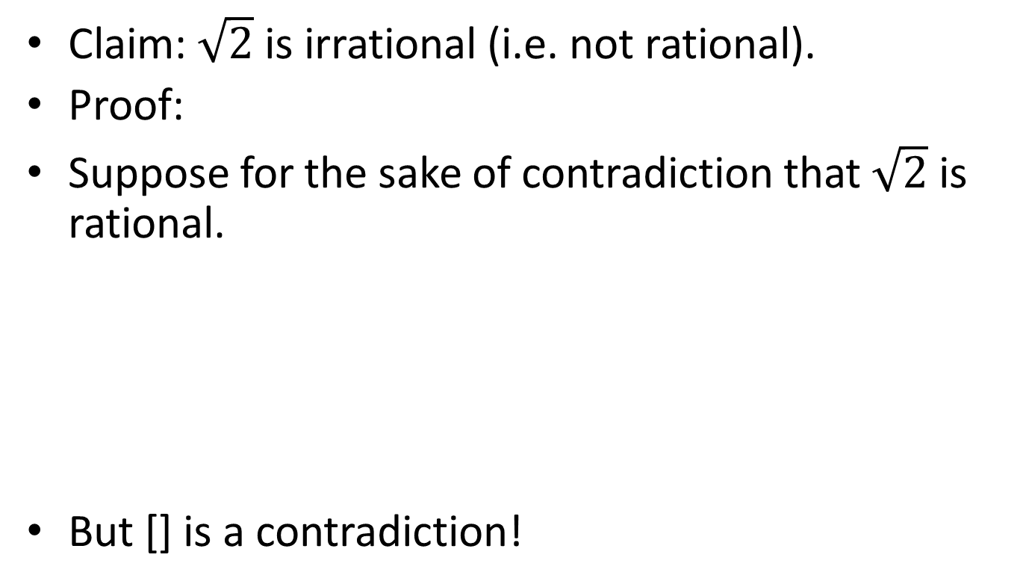
Proof By Contradiction
Claim: $\sqrt{2}$ is irrational (i.e. not rational).
Proof:
Suppose for the sake of contradiction that $\sqrt{2}$ is rational.
But [] is a contradiction!
We don’t have a fixed target.
That can make this proof harder.

Slide 52
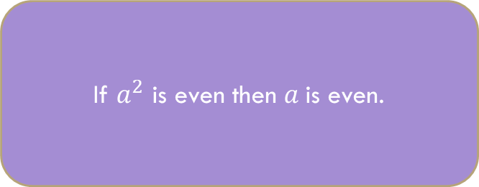
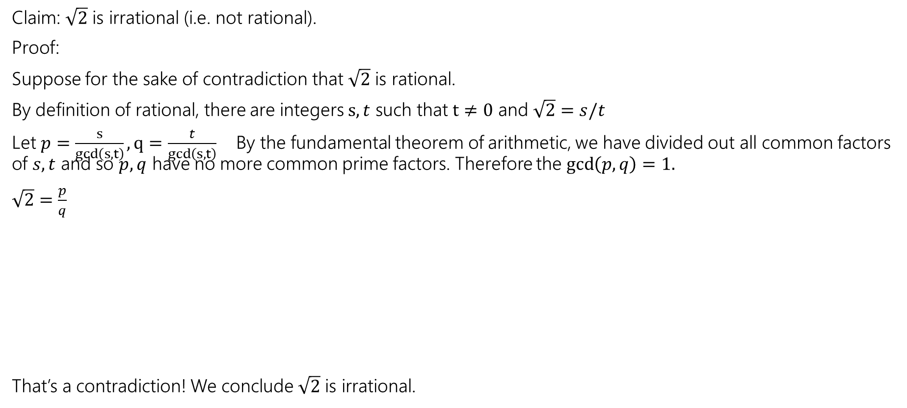
Proof By Contradiction
If $a^{2}$ is even then $a$is even.
Claim: $\sqrt{2}$ is irrational (i.e. not rational).
Proof:
Suppose for the sake of contradiction that $\sqrt{2}$ is rational.
By definition of rational, there are integers $s,t$ such that $t≠0$ and $\sqrt{2}=s/t$
Let $p=\frac{s}{gcd\left(s,t\right)}, q=\frac{t}{gcd\left(s,t\right)}$ By the fundamental theorem of arithmetic, we have divided out all common factors of $s,t$ and so $p,q$ have no more common prime factors. Therefore the $\gcd\left(p,q\right)=1.$
$\sqrt{2}=\frac{p}{q}$
That’s a contradiction! We conclude $\sqrt{2}$ is irrational.

Slide 53
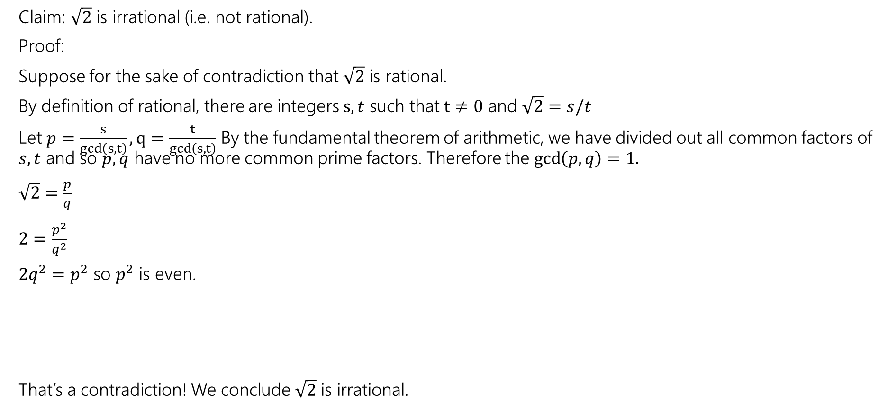
Proof By Contradiction
If $a^{2}$ is even then $a$is even.
Claim: $\sqrt{2}$ is irrational (i.e. not rational).
Proof:
Suppose for the sake of contradiction that $\sqrt{2}$ is rational.
By definition of rational, there are integers $s,t$ such that $t≠0$ and $\sqrt{2}=s/t$
Let $p=\frac{s}{gcd\left(s,t\right)}, q=\frac{t}{gcd\left(s,t\right)}$ By the fundamental theorem of arithmetic, we have divided out all common factors of $s,t$ and so $p,q$ have no more common prime factors. Therefore the $\gcd\left(p,q\right)=1.$
$\sqrt{2}=\frac{p}{q}$
$2=\frac{p^{2}}{q^{2}}$
$2q^{2}=p^{2}$ so $p^{2}$ is even.
That’s a contradiction! We conclude $\sqrt{2}$ is irrational.

Slide 54
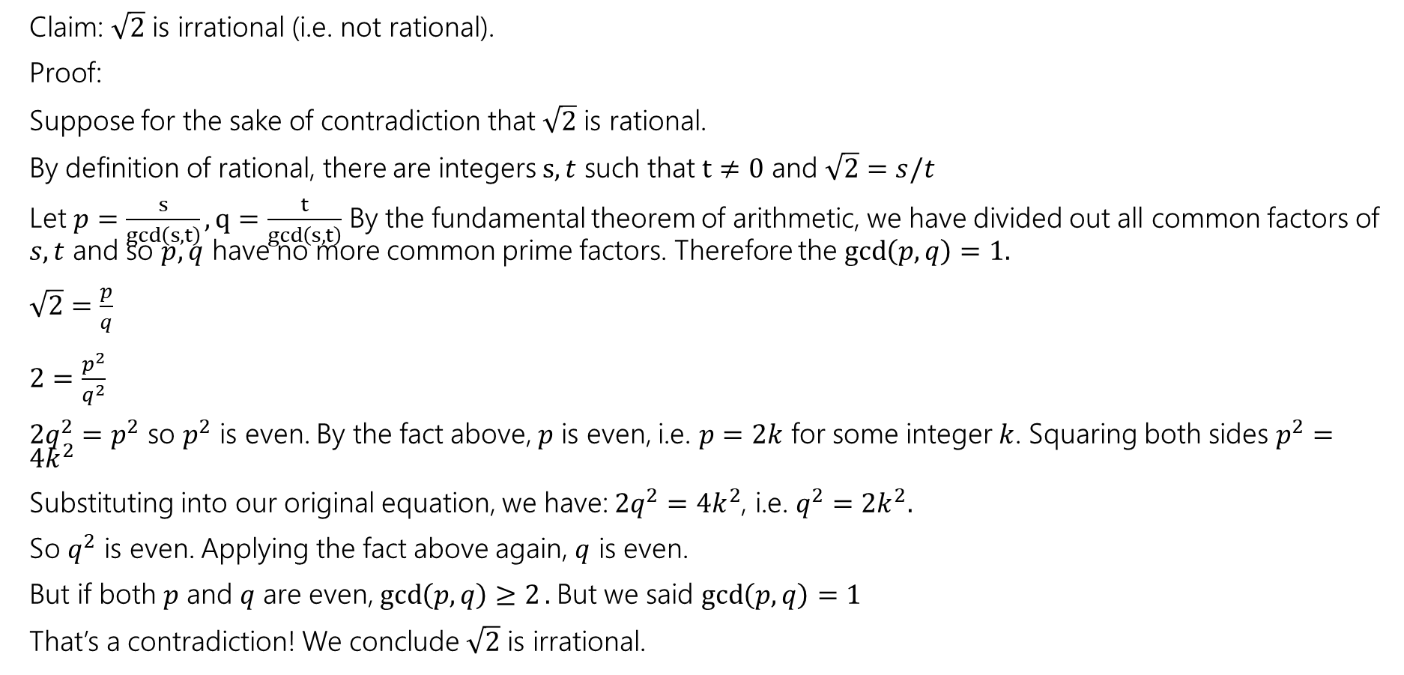
Proof By Contradiction
If $a^{2}$ is even then $a$is even.
Claim: $\sqrt{2}$ is irrational (i.e. not rational).
Proof:
Suppose for the sake of contradiction that $\sqrt{2}$ is rational.
By definition of rational, there are integers $s,t$ such that $t≠0$ and $\sqrt{2}=s/t$
Let $p=\frac{s}{gcd\left(s,t\right)}, q=\frac{t}{gcd\left(s,t\right)}$ By the fundamental theorem of arithmetic, we have divided out all common factors of $s,t$ and so $p,q$ have no more common prime factors. Therefore the $\gcd\left(p,q\right)=1.$
$\sqrt{2}=\frac{p}{q}$
$2=\frac{p^{2}}{q^{2}}$
$2q^{2}=p^{2}$ so $p^{2}$ is even. By the fact above, $p$ is even, i.e. $p=2k$ for some integer $k$. Squaring both sides $p^{2}=4k^{2}$
Substituting into our original equation, we have: $2q^{2}=4k^{2}$, i.e. $q^{2}=2k^{2}.$
So $q^{2}$ is even. Applying the fact above again, $q$ is even.
But if both $p$ and $q$ are even, $\gcd\left(p,q\right)≥2.$But we said $\gcd\left(p,q\right)=1$
That’s a contradiction! We conclude $\sqrt{2}$ is irrational.

Slide 55
Proof By Contradiction
How in the world did we know how to do that?
In real life…lots of attempts that didn’t work.
Be very careful with proof by contradiction – without a clear target, you can easily end up in a loop of trying random things and getting nowhere.

Slide 56
Another Proof By Contradiction
Claim: There are infinitely many primes.
Proof:

Slide 57
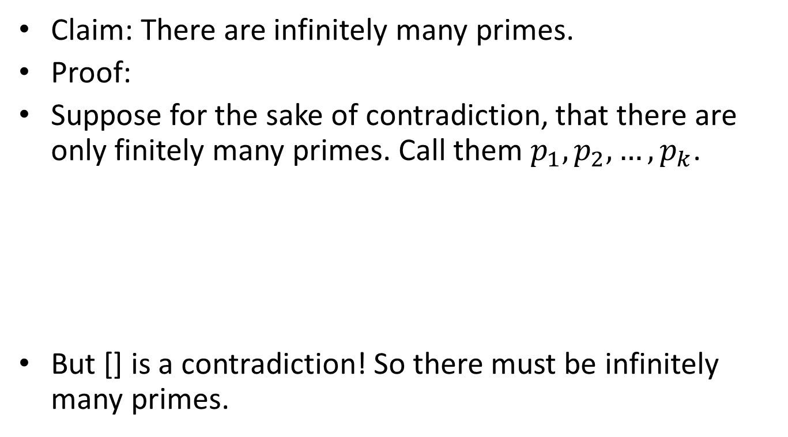
Another Proof By Contradiction
Claim: There are infinitely many primes.
Proof:
Suppose for the sake of contradiction, that there are only finitely many primes. Call them $p_{1},p_{2},…,p_{k}$.
But [] is a contradiction! So there must be infinitely many primes.

Slide 58
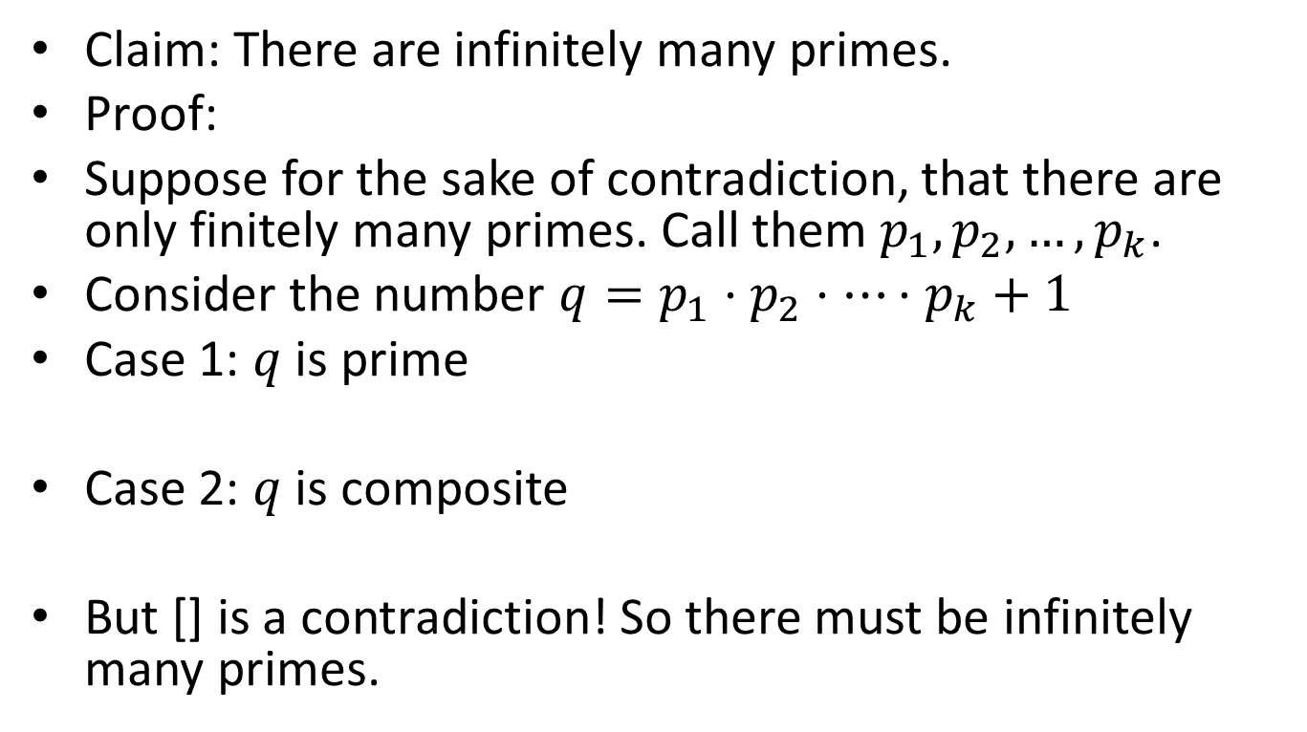
Another Proof By Contradiction
Claim: There are infinitely many primes.
Proof:
Suppose for the sake of contradiction, that there are only finitely many primes. Call them $p_{1},p_{2},…,p_{k}$.
Consider the number $q=p_{1}⋅p_{2}⋅⋯⋅p_{k}+1$
Case 1: $q$ is prime
Case 2: $q$ is composite
But [] is a contradiction! So there must be infinitely many primes.

Slide 59
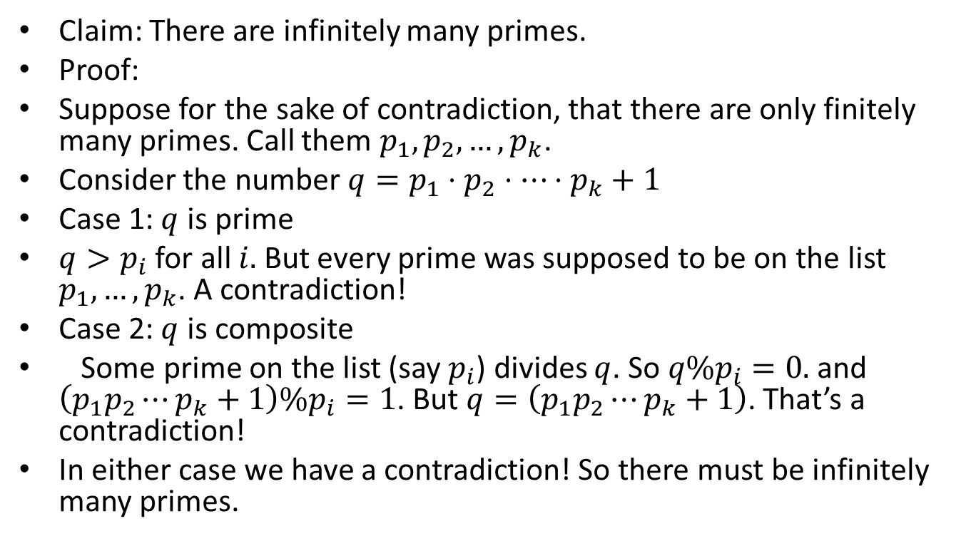
Another Proof By Contradiction
Claim: There are infinitely many primes.
Proof:
Suppose for the sake of contradiction, that there are only finitely many primes. Call them $p_{1},p_{2},…,p_{k}$.
Consider the number $q=p_{1}⋅p_{2}⋅⋯⋅p_{k}+1$
Case 1: $q$ is prime
$q>p_{i}$ for all $i.$ But every prime was supposed to be on the list $p_{1},…,p_{k}$. A contradiction!
Case 2: $q$ is composite
Some prime on the list (say $p_{i}$) divides $q$. So $q\%p_{i}=0.$and $\left(p_{1}p_{2}⋯p_{k}+1\right)\%p_{i}=1$. But $q=\left(p_{1}p_{2}⋯p_{k}+1\right)$. That’s a contradiction!
In either case we have a contradiction! So there must be infinitely many primes.

Slide 60
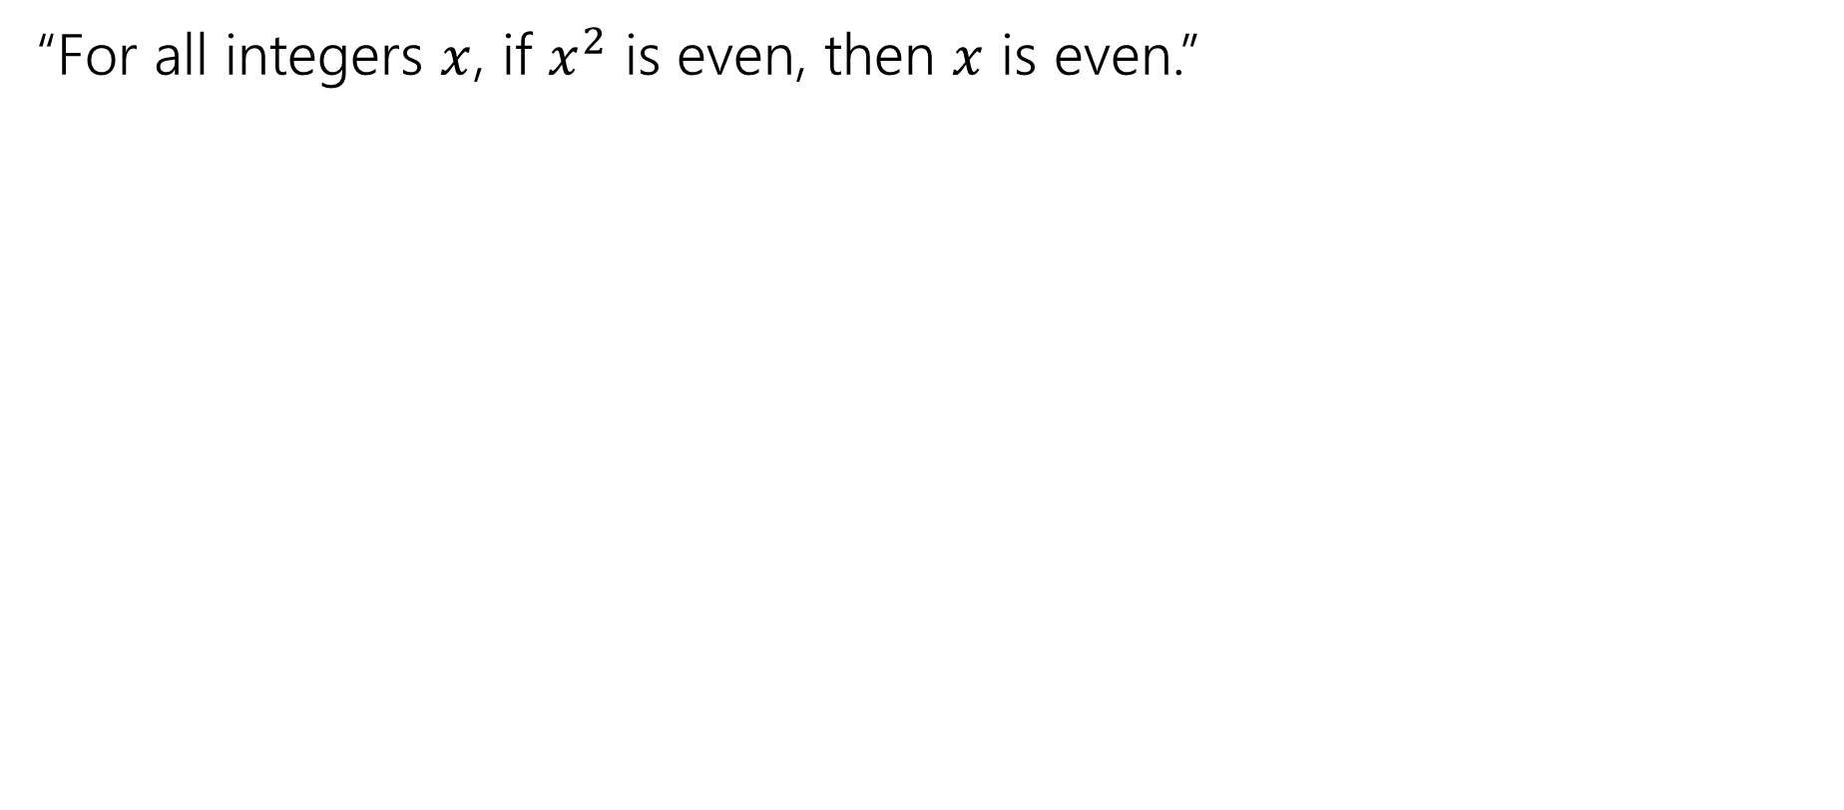
Just the Skeleton
“For all integers $x$, if $x^{2}$ is even, then $x$ is even.”

Slide 61
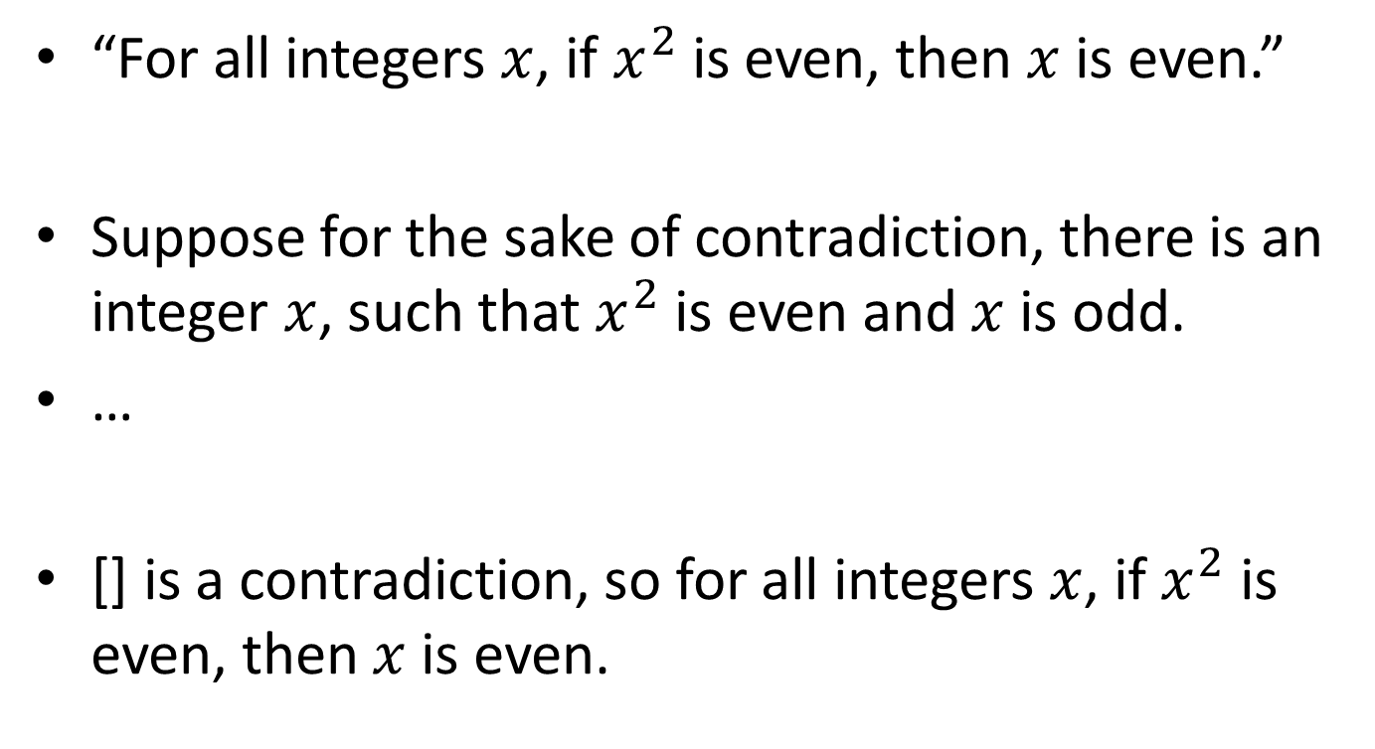
Just the Skeleton
“For all integers $x$, if $x^{2}$ is even, then $x$ is even.”
Suppose for the sake of contradiction, there is an integer $x$, such that $x^{2}$ is even and $x$ is odd.
…
[] is a contradiction, so for all integers $x$, if $x^{2}$ is even, then $x$ is even.

Slide 62
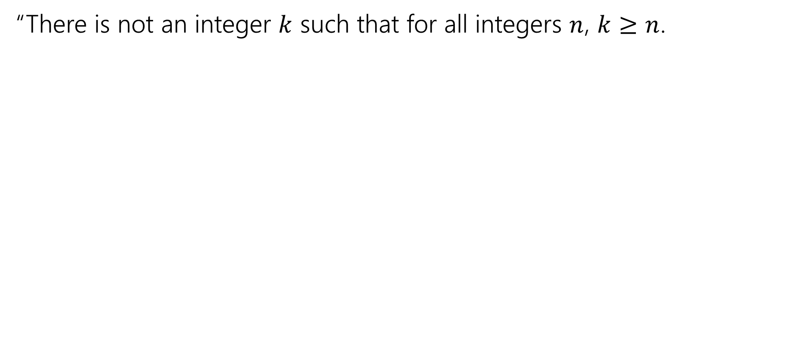
Just the Skeleton
“There is not an integer $k$ such that for all integers $n$, $k≥n$.

Slide 63
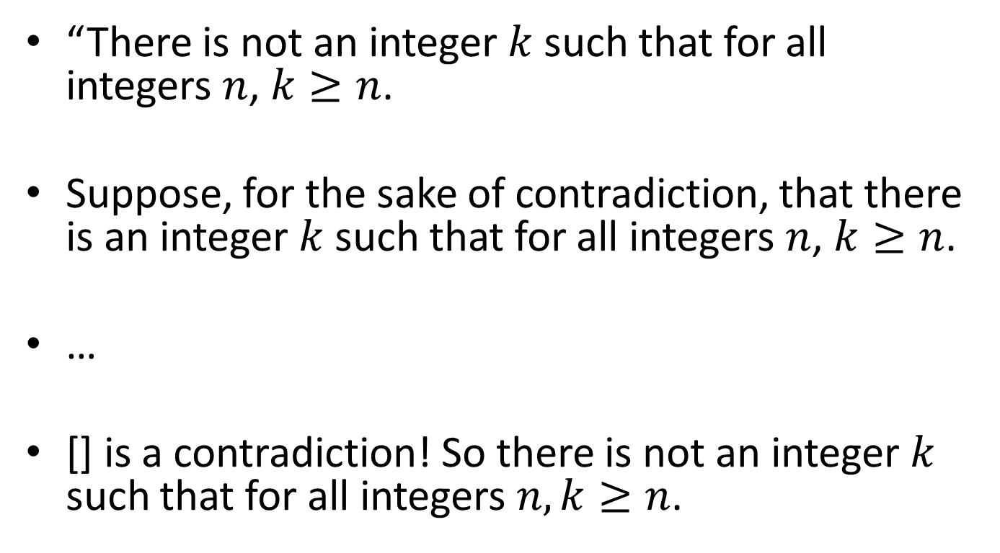
Just the Skeleton
“There is not an integer $k$ such that for all integers $n$, $k≥n$.
Suppose, for the sake of contradiction, that there is an integer $k$ such that for all integers $n$, $k≥n$.
…
[] is a contradiction! So there is not an integer $k$ such that for all integers $n,k≥n$.

Slide 64
Contradiction vs. Contraposition
Would this be a proof by contradiction or proof by contraposition?
Proof by contraposition is preferred.

Slide 65
Contradiction vs. Contraposition?
Theorem: Prove that if x is irrational, then –x is also irrational.
Proof:
Suppose that x is irrational and that –x is rational.
Let –x = a/b, where a and b are integers.
Then x = –(a/b) = (–a)/b, which is rational.
This is a contradiction.
Therefore, if x is irrational, then –x is also irrational.

Slide 66
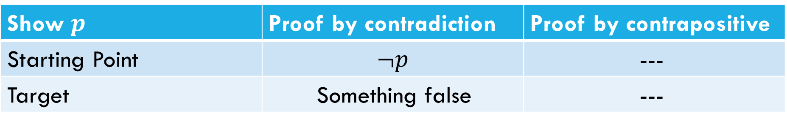
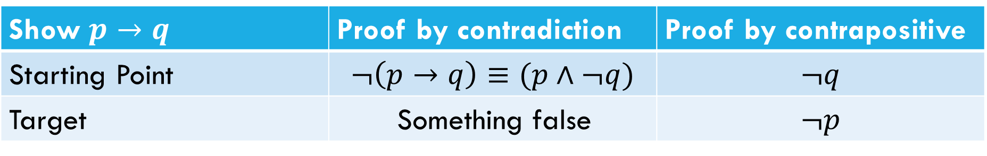
What’s the difference?
What’s the difference between proof by contrapositive and proof by contradiction?
Show $p→q$ | Proof by contradiction | Proof by contrapositive
Starting Point | $$¬\left(p→q\right)≡(p∧¬q)$$ | $$¬q$$
Target | Something false | $$¬p$$
Show $p$ | Proof by contradiction | Proof by contrapositive
Starting Point | $$¬p$$ | ---
Target | Something false | ---

Slide 67
Counterexamples
To disprove
we simply need to find one number x in the domain of discourse that makes false.
Such a value of x is called a counterexample

Slide 68
Example 3
Analysis | The statement is false

Slide 69
Example 4

Slide 70
Automata Theory

Slide 71
What is Automata Theory?
Study of abstract computing devices, or “machines”
Automaton = an abstract computing device
Note: A “device” need not even be a physical hardware!
A fundamental question in computer science:
Find out what different models of machines can do and cannot do
The theory of computation
Computability vs. Complexity

Slide 72
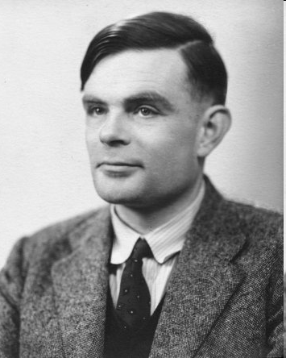
Alan Turing (1912-1954)
Father of Modern Computer Science
English mathematician
Studied abstract machines called Turing machines even before computers existed
Heard of the Turing test?

Slide 73
Theory of Computation: A Historical Perspective
1930s
Alan Turing studies Turing machines
Decidability
Halting problem
1940-1950s
“Finite automata” machines studied
Noam Chomsky proposes the “Chomsky Hierarchy” for formal languages
1969
Cook introduces “intractable” problems or “NP-Hard” problems
1970-
Modern computer science: compilers, computational & complexity theory evolve

Slide 74
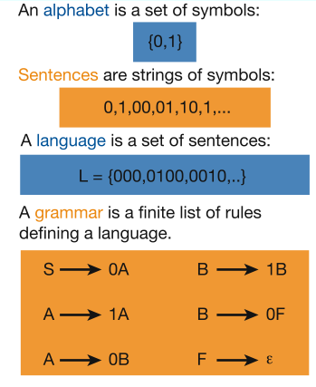
Languages & Grammars
Languages: “A language is a collection of sentences of finite length all constructed from a finite alphabet of symbols”
Grammars: “A grammar can be regarded as a device that enumerates the sentences of a language” - nothing more, nothing less
N. Chomsky, Information and Control, Vol 2, 1959
Or “words”
Image source: Nowak et al. Nature, vol 417, 2002

Slide 75
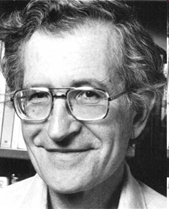
The Chomsky Hierachy
A containment hierarchy of classes of formal languages
Recursively- enumerable (TM)
Context- sensitive (LBA)
Context- free
(PDA)
Regular
(DFA)

Slide 76
COMPUTATIONAL MODELS
Computational models are
mathematical abstractions used to understand, describe, and analyze the functioning of computational systems
provides a theoretical framework for studying algorithms, complexity, and the limits of computation.

Slide 77
Definition
A computational model specifies a mechanism for computation, describing how input data is processed and transformed into output through a set of rules or operations. These models are used to:
Represent algorithms and their execution.
Analyze computational problems and their solvability.
Study computational complexity.

Slide 78
Classification of Computational Models
Finite Automata
Pushdown Automata
Turing Machines
Lambda Calculus

Slide 79
Practical Computational Models
Register Machines:
Simulate CPU operations with simple instructions.
Basis for assembly languages.
Neural Networks:
Inspired by biological systems.
Used in AI for image recognition, natural language processing.
Quantum Computers:
Leverage quantum superposition and entanglement.
Solve problems like factorization and search efficiently.

Slide 80
Real-World Applications of Computational Models
Compiler Design: Automata and grammars for parsing.
Cryptography: Turing Machines for secure computations.
AI and Machine Learning: Neural networks for decision-making.
Algorithm Design: Frameworks for developing efficient algorithms.

Slide 81
Different kinds of automata
This was only one example of a computational device, and there are others…
We will look at different devices, and look at these kinds of questions:
What kinds of problems can a given type of device solve?
What things are impossible for this kind of device?
Is one type of device more powerful than another?

Slide 82
Some devices we will see
Finite automata | Devices with a finite amount of memory. Used to model “small” computers.
Push-down automata | Devices with infinite memory that can be accessed in a restricted way. Used to model parsers, etc.
Turing Machines | Devices with infinite memory. Used to model any computer.
Time-bounded Turing Machines | Infinite memory, but bounded running time. Used to model any computer program that runs in a “reasonable” amount of time.

Slide 83
Some Utilities
Turing Machines
This is a general model of a computer, capturing anything we could ever hope to compute
But there are many things that computers cannot do:
Given the code of a computer program, can you
tell if it prints “computer”?
#include <stdio.h>
main(t,_,a)char *a;{return!0<t?t<3?main(-79,-13,a+main(-87,1-_,
main(-86,0,a+1)+a)):1,t<_?main(t+1,_,a):3,main(-94,-27+t,a)&&t==2?_<13?
main(2,_+1,"%s %d %d\n"):9:16:t<0?t<-72?main(_,t,
"@n'+,#'/*{}w+/w#cdnr/+,{}r/*de}+,/*{*+,/w{%+,/w#q#n+,/#{l,+,/n{n+,/+#n+,/#\
;#q#n+,/+k#;*+,/'r :'d*'3,}{w+K w'K:'+}e#';dq#'l \
q#'+d'K#!/+k#;q#'r}eKK#}w'r}eKK{nl]'/#;#q#n'){)#}w'){){nl]'/+#n';d}rw' i;# \
){nl]!/n{n#'; r{#w'r nc{nl]'/#{l,+'K {rw' iK{;[{nl]'/w#q#n'wk nw' \
iwk{KK{nl]!/w{%'l##w#' i; :{nl]'/*{q#'ld;r'}{nlwb!/*de}'c \
;;{nl'-{}rw]'/+,}##'*}#nc,',#nw]'/+kd'+e}+;#'rdq#w! nr'/ ') }+}{rl#'{n' ')# \
}'+}##(!!/")
:t<-50?_==*a?putchar(31[a]):main(-65,_,a+1):main((*a=='/')+t,_,a+1)
:0<t?main(2,2,"%s"):*a=='/'||main(0,main(-61,*a,
"!ek;dc i@bK'(q)-[w]*%n+r3#l,{}:\nuwloca-O;m .vpbks,fxntdCeghiry"),a+1);}
?
computer

Slide 84
Some Utilities
Time-bounded Turing Machines
Many problems are possible to solve on a computer in principle, but take too much time in practice
Traveling salesman: Given a list of cities, find the shortest way to visit them and come back home
Easy in principle: Try the cities in every possible order
Hard in practice: For 100 cities, this would take 100+ years even on the fastest computer!
Delhi
Jaypur
Ahmedabad
Kolkata
Bhopal
Chennai

Slide 85
Preliminaries of automata theory
How do we formalize the question
First, we need a way of describing the problems that we are interested in solving
Can device A solve problem B?

Slide 86
Problems
Examples of problems we will consider
Given a word a, does it contain the subword “comp”?
Given a number b, is it divisible by 11?
Given a pair of words a and b, are they the same?
Given an expression with brackets, e.g. (()()), does every left bracket match with a subsequent right bracket?
All of these have “yes/no” answers.
There are other types of problems, like “Find this” or “How many of that” but we won’t look at them now.

Slide 87
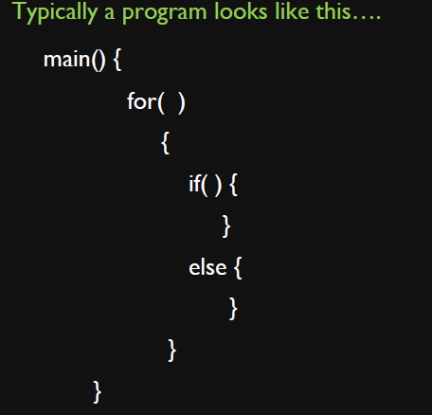
Let’s solve

Slide 88
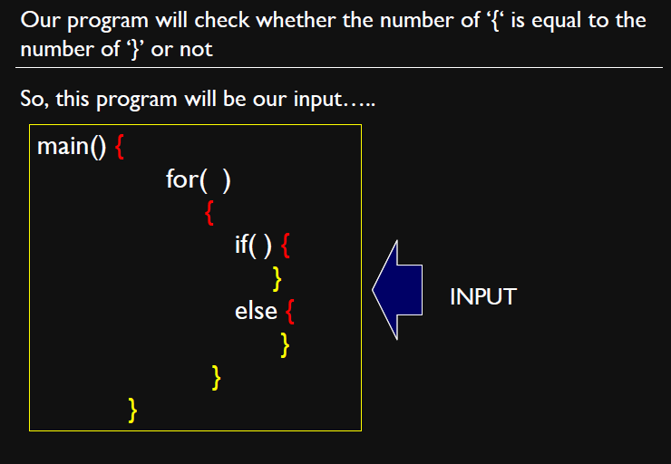

Slide 89
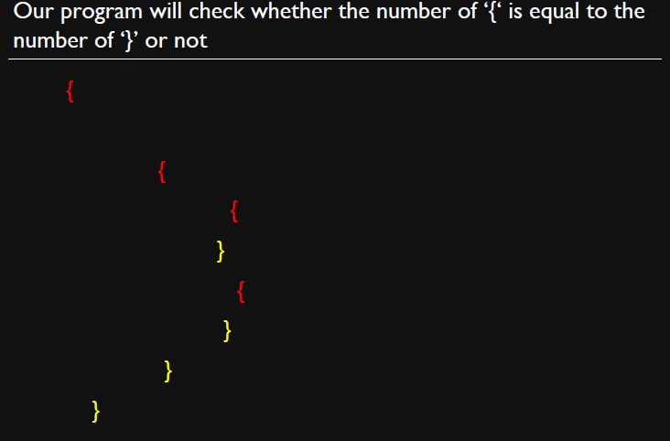

Slide 90
Next problem
Can we write a program that prints all numbers from 1 to 10 ?

Slide 91
Next problem
Can we write a program that prints all numbers from 1 to 10 ?
Can we write a program that prints all numbers from 1 to ∞ ?

Slide 92
Next problem
Can we write a program that prints all numbers from 1 to 10 ?
Can we write a program that prints all numbers from 1 to ∞ ?
Can we write a program that prints all numbers from 1 to 2 ?

Slide 93
Relevant Question
Is there any problem which is beyond computation?
Can we prove our assumption and build our own theory with proof ?

Slide 94
Algorithm
A finite sequence of simple instructions that is guaranteed to halt in a finite amount of time.

Slide 95
Algorithm
A finite sequence of simple instructions that is guaranteed to halt in a finite amount of time.
This is a very abstract definition, since:
We didn’t specify the nature of this simple instructions.
For example an instruction can be “increment a number by one” or “Calculate the triple integral”

Slide 96
Algorithm
A finite sequence of simple instructions that is guaranteed to halt in a finite amount of time.
This is a very abstract definition, since:
We didn’t specify the nature of this simple instructions.
For example an instruction can be “increment a number by one” or “Calculate the triple integral”
We didn’t specify the entity which can execute these instructions.

Slide 97
Algorithm
A finite sequence of simple instructions that is guaranteed to halt in a finite amount of time.
This is a very abstract definition, since:
We didn’t specify the nature of this simple instructions.
For example an instruction can be “increment a number by one” or “Calculate the triple integral”
We didn’t specify the entity which can execute these instructions.
For example is this entity a person, a computer, …
If it is a computer what is the processor type? How much memory does it have? …. ?

Slide 98
Central Concepts

Slide 99
Alphabets and strings
A common way to talk about words, numbers, pairs of words, etc. is by representing them as strings
To define strings, we start with an alphabet
Examples
An alphabet is a finite set of symbols.
Σ₁ = {a, b, c, d, …, z}: the set of letters in English
Σ₂ = {0, 1, …, 9}: the set of (base 10) digits
Σ₃ = {a, b, …, z, #}: the set of letters plus the special symbol #
Σ₄ = {(, )}: the set of open and closed brackets

Slide 100
Strings
A string over alphabet Σ is a finite sequence of symbols in Σ.
The empty string will be denoted by ε
Length of a string w, denoted by “|w|”, is equal to the number of (non- ε) characters in the string
E.g., x = 010100 |x| = 6
x = 01 ε 0 ε 1 ε 00 ε |x| = ?
xy = concatentation of two strings x and y
Examples
abfbz is a string over Σ₁ = {a, b, c, d, …, z}
9021 is a string over Σ₂ = {0, 1, …, 9}
ab#bc is a string over Σ₃ = {a, b, …, z, #}
))()(() is a string over Σ₄ = {(, )}

Slide 101
Powers of an alphabet
Let ∑ be an alphabet.
∑^{k} = the set of all strings of length k
∑* = ∑⁰ U ∑¹ U ∑² U …
∑⁺ = ∑¹ U ∑² U ∑³ U …

Slide 102
Languages
A language is a set of strings over an alphabet.
Languages can be used to describe problems with “yes/no” answers, for example:
L₁ = The set of all strings over Σ₁ that contain the substring “fool”
L₂ = The set of all strings over Σ₂ that are divisible by 7 = {7, 14, 21, …}
L₃ = The set of all strings of the form s#s where s is any string over {a, b, …, z}
L₄ = The set of all strings over Σ₄ where every ( can be matched with a subsequent )

Slide 103
Languages
L is a said to be a language over alphabet ∑, only if L ⊆ ∑*
➔ this is because ∑* is the set of all strings (of all possible length including 0) over the given alphabet ∑
Examples:
Let L be the language of all strings consisting of n 0’s followed by n 1’s: L = {ε, 01, 0011, 000111,…}
Let L be the language of all strings of with equal number of 0’s and 1’s:
L = {ε, 01, 10, 0011, 1100, 0101, 1010, 1001,…}
Definition: Ø denotes the Empty language
Let L = {ε}; Is L=Ø?
Canonical ordering of strings in the language
NO

Slide 104
Empty String
An empty string (or null string), denoted by ε, is a string containing no symbol.
ε is a string over any alphabet.

Slide 105
Length of a String
The length of a string x, denoted by length(x) or |x|, is the number of symbols in the string.
Let Σ = {a, b, …, z}.
Let w₁= abcd and w₂ = fgh
Then,
length(w₁) = 4 or |w₁ | = 4
length(w₂) = 3 or |w₂ | = 3
length(ε) = 0 or | ε | = 0
x(i) or x_{i} , denotes the symbol in the i ^{th} position of a string x, for 1 ≤ i ≤ length(x).

Slide 106
String Operations
Concatenation
Substring
Reversal
Kleene Closure and Positive Closure

Slide 107
Concatenation
Concatenation of two strings w₁ and w₂ is defined as the sequence of symbols in w₁ followed by sequence of symbols in w₂
Let w₁= abcd and w₂ = fgh
Then w₁w₂ = abcdfgh
w₂w₁ = fghabcd
The concatenation of string x for n times, where n≥0, is denoted by x^{n}
x⁰ = ε
x¹ = x
x² = x x
x³ = x x x
…

Slide 108
Substring
Let x and y be strings over an alphabet Σ
The string x is a substring of y if there exist strings w and z over Σ such that y = w x z.
ε is a substring of every string.
For every string x, x is a substring of x itself.
Example
ε, comput and computation are substrings of computation.

Slide 109
Reversal
The reversal of a string is a string with same symbols in reverse order, denoted by w^{R}
Example
Let w = abcdmno
Then
w^{R} = onmdcba

Slide 110
Kleene Closure
Let ∑ ={ a, b} i.e. ∑¹ ={ a, b}
∑² = ∑¹ . ∑¹ = { a, b}. { a, b} = {aa, ab, ba, bb}
∑³= ∑¹ . ∑¹ . ∑¹ = { a, b}. { a, b}. { a, b}
= {aa, ab, ba, bb}. { a, b}
={aaa, aab, aba, abb, baa, bab, bba, bbb}
∑⁰ ={ε}
The Kleene closure of Σ, denoted by ∑* is defined as follows:
Σ* = ∑⁰ U ∑¹ U ∑² U ∑³ …….. = {ε, a, b, aa, ab, ba, bb, aaa,….}
That is, ∑^{* =} ∪_{i=}∞₀ ∑^{i}

Slide 111
Positive Closure
The Positive closure of Σ, denoted by ∑⁺ is defined as follows:
∑⁺ = ∑* -{ ε } or ∑⁺ = ∪_{i}∞₌ ₁ ∑^{i}

Slide 112
Operations on Languages
Σ* denotes the set of all finite strings over Σ
A formal language L over the alphabet Σ is a subset of Σ*
That is L is a subset of Σ*
Let Σ = {0, 1} be the alphabet.
L = {ω∈Σ* | the number of 1’s in ω is even}.
ε, 0, 00, 11, 000, 110, 101, 011, 0000, 1100, 1010, 1001, 0110, 0101, 0011, … are in L

Slide 113
Operations on Languages
Complementation
Union
Intersection
Concatenation
Reversal
Closure

Slide 114
Complementation
Let L be a language over an alphabet Σ.
The complementation of L, denoted by ‾L ( or L’), is Σ*– L.
Example:
Let Σ = {0, 1} be the alphabet.
L = {ω∈Σ* | the number of 1’s in ω is even}.
L’ = {ω∈Σ* | the number of 1’s in ω is not even}.
L’ = {ω∈Σ* | the number of 1’s in ω is odd}.

Slide 115
Union
Let L₁ and L₂ be languages over an alphabet Σ.
The union of L₁ and L₂, denoted by L₁∪L₂, is
L₁∪L₂ = {x | x is in L₁ or L₂}.
Example:
{ x∈ {0,1}* | x begins with 0 } ∪ {x∈{0,1}*|x ends with 0}
= {x ∈ {0,1}*| x begins or ends with 0}

Slide 116
Intersection
Let L₁ and L₂ be languages over an alphabet Σ.
The intersection of L₁ and L₂, denoted by L₁∩L₂, is { x | x is in L₁ and L₂}.
Example:
{ x∈{0,1}* | x begins with 0} ∩ { x∈{0,1}*| x ends with 0}
= { x∈{0,1}*| x begins and ends with 0}

Slide 117
Concatenation
Let L₁ and L₂ be languages over an alphabet Σ.
The concatenation of L₁ and L₂, denoted by L₁⋅L₂, is {w₁⋅w₂| w₁ is in L₁ and w₂ is in L₂}.
Example
L₁ = { x ∈ {0,1}*| x begins with 1} L₂ ={x ∈ {0,1}*| x ends with 0}
L₁⋅L₂ = { x ∈ {0,1}*| x begins with 1 and ends with 0 and length(x) ≥ 2}
L₁ = { x ∈ {0,1}*| x ends with 0} L₂ = {x ∈ {0,1}*| x begins with 1}
L₁⋅L₂ = = { x ∈ {0,1}*| x has 01 as a substring}

Slide 118
Reversal
Let L be a language over an alphabet Σ.
The reversal of L, denoted by L^{R}, is {w^{R} | w is in L}.
Example
L = {x ∈ {0,1}*| x begins with 1}
L^{R} = {x ∈ {0,1}*| x ends with 1}
L = {x ∈ {0,1}*| x has 10 as a substring}
L^{R} = {x ∈ {0,1}*| x has 01 as a substring}

Slide 119
Kleene’s closure
Let L be a language over an alphabet Σ.
The Kleene’s closure of L, denoted by L*, is {x | for an integer n ≥ 0 x = x₁ x₂ … x_{n} and x₁, x₂ , …, x_{n} are in L}.
That is, L* = ∪_{i}∞₌ ₀ L^{i}
Example: Let Σ = {0,1} and
L_{e} = {ω∈Σ* | the number of 1’s in ω is even}
L_{e}* = {ω∈Σ* | the number of 1’s in ω is even}
(‾L_{e})* = {ω∈Σ*| the number of 1’s in ω is odd}*
= {ω∈Σ*| the number of 1’s in ω > 0}

Slide 120
Grammars
A grammar (when the context is not given, often called a formal grammar for clarity) describes how to form strings from a language's alphabet that are valid according to the language's syntax.
A grammar does not describe the meaning of the strings or what can be done with them in whatever context—only their form.
A formal grammar is defined as a set of production rules for strings in a formal language.

Slide 121
Grammars
Definition: A grammar is a 4-tuple G = (N, T, P, S), where
N is a finite set of symbols called non-terminals (uppercase alpha)
T is a finite set of symbols called terminals (lowercase alpha)
S is the start symbol
P is the set of productions of the form

Slide 122
Grammars
Let G = (N, T, P, S) be a grammar.
Then L(G) is called the language generated by G.
L(G) = { }
Grammars are language generating device
Automata are language accepting device

Slide 123
Chomsky Hierarchy (Classification of Grammars)
 | Language | Grammar | Machine | Example
Type 3 | Regular languages | Regular grammars • Right-linear grammars • Left-linear grammars | Finite-state automata | a*
Type 2 | Context-free languages | Context-free grammars | Push-down automata | a^{n}b^{n}
Type 1 | Context-sensitive languages | Context-sensitive grammars | Linear-bound automata | a^{n}b^{n}c^{n}
Type 0 | Recursive languages Recursively enumerable languages | Unrestricted grammars | Turing machines | any computable function

Slide 124
Grammars
Chomsky Hierarchy is a broad classification of the various types of grammar available
These include
Unrestricted grammar – Type 0-
context-sensitive grammar -Type 1
context-free grammar–Type 2
and restricted grammar-Type 3
Grammars are classiﬁed by the form of their productions.
Each category represents a class of languages that can be recognized by a diﬀerent automaton
The classes are nested, with type 0 being the largest and most general, and type 3 being the smallest and most restricted.

Slide 125
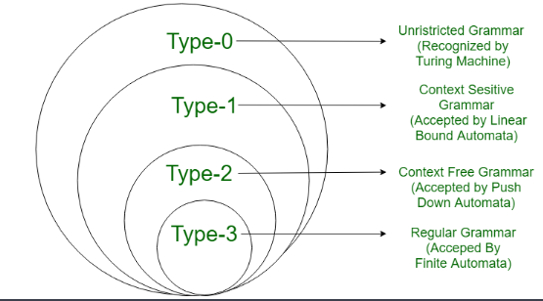

Slide 126
Grammars
According to chomsky hierarchy, grammars are divided of 4 types:
Type 0 known as unrestricted grammar.
Type 1 known as context sensitive grammar.
Type 2 known as context free grammar.
Type 3 Regular Grammar.
T or ∑ = set of alphabet/Character/terminals = ( a, b,c,…., +,-,*, …. )
V or N = Set of non-terminals or variables =( A,B,C, …., )- can be replaced during the processing of grammar by replacing it by various rule/production
∑ U V or T U V,T+V = combination of variables and terminals aXXaY, a,aA,Aa, BaA

Slide 127
Grammars and Languages
S
Derivation Tree
or
NP1
VP
Syntax Tree
or
Parse Tree
PN
VER
ART
ADJ
NP2
Napoleon
is
a
great
warrior

Slide 128
Derivation
<S> → <NP1> <VP>
<NP1> → <PN>
<PN> → Napoleon
<VP> → <VER> <ART> <ADV> < NP2>
<VER> → is
<ART> → a
<ADV> → great
< NP2> → warrior
Rules
or
Productions
or
Production rules
→ - rewritten as
- directly derives

Slide 129
Derivation
<S> <NP1> <VP> <PN> <VP> Napoleon <VP>
Napoleon <VER> <ART> <ADV> < NP2>
Napoleon is <ART> <ADV> < NP2>
Napoleon is a <ADV> < NP2>
Napoleon is a great < NP2>
Napoleon is a great warrior
Leftmost Derivation

Slide 130
<S> <NP1> <VP>
<NP1><VER> <ART> <ADV> < NP2>
<NP1><VER> <ART> <ADV> warrior
<NP1><VER> <ART> great warrior
<NP1><VER> a great warrior
<NP1> is a great warrior
Napoleon is a great warrior
Rightmost Derivation

Slide 131
Derivation
Non terminals - N
Terminals – T
Total alphabet - V = N ∪ T
are strings in
is obtained from in one step
is obtained from in zero or more steps
reflexive transitive closure of

Slide 132
Grammar (Examples)
G = ({S, A}, {a, b}, P, S), where
P: S → aA
A → b
S
a
A
b
L(G) = { ab }

Slide 133
Grammar
G = ({S}, {a, b}, P, S), where
P: S → aS
S → b
S
S
S
S
a
S
a
S
b
a
S
a
a
S
S
b
a
S
b
L(G) = { b, ab, a²b, a³b,. . . }
b
L(G) = { a^{n}b / n ≥ 0 }

Slide 134
Grammar (Examples)
G= ({E}, {+, *, (, ), id }, P, E), where
P: E → E + E (rule 1)
E → E * E (rule 2)
E → (E) (rule 3)
E → id (rule 4)
Leftmost derivation
Rightmost derivation
E
E
E
id
E
+
E
E
*
E
id
id
id
id

Slide 135
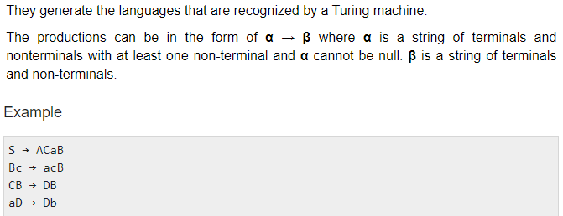
Type 0 ( Unrestricted Grammar )
Type-0 grammars include all formal grammars. Type 0 grammar language are recognized by Turing machine.
These languages are also known as the recursively enumerable languages.
Grammar Production in the form of

Slide 136
Type 0 ( Unrestricted Grammar )
Grammar: Unrestricted
Language: Recursively Enumerable, Recursive
Automaton: Turing machine
Definition:(CUV)*→(∑UV)* With at least one variable in LHS
Example:
S → Aa
sBb → abc
a → Acb (not type-0 as there is no variable on LHS)
aB → BabcS

Slide 137
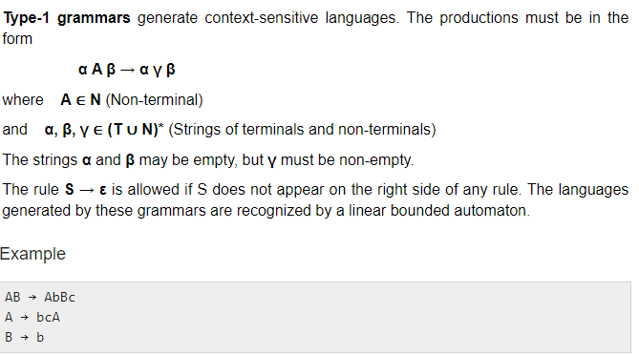
Type 1 (Context Sensitive )
Type-1 grammars generate the context-sensitive languages. The language generated by the grammar are recognized by the Linear Bound Automata.

Slide 138
Type 1 (Context Sensitive )
Grammar: context-sensitive
Language: context-sensitive
Automaton: linear-bounded automaton
Definition: (TUV)*→ (TUV)* Size of LHS ≤ RHS
i.e. if x→y then│x│≤ │y│ and αAβ → αBβ
Where α = left context,
β = right context,
A = a Variable,
B = anything (TUV)*(Should not be empty)
T-Terminal (∑) and V- Nonterminal or Variable

Slide 139
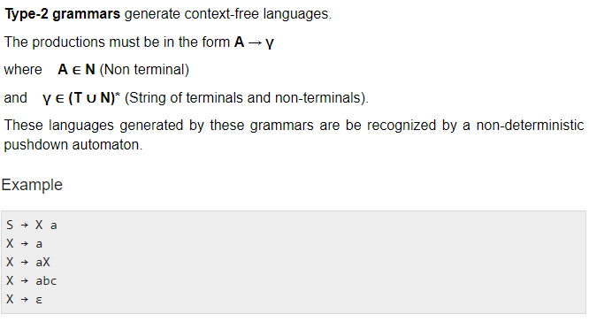
Type 2 ( Context Free )
Type-2 grammars generate the context-free languages. The language generated by the grammar is recognized by a Non Deterministic Push down Automata..

Slide 140
Type 2 ( Context Free )
Grammar: context-free
Language: context-free
Automaton: pushdown automaton
Definition: x → y, x∈ V(Non terminal), y∈ (V ∪ T)*,
T -terminal
Example:
S → Aa
Sb → Aa (not type-2 as left hand side other than a varible one terminal is also there)
B → bAa

Slide 141
Type 3 (Regular Grammar)
Type-3 grammars generate the regular languages.These languages are exactly all languages that can be decided by a finite state automaton.
Type 3 is most restricted form of grammar.
A regular grammar is right-linear or left- linear (but not both) The productions must be in the form X → a or X → aY ,where X, Y ∈ V (Non terminal),and a ∈ T (Terminal)
The rule S → ε is allowed if S does not appear on the right side of any rule.
Example ` example :V = {S},T = {a}
X → ε P : S→ aS
X → a | aY S→|є
Y → b
Right-Linear productions have the form X → aY or X → a
Left-Linear productions have the form X → Yb or X → b
generate regular languages
recognized by ﬁnite state automata

Slide 142
Type 3 (Regular Grammar)
Grammar: Regular
Language: Regular
Automaton: finite-state automaton
Definition:
A → a , A → aB --> Right linear Grammar
A → a , A → Ba --> Left linear grammar
Example:
A → aB/Ba/a
A → BAa (not type-3 as right hand side has more than one i.e 2 variables which is not allowed in regular grammar )
Ab → aB (not type-3 as LHS has symbols other than a variable)

Slide 143
Null Production
Null Production A → ε is not allowed in Type 1, Type 2 and
Type 3. But in a special case, if the null string is a part of the
language i.e., ε ϵ L, then we allow null production in form of S→ε,
but with the condition that it will not be further used for substitution
purpose.

Slide 144
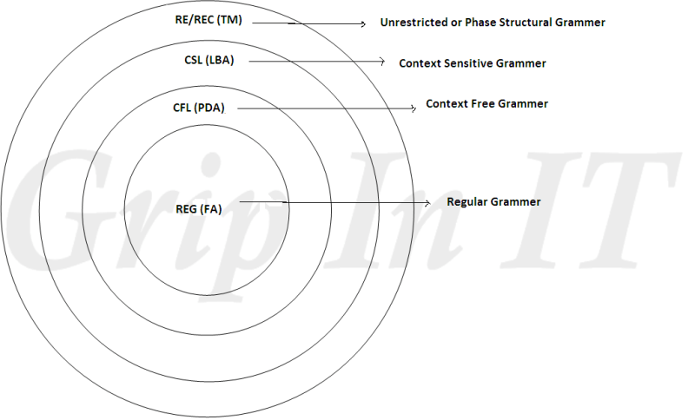

Slide 145
Grammars and Languages-Identifying Language from given Grammar
1) G= ({S}, {a}, P, S), where
P: S → aS (rule 1) S a
S → a (rule 2) S aS aa
S aS aaS aaa
L(G) = { a^{n} / n ≥ 1 }
2) G = ({S}, {a, b}, P, S), where
P: S → aS (rule 1) S b
S → b (rule 2) S aS ab
S aS aaS aab
L(G) = { a^{n}b/ n ≥ 0 }

Slide 146
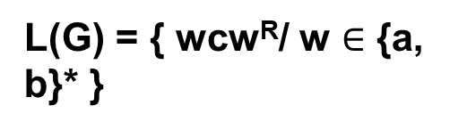
Grammars and Languages
3) G= ({S}, {a, b }, P, S), where
P: S → aSb (rule 1) S ab
S → ab (rule 2) S aSb aabb
S aSb aaSbb aaabbb
4) G= ({S}, {a, b, c }, P, S), where
P: S → aSa (rule 1) S c
S → bSb (rule 2) S aSa aca
S → c (rule 3) S bSb bcb
S aSa abSba abcba
S bSb baSab bacab
L(G) = { a^{n}b^{n} / n ≥ 1 }

Slide 147
Grammars and Languages
5) G= ({S}, {a, b, c }, P, S), where
P: S → aSBc (rule 1) S abc
S → abc (rule 2) S aSBc aabcBc aabBcc aabbcc
cB → Bc (rule 3)
bB →bb (rule 4) S aSBc aaSBcBc aaabcBcBc
aaabBccBc aaabBcBcc aaabBBccc
aaabbBccc aaabbbccc
L(G) = { a^{n}b^{n}C^{n}/ n ≥ 1 }

Slide 148
Grammars and Languages
6) G= ({S, A, B}, {a, b}, P, S), where
P: S → AB (rule 1) S AB aAbB aaB aaε = aa
A → aAb (rule 2) S AB aAbB aAbbbB aAbbbε
bB → bbbB (rule 3) aabb
aAb →aa (rule 4) S AB aAbB aAbbbB aAbbbε
B → ε (rule 5) aaAbbbb
aaabbb
L(G) = { a^{n+1}b^{n+k}/ n ≥ 1, k = -1, 1, 3, 5, . . .}

Slide 149
Grammars and Languages
7) Grammar for FORTRAN identifier
Length – 6 First symbol is the letter
Letter = {A, B, C, …, Z}
Digit = {0, 1, …,9}
S → (A / B / C /…./ Z) S1
S1 → ε
S1 → (A / B / C /…./ Z / 0 / 1 / 2 / …./ 9) S2
S2 → ε
S2 → (A / B / C /…./ Z / 0 / 1 / 2 / …./ 9) S3

Slide 150
Grammars and Languages
S3 → ε
S3 → (A / B / C /…./ Z / 0 / 1 / 2 / …./ 9) S4
S4 → ε
S4 → (A / B / C /…./ Z / 0 / 1 / 2 / …./ 9) S5
S5→ ε
S5 → (A / B / C /…./ Z / 0 / 1 / 2 / …./ 9) S6
S6→ ε

Slide 151
The Membership Problem
Given a string w ∈∑*and a language L over ∑, decide whether or not w ∈L.
Example:
Let w = 100011
Q) Is w ∈ the language of strings with equal number of 0s and 1s?

Slide 152
Finite Automata
Some Applications
Software for designing and checking the behavior of digital circuits
Lexical analyzer of a typical compiler
Software for scanning large bodies of text (e.g., web pages) for pattern finding
Software for verifying systems of all types that have a finite number of states (e.g., stock market transaction, communication/network protocol)

Slide 153
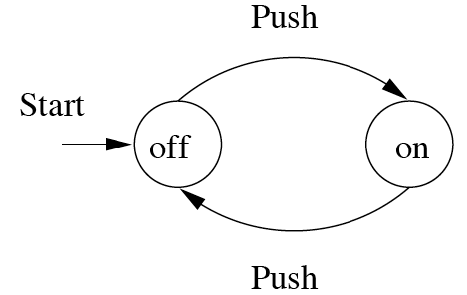
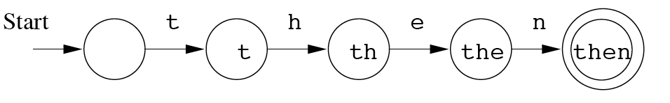
Finite Automata : Examples
On/Off switch
Modeling recognition of the word “then”
action
state
Start state
Transition
Intermediate state
Final state

Slide 154
Structural expressions
Grammars
Regular expressions
E.g., unix style to capture city names such as “Palo Alto CA”:
[A-Z][a-z]*([ ][A-Z][a-z]*)*[ ][A-Z][A-Z]
Start with a letter
A string of other letters (possibly empty)
Should end w/ 2-letter state code
Other space delimited words (part of city name)

