Slide 1

SMART INDIA HACKATHON 2026
JalRaksha
Dam-break screening you can check.
Problem Statement ID — 26161
Problem Statement Title — Dam Break Inundation Modelling Using Hydrodynamic Modelling of any River
Theme — Disaster Management
PS Category — Software
Team ID — <Team ID from SIH portal>
Team Name (Registered on portal) — <TEAM NAME>
THEME
#0F2B46
#0E7C7B
#B02E2A
Near-field SPH × far-field 2D shallow water, cross-checked against a real Delft3D FM kernel — arrival-time maps for any Indian dam from nothing but lat/lon, height and storage. Open data only. No ground survey.

Slide 2
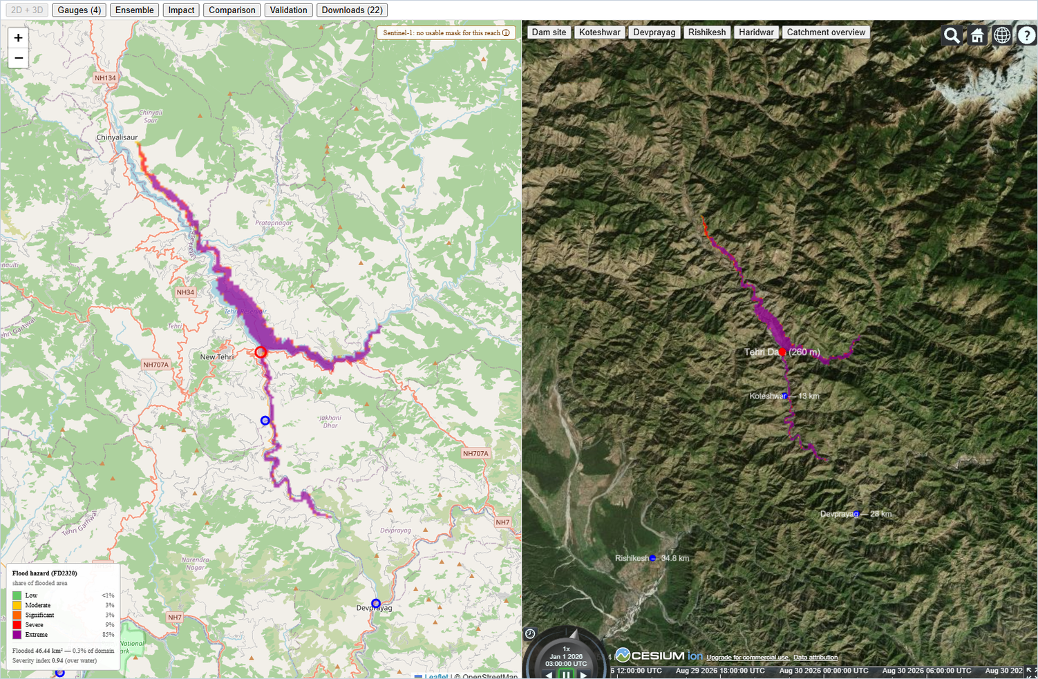
JALRAKSHA — dam-break screening, with the model checked
<TEAM NAME>
Detailed explanation of the proposed solution
The prototype, running
How it addresses the problem
▪ Operator enters four things — lat/lon, dam height, gross storage, breach mode. Nothing else.
▪ Data fetches itself: Copernicus GLO-30 DEM from public AWS COGs, GHSL population, Sentinel-1 SAR via Earth Engine, ESA WorldCover roughness.
▪ Breach hydrograph from a 4-regression Monte-Carlo ensemble — Costa 1985, Froehlich 1995, MacDonald–Langridge 1984, Von Thun–Gillette 1990.
▪ Far field: in-house 2D shallow-water finite volume — HLLC Riemann solver, Audusse hydrostatic reconstruction, MUSCL, wetting and drying.
▪ Near field: Smoothed Particle Hydrodynamics resolves the non-hydrostatic breach jet, where depth-averaging is invalid. One-way handoff, ~600 m over 15 s.
▪ Outputs depth, velocity and arrival-time rasters to a browser dashboard, plus GeoTIFF, .SHP and .KML/KMZ.
▪ Engineered dam break and natural landslide-dam blockage, one pipeline.
▪ GUI for input and tiled output; .shp / .kml export exactly as the PS asks.
▪ Any DEM, any AOI, any Indian dam — five presets plus custom coordinates.
▪ Sentinel-1 SAR loop scores simulated extent against observed flood extent.
▪ Runs offline from cache after first fetch — demo-day networks assumed hostile.
Innovation and uniqueness of the solution
Against how Tier-1 screening is done today:
Current practice | JalRaksha
Weeks of specialist setup | Minutes, 4 inputs
Licence + field survey | Free data, no survey
No independent check | Scored vs Delft3D FM
One number for peak flow | p05–p95 band
Bad SAR scenes drawn | Refused at a 0.50 gate
Live dashboard — Tehri (260 m, 3,540 MCM). Left: Leaflet inundation envelope with hazard classes over the Bhagirathi. Right: the same envelope on Cesium 3D over Copernicus terrain, with gauges labelled by downstream distance. 600×600 cells at 200 m, 60 km radius, 3 h simulated, EPSG:32644.
The cross-check is the product. The same Ritter dam-break runs through our solver and through a real Deltares kernel, and both are scored against the exact solution. Most entries have no independent check at all.

Slide 3











TECHNICAL APPROACH
<TEAM NAME>
Technologies to be used
SOLVERS
OPEN DATA
PROOF
In-house 2D shallow-water finite volume — HLLC flux · Audusse hydrostatic reconstruction · MUSCL/minmod on η = b + h. SPH near field. Delft3D FM (dflowfm-cli) as reference kernel.
Copernicus GLO-30 from public AWS COGs · GHSL P2023A · Sentinel-1 GRD · JRC Global Surface Water · ESA WorldCover · CWC NRLD/NRSD. None login-gated.
Monte-Carlo over four breach regressions with Wahl bands. pytest gates — analytical, lake-at-rest, mass conservation and the Delft3D FM cross-check, all currently passing.
Python
NumPy
Numba
GDAL
FastAPI
SQLite
React
Leaflet
Cesium
Earth Engine
pytest
Methodology and process for implementation
INGEST — open data, no login
SOLVE — near field + far field
DELIVER — decision products
Operator input
lat/lon · height · storage · breach mode
Far field — 2D SWE
HLLC · Audusse · MUSCL 600×600 cells at 200 m, 3 h
Impact
GHSL population at risk, bucketed by warning lead time
BREACH HYDROGRAPH
Monte-Carlo over 4 published regressions — Q(t) with a p05–p95 band, never one number
Copernicus GLO-30
30 m DEM, public AWS COGs
conditioned DEM + Manning's n
Q(t) at the breach 229,952 m³/s median
depth · velocity · arrival time
Near field — SPH
Lagrangian, non-hydrostatic ~600 m over 15 s, one-way
Export
Cloud-Optimized GeoTIFF · .SHP · .KML / KMZ
Google Earth Engine
Sentinel-1 · GHSL P2023A · WorldCover
Delft3D FM
dflowfm-cli — 0.0349 m RMSE against our 0.0317 m
Dashboard
Leaflet 2D + Cesium 3D, run picker works offline
Offline cache
COG + SQLite — runs from disk
GEE VALIDATION LOOP ↻ Sentinel-1 observed extent scored against the simulation; scenes below 0.50 precision against JRC water are refused, not drawn.

Slide 4
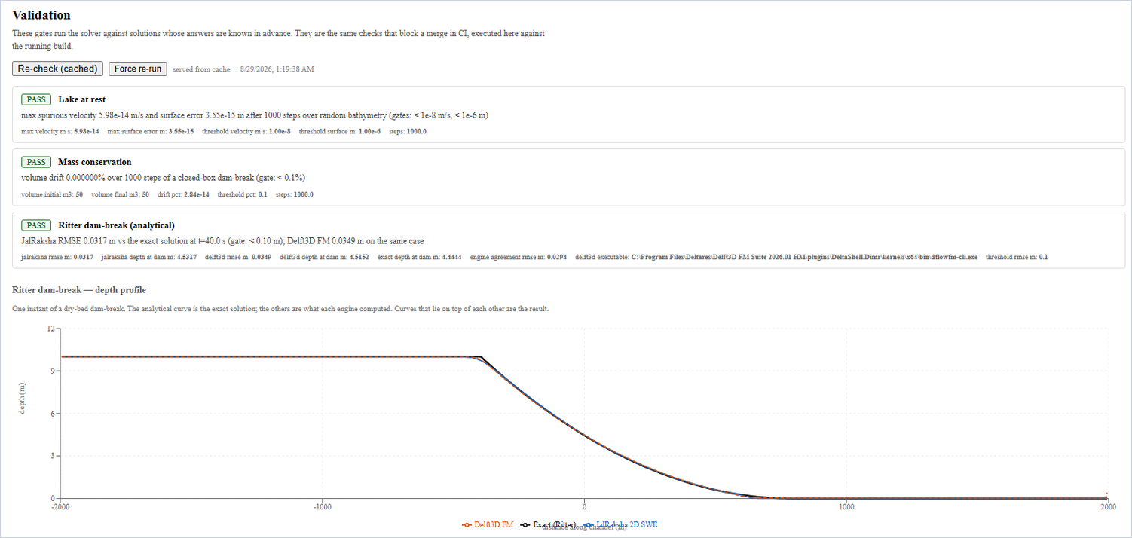
FEASIBILITY AND VIABILITY
<TEAM NAME>
Analysis of the feasibility of the idea
The gates, run from the dashboard
Not a proposal — a built system. These gates run against the live build, and are the same checks that block a merge in CI:
Blocking gate | Measured | Gate
Lake at rest — spurious velocity | 5.98e-14 m/s | < 1e-8
Mass conservation — volume drift | 0.000000 % | < 0.1 %
Ritter dam-break — RMSE vs exact | 0.0317 m | < 0.10 m
Both engines against the exact Ritter solution, same grid, same instant:
Engine | RMSE vs exact | Depth at dam
JalRaksha 2D SWE | 0.0317 m | 4.532 m
Delft3D FM (dflowfm-cli) | 0.0349 m | 4.515 m
All three PASS. h₀ = 10 m, t = 40 s, Δx = 10 m, frictionless flat bed; exact 4h₀/9 = 4.444 m, and the two engines agree to 0.0294 m RMSE.
Potential challenges and risks
Strategies for overcoming these challenges
▪ Wet–dry front instability — negative depths and spurious velocities. This fails visibly in a live demo.
▪ 30 m GLO-30 is a surface model with no reservoir bathymetry; it flattens water and puts canopy in the channel. 1–2 cells span a Himalayan gorge.
▪ Breach regressions disagree by 3–4× — the dominant uncertainty term, and a documented state of the art rather than a defect in this implementation.
▪ SPH does not scale — uniform resolution is an acknowledged limitation (SPHERIC Grand Challenge 3); it cannot span a basin.
▪ Debris, not clear water — Chamoli was ~80% rock by volume, and clear-water physics understates such an event.
▪ Manning's n is uncertain, and inundation extent is sensitive to it.
▪ Positivity-preserving scheme — Audusse reconstruction under a CFL ≤ 1/2 bound; lake-at-rest and mass conservation gate every merge, and both pass now.
▪ Lead with arrival time and extent, not point depth. Every depth figure here is labelled indicative; the DEM limit is stated, not buried.
▪ Quote the band, never the number — Monte-Carlo over all four regressions returns p05 / median / p95 for outflow, depth and arrival time.
▪ Confine SPH to a near-field box (~600 m, 15 s) and hand off one-way; the far field is left to the depth-averaged solver, where it is valid.
▪ Positioned as a Tier-1 screening layer under CWC CDSO_GUD_DS_05: it triages which dams warrant a full Tier-2/3 study, and does not replace one.

Slide 5
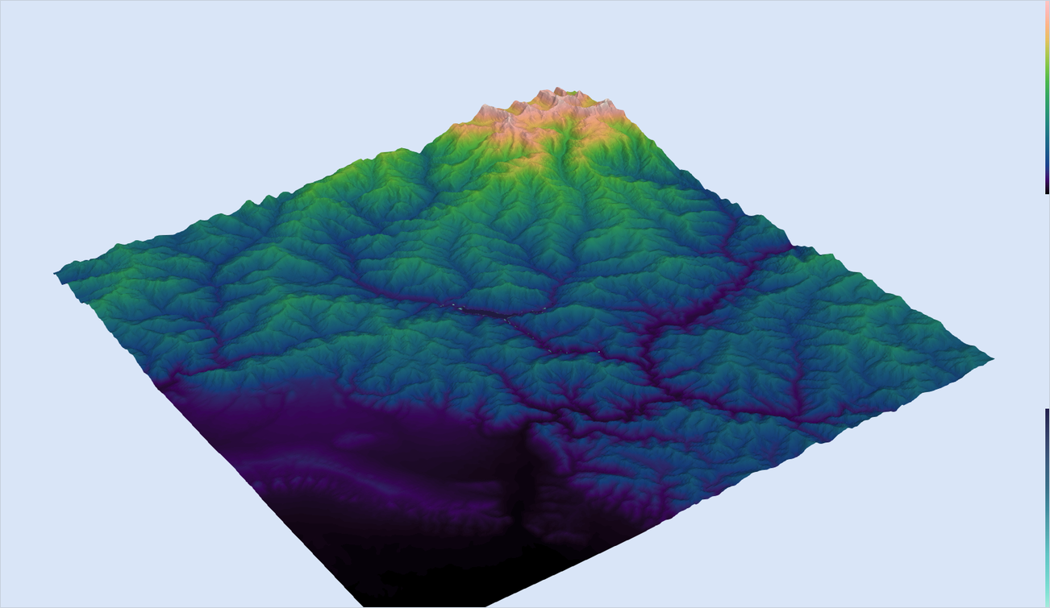
IMPACT AND BENEFITS
<TEAM NAME>
1,180,102
1,760
193
50.2 min
46.44 km²
people in the modelled domain
(GHSL P2023A, epoch 2020)
reach 0.1 m depth or more — the
population actually at risk
have under 15 min of warning at a
30 min lead-time assumption
for the wave to reach Koteshwar,
13.0 km downstream
inundated envelope, severity
index 0.94 over water
One real run, not an illustration: Tehri Dam (260 m, 3,540 MCM), central breach, 600×600 cells at 200 m over a 60 km radius, 3 h simulated. Peak breach outflow 229,952 m³/s (p05–p95 117,061–353,612); breach formation 29.3 min; maximum depth anywhere 99.9 m (75.1–120.6 m). Depth on a 30 m DEM is indicative — lead with arrival time. Target — at ~1 min per dam measured, screening all ~6,000 NRLD large dams at Tier-1 is under a week of compute; a state's worth in an afternoon.
Potential impact on the target audience
Real terrain, real reach
▪ NDMA / SDMA / DDMA — depth, extent and arrival time are exactly what an evacuation order needs; .kml drops into the GIS they already run.
▪ CWC / NDSA — a Tier-1 screening layer under CDSO_GUD_DS_05, to triage which of India's large dams warrant a full expert study first.
▪ NTRO / HADR planners — scenarios for dams and landslide lakes that cannot be ground-surveyed, including reaches with no site access.
▪ Army / BRO / NDRF — pre-positioning, and deliberate-breach planning of the kind executed at Phuktal in 2015.
▪ Downstream communities — the people counted in the 1,760 above, who at Chamoli in 2021 received no warning at all.
Benefits of the solution (social, economic, environmental)
SOCIAL
ECONOMIC
ENVIRONMENTAL
Arrival time is lead time, and lead time is evacuation. The exposed population is split by how many minutes each group actually has — 193 of them under 15. Works for terrain that cannot be surveyed or reached at all.
Zero licence cost, and automation replaces weeks of specialist setup per site. .shp / .kml at the 1:50,000 and 1:10,000 scales CWC's Emergency Action Plan guidelines specify — usable, not merely viewable.
Identifies cropland and ecosystems in the flood path, and supports scheduled controlled release over emergency release. Open and reproducible: anyone can re-run the cross-check and get these numbers.
Bhagirathi valley below Tehri on Copernicus GLO-30, rendered in ParaView with the computed depth draped over it. Rishikesh and Haridwar report no arrival — Rishikesh sits 18 m above the nearest channel — reported as a null, not dropped.
Roadmap — done, now, next
DONE
NOW
NEXT
Jan – Aug 2026
Sep 2026
Oct 2026 →
▪ Solver + blocking gates
▪ Delft3D FM cross-check
▪ Dashboard, exports, SPH
▪ Tehri + Khadakwasla runs
▪ Sentinel-1 validation loop
▪ SIH prototype review
▪ All CWC NRLD dams
▪ EAP-format map packs
▪ SDMA field pilot

Slide 6
RESEARCH AND REFERENCES
<TEAM NAME>
Details / Links of the reference and research work
Problem domain — Indian events and regulation
Numerical methods
Open data and software — free, none login-gated
▪ CWC / CDSO, Guidelines for Mapping Flood Risks Associated with Dams, CDSO_GUD_DS_05 v1.0, 2018 — the Tier 1–3 framework this tool targets
▪ CWC, Emergency Action Plan guidelines — index maps 1:50,000, detailed maps 1:10,000
▪ Shugar et al. 2021, Science 373:300–306, doi 10.1126/science.abh4455 — Chamoli; travel times matched to under 5%
▪ Rana et al. 2023, Natural Hazards, doi 10.1007/s11069-023-05972-5 — an independent reconstruction of the same event
▪ Sinha 2009, Current Science 97:429–433 — the 2008 Kosi avulsion
▪ Costa & Schuster 1988, GSA Bulletin — formation and failure of natural dams
▪ CWC NRLD 2019 and NRSD 2025 national dam registers
▪ Toro 2001, Shock-Capturing Methods for Free-Surface Shallow Flows, Wiley — HLLC wave speeds, two-rarefaction estimate
▪ Audusse et al. 2004, SIAM J. Sci. Comput. 25:2050 — hydrostatic reconstruction, the well-balanced property this solver rests on
▪ Froehlich 2008, J. Hydraul. Eng. 134(12) — embankment breach regressions
▪ Xu & Zhang 2009, J. Geotech. Geoenviron. Eng. 135(12)
▪ Wahl 2004, J. Hydraul. Eng. 130(5) — uncertainty of breach parameters
▪ Maranzoni & Tomirotti 2023, Water 15(17):3130, doi 10.3390/w15173130 — recommends exactly this coupled 2D–3D decomposition
▪ Vacondio et al. 2020, Comp. Particle Mech. 8:575 — SPH Grand Challenge 3
▪ Ramachandran et al. 2021, ACM TOMS 47(4), doi 10.1145/3460773 — PySPH
▪ Copernicus DEM GLO-30 — 30 m, public AWS Cloud-Optimized GeoTIFFs
▪ Sentinel-1 GRD and JRC Global Surface Water via Google Earth Engine
▪ GHSL P2023A gridded population, epoch 2020 (JRC)
▪ ESA WorldCover — land cover driving Manning's n
▪ Google Open Buildings — CC BY 4.0
▪ Delft3D FM, Deltares — Suite 2026.01 HM, dflowfm-cli
▪ PySPH — BSD licence, developed at IIT Bombay
▪ Deliberately excluded: FABDEM (CC BY-NC-SA), MERIT (CC BY-NC / ODbL) and OSM (ODbL share-alike) are kept out of redistributed outputs on licence grounds.
Reproduce every number on this deck: python scripts/validate_against_delft3d.py --case ritter | jalraksha run --dam tehri | dashboard at localhost:3000

