Slide 1
NLP with R
Presented by
Satyajit Saha -10505118
Aparna Samboji-10519676

Slide 2
What is NLP
Natural Language Processing is a set of techniques through which computers and people can interact.
It Basically refers to the language used by humans to communicate with each other. This communication can be verbal or textual.
NLP is a field that brings together computer science, artificial intelligence and linguistics.
If one would have to break down NLP to one equation it would be:
NLP= computer science + Artificial Intelligence + Computational linguistics

Slide 3
Brief History
NLP is a field that started in the 1950’s(And the goal is to make machines understand our language.)
In 1970 many programmers began to write “conceptual ontologies” with real world information into computer-understandable data
In late 1980 there was revolution in natural language processing with introduction of Machine learning algorithm
In 2010 representation learning and deep neural network style machine learning method became widespread in Natural Language Processing.

Slide 4
Application of NLP in real life
Natural Language Processing(NLP) is present in our daily lives.
NLP is present in:
Auto –Predict ( Google predict automatic search)
Sentiment analysis
Auto – correct (Google Keyboard)
Speech recognition (Google Web Speech)
Report generation in our Analytical tools
Spam filter( Google filter spam emails separately)
Question Answering ( IBM Watson’s answer a query)

Slide 5
Mechanism of NLP
When Text is composed of speech teste Text conversion. The mechanism of NLP involves in two process
1)Natural Language Understanding(NLU): It can understand the meaning of the given text
2)Natural Language Generation (NLG): It’s the process of Automatically producing text from structured data in a readable format with meaningful phrases and sentences
NLG is a subset of NLP

Slide 6
Steps in NLP
Tokenization
Stemming
Lemmatization
Named Entry Recognition
Chunking

Slide 7
Tokenization
First step in NLP.
It involves breaking a text documents into piece so machine can understand.
Understand each words in respect to the sentences
Produce a structural description on an input sentence

Slide 8
Stemming
Normalise words into it’s base form or root form
It takes common prefix or suffix to detect key words
Detection
Detected
Detection
Detecting
Stemming
Detect

Slide 9
Lemmatization
It takes morphological analysis of words
Groups together different inflected forms of a word, called Lemma
Somehow similar to stemming as it maps several words into one common root
Output should be proper word
Gone
Going
Went
Go

Slide 10
Named Entry Recognition
NER is also known as entity chunking / extraction
Popular technique used in information extraction to identify and classify the segments
Google’s CEO launched Sundar Pichai introduced the new pixel3 at New York Central Mall
Organization
Person
Location
Organization

Slide 11
Chunking
Picking up group of information and grouping them into bigger pieces
It works on top of POS tagging
It used POS tagging as input and provide chunk as output

Slide 12
Implication of NLP
Technologies that used to build NLP pipelines are:
1) R (Covered topic)
2) Python
Natural Language Toolkit
spacy

Slide 13
Dataset
Restaurant Review

Slide 14
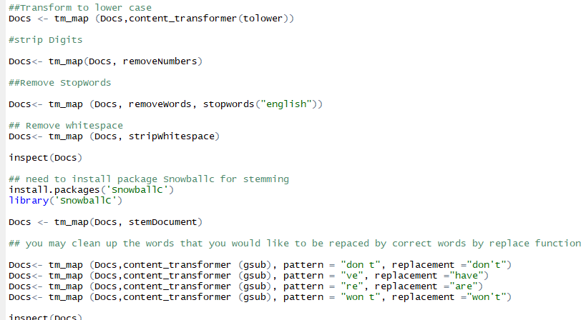
Scripting in R

Slide 15
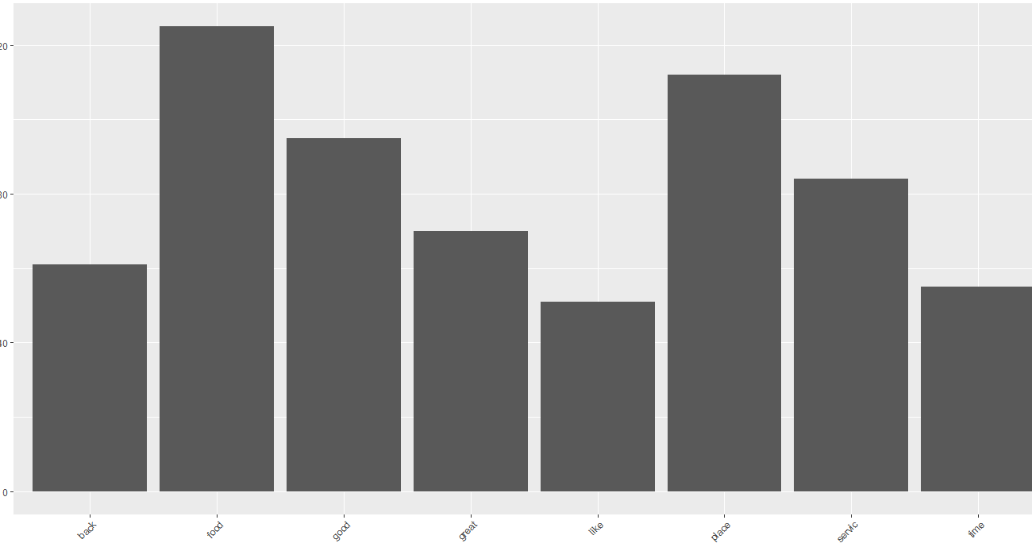
Analysis

Slide 16
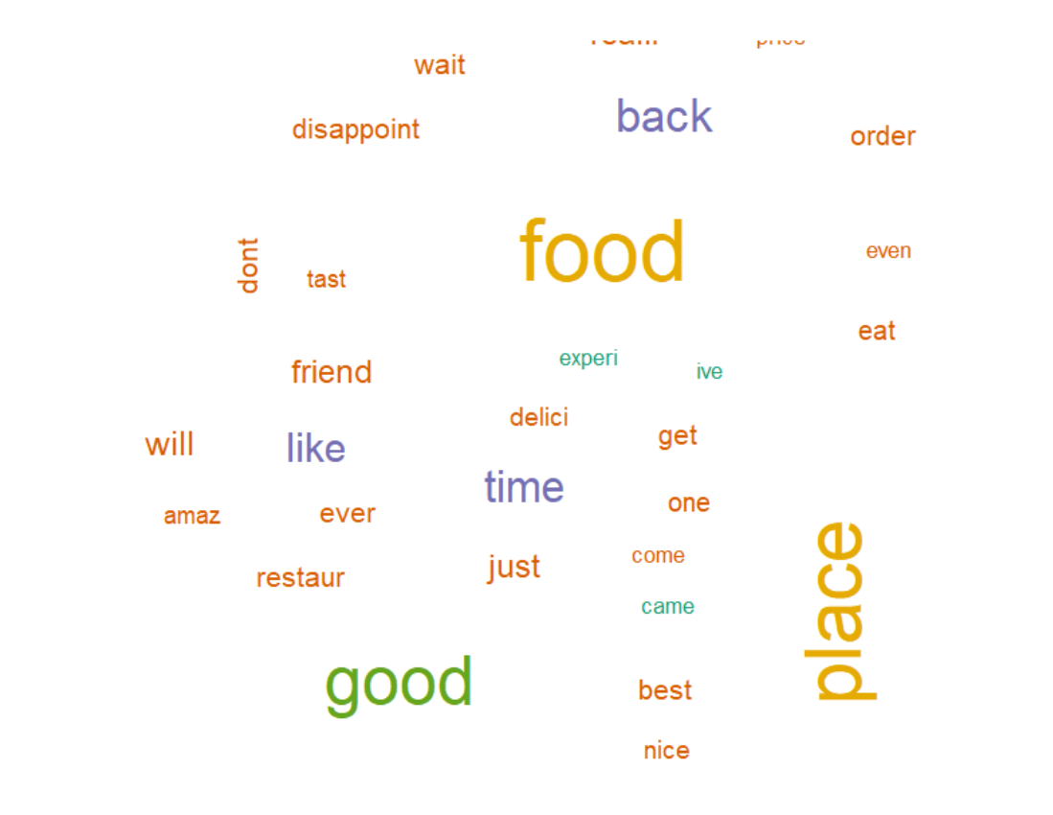
Analysis

Slide 17


