Slide 1
FULL ADDER USING 3-TO-8 DECODER & BASIC LOGIC GATES
Verilog HDL Design , Simulation & Verification
Computer Organisation & Architecture(CSC311)
Group No. - 06
Indian Institute of Information Technology , Kalyani

Slide 2
1.Aim of The Project
To design a 3-to-8 Decoder using Verilog HDL.
To implement a 1-bit Full Adder using the outputs of the Decoder.
To generate the Sum & Carry outputs using OR Logic from the decoder minterms.
To verify the complete design through a Verilog testbench and simulation.

Slide 3
2.Design Principle
Full Adder implemented using decoder minterms
A Full Adder has three inputs : A , B and Cin.
It produces two outputs : Sum and Cout.
Sum = A ^ B ^ Cin
The 3-to-8 Decoder activates exactly one output for each input combination.
Therefore , Sum and Cout can be obtained by ORings the required decoder minterms.

Slide 4
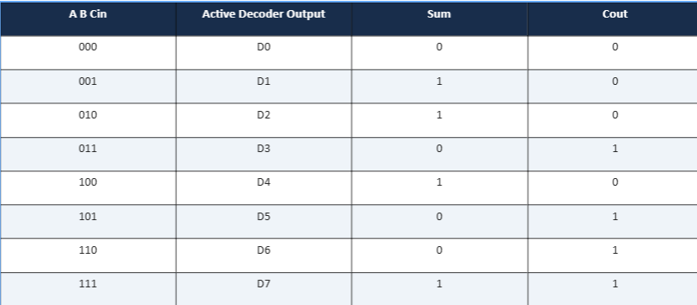
3. Decoder-to-Full-Adder Mapping

Slide 5
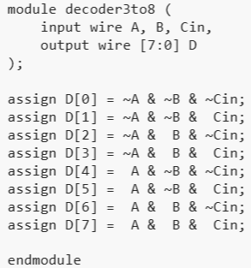
4. Program----3-to-8 Decoder

Slide 6
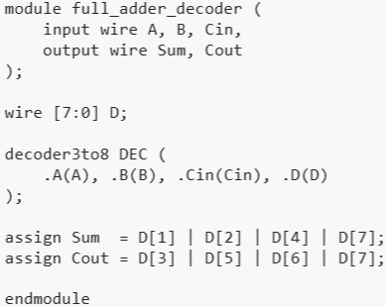
5. Program ---- Full Adder Using Decoder

Slide 7
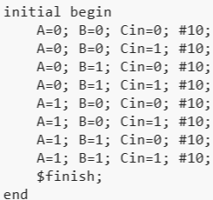
6. Testbench / Program Simulation

Slide 8
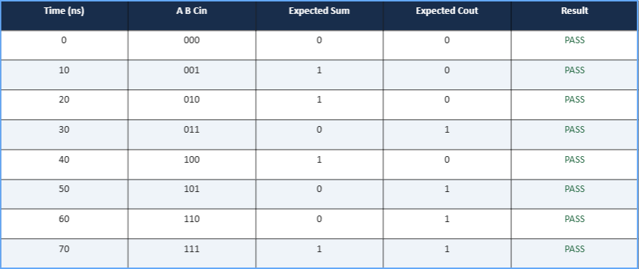
7. Program Output

Slide 9
8. Output Interpretation
D0 – D7 represent the 8 – minterms generated by the 3-to-8 Decoder.
Sum is HIGH for minterms D1 , D2 , D4 & D7.
Cout is HIGH for minterms D3 , D5 , D6 & D7.
The simulated waveform follows the standard full-adder truth table.
The testbench confirms correct operation for every possible input combination.

Slide 10
9. Conclusion
A 3-to-8 Decoder was successfully designed using Verilog HDL.
The Decoder was used to implement a 1-bit full adder using
decoder minterms.
OR combinations of Decoder outputs generated the correct Sum
and Carry functions.
Simulation verified all eight possible input combinations successfully.
The project demonstrates the use of decoders as practical building
blocks for Combinational Logic.

Slide 11
Thank You
Group members – Aayan Kumar Mondal (1402) , Angan Jana (1416) ,
Aritra Dey Sarkar (1419) , Satyaki Banerjee (1482)

