Slide 1
MASTERMIND CODEBREAKER GAME
MIPS Assembly Programming Using QtSPIM
Project No. - 20
Group No. - 06
Indian Institute of Information Technology , Kalyani

Slide 2
1.Aim of The Project
To develop an interactive 4-digit codebreaker game using MIPS Assembly
QtSPIM.
To generate a pseudo-random 4-digit secret sequence.
To give the player a maximum of 7 attempts to guess the sequence.
To provide feedback on correct positions , correct digits in wrong positions ,
and absent digits.
To demonstrates procedures , loops , arrays , system calls , registers and
conditional branching.

Slide 3
2. Game Rules & Working
The secret sequence contains exactly 4 digits , with each digit between 0 to 9.
The player receives 7 attempts.
Correct position : the guessed digit matches the secret at the same position.
Correct digit , wrong position : The digit exists in secret but occurs elsewhere.
Digit not present : the digit does not occur in secret sequence.
The game ends when all four positions are correct or after the 7th unsuccessful
attempt.

Slide 4
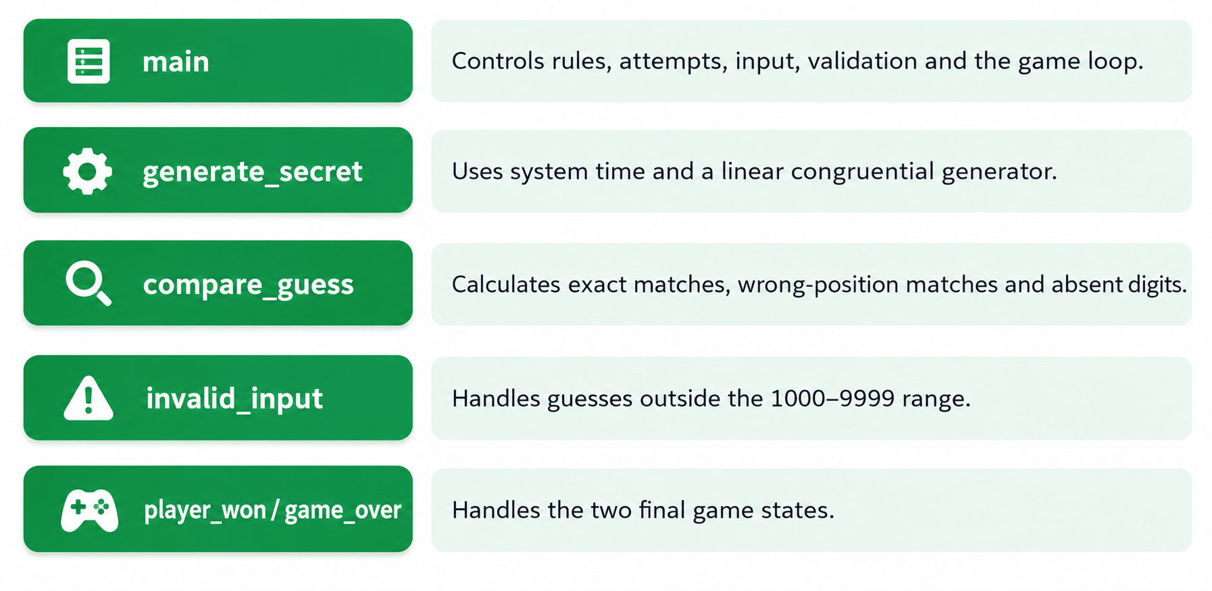
3. Program Structure
Major procedures used in MIPS Program

Slide 5
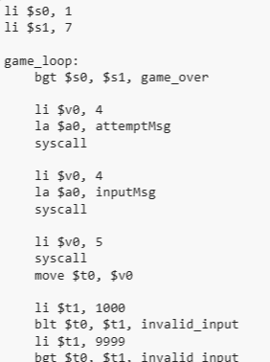

4. Program --- The Main Game Loop

Slide 6
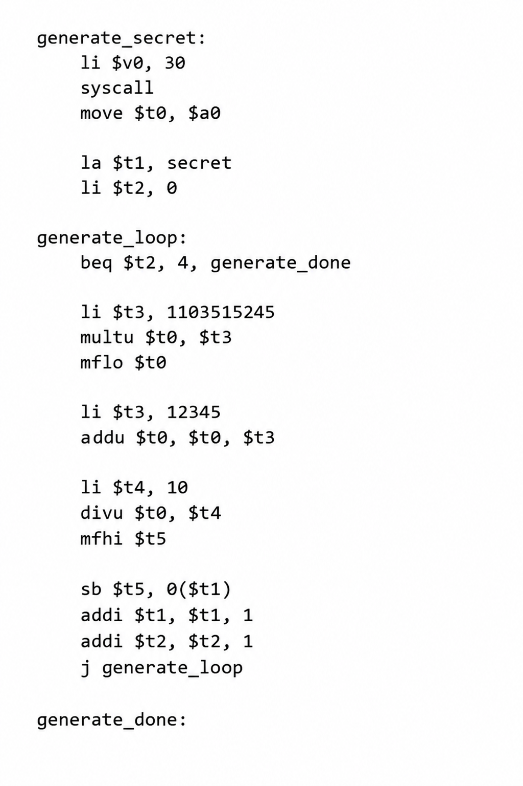
5. Program --- Secret Sequence Generation

Slide 7
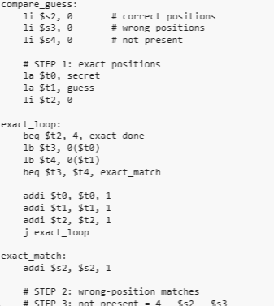
6. Program --- Guess Comparison

Slide 8
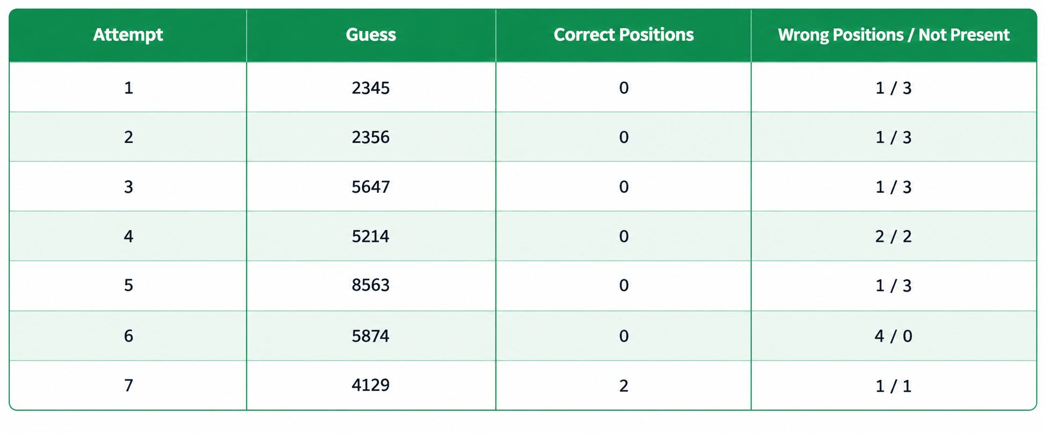
7. Sample Simulation Output
Based on QtSPIM Console Run
After attempt 7 , the program displays GAME OVER and reveals the Secret Sequence

Slide 9
8. Output Analysis
The program processes all 7 guesses sequentially.
The sixth guess , 5874 , reports 0 correct positions , 4 correct digits in
wrong positions and 0 digits & 0 digits present .
The seventh guess , 4129 , reports 2 correct positions , 1 wrong- position digit and
1 absent digit.
After the seventh attempt , the program prints GAME OVER.
The provided run displays the secret sequence as 6121.

Slide 10
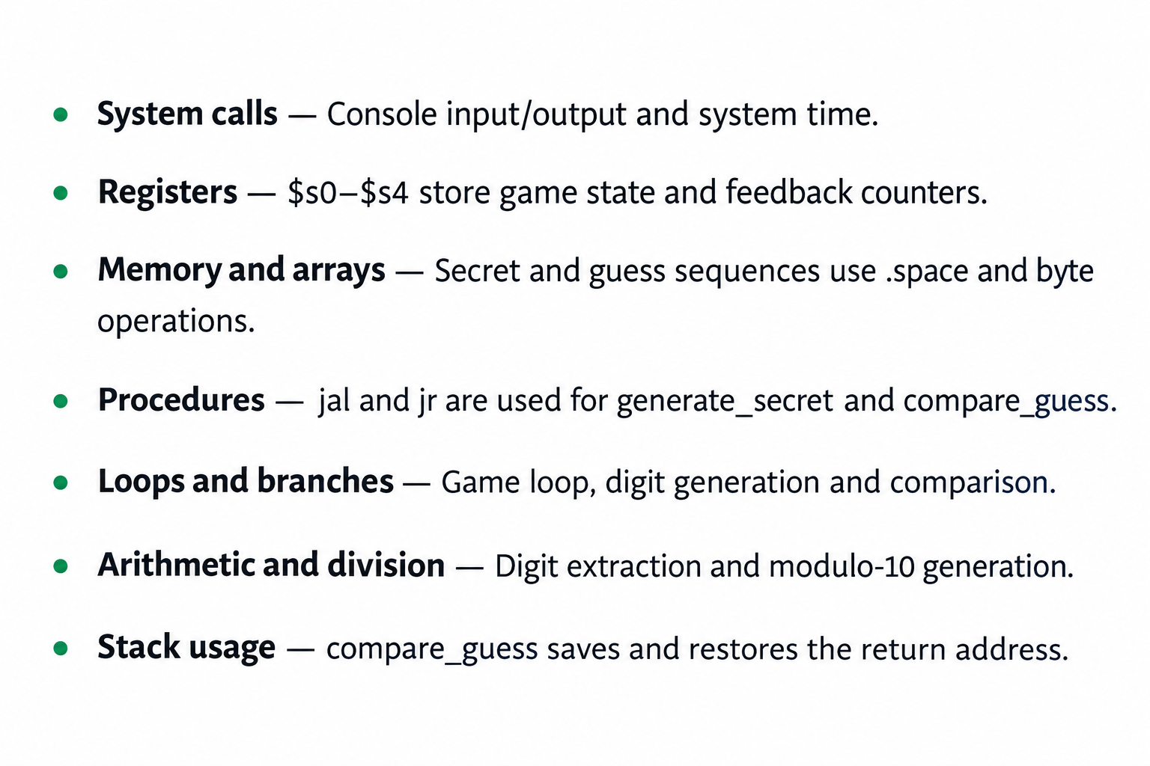
9. MIPS Concepts Demonstrated

Slide 11
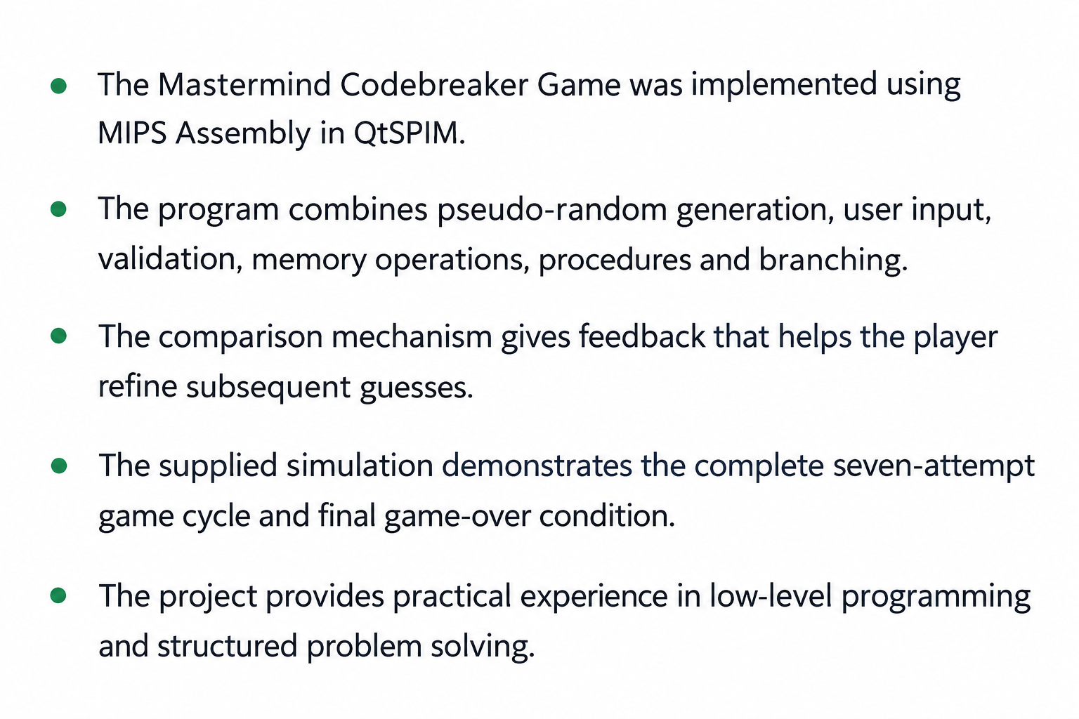
10. Conclusion

Slide 12
Thank You
Group Members – Aayan Kumar Mondal (1402) , Angan Jana (1416) ,
Aritra Dey Sarkar (1419) , Satyaki Banerjee (1482)

