Slide 1
C Programming Project
TETRIS GAME USING C
A Console-based interactive game built with arrays ,
Functions & game logic
Presented By : Satyaki Banerjee
Department of Computer Science & Engineering ,
Indian Institute of Information Technology , Kalyani
</>

Slide 2
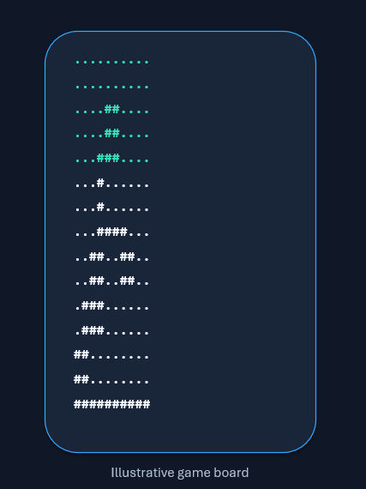
OVERVIEW
7 Different Tetromino shapes fall into 10 x 20 playing field.
The players move and rotate each shape to form complete horizontal lines.
Completed lines disappear and increase the score.
The game ends when a new shape cannot fit as its starting position.

Slide 3
OBJECTIVES
Build an interactive console based game using C programming.
Process keyboard input without pressing ENTER after every move.
Detect Collisions before moving and rotating the shape.
Clear full rows & maintain a running score.
Organise the program into reusable , focused functions.

Slide 4
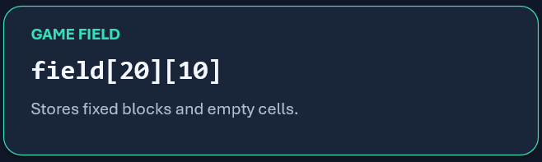
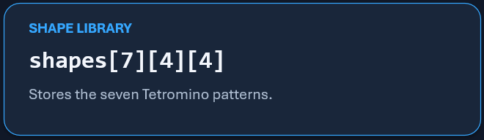
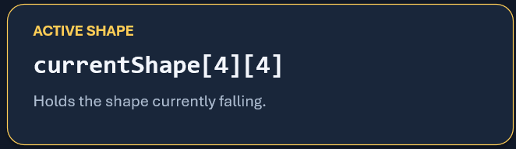
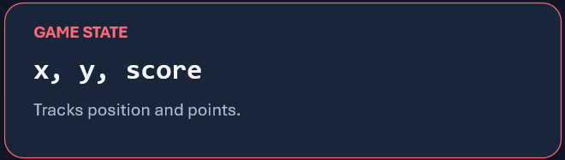
GAME COMPONENTS
The board & shapes are represented with 2-D arrays.

Slide 5
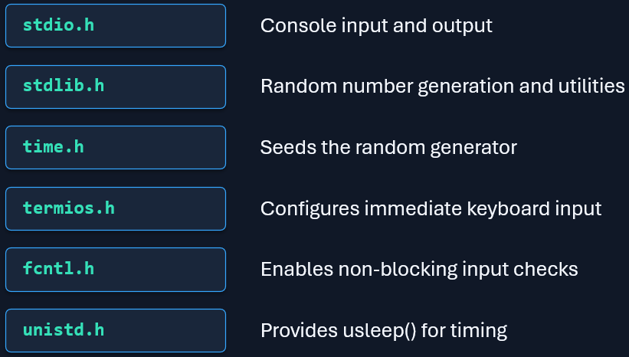
TECHNOLOGIES & LIBRARIES USED
The implementation uses terminal features available in POSIX-like environment

Slide 6
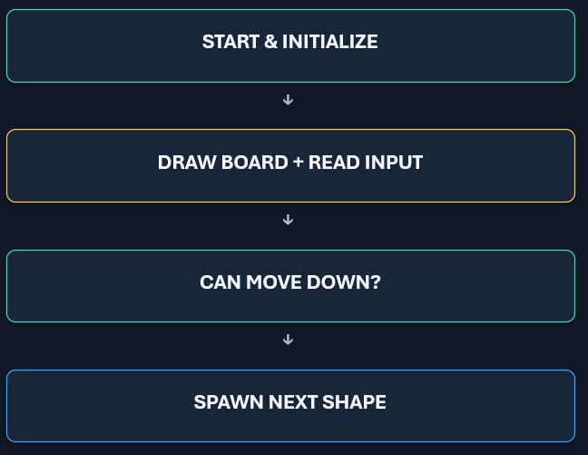
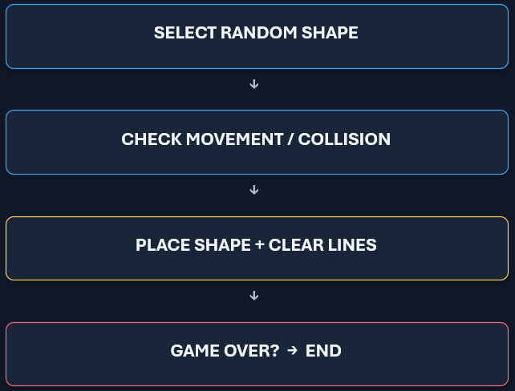
MAIN GAME FLOW
A simplified view of loop inside main().
The loop repeats until the next shape collides at its own position.

Slide 7
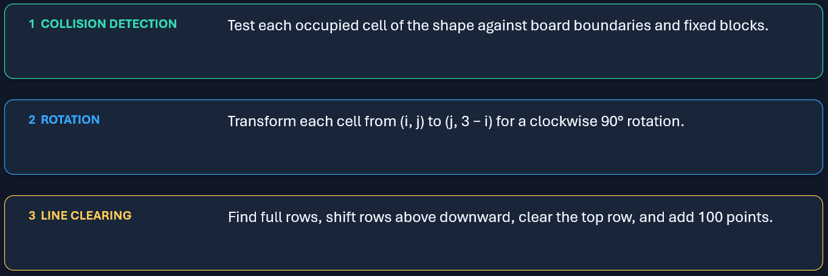
HOW THE GAME WORKS
Three key operations keep gameplay consistent.

Slide 8
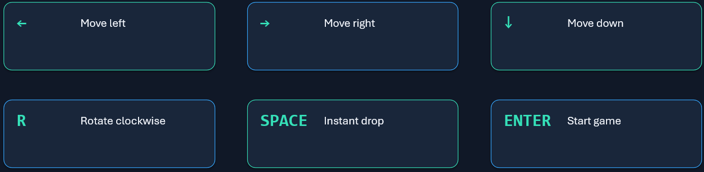
CONTROLS & CONSOLE OUTPUT
The board is drawn using # for occupied cells & . For empty cells.

Slide 9
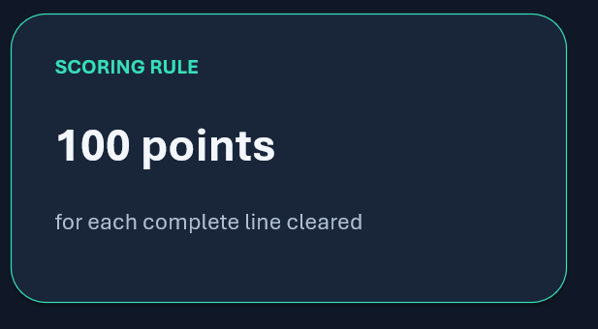
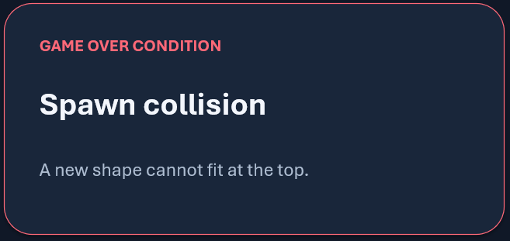
SCORING & GAMEOVER
Simple rules determine progress and the end of a round.
Example : 3 cleared lines x 100 points = 300 points

Slide 10
LIMITS AND FUTURE SCOPE
Possible improvements beyond the current console version .
Add levels with increasing falling speed.
Preview the next Tetromino & display a high score table.
Add colours , sound effects , pause and restart options.
Create a graphical version using SDL or another library.
Improve terminal portability and input handling for Windows.

Slide 11
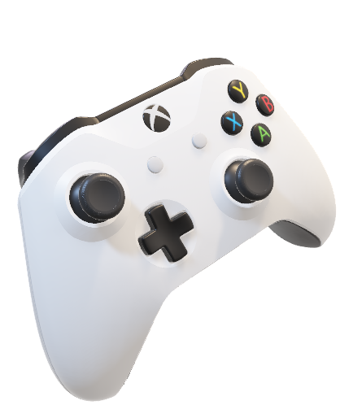
CONCLUSION
A small game , a lot of useful programming.
This project brings together arrays , functions , loops ,
Conditionals , Randomization , Matrix Transformations ,
Collision Detections , and Terminal Input Handling.

Slide 12
Thank You
Questions ?

