Slide 1
E commerce site Fraud merchant detection

Slide 2
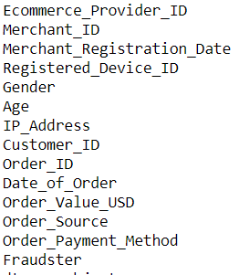
PROBLEM STATEMENT
To detect if the merchant is fraud or not given

Slide 3
SOLUTION APPROACH
Getting the correct data
Exploratory data analysis to identify important features
Train-validation split
Pre-processing and feature transformation
Model building and prediction

Slide 4
EXPLORATORY DATA ANALYSIS
Merchant information, order information and fraudster label ID were present in 3 files which was combined into a consolidated dataset
Exploratory data analysis was carried out to identify important features
E commerce provider ID was same for all rows and hence dropped
Order ID was dropped as every transaction had a unique order ID
Some customer IDs and device IDs occurred more than once and hence could provide insight into returning customers and devices
Orders came from primarily 3 sources

Slide 5
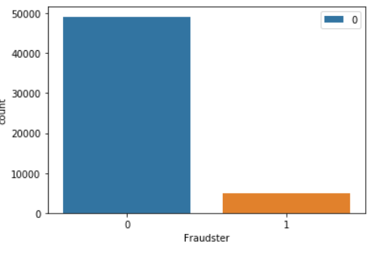
EXPLORATORY DATA ANALYSIS
Plotting the distribution of fraudsters show that roughly 10% of the transactions are fraudulent. Therefore class imbalance problem exists

Slide 6
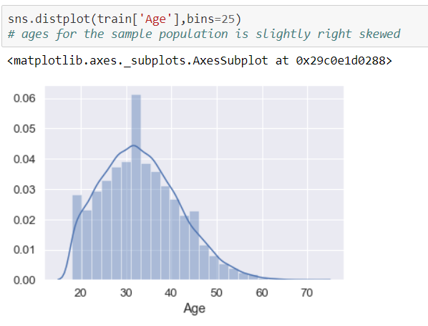
EXPLORATORY DATA ANALYSIS
Age of the sampled population is roughly normally distributed with a slightly longer tail to the right

Slide 7
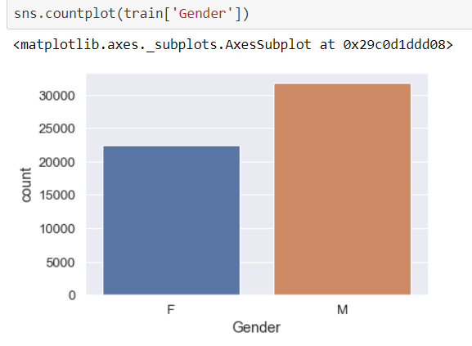
EXPLORATORY DATA ANALYSIS
Gender wise split shows more men than women in sample dataset

Slide 8
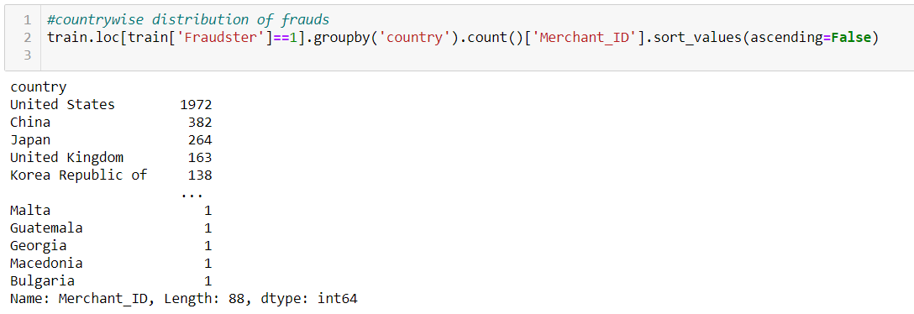
EXPLORATORY DATA ANALYSIS
The IP_addresses were converted into numbers and matched with the ip address vs country list to determine countries for each transaction.
A quick analysis reveals that more populous countries tend to have more frauds

Slide 9
PRE-PROCESSING
The unnecessary columns were dropped to get the final data which was then split into train(90%) and test(10%)
Two transformations were done to the columns registered device id and customer id
First the count for each device and customer were determined
Then if count of a device or customer was greater than 1, it would be classified as repeated use device or customer
The countries column had about 7000(13%) missing values. So those were imputed using mode of the countries column.
The countries column had 146 levels. So count for each level was determined and countries having more than 1000 transactions were classified as frequently occurring countries while others were classified as infrequent countries

Slide 10
PRE-PROCESSING
The features were then split into numeric and categorical attributes .
Numeric attributes were scaled using standard scaler
Categorical attributes were dummified

Slide 11
MODEL BUILDING
Models using 6 different algorithms were tried to predict the label (if a given merchant was fraudster or not)
Logistic Regression
Linear Discriminant analysis
Decision tree
Random Forest
K neighbors classifier
Gradient boosting classifier using decision tree base learner
Since 90% data was not fraud, the correct metric for model evaluation was chosen to be F1 score which is given as
F1 score=2*precision*recall/(precision+recall)
Among the models random forest gave best prediction which was used to predict on unseen data with a precision score of 0.52

Slide 12
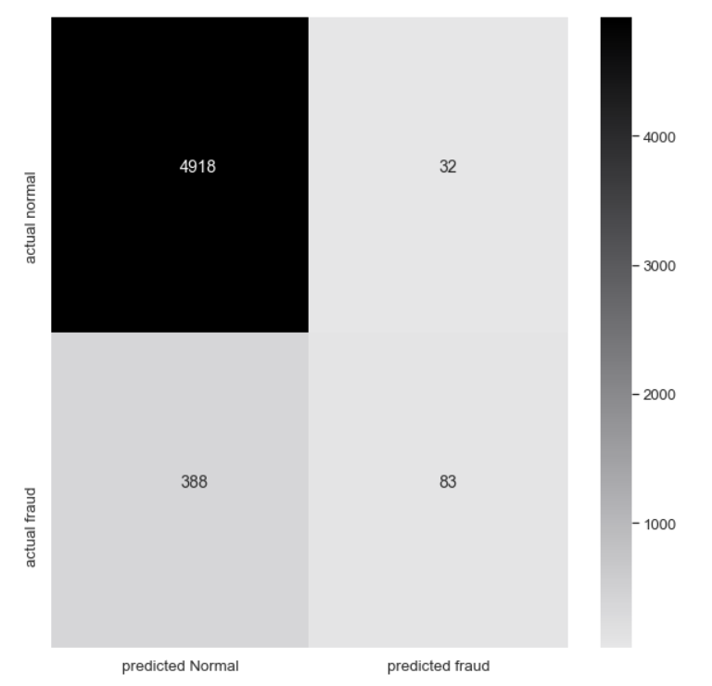
MODEL EVALUATION
Confusion matrix for the predicted models was plotted

Slide 13
Backup Slides

Slide 14
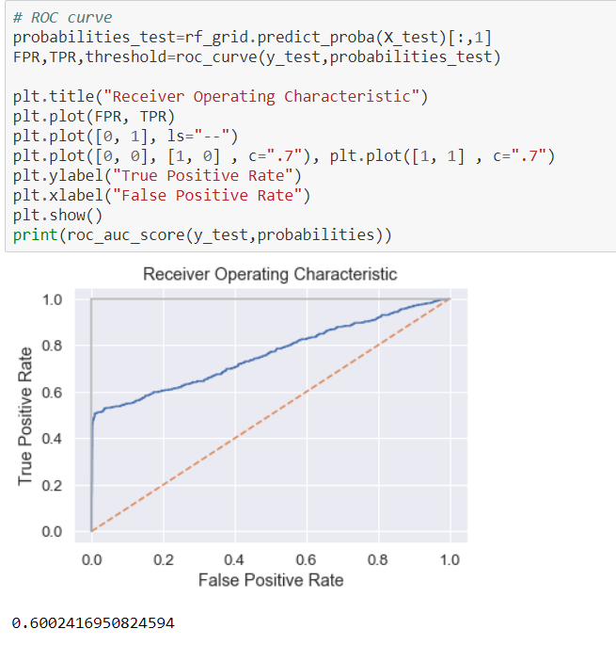

Slide 15
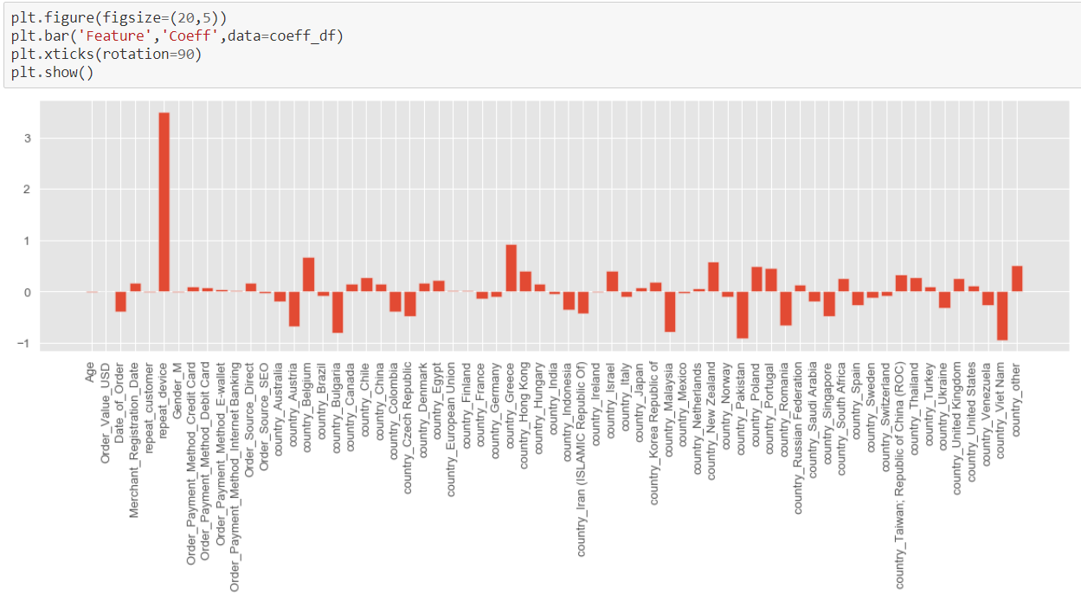

Slide 16
