Slide 1
Predicting Employee Attrition

Slide 2
Problem Description
A company which is active in Big Data and Data Science wants to hire data scientists among people who successfully complete some courses conducted by the company. Many people signup for their training. They want to know which of these candidates really want to work for the company after training or look for new employment. They are interested in reducing the cost and time for planning the courses and categorization of candidates. Information related to demographics, education, experience are collected from the candidates at the time of enrollment

Slide 3
Data description
enrollee_id : Unique ID for candidate
city: City code
city_ development _index : Development index of the city (scaled)
gender: Gender of candidate
relevent_experience: Relevant experience of candidate
enrolled_university: Type of University course enrolled if any
education_level: Education level of candidate
major_discipline :Education major discipline of candidate
experience: Candidate total experience in years
company_size: No of employees in current employer's company
company_type : Type of current employer
lastnewjob: Difference in years between previous job and current job
training_hours: training hours completed
target: 0 – Not looking for job change, 1 – Looking for a job change

Slide 4
Data visualization

Slide 5
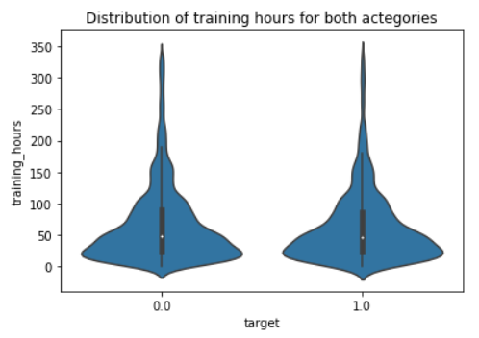
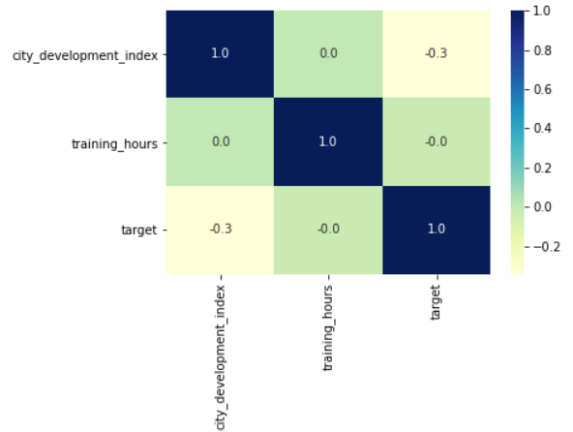
Association between numeric columns and target
0: candidate stays
1: candidate leaves
It can be seen that the distribution of training hours is exactly the same for both categories. Hence Training hours can be dropped

Slide 6
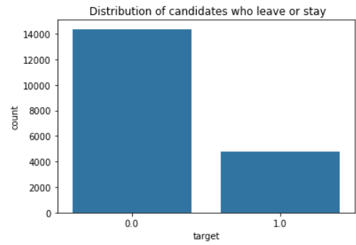
Distribution of the attrition column
0: candidate stays
1: candidate leaves

Slide 7
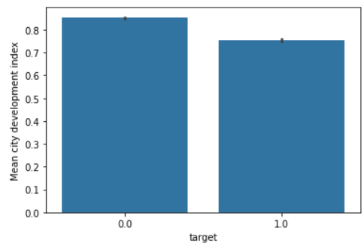
City development index vs attrition
0: candidate stays
1: candidate leaves
It can be seen that candidates from more developed cities tend to stay

Slide 8
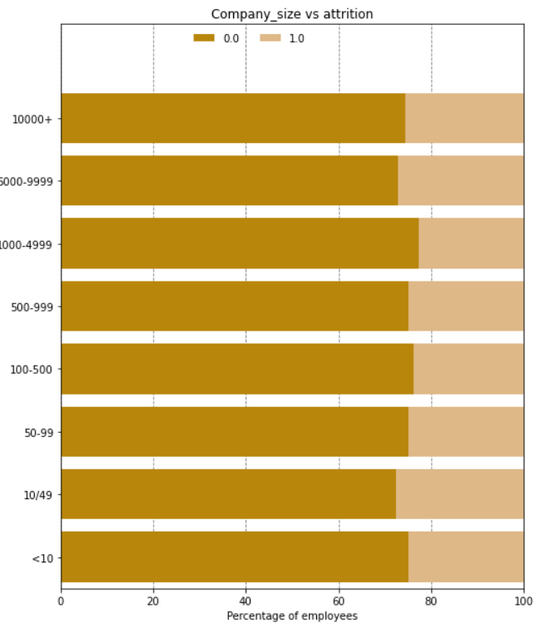
Company Size vs Attrition
It can be seen that mid size companies have higher attrition rates than smaller and larger companies
0: candidate stays
1: candidate leaves

Slide 9
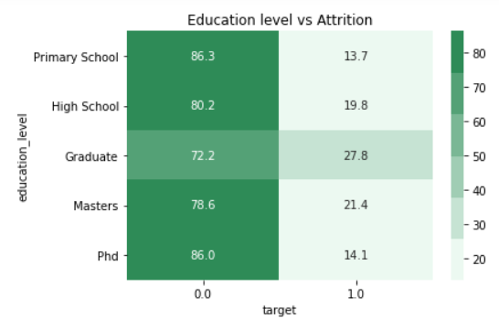
Education level vs Attrition
0: candidate stays
1: candidate leaves
It appears that people have having bachelor's or master's degrees have highest chance of leaving the company

Slide 10
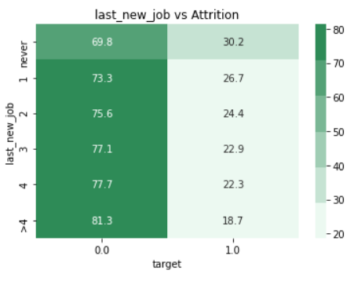
Years since last job vs attrition
0: candidate stays
1: candidate leaves
It can been that attrition rate is highest among freshers. This can be because of freshers being unsure of their career path and aspirations

Slide 11
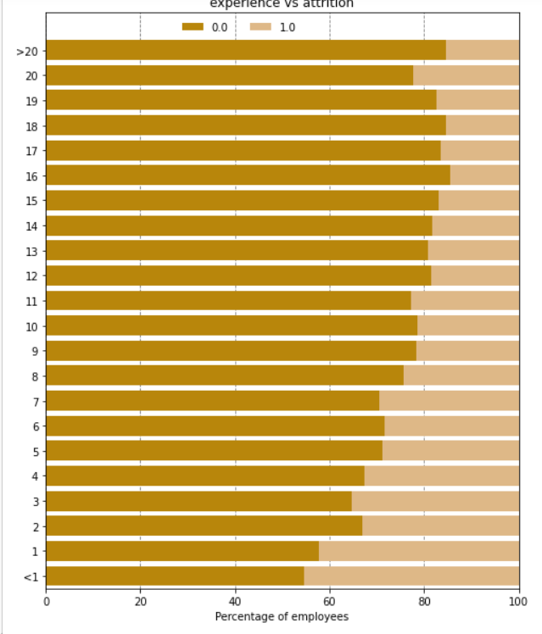
Years of experience vs Attrition
As can be seen, people with low experience tend to leave more.
0: candidate stays
1: candidate leaves

Slide 12
Results and conclusion

Slide 13
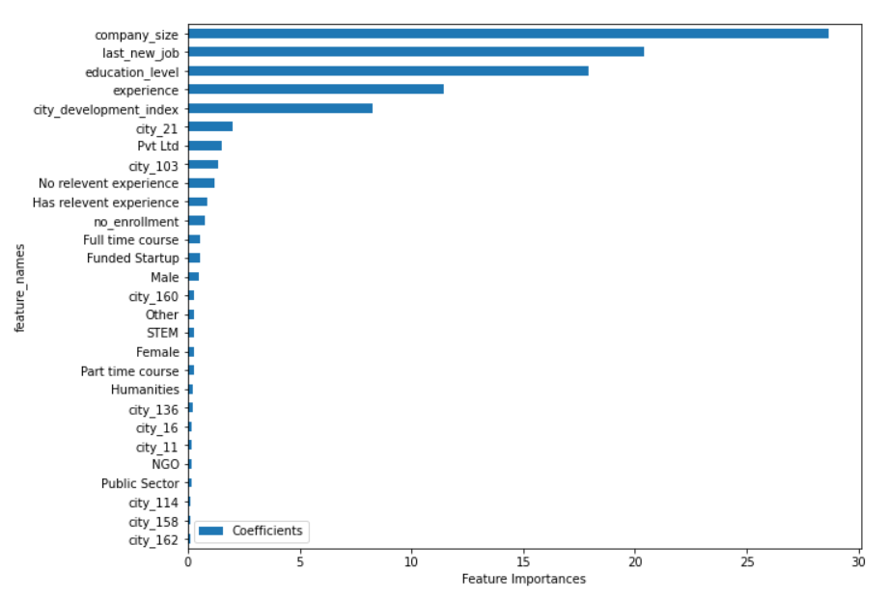
Top five factors for employee retention

Slide 14
Therefore top 5 factors pertaining to employee retainment are
company size people from midsize companies tend to leave more than really small or really big companies
years since last new job Freshers have the highest attrition rate. People who settle into the job tend to stay
education level Here again, there's a trend of mid level people leaving. People with bachelor's or masters degrees have highest attrition rates
experience People with low experience/freshers tend to leave more
City development index People from more developed cities tend to leave less

