Slide 1






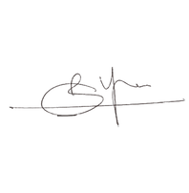
CERTIFICATE
OF PARTICIPATION
is presented to
NAME OF PARTICIPANTS
For participating in UNO organized by Team LEVEL UP SOCIETY on
November 18th, 2023
CONVENOR

