Slide 1

Coforge ltd.
General insurance portal
Submitted by: Satyam Kumar ,
Ritesh Dhaniya ,
Shreyansh Gupta
Batch: Java Full Stack Development(Batch-2)
Date: 21-12-2024

Slide 2
Contribution in the Project
Team Member | Work Done
Satyam Kumar | Buy Insurance(front-end) ,Estimate Insurance, claim Insurance(front end)
Ritesh Dhaniya | Buy insurance(backend), Renew Insurance, Register
Shreyansh Gupta | Claim Insurance (backend), Login page ,Documentation(PPT)

Slide 3
Introduction
The General Insurance System is a comprehensive platform designed to streamline and automate the processes involved in managing general insurance policies. This project leverages the power of a Spring Boot backend and an Angular frontend to provide a robust, user-friendly, and secure solution for both customers and administrators.
The primary objective of this project is to enhance the efficiency and effectiveness of insurance operations, providing a seamless experience for users to buy, renew, claim, and estimate insurance policies.

Slide 4
Functional Overview
Registration
Login
Buy Insurance
Renew Insurance
Claim Insurance
Estimate Insurance

Slide 5
Technology Overview
Front-end :
Angular (VS Code)
Backend :
Spring Boot, Java (Spring Tool Suite)
DataBase :
MySQL
Postman :
For API testing

Slide 6
Data Flow
Angular Frontend Spring Boot Backend MySQL Database
(1) User register/login
(2) Authenticates user validates Credentials Generates token/Cookie
| | |
| | |
| | |
| | |
| | |
| | |
| | |
| | |
| | |
| | |
| | |
| | |
| | |
(3) Token/Cookies Stored
(5) Verifies Token/Cookies
(4) Request to buy/renew/claim/estimate
(6) Process Request
-buy insurance
-renew insurance
-claim insurance
-estimate insurance
(7) Receives response
(8) Retrieves/Updates Data
(9) Updates Records
(10) Receives Status
(11) Retrieves Status
User Actions
Buisness Logic
(Spring Boot)
Data Storage
(MYSQL)

Slide 7
Functional Diagram
+---------------------------------------------------------------+
| User Interface (UI)(Angular Frontend) |
+---------------------------------------------------------------+
| (1) User Actions (Login, Register, Buy, Renew, Claim, Estimate)
+-----------v--------------------------------------------------+
| Authentication & Authorization |
+---------------------------------------------------------------+
| (2) Validate Credentials / Token
+-----------v--------------------------------------------------+
| Insurance Management (Spring Boot) |
+---------------------------------------------------------------+
| (3) Handle Requests
+-----------v---------------------+
| Policy Services |
+----^---------------------------+
| | (4) Create/Renew Policies, Estimate, Claims
+----v-------v-------------------+
| Claim Services |
+----^---------------------------+
| |
+----v-------v--------------+ +---------------------------------------------+
| User Services | |Database Layer (MySQL) |
+----------------------------+ +--------------------------------------------+

Slide 8

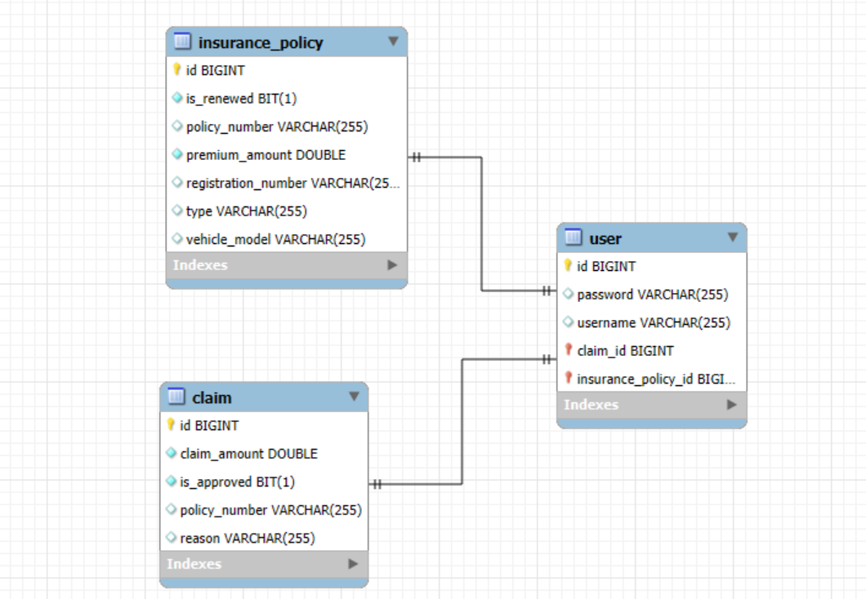



ER Diagram

Slide 9

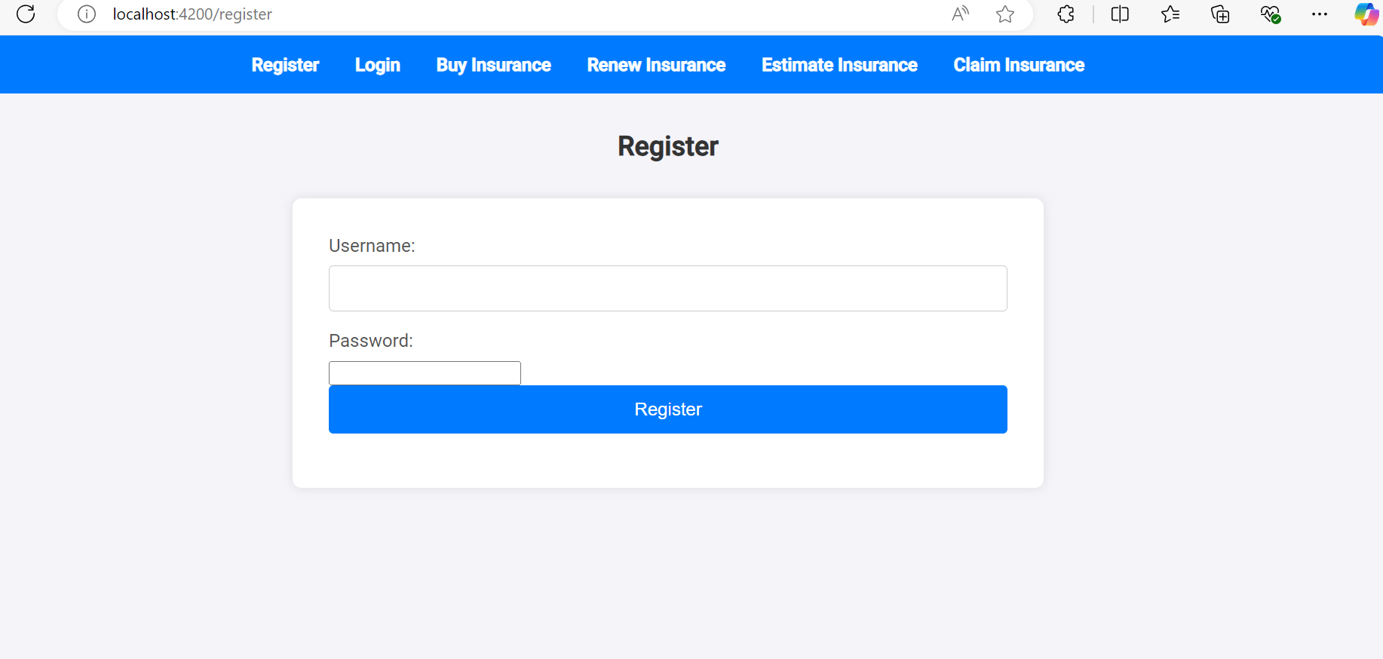
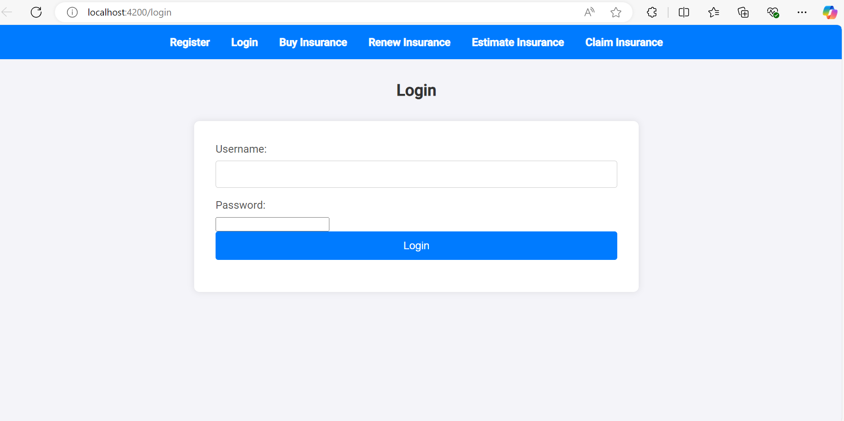
ScreenShots

Slide 10
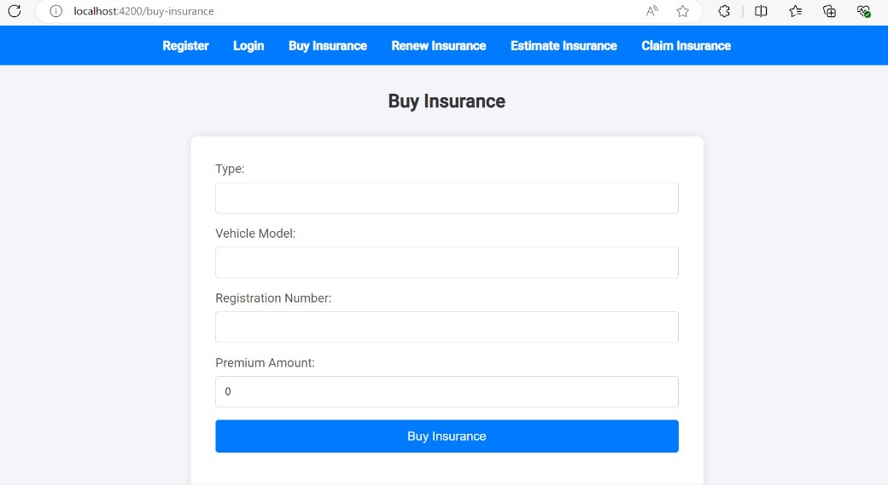

Slide 11
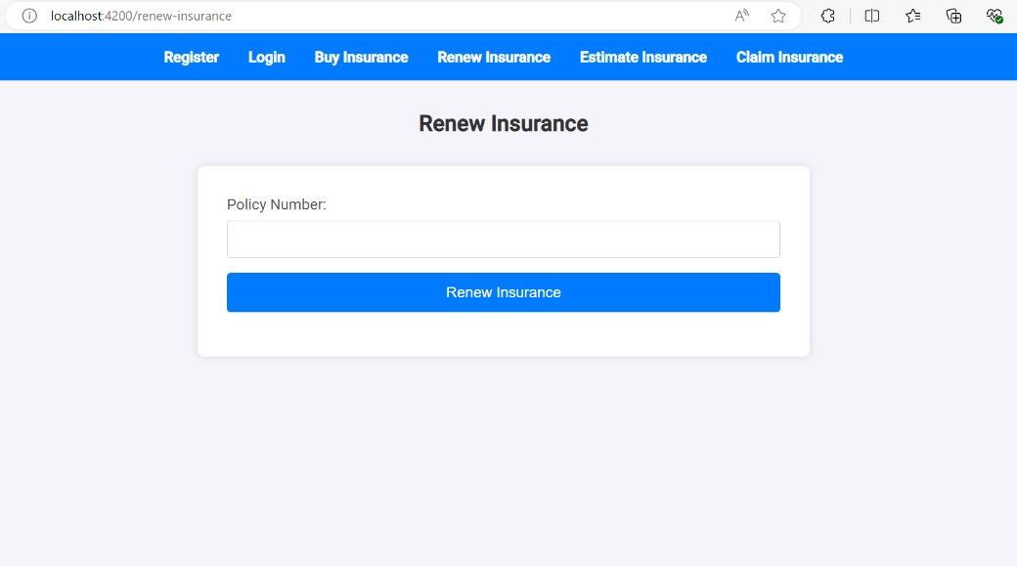

Slide 12
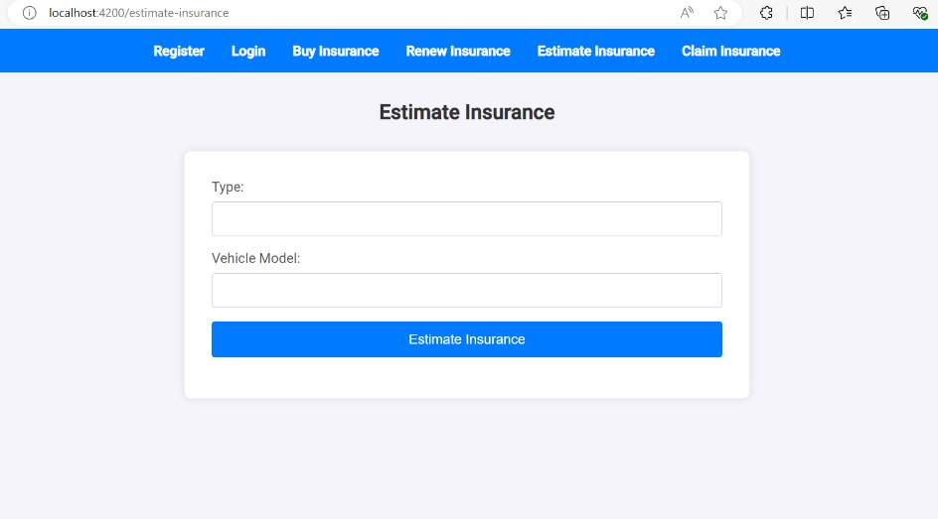

Slide 13
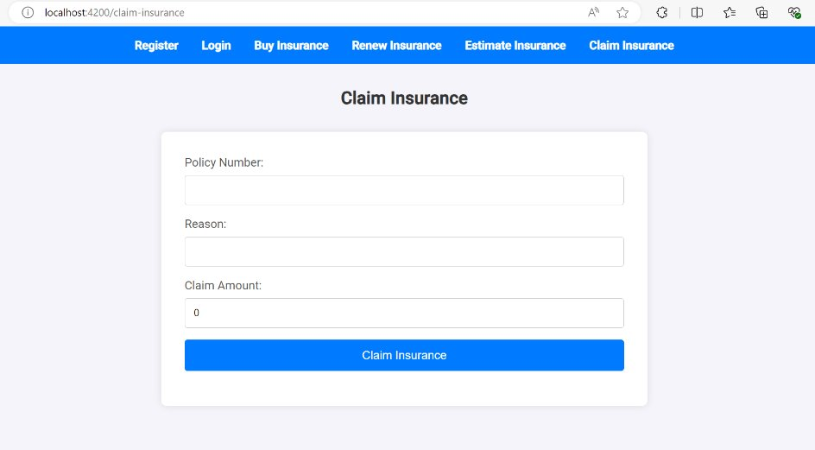

Slide 14
Conclusion
The General Insurance Management System is a powerful tool designed to make managing insurance policies easier and more efficient. By combining a Spring Boot backend with an Angular frontend, this system provides a smooth and secure experience for users.
Key Points:
User-Friendly: The Angular frontend makes it easy for users to navigate and manage their insurance needs.
Efficient Backend: The Spring Boot backend handles all the important processes and ensures data is processed quickly and securely.
Secure Data: Using Spring Security and MySQL, the system ensures that all user data and insurance details are kept safe

