Slide 1
DIY POPUPS
An online Advertising platform to post and view ads, where an Advertiser can post Ads and a viewer can view the ads posted by all the advertisers. There are two types of user- Business User/Advertiser & Normal User. The Advertiser can create/post Ads and can recharge credits if needed. Normal User can view all Ads posted by all advertisers. On clicking ads, normal user can earn credits which can be redeemed. The Technologies Used.

Slide 2
USER REGISTRATION
(SIGN UP SERVICE)
NO /CREDENITIALS
LOG IN
MY DASH BOARD
YES /CREDENITIALS
(DB SERVICE)
LOGOUT
(SIGN UP SERVICE)
(REDIRECTED TO LOGIN)
AUTO-CREDIT
60 BONUS CREDITS
ADVERTISEMENT
RECHARGE
(CREATE, EDIT,DELETE)
(Recharge credits)
BUSINESS USER/ ADVERTISER

Slide 3
USER REGISTRATION
(SIGN UP SERVICE)
NO /CREDENITIALS
LOG IN
MY DASH BOARD
YES /CREDENITIALS
(DB SERVICE)
LOGOUT
(SIGN UP SERVICE)
(REDIRECTED TO LOGIN)
AUTO-CREDIT
ADVERTISEMENT
REDEEM CREDITS
VIEW WALLET
50 BONUS CREDITS
(VIEW-ALL,EARN CREDITS)
REDEEM
(REDEEMED AMOUNT IN RS.)
FILTER ADS
SEARCH ADS BY CATEGORY
NORMAL USER

Slide 4
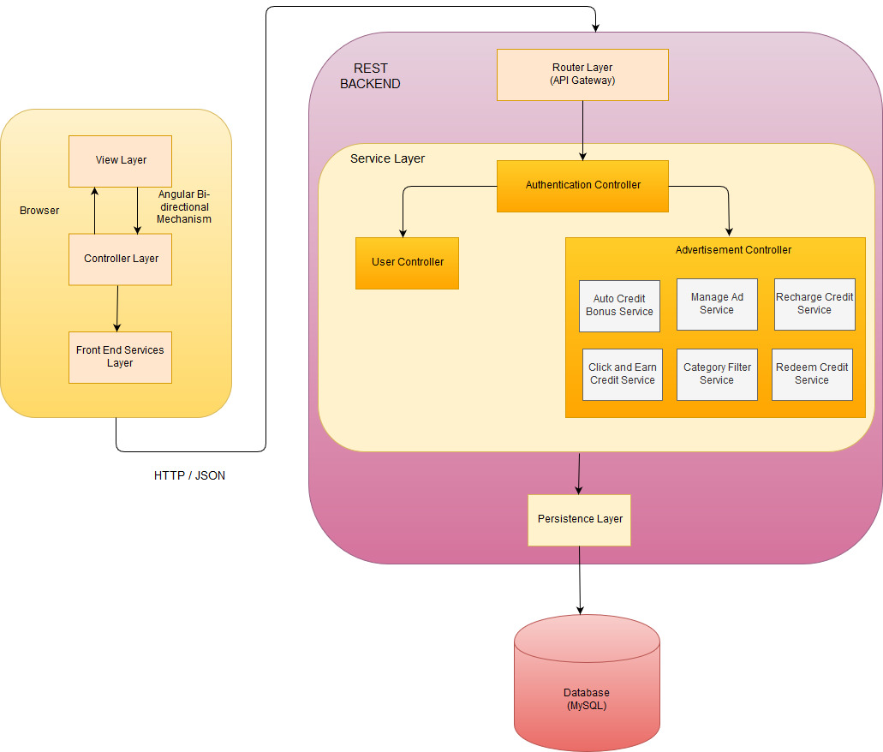
Technical Architecture

