Slide 1
Overfitting in Neural Nets: Backpropagation, Conjugate Gradient, and Early Stopping
Name:- Satyam kumar
Roll No. :- B19BB060
Machine Learning:- Project

Slide 2
Introduction
It is commonly believed that large multi-layer perceptrons (MLPs) generalize poorly: nets with too much capacity overfit the training data. Restricting net capacity prevents overfitting because the net has insufficient capacity to learn models that are too complex.
Once Applying large nets on real problems, it is observed that the overfitting they expected from nets with excess capacity did not occur.
After this, results showing that MLPs with excess capacity often do not overfit. On the contrary, we observe that large nets often generalize better than small nets of sufficient capacity.
Backprop appears to use excess capacity to better fit regions of high non-linearity, while still fitting regions of low non-linearity smoothly.
If early stopping is used, training of the large net can be halted when the large net's model is similar to models learned by smaller nets.

Slide 3
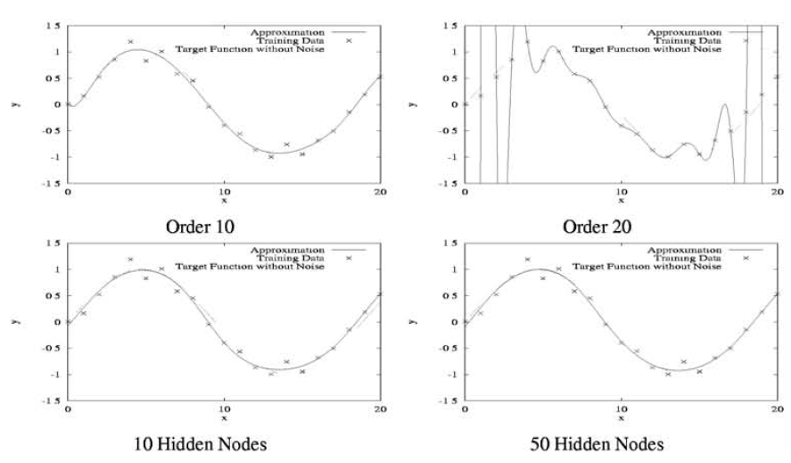
Overfitting
This Figure illustrates polynomial overfitting. We created a training dataset by evaluating y = sin(x/3)+v at 0,1,…..,20 where v is a uniformly distributed random variable between -0.25 and 0.25.
We fit polynomial models with orders 2-20 to the data. Underfitting occurs with order 2. The fit is good with order 10. As the order (and number of parameters) increases, however, significant overfitting (poor generalization) occurs.
At the order 20, the polynomial fits the training data well, but interpolates poorly.

Slide 4
This figure shows MLPs fit to the data. We used a single hidden layer MLP, backpropagation (BP), and 100,000 stochastic updates. The learning rate was reduced linearly to zero from an initial rate of 0.5.
Unlike polynomials, however, networks with 10 HU (31 weights) and 50 HU (151 weights) also yield good models. MLPs with seven times as many parameters as data points trained with BP do not significantly overfit this data.
The experiments confirm that this bias of BP-trained MLPs towards smooth models is not limited to the simple 2-D problem used here.

Slide 5
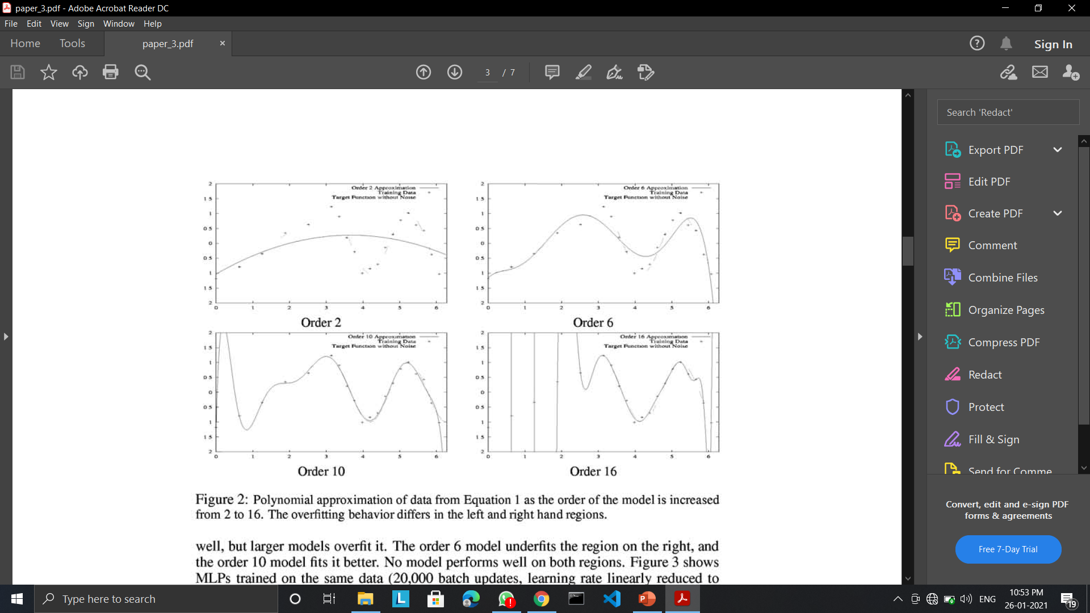
Local Overfitting
Overfitting varies significantly in different regions of the model. As we see in the figure, order 6 model fits the left region well, but larger model overfit it.
The order 6 model underfits the region on the right, and the order 10 model fits it better.
The degree of overfitting varies in different regions. When the net is large enough to fit the region of high non-linearity, overfitting is often seen in the region of low non-linearity.
Till now we see that BP nets are less prone to overfitting than expected. But MLPs can do overfit.

Slide 6
Generalization, Network Capacity, and Early stopping
Now in this section, we want to examine Overfitting vs Net Size on seven problems:- NETtalk, 7 and 12 bit parity, an inverse kinematic model for a robot arm, Base 1 and Base 2: two sonar modelling problems, and vision data used to learn to steer an autonomous car.
For each problem we used small training sets (100-1000 points, depending on the problem) so that overfitting was possible. We trained fully connected feedforward MLPs with one hidden layer whose size varied from 2 to 800 HU (about 500-100,000 parameters). All the nets were trained with BP using stochastic updates, learning rate 0.1, and momentum 0.9.
We used early stopping for regularization because it doesn't interfere with backprop's ability to control capacity locally. Early stopping combined with backprop is so effective that very large nets can be trained without significant overfitting.

Slide 7
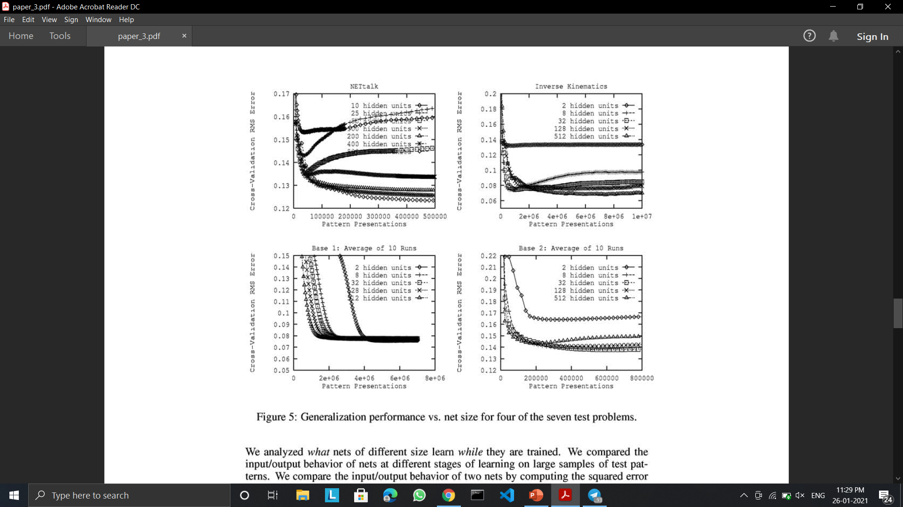
Result
Figure 5 shows generalization curves for four of the seven problems discuss in previous slide.
Examining the results for all seven problems, we observe that on only three (Base 1, Base 2, and ALVINN), do nets that are too large yield worse generalization than smaller networks, but the loss is surprisingly small. Many trials were required before statistical tests confirmed that the differences between the optimal size net and the largest net were significant.
Moreover, the results suggest that generalization is hurt more by using a net that is a little too small than by using one that is far too large, i.e., it is better to make nets too large than too small.
Regularization (e.g., early stopping) is critical for nets of all sizes - not just ones that are too big.

Slide 8
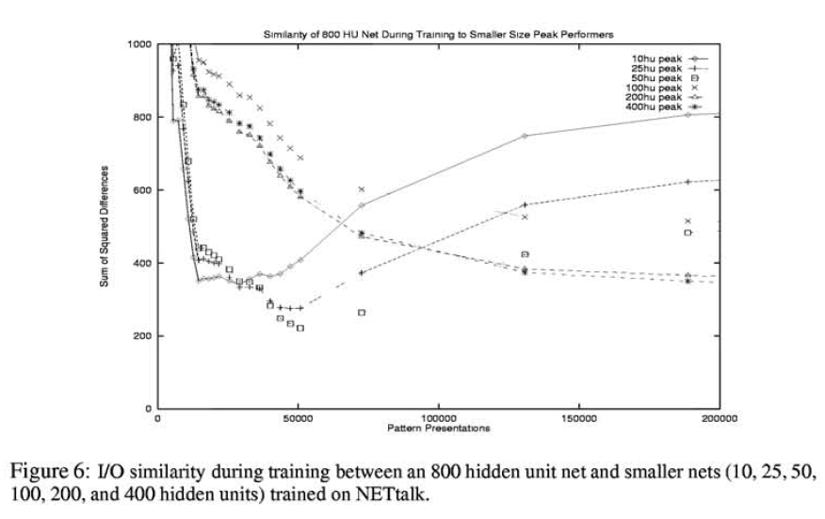
We trained a BP net with 800 HU, and after each epoch compared this net's model with the best models saved for nets of 10-400 HU. This lets us compare the sequence of models learned by the 800 HU net to the best models learned by smaller nets.
Figure 6 shows this comparison. The horizontal axis is the number of backprop passes applied to the 800 HU net. The vertical axis is the error between the 800 HU net model and the best model for each smaller net. The 800 HU net starts off distant from the good smaller models, then becomes similar to the good models, and then diverges from them.
But the interesting is that the 800 HU net first becomes closest to the best 10 HU net, then closest to the 25 HU net, then closest to the 50 HU net, etc.
If early stopping is used, training of the 800 HU net can be stopped when it behaves similar to the best model that could be learned with nets of 10, 25, 50, . .. HU.

Slide 9
Summary
Nets of all sizes overfit some problems. BP nets with excess capacity learn a sequence of models functionally similar to what smaller nets learn, Early stopping can often be used to stop training large nets when they have learned models similar to those learned by smaller nets of optimal size.
Overfitting can vary significantly in different regions of the model. MLPs trained with BP use excess parameters to improve fit in regions of high non-linearity, while not significantly overfitting other regions.
Nets trained with conjugate gradient, however, are more sensitive to net size. BP nets appear to be better than CG nets at avoiding overfitting in regions with different degrees of non-linearity, perhaps because CG is more effective at learning more complex functions that overfit training data, while BP is biased toward learning smoother functions.

Slide 10
Thank you

