Slide 1

Convolve
Data Science Hackathon
Team: Data Dashers
Cisco Inventory Management and Demand Prediction

Slide 2
UNDERSTANDING THE PROBLEM STATEMENT
Cisco Inventory Management and Demand Prediction
Companies need to be able to predict demand for each product and plan inventory levels for the next quarter to avoid delays in order fulfillment.
In addition, it is necessary to determine which products should be stored in which storage facilities for efficient use of the products.

Slide 3
Approach
We explored each and every Product ID, Business Unit and Product family.
Trained several time series ML models like SARIMAX, Prophet etc, and made an ensemble using XGBoost Regressor Model.
We developed a website where the user can use individual Product ID and month for forecasting predictions up to next year.

Slide 4
Work Flow
Exploratory Data Analysis
Looking for insights across the data through visualizations and analyzing time series elements of the data
Pre- processing & Feature engineering
Model selection and Pipeline
Ensemble & Final prediction
Evaluation
And Results
Scaling features to a standard range to ensure uniformity and generating different features from given data.
  Selecting various time-series and machine learning models and generating their predictions.
  Applying ensemble to predictions of different models and compiling final results
  Selection of appropriate evaluation metric and analyzing results

Slide 5
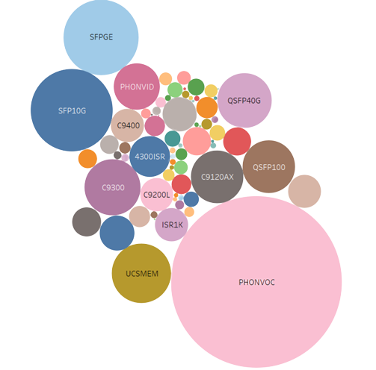
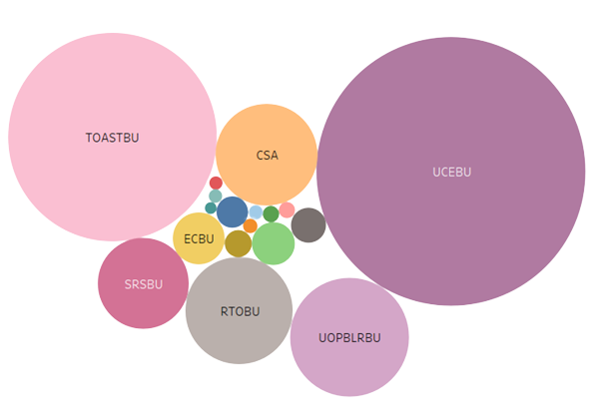
Exploratory Data Analysis
Distribution of business unit and product family by their quantity.

Slide 6
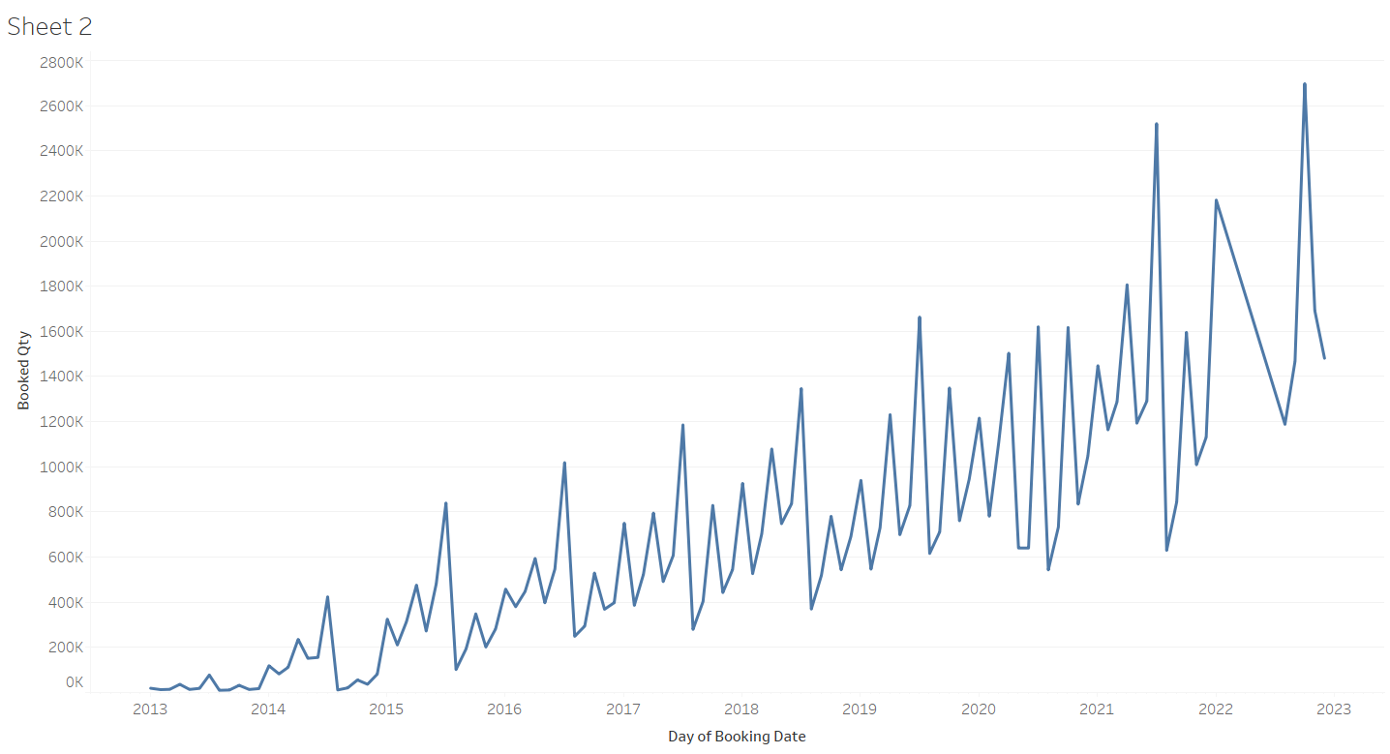
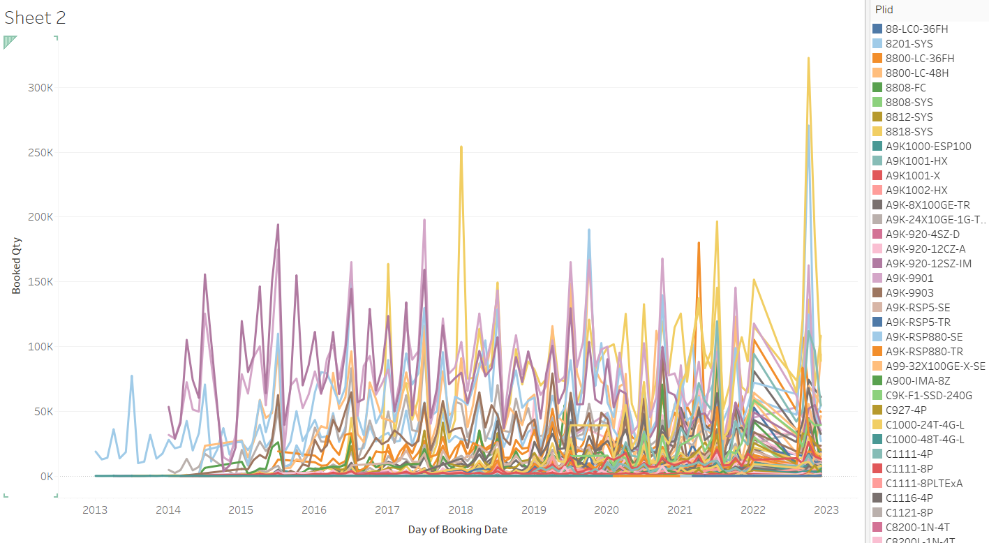
Total quantities of different products v/s Date
Total booked quantities of all products v/s Date

Slide 7
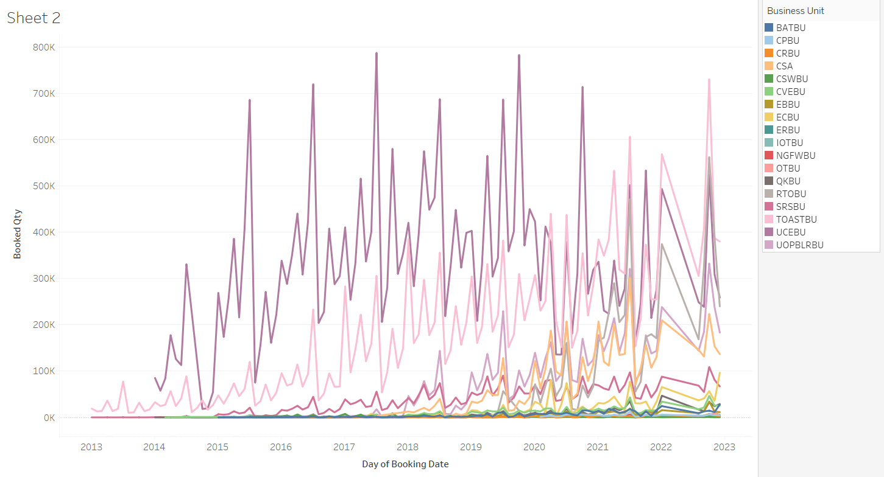
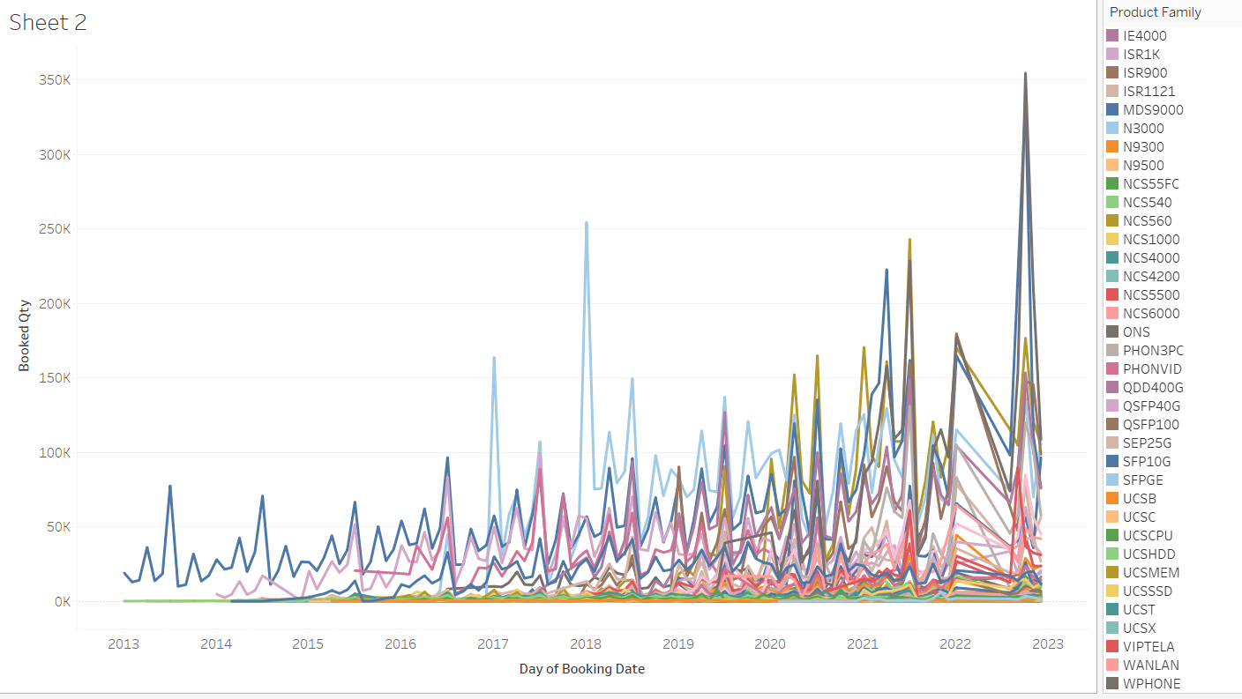
Total booked quantities of different product families v/s Date
Total booked quantities of different business units v/s Date

Slide 8

Pre- processing & Feature engineering
FEATURE SCALING
Feature Scaling is a method to transform the numeric features in a dataset to a uniform, standard range so that the performance of the machine learning algorithm improves.
Why?
Rescale the features to reduce the computation time
Prevent optimization from getting stuck in local optima.
Min-Max Scaler
a
It subtracts the minimum value in a feature
from each value in the feature and then divides
by the range.

Slide 9
SARIMAX is an updated version of the ARIMA model which includes seasonal effects and exogenous factors for time series modelling
It uses differencing at a lag equal to the number of seasons (s) to remove additive seasonal effects
Model Selection and Pipeline
Holt Winter
SARIMAX
The Holt-Winters method uses exponential smoothing to encode lots of values from the past and use them to predict “typical” values for the present and future
Why?
It accounts for a linear trend
It allows us to include seasonality while making the prediction along with the trend
Why?
Better for capturing Seasonality

Slide 10
Prophet is a procedure for forecasting time series data based on an additive model where non-linear trends are fit with seasonal effects.
Model Selection and Pipeline
Facebook
PROPHET
Exponential Smoothing
Exponential smoothing is a time series forecasting method for univariate data which develops a model where the prediction is a weighted linear sum of recent past observations or lags.
Why?
It is robust to missing data and shifts in the trend, and typically handles outliers well.
Why?
Good for short term forecasts

Slide 11
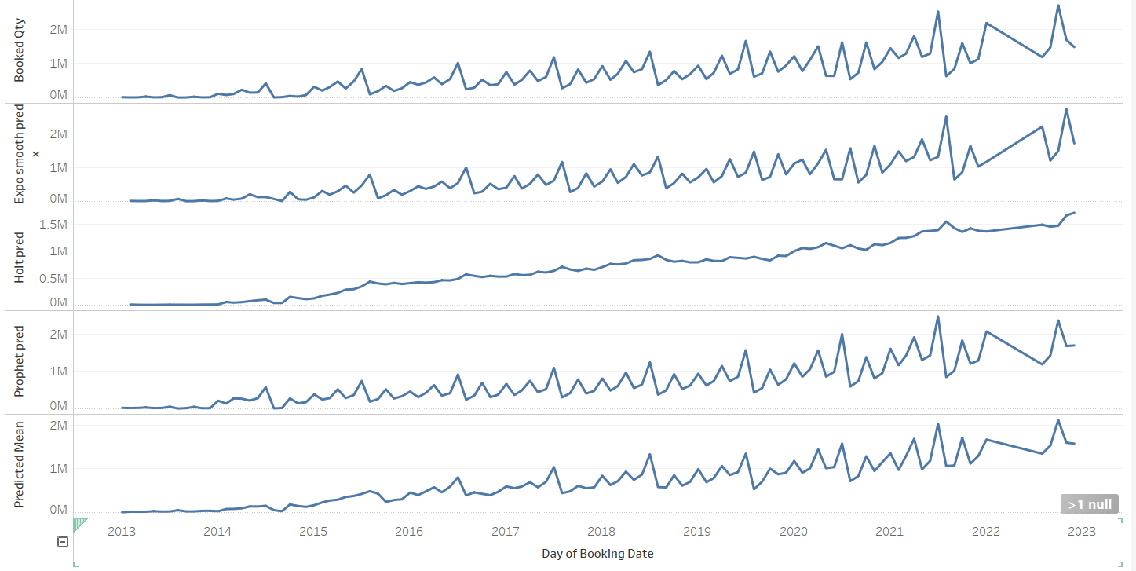
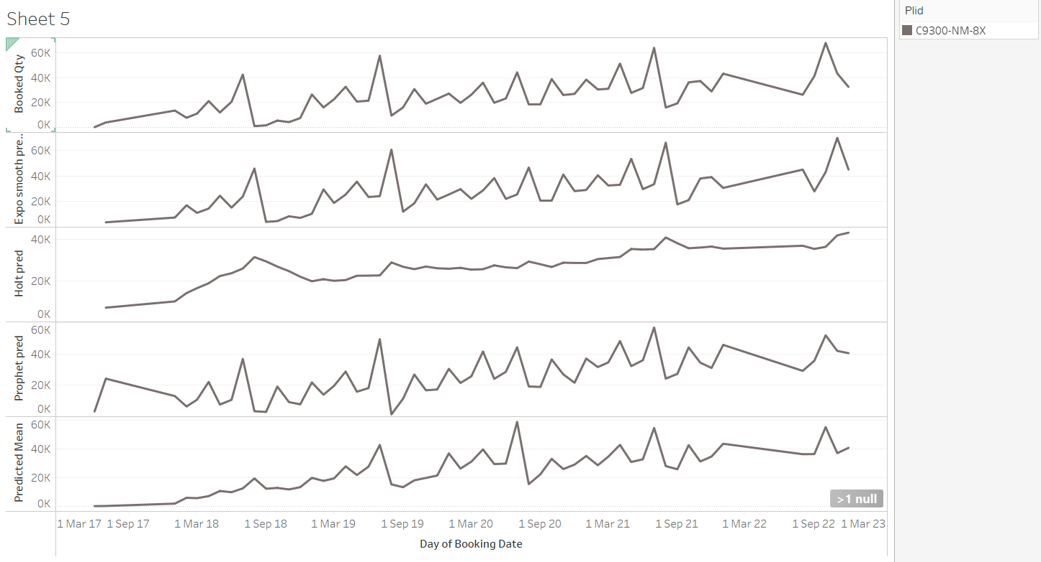
Trends of a particular Product booking prediction with Time for above 4 models and actual product booking
Trends of Total Product booking prediction with Time for above 4 models and actual total product booking

Slide 12
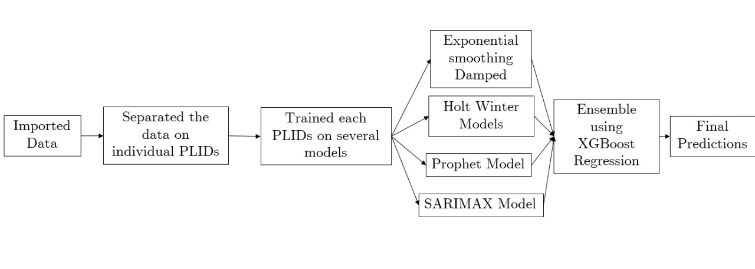
XGBoost is an efficient implementation of gradient boosting that can be used for regression predictive modeling.
Ensemble & Final prediction
Strategy:
We used it to ensemble the predictions made by the time series models using stacking.
XG-Boost
Regressor

Slide 13
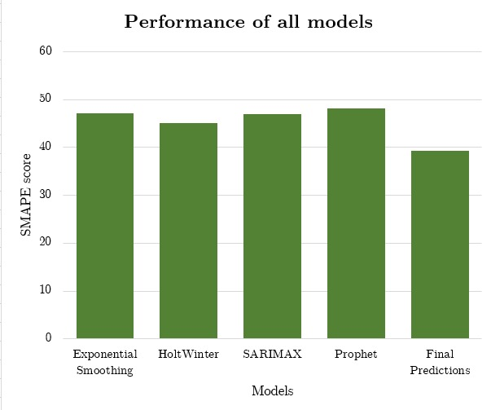

Evaluation
&
Results
Metric Used: SMAPE
Symmetric mean absolute percentage error (SMAPE) is an accuracy measure based on percentage (or relative) errors.
In our predictions, we see data with lot of variation and when we look at RMSE or MAE metric, the values may not seem sensible.
In such cases, we can go with MAPE or SMAPE but MAPE takes erratic values when there are zero values in our results.
As we can see from the graph the ensemble model has lowest SMAPE of 39.26 %.
Hence, we used this to make our final predictions

Slide 14
Thank You!
Satyam Kumar
Jagteshver Singh Sahni
Susanket Sarkar
Vaibhav Mohite
Notes:
©

