Slide 1
CLOUD9
Next Up
(Containered Cloud Optimization with Deep Learning)

Slide 2

GEETHANJALI COLLEGE OF ENGINEERING AND TECHNOLOGY
CH.SRICHARAN(21R11A05B7)
SADHANAND GOUD(21R11A05E2)
SATYAM DAS(21R11A05E5)
Under the Guidance of:
M.PRASANTH
(Assistant Professor)

Slide 3
Table of contents
01.
02.
03.
04.
05.
06.
Motivation
Literature review
Introduction
Problem Statement
Objectives
References

Slide 4
01.
Motivation

Slide 5
MOTIVATION
Initially wanted to work on cloud based environments.Took up
a project involving data lake which got rejected.Then sought
help from mentor and eventually took up a proposal.

Slide 6
02.
Introduction

Slide 7
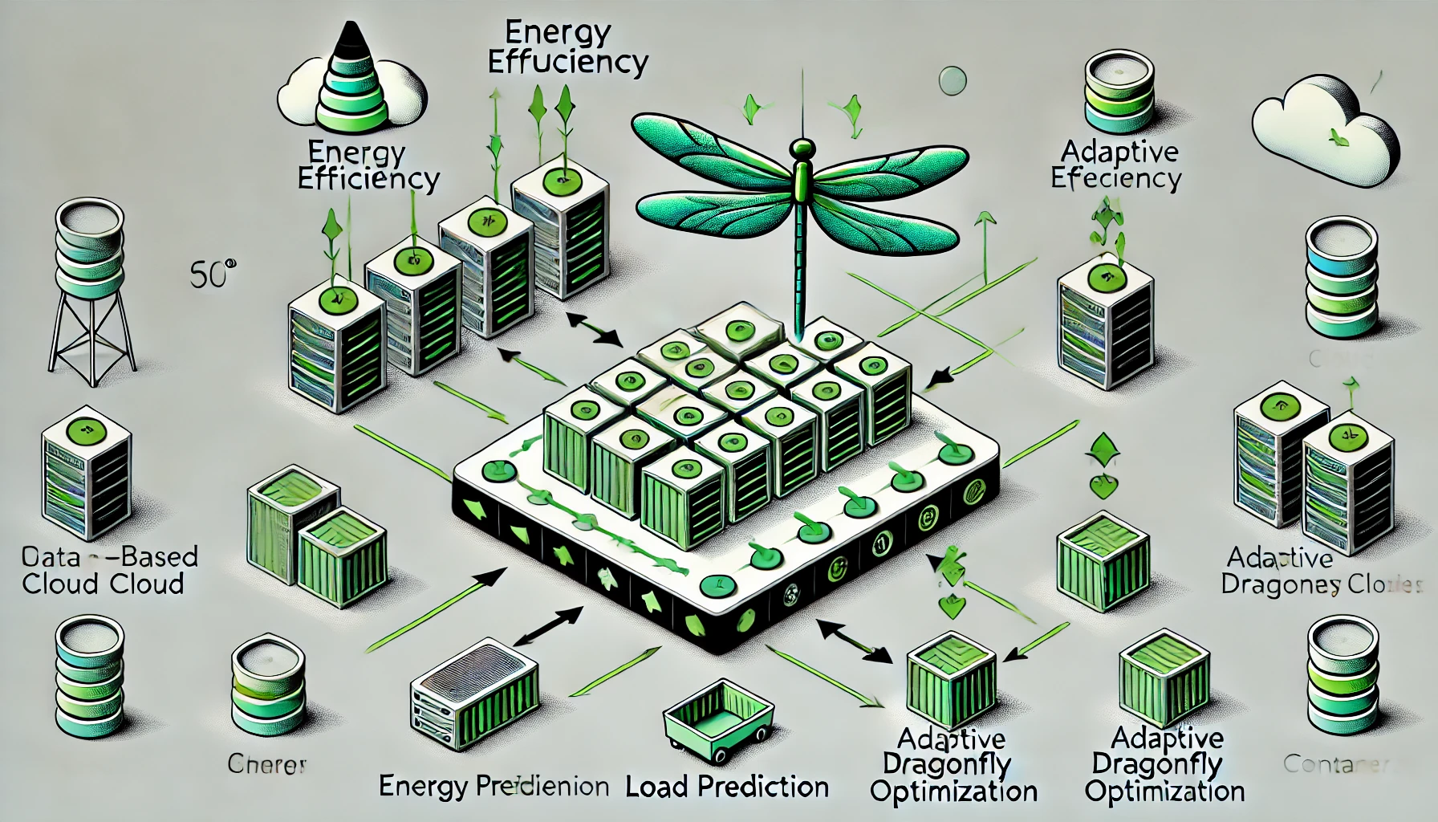
Introduction
Container-based heterogeneous cloud environments face interoperability challenges. The proposed solution leverages Adaptive Dragonfly Optimization (ADrO) for efficient data migration, addressing local optima trapping through Levy flight strategy integration. User tasks are containerized for optimal resource allocation. Load prediction utilizes Actor-Critic Neural Networks (ACNN) to inform migration decisions. A multi-objective function evaluates migration based on parameters like transmission cost, demand, capacity, agility, reputation, time, and energy consumption. Python-based implementation demonstrates enhanced performance in heterogeneous cloud environments.

Slide 8
03.
Literature Review

Slide 9
S.No | Author | Paper | Parameters | Observations
1 | Mohammad Al Shinwan,Lalith Abualigah,Mohammad Shehab | Dragonfly algorithm: a comprehensive survey of its results, variants, and applications
2 | Tej.C. Hiremath, K.S. Rekha | Energy Efficient Data Migration Concerning Interoperability Using Optimized Deep Learning in Container-Based Heterogeneous Cloud Computing

Slide 10
S.No | Author | Paper | Parameters | Observations
3 | Chnoor M Rahman, Tarik A Rashid | Dragonfly Algorithm and Its Applications in Applied Science Survey
4 | Tej.C. Hiremath, K.S. Rekha | Energy Efficient Data Migration Concerning Interoperability Using Optimized Deep Learning in Container-Based Heterogeneous Cloud Computing

Slide 11
04.
Problem Statement

Slide 12
05.
Objectives

Slide 13





Objectives
Efficient Migration
Load Balancing
Avoidance of Local Optima
MOPE
Minimized Downtime
Time and Energy consumption
Prevents Server overloads
Avoids local optima traps and improves E-E balance
Multi-Objective Performance Evaluation
Reduces server interruption

Slide 14
06.
References

Slide 15
References

Slide 16


In conclusion the proposed solution enables for:
Adaptive Dragonfly Optimization (ADrO) for efficient data migration.
Levy flight strategy to avoid local optima.
Containerization for optimal resource allocation.
Actor-Critic Neural Network (ACNN) for accurate load prediction.
Multi-objective evaluation considering cost, demand, capacity, and energy.

Slide 17
THANK YOU!
Optimization loading…….

