Slide 1

LZW-Driven Medical Image Compression
Compressing images, not quality.

Slide 2
TABLE OF CONTENTS
01
MOTIVATION
02
ALL ABOUT EXISTING SYSTEM
03
PROPOSED SYSTEM AND IMPLEMENTATION
04
FUTURE ENHANCEMENTS AND CONCLUSION

Slide 3
MOTIVATION

Slide 4
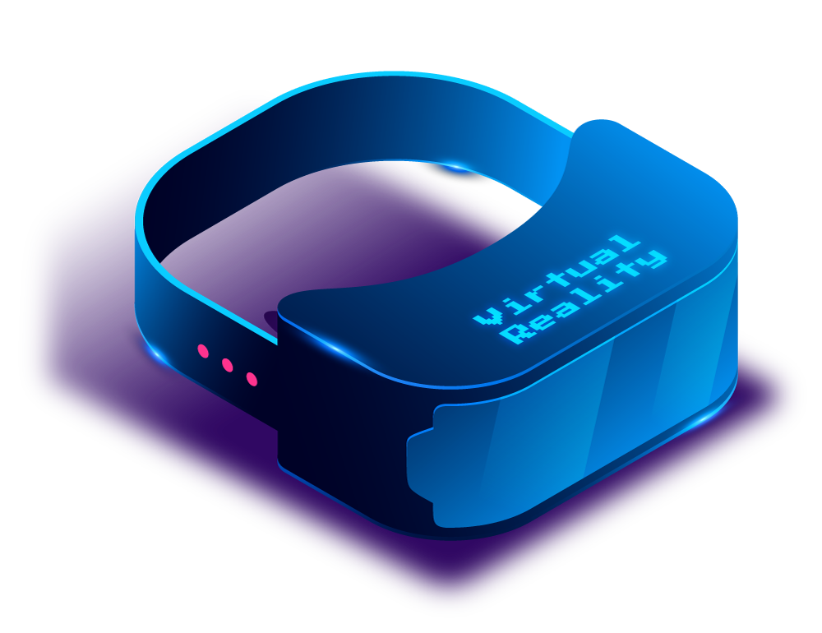
EXISTING SYSTEM
1. JPEG (Joint Photographic Experts Group): A common compression method that reduces image quality to reduce file size.
2. DICOM (Digital Imaging and Communications in Medicine): A standard format for medical images that allows for some compression, but can still result in large file sizes.
3. Lossy Compression: Reduces image quality to reduce file size, which can affect diagnosis accuracy.

Slide 5
LIABILITIES OF EXISTING SYSTEM
LOSSY
COMPLEX TO USE
INEFFICIENT

Slide 6
COMPARISON
EXISTING SYSTEM
PROPOSED SYSTEM
1.Reduced Image Quality.
2.Large File Sizes.
3.Low Compression ratios.
4.Inefficient Storage.
5.Less Secured.
1.Preserved Image Quality.
2.Smaller File Sizes.
3.High Compression ratios.
4.Efficient Storage.
5.More Secured.

Slide 7
IMPLEMENTATION
UPLOADING IMAGE
ENCRYPTION AND DECRYPTION
APPLYING ALGORITHM
DOWNLOADING IMAGE
02
04
01
03

Slide 8
ADVANTAGES
LOSSLESS
SIMPLE IMPLEMENTATION
IMPROVED DATA SECURITY
MAINTAINS IMAGE QUALITY
FASTER DATA TRANSMISSION
EASY DECOMPRESSION

Slide 9
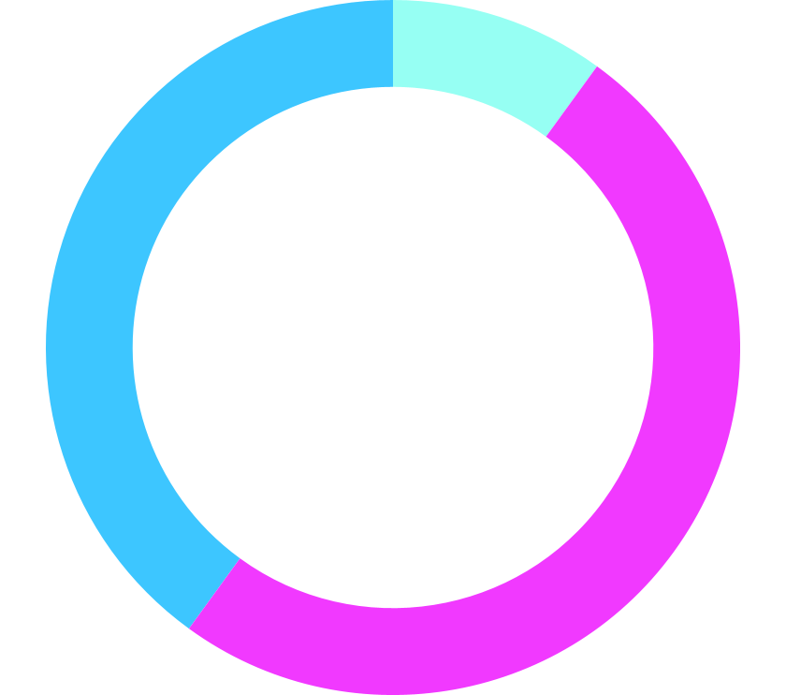
FURTHER ENHANCEMENTS
1.SUPPORT FOR MULTIPLE COMPRESSION ALGORITHMS
2.INTEGRATION WITH CLOUD STORAGE
3.TESTING WITH LARGER DATASETS

Slide 10
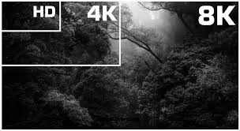
CONCLUSION
In conclusion, LZW-driven medical image compression is a valuable tool that reduces the size of medical images without losing important details. This makes storing, sharing, and managing images more efficient and convenient for healthcare professionals, ensuring that patient care is supported by high-quality imaging data while optimizing storage and transmission resources.

Slide 11

THANKS
Do you have any questions?
Please keep this slide for attribution

