Slide 1
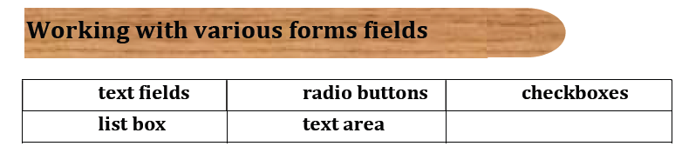

Slide 2
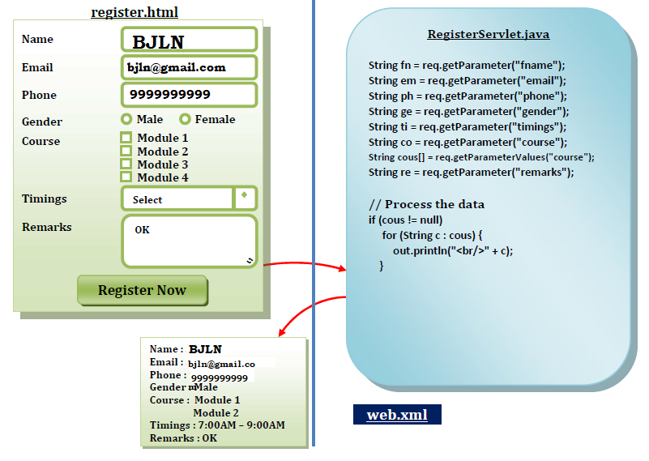

Slide 3
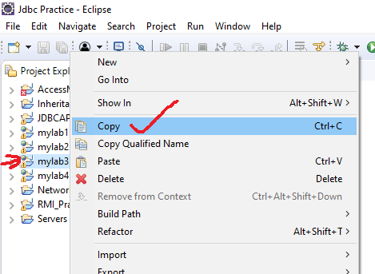

Slide 4
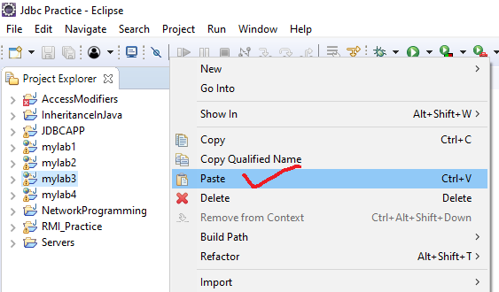

Slide 5
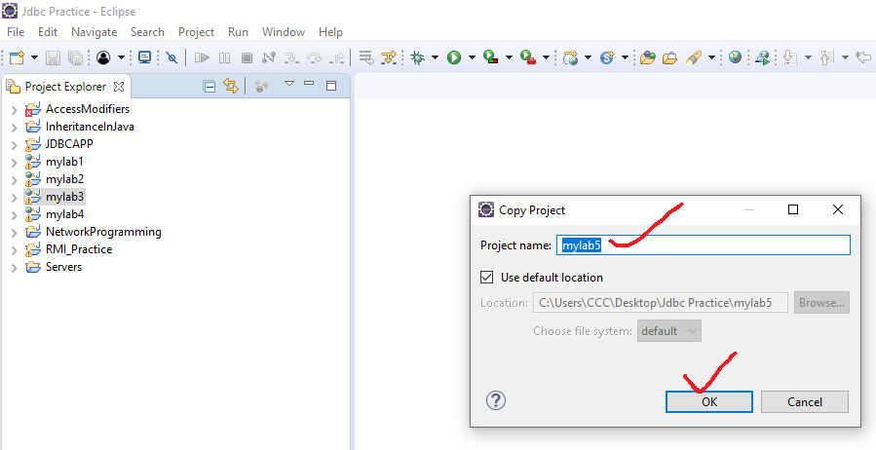

Slide 6
Change the
context root

Slide 7
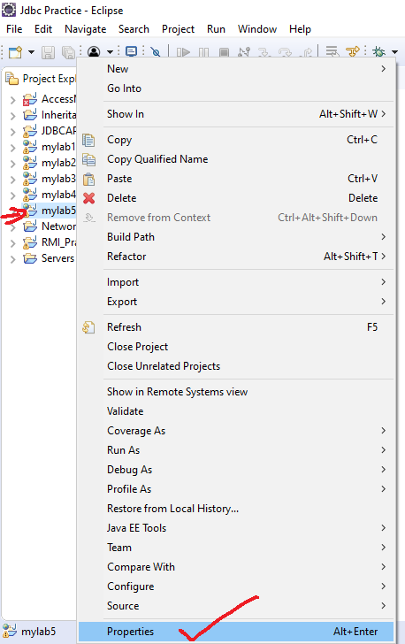

Slide 8
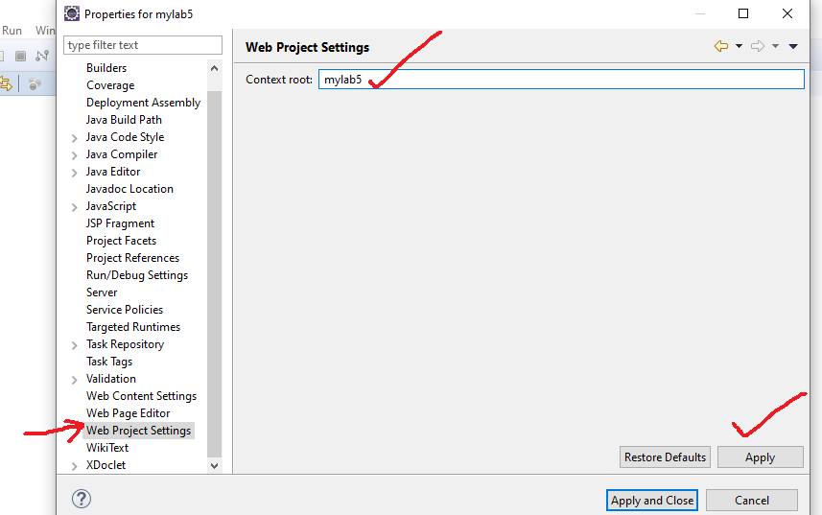

Slide 9
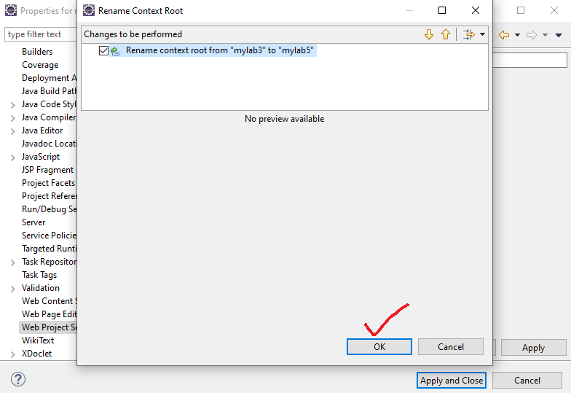

Slide 10
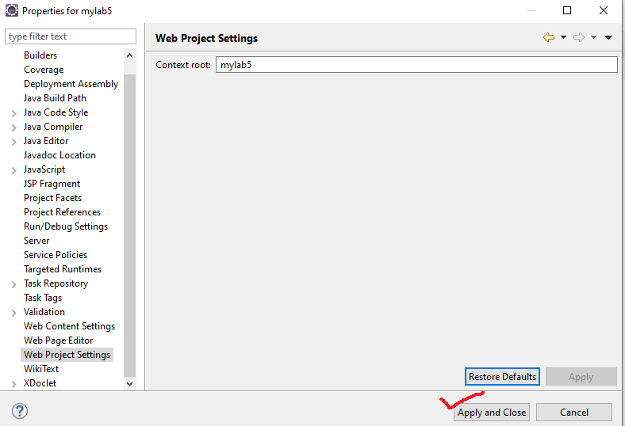

Slide 11
<!DOCTYPE html>
<html>
<head>
<title>Welcome to JAVA Web APP</title>
</head>
<body>
<h2>Welcome to Java Servlets</h2>
<h3>Registration Form(Lab5)</h3>
<form action="myregister" method="post">
<table>
<tr>
<td>Full Name</td>
<td><input type="text" name="fname" /></td>
</tr>
<tr>
<td>Email</td>
<td><input type="text" name="email" /></td>
</tr>
<tr>
<td>Phone</td>
<td><input type="text" name="phone" /></td>
</tr>
<tr>
<td>Gender</td>
<td><input type="radio" name="gender" value="Male" /> Male <br />
<input type="radio" name="gender" value="Female" /> Female</td>
</tr>
<tr>
<td>Courses</td>
<td><input type="checkbox" name="mycourses" value="Java Developer" />
Java Developer Course <br />
<input type="checkbox" name="mycourses" value="Angular" />
Angular Course <br />
<input type="checkbox" name="mycourses" value="React" />
React Course <br />
<input type="checkbox" name="mycourses" value="Spring Boot and MS" />
Spring Boot and MS Course <br />
<input type="checkbox" name="mycourses" value="DevOps" />
DevOps Course <br />
</td>
</tr>
<tr>
<td>Timings</td>
<td><select name="timings">
<option value="">--- Select ---</option>
<option value=" 4.00P.M to 6.00P.M">4.00P.M to 6.00P.M</option>
<option value="6.00P.M to 8.00P.M">6.00P.M to 8.00P.M</option>
<option value="8.00P.M to 10.00P.M">8.00P.M to 10.00P.M</option>
</select>
</td>
</tr>
<tr>
<td>Remarks</td>
<td><textarea name="remarks" rows="5" cols="25"> </textarea></td>
</tr>
<tr>
<td colspan="2" align="center"><input type="submit"
value="Register Now" /></td>
</tr>
</table>
</form>
</body>
</html>
register.html

Slide 12
package com.vrsec.servlets;
import java.io.IOException;
import java.io.PrintWriter;
import javax.servlet.ServletException;
import javax.servlet.http.HttpServlet;
import javax.servlet.http.HttpServletRequest;
import javax.servlet.http.HttpServletResponse;
public class RegisterServlet extends HttpServlet {
public void service(HttpServletRequest request, HttpServletResponse response) throws IOException, ServletException {
// 1.Collect Input Data
String fname = request.getParameter("fname");
String email = request.getParameter("email");
String phone = request.getParameter("phone");
String gender = request.getParameter("gender");
String timings = request.getParameter("timings");
String remarks = request.getParameter("remarks");
String mycourses[] = request.getParameterValues("mycourses");
// 2.Do Processing
System.out.println(fname);
System.out.println(email);
System.out.println(phone);
System.out.println(gender);
System.out.println(timings);
System.out.println(remarks);
for (String cou : mycourses) {
System.out.println(cou);
}
// 3.Send Response
response.setContentType("text/html");
PrintWriter out = response.getWriter();
out.print("<h3> Your registraion is completed successfully<h3>");
out.print("<h3> with the following info<h3>");
out.print("<table>");
out.print("<tr>");
out.print("<td> Full Name </td>");
out.print("<td> " + fname + " </td>");
out.print("</tr>");
out.print("<tr>");
out.print("<td> Email </td>");
out.print("<td> " + email + " </td>");
out.print("</tr>");
out.print("<tr>");
out.print("<td> Phone</td>");
out.print("<td> " + phone + " </td>");
out.print("</tr>");
out.print("<tr>");
out.print("<td> Gender </td>");
out.print("<td> " + gender + " </td>");
out.print("</tr>");
out.print("<tr>");
out.print("<td> Timings </td>");
out.print("<td> " + timings + " </td>");
out.print("</tr>");
out.print("<tr>");
out.print("<td> Remarks </td>");
out.print("<td> " + remarks + " </td>");
out.print("</tr>");
out.print("<tr>");
out.print("<td> Courses </td>");
out.print("<td>");
for (String cou : mycourses) {
out.print(cou + " <br/> ");
}
out.print("</td>");
out.print("</tr>");
out.print("</table>");
}
}
RegisterServlet.java

Slide 13
<?xml version="1.0" encoding="UTF-8"?>
<web-app xmlns:xsi="http://www.w3.org/2001/XMLSchema-instance"
xmlns="http://xmlns.jcp.org/xml/ns/javaee"
xsi:schemaLocation="http://xmlns.jcp.org/xml/ns/javaee http://xmlns.jcp.org/xml/ns/javaee/web-app_3_1.xsd"
id="WebApp_ID" version="3.1">
<display-name>mylab5</display-name>
<welcome-file-list>
<welcome-file>register.html</welcome-file>
</welcome-file-list>
<servlet>
<servlet-name>register</servlet-name>
<servlet-class>com.vrsec.servlets.RegisterServlet</servlet-class>
</servlet>
<servlet-mapping>
<servlet-name>register</servlet-name>
<url-pattern>/myregister</url-pattern>
</servlet-mapping>
</web-app>
web.xml

Slide 14
In , mylab6 , we used annotations , instead of web.xml

Slide 15
<!DOCTYPE html>
<html>
<head>
<title>Welcome to Java Web APP</title>
</head>
<body>
<h2>Welcome to Java Sevlets</h2>
<h3>Registration Form(Lab6)</h3>
<form action="myregister" method="post">
<table>
<tr>
<td>Full Name</td>
<td><input type="text" name="fname" /></td>
</tr>
<tr>
<td>Email</td>
<td><input type="text" name="email" /></td>
</tr>
<tr>
<td>Phone</td>
<td><input type="text" name="phone" /></td>
</tr>
<tr>
<td>Gender</td>
<td><input type="radio" name="gender" value="Male" /> Male <br />
<input type="radio" name="gender" value="Female" /> Female</td>
</tr>
<tr>
<td>Courses</td>
<td><input type="checkbox" name="mycourses" value="Java Developer" />
Java Developer Course <br />
<input type="checkbox" name="mycourses" value="Angular" />
Angular Course <br />
<input type="checkbox" name="mycourses" value="React" />
React Course <br />
<input type="checkbox" name="mycourses" value="Spring Boot and MS" />
Spring Boot and MS Course <br />
<input type="checkbox" name="mycourses" value="DevOps" />
DevOps Course <br />
</td>
</tr>
<tr>
<td>Timings</td>
<td><select name="timings">
<option value="">--- Select ---</option>
<option value=" 4.00P.M to 6.00P.M">4.00P.M to 6.00P.M</option>
<option value="6.00P.M to 8.00P.M">6.00P.M to 8.00P.M</option>
<option value="8.00P.M to 10.00P.M">8.00P.M to 10.00P.M</option>
</select>
</td>
</tr>
<tr>
<td>Remarks</td>
<td><textarea name="remarks" rows="5" cols="25"> </textarea></td>
</tr>
<tr>
<td colspan="2" align="center"><input type="submit"
value="Register Now" /></td>
</tr>
</table>
</form>
</body>
</html>
register.html

Slide 16
package com.vrsec.servlets;
import java.io.IOException;
import java.io.PrintWriter;
import javax.servlet.ServletException;
import javax.servlet.annotation.WebServlet;
import javax.servlet.http.HttpServlet;
import javax.servlet.http.HttpServletRequest;
import javax.servlet.http.HttpServletResponse;
@WebServlet(name="register",urlPatterns = "/myregister")
public class RegisterServlet extends HttpServlet {
public void service(HttpServletRequest request, HttpServletResponse response) throws IOException, ServletException {
// 1.Collect Input Data
String fname = request.getParameter("fname");
String email = request.getParameter("email");
String phone = request.getParameter("phone");
String gender = request.getParameter("gender");
String timings = request.getParameter("timings");
String remarks = request.getParameter("remarks");
String mycourses[] = request.getParameterValues("mycourses");
// 2.Do Processing
System.out.println(fname);
System.out.println(email);
System.out.println(phone);
System.out.println(gender);
System.out.println(timings);
System.out.println(remarks);
for (String cou : mycourses) {
System.out.println(cou);
}
// 3.Send Response
response.setContentType("text/html");
PrintWriter out = response.getWriter();
out.print("<h3> Your registraion is completed successfully<h3>");
out.print("<h3> with the following info<h3>");
out.print("<table>");
out.print("<tr>");
out.print("<td> Full Name </td>");
out.print("<td> " + fname + " </td>");
out.print("</tr>");
out.print("<tr>");
out.print("<td> Email </td>");
out.print("<td> " + email + " </td>");
out.print("</tr>");
out.print("<tr>");
out.print("<td> Phone</td>");
out.print("<td> " + phone + " </td>");
out.print("</tr>");
out.print("<tr>");
out.print("<td> Gender </td>");
out.print("<td> " + gender + " </td>");
out.print("</tr>");
out.print("<tr>");
out.print("<td> Timings </td>");
out.print("<td> " + timings + " </td>");
out.print("</tr>");
out.print("<tr>");
out.print("<td> Remarks </td>");
out.print("<td> " + remarks + " </td>");
out.print("</tr>");
out.print("<tr>");
out.print("<td> Courses </td>");
out.print("<td>");
for (String cou : mycourses) {
out.print(cou + " <br/> ");
}
out.print("</td>");
out.print("</tr>");
out.print("</table>");
}
}
RegisterServlet.java

Slide 17
<?xml version="1.0" encoding="UTF-8"?>
<web-app xmlns:xsi="http://www.w3.org/2001/XMLSchema-instance"
xmlns="http://xmlns.jcp.org/xml/ns/javaee"
xsi:schemaLocation="http://xmlns.jcp.org/xml/ns/javaee http://xmlns.jcp.org/xml/ns/javaee/web-app_3_1.xsd"
id="WebApp_ID" version="3.1">
<display-name>mylab5</display-name>
<welcome-file-list>
<welcome-file>register.html</welcome-file>
</welcome-file-list>
</web-app>
web.xml

Slide 18
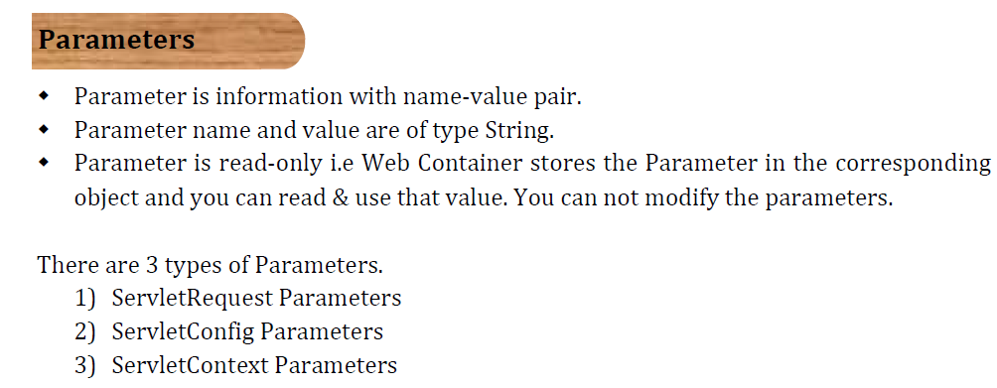
Request parameters are available in ServletRequest object.
Config parameters are available in ServletConfig object.
Context parameters are available in ServletContext object.

Slide 19
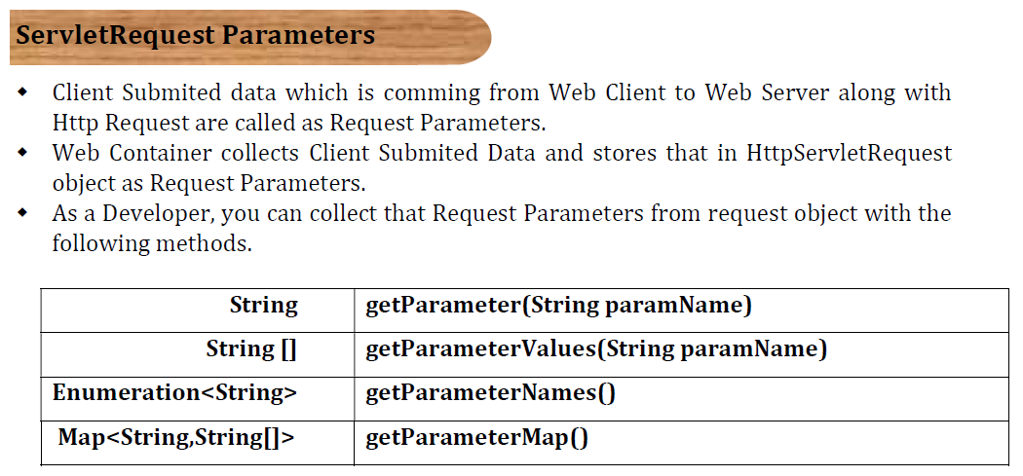

Slide 20
ServletContext Parameters
myapp
HelloServlet.java
HaiServlet.java
hello.html
hai.html
Web Container
Web Server

Slide 21
I have a web server , and web container is running inside a web server .
I have a application , and I have 2 Servlets and 2 html files in my application , HelloServlet.java
HaiServlet.java ,hello.html , hai.html
So these 2 html files and 2 Servlets are written and deployed in the web container.

Slide 22
What Happens when I start my Server ?
I just developed my application and deployed in the container , when I am deploying I don’t have any customers now , I don’t have any users now to use , no request is coming to my server , I am just starting my server .
When ever you are starting a web server , web server will start first and web server will start internally the web container .
At the time of starting the web container , web container will create “Servlet Context “ object.

Slide 23
When ServletContext object will be created?
At the time of web container start up

Slide 24
myapp
HelloServlet.java
HaiServlet.java
hello.html
hai.html
ServletContext
Web Container
Web Server

Slide 25
After creating ServletContext object , it will be initialized with context parameters.
What are context parameters?
context parameters are the parameters which we can specify in the web.xml file.
<context-param>
<param-name>state</param-name>
<param-value>telangana</param-value>
</context-param>

Slide 26
Per one application , there will be only one ServletContext object
One application can have 100 Servlets , or 1000 Servlets , but only one ServletContext object is created per application.
You can store the common data for the entire application in the ServletContext object .
The data which is common to all the users has to be placed inside the ServletContext object .

Slide 27
If you have any common data for all users , you write it as a context-param in web.xml file , what ever context-param you write , your web container , will read it from web.xml file and stores that in the ServletContext object.

Slide 28
myapp
HelloServlet.java
HaiServlet.java
hello.html
hai.html
ServletContext
state telangana
city Hyderabad
Web Container
Web Server

Slide 29
ServletConfig Parameters

Slide 30
myapp
HelloServlet.java
HaiServlet.java
hello.html
hai.html
hello.html
Enter Name:
bjln
Submit
ServletContext
state telangana
city Hyderabad
Web Container
Web Server

Slide 31
When ever you enter the name and click on submit button , request will go to server , Consider request you are sending to HelloServlet on clicking on submit button.(i.e. in form tag ,action attribute, you specified HelloServlet URL-pattern)
When ever you send a request to HelloServlet , web container has to process the HelloServlet now .

Slide 32
So web container will load the HelloServlet class into the memory .
Web container will create HelloServlet instance .
The web container will create one ServletConfig Object .
After creating ServletConfig Object ,Container will initialize the ServletConfig Object , with Config parameters ,which are specified in web.xml file or annotations .
After initializing ServletConfig Object , web container will call the life cycle method init() by passing ServletConfig Object i.e. hs.init(sconfig) (hs is reference to HelloServlet object)

Slide 33
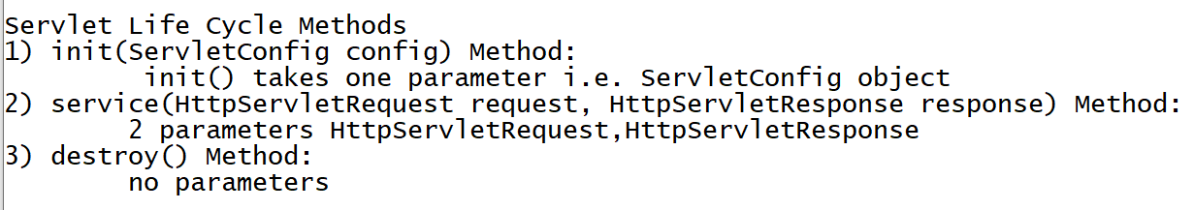

Slide 34
myapp
HelloServlet.java
HaiServlet.java
hello.html
hai.html
hello.html
Enter Name:
ServletConfig
bjln
Submit
ServletContext
hs.init(Sconfig);
state telangana
city Hyderabad
Web Container
Web Server

Slide 35
After calling init() , web container has to call service() method , in order to call service() method , it needs two parameters , HttpServletRequest and HttpServletResponse .
So container will create one request object and one response object .
Client submitted data , will be stored in request object , as request parameter .

Slide 36
myapp
HelloServlet.java
HaiServlet.java
hello.html
hai.html
hello.html
ServletConfig
Enter Name:
hs.init(Sconfig);
bjln
Req
Submit
Name bjln
ServletContext
Res
state telangana
city Hyderabad
Web Container
Web Server

Slide 37
parameters available in ServletRequest object are called Request parameters
parameters available in ServletConfig object are called Config parameters
parameters available in ServletContext object are called Context parameters

Slide 38
hello.html
ServletConfig
myapp
HelloServlet.java
HaiServlet.java
hello.html
hai.html
Enter Name:
bjln
hs.init(Sconfig);
ServletContext
Req
Submit
state telangana
city Hyderabad
Name bjln
hai.html
ServletConfig
Enter Phone No:
hais.init(Sconfig);
9999999999
Req
Submit
phone 999999999
Web Container
Web Server

Slide 39
Let's say we have an HTML form, hai.html. When the submit button is clicked, a request is sent to the server. Specifically, the request is sent to the HaiServlet (assuming that the action attribute in the form tag specifies the URL pattern for HaiServlet).
As of now HaiServlet is not loaded , not yet instantiated , not yet initialized .
What about HelloServlet ?
HelloServlet loaded , HelloServlet instantiated , HelloServlet is initialized by calling init() method.

Slide 40
These 3 things (loading,instantiation and initialization) will happen only once in the servlet life .
It means , how many instances will be created for HelloServlet ?
Ans : Only one instance
how many instances will be created for HaiServlet ?
Ans : Only one instance
For every servlet only one instance will be created.

Slide 41
How many ServletConfig objects will be created per application?
Ans : many depending one no.of Servlets
If there are 2 Servlets 2 ServeltConfig objects
How many ServletConfig objects will be created per Servlet?
Ans : one , if there are 2 Servlets 2 ServletConfig objects will be created
How many request objects will be created per Servlet?
Ans : many , as many requests , those many objects

Slide 42
When ever you send a request to HaiServlet by clicking on submit button, web container will load the HaiServlet class into the memory .
Web container will create HaiServlet instance .
The web container will create one ServletConfig Object for this HaiServlet .
After creating ServletConfig Object ,Container will initialize the ServletConfig Object , with Config parameters ,which are specified in web.xml file or annotations .
After initializing ServletConfig Object , web container will call the life cycle method init() by passing ServletConfig Object i.e. hais.init(sconfig) (hais is reference to HaiServlet object)

Slide 43
After calling init() , web container has to call service() method , in order to call service() method , it needs two parameters , HttpServletRequest and HttpServletResponse .
So container will create one more request object and one more response object .
Client submitted data , will be stored in corresponding request object , as request parameter .

Slide 44
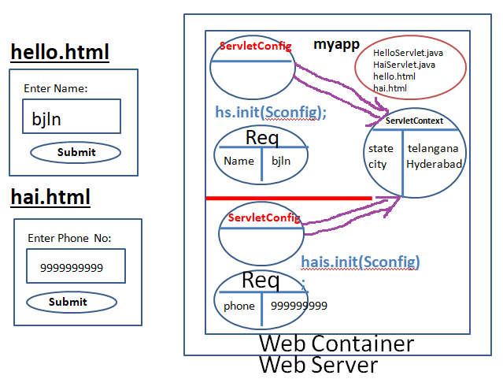
ServletContext object we can not access directly , we will access it from ServletConfig object , from config we can call getServletContext() method.
Your servlet will have access to ServletConfig object , ServletConfig object will have access to ServletContext object . Context object address available with config object .

Slide 45
How many times servlet class will be loaded ?
Ans : only one time
How many times servlet instance will be created ?
Ans : only one time per application
How many times init() method will be called in the servlet life ?
Ans : only once

Slide 46
Who is storing the parameters in the respective objects(request , config and context objects)?
Ans : Web Container
Can you modify any of these parameters ?
Ans: you can not modify these , these parameters are read-only

Slide 47
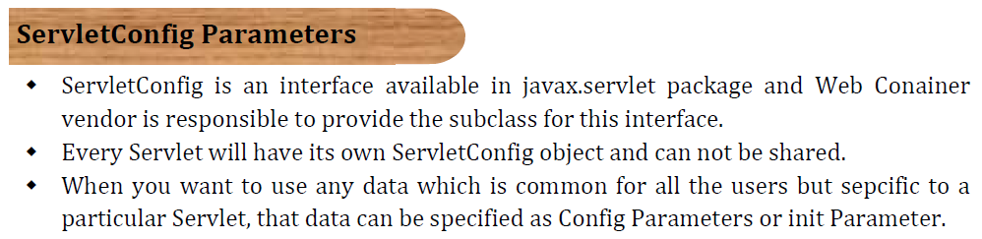
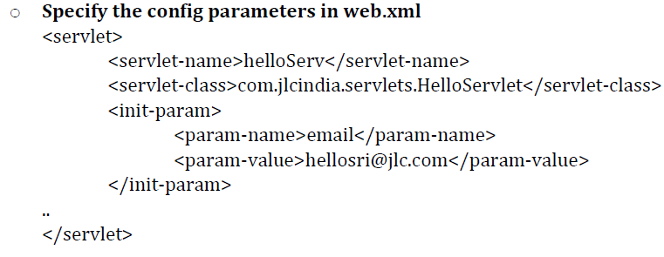

Slide 48
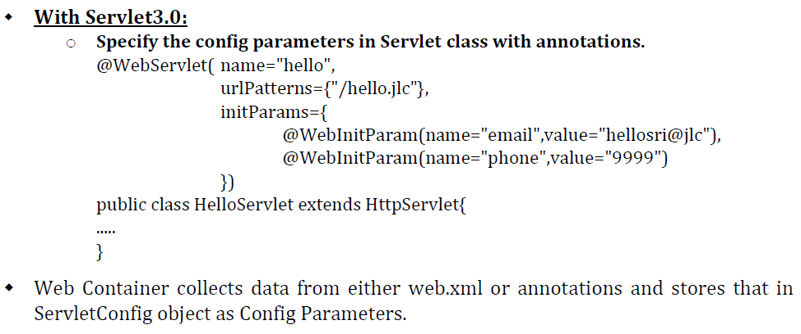

Slide 49
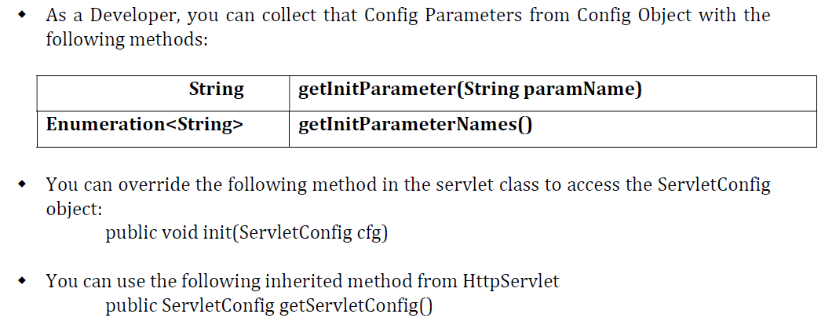

Slide 50
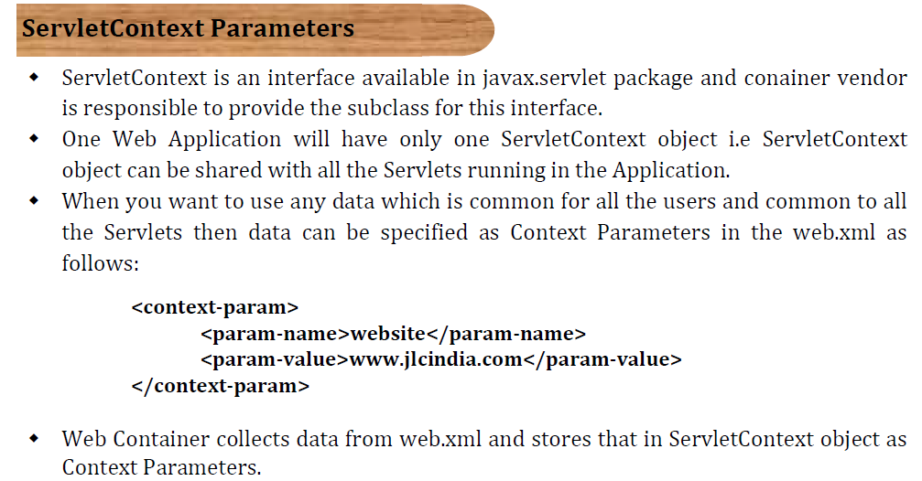

Slide 51
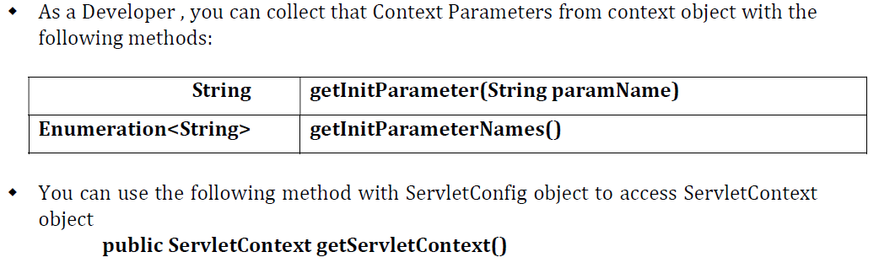

Slide 52
<!DOCTYPE html>
<html>
<head>
<title>Welcome to Web App</title>
</head>
<body>
<h2>Welcome to Java Servlets</h2>
<h3>Hello Form</h3>
<form action="hello">
<table>
<tr>
<td>Full Name</td>
<td><input type="text" name="fname" /></td>
</tr>
<tr>
<td colspan="2" align="center"><input type="submit"
value="Submit" /></td>
</tr>
</table>
</form>
<!-- this web page has two forms , it is valid -->
<h3>Hai Form</h3>
<form action="hai">
<table>
<tr>
<td>Phone</td>
<td><input type="text" name="phone" /></td>
</tr>
<tr>
<td colspan="2" align="center"><input type="submit"
value="Submit" /></td>
</tr>
</table>
</form>
</body>
</html>
mylab7
index.html

Slide 53
package com.vrsec.servlets;
import java.io.IOException;
import java.io.PrintWriter;
import javax.servlet.ServletConfig;
import javax.servlet.ServletContext;
import javax.servlet.ServletException;
import javax.servlet.http.HttpServlet;
import javax.servlet.http.HttpServletRequest;
import javax.servlet.http.HttpServletResponse;
public class HelloServlet extends HttpServlet {
ServletConfig sconfig = null;
//static block , constructor and init() executed only in
//servlet life i.e. only for first request , for rest of the
//requests only service() will be executed
static {
System.out.println("HelloServlet - S.B");
}
public HelloServlet() {
System.out.println("HelloServlet - D.C");
}
public void init(ServletConfig sconfig) {
System.out.println("HelloServlet - init()");
this.sconfig = sconfig;
}
public void service(HttpServletRequest request, HttpServletResponse response) throws IOException, ServletException {
System.out.println("HelloServlet - service()");
// 1.Collect Request Params
String fname = request.getParameter("fname");
String phone = request.getParameter("phone"); // null , if parameter name does not exists getParameter() method returns null value
// 2.Collect Config Params
String email = sconfig.getInitParameter("email");
// 3.Collect Context Params
ServletContext scontext = sconfig.getServletContext();
String web = scontext.getInitParameter("website");
// 4.Do Processing
System.out.println(fname);
System.out.println(phone);
System.out.println(email);
System.out.println(web);
// 5.Send Response
response.setContentType("text/html");
PrintWriter out = response.getWriter();
out.print("<h3> <u>1.Request Parameters </u> <h3>");
out.print("<table>");
out.print("<tr>");
out.print("<td> Full Name </td>");
out.print("<td> " + fname + " </td>");
out.print("</tr>");
out.print("</table>");
out.print("<h3> <u>2.Config Parameters </u> <h3>");
out.print("<table>");
out.print("<tr>");
out.print("<td> Email</td>");
out.print("<td> " + email + " </td>");
out.print("</tr>");
out.print("</table>");
out.print("<h3> <u>3.Context Parameters </u> <h3>");
out.print("<table>");
out.print("<tr>");
out.print("<td> Website </td>");
out.print("<td> " + web + " </td>");
out.print("</tr>");
out.print("</table>");
}
public void destroy() {
System.out.println("HelloServlet - destroy()");
}
}
HelloServlet.java

Slide 54
package com.vrsec.servlets;
import java.io.IOException;
import java.io.PrintWriter;
import javax.servlet.ServletConfig;
import javax.servlet.ServletContext;
import javax.servlet.ServletException;
import javax.servlet.http.HttpServlet;
import javax.servlet.http.HttpServletRequest;
import javax.servlet.http.HttpServletResponse;
public class HaiServlet extends HttpServlet {
static {
System.out.println("HaiServlet - S.B");
}
public HaiServlet() {
System.out.println("HaiServlet - D.C");
}
public void init(ServletConfig sconfig) throws ServletException {
super.init(sconfig);
System.out.println("HaiServlet - init()");
}
public void service(HttpServletRequest request, HttpServletResponse response) throws IOException, ServletException {
System.out.println("HaiServlet - service()");
// 1.Collect Request Params
String fname = request.getParameter("fname");// null
String phone = request.getParameter("phone");
// 2.Collect Config Params
ServletConfig sconfig = getServletConfig();
String email = sconfig.getInitParameter("email");
// 3.Collect Context Params
ServletContext scontext = sconfig.getServletContext();
String web = scontext.getInitParameter("website");
// 4.Do Processing
System.out.println(fname);
System.out.println(phone);
System.out.println(email);
System.out.println(web);
// 5.Send Response
response.setContentType("text/html");
PrintWriter out = response.getWriter();
out.print("<h3> <u>1.Request Parameters </u> <h3>");
out.print("<table>");
out.print("<tr>");
out.print("<td> Phone </td>");
out.print("<td> " + phone + " </td>");
out.print("</tr>");
out.print("</table>");
out.print("<h3> <u>2.Config Parameters </u> <h3>");
out.print("<table>");
out.print("<tr>");
out.print("<td> Email</td>");
out.print("<td> " + email + " </td>");
out.print("</tr>");
out.print("</table>");
out.print("<h3> <u>3.Context Parameters </u> <h3>");
out.print("<table>");
out.print("<tr>");
out.print("<td> Website </td>");
out.print("<td> " + web + " </td>");
out.print("</tr>");
out.print("</table>");
}
public void destroy() {
System.out.println("HaiServlet - destroy()");
}
}
HaiServlet.java

Slide 55
<?xml version="1.0" encoding="UTF-8"?>
<web-app xmlns:xsi="http://www.w3.org/2001/XMLSchema-instance"
xmlns="http://xmlns.jcp.org/xml/ns/javaee"
xsi:schemaLocation="http://xmlns.jcp.org/xml/ns/javaee http://xmlns.jcp.org/xml/ns/javaee/web-app_3_1.xsd"
id="WebApp_ID" version="3.1">
<display-name>mylab7</display-name>
<welcome-file-list>
<welcome-file>index.html</welcome-file>
</welcome-file-list>
<context-param>
<param-name>website</param-name>
<param-value>www.mycompany.com</param-value>
</context-param>
<servlet>
<servlet-name>hello</servlet-name>
<servlet-class>com.vrsec.servlets.HelloServlet</servlet-class>
<init-param>
<param-name>email</param-name>
<param-value>hello@hello.com</param-value>
</init-param>
</servlet>
<servlet-mapping>
<servlet-name>hello</servlet-name>
<url-pattern>/hello</url-pattern>
</servlet-mapping>
<servlet>
<servlet-name>hai</servlet-name>
<servlet-class>com.vrsec.servlets.HaiServlet</servlet-class>
<init-param>
<param-name>email</param-name>
<param-value>hai@hai.com</param-value>
</init-param>
</servlet>
<servlet-mapping>
<servlet-name>hai</servlet-name>
<url-pattern>/hai</url-pattern>
</servlet-mapping>
</web-app>
web.xml

Slide 56
Here initialized means all 3 , loading , instantiation , initialization
<load-on-startup>1</load-on-startup>
in xml file
(Or )
Using annotation , by using loadOnStartup = 2
attribute

Slide 57
<!DOCTYPE html>
<html>
<head>
<title>Welcome to Web App</title>
</head>
<body>
<h2>Welcome to Java Servlets</h2>
<h3>Hello Form</h3>
<form action="hello">
<table>
<tr>
<td>Full Name</td>
<td><input type="text" name="fname" /></td>
</tr>
<tr>
<td colspan="2" align="center"><input type="submit"
value="Submit" /></td>
</tr>
</table>
</form>
<!-- this web page has two forms , it is valid -->
<h3>Hai Form</h3>
<form action="hai">
<table>
<tr>
<td>Phone</td>
<td><input type="text" name="phone" /></td>
</tr>
<tr>
<td colspan="2" align="center"><input type="submit"
value="Submit" /></td>
</tr>
</table>
</form>
</body>
</html>
mylab8
index.html

Slide 58
package com.vrsec.servlets;
import java.io.IOException;
import java.io.PrintWriter;
import javax.servlet.ServletConfig;
import javax.servlet.ServletContext;
import javax.servlet.ServletException;
import javax.servlet.annotation.WebInitParam;
import javax.servlet.annotation.WebServlet;
import javax.servlet.http.HttpServlet;
import javax.servlet.http.HttpServletRequest;
import javax.servlet.http.HttpServletResponse;
@WebServlet(
name="hello",
urlPatterns = "/hello",
loadOnStartup = 1,
initParams = {
@WebInitParam(name="email",value="hello@hello.com")
}
)
public class HelloServlet extends HttpServlet {
ServletConfig sconfig = null;
//static block , constructor and init() executed only once in
//servlet life i.e. only for first request , for rest of the
//requests only service() will be executed
static {
System.out.println("HelloServlet - S.B");
}
public HelloServlet() {
System.out.println("HelloServlet - D.C");
}
public void init(ServletConfig sconfig) {
System.out.println("HelloServlet - init()");
this.sconfig = sconfig;
}
public void service(HttpServletRequest request, HttpServletResponse response) throws IOException, ServletException {
System.out.println("HelloServlet - service()");
// 1.Collect Request Params
String fname = request.getParameter("fname");
String phone = request.getParameter("phone"); // null , if parameter name does not exists getParameter() method returns null value
// 2.Collect Config Params
String email = sconfig.getInitParameter("email");
// 3.Collect Context Params
ServletContext scontext = sconfig.getServletContext();
String web = scontext.getInitParameter("website");
// 4.Do Processing
System.out.println(fname);
System.out.println(phone);
System.out.println(email);
System.out.println(web);
// 5.Send Response
response.setContentType("text/html");
PrintWriter out = response.getWriter();
out.print("<h3> <u>1.Request Parameters </u> <h3>");
out.print("<table>");
out.print("<tr>");
out.print("<td> Full Name </td>");
out.print("<td> " + fname + " </td>");
out.print("</tr>");
out.print("</table>");
out.print("<h3> <u>2.Config Parameters </u> <h3>");
out.print("<table>");
out.print("<tr>");
out.print("<td> Email</td>");
out.print("<td> " + email + " </td>");
out.print("</tr>");
out.print("</table>");
out.print("<h3> <u>3.Context Parameters </u> <h3>");
out.print("<table>");
out.print("<tr>");
out.print("<td> Website </td>");
out.print("<td> " + web + " </td>");
out.print("</tr>");
out.print("</table>");
}
public void destroy() {
System.out.println("HelloServlet - destroy()");
}
}
HelloServlet.java

Slide 59
package com.vrsec.servlets;
import java.io.IOException;
import java.io.PrintWriter;
import javax.servlet.ServletConfig;
import javax.servlet.ServletContext;
import javax.servlet.ServletException;
import javax.servlet.annotation.WebInitParam;
import javax.servlet.annotation.WebServlet;
import javax.servlet.http.HttpServlet;
import javax.servlet.http.HttpServletRequest;
import javax.servlet.http.HttpServletResponse;
@WebServlet(
name="hai",
urlPatterns = "/hai",
loadOnStartup = 2,
initParams = {
@WebInitParam(name="email",value="hai@hai.com")
}
)
public class HaiServlet extends HttpServlet {
static {
System.out.println("HaiServlet - S.B");
}
public HaiServlet() {
System.out.println("HaiServlet - D.C");
}
public void init(ServletConfig sconfig) throws ServletException {
super.init(sconfig);
System.out.println("HaiServlet - init()");
}
public void service(HttpServletRequest request, HttpServletResponse response) throws IOException, ServletException {
System.out.println("HaiServlet - service()");
// 1.Collect Request Params
String fname = request.getParameter("fname");// null
String phone = request.getParameter("phone");
// 2.Collect Config Params
ServletConfig sconfig = getServletConfig();
String email = sconfig.getInitParameter("email");
// 3.Collect Context Params
ServletContext scontext = sconfig.getServletContext();
String web = scontext.getInitParameter("website");
// 4.Do Processing
System.out.println(fname);
System.out.println(phone);
System.out.println(email);
System.out.println(web);
// 5.Send Response
response.setContentType("text/html");
PrintWriter out = response.getWriter();
out.print("<h3> <u>1.Request Parameters </u> <h3>");
out.print("<table>");
out.print("<tr>");
out.print("<td> Phone </td>");
out.print("<td> " + phone + " </td>");
out.print("</tr>");
out.print("</table>");
out.print("<h3> <u>2.Config Parameters </u> <h3>");
out.print("<table>");
out.print("<tr>");
out.print("<td> Email</td>");
out.print("<td> " + email + " </td>");
out.print("</tr>");
out.print("</table>");
out.print("<h3> <u>3.Context Parameters </u> <h3>");
out.print("<table>");
out.print("<tr>");
out.print("<td> Website </td>");
out.print("<td> " + web + " </td>");
out.print("</tr>");
out.print("</table>");
}
public void destroy() {
System.out.println("HaiServlet - destroy()");
}
}
HaiServlet.java

Slide 60
<?xml version="1.0" encoding="UTF-8"?>
<web-app xmlns:xsi="http://www.w3.org/2001/XMLSchema-instance"
xmlns="http://xmlns.jcp.org/xml/ns/javaee"
xsi:schemaLocation="http://xmlns.jcp.org/xml/ns/javaee http://xmlns.jcp.org/xml/ns/javaee/web-app_3_1.xsd"
id="WebApp_ID" version="3.1">
<display-name>mylab8</display-name>
<welcome-file-list>
<welcome-file>index.html</welcome-file>
</welcome-file-list>
<context-param>
<param-name>website</param-name>
<param-value>www.mywebsite.com</param-value>
</context-param>
</web-app>
web.xml

Slide 61
<!DOCTYPE html>
<html>
<head>
<title>Welcome to Java Web App</title>
</head>
<body>
<h2>Welcome to Java Servlets</h2>
<h3>Demo Form</h3>
<form action="mydemo" method="post">
<table>
<tr>
<td>Full Name</td>
<td><input type="text" name="fname" /></td>
</tr>
<tr>
<td>Phone</td>
<td><input type="text" name="phone" /></td>
</tr>
<tr>
<td colspan="2" align="center"><input type="submit"
value="Submit" /></td>
</tr>
</table>
</form>
</body>
</html>
mylab9
index.html

Slide 62
package com.vrsec.servlets;
import java.io.*;
import java.util.*;
import javax.servlet.*;
import javax.servlet.http.*;
public class DemoServlet extends HttpServlet {
static {
System.out.println("DemoServlet - S.B");
}
public DemoServlet() {
System.out.println("DemoServlet - D.C");
}
public void init(ServletConfig sconfig) throws ServletException {
super.init(sconfig);
System.out.println("DemoServlet - init()");
}
public void service(HttpServletRequest request, HttpServletResponse response) throws IOException, ServletException {
System.out.println("DemoServlet - service()");
// A.Collect Request Params
System.out.println("----A. Request Params-----");
System.out.println("----Option 1: ------");
String fname = request.getParameter("fname");
String phone = request.getParameter("phone");
System.out.println(fname);
System.out.println(phone);
System.out.println("----Option 2: ------");
Enumeration<String> enms = request.getParameterNames();
List<String> paramNames1 = Collections.list(enms);
for (String pname : paramNames1) {
String pvalue = request.getParameter(pname);
System.out.println(pname + "\t" + pvalue);
}
System.out.println("----Option 3: ------");
Map<String, String[]> paramMap = request.getParameterMap();
Set<String> panamMames2 = paramMap.keySet();
for (String pname : panamMames2) {
String pvalue[] = paramMap.get(pname);
System.out.println(pname + "\t" + pvalue[0]);
}
System.out.println("--------------------------");
// B.Collect Config Params
System.out.println("---B.Config Params-----");
ServletConfig sconfig = getServletConfig();
System.out.println("----Option 1: ------");
String email = sconfig.getInitParameter("email");
String city = sconfig.getInitParameter("city");
System.out.println(email);
System.out.println(city);
System.out.println("----Option 2: ------");
Enumeration<String> enms1 = sconfig.getInitParameterNames();
List<String> configParams = Collections.list(enms1);
for (String pname : configParams) {
String pvalue = sconfig.getInitParameter(pname);
System.out.println(pname + "\t" + pvalue);
}
System.out.println("--------------------------");
// C.Collect Context Params
System.out.println("---C.Context Params-----");
ServletContext scontext = sconfig.getServletContext();
System.out.println("----Option 1: ------");
String state = scontext.getInitParameter("state");
String country = scontext.getInitParameter("country");
System.out.println(state);
System.out.println(country);
System.out.println("----Option 2: ------");
Enumeration<String> enms2 = scontext.getInitParameterNames();
List<String> contextParams = Collections.list(enms2);
for (String pname : contextParams) {
String pvalue = scontext.getInitParameter(pname);
System.out.println(pname + "\t" + pvalue);
}
// 5.Send Response
response.setContentType("text/html");
PrintWriter out = response.getWriter();
out.print("<h2> Check the Server Console <h2>");
}
public void destroy() {
System.out.println("DemoServlet - destroy()");
}
}
DemoServlet.java

Slide 63
<?xml version="1.0" encoding="UTF-8"?>
<web-app xmlns:xsi="http://www.w3.org/2001/XMLSchema-instance"
xmlns="http://xmlns.jcp.org/xml/ns/javaee"
xsi:schemaLocation="http://xmlns.jcp.org/xml/ns/javaee http://xmlns.jcp.org/xml/ns/javaee/web-app_3_1.xsd"
id="WebApp_ID" version="3.1">
<display-name>mylab9</display-name>
<welcome-file-list>
<welcome-file>index.html</welcome-file>
</welcome-file-list>
<context-param>
<param-name>state</param-name>
<param-value>Andhra</param-value>
</context-param>
<context-param>
<param-name>country</param-name>
<param-value>India</param-value>
</context-param>
<servlet>
<servlet-name>demo</servlet-name>
<servlet-class>com.vrsec.servlets.DemoServlet</servlet-class>
<init-param>
<param-name>email</param-name>
<param-value>demo@gmail.com</param-value>
</init-param>
<init-param>
<param-name>city</param-name>
<param-value>Vijayawada</param-value>
</init-param>
<load-on-startup>99</load-on-startup>
</servlet>
<servlet-mapping>
<servlet-name>demo</servlet-name>
<url-pattern>/mydemo</url-pattern>
</servlet-mapping>
</web-app>
web.xml

Slide 64
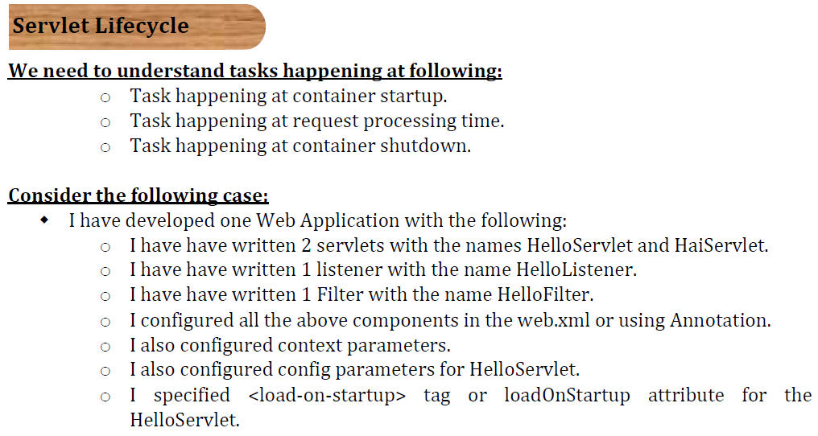

Slide 65
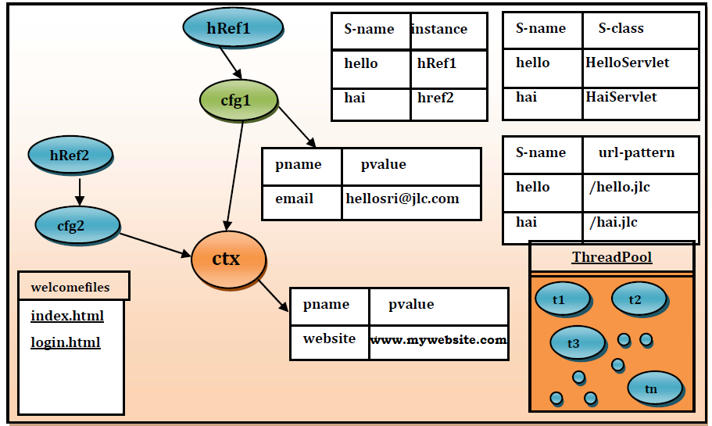

Slide 66
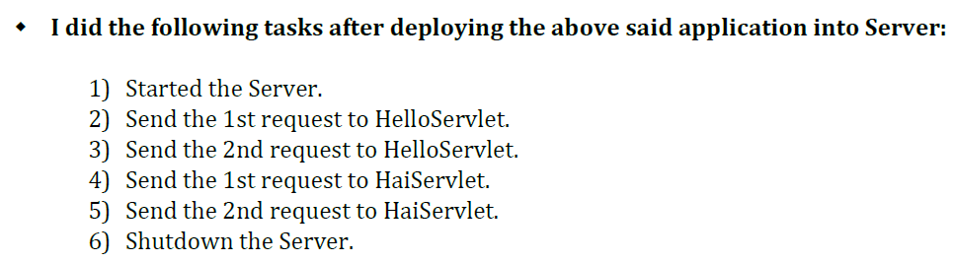

Slide 67
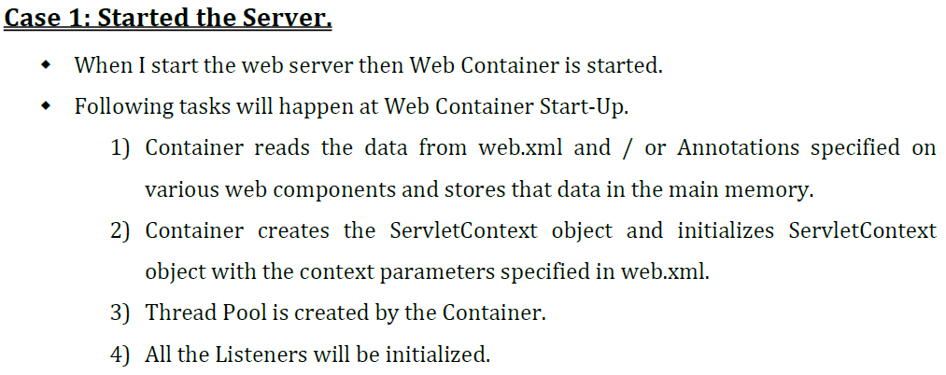
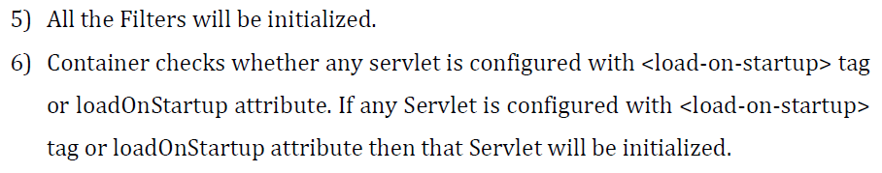

Slide 68
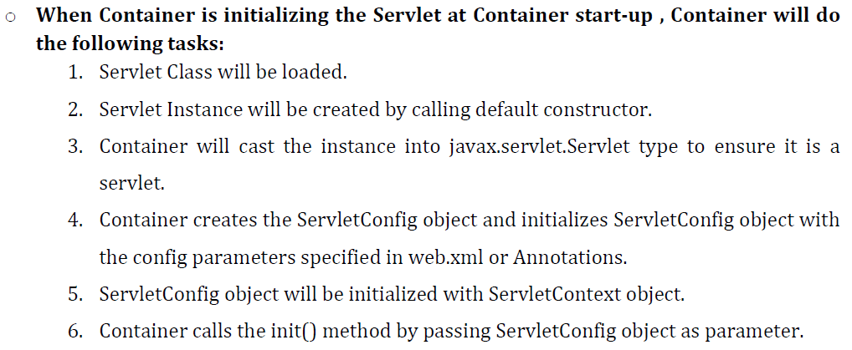

Slide 69
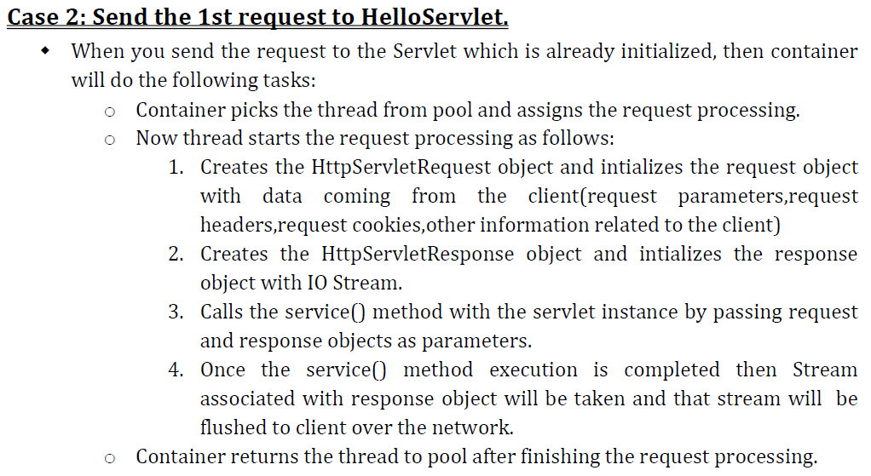

Slide 70


Slide 71
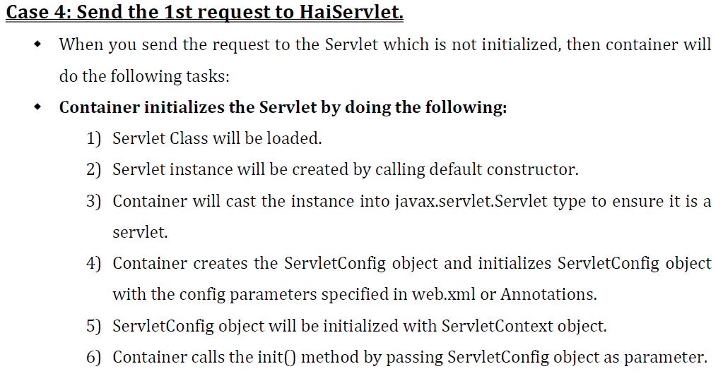

Slide 72
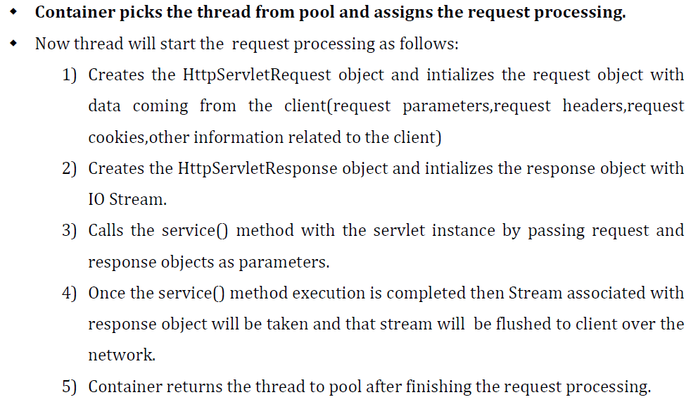

Slide 73


Slide 74
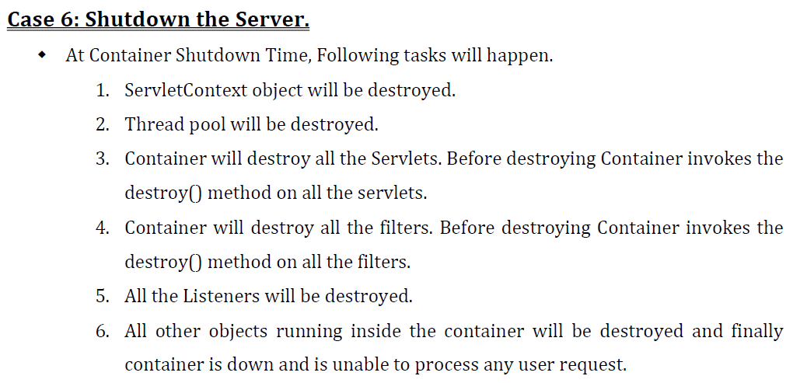

Slide 75
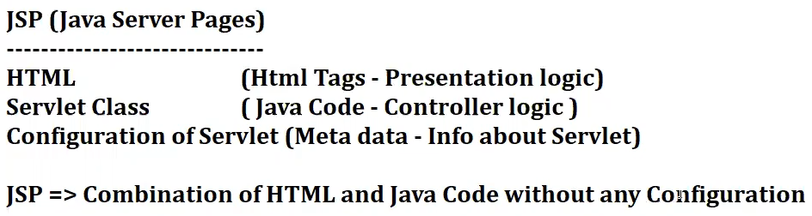
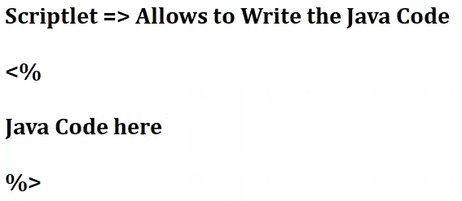
Note: Internally for container JSP is equivalent to servlet

Slide 76
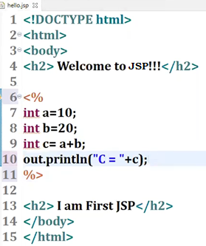

Slide 77
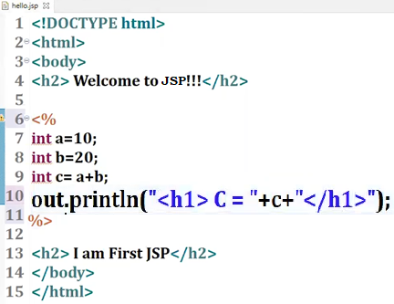

Slide 78
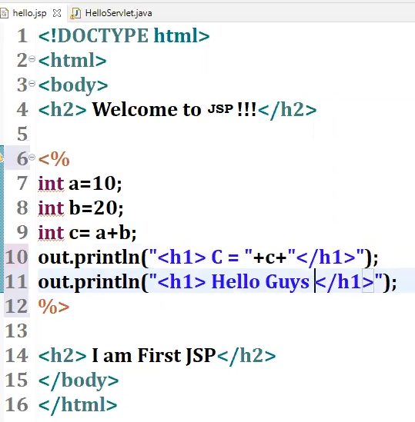

Slide 79
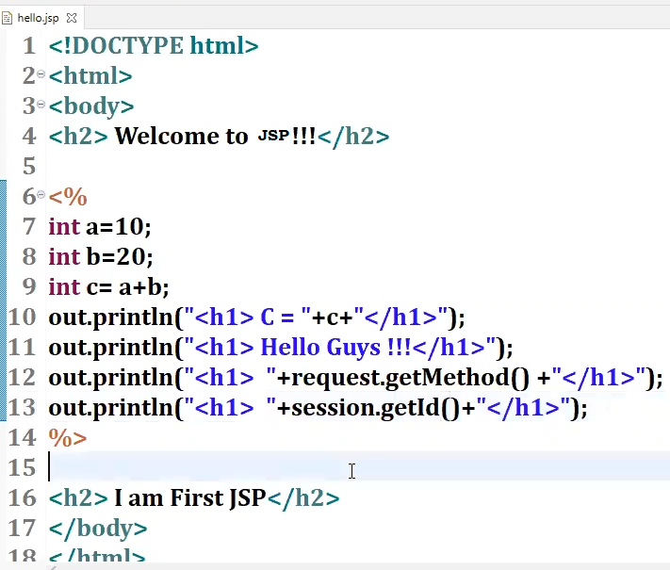

Slide 80

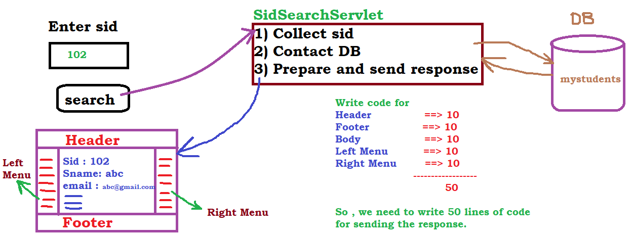
(interface)

Slide 81
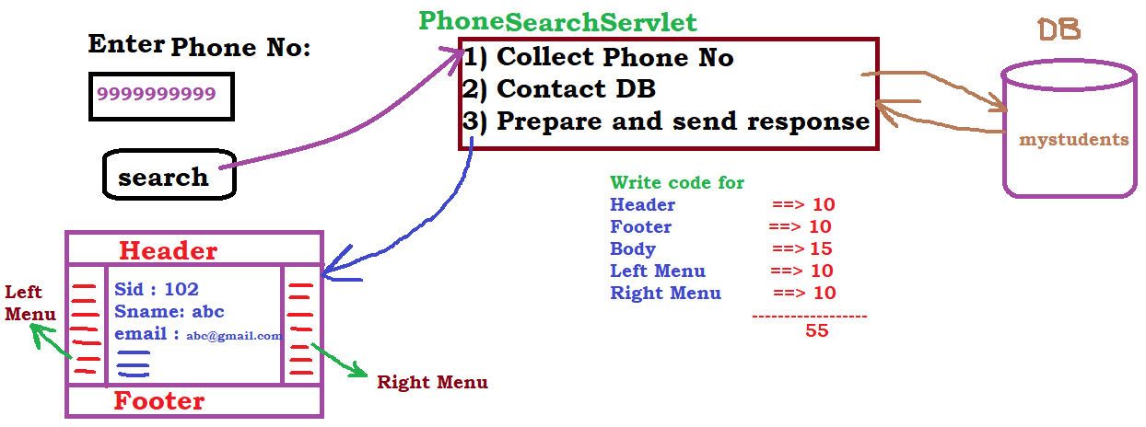
Here only body code is changing . Header , Footer ,Left Menu , Right Menu code is same here also.

Slide 82
Like this I have other requirements like search by “email id”
Search by “name”
Search by “city”
Search by “fee balance”
Search by “dob”
Search by “course”
…………………
So if you have 10 search functionalities , you need to write 10 Servlets .

Slide 83
Now tell me what is the problem here ?
Problem is code duplication
40 lines of code is common across all the servlets .
Code duplication leads to maintenance problem
For example my manager asked me to change the logo , now we need to change in all the servlets

Slide 84
So only the presentation logic (i.e. 3rd step) changing from requirement to requirement .
So to write this presentation logic we have JSP.
So JSP is used to write the presentation logic .

Slide 85
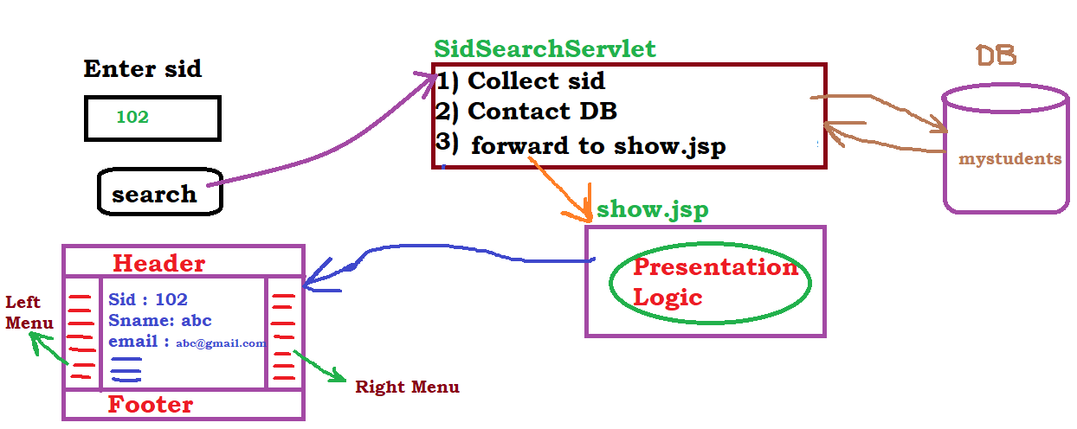

Slide 86
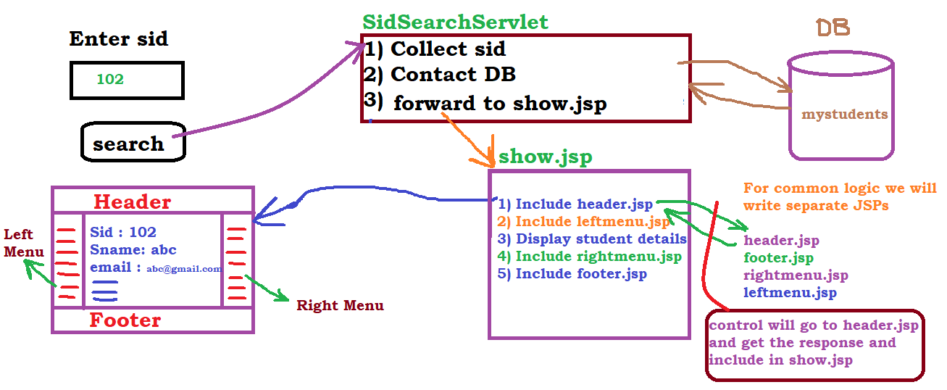

Slide 87
include means the request is forwarded to another resource, it processes and returns the response back to the original servlet, and the content is included in the final response.
forward means the request is transferred to another resource, and the control is not returned to the original servlet after the forwarded resource processes the request.

Slide 88
forward() is used to forward the control from one web componet(jsp or servlet) to another web component
Now onwards in any real time applications your servlet is, not yet all responsible to deliver a response , means we will not use "out" (which is of type PrintWriter ) variable in the servlet .
Then who will deliver the response ?
Jsp has to do it.Servlet has to forward the control to JSP.
include() is used to include the response of one web component in another web component.

Slide 89
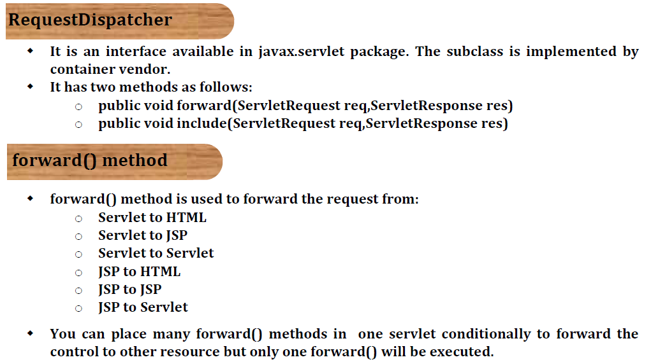

Slide 90
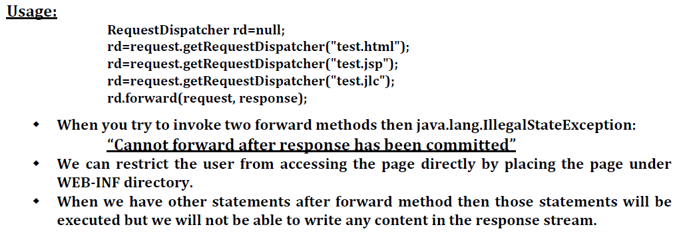

Slide 91
<!DOCTYPE html>
<html>
<body>
<h2>Welcome to My App!!!</h2>
<h3>Login Form</h3>
<font color="red" size="4">
<%
Object obj = request.getAttribute("MSG");
if (obj != null) {
out.print(obj);
}
%>
</font>
<form action="mylogin" method="post">
<table>
<tr>
<td>Username</td>
<td><input type="text" name="myusername" /></td>
</tr>
<tr>
<td>Password</td>
<td><input type="password" name="mypassword" /></td>
</tr>
<tr>
<td colspan="2" align="center"><input type="submit"
value="Login Now" /></td>
</tr>
</table>
</form>
</body>
</html>
mylab10
login.jsp

Slide 92
<!DOCTYPE html>
<html>
<body>
<h2> Hello
<%
Object obj=request.getAttribute("UN");
if(obj!=null){
out.print(obj);
}
%>
, </h2>
<h2> Welcome to My APP!!!</h2>
<h3> This is the Home Page </h3>
<h3> This is the Home Page </h3>
<h3> This is the Home Page </h3>
<h3> This is the Home Page </h3>
</body>
</html>
mylab10
home.jsp

Slide 93
package com.vrsec.servlets;
import java.io.IOException;
import java.io.PrintWriter;
import javax.servlet.RequestDispatcher;
import javax.servlet.ServletException;
import javax.servlet.annotation.WebServlet;
import javax.servlet.http.HttpServlet;
import javax.servlet.http.HttpServletRequest;
import javax.servlet.http.HttpServletResponse;
@WebServlet(name = "login", urlPatterns = { "/mylogin" })
public class LoginServlet extends HttpServlet {
public void service(HttpServletRequest request, HttpServletResponse response) throws IOException, ServletException {
// 1.Collect Input Data
String un = request.getParameter("myusername");
String pw = request.getParameter("mypassword");
// 2.Do Processing and Prepare the Response
String page = "";
if (un.equals(pw)) {
request.setAttribute("UN", un);
page = "home.jsp";
} else {
String msg = "Invalid Username or Password";
request.setAttribute("MSG", msg);
page = "login.jsp";
}
RequestDispatcher rd = request.getRequestDispatcher(page);
rd.forward(request, response);
// rd.forward(request, response);
}
}
mylab10
LoginServlet.java

Slide 94
<?xml version="1.0" encoding="UTF-8"?>
<web-app xmlns:xsi="http://www.w3.org/2001/XMLSchema-instance"
xmlns="http://xmlns.jcp.org/xml/ns/javaee"
xsi:schemaLocation="http://xmlns.jcp.org/xml/ns/javaee http://xmlns.jcp.org/xml/ns/javaee/web-app_3_1.xsd"
id="WebApp_ID" version="3.1">
<display-name>mylab10</display-name>
<welcome-file-list>
<welcome-file>login.jsp</welcome-file>
</welcome-file-list>
</web-app>
mylab10
web.xml

Slide 95
mylab11
demo.html
<!DOCTYPE html>
<html>
<body>
<!-- by clicking on hyperlink also we can send request to a servlet -->
<h1> <a href="mydemo"> Click Here </a></h1>
</body>
</html>

Slide 96
<!DOCTYPE html>
<html>
<body>
<u> <h2> Advanced Java Learning </h2></u>
<br/>
</body>
</html>
mylab11
header.jsp

Slide 97
mylab11
footer.html
<!DOCTYPE html>
<html>
<body>
<h2>All Rights Reserved.2021- ABC</h2>
<br/><br/>
</body>
</html>

Slide 98
mylab11
home.jsp
<!DOCTYPE html>
<html>
<body>
<h3> This is the Home Page </h3>
<h3> This is the Home Page </h3>
<h3> This is the Home Page </h3>
<h3> This is the Home Page </h3>
<h3> This is the Home Page </h3>
<h3> This is the Home Page </h3>
<h3> This is the Home Page </h3>
<h3> This is the Home Page </h3>
</body>
</html>

Slide 99
mylab11
DemoServlet.java
package com.vrsec.servlets;
import java.io.IOException;
import javax.servlet.RequestDispatcher;
import javax.servlet.ServletException;
import javax.servlet.annotation.WebServlet;
import javax.servlet.http.HttpServlet;
import javax.servlet.http.HttpServletRequest;
import javax.servlet.http.HttpServletResponse;
@WebServlet(name = "demo", urlPatterns = { "/mydemo" })
public class DemoServlet extends HttpServlet {
public void service(HttpServletRequest request, HttpServletResponse response) throws IOException, ServletException {
RequestDispatcher rd1 = request.getRequestDispatcher("header.jsp");
rd1.include(request, response);
RequestDispatcher rd2 = request.getRequestDispatcher("home.jsp");
rd2.include(request, response);
RequestDispatcher rd3 = request.getRequestDispatcher("footer.html");
rd3.include(request, response);
}
}

Slide 100
mylab11
web.xml
<?xml version="1.0" encoding="UTF-8"?>
<web-app xmlns:xsi="http://www.w3.org/2001/XMLSchema-instance"
xmlns="http://xmlns.jcp.org/xml/ns/javaee"
xsi:schemaLocation="http://xmlns.jcp.org/xml/ns/javaee http://xmlns.jcp.org/xml/ns/javaee/web-app_3_1.xsd"
id="WebApp_ID" version="3.1">
<display-name>mylab11</display-name>
<welcome-file-list>
<welcome-file>demo.html</welcome-file>
</welcome-file-list>
</web-app>

Slide 101
mylab11
test.jsp
<!DOCTYPE html>
<html>
<body>
<jsp:include page="header.jsp"/>
<jsp:include page="home.jsp"/>
<jsp:include page="footer.html"/>
</body>
</html>
URL to send request to test.jsp
http://localhost:12345/mylab11/test.jsp

Slide 102
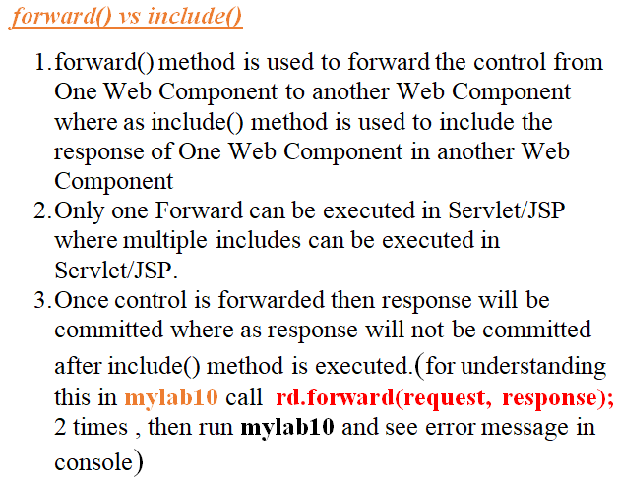

Slide 103
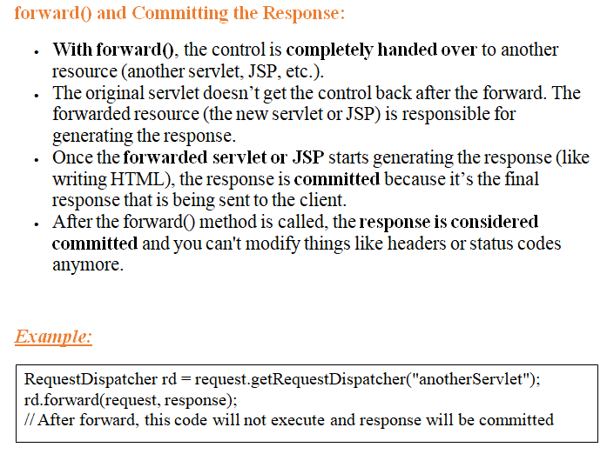

Slide 104
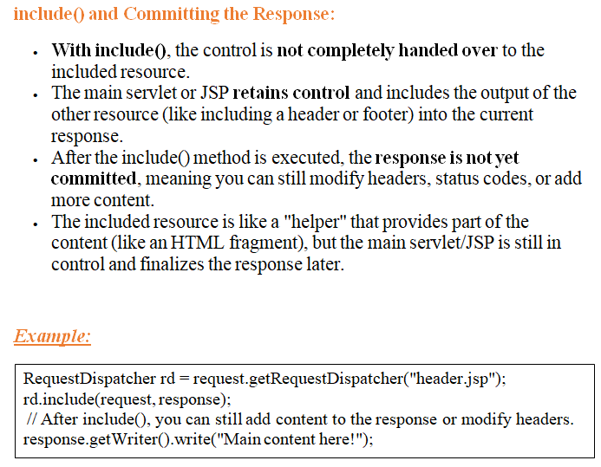

Slide 105
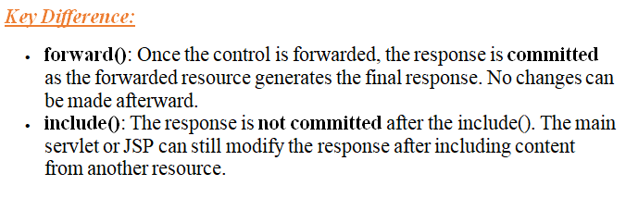

Slide 106
what is happening internally in the case of forward() and in the case of include() in servlets

