Slide 1
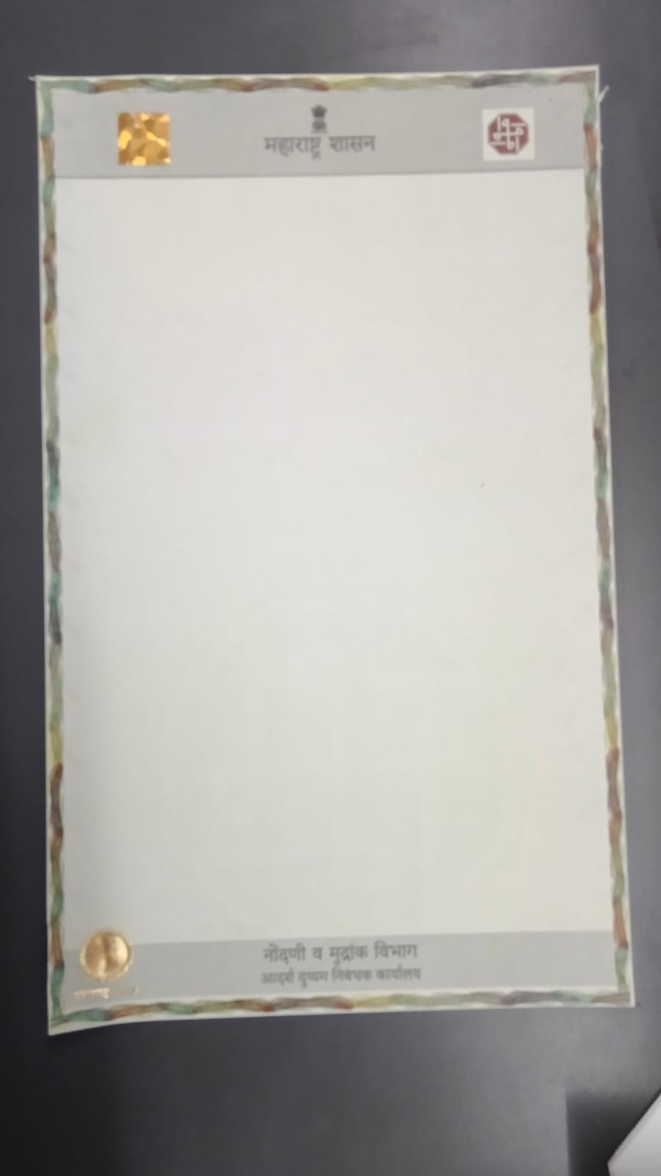
MAHARASHTRA · REGISTRATION & STAMPS
PROPIX | PRAKRUTI GRAPHIC PVT. LTD.
Secure Legal Paper
for Property Registration
Physical Security + Digital QR + Traceability
Non-tearable 130–140 micron in-house paper
Watermark, VOID, UV, hologram, foil & emboss
Unique QR for verify · access · track & trace
Built for INDEX-I / Stamp & Registration use
prakruti@prakrutigraphic.com · +91 98212 32349

Slide 2
PRAKRUTI GRAPHIC / PROPIX
Overview
2 / 24
What's Inside
Problem → Facts → Product → Features → Digital Trace → Impact
01
02
03
The Challenge
Maharashtra Facts
Propix Mudrank
Fraud, duplication & weak document barriers
Revenue scale + recent case evidence
Non-tearable secure legal paper platform
04
05
06
Physical Features
Digital Layer
Impact & Ask
8-process security manufacturing stack
QR verify, access of information, track & trace
Control, trust and revenue protection
Secure Legal Paper | Physical + Digital | Track & Trace
Confidential · www.pgpltechprint.com

Slide 3
PRAKRUTI GRAPHIC / PROPIX
Context
3 / 24
Why Secure Legal Paper — Now
Maharashtra's registration ecosystem is large, valuable, and under fraud pressure
₹59,150 Cr
13.4 Lakh+
₹10–20k Cr
Stamps & Registration Fees
(CAG Accounts FY 2024–25)
Documents registered
(IGR Maharashtra FY 2024–25)
Alleged adjudication irregularities
under statewide probe*
What is at stake
Current paper gap
• Property documents are the backbone of ownership & lending
• Weak stationery + process gaps enable forgery & misuse
• Banks, buyers and citizens need instant authenticity checks
• State needs barriers that protect revenue and public trust
• Mostly plain / green legal stationery in common use
• Easy to photocopy, tear, alter or visually fake
• No strong sheet-level digital identity on paper
• Limited physical barriers across the full process
*Source references: CAG Accounts at a Glance 2024–25; IGR Maharashtra; Maharashtra Assembly / media reports on stamp duty probe.
Secure Legal Paper | Physical + Digital | Track & Trace
Confidential · www.pgpltechprint.com

Slide 4
PRAKRUTI GRAPHIC / PROPIX
Problem Frame
4 / 24
Five Control Gaps in Documentation
Your core problem statement — mapped for solution design
1
Online / Process Fraud
Fraudulent registrations and misuse found in recent cases
2
Documentation Duplication
Forged deeds, fake seals, duplicate sales & AI-made papers
3
No Process Barriers
No consistent QR / security paper checkpoints end-to-end
4
No Physical + Digital Combo
Digital systems and paper security are not tightly combined
5
Need Strong Traceability
Verify authenticity, access info, and track document life
Secure Legal Paper | Physical + Digital | Track & Trace
Confidential · www.pgpltechprint.com

Slide 5
PRAKRUTI GRAPHIC / PROPIX
Point 01 · Fraud
5 / 24
Online / Process Fraud Found in Past
Recent Maharashtra cases show registration & stamp process vulnerabilities
Navi Mumbai
Statewide Probe
₹13.91 Cr
₹10–20k Cr*
141+ property documents of unauthorised buildings allegedly registered with under-collected stamp duty; FIR against officials/agents.
AG-led task force ordered to review stamp duty adjudication cases (Apr 2021–Mar 2026) after irregularity reports.
Marathwada Racket
Satara Land Grab
16+ cases
Fake seals
Forged ownership docs, fake inheritance certificates, duplicate sales; AI-generated documents & impersonation flagged.
Forged sale deed + fake sub-registrar seals/signatures; registration number not found in official records.
Secure Legal Paper | Physical + Digital | Track & Trace
Confidential · www.pgpltechprint.com

Slide 6
PRAKRUTI GRAPHIC / PROPIX
Point 02 · Duplication
6 / 24
Documentation Duplication Found in Past
Forgery thrives when paper can be copied and seals can be faked
What investigators keep finding
Why plain green paper fails
• Forged sale deeds used to transfer ownership
• Fake sub-registrar seals & forged signatures
• Duplicate / multiple sales of same property
• Fabricated inheritance / ownership certificates
• AI-assisted document generation reported in probes
• Plain stationery photocopies look 'good enough'
• No VOID / anti-copy reaction on many sheets
• Weak tactile / optical cues for field officers
• Hard for citizens & banks to spot fakes quickly
• Paper identity not bound to a unique digital record
Secure Legal Paper | Physical + Digital | Track & Trace
Confidential · www.pgpltechprint.com

Slide 7
PRAKRUTI GRAPHIC / PROPIX
Point 03 · No Barriers
7 / 24
No Control on Documentation Process
Because barriers (security paper + QR + digital checks) are missing across the chain
1. Draft
2. Stamp
3. Register
4. Mutate
5. Finance
Deed prepared
on plain paper
→
Duty paid /
stationery issued
→
Sub-registrar
execution
→
Mutation &
record update
→
Bank / buyer
verification
Gap today: open process without layered barriers
• No mandatory high-security substrate on every critical sheet
• No unique QR / serial binding paper to cloud identity
• No instant Genuine / Fake scan for field & bank use
• No live scan intelligence (location / reuse / anomaly)
Secure Legal Paper | Physical + Digital | Track & Trace
Confidential · www.pgpltechprint.com

Slide 8
PRAKRUTI GRAPHIC / PROPIX
Facts & Data
8 / 24
Maharashtra Stamp & Registration Scale
High-value ecosystem that needs high-security stationery
Stamp Duty & Registration Collection Trend (₹ Crore)
Why this matters
57,670
• Large document volumes every year
• High revenue sensitivity to leakage
• Fraud cases show process pressure
• Secure paper + QR reduces forgery surface
• Better verify = faster bank / citizen trust
40,099
35,029
25,288
FY21-22
FY22-23
FY23-24
FY24-25*
*FY24–25 collection ~₹57,670 Cr reported for Registration & Stamps dept (media). Earlier years from IGR published series. Use as directional context.
Secure Legal Paper | Physical + Digital | Track & Trace
Confidential · www.pgpltechprint.com

Slide 9
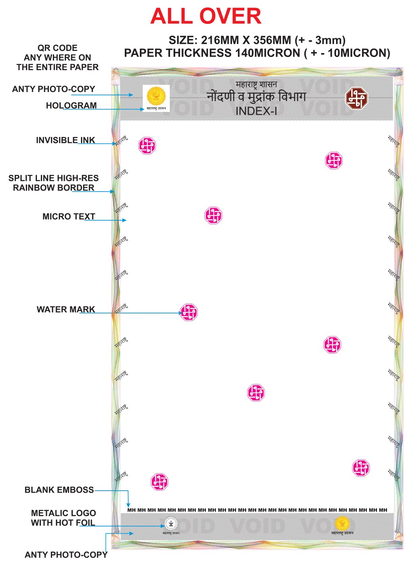
PRAKRUTI GRAPHIC / PROPIX
Solution
9 / 24
Propix Mudrank — Secure Legal Paper
In-house non-tearable 130–140 micron paper with multi-layer physical + digital security
Document
INDEX-I style layout for Registration & Stamps
Size
216 × 356 mm (±3 mm) — legal format
Thickness
140 micron (±10) non-tearable substrate
Authority
महाराष्ट्र शासन · नोंदणी व मुद्रांक विभाग
Physical
Watermark · VOID · UV · Hologram · Foil · Emboss
Digital
QR anywhere on paper for verify & trace
Secure Legal Paper | Physical + Digital | Track & Trace
Confidential · www.pgpltechprint.com

Slide 10
PRAKRUTI GRAPHIC / PROPIX
Point 04 · Combination
10 / 24
Physical + Digital — Together on One Paper
Security is incomplete if either layer is missing
PHYSICAL ON PAPER
DIGITAL ON PAPER
• Non-tearable 140µ substrate
• Watermark & micro patterns
• Anti-copy VOID pantograph
• Rainbow guilloche border
• Invisible / UV ink
• Hologram + metallic hot foil
• Blank emboss (MH)
• Unique QR / serial per sheet
• Cloud authenticity match
• Instant Genuine / Fake result
• Access of registered information
• Scan location · time · reuse alerts
• Admin Track & Trace dashboard
• Barrier at every verification point
Secure Legal Paper | Physical + Digital | Track & Trace
Confidential · www.pgpltechprint.com

Slide 11
PRAKRUTI GRAPHIC / PROPIX
Manufacturing
11 / 24
8-Process Security Manufacturing Stack
In-house process-wise build — each layer adds a verification barrier
1
2
3
4
Green Base
Watermark
Anti-Copy
4-Colour
Secure colour substrate
Embedded identity mark
VOID on photocopy
Official print layout
5
6
7
8
Invisible Ink
Hologram
Metallic Logo
Blank Emboss
UV महाराष्ट्र marks
Hot foil stamping
Govt seal hot foil
Tactile MH pattern
Secure Legal Paper | Physical + Digital | Track & Trace
Confidential · www.pgpltechprint.com

Slide 12

PRAKRUTI GRAPHIC / PROPIX
Physical Features
12 / 24
PROCESS 01
Non-tearable Secure Substrate
In-house 130–140 micron paper — built for legal durability
• Special non-tearable substrate processed in-house
• 140 micron (±10) thickness for legal-format strength
• Resists casual tear, substitution and weak stationery fraud
• Premium feel vs ordinary green legal paper
• Foundation layer for all overt & covert features
Secure Legal Paper | Physical + Digital | Track & Trace
Confidential · www.pgpltechprint.com

Slide 13
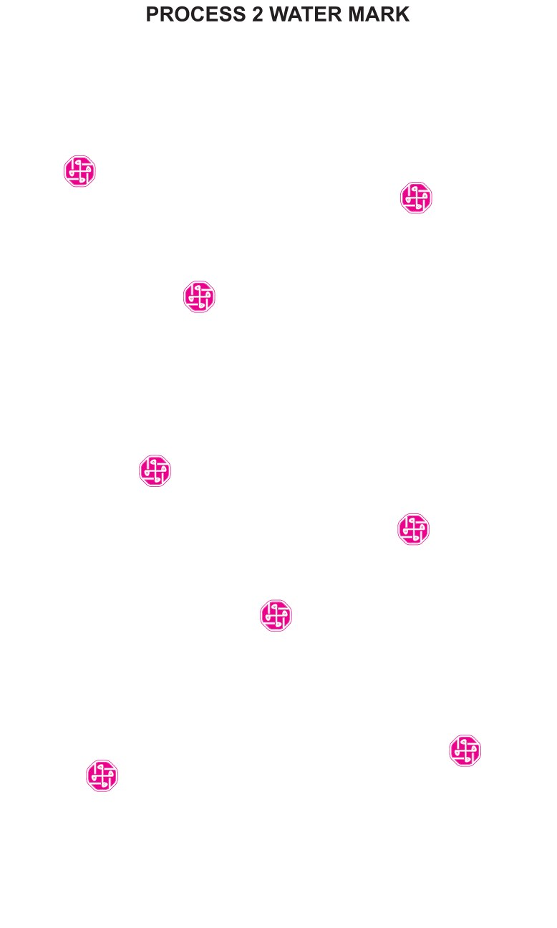
PRAKRUTI GRAPHIC / PROPIX
Physical Features
13 / 24
PROCESS 02
Watermark Security
Embedded paper identity that photocopy cannot carry
• Process-integrated watermark marks across the sheet
• Visible authentication under light / inspection
• Fails under ordinary photocopy and low-grade reprint
• Supports government-document authenticity cues
Secure Legal Paper | Physical + Digital | Track & Trace
Confidential · www.pgpltechprint.com

Slide 14
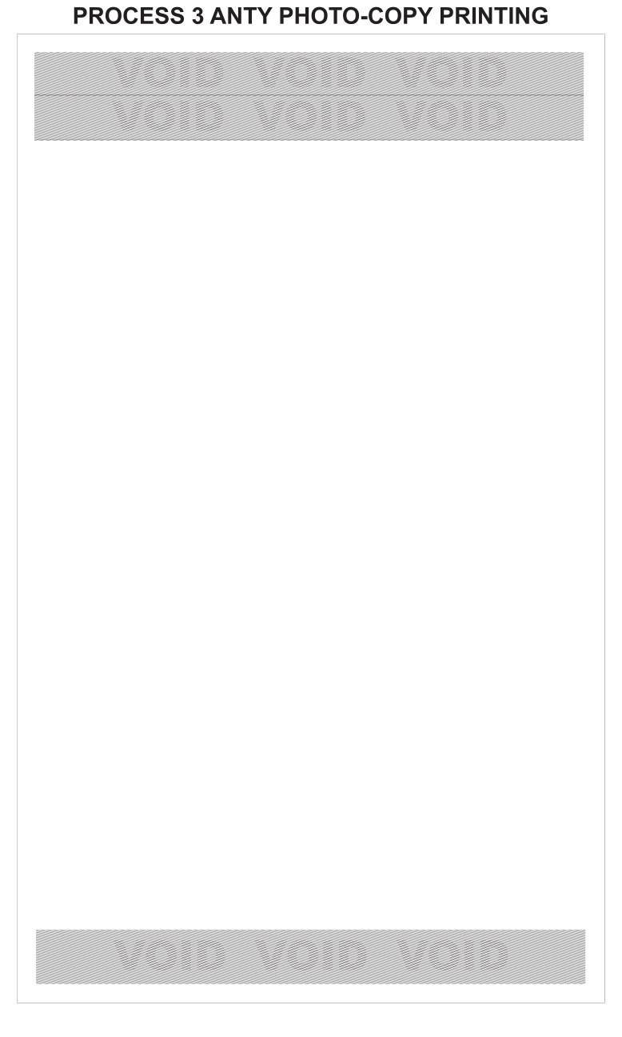
PRAKRUTI GRAPHIC / PROPIX
Physical Features
14 / 24
PROCESS 03
Anti-Photocopy VOID Printing
Hidden pantograph that exposes duplication attempts
• Fine-line security bands with hidden VOID pattern
• Original looks clean; copy reveals VOID warning
• Direct counter to documentation duplication fraud
• Works as an instant visual barrier for examiners
Secure Legal Paper | Physical + Digital | Track & Trace
Confidential · www.pgpltechprint.com

Slide 15
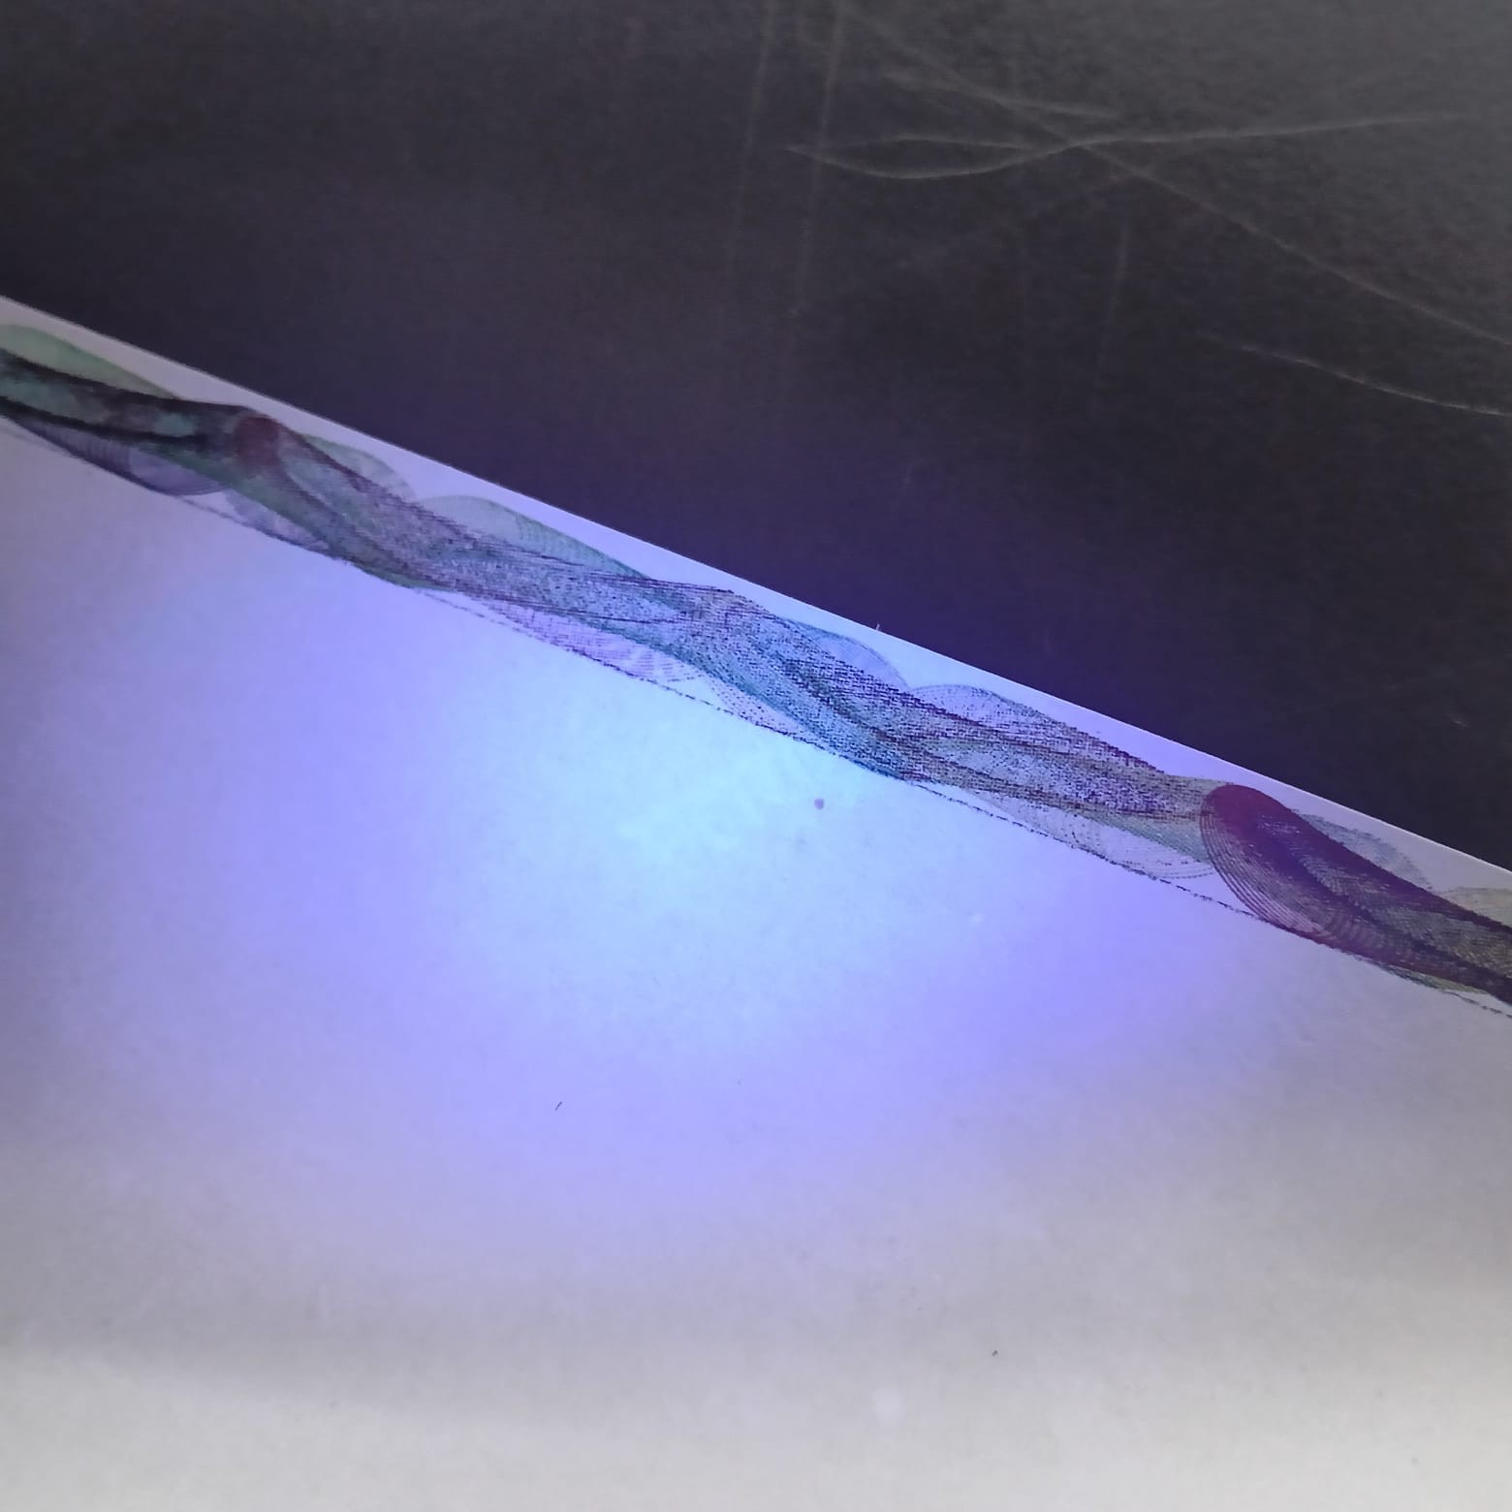
PRAKRUTI GRAPHIC / PROPIX
Physical Features
15 / 24
PROCESS 04–05
Rainbow Border · Official Print · UV Ink
High-resolution guilloche + 4-colour layout + invisible महाराष्ट्र marks
• Split-line high-res rainbow / guilloche border
• 4-colour official INDEX-I style government layout
• Invisible ink printing of महाराष्ट्र on margins
• UV inspection for covert field verification
• Original close-up photos available for live demo
Secure Legal Paper | Physical + Digital | Track & Trace
Confidential · www.pgpltechprint.com

Slide 16
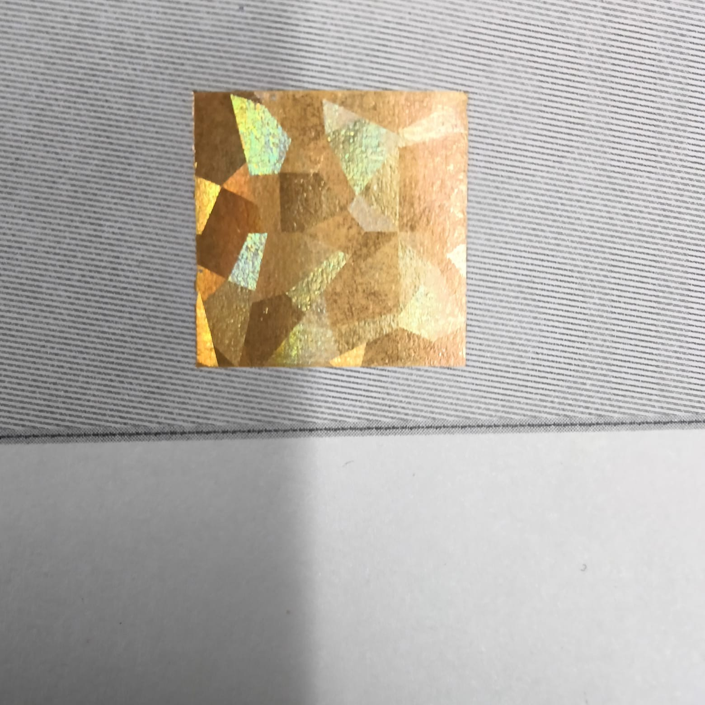
PRAKRUTI GRAPHIC / PROPIX
Physical Features
16 / 24
PROCESS 06–08
Hologram · Metallic Foil · Blank Emboss
Optical + tactile government authentication layers
• Hologram hot foil stamping for optical security
• Metallic Maharashtra logo / seal with hot foil
• Blank emboss repeating MH for feel-to-verify
• Hard to replicate on desktop / office printers
• Strong overt deterrent against forged stationery
Secure Legal Paper | Physical + Digital | Track & Trace
Confidential · www.pgpltechprint.com

Slide 17
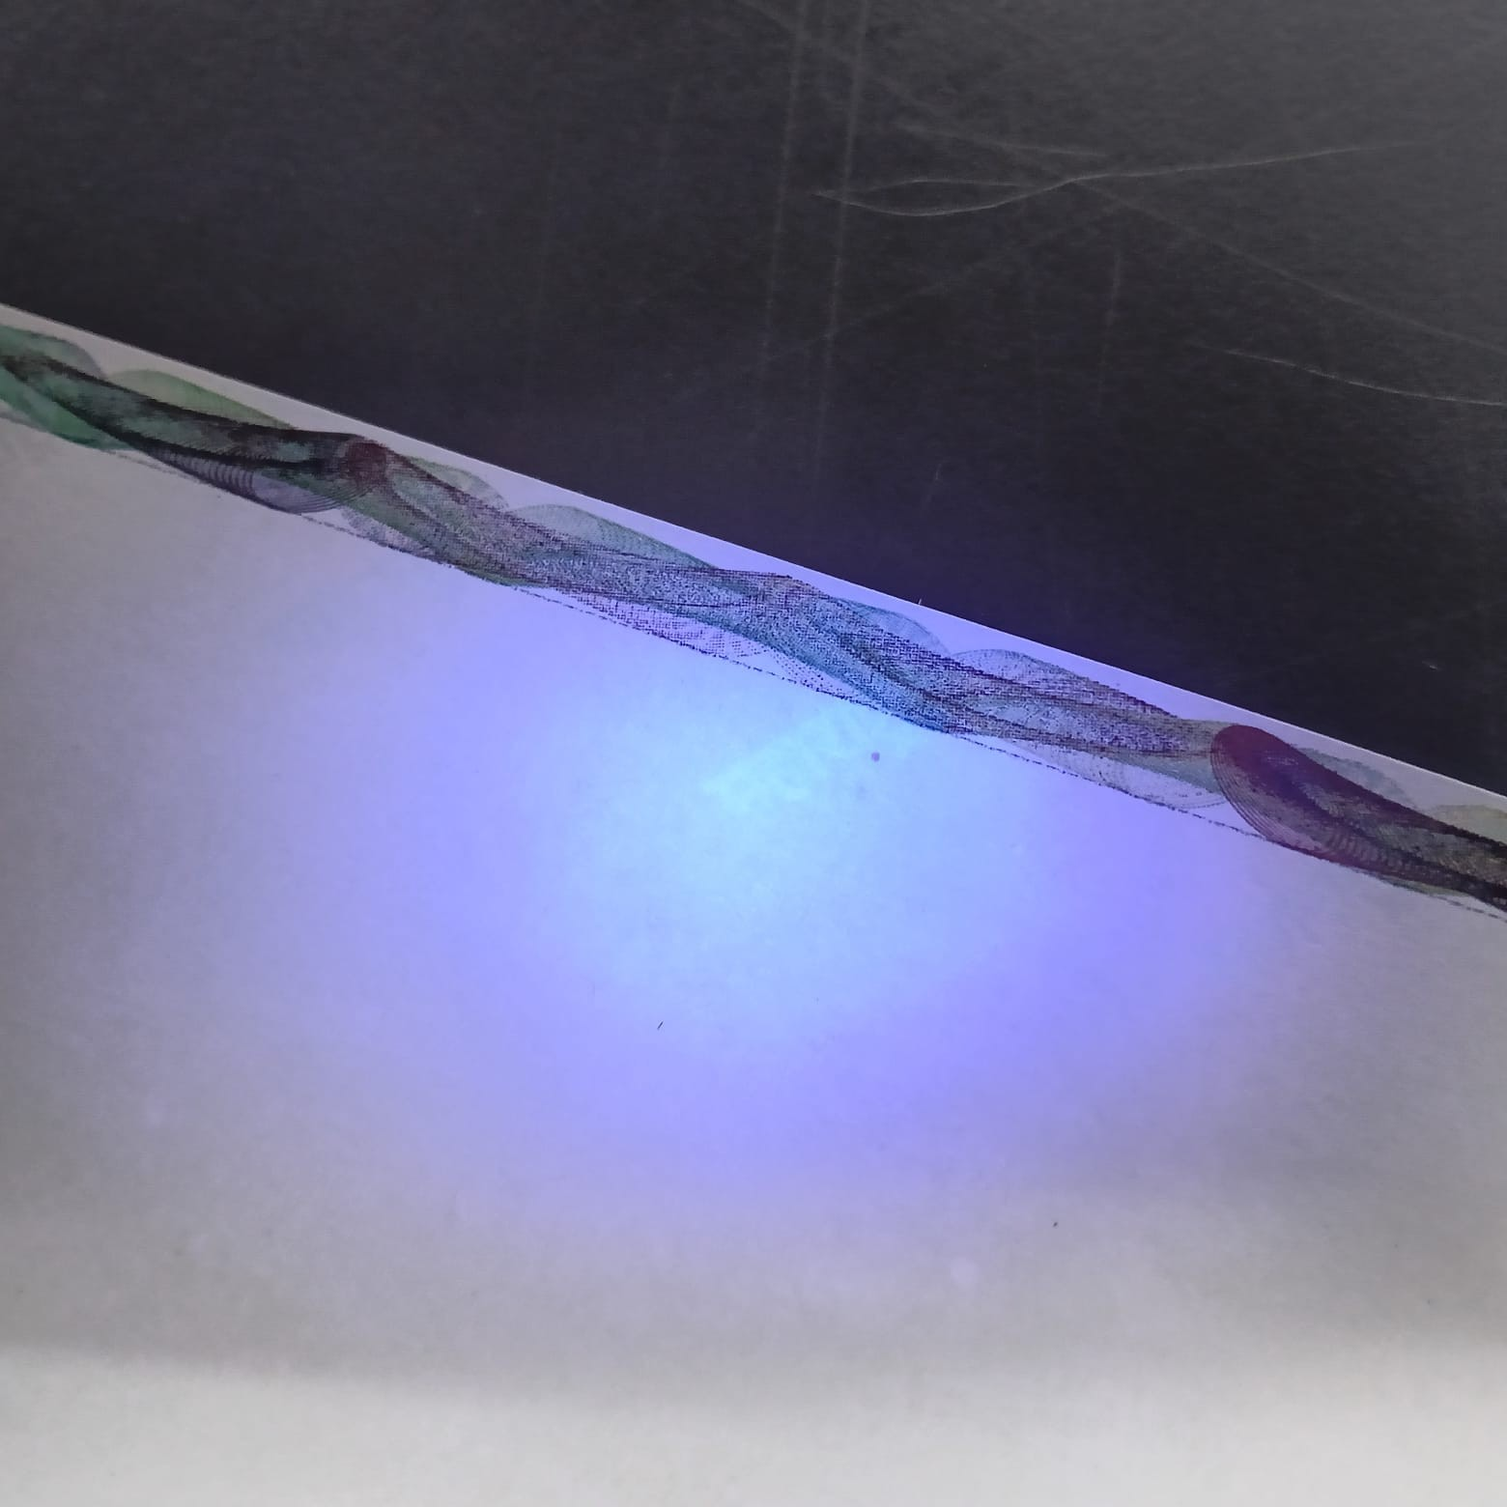
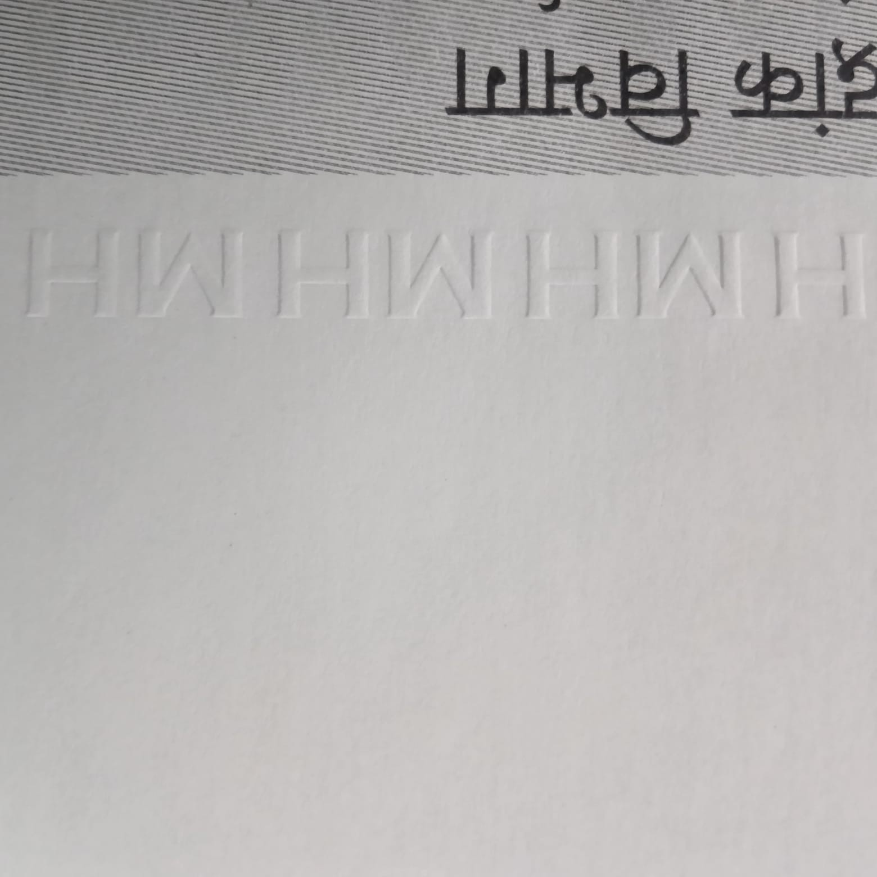
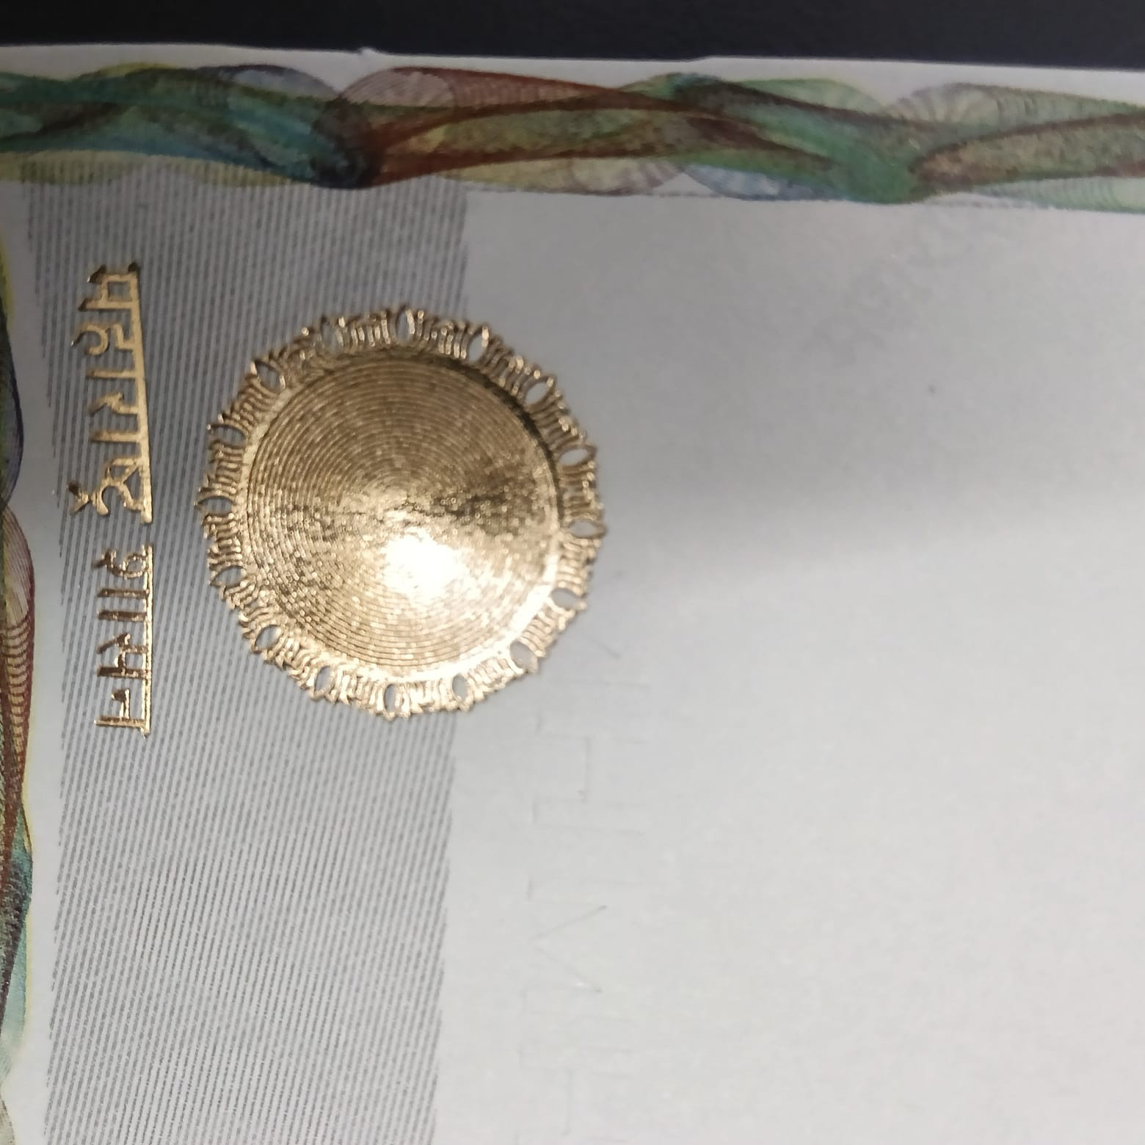
PRAKRUTI GRAPHIC / PROPIX
Original Feature Photos
17 / 24
Original Security Feature Close-ups
Captured from Propix Mudrank sample legal paper
Rainbow Guilloche / UV
Invisible / UV Reaction
MH Blank Emboss
Metallic Hot Foil Seal
Security Hologram
Full Paper Specimen
Secure Legal Paper | Physical + Digital | Track & Trace
Confidential · www.pgpltechprint.com

Slide 18
PRAKRUTI GRAPHIC / PROPIX
Physical Features
18 / 24
Security Features Matrix
Overt · Covert · Forensic — multi-layer defence on a single sheet
Feature
Type
How it stops fraud
Non-tearable 140µ
Overt
Hard to tear / substitute with normal paper
Watermark
Covert
Visible in light; fails on photocopy
Anti-copy VOID
Covert
Hidden VOID appears on photocopy/scan
Guilloche border
Overt
Fine-line pattern resists consumer print
Invisible / UV ink
Covert
UV check reveals महाराष्ट्र marks
Hologram + foil
Overt
Optical / metallic features hard to fake
MH blank emboss
Tactile
Feel-to-verify raised authentication
Unique QR
Digital
Cloud match + reuse/anomaly detection
Secure Legal Paper | Physical + Digital | Track & Trace
Confidential · www.pgpltechprint.com

Slide 19
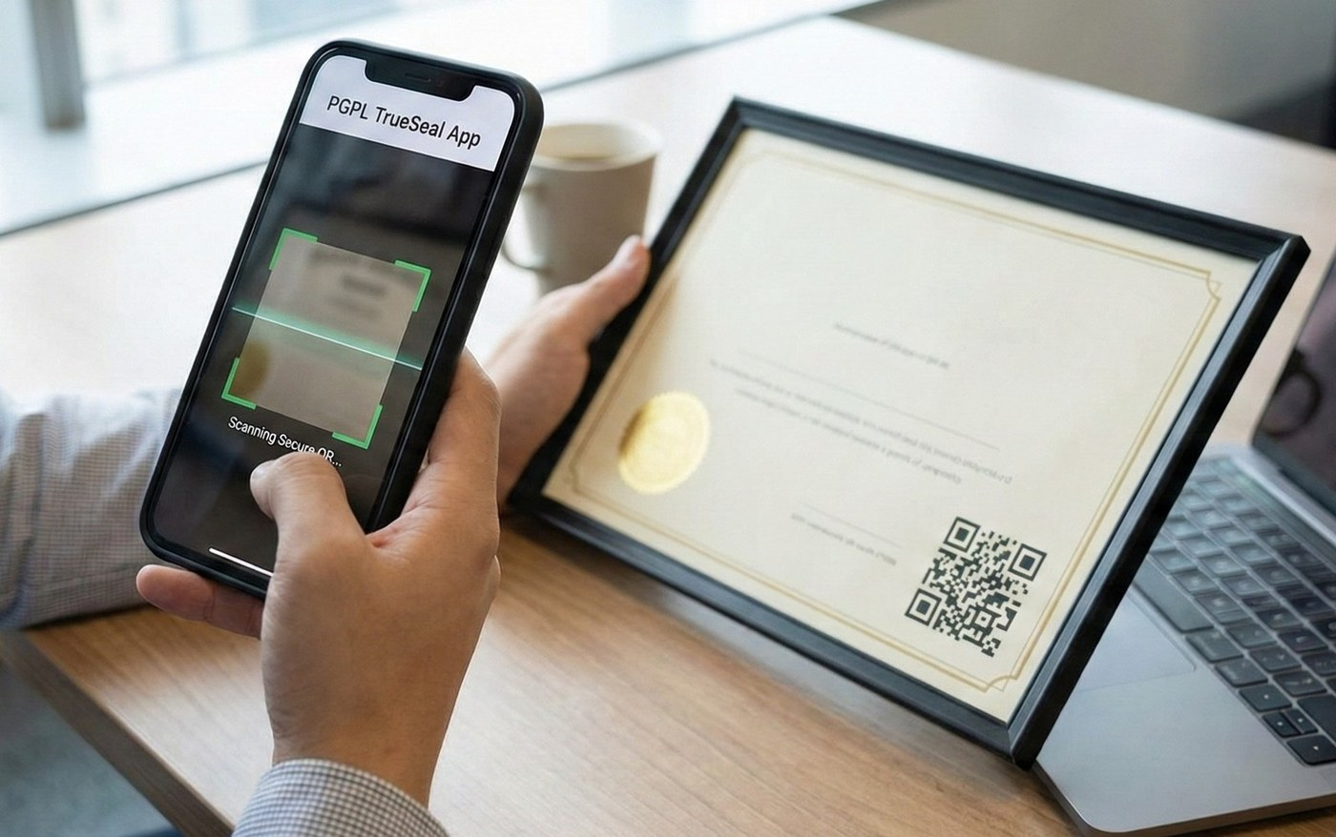
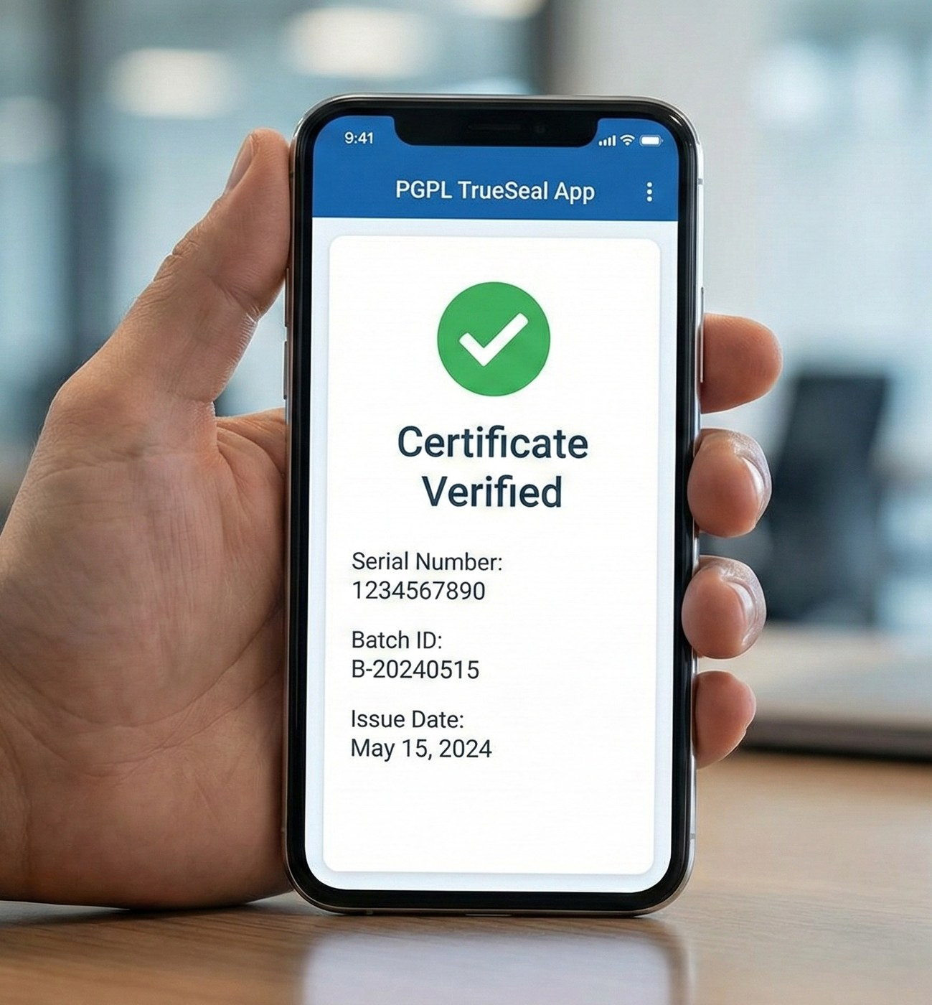
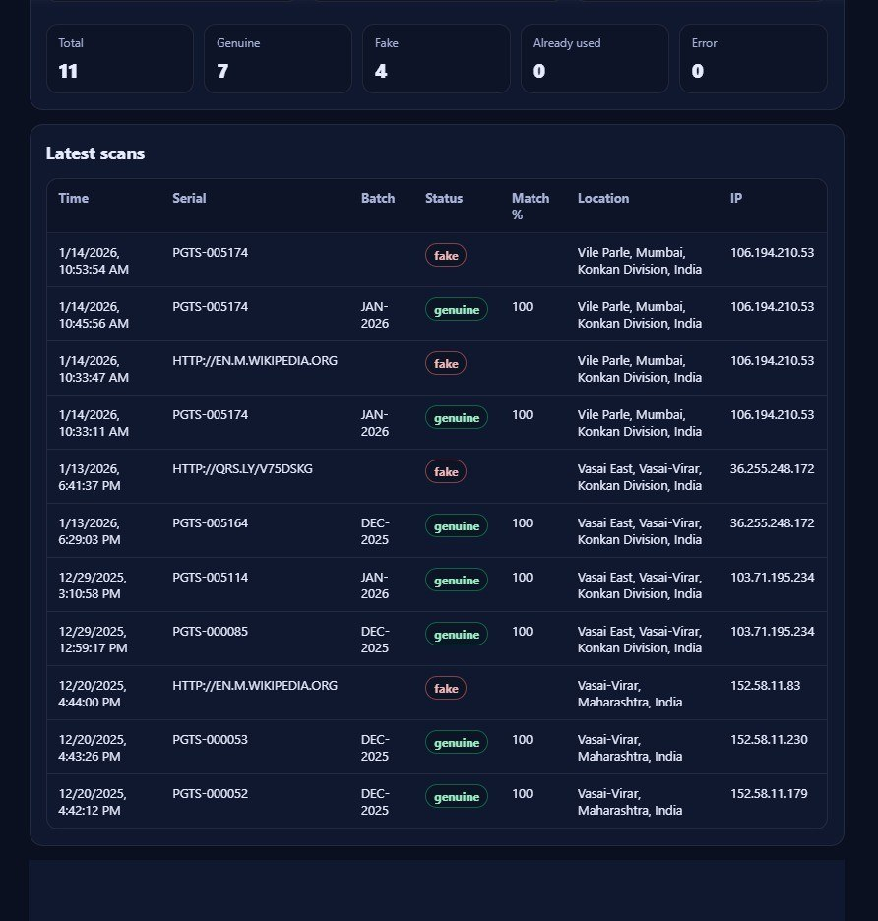
PRAKRUTI GRAPHIC / PROPIX
Point 05 · Digital
19 / 24
Strong Digital Support for Traceability
Access of information · authenticity · security — from one scan
1
2
3
4
5
Scan QR
Cloud Match
Access Info
Decision
Trace Log
Officer / bank / citizen scans sheet QR
Serial + security payload checked live
Document identity / status returned
Genuine · Fake · Already Used
Time, place, IP stored on dashboard
Secure Legal Paper | Physical + Digital | Track & Trace
Confidential · www.pgpltechprint.com

Slide 20
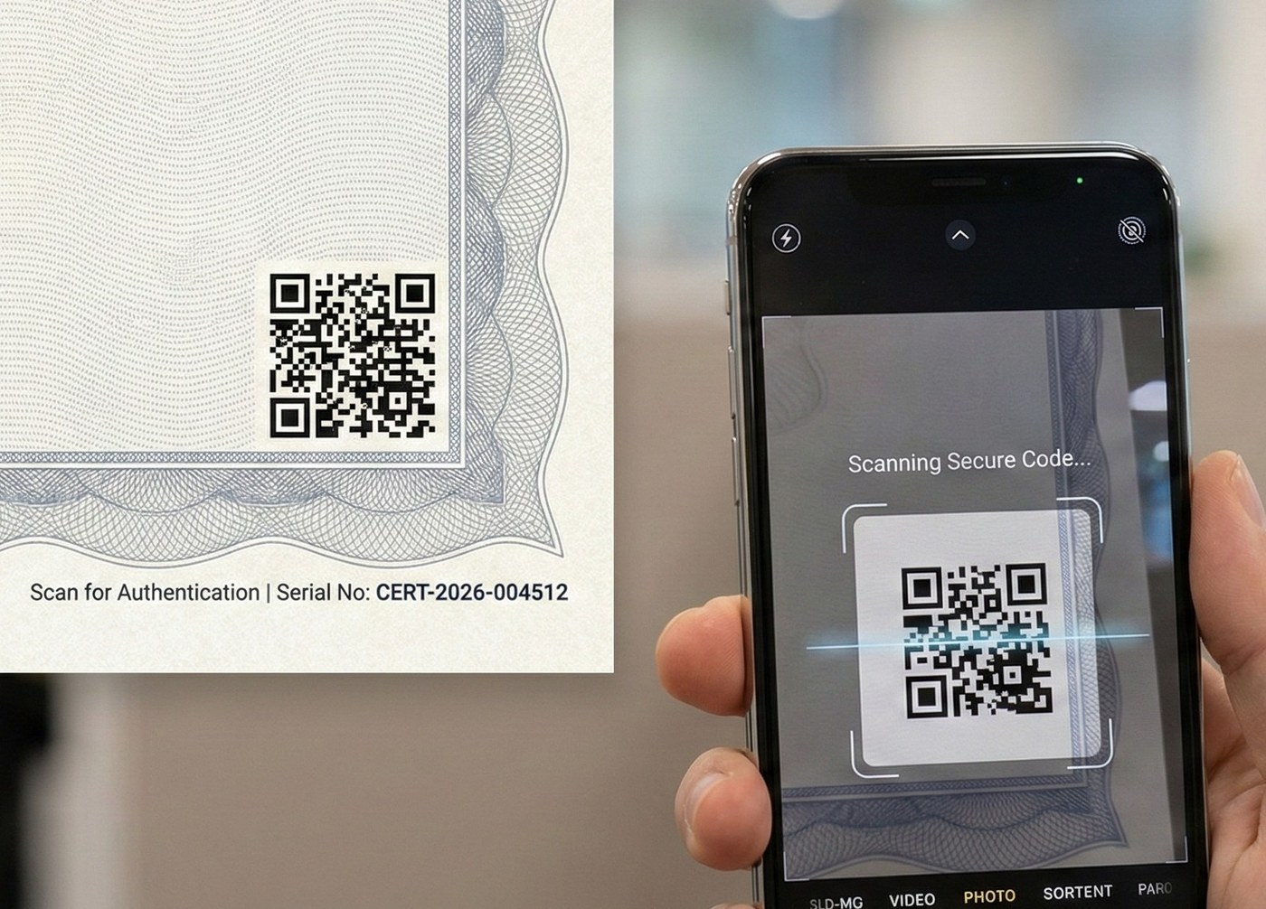
PRAKRUTI GRAPHIC / PROPIX
Digital Authentication
20 / 24
Unique Security QR on Every Sheet
Each legal paper carries a unique digital identity linked to secure cloud
• Unique serial + matching QR for every sheet / batch
• QR linked to centralized secure database record
• Every scan validates against original cloud data
• Supports citizen / bank / officer authentication
• Admin can generate batches and monitor scan events
• Detects duplicate use, suspicious reuse and location anomalies
Secure Legal Paper | Physical + Digital | Track & Trace
Confidential · www.pgpltechprint.com

Slide 21
PRAKRUTI GRAPHIC / PROPIX
Track & Trace
21 / 24
Track & Trace + Live Scan Intelligence
From issue to registration to later verification — full visibility
End-to-end control loop
• Generate unique serial + Security QR in secure cloud
• Print / issue on Propix Mudrank legal paper
• Scan at stamp / registration / bank checkpoints
• Citizen or officer verifies via app / portal
• Admin sees Genuine / Fake / Already-used with geo + time
Secure Legal Paper | Physical + Digital | Track & Trace
Confidential · www.pgpltechprint.com

Slide 22
PRAKRUTI GRAPHIC / PROPIX
Impact
22 / 24
Before vs After — Control Comparison
From open stationery to barrier-based secure legal paper
Dimension
Today (Plain / Green)
Propix Mudrank
Paper strength
Easily tearable / substitutable
Non-tearable 130–140µ
Copy resistance
Photocopy looks similar
VOID + fine-line + UV fails copy
Visual auth
Limited cues
Hologram, foil, emboss, border
Digital identity
Usually absent on sheet
Unique QR + cloud record
Traceability
Fragmented / manual
Live scan Track & Trace
Process barrier
Weak checkpoints
Physical + digital barriers
Secure Legal Paper | Physical + Digital | Track & Trace
Confidential · www.pgpltechprint.com

Slide 23
PRAKRUTI GRAPHIC / PROPIX
Stakeholders
23 / 24
Who Gains — and How
One secure paper system serving government, citizens and finance
State / IGR
Sub-Registrar
Citizens
Banks / NBFCs
• Higher forgery resistance
• Better process control
• Revenue & record integrity
• Faster authenticity cues
• UV / emboss / QR checks
• Lower dispute friction
• Harder to fake deeds
• Scan-to-verify confidence
• Safer property transfers
• Instant sheet verification
• Lower title-document risk
• Cleaner onboarding
Secure Legal Paper | Physical + Digital | Track & Trace
Confidential · www.pgpltechprint.com

Slide 24
Secure the Paper. Control the Process.
Propix Mudrank combines non-tearable physical security with QR-based digital traceability
for Maharashtra Registration & Stamps documentation.
Stop easy duplication
Add real barriers
Combine physical + digital
Enable track & verify
Next step: Pilot deployment / sample evaluation with IGR Maharashtra
prakruti@prakrutigraphic.com · +91 98212 32349 · www.pgpltechprint.com
Thank You

