Slide 1
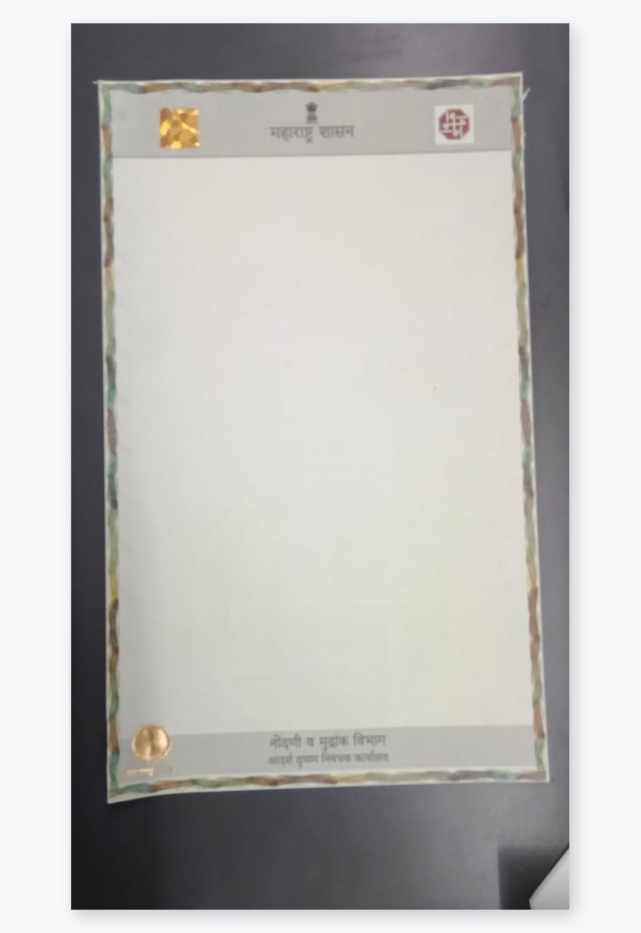
MAHARASHTRA · REGISTRATION & STAMPS
PRAKRUTI GRAPHIC PVT. LTD.
Secure Legal Paper
for Property Registration
Safe paper + QR check + easy tracking
Strong paper that does not tear easily
Hidden marks, hologram, foil and raised print
Scan QR to check if paper is real
Made for property registration documents
prakruti@prakrutigraphic.com · +91 98212 32349

Slide 2
PRAKRUTI GRAPHIC PVT. LTD.
Overview
2 / 24
What's Inside
Problem → Facts → Product → Features → Digital Check → Result
01
02
03
The Problem
Maharashtra Facts
Our Secure Paper
Fraud, fake papers and weak checks
Big money + recent fraud cases
Strong paper with many safety marks
04
05
06
Paper Features
QR & Tracking
Final Benefit
Step-by-step safety layers on paper
Scan, check and follow each paper
More control, more trust, less loss
Secure Legal Paper | Paper Security + QR Check + Tracking
Confidential · www.pgpltechprint.com

Slide 3
PRAKRUTI GRAPHIC PVT. LTD.
Context
3 / 24
Why Do We Need Secure Legal Paper Now?
Property papers handle big money — fake papers cause big loss
₹59,150 Cr
13.4 Lakh+
₹10–20k Cr
Stamp & registration money
collected in FY 2024–25
Property documents
registered in one year
Possible loss under
state-level fraud probe*
What is at risk
Problem with today's paper
• Property papers prove who owns the land or house
• Banks also depend on these papers for loans
• Fake papers can cheat buyers and the government
• State needs stronger paper to protect public money
• Mostly simple green / plain legal paper
• Easy to copy, tear, or make a fake look real
• No easy way to scan and confirm it is original
• Weak safety checks in the full process
*Sources: CAG report, IGR Maharashtra, news reports on stamp duty probe.
Secure Legal Paper | Paper Security + QR Check + Tracking
Confidential · www.pgpltechprint.com

Slide 4
PRAKRUTI GRAPHIC PVT. LTD.
Problem
4 / 24
Five Big Problems in Documents
These gaps make fraud and fake papers easier
1
Fraud in the past
Fake registration and wrong process cases found
2
Same paper copied again
Fake sale deeds, fake seals, double selling
3
No strong checks
No QR / safety marks at every step
4
Paper and digital not joined
Online systems and paper safety stay separate
5
Need easy tracking
Anyone should quickly check if paper is real
Secure Legal Paper | Paper Security + QR Check + Tracking
Confidential · www.pgpltechprint.com

Slide 5
PRAKRUTI GRAPHIC PVT. LTD.
Problem 01 · Fraud
5 / 24
Fraud Found in Past
Recent Maharashtra cases show how weak checks can cause big loss
Navi Mumbai
Full State Check
₹13.91 Cr
₹10–20k Cr*
Many property papers of illegal buildings were registered with less stamp duty. Case filed against officers and agents.
Government ordered a big check on stamp duty cases from 2021 to 2026 after fraud reports.
Marathwada Cases
Satara Land Case
16+ cases
Fake seals
Fake ownership papers, fake inheritance papers, and double selling. Even AI-made fake papers reported.
Fake sale deed and fake office seals used. Registration number was not found in real records.
Secure Legal Paper | Paper Security + QR Check + Tracking
Confidential · www.pgpltechprint.com

Slide 6
PRAKRUTI GRAPHIC PVT. LTD.
Problem 02 · Copying
6 / 24
Document Copying Found in Past
When paper is easy to copy, fake papers look almost real
What police / officers keep finding
Why plain green paper fails
• Fake sale deeds used to transfer property
• Fake office seals and fake signatures
• Same property sold more than once
• Fake ownership / inheritance papers
• Computer-made fake papers also found
• Simple paper copies can look good enough
• No clear 'FAKE COPY' mark on photocopy
• Hard for officers to feel or see the difference
• Buyers and banks cannot check quickly
• Each paper has no unique digital ID
Secure Legal Paper | Paper Security + QR Check + Tracking
Confidential · www.pgpltechprint.com

Slide 7
PRAKRUTI GRAPHIC PVT. LTD.
Problem 03 · No Checks
7 / 24
No Strong Control on the Process
Because safety checks are missing from start to end
1. Draft
2. Stamp
3. Register
4. Record
5. Bank
Paper written
on plain sheet
→
Stamp duty
paid / paper given
→
Office signs
the document
→
Land record
gets updated
→
Bank / buyer
checks paper
Gap today: process is open — safety locks are missing
• No strong secure paper on every important sheet
• No unique QR linked to each paper
• No quick Real / Fake check for officers and banks
• No live record of who scanned the paper and where
Secure Legal Paper | Paper Security + QR Check + Tracking
Confidential · www.pgpltechprint.com

Slide 8
PRAKRUTI GRAPHIC PVT. LTD.
Facts & Numbers
8 / 24
Maharashtra Stamp & Registration Money
A very big system — needs very strong paper
Money collected from stamp & registration (₹ Crore)
Why this matters
57,670
• Many documents every year
• Even small fraud causes big loss
• Recent cases show pressure
• Secure paper reduces fake risk
• Quick check builds trust
40,099
35,029
25,288
FY21-22
FY22-23
FY23-24
FY24-25*
*FY24–25 about ₹57,670 Cr (news). Older years from IGR data. Shown for simple understanding.
Secure Legal Paper | Paper Security + QR Check + Tracking
Confidential · www.pgpltechprint.com

Slide 9
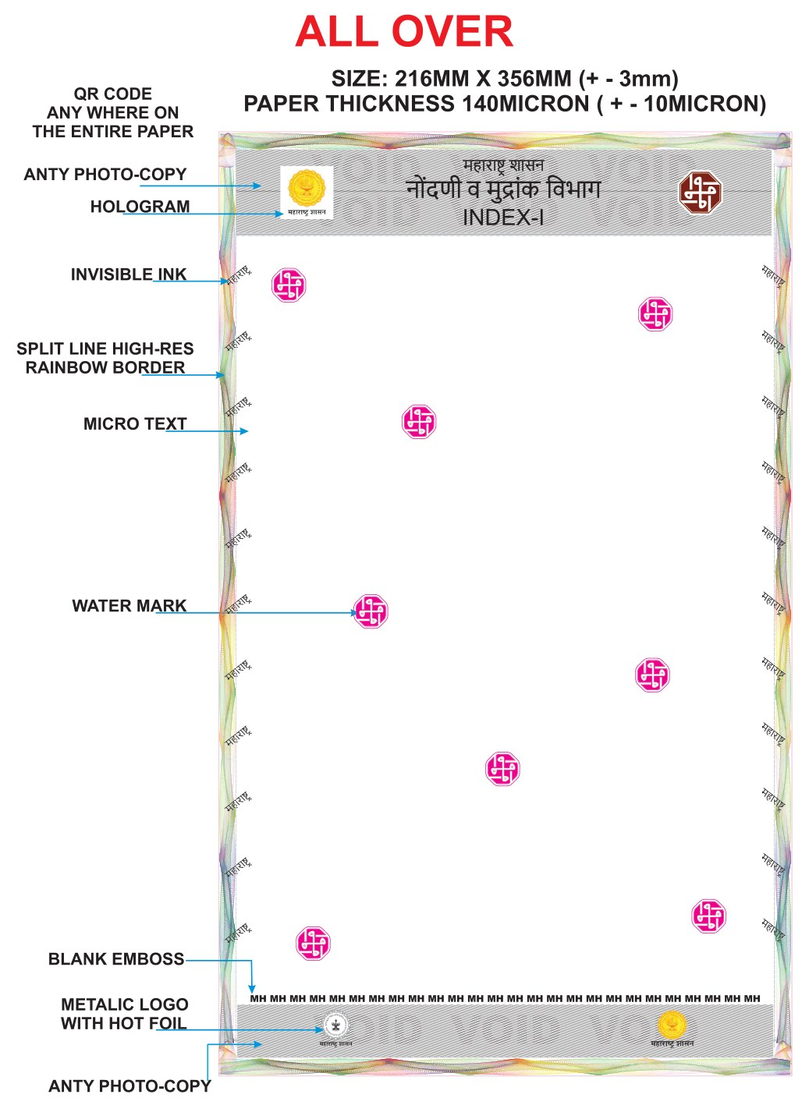
PRAKRUTI GRAPHIC PVT. LTD.
Solution
9 / 24
Our Secure Legal Paper
Strong paper made in-house — with many safety marks + QR check
Use
Property registration / stamp department papers
Size
Legal size — 216 × 356 mm
Paper
Thick strong paper (about 140 micron) — hard to tear
For
Maharashtra Registration & Stamps Department
On paper
Watermark, copy-stop mark, UV mark, hologram, foil, raised print
Digital
QR code on paper for Real / Fake check and tracking
Secure Legal Paper | Paper Security + QR Check + Tracking
Confidential · www.pgpltechprint.com

Slide 10
PRAKRUTI GRAPHIC PVT. LTD.
Problem 04 · Together
10 / 24
Paper Safety + Digital Check — Together
Only paper or only online is not enough. Both must work as one.
ON THE PAPER
ON PHONE / COMPUTER
• Strong paper that does not tear easily
• Watermark and fine line patterns
• Copy shows warning mark
• Rainbow border design
• Hidden mark seen under special light
• Hologram and shiny foil logo
• Raised MH print you can feel
• Unique QR on every sheet
• Check against secure online record
• Instant Real / Fake result
• See basic paper information
• Scan place and time gets saved
• Admin can track all scans
• Safety check at every step
Secure Legal Paper | Paper Security + QR Check + Tracking
Confidential · www.pgpltechprint.com

Slide 11
PRAKRUTI GRAPHIC PVT. LTD.
How Paper is Made
11 / 24
8 Safety Steps on One Paper
Each step adds one more lock against fake papers
1
2
3
4
Strong Base
Watermark
Copy Stop
Colour Print
Thick green secure paper
Hidden mark in paper
Copy shows warning
Official government look
5
6
7
8
Hidden Ink
Hologram
Metal Logo
Raised Print
Seen under special light
Shiny security stamp
Hot foil government seal
MH mark you can feel
Secure Legal Paper | Paper Security + QR Check + Tracking
Confidential · www.pgpltechprint.com

Slide 12
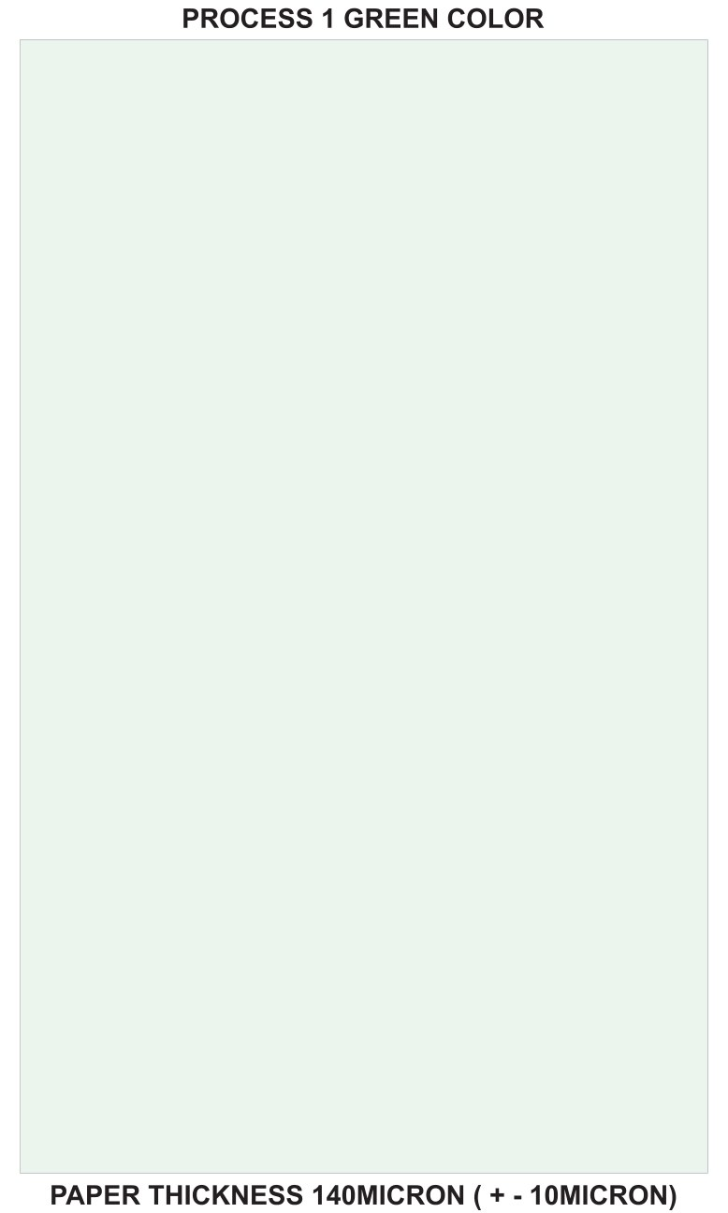
PRAKRUTI GRAPHIC PVT. LTD.
Paper Features
12 / 24
STEP 01
Strong Paper That Does Not Tear Easily
Made in-house — thicker and stronger than normal legal paper
• Special strong paper made by us
• About 140 micron thick — hard to tear
• Harder to replace with normal office paper
• Feels better and safer than plain green paper
• Base for all other safety marks
Secure Legal Paper | Paper Security + QR Check + Tracking
Confidential · www.pgpltechprint.com

Slide 13
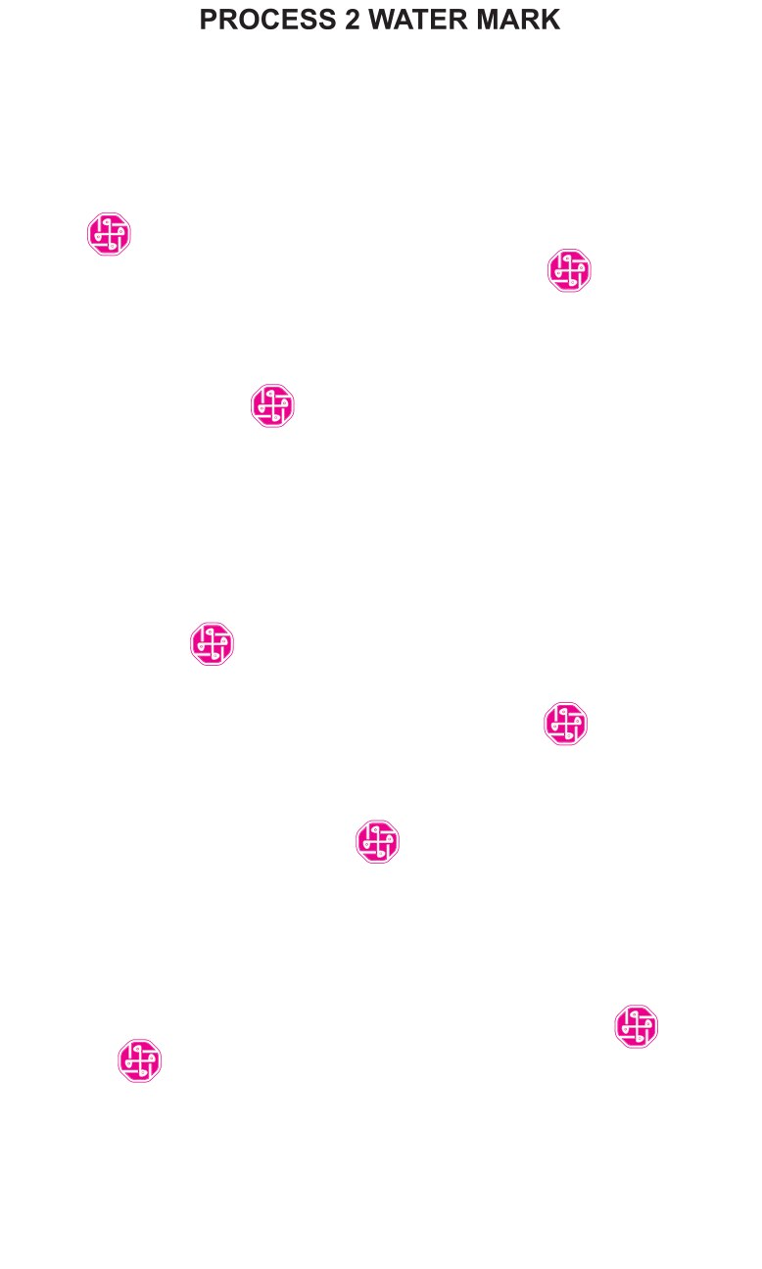
PRAKRUTI GRAPHIC PVT. LTD.
Paper Features
13 / 24
STEP 02
Watermark Safety
Hidden mark inside the paper — copy cannot keep it
• Watermark added during paper making
• Can be checked in light
• Normal photocopy cannot copy it properly
• Helps confirm the paper is original
Secure Legal Paper | Paper Security + QR Check + Tracking
Confidential · www.pgpltechprint.com

Slide 14
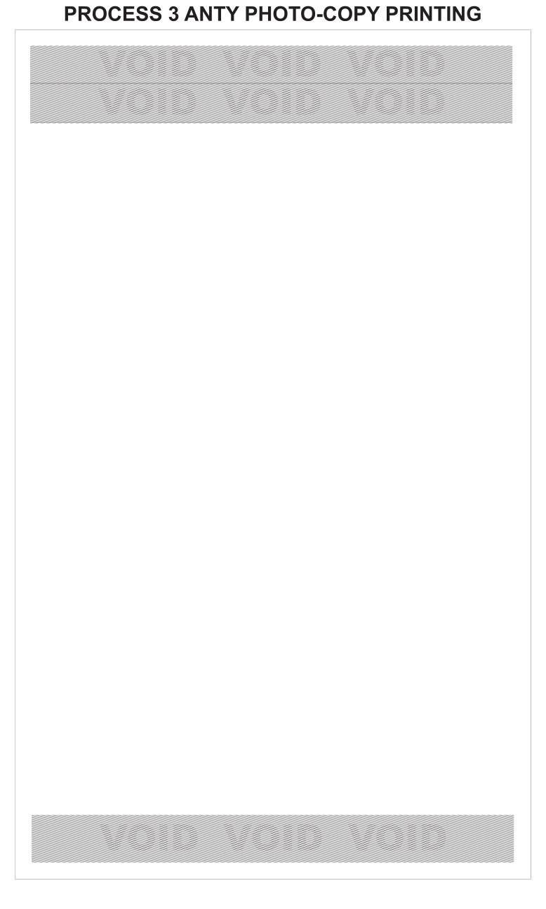
PRAKRUTI GRAPHIC PVT. LTD.
Paper Features
14 / 24
STEP 03
Copy-Stop Printing
If someone photocopies, a warning mark can appear
• Special print that stops easy copying
• Original looks clean
• Copy can show a warning word
• Direct help against fake duplicate papers
Secure Legal Paper | Paper Security + QR Check + Tracking
Confidential · www.pgpltechprint.com

Slide 15
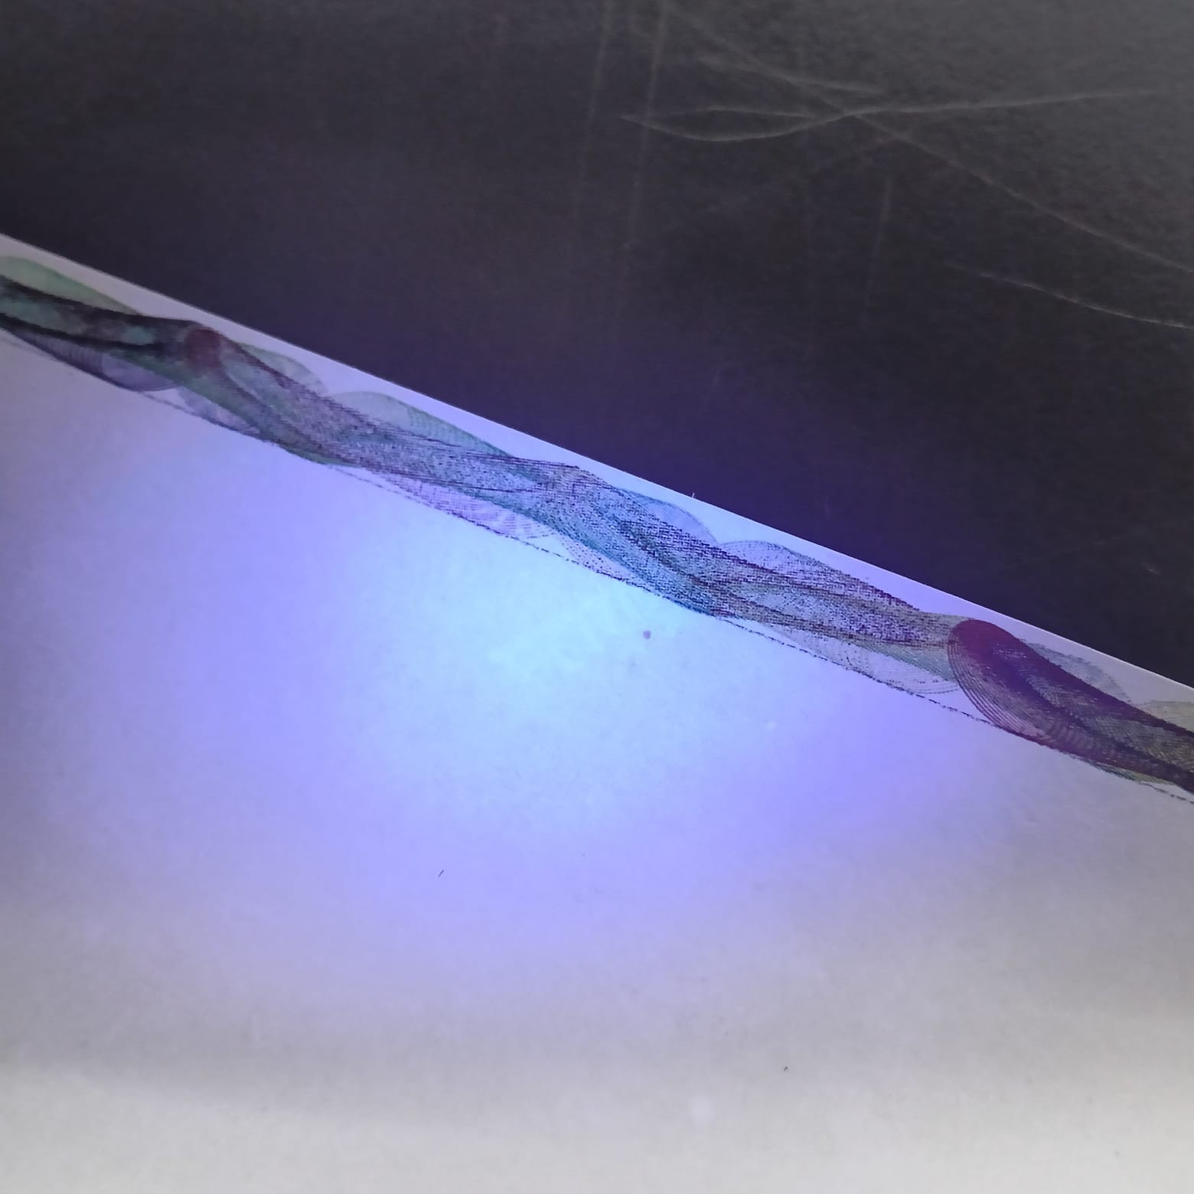
PRAKRUTI GRAPHIC PVT. LTD.
Paper Features
15 / 24
STEP 04–05
Rainbow Border · Official Print · Hidden Ink
Fine border + government look + secret marks under special light
• Fine rainbow / wave border — hard to print at home
• Official Maharashtra department printing
• Hidden 'महाराष्ट्र' marks on the sides
• Seen under special light for quick check
• Real close-up photos available for demo
Secure Legal Paper | Paper Security + QR Check + Tracking
Confidential · www.pgpltechprint.com

Slide 16
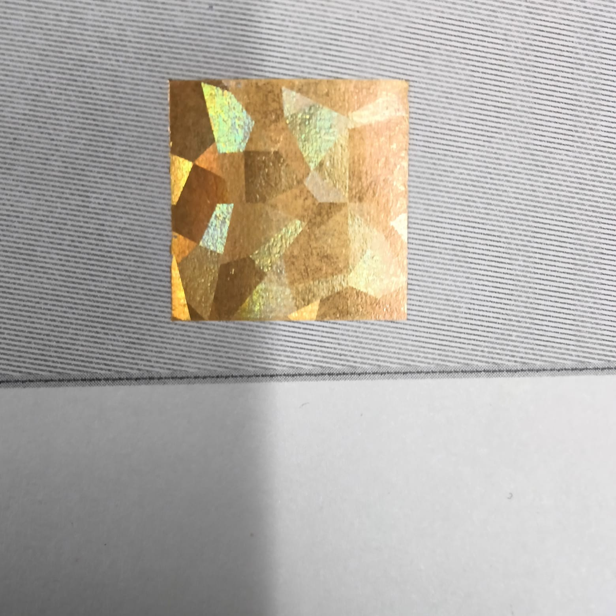
PRAKRUTI GRAPHIC PVT. LTD.
Paper Features
16 / 24
STEP 06–08
Hologram · Shiny Foil · Raised Print
See and feel these marks to confirm the paper is real
• Hologram stamp for shiny optical safety
• Metal-look Maharashtra logo with hot foil
• Raised MH print that you can feel by hand
• Very hard to make on normal printers
• Strong visual warning against fake paper
Secure Legal Paper | Paper Security + QR Check + Tracking
Confidential · www.pgpltechprint.com

Slide 17
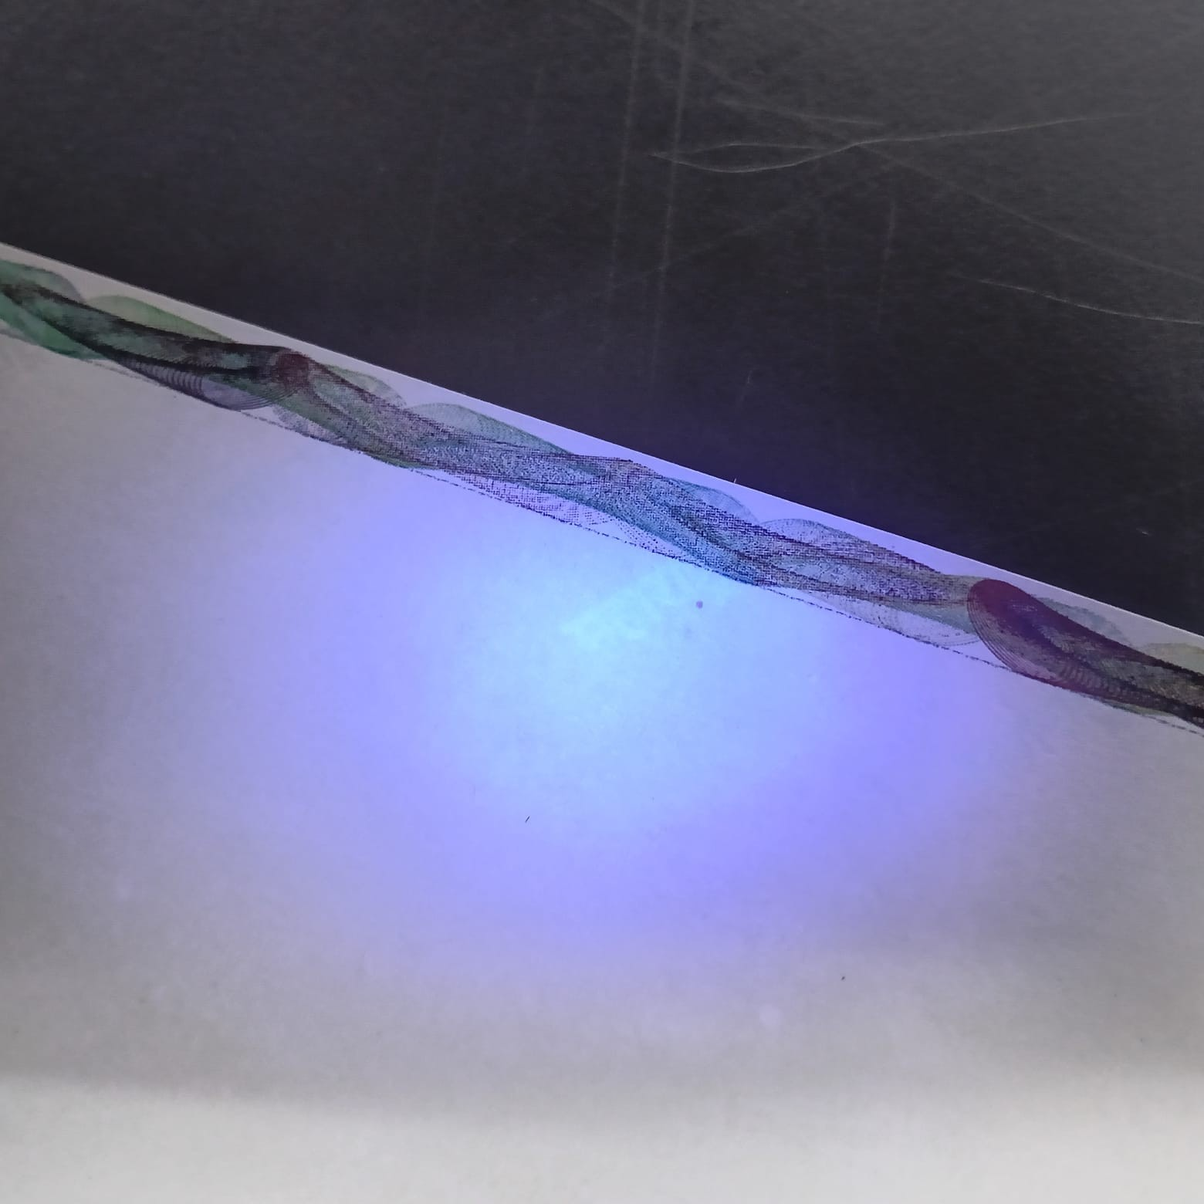
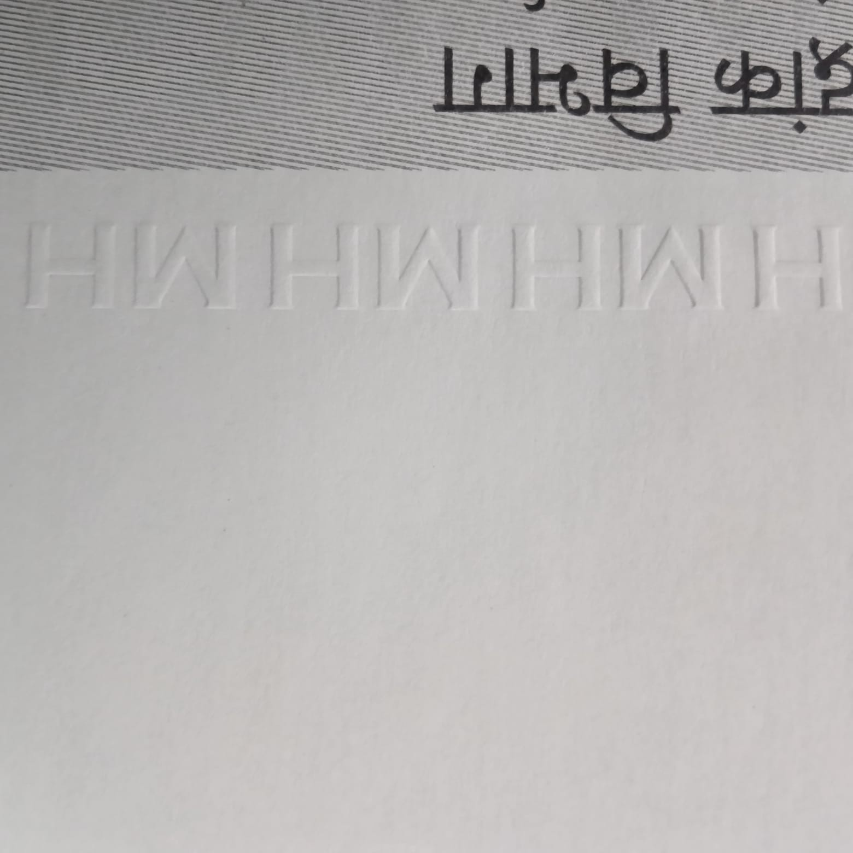
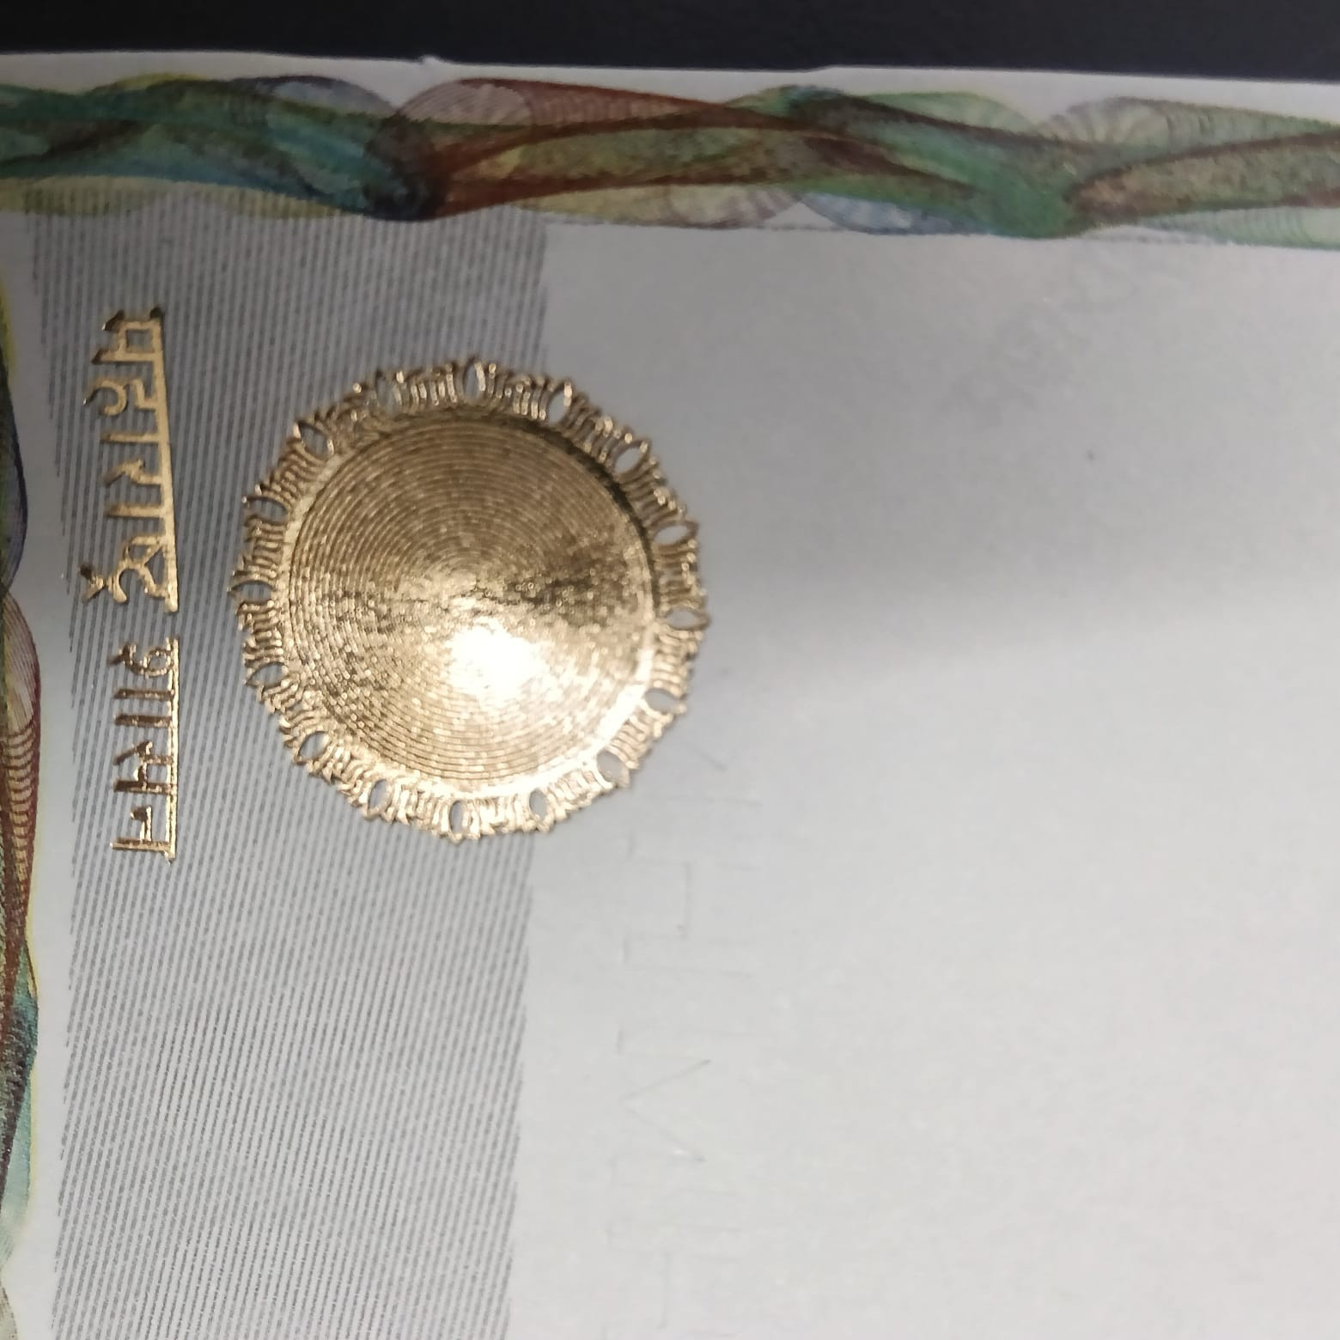
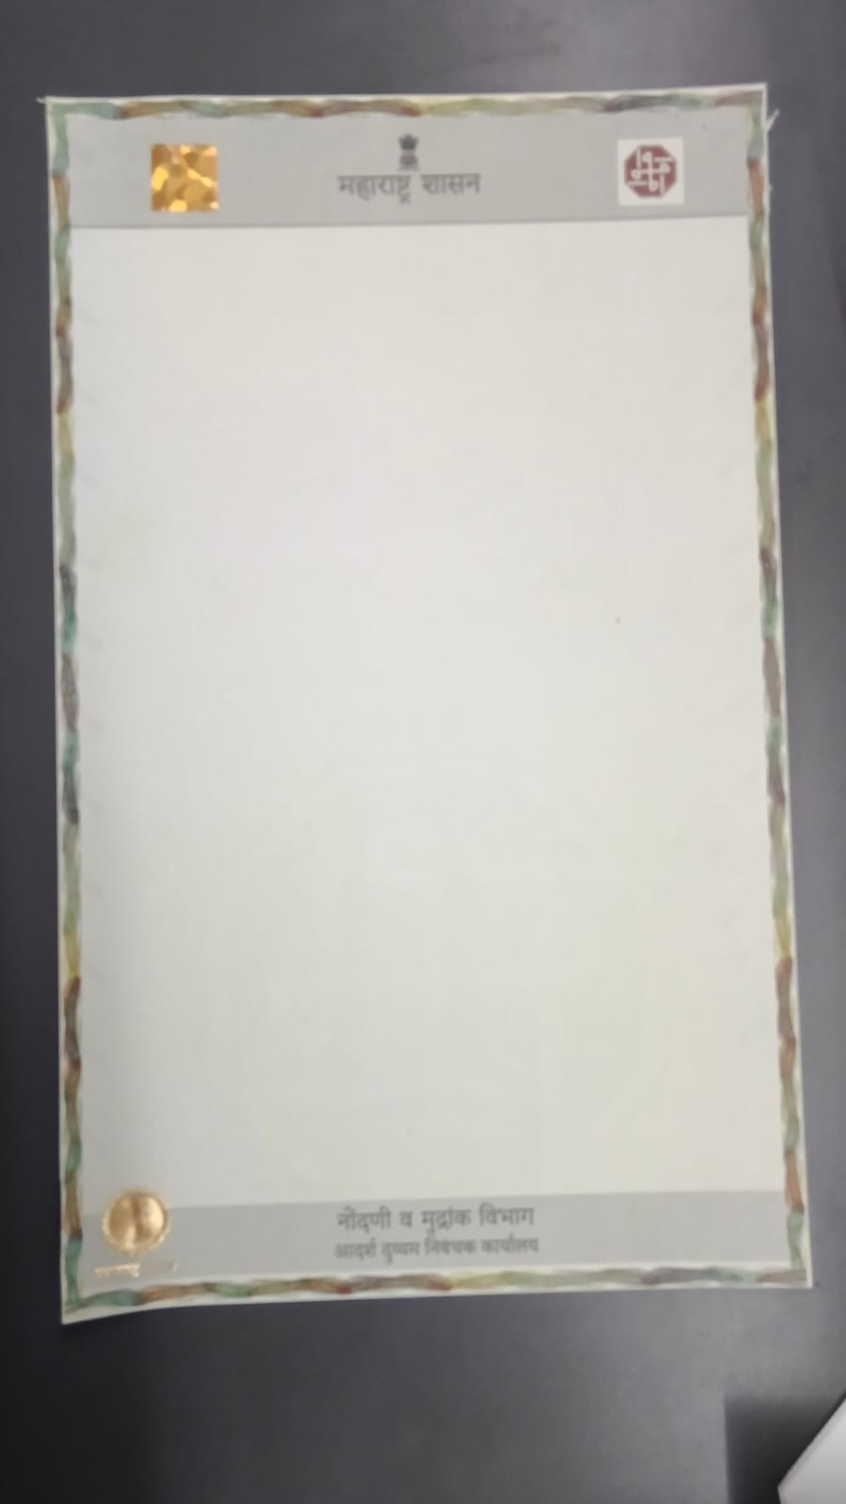
PRAKRUTI GRAPHIC PVT. LTD.
Real Photos
17 / 24
Real Close-up Photos of Safety Marks
Taken from our sample secure legal paper
Rainbow border + special light
Hidden mark under light
Raised MH print
Shiny foil seal
Security hologram
Full paper sample
Secure Legal Paper | Paper Security + QR Check + Tracking
Confidential · www.pgpltechprint.com

Slide 18
PRAKRUTI GRAPHIC PVT. LTD.
Paper Features
18 / 24
Safety Marks — Easy View
See · Feel · Scan — many ways to confirm the paper is real
Feature
Type
How it helps
Strong thick paper
See / Feel
Hard to tear or replace with normal paper
Watermark
See in light
Copy cannot carry the same mark
Copy-stop mark
On photocopy
Copy shows a warning word
Rainbow border
See
Fine design is hard to print at home
Hidden ink
Special light
Secret Maharashtra marks appear
Hologram + foil
See
Shiny marks are hard to fake
Raised MH print
Feel
Touch and confirm it is original
Unique QR
Phone scan
Online check + reuse warning
Secure Legal Paper | Paper Security + QR Check + Tracking
Confidential · www.pgpltechprint.com

Slide 19
PRAKRUTI GRAPHIC PVT. LTD.
Result
22 / 24
Before vs After
From weak plain paper to strong secure legal paper
Point
Today (Plain / Green)
Our Secure Paper
Paper strength
Tears / easy to replace
Strong, hard to tear
Copy safety
Copy looks almost same
Copy shows warning mark
Visual check
Few clear signs
Hologram, foil, border, raised print
Digital ID
Usually missing
Unique QR on every sheet
Tracking
Hard / manual
Live scan tracking
Process control
Weak checks
Paper + QR checks together
Secure Legal Paper | Paper Security + QR Check + Tracking
Confidential · www.pgpltechprint.com

Slide 20
PRAKRUTI GRAPHIC PVT. LTD.
Who Gains
23 / 24
Who Gains — and How
One secure paper helps government, people and banks
State / Department
Registration Office
Citizens
Banks
• Less fake paper risk
• Better process control
• Protects public money
• Easy Real / Fake check
• Feel, see and scan marks
• Fewer disputes
• Harder to fake deeds
• Scan and feel safe
• Safer property deals
• Quick paper check
• Lower document risk
• Faster trust on papers
Secure Legal Paper | Paper Security + QR Check + Tracking
Confidential · www.pgpltechprint.com

Slide 21
Make the Paper Safe. Control the Process.
Our secure legal paper joins strong paper marks with QR checking and tracking
for Maharashtra Registration & Stamps documents.
Stop easy copying
Add real checks
Join paper + digital
Track and verify
Next step: Sample check / small pilot with the department
prakruti@prakrutigraphic.com · +91 98212 32349 · www.pgpltechprint.com
Thank You

