Slide 1
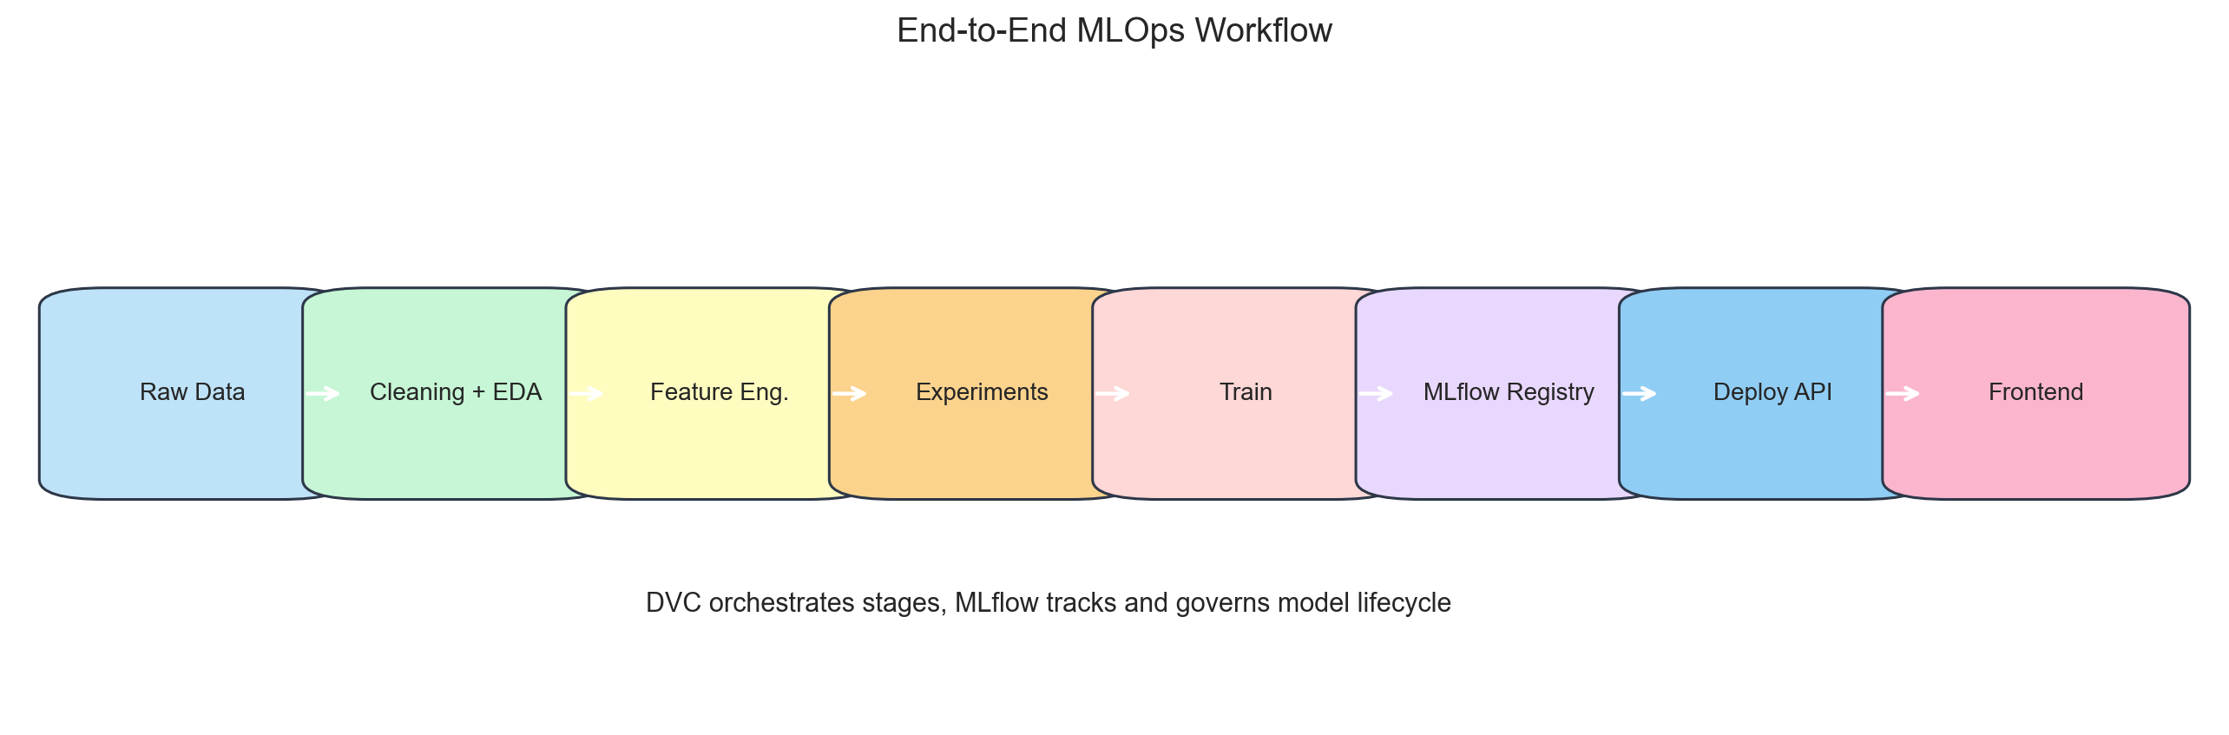
End-to-End Iron Ore Price Forecasting and MLOps Workflow
Problem: forecast iron ore prices under regime changes and market turbulence
Scope: production ML pipeline plus research-aligned benchmarking
Stack: DVC, MLflow, FastAPI, Docker, Jupyter notebooks

Slide 2
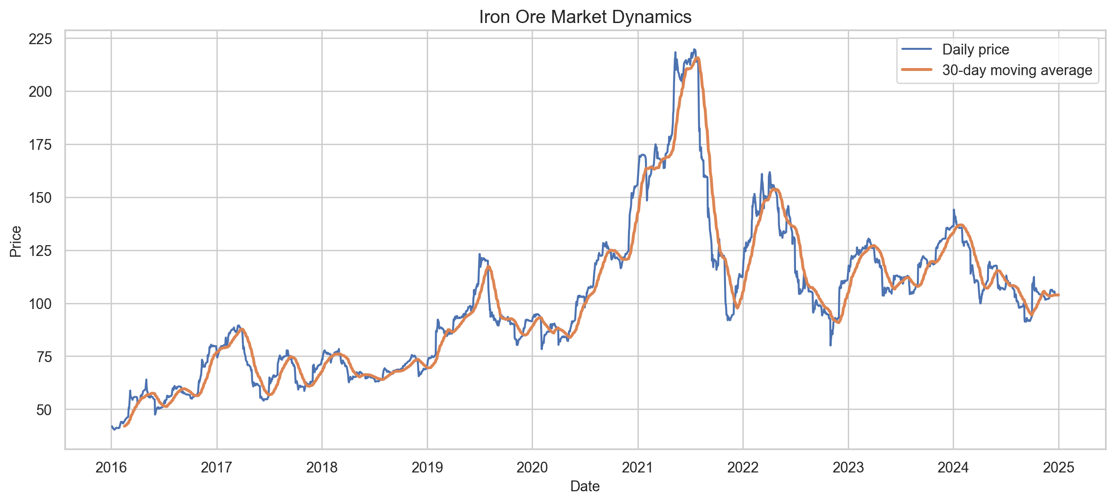
Iron Ore Market Dynamics
2,264 trading-day records from 2016-01-04 to 2024-12-31
Core variables: Price, Open, High, Low, Volume, Change %
Series shows trends, reversals, and volatility bursts
Static forecasting assumptions are not reliable here

Slide 3
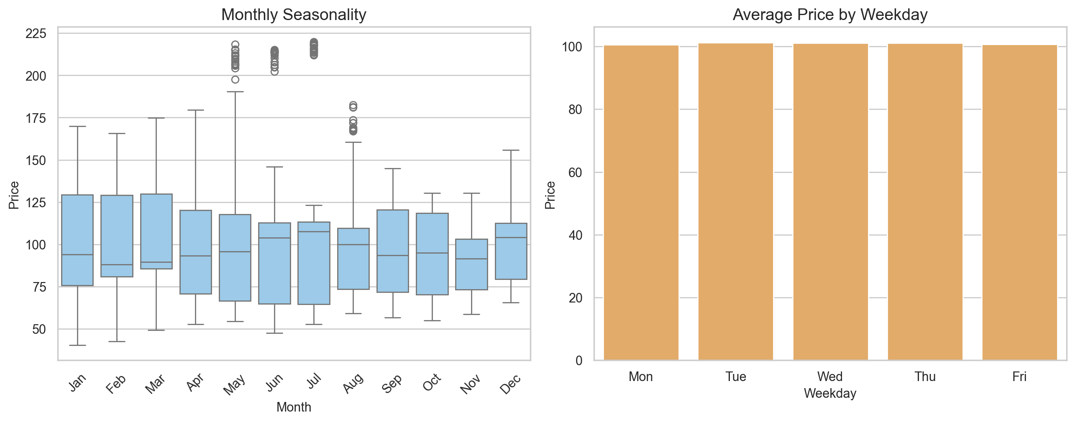
Data Ingestion, Cleaning, and EDA
Raw CSV is ingested into a DVC-tracked artifact
Cleaning standardizes schema, parses dates, and converts numeric fields
Volume and percentage columns are normalized for modeling
EDA checks seasonality, volatility, and feature relationships

Slide 4
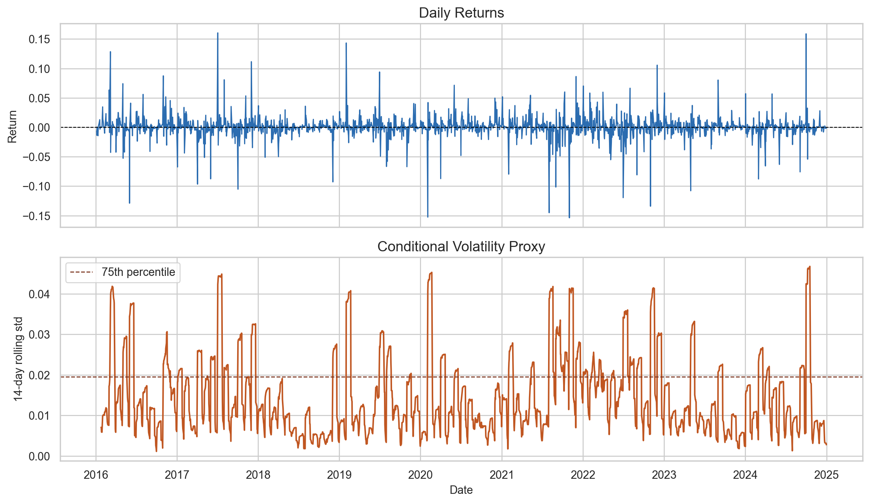
Volatility and Conditional Variance
Returns are unstable across time and cluster during turbulent periods
Research workflow tracks a 14-day rolling volatility proxy
A 75th percentile threshold separates high- and low-volatility regimes
EWMA variance error quantifies conditional-variance mismatch

Slide 5
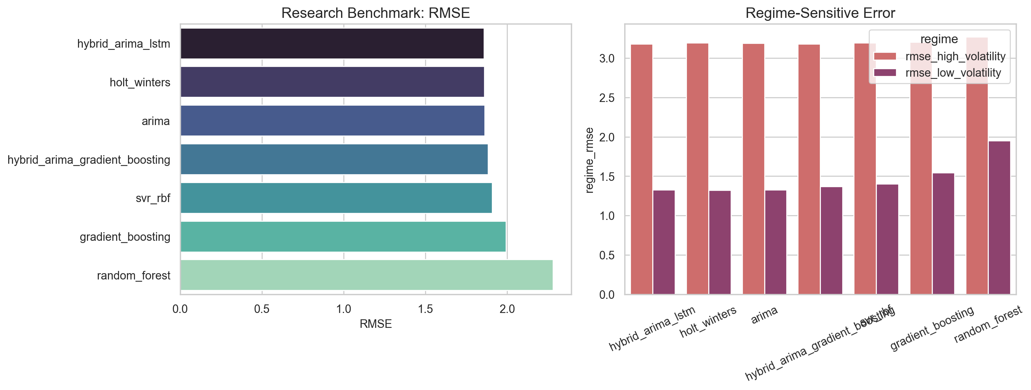
Linear Models Under Turbulence
After correcting to rolling one-step evaluation, ARIMA and Holt-Winters remain strong baselines
ARIMA RMSE: 1.862 and Holt-Winters RMSE: 1.860 on the research benchmark
Their high-volatility RMSE still stays above 3.18, where turbulence exposes the limits of linear structure
This supports residual hybridization rather than discarding statistical models entirely

Slide 6
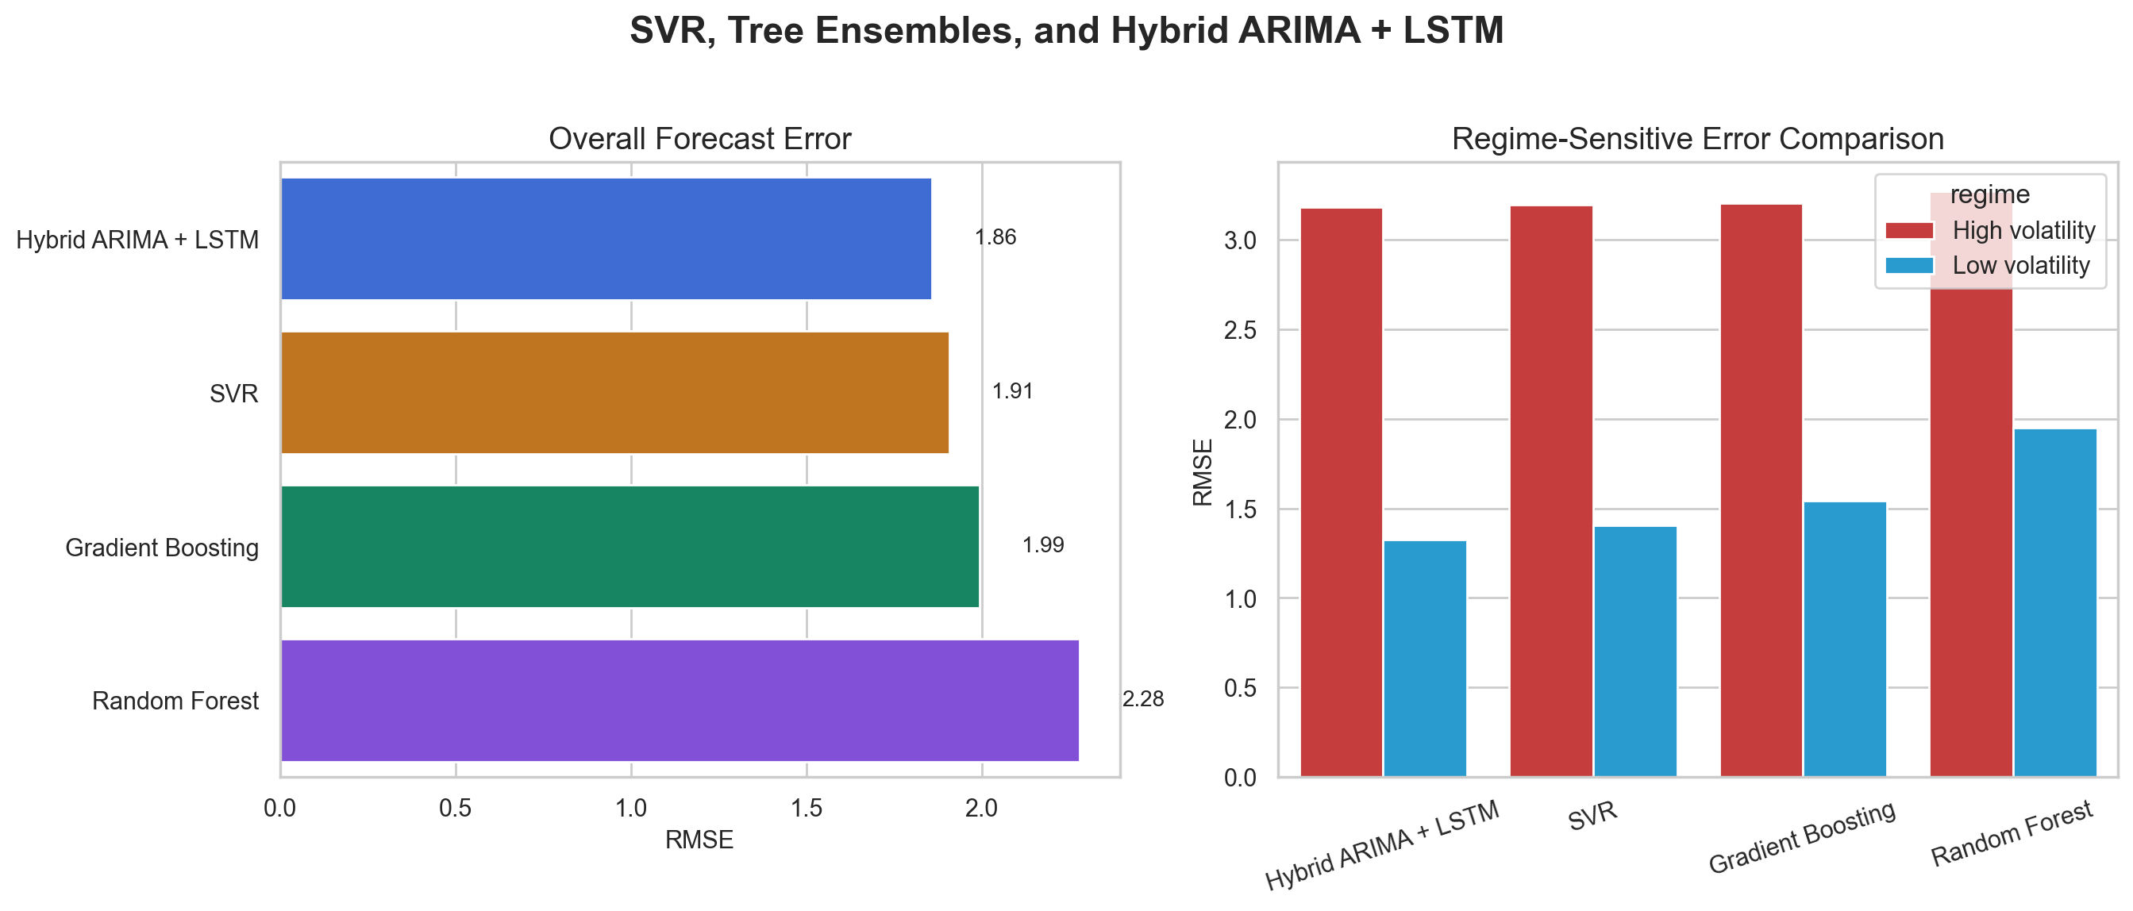
Machine Learning Approaches
SVR formulates nonlinear forecasting as a convex optimization problem in a kernel-induced high-dimensional feature space
SVR accuracy depends on epsilon-insensitive regularization, kernel choice, hyperparameter calibration, and lag-feature design
Random Forest and Gradient Boosting reduce variance via feature subsampling, bootstrap aggregation, and sequential tree refinement
Core limitation: these models do not natively preserve ordered temporal memory without explicit lag engineering
SVR is the strongest pure ML model at RMSE 1.9082, but Hybrid ARIMA + LSTM improves further to 1.8576

Slide 7
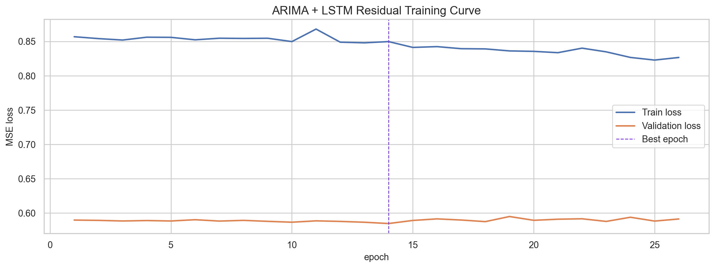
Deep Learning for Sequence Modeling
LSTM models internalize sequential state dynamics instead of relying only on handcrafted lags
In this project, the residual LSTM stopped after 26 epochs and reached its best validation loss at epoch 14
The recurrent block models ARIMA residuals rather than raw price directly
This turns the paper's ARIMA-LSTM idea into a real benchmarked experiment in the repo

Slide 8
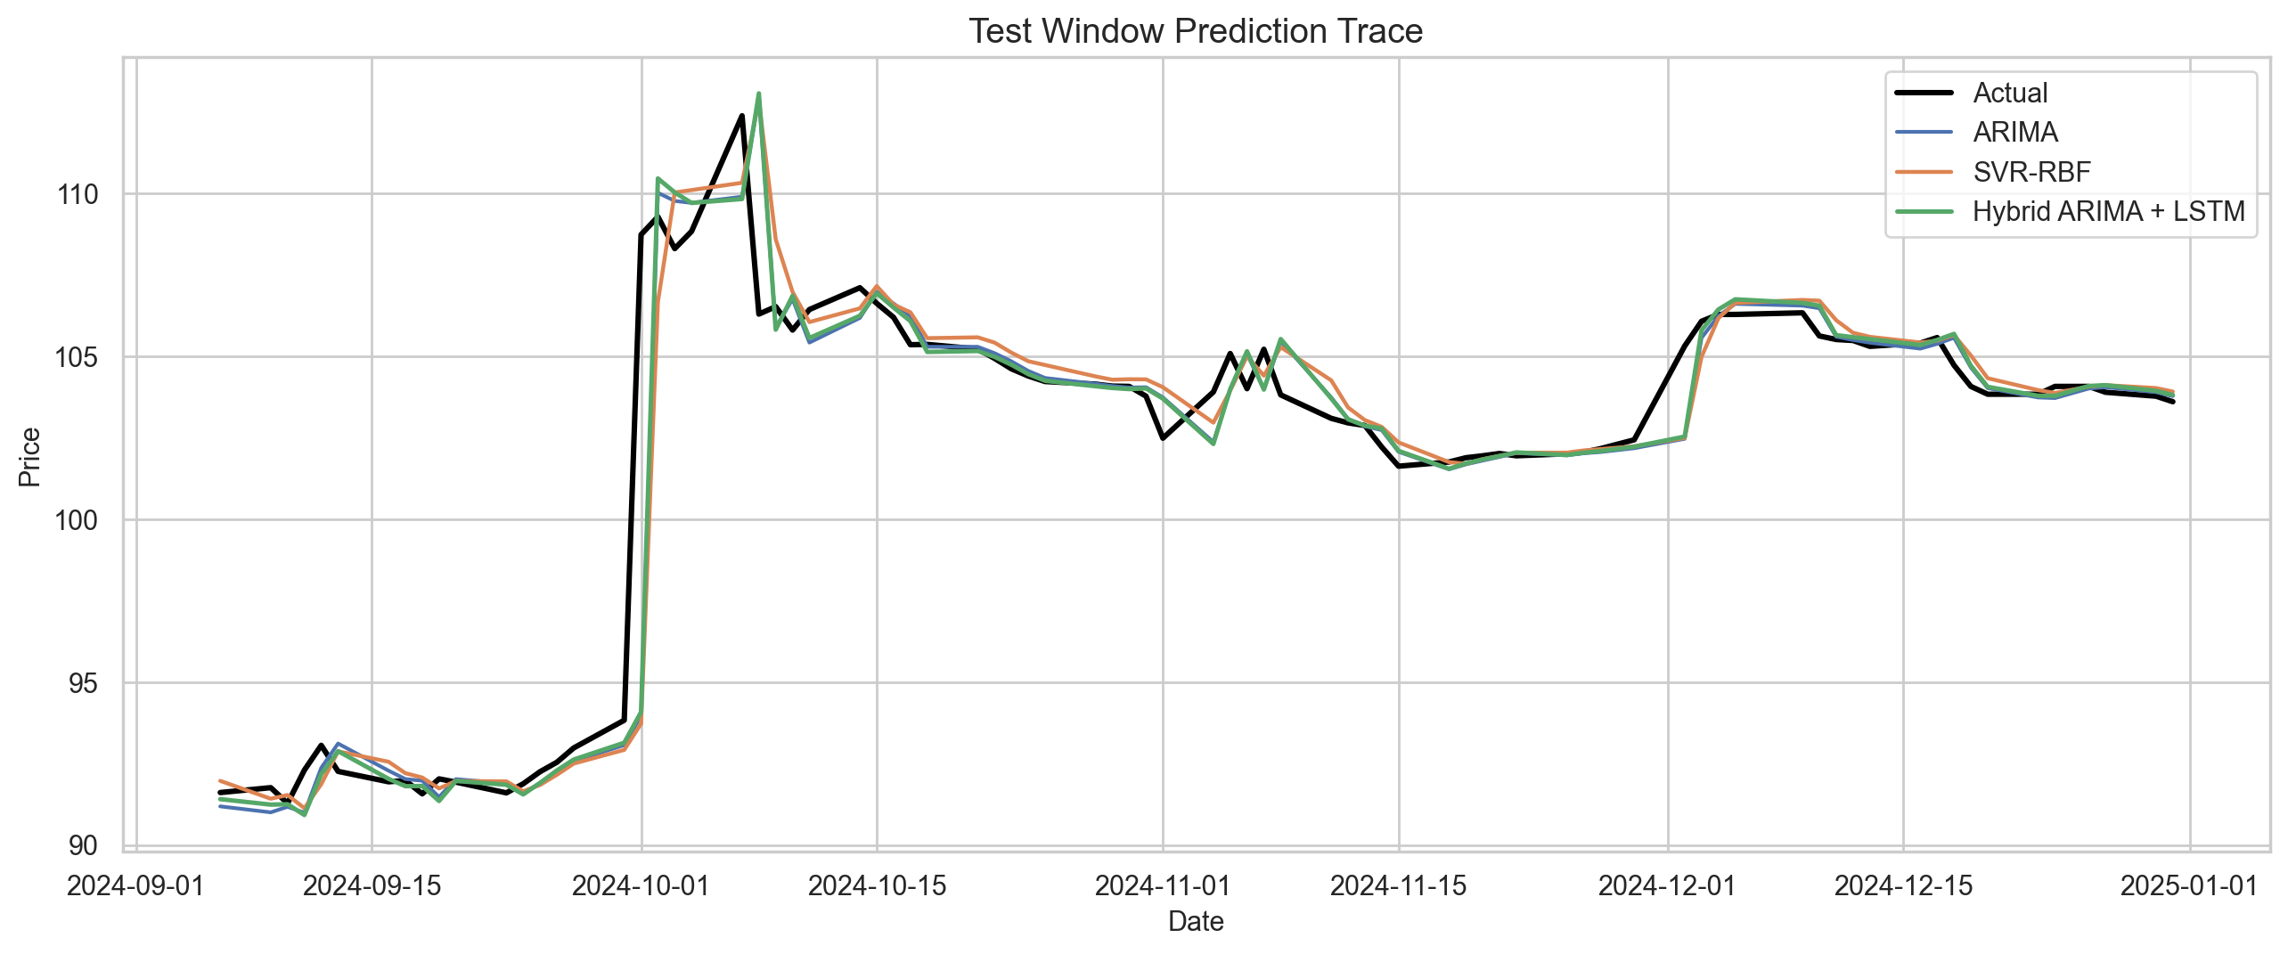
The Hybrid Ensemble Philosophy
Hybrid models assume linear and nonlinear components should be learned separately
ARIMA provides the rolling one-step linear forecast and LSTM models the nonlinear residual structure
Hybrid ARIMA + LSTM is the best research model with RMSE 1.8576 and R2 0.9760
High-volatility RMSE falls to 3.1817, slightly better than ARIMA, Holt-Winters, and SVR
The gain is small but consistent, which is typical of residual-correction hybrids

Slide 9
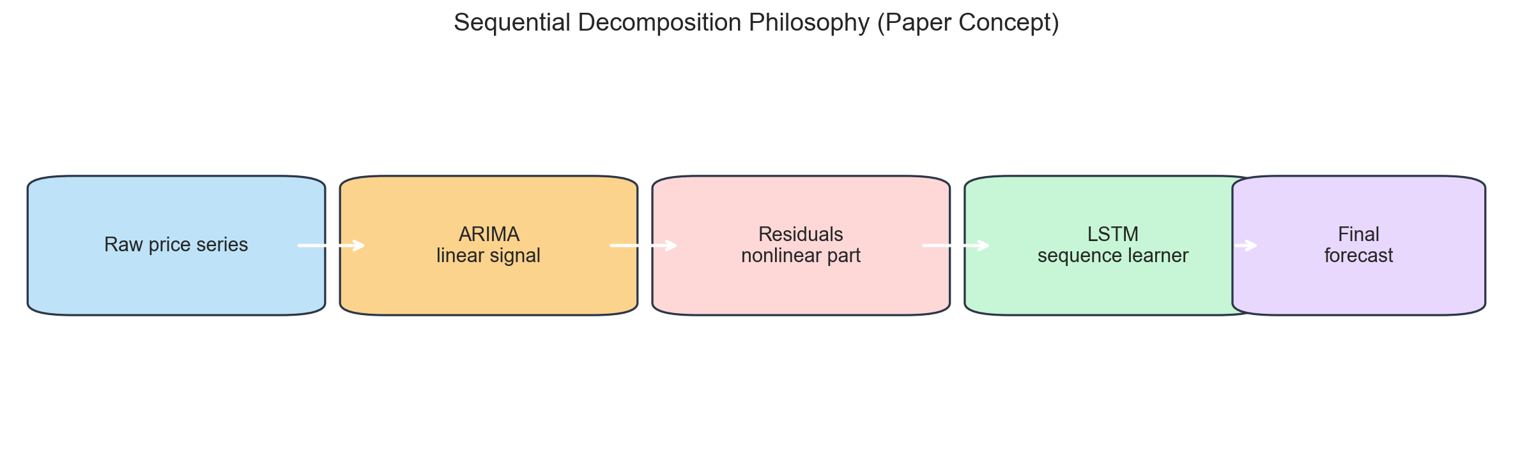
Sequential Decomposition (ARIMA-LSTM) as the Next Step
Step 1: fit ARIMA on the raw series for the linear component
Step 2: compute residuals from ARIMA forecasts
Step 3: train LSTM on residual sequences for nonlinear structure
Step 4: combine both forecasts into the final signal

Slide 10
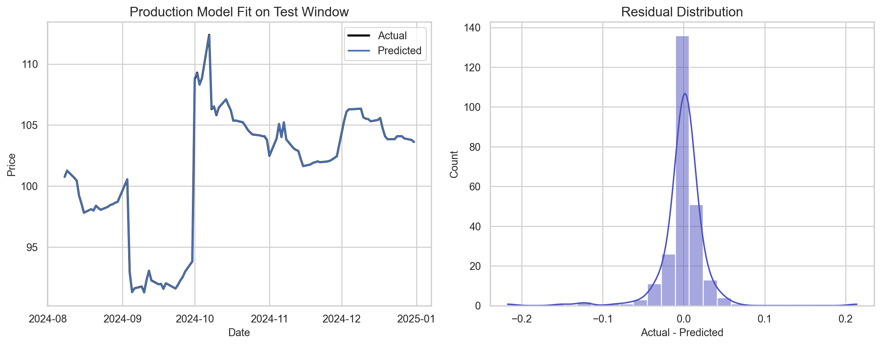
Performance Evaluation
Evaluation is not limited to RMSE
Production reports RMSE, MAE, MAPE, and R2
Research adds regime RMSE, rolling RMSE, procurement-cost proxy, and EWMA variance error
Best research result is Hybrid ARIMA + LSTM with RMSE 1.8576 and procurement-cost proxy 2.22M
This makes evaluation closer to business and risk reality

Slide 11
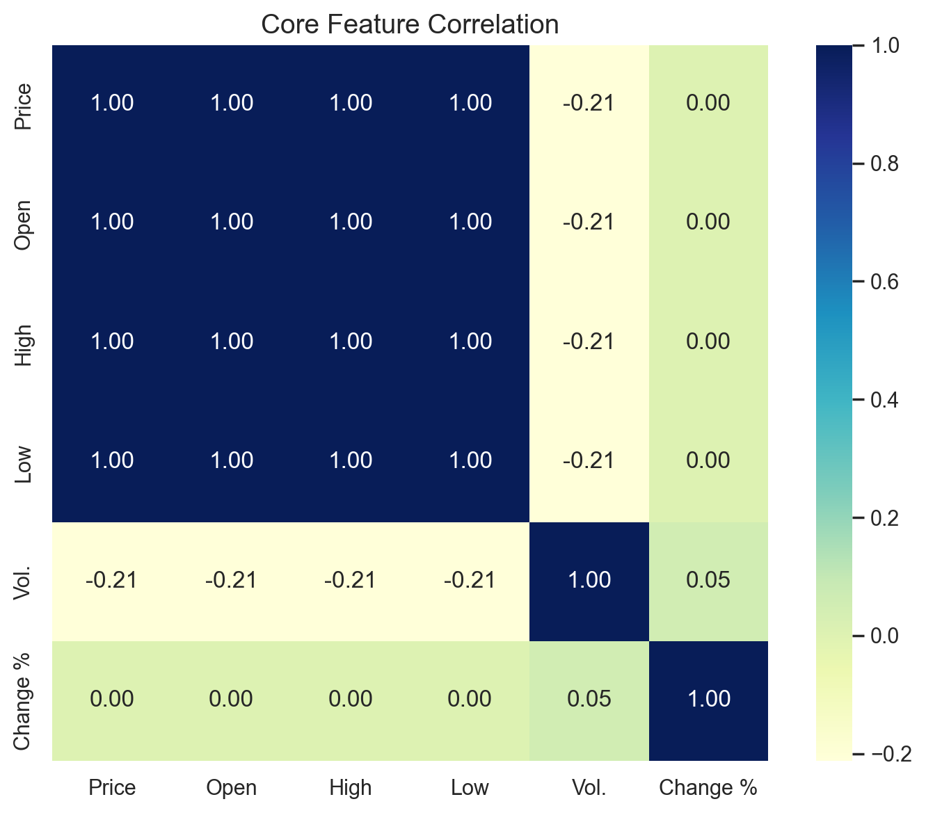
Identified Research Gaps
Conditional variance is diagnosed but not yet modeled explicitly with GARCH-family methods
Structural-break detection is not yet part of the pipeline
ARIMA-LSTM is benchmarked, but not yet wired into production training, registry, or deployment
Exogenous macro or event variables are still missing

Slide 12
MLOps Workflow and Deployment
DVC orchestrates ingestion, cleaning, feature engineering, selection, training, and deployment stages
MLflow tracks experiments and manages model lifecycle
Promotion gates move models across testing, staging, and production
FastAPI serves predictions and Docker packages the stack

Slide 13
Conclusion
The project combines classical forecasting, machine learning, and MLOps in one workflow
Production pipeline delivers a strong deployable Ridge model on selected engineered features
Research pipeline now includes a real ARIMA + LSTM residual hybrid with volatility-aware diagnostics
The strongest next step is richer variance modeling and structural-break detection around that hybrid core

