Slide 1

Project Title: AI Powered Quiz Application
Problem Statement: Traditional quiz applications often rely on static question banks, offering limited personalization and adaptability. Users may encounter repetitive questions or quizzes that do not match their knowledge level.
Project Group Number: 01
Group Member Details: Satyam Kumar (0187CS211150)
Sintu Kumar (0187CS211165)
Samrat Singh (0187CS211145)
Shivankit Dubey (0187CS211158)
Project Guide: Prof. Amit Swami
Major Project - II
CS- 805
Notes:
Team mentor

Slide 2
Idea/Approach Details
Describe your idea Solution/Prototype :
AI-Generated Questions: The application dynamically generates questions based on selected topics using an AI model.
Adaptive Difficulty: The AI adjusts question difficulty based on the user's input.
Instant Feedback: Users receive immediate explanations for their answers, helping them learn.
Customization: Users can choose topics, question types (MCQ), and difficulty levels.
Abstract:
The AI-Powered Quiz Application is an intelligent, interactive platform designed to enhance learning and assessment through dynamic and adaptive quizzes. This application leverages artificial intelligence (AI) to generate, and personalize quizzes based on user’s input patterns.
Describe your Technology stack :
Hardware Components: Android device
Software Components: Android studio
Development and Debugging Tools: Android studio logcat and IDE features.

Slide 3
Project Requirements
Client-Side Hardware Requirements:
Device: Smartphone
Internet Connection: Stable and fast connection
Client-Side Software Requirements:
Operating System: Android 13+
Developer-Side Hardware Requirements:
Device: Desktop or laptop
Memory (RAM): 8GB or more
Internet Connection: Stable and fast connection
Developer-Side Software Requirements:
Operating System: Android 13+, Windows
IDE: Android studio IDE
Language: Kotlin

Slide 4
Project Requirements
Functional Requirements:
User Management:
Users can signup and login using firebase auth options.
AI-Generated Questions & Adaptability:
AI generates quiz questions based on user-selected topics.
Quiz Creation & Customization:
Users can select from predefined quizzes or generate AI-powered custom quizzes in real time.
Non-Functional Requirements:
Performance Requirements
Scalability
Availability & Reliability
Security Requirements
Maintainability & Upgradability
Usability & Accessibility
Compliance & Legal Requirements
Logging & Monitoring

Slide 5
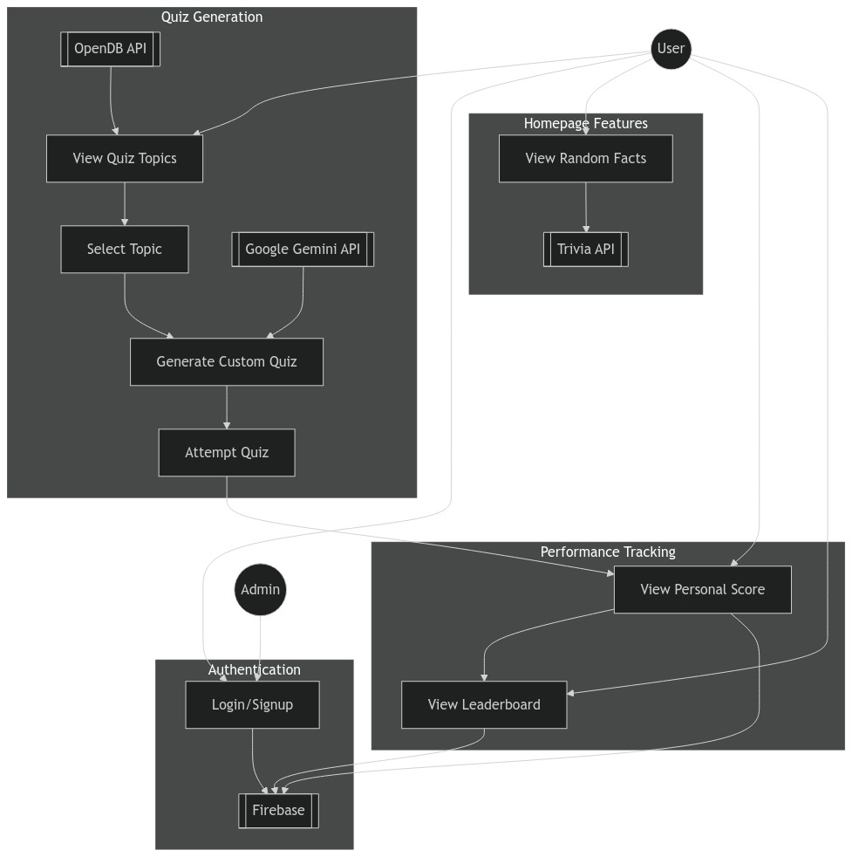
Design
Use Cases:

Slide 6
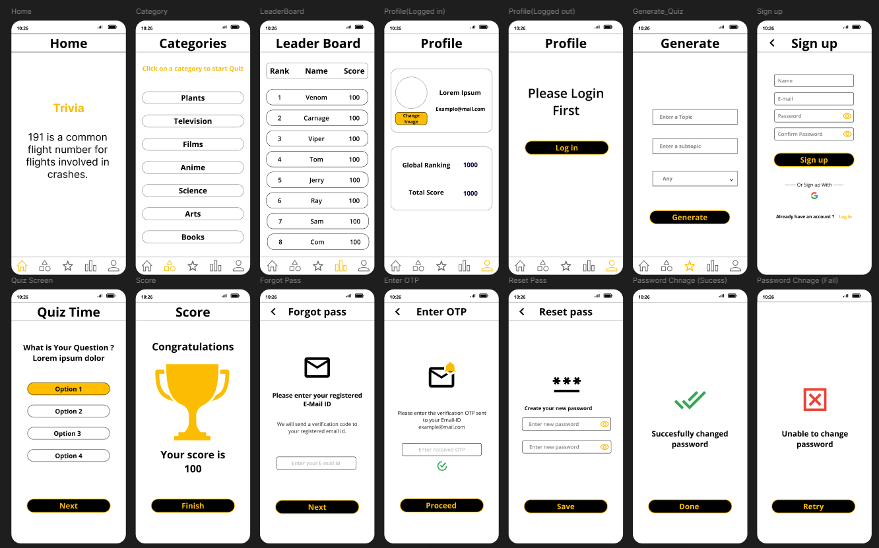
Design

Slide 7
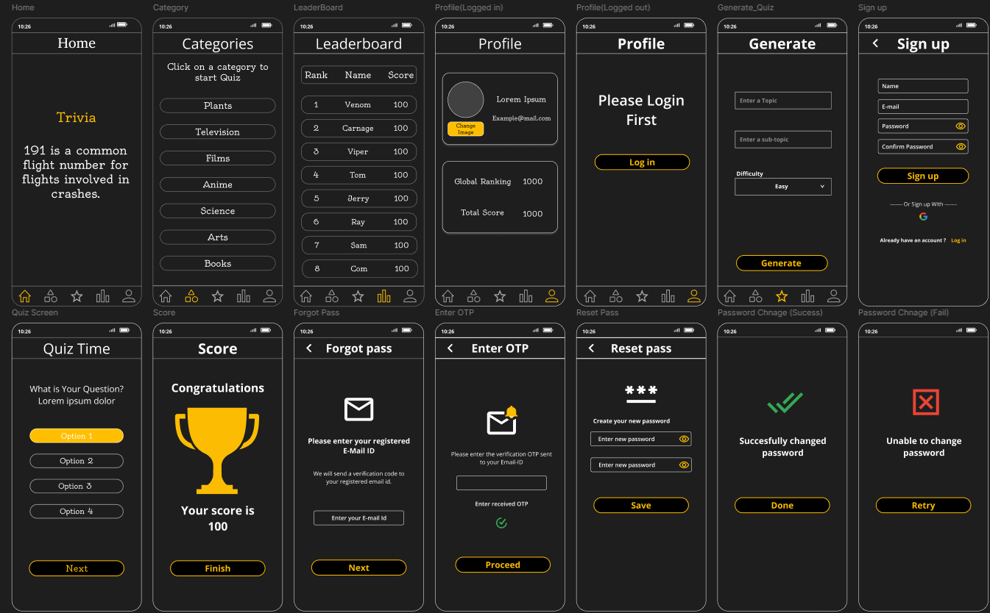
Design

Slide 8
Maintenance
Regular Updates and Bug Fixes: Use tools to monitor the application for bugs, performance issues, and other anomalies
Performance Optimization: Ensure the application can handle high traffic by distributing the load efficiently.
Security: Use encryption and secure data transmission protocols to protect user data.
Data Protection: Use secure data storage methods to protect user data like encryption of user data in cloud.
Regular System Audits: Conduct regular system audits to identify and fix vulnerabilities and to ensure smooth delivery of service across the devices.

Slide 9
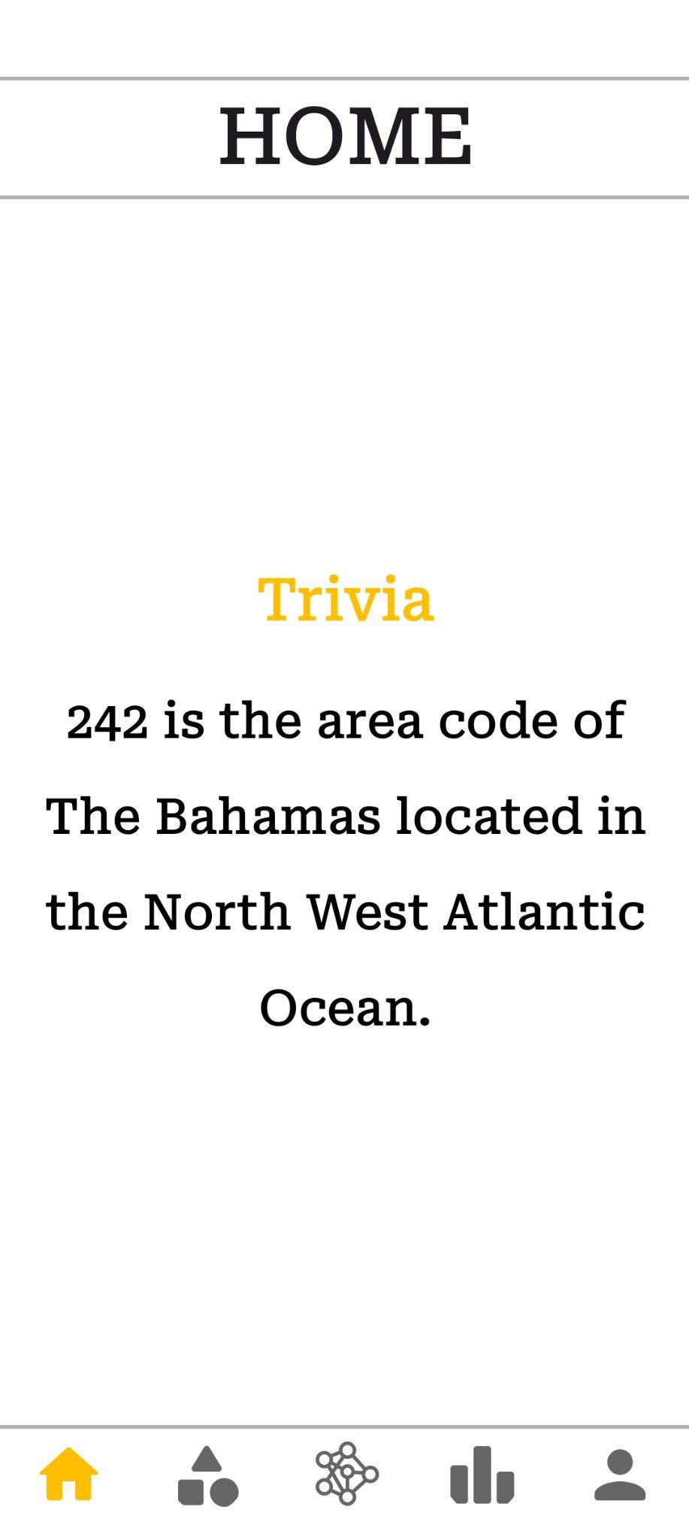
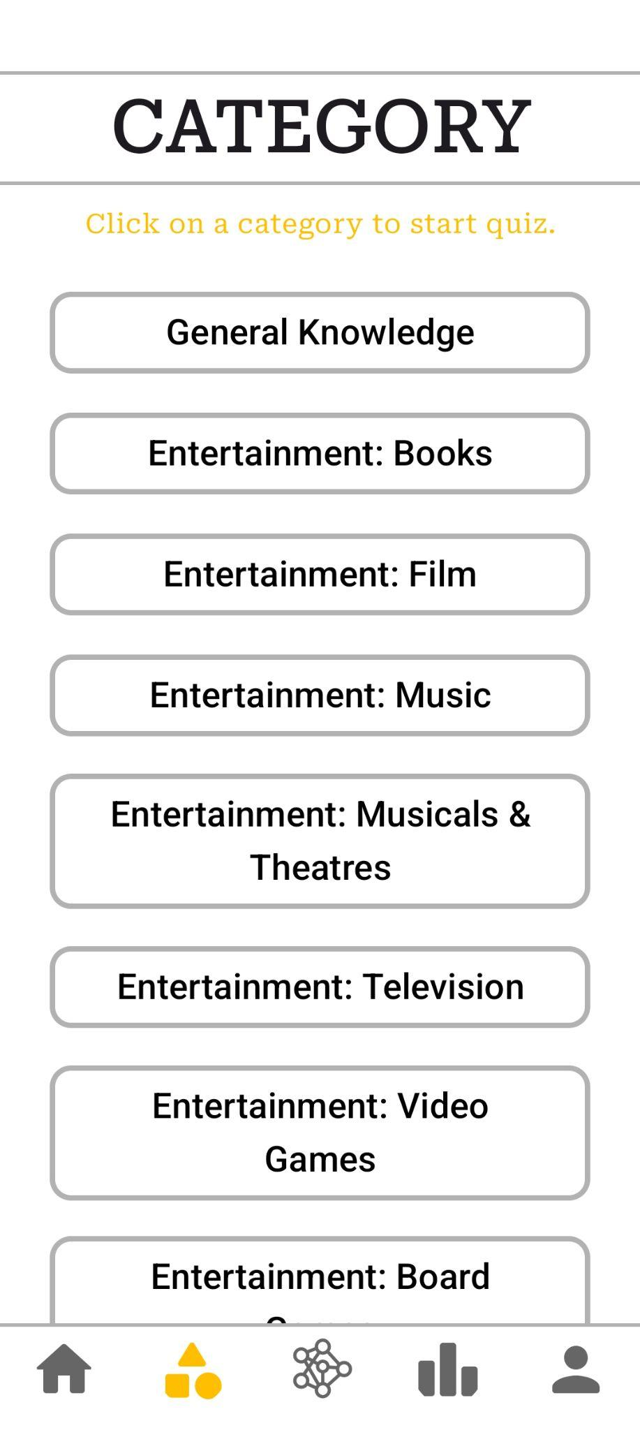
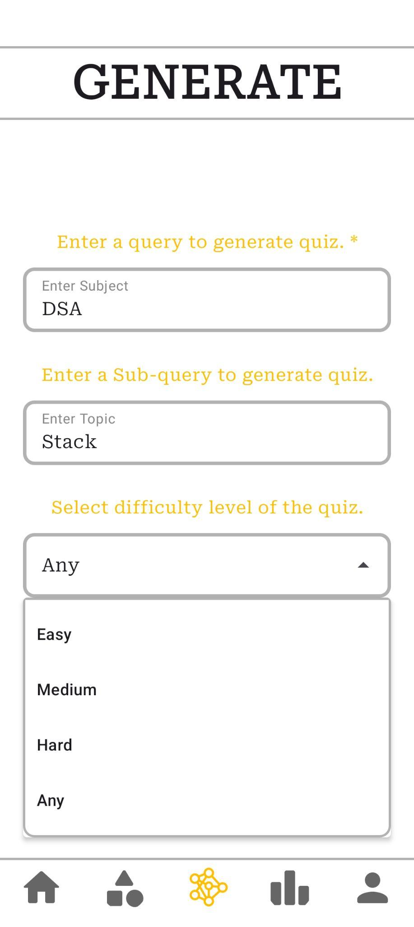
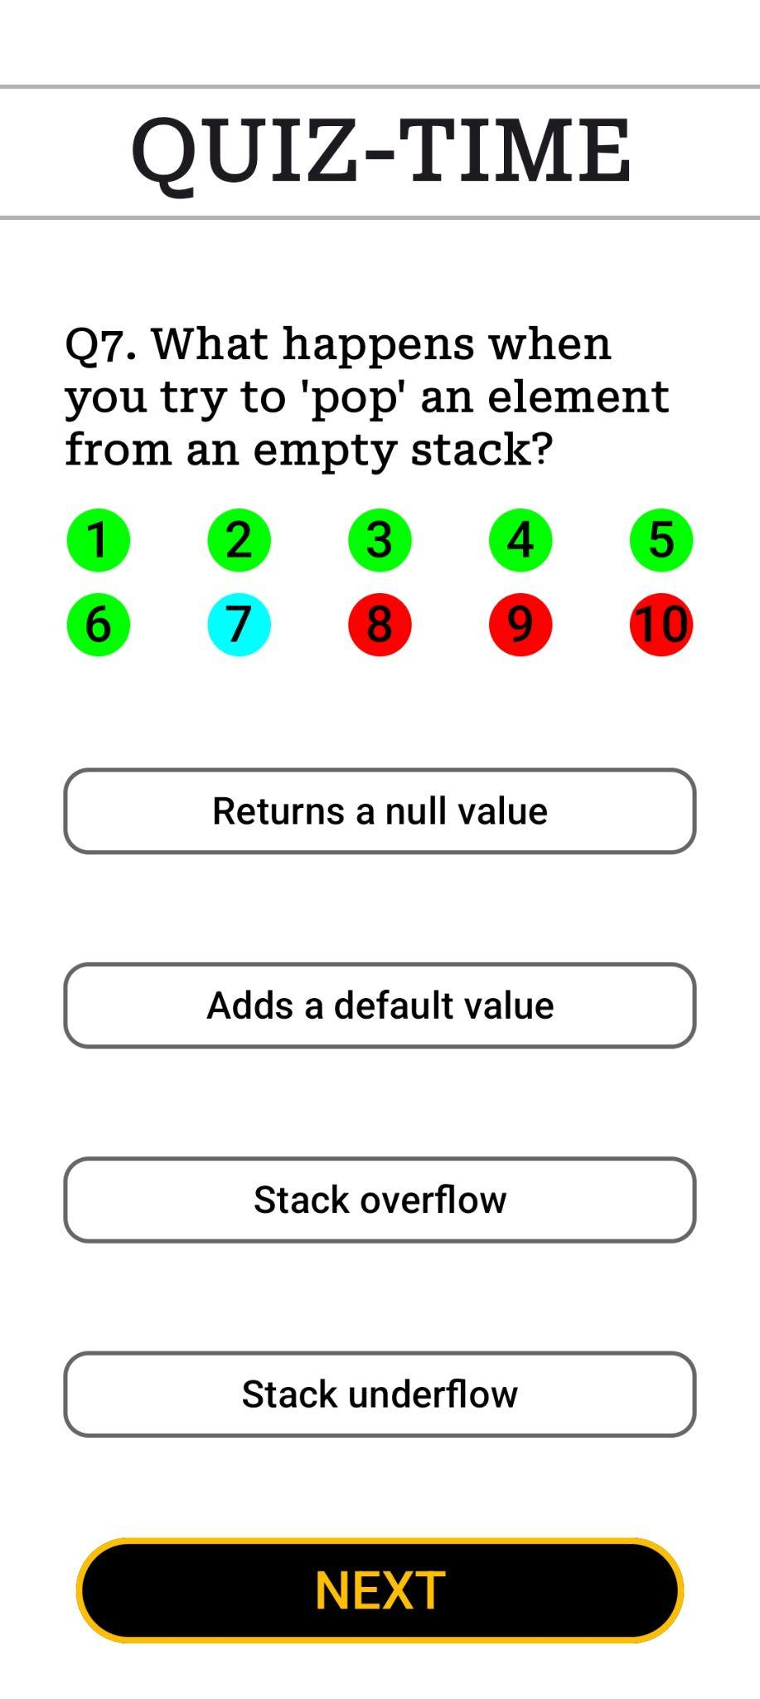
Project Screenshots

Slide 10


