Slide 1
Customer shopping behavior:
what the data says
3,900 purchases reveal who spends, what sells, and where retention and margin opportunities sit.

Slide 2
The dataset is broad enough to separate behavior from noise
3,900 purchases
$59.76 average purchase
37 ratings imputed
Across 18 columns, 25 products, 4 categories, 50 locations, and 4 seasons.
Average review rating: 3.75.
Missing review ratings were imputed by product-category median.
Source: Customer Shopping Behavior Analysis

Slide 3
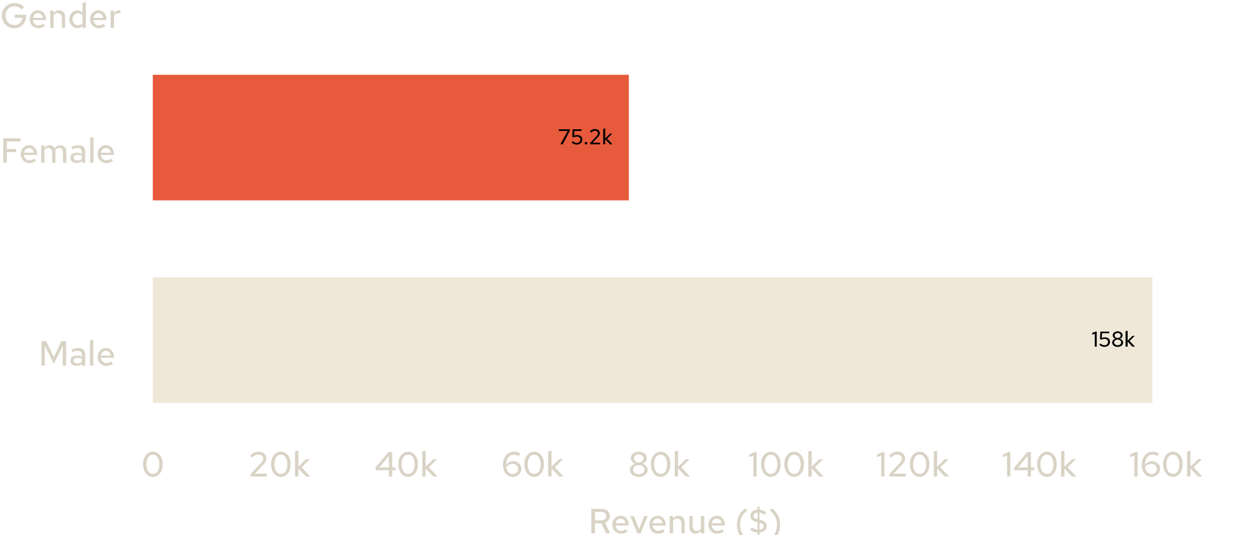
Revenue is concentrated among male customers in this sample
Revenue by gender
SAMPLE SIGNAL
$157,890
Male-customer revenue
$75,191 female-customer revenue.
Use the gap as a targeting signal, not as a demographic conclusion beyond this dataset.
Source: Customer Shopping Behavior Analysis

Slide 4
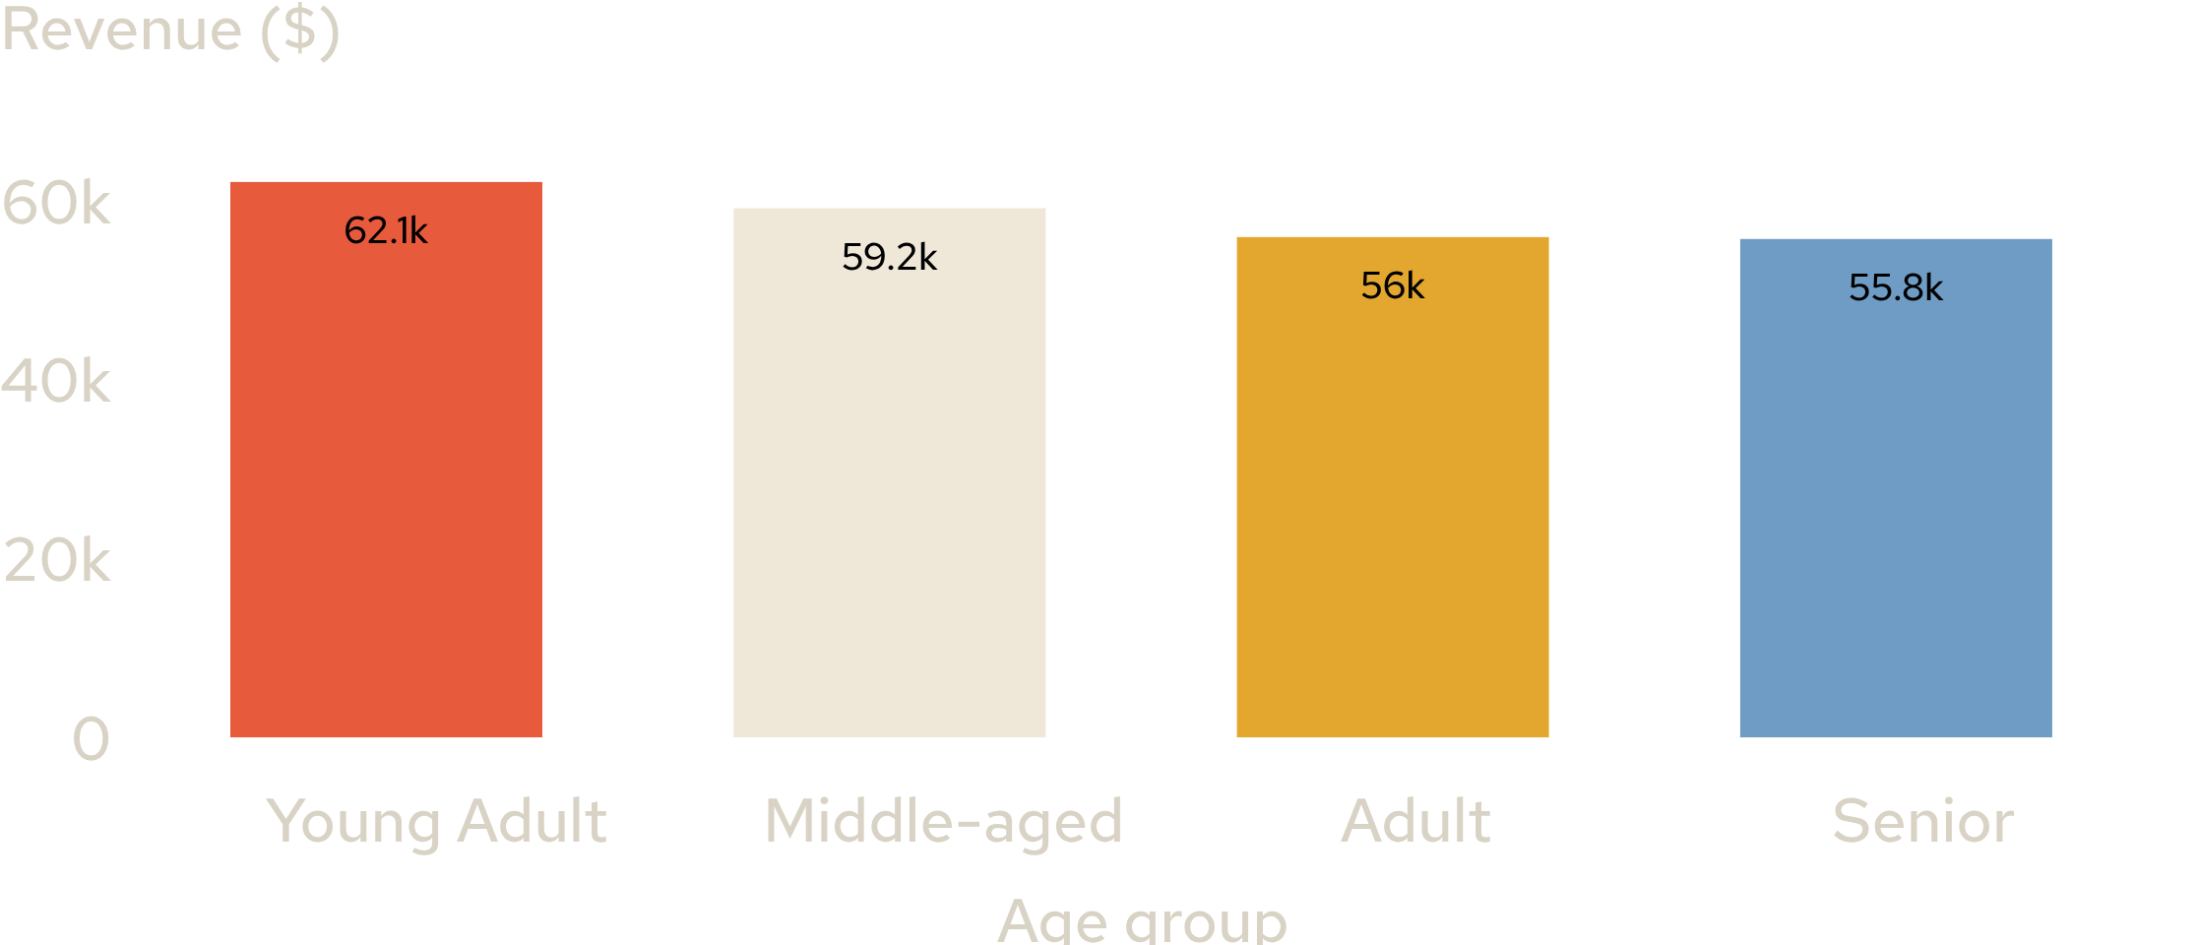
Young adults lead revenue, but no age group is far behind
Revenue by age group
$62,143
Young Adult revenue
Middle-aged: $59,197
Adult: $55,978
Senior: $55,763
Prioritize young adults while keeping broad lifecycle coverage.
Source: Customer Shopping Behavior Analysis

Slide 5
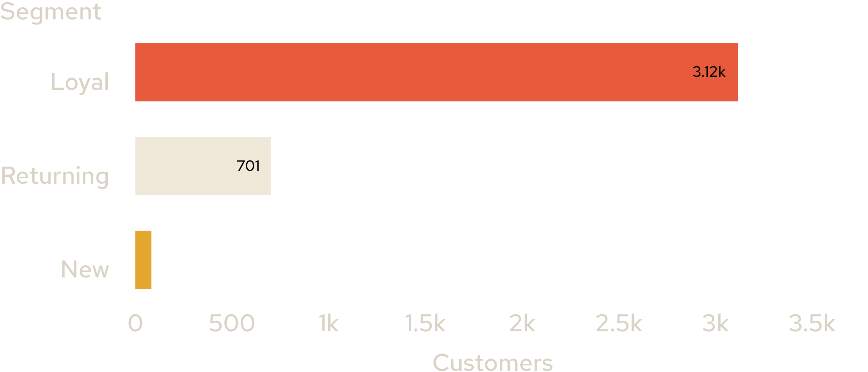
Loyal customers are the engine of the dataset
Customer segments
THE MIX IS DECISIVE
3,116
Loyal customers
Returning: 701
New: 83
The segment mix points toward retention and reactivation over pure acquisition. Define loyalty benefits that reward the next purchase, not only the first.
Source: Customer Shopping Behavior Analysis

Slide 6
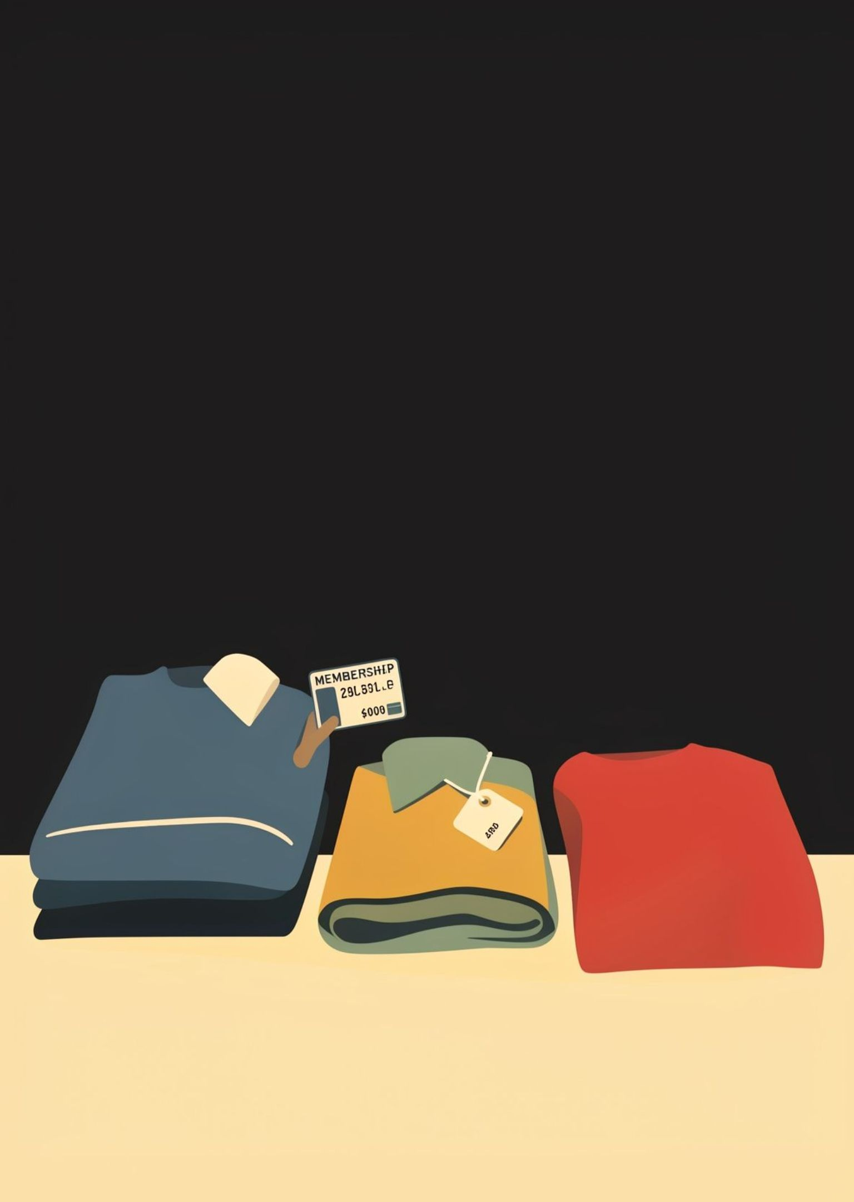
Subscriptions have reach, but not a spending advantage yet
Subscription status covers 27% of customers in the dashboard view.
Subscribers: 1,053 customers, $62,645 total revenue, $59.49 average spend.
Non-subscribers: 2,847 customers, $170,436 total revenue, $59.87 average spend.
Meaningful adoption has not yet lifted average purchase value.

Slide 7
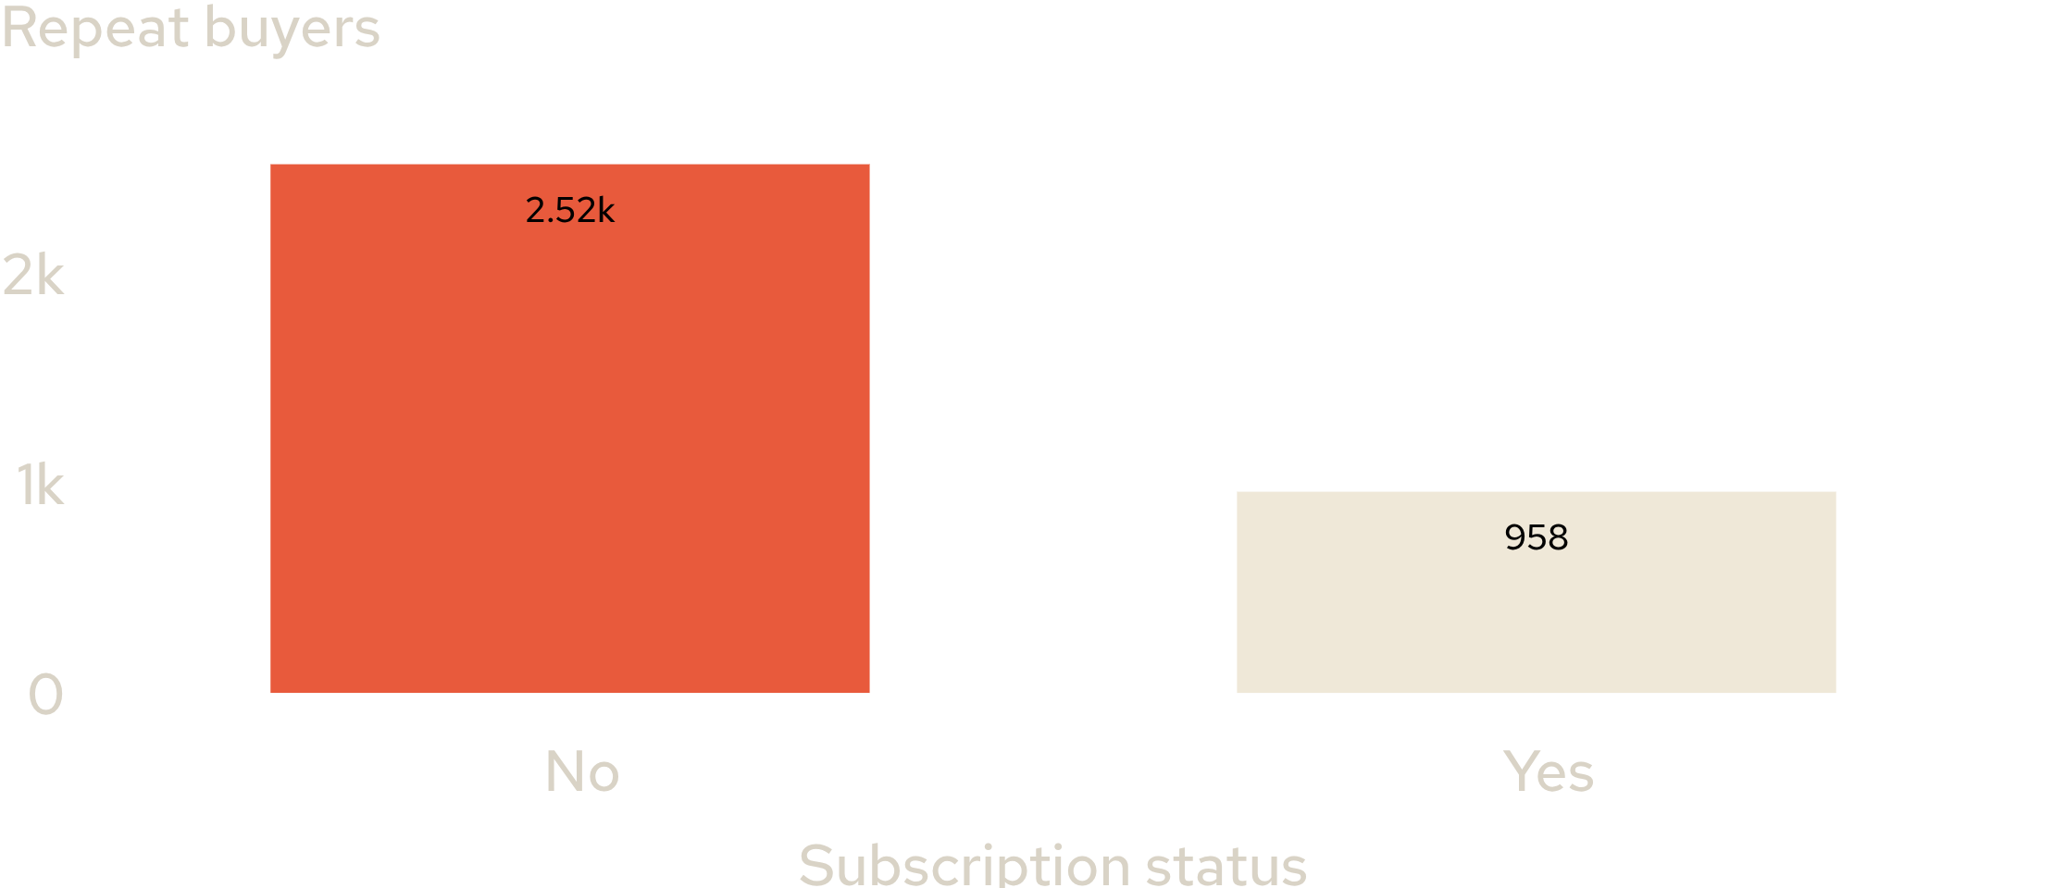
Repeat buyers are more common outside the subscription program
Repeat buyers with more than five purchases
CONVERSION POOL
3,476
Repeat buyers
2,518 non-subscribers
958 subscribers
The clearest opportunity is converting proven repeat behavior into subscription value.
Source: Customer Shopping Behavior Analysis

Slide 8
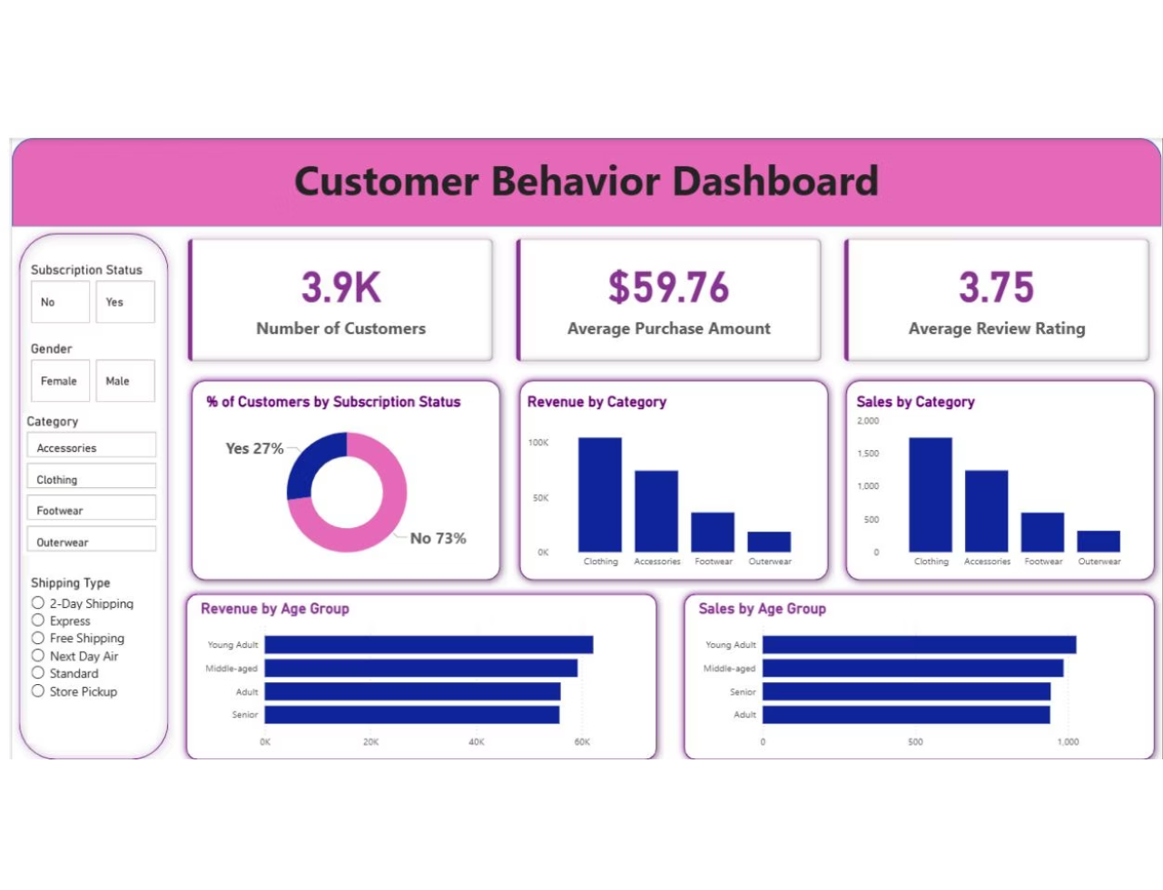
Clothing is the commercial center of the assortment
The Power BI dashboard ranks Clothing highest in both revenue and sales among the four categories.
Accessories, Footwear, and Outerwear follow in the dashboard ranking.
Use Clothing to anchor campaigns, then cross-sell adjacent categories.

Slide 9




Best sellers vary by category, creating clear merchandising hooks
Accessories
Clothing
Jewelry, Sunglasses, Belt
Blouse, Pants, Shirt
Footwear
Outerwear
Sandals, Shoes, Sneakers
Jacket, Coat
Category-specific leaders create distinct merchandising hooks, rather than one universal best-seller story.

Slide 10
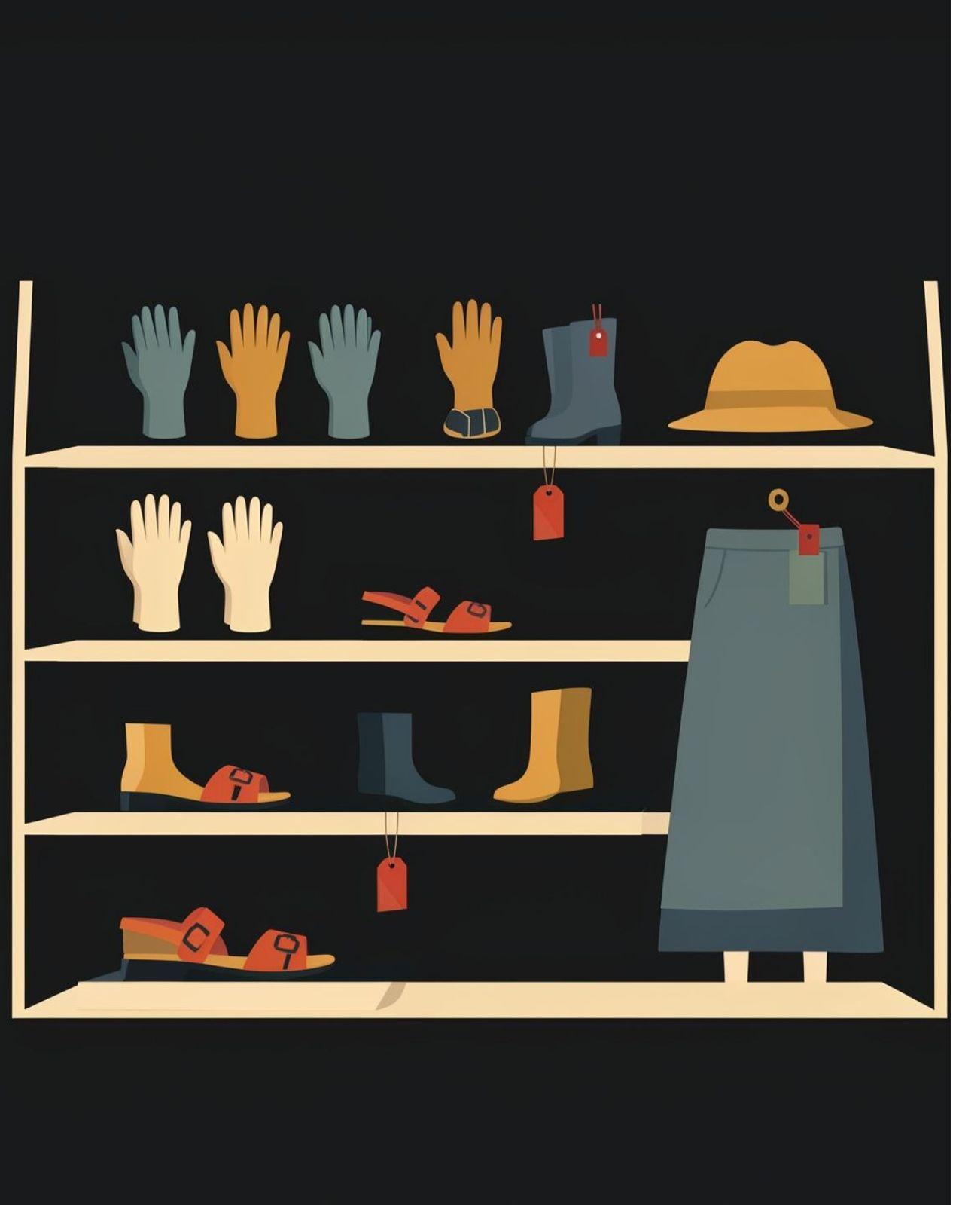
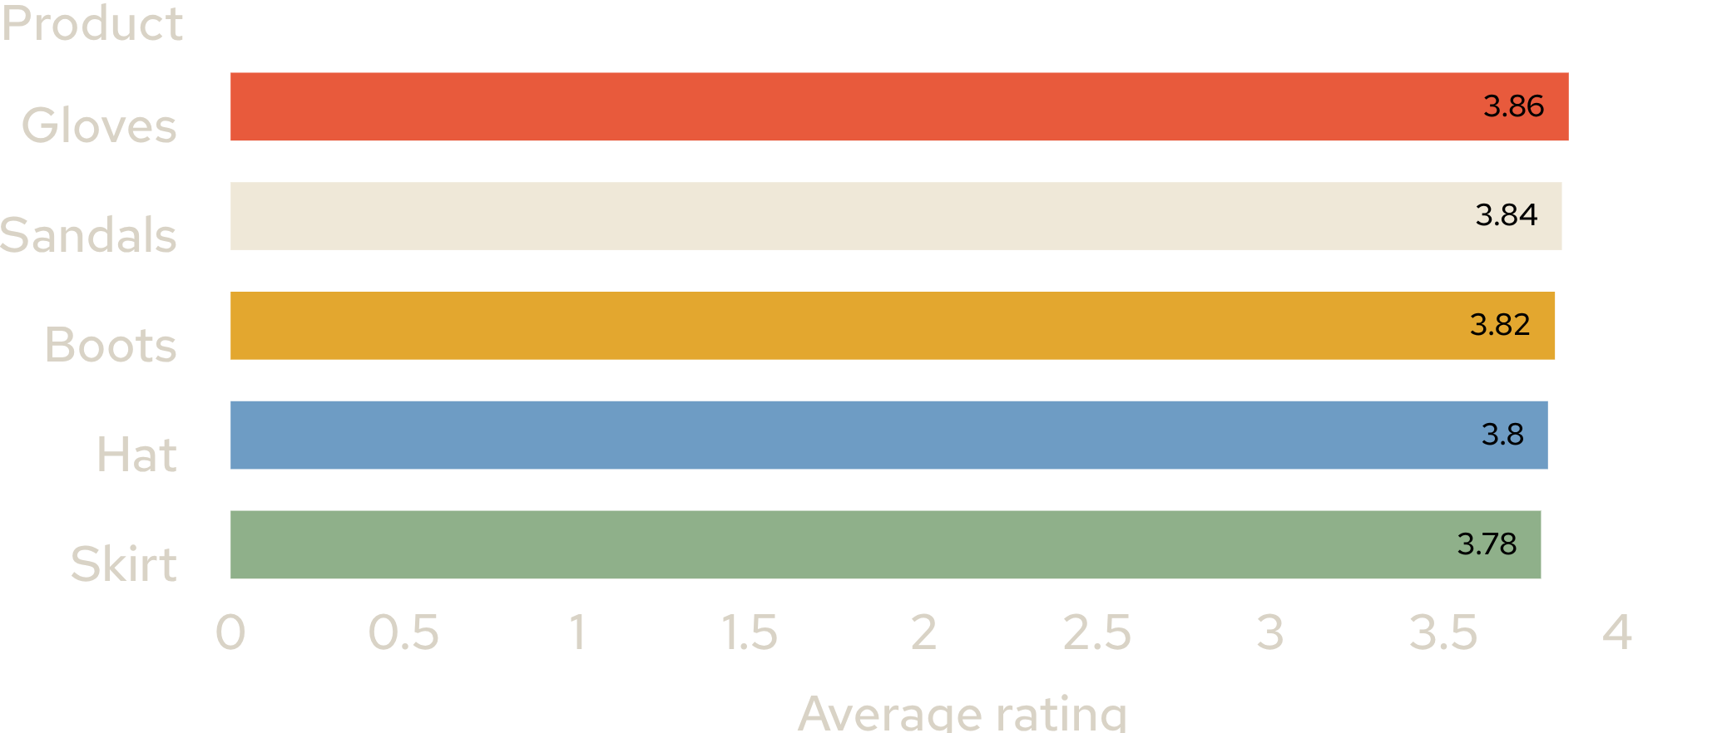
Top-rated products are not identical to top-selling products
Top five products by average rating
All five products cluster between 3.78 and 3.86.
Use ratings to build quality-led campaigns alongside volume-led best-seller campaigns.

