Slide 1
Project – Retail Analytics
MySQL

Slide 2
Problem Statement
1) Write a query to identify the number of duplicates in "sales_transaction" table. Also, create a separate table containing the unique values and remove the the original table from the databases and replace the name of the new table with the original name.
2) Write a query to identify the discrepancies in the price of the same product in "sales_transaction" and "product_inventory" tables. Also, update those discrepancies to match the price in both the tables.
3) Write a SQL query to identify the null values in the dataset and replace those by “Unknown”.
4) Write a SQL query to clean the DATE column in the dataset.

Slide 3
Problem Statement
5) Write a SQL query to summarize the total sales and quantities sold per product by the company.
6) Write a SQL query to count the number of transactions per customer to understand purchase frequency.
7) Write a SQL query to evaluate the performance of the product categories based on the total sales which help us understand the product categories which needs to be promoted in the marketing campaigns.
8) Write a SQL query to find the top 10 products with the highest total sales revenue from the sales transactions. This will help the company to identify the High sales products which needs to be focused to increase the revenue of the company.

Slide 4
Problem Statement
9) Write a SQL query to find the ten products with the least amount of units sold from the sales transactions, provided that at least one unit was sold for those products.
10) Write a SQL query to identify the sales trend to understand the revenue pattern of the company.
11) Write a SQL query to understand the month on month growth rate of sales of the company which will help understand the growth trend of the company.
12) Write a SQL query that describes the number of transaction along with the total amount spent by each customer which are on the higher side and will help us understand the customers who are the high frequency purchase customers in the company.

Slide 5
Problem Statement
13) Write a SQL query that describes the number of transaction along with the total amount spent by each customer, which will help us understand the customers who are occasional customers or have low purchase frequency in the company.
14) Write a SQL query that describes the total number of purchases made by each customer against each productID to understand the repeat customers in the company.
15) Write a SQL query that describes the duration between the first and the last purchase of the customer in that particular company to understand the loyalty of the customer.

Slide 6
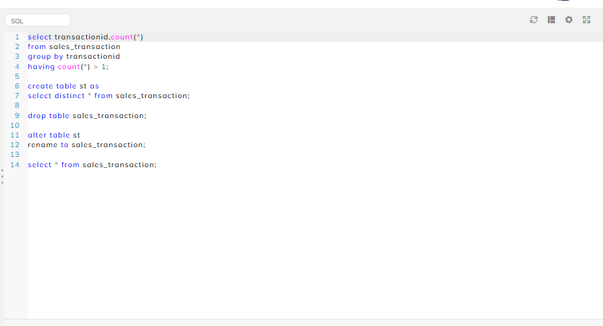
Output - 1

Slide 7
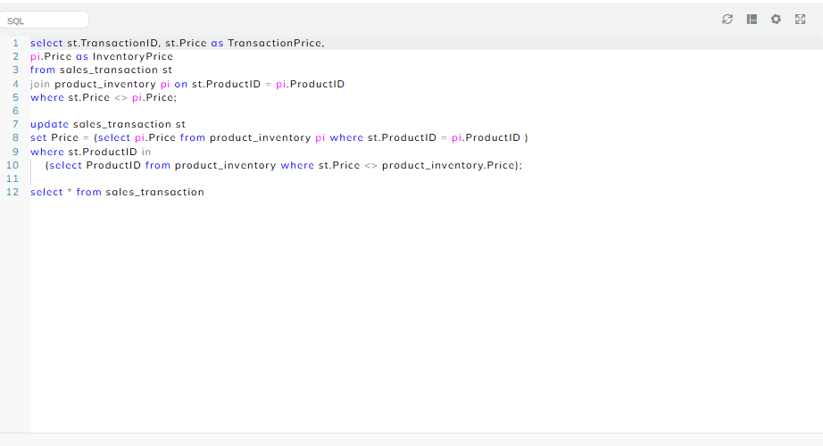
Output - 2

Slide 8
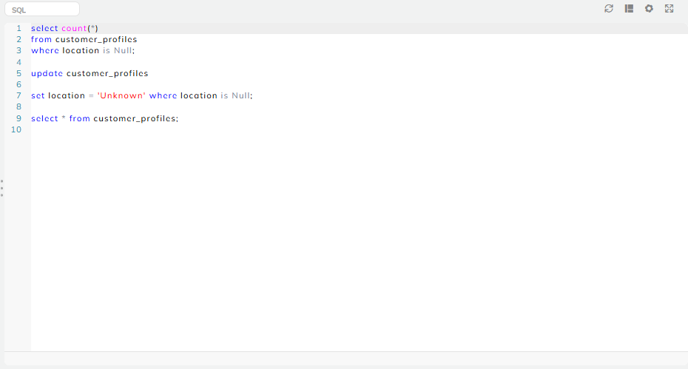
Output - 3

Slide 9
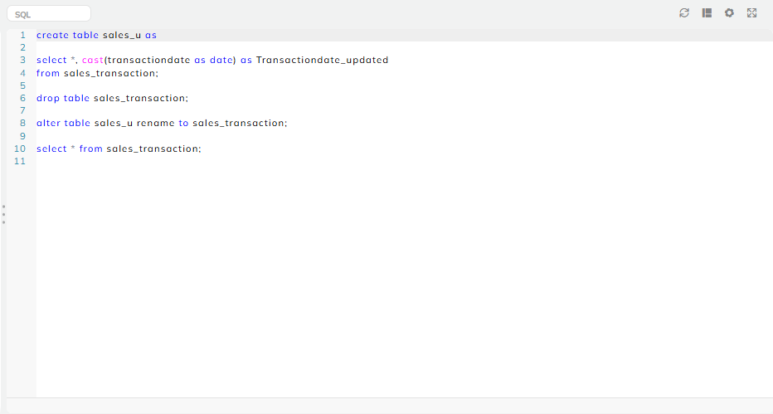
Output - 4

Slide 10
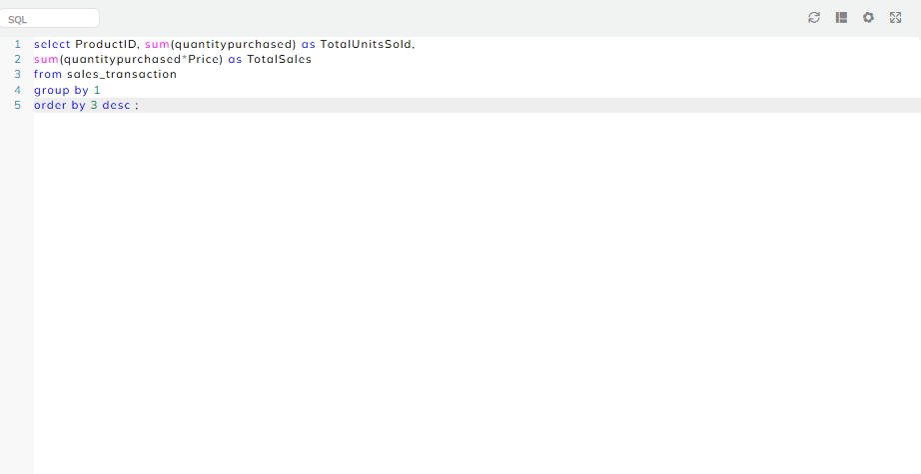
Output - 5

Slide 11
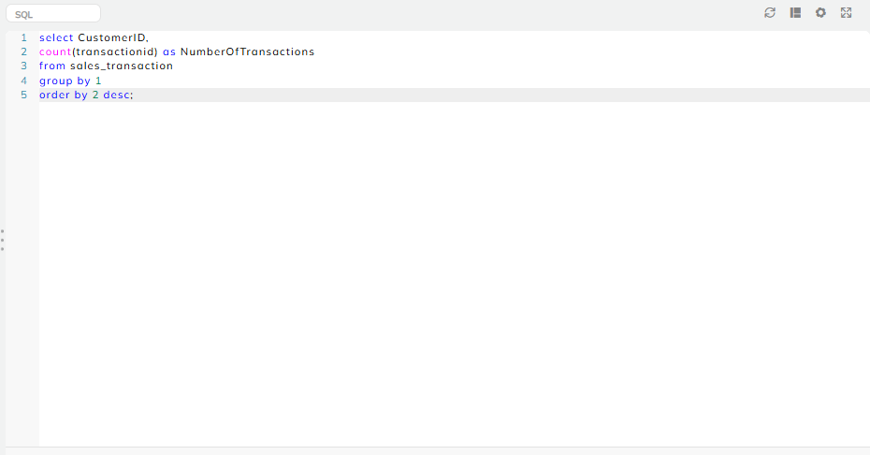
Output - 6

Slide 12
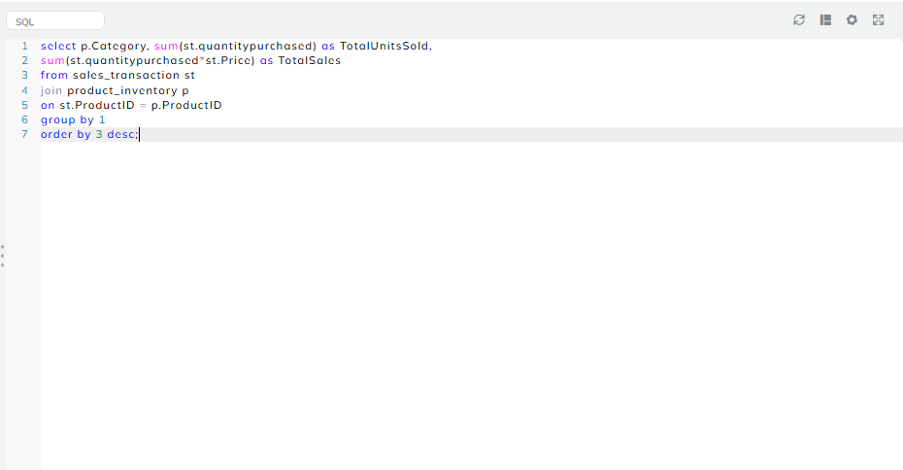
Output - 7

Slide 13
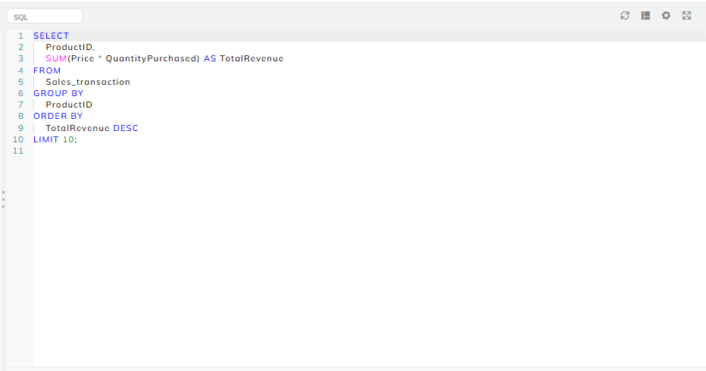
Output - 8

Slide 14
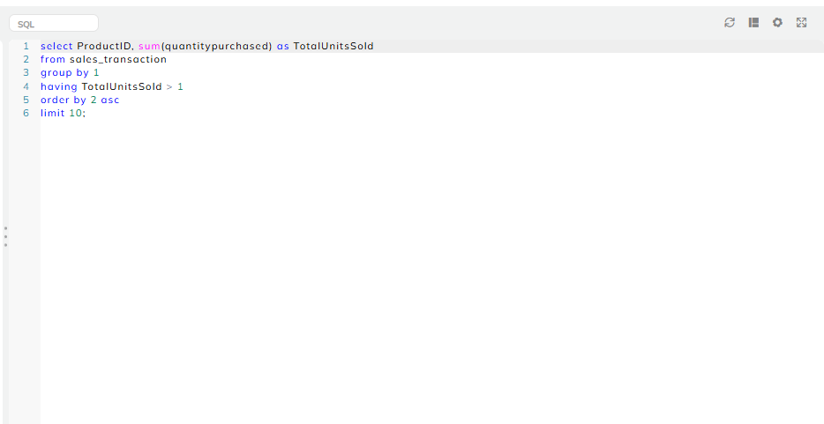
Output - 9

Slide 15
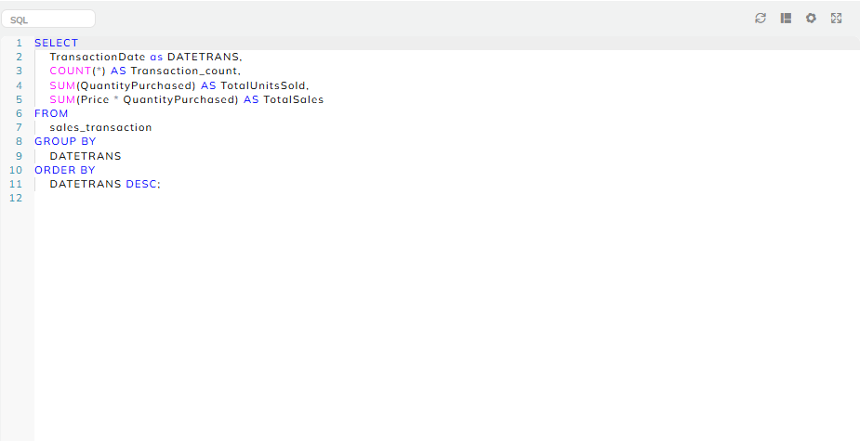
Output - 10

Slide 16
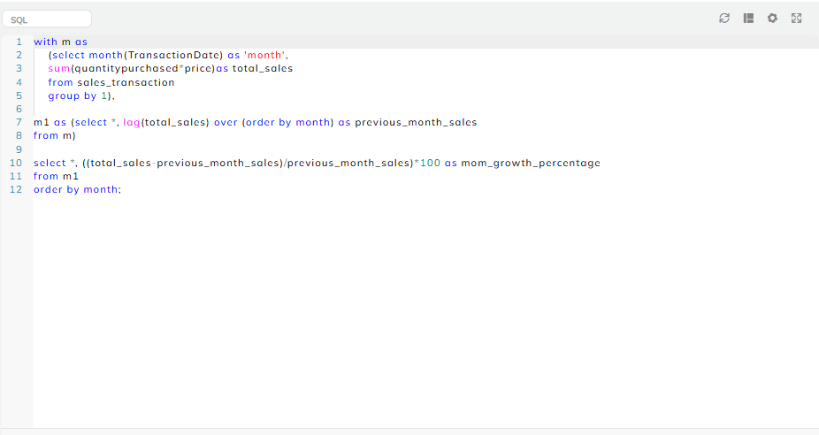
Output - 11

Slide 17
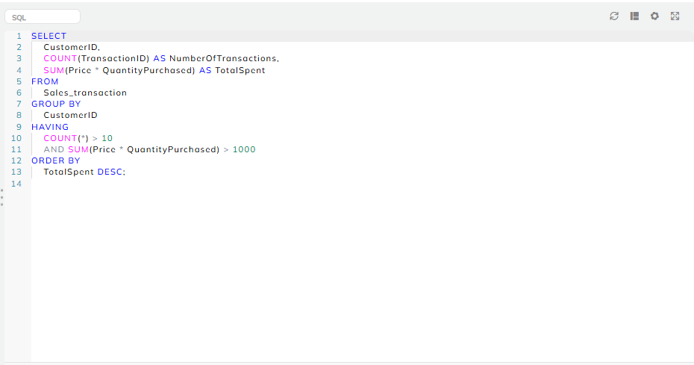
Output - 12

Slide 18
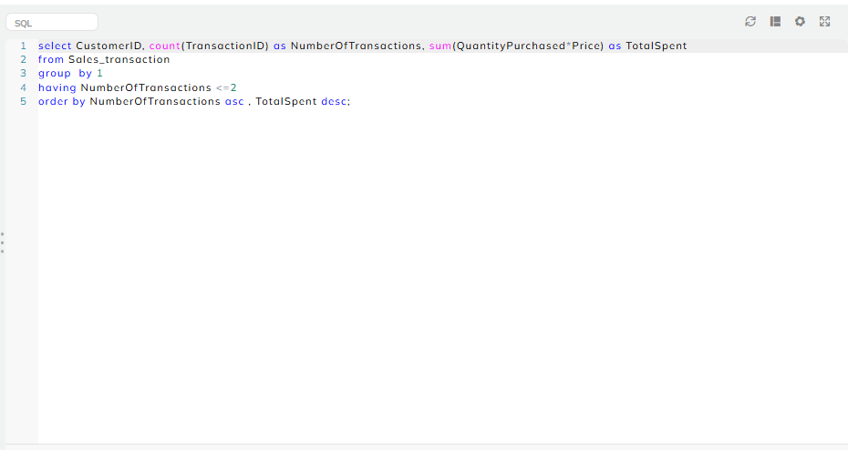
Output - 13

Slide 19
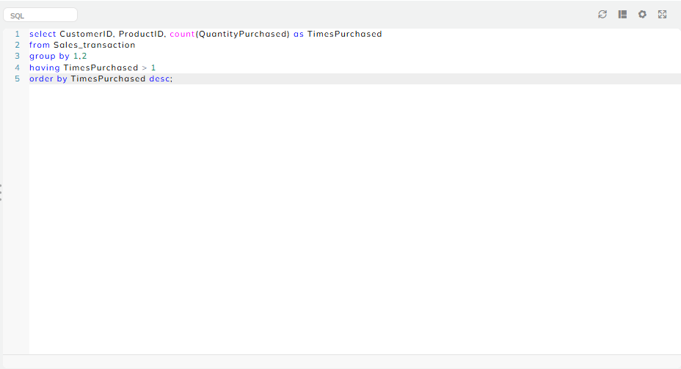
Output - 14

Slide 20
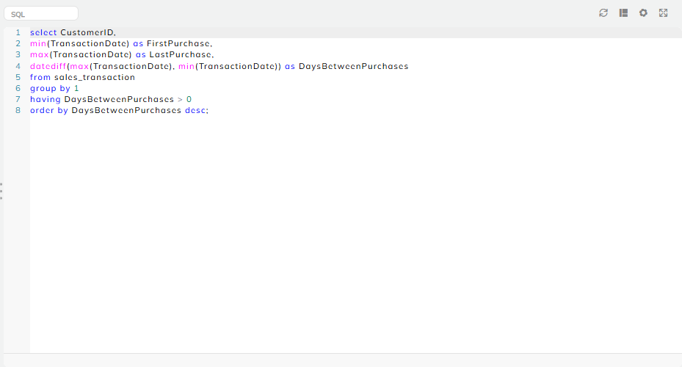
Output - 15

Slide 21


