Slide 1
Cape Lab
Group : 1
Name : Satyam Rahangdale
Roll no. : 22CH10062
Week – 4 (07/02/25)
Topic – BVP solution

Slide 2
Summary
Problem 1: Numerical solution of BVP
Solutions:
Finite Difference Method
Shooting Method
MATLAB function bvp4c

Slide 3
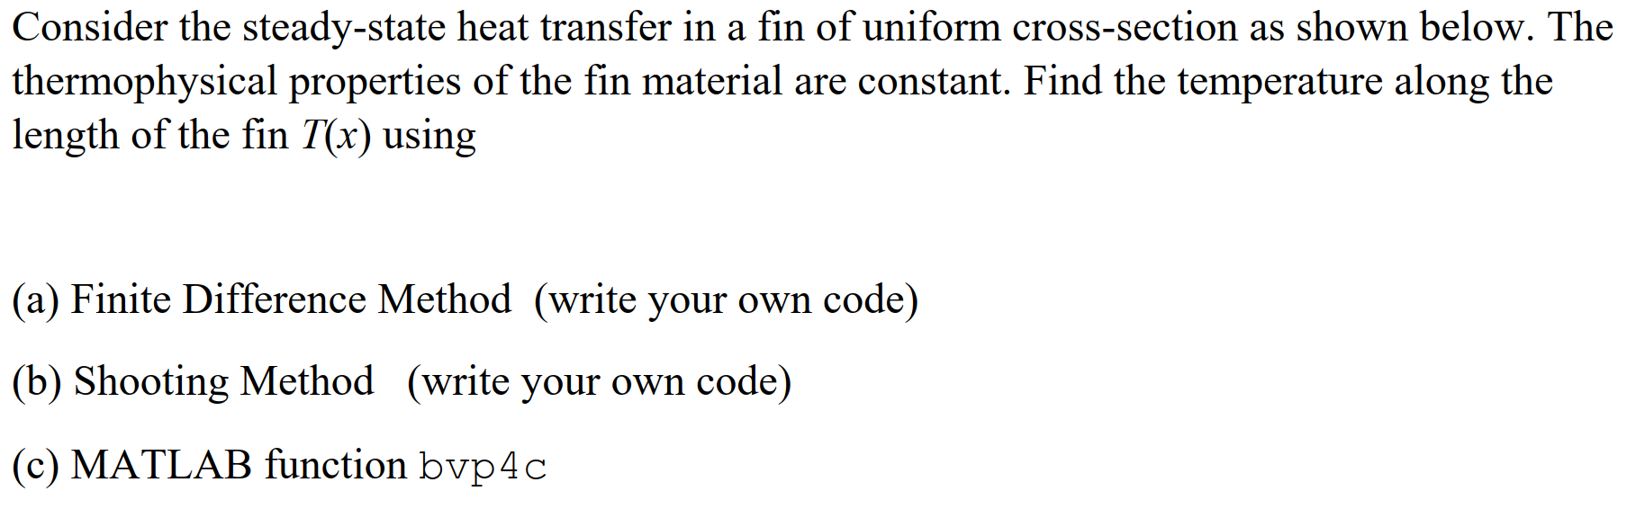
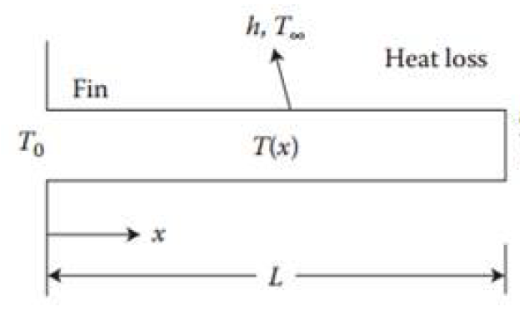
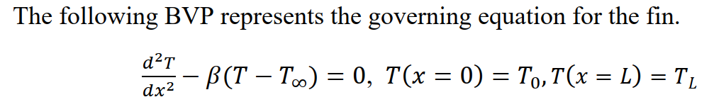
Problem

Slide 4
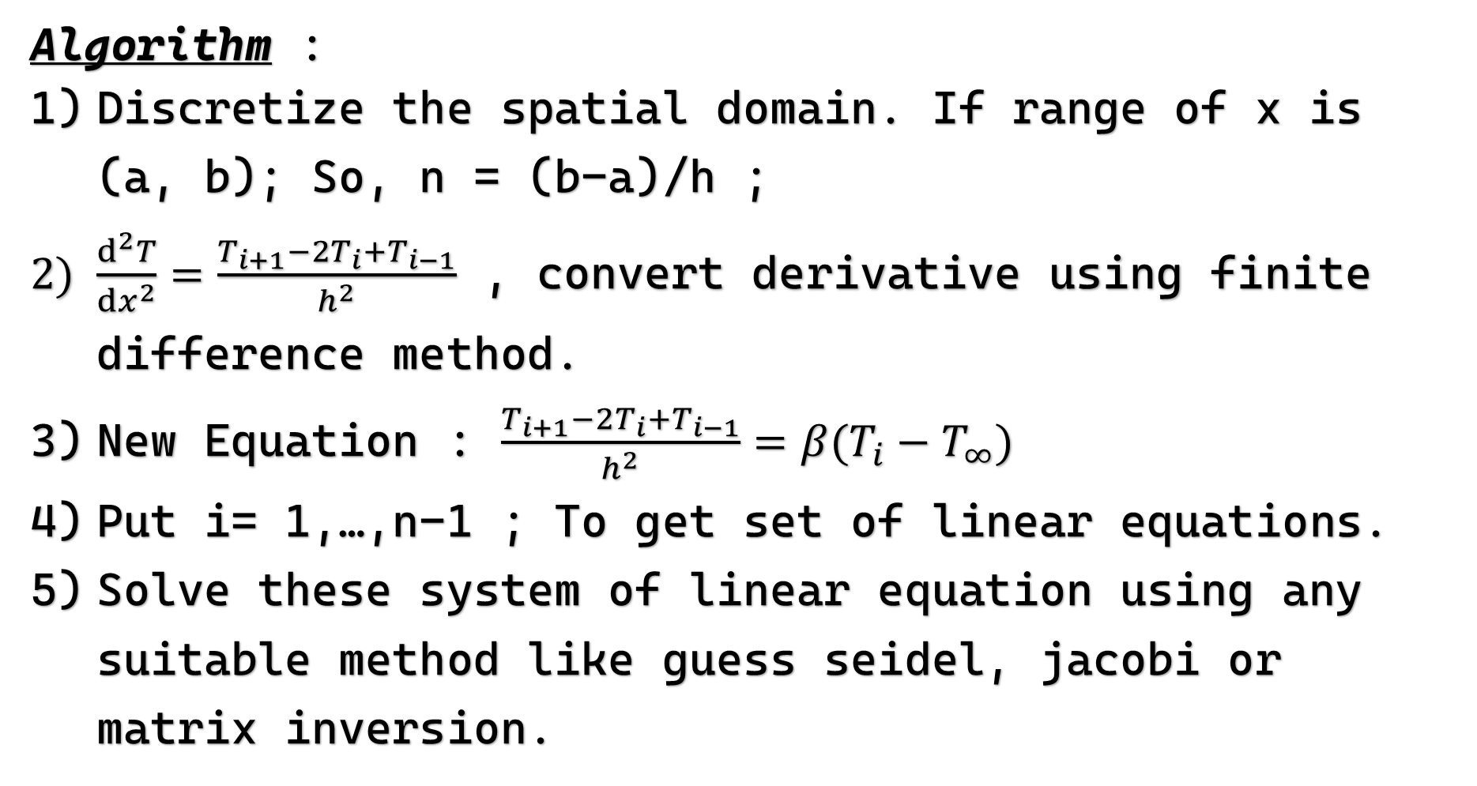
a) Finite Difference method
Algorithm :
Discretize the spatial domain. If range of x is (a, b); So, n = (b-a)/h ;
$\frac{ⅆ^{2}T}{ⅆx^{2}}=\frac{T_{i+1}−2T_{i}+T_{i−1}}{h^{2}}$ , convert derivative using finite difference method.
New Equation : $\frac{T_{i+1}−2T_{i}+T_{i−1}}{h^{2}}=β(T_{i}−T_{∞})$
Put i= 1,…,n-1 ; To get set of linear equations.
Solve these system of linear equation using any suitable method like guess seidel, jacobi or matrix inversion.

Slide 6
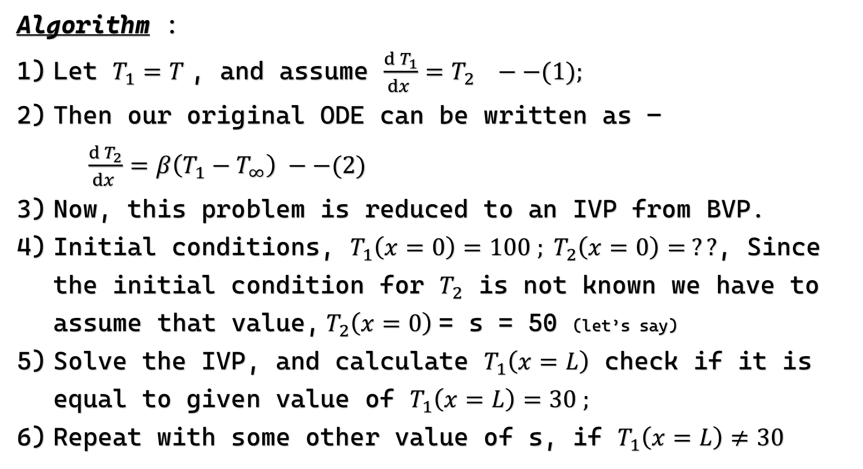
b) Shooting Method
Algorithm :
Let $T_{1}=T$, and assume $\frac{ⅆ^{ }T_{1}}{ⅆx^{ }}=T_{2} −−(1);$
Then our original ODE can be written as – $\frac{ⅆ^{ }T_{2}}{ⅆx^{ }}=β\left(T_{1}−T_{∞}\right) −−(2)$
Now, this problem is reduced to an IVP from BVP.
Initial conditions, $T_{1}\left(x=0\right)=100 ; T_{2}\left(x=0\right)= ??$, Since the initial condition for $T_{2}$ is not known we have to assume that value, $T_{2}\left(x=0\right)$= s = 50 (let’s say)
Solve the IVP, and calculate $T_{1}\left(x=L\right)$ check if it is equal to given value of $T_{1}\left(x=L\right)=30 ;$
Repeat with some other value of s, if $T_{1}\left(x=L\right)≠30$

Slide 8
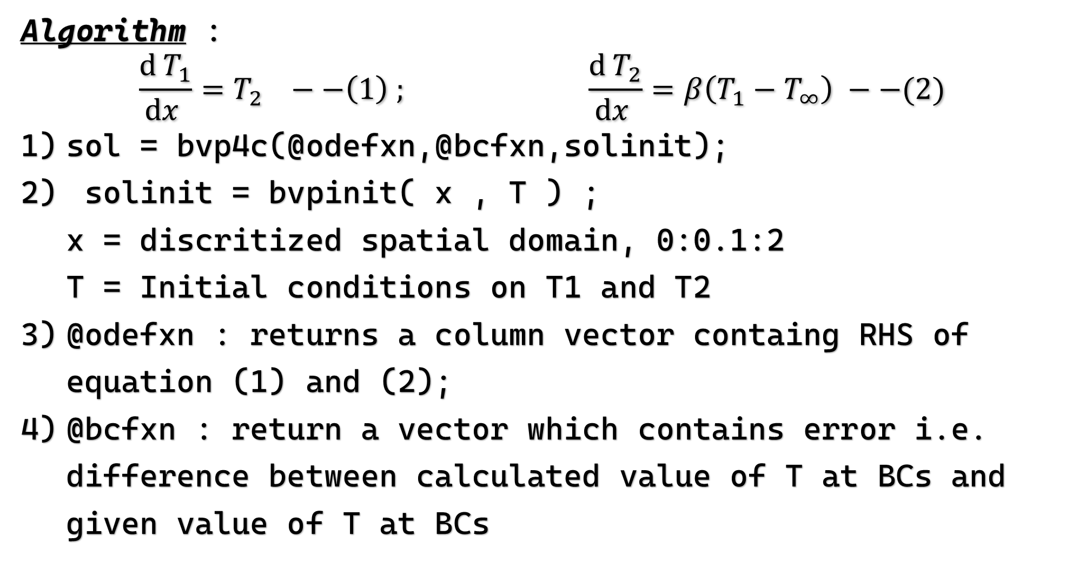
b) Using Matlab bvp4c
Algorithm : $$\frac{ⅆ^{ }T_{1}}{ⅆx^{ }}=T_{2} −−\left(1\right) ; \frac{ⅆ^{ }T_{2}}{ⅆx^{ }}=β\left(T_{1}−T_{∞}\right) −−(2)$$
sol = bvp4c(@odefxn,@bcfxn,solinit);
solinit = bvpinit( x , T ) ; x = discritized spatial domain, 0:0.1:2 T = Initial conditions on T1 and T2
@odefxn : returns a column vector containg RHS of equation (1) and (2);
@bcfxn : return a vector which contains error i.e. difference between calculated value of T at BCs and given value of T at BCs

Slide 10
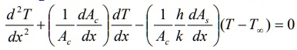
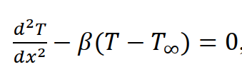
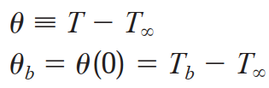
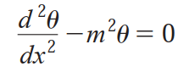

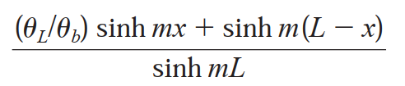


b) Analytical Solution
Using BCs, in above equation

Slide 12
Conclusion : All method results

Slide 13
