Slide 1
Cape Lab
Group : 1
Name : Satyam Rahangdale
Roll no. : 22CH10062
Week – 3 (23/01/25)
Topic – System of ODEs

Slide 2
Summary
Problem 1
Solutions:
MATLAB ode45
RK4
Types of Steady States
Conclusion
Problem 2
Solutions:
Matlab ode45
RK4
Matlab ode15s
Explicit Euler
Implicit Euler

Slide 3
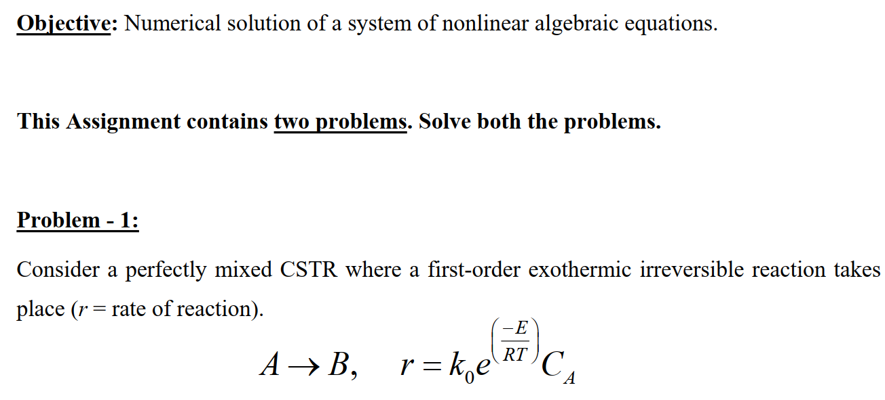
Problem 1

Slide 4
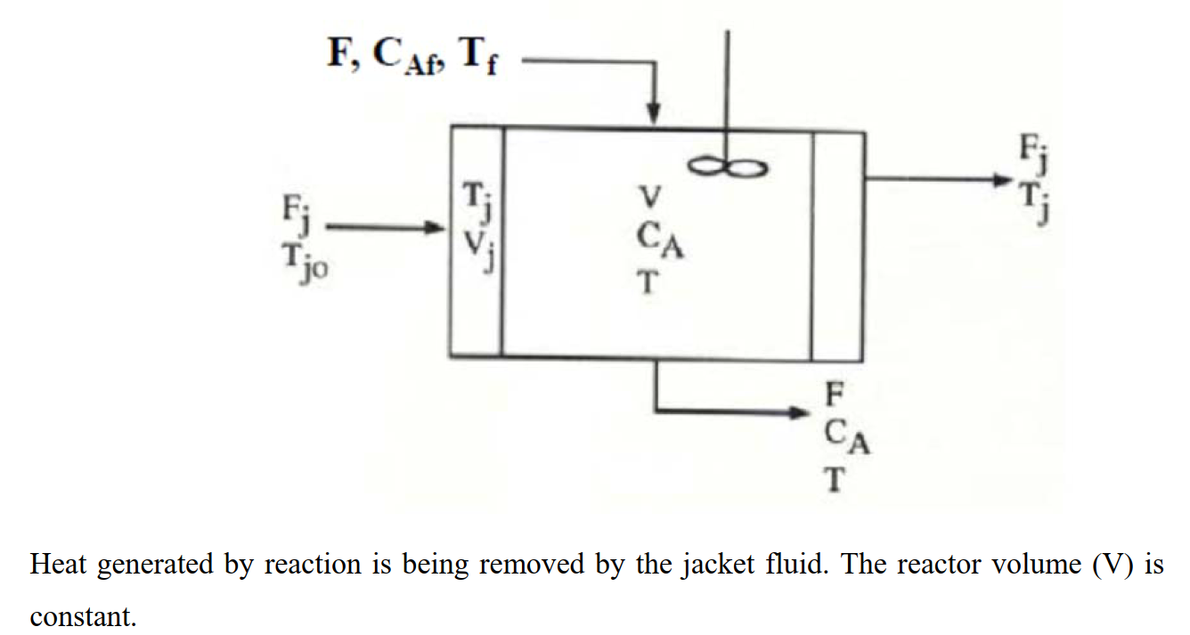

Slide 5
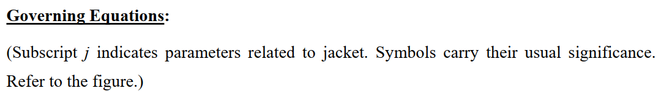
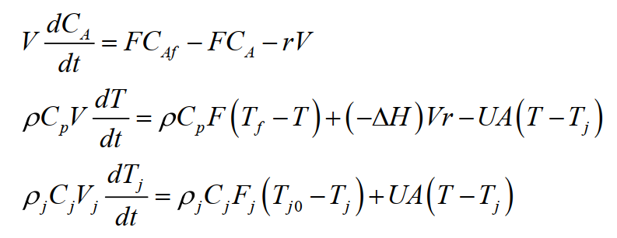

Slide 6
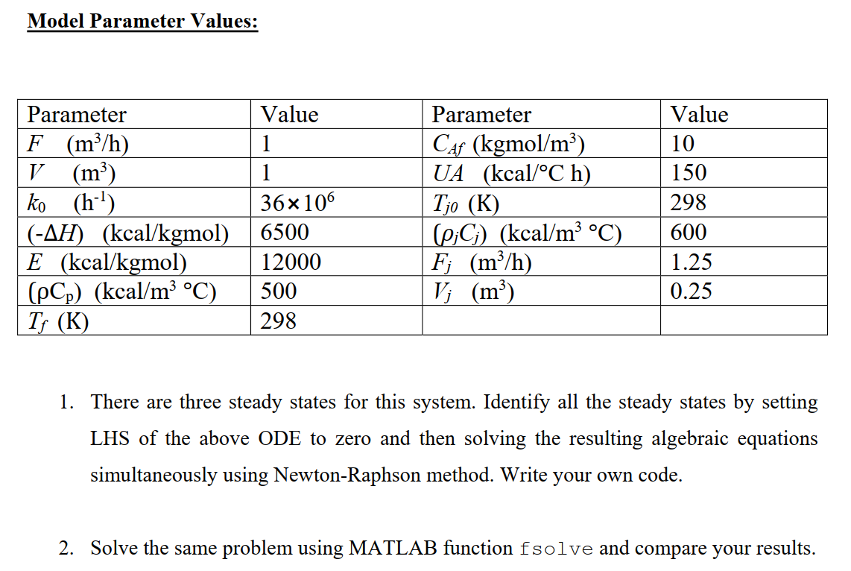
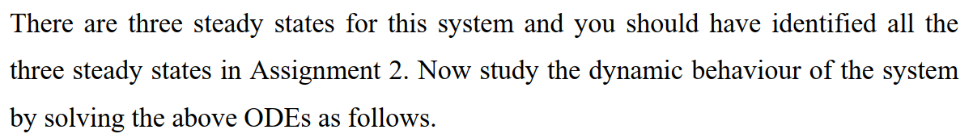

Slide 7
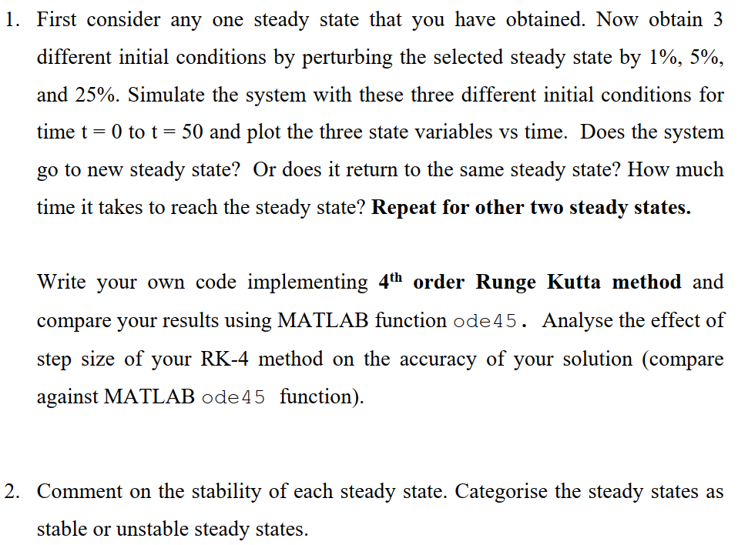

Slide 8
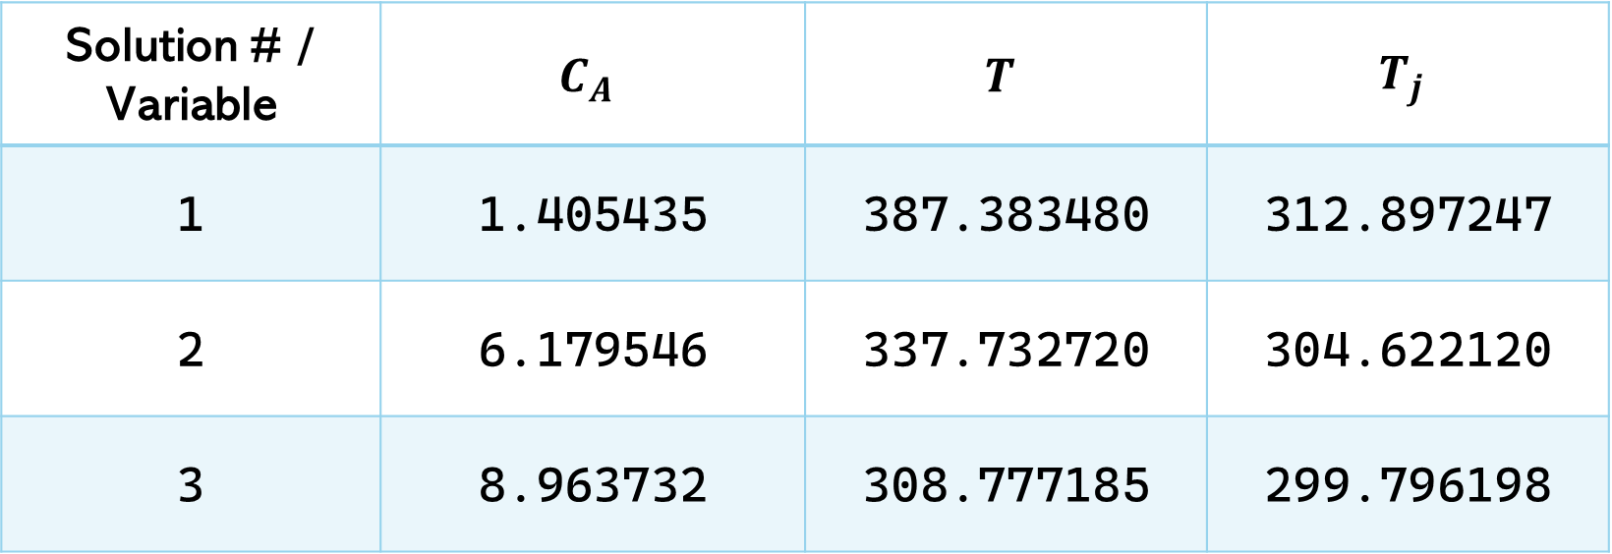
Previously we have solved this problem by putting LHS = 0,to get steady state values of process variables:
Solution # / Variable | $$C_{A}$$ | $$T$$ | $$T_{j}$$
1 | 1.405435 | 387.383480 | 312.897247
2 | 6.179546 | 337.732720 | 304.622120
3 | 8.963732 | 308.777185 | 299.796198

Slide 9
SS1

Slide 10
SS1 +25%

Slide 11
SS1 - 25%

Slide 12
SS1 +5%

Slide 13
SS1 - 5%

Slide 14
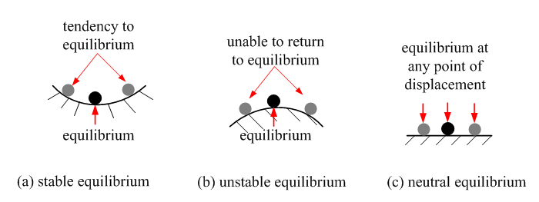
Hence, Steady State 1(SS1) is a stable steady State

Slide 15
SS2 : [6.179546 ; 337.732720 ; 304.622120]

Slide 16
SS2 +25%

Slide 17
SS2 - 25%

Slide 18
SS2 +5%

Slide 19
SS2 - 5%

Slide 20
SS2 +1%

Slide 21
SS2 - 1%

Slide 22
Hence, Steady State 2(SS1) is an unstable steady State

Slide 23
SS3 : [8.963732 ; 308.777185 ; 299.796198]

Slide 24
SS3 +25%

Slide 25
SS3 -25%

Slide 26
SS3 +5%

Slide 27
SS3 -5%

Slide 28
Hence, Steady State 1(SS1) is a stable steady State

Slide 29
Effect of step size(h) on Accuracy
t(s) | h = 0.4 | h = 0.2 | h = 0.1 | true value (h=0.01)
 | T(K) | T(K) | T(K) | T(K)
0 | 367 | 367 | 367 | 367
0.4 | 356.603507 | 356.424526 | 356.423712 | 356.4237875
0.8 | 352.5313699 | 352.430012 | 352.433683 | 352.4339375
1.2 | 351.195385 | 351.165499 | 351.170832 | 351.1711686
1.6 | 351.77976 | 351.803687 | 351.810765 | 351.8112081
2 | 354.3001079 | 354.37385 | 354.383833 | 354.3844564
2.4 | 359.4287676 | 359.564778 | 359.579874 | 359.580817
2.8 | 368.5969844 | 368.820742 | 368.843921 | 368.8453724
3.2 | 381.987175 | 382.247353 | 382.271848 | 382.2733736
3.6 | 390.7201841 | 390.867498 | 390.881143 | 390.8819664
4 | 391.0902497 | 391.369032 | 391.376266 | 391.3765856

Slide 31
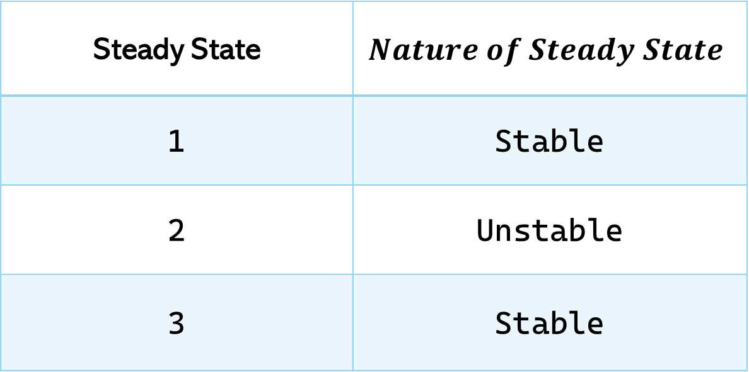
Conclusion
Steady State | $$Nature of Steady State$$
1 | Stable
2 | Unstable
3 | Stable
On decreasing the step size(h), accuracy of the solution increased.

Slide 32
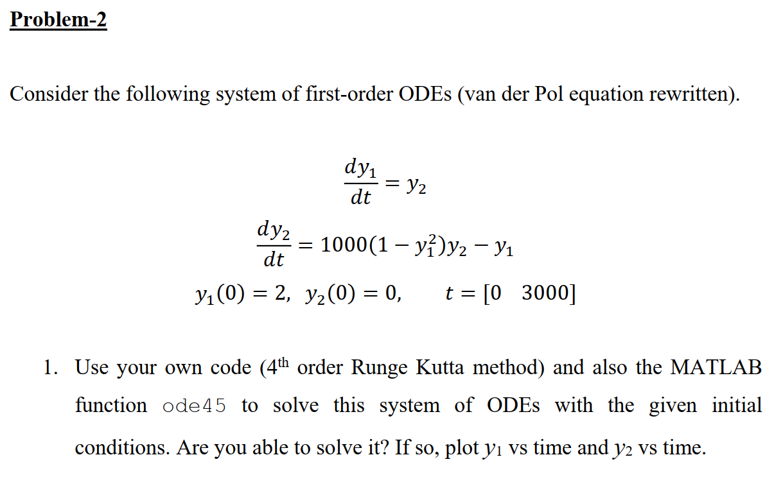

Slide 33
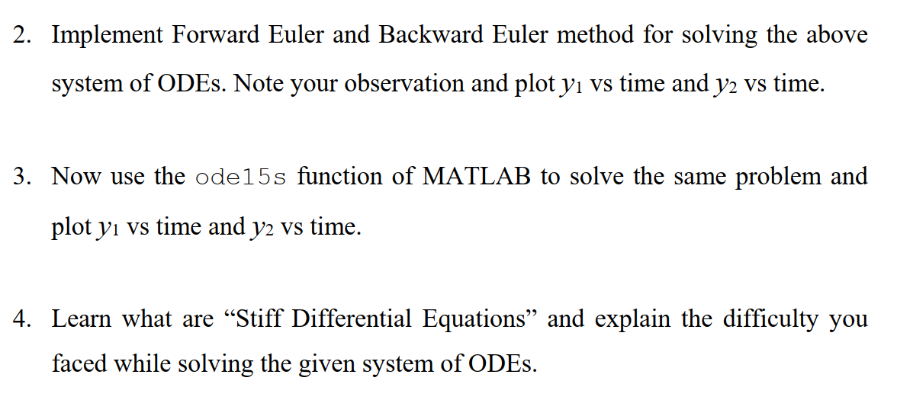

Slide 34
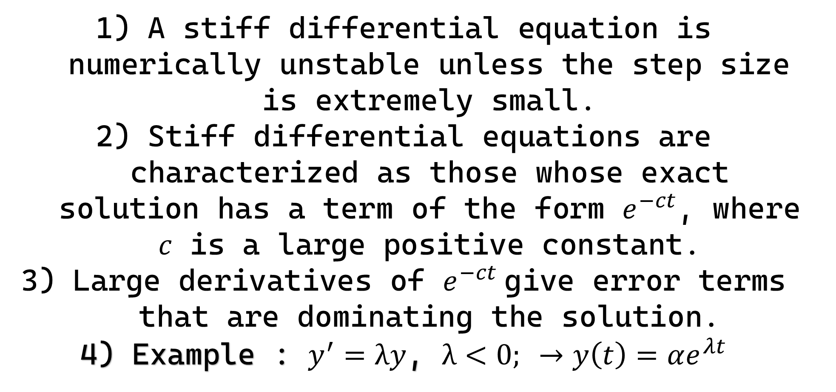
What is Stiff differential equation?
A stiff differential equation is numerically unstable unless the step size is extremely small.
Stiff differential equations are characterized as those whose exact solution has a term of the form $e^{−ct}$, where 𝑐 is a large positive constant.
Large derivatives of $e^{−ct}$give error terms that are dominating the solution.
Example : $y^{′}=λy$, $λ<0; →y\left(t\right)=αe^{λt}$

Slide 35
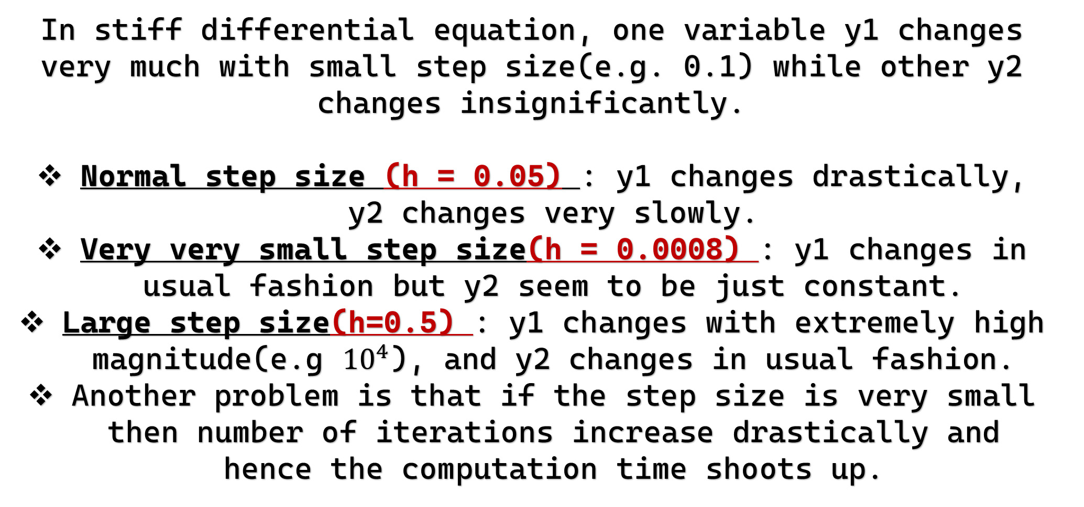
Difficulties in solving Stiff ODEs
In stiff differential equation, one variable y1 changes very much with small step size(e.g. 0.1) while other y2 changes insignificantly.
Normal step size (h = 0.05) : y1 changes drastically, y2 changes very slowly.
Very very small step size(h = 0.0008) : y1 changes in usual fashion but y2 seem to be just constant.
Large step size(h=0.5) : y1 changes with extremely high magnitude(e.g ${10}^{4}$), and y2 changes in usual fashion.
Another problem is that if the step size is very small then number of iterations increase drastically and hence the computation time shoots up.

Slide 36
a) Matlab ode45

Slide 37

b) RK4
$$h = 0.0008$$
iteration = 80000

Slide 38
c) Matlab ode15s

Slide 39

d) Explicit Euler
$$h = 0.0008$$
iteration = 80000

Slide 40
e) Implicit Euler
h=0.1

Slide 41
e) Implicit Euler
h=0.01

Slide 42
e) Implicit Euler
h=0.0001

