Slide 1
Cape Lab
Group : 1
Name : Satyam Rahangdale
Roll no. : 22CH10062
Week – 2 (23/01/25)
Topic – System of Non-linear Equation

Slide 2
Summary
Problem Statement 1
Solutions:
Newton’s method
MATLAB built in function fzero
Problem 2
Solutions

Slide 3
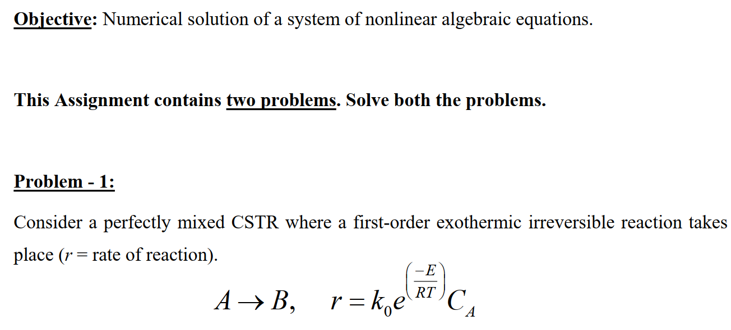
Problem 1

Slide 4
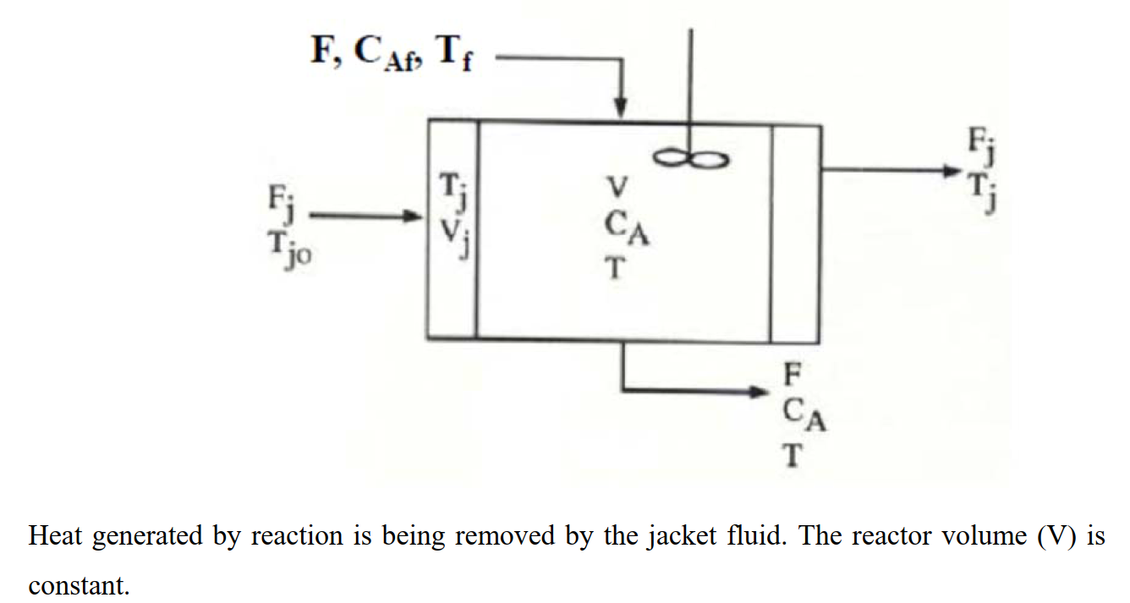

Slide 5
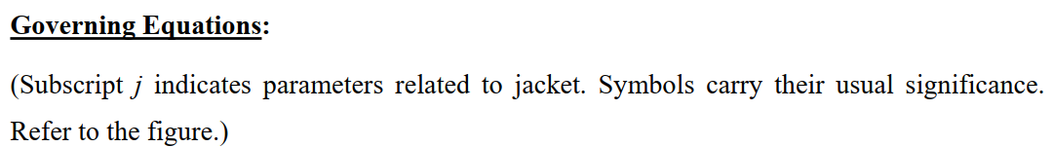
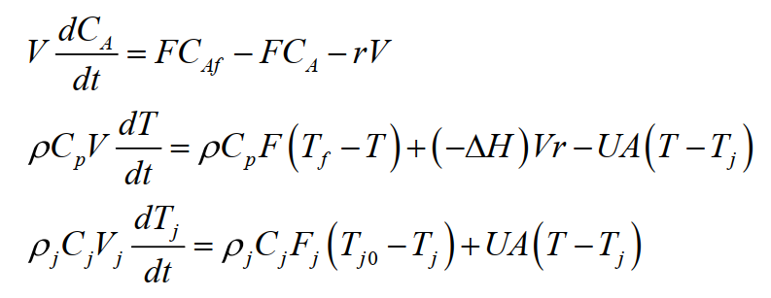

Slide 6
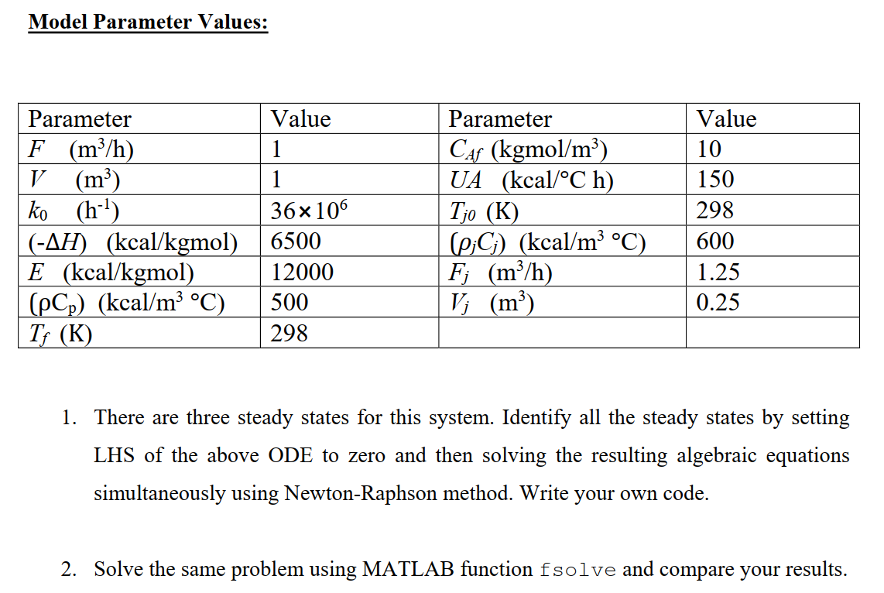

Slide 7
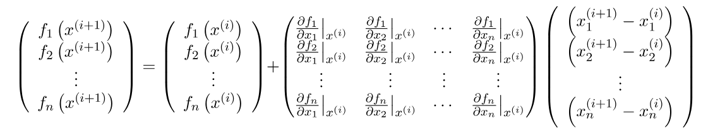
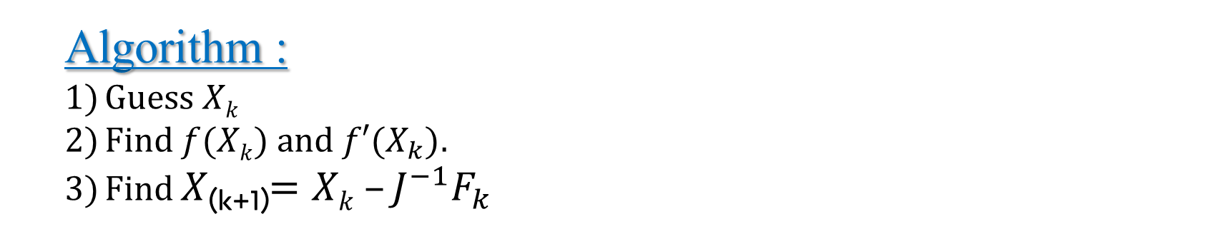
b) Newton’s Rapson Method
Algorithm :
Guess $Xk$
Find $f(Xk)$and $f′(X_{k})$.
Find $X$_{(k+1)}$=Xk –J^{−1}F_{k}$
Order of convergence = 2.
-1

Slide 8
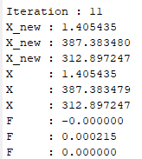
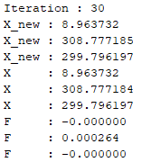
Results :-
Solution 1
Solution 2

Slide 9
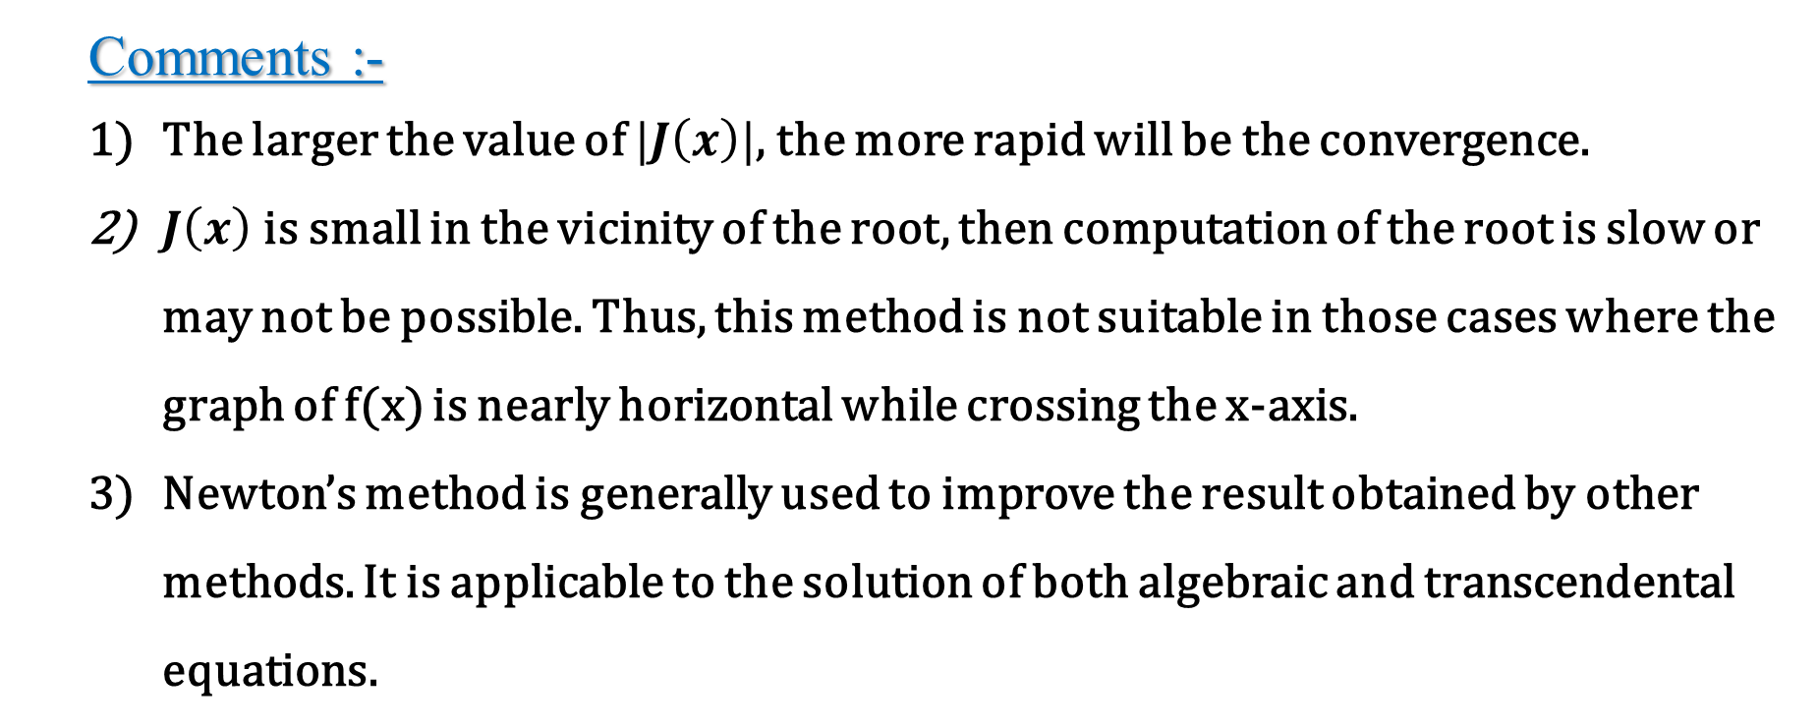
Analysis of Results :-
Comments :-
The larger the value of $|J\left(x\right)|$, the more rapid will be the convergence.
$J\left(x\right)$ is small in the vicinity of the root, then computation of the root is slow or may not be possible. Thus, this method is not suitable in those cases where the graph of f(x) is nearly horizontal while crossing the x-axis.
Newton’s method is generally used to improve the result obtained by other methods. It is applicable to the solution of both algebraic and transcendental equations.

Slide 10
d) Built in fsolve
Algorithm :
Make initial guess of X=[CA, T, Tj] as close as possible to solution.
Call built in fsolve function
This will give only one of the many possible solutions.
To find all possible solutions , try different initial guess.
Code[Matlab]

Slide 11
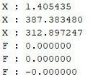
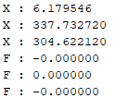
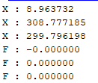
Results :-
Solution 1
Solution 2
Solution 3

Slide 12
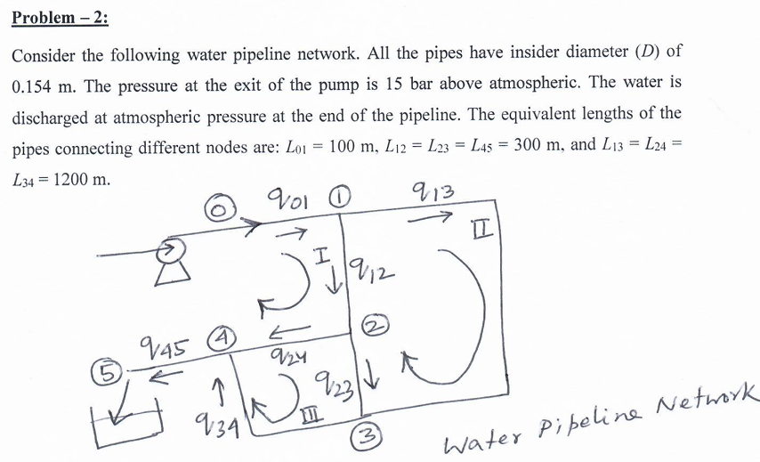
Problem 2

Slide 13
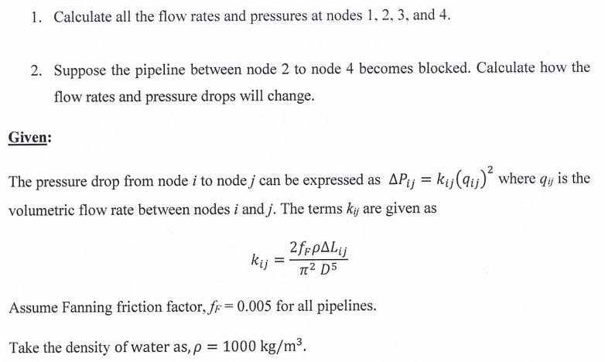

Slide 14

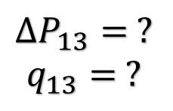






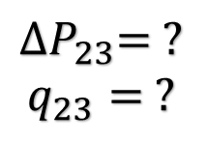

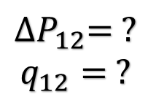
Case 1 : (Pipe)24 is open
$$P_{0}=16 bar$$
$$P_{atm}=1 bar$$
0
1
$${∆P}_{01}=?, q_{01}=?$$
$$∆P_{13}= ?$$
$$q_{13}= ?$$
$$∆P_{pump}=15 bar$$
$${∆P}_{12}= ?$$
$$q_{12}= ?$$
$${∆P}_{45}= ?, q_{45}= ?$$
$${∆P}_{24}= ?, q_{24}= ?$$
5
4
2
$${∆P}_{23}= ?$$
$$q_{23}= ?$$
$${∆P}_{34}= ?, q_{34}= ?$$
3

Slide 15
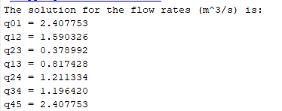
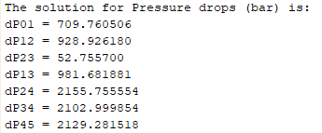
Results
Iteration : 5

Slide 16
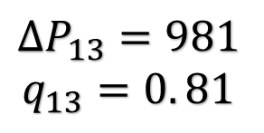
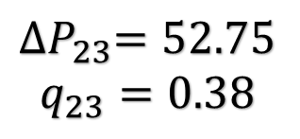




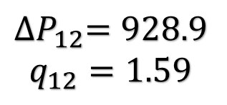
$$P_{0}=16 bar$$
$$P_{atm}=1 bar$$
0
1
$${∆P}_{01}=709.7, q_{01}=2.4$$
$$∆P_{13}=981$$
$$q_{13}=0. 81$$
$$∆P_{pump}=15 bar$$
$${∆P}_{12}=928.9$$
$$q_{12}=1.59$$
$${∆P}_{45}=2129, q_{45}=2.4$$
$${∆P}_{24}=2155.7, q_{24}=1.21$$
5
4
2
$${∆P}_{23}=52.75$$
$$q_{23}=0.38$$
$${∆P}_{34}=2103, q_{34}=1.2$$
3

Slide 17
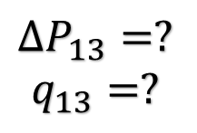



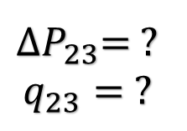
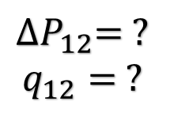
Case 2 : (Pipe)24 is closed
$$P_{0}=16 bar$$
$$P_{atm}=1 bar$$
0
1
$${∆P}_{01}=?, q_{01}=?$$
$$∆P_{13}=?$$
$$q_{13}=?$$
$$∆P_{pump}=15 bar$$
$${∆P}_{12}= ?$$
$$q_{12}= ?$$
$${∆P}_{45}=2129, q_{45}=2.4$$
$${∆P}_{24}=?, q_{24}=1.2$$
5
4
2
${∆P}_{23}=$ ?
$$q_{23}= ?$$
$${∆P}_{34}= ?, q_{34}=?$$
3

Slide 18
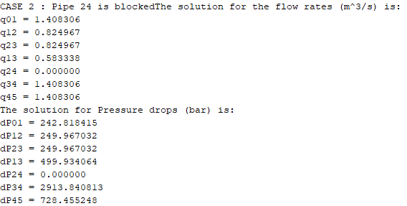
Results
Iteration : 5

Slide 19
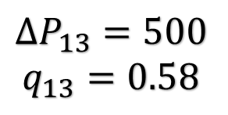
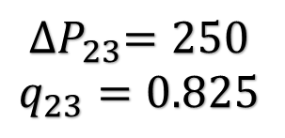




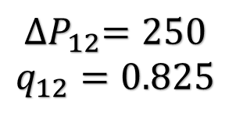
$$P_{0}=16 bar$$
$$P_{atm}=1 bar$$
0
1
$${∆P}_{01}=242, q_{01}=1.4$$
$$∆P_{13}=500$$
$$q_{13}=0.58$$
$$∆P_{pump}=15 bar$$
$${∆P}_{12}=250$$
$$q_{12}=0.825$$
$${∆P}_{45}=728, q_{45}=1.4$$
$${∆P}_{24}=0, q_{24}=0$$
5
4
2
$${∆P}_{23}=250$$
$$q_{23}=0.825$$
$${∆P}_{34}=2913, q_{34}=1.4$$
3

Slide 20
Case 1: pipe 24 is open
Open Vs Closed Pipe

