Slide 1

Name: SATYAM KUMAR YADAV Course: B.TECH CSE UEN: RTU24101CS013 Subject: MACHINE LEARNING Topic : FAKE JOB DETECTION Presented To: MR. KUMAR SATYAM TANTI

Slide 2
Introduction
Fake job postings are fraudulent job ads made to trick people.
The goal of this project is to detect whether a job posting is real or fake using Machine Learning.
Algorithm Used: Naive Bayes with TF-IDF features.
Language: Python

Slide 3
Dataset Description
Dataset Source: Kaggle – Fake Job Postings Dataset
It contains job title, description, requirements, and label.
Target Column: fraudulent
0 → Real
1 → Fake
Around 18,000 job postings used.

Slide 4
Workflow Diagram
Data → Preprocessing → Feature Extraction → Model Training → Evaluation → Deployment

Slide 5
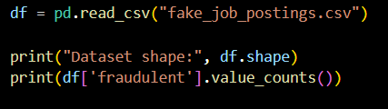
Step 1: Load the Data
Used Pandas to load the dataset.
Checked dataset size and how many fake/real jobs there are.

Slide 6
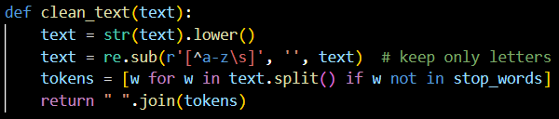
Step 2: Clean the Text
Converted text to lowercase.
Removed special characters using regex.
Removed stopwords like the, is, and.
Combined title, description, and requirements into one clean text column.

Slide 7
Step 3: Train–Test Split
Divided data into 80% training and 20% testing.
Ensures model is tested on unseen data.

Slide 8

Step 4: Build Pipeline
TF-IDF converts text → numbers.
Naive Bayes predicts if job is real or fake.
Pipeline makes the whole process automatic.

Slide 9
Step 5: Evaluation
Accuracy shows how well the model predicts.
Confusion Matrix tells correct and wrong predictions visually.
Classification report shows precision, recall, F1-score.
🧠 Example: “Model Accuracy = 97%”

Slide 10

Step 6: Save Model
Saved the model using Joblib.
Can reuse later without retraining

Slide 11
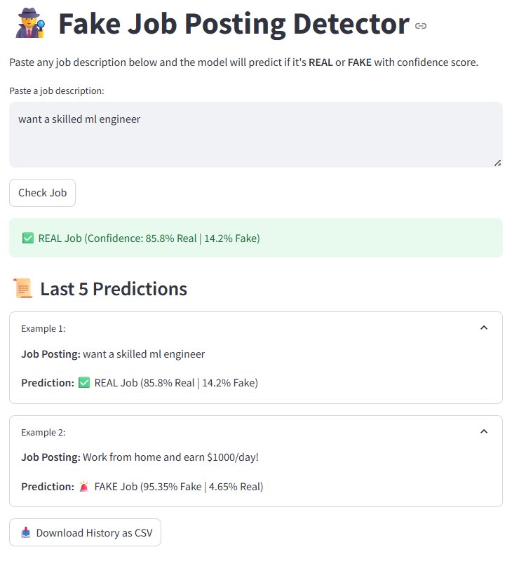
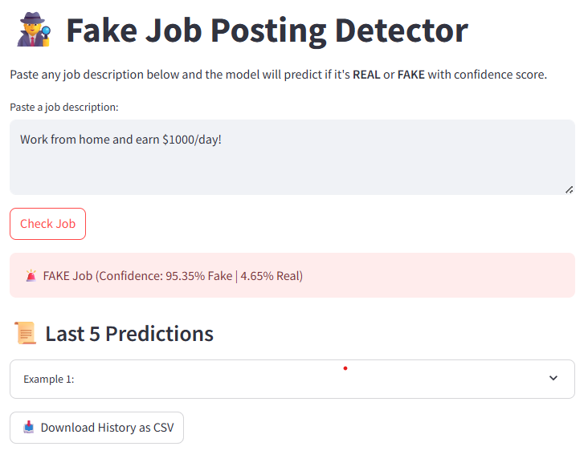
Step 7: Quick Demo

Slide 12
Conclusion & Future Scope
The model successfully detects fake job posts with high accuracy.
Helps prevent people from falling for scams.
Future Improvements:
Use Deep Learning (BERT).
Add more real-world data.
* Click on GITHUB to see the code

Slide 13


