Slide 1
Data Science Capstone

Slide 2
Healthcare Insurance Analysis

Slide 3
Business Scenario
Problem statement:
A significant public health concern is the rising cost of healthcare. Therefore, it's crucial to be able to predict future costs and gain a solid understanding of their causes. The insurance industry must also take this analysis seriously. This analysis may be used by healthcare insurance providers to make a variety of strategic and tactical decisions.
Objective:
The objective of this project is to predict patients’ healthcare costs and to identify factors contributing to this prediction. It will also be useful to learn the interdependencies of different factors and comprehend the significance of various tools at various stages of the healthcare cost prediction process.

Slide 4
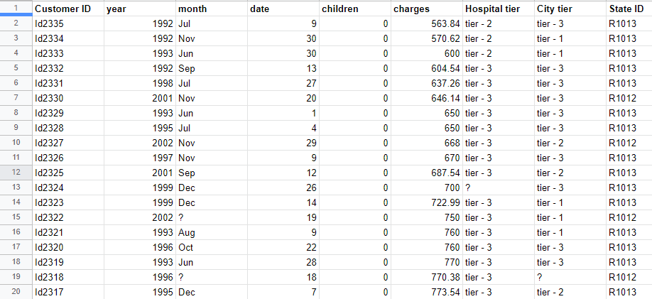
Dataset Snapshot
Hospitalization details.xlsx

Slide 5
Dataset Description
Hospitalization details.xlsx
Variables | Description
Customer ID | Unique identification for beneficiary(primary)
year | Year of birth
month | Month of birth
date | Date of birth
children | No. of children as dependents
charges | Hospitalization cost
Hospital tier | Level of hospital, tier-1 being the best
City tier | Level of city per government document, tier-1 referring to the most developed
State ID | ID of the state

Slide 6
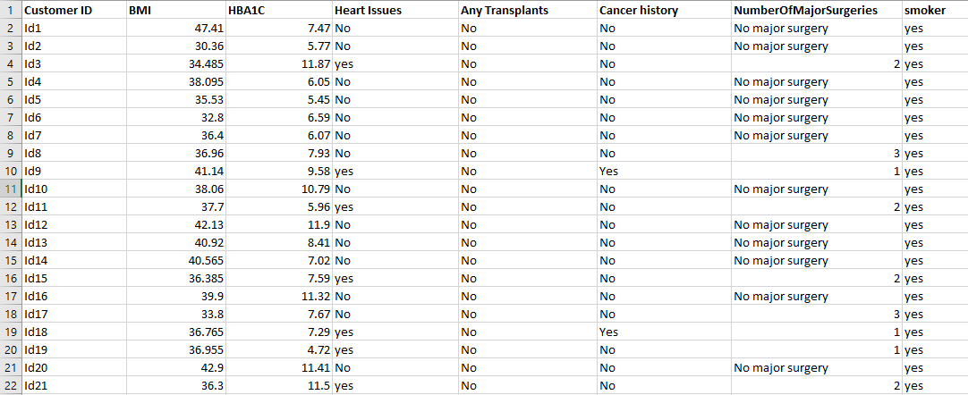
Dataset Snapshot
Medical Examinations.xlsx

Slide 7
Dataset Description
Medical Examinations.xlsx
Variables | Description
Customer ID | Unique identification for beneficiary(primary)
BMI | Shows the body mass index of the individual (BMI measures body fat based on height and weight)
HBA1C | Shows the HBA1C report (HBA1C measures the amount of sugar in the blood (glucose), where HBA1C greater than 6.5 is considered diabetic
Heart Issues | Shows if a patient has heart-related issues
Any Transplants | Shows if a patient has any transplants in their body
Cancer history | Shows if a patient has any history of cancer in the family
NumberOfMajorSurgeries | Displays the number of major surgeries a patient has gone through
smoker | Indicates if a patient smokes cigarettes

Slide 8
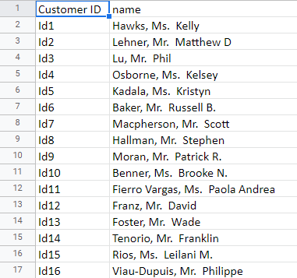
Dataset Snapshot
Names.xlsx

Slide 9
Dataset Description
Names.xlsx
Variables | Description
Customer ID | Unique identification for beneficiary(primary)
name | Name of the beneficiary(primary)

Slide 10
Project Task: Week 1
Data science
Collate the files so that all the information is in one place
Check for missing values in the dataset
Find the percentage of rows that have trivial value (for example, ?), and delete such rows if they do not contain significant information
Use the necessary transformation methods to deal with the nominal and ordinal categorical variables in the dataset
The dataset has State ID, which has around 16 states. All states are not represented in equal proportions in the data. Creating dummy variables for all regions may also result in too many insignificant predictors. Nevertheless, only R1011, R1012, and R1013 are worth investigating further. Design a suitable strategy to create dummy variables with these restraints.
The variable NumberOfMajorSurgeries also appears to have string values. Apply a suitable method to clean up this variable.

Slide 11
Project Task: Week 1
Data science
Age appears to be a significant factor in this analysis. Calculate the patients' ages based on their dates of birth.
The gender of the patient may be an important factor in determining the cost of hospitalization. The salutations in a beneficiary's name can be used to determine their gender. Make a new field for the beneficiary's gender.
You should also visualize the distribution of costs using a histogram, box and whisker plot, and swarm plot.
State how the distribution is different across gender and tiers of hospitals
Create a radar chart to showcase the median hospitalization cost for each tier of hospitals
Create a frequency table and a stacked bar chart to visualize the count of people in the different tiers of cities and hospitals

Slide 12
Project Task: Week 1
Data science
Test the following null hypotheses:
The average hospitalization costs for the three types of hospitals are not significantly different.
The average hospitalization costs for the three types of cities are not significantly different.
The average hospitalization cost for smokers is not significantly different from the average cost for nonsmokers.
Smoking and heart issues are independent.

Slide 13
Project Task: Week 2
Machine learning
Examine the correlation between predictors to identify highly correlated predictors
Hint: Use a heatmap to visualize this
Develop a regression model Linear or Ridge. Evaluate the model with k-fold cross validation. Also, ensure that you apply all the following suggestions:
Implement the stratified 5-fold cross validation technique for both model building and validation
Utilize effective standardization techniques and hyperparameter tuning
Incorporate sklearn-pipelines to streamline the workflow
Apply appropriate regularization techniques to address the bias-variance trade-off
Create five folds in the data, and introduce a variable to identify the folds
Develop Gradient Boost model and determine the variable importance scores, and identify the redundant variables

Slide 14
Project Task: Week 2
Machine learning
Case scenario:
Estimate the cost of hospitalization for Christopher, Ms. Jayna (Date of birth 12/28/1988; height 170 cm; and weight 85 kgs). She lives with her partner and two children in a tier-1 city, and her state’s State ID is R1011. She was found to be nondiabetic (HbA1c = 5.8). She smokes but is otherwise healthy. She has had no transplants or major surgeries. Her father died of lung cancer. Hospitalization costs will be estimated using tier-1 hospitals.
Find the predicted hospitalization cost using the best models

Slide 15
Project Task: Week 2
SQL
To gain a comprehensive understanding of the factors influencing hospitalization costs
a. Merge the two tables by first identifying the columns in the data tables that will help you in merging
b. In both tables, add a Primary Key constraint for these columns
Hint: You can remove duplicates and null values from the column and then use ALTER TABLE to add a Primary Key constraint.

Slide 16
Project Task: Week 2
SQL
Retrieve information about people who are diabetic and have heart problems with their average age, the average number of dependent children, average BMI, and average hospitalization costs
Find the average hospitalization cost for each hospital tier and each city level
Determine the number of people who have had major surgery with a history of cancer
Determine the number of tier-1 hospitals in each state

Slide 17
Project Task: Week 2
Tableau
Create a dashboard in Tableau by selecting the appropriate chart types and business metrics
Note: Put more emphasis on data storytelling

Slide 18
Thank You

