Slide 1
Data Science Capstone

Slide 2
United States Airlines Analysis

Slide 3
Business Scenario
Problem statement:
According to air travel consumer reports, a large proportion of consumer complaints are about frequent flight delays. Out of all the complaints received from consumers about airline services, 32% were related to cancellations, delays, or other deviations from the airlines’ schedules.
There are unavoidable delays that can be caused by air traffic, no passengers at the airport, weather conditions, mechanical issues, passengers coming from delayed connecting flights, security clearance, and aircraft preparation.
Objective:
The objective of this project is to identify the factors that contribute to avoidable flight delays. You are also required to build a model to predict if the flight will be delayed.

Slide 4
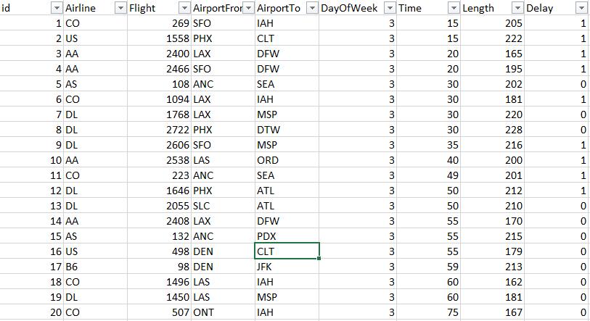
Dataset Snapshot
Airlines.xlsx

Slide 5
Dataset Description
Airlines.xlsx
Variables | Description
id | Flight number
Airline | Type of commercial airlines
Flight | Type of aircraft
AirportFrom | Source airport
AirportTo | Destination airport
DayOfWeek | Day of the week
Time | Departure time measured in minutes from midnight (range is from 10 to 1439)
Length | Duration of the flight in minutes
Delay | If the flight is delayed

Slide 6
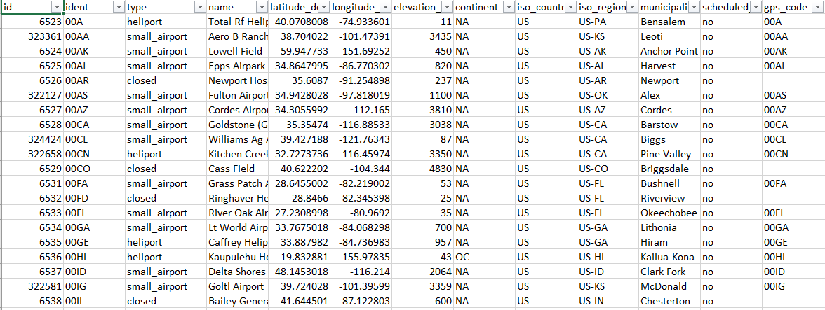
Dataset Snapshot
airports.xlsx

Slide 7
Dataset Description
airports.xlsx
Variables | Description
id | This is an identifier for the airport. It will stay persistent even if the airport code changes.
ident | This is the text identifier used in the OurAirports URL. This will be the International Civil Aviation Organization (ICAO) code if available. Otherwise, it will be a local airport code (if there is no conflict) or will be an internally-generated code starting with the ISO2 country code followed by a dash and a four-digit number.
type | This shows the type of the airport. The values allowed here are closed_airport, heliport, large_airport, medium_airport, seaplane_base, and small_airport.
name | This shows the official name of the airport, including Airport and Airstrip
latitude_deg | This shows the latitude of the airport in decimal degrees (north is positive).
longitude_deg | This shows the longitude of the airport in decimal degrees (east is positive).

Slide 8
Dataset Description
airports.xlsx
Variables | Description
elevation_ft | This shows the elevation MSL of the airport in feet (not meters).
continent | This shows the code for the continent where the airport is (primarily) located. The allowed values include AF (Africa), AN (Antarctica), AS (Asia), EU (Europe), NA (North America), OC (Oceania), or SA (South America).
iso_country | This shows the two-character ISO 3166:1-alpha2 code for the country where the airport is (primarily) located. A handful of unofficial, non-ISO codes are also in use, such as XK for Kosovo.
iso_region | This is an alphanumeric code for the high-level administrative subdivision of a country where the airport is primarily located (e.g., province and governorate) prefixed by the ISO2 country code and a hyphen. OurAirports uses ISO 3166:2 codes whenever possible, preferring higher administrative levels, but also includes some custom codes.
municipality | This shows the primary municipality that the airport serves (when available). Note that this is not necessarily the municipality where the airport is physically located.

Slide 9
Dataset Description
airports.xlsx
Variables | Description
scheduled_service | This shows yes if the airport currently has scheduled airline service and no if otherwise.
gps_code | This shows the code that an aviation GPS database (such as, Jeppesen's or Garmin's) would normally use for the airport. This will always be the ICAO code if one exists. Note that, unlike the ident column, this is not guaranteed to be globally unique.
iata_code | This shows the three-letter IATA code for the airport (if it has one).
local_code | This shows the local country code for the airport if it’s different from the gps_code and iata_code fields (used mainly for US airports).
home_link | This shows the URL of the airport's official home page on the web if one exists.
wikipedia_link | This shows the URL of the airport's page on Wikipedia if one exists.
Keywords | This field contains other keywords or phrases to assist with the search. These are separated by a comma. It may also include former names for the airport, alternate codes, names in other languages, and nearby tourist destinations.

Slide 10
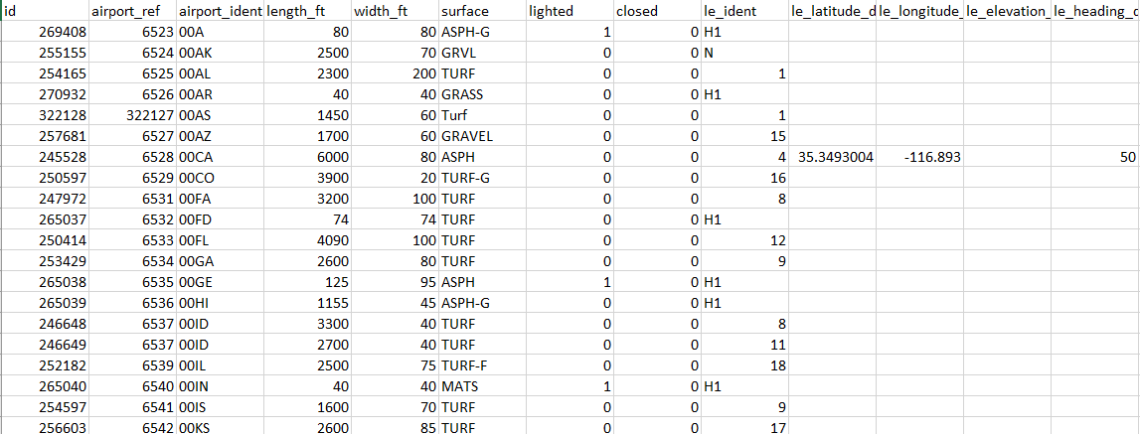
Dataset Snapshot
runways.xlsx

Slide 11
Dataset Description
runways.xlsx
Variables | Description
id | This shows the internal OurAirports integer identifier for the runway. This will stay persistent even if the runway numbering changes.
airport_ref | This shows the internal integer foreign key matching the id column for the associated airport in airports.csv. Here, airport_ident is a better alternative.
airport_ident | This shows the externally-visible string foreign key matching the ident column for the associated airport in airports.csv.
length_ft | This shows the length of the full runway surface (including displaced thresholds and overrun areas) in feet.
width_ft | This shows the width of the runway surface in feet.
surface | This shows the code for the runway surface type. This is not a controlled vocabulary yet, but it will be soon (probably). Some common values include ASP (asphalt), TURF (turf), CON (concrete), GRS (grass), GRE (gravel), WATER (water), and UNK (unknown).

Slide 12
Dataset Description
runways.xlsx
Variables | Description
lighted | This shows 1 if the surface is lit at night and 0 if not. Note that this is inconsistent with airports.csv which uses yes and no instead.)
closed | This shows 1 if the runway surface is currently closed and 0 if not.
le_ident | This shows the identifier for the low-numbered end of the runway.
le_latitude_deg | This shows the latitude of the center of the low-numbered end of the runway in decimal degrees (north is positive) if available.
le_longitude_deg | This shows the longitude of the center of the low-numbered end of the runway in decimal degrees (east is positive) if available.
le_elevation_ft | This shows the elevation above MSL of the low-numbered end of the runway in feet.
le_heading_degT | This shows the heading of the low-numbered end of the runway in degrees true (non-magnetic).

Slide 13
Dataset Description
runways.xlsx
Variables | Description
le_displaced_threshold_ft | This shows the length of the displaced threshold (if any) for the low-numbered end of the runway in feet.
he_ident | This shows the identifier for the high-numbered end of the runway.
he_latitude_deg | This shows the latitude of the center of the high-numbered end of the runway in decimal degrees (north is positive) if available.
he_longitude_deg | This shows the longitude of the center of the high-numbered end of the runway in decimal degrees (east is positive) if available.
he_elevation_ft | This shows the elevation above MSL of the high-numbered end of the runway in feet.
he_heading_degT | This shows the heading of the high-numbered end of the runway in degrees true (non-magnetic).
he_displaced_threshold_ft | This shows the length of the displaced threshold (if any) for the high-numbered end of the runway in feet.

Slide 14
Project Task: Week 1
Data science
Import and aggregate data:
Collect information related to flights, airports (e.g., type of airport and elevation), and runways (e.g., length_ft, width_ft, surface, and number of runways). Gather all fields you believe might cause avoidable delays in one dataset.
Hint: In this case, you would have to determine the keys to join the tables. A data description will be useful.
When it comes to on-time arrivals, different airlines perform differently based on the amount of experience they have. The major airlines in this field include US Airways Express (founded in 1967), Continental Airlines (founded in 1934), and Express Jet (founded in 19860. Pull such information specific to various airlines from the Wikipedia page link given below.
https://en.wikipedia.org/wiki/List_of_airlines_of_the_United_States.
Hint: Here, you should use web scraping to learn how long an airline has been operating for.

Slide 15
Project Task: Week 1
Data science
You should then get all the information gathered so far in one place.
The total passenger traffic may also contribute to flight delays. The term hub refers to busy commercial airports. Large hubs are airports that account for at least 1 percent of the total passenger enplanements in the United States. Airports that account for 0.25 percent to 1 percent of total passenger enplanements are considered medium hubs. Pull passenger traffic data from the Wikipedia page given below using web scraping and collate it in a table.
https://en.wikipedia.org/wiki/List_of_the_busiest_airports_in_the_United_States
You should then examine the missing values in each field, perform missing value treatment, and justify your actions.

Slide 16
Project Task: Week 1
Data science
Perform data visualization and share your insights on the following points:
According to the data provided, approximately 70% of Southwest Airlines flights are delayed. Visualize it to compare it with the data of other airlines.
Flights were delayed on various weekdays. Which day of the week is the safest for travel?
Which airlines should be recommended for short-, medium-, and long-distance travel?
Do you notice any patterns in the departure times of long-duration flights?
How many flights were delayed at large hubs compared to medium hubs? Use appropriate visualization to represent your findings.

Slide 17
Project Task: Week 1
Data science
Use hypothesis testing strategies to discover:
If the airport's altitude has anything to do with flight delays for incoming and departing flights
If the number of runways at an airport affects flight delays
If the duration of a flight (length) affects flight delays
Hint: Test this from the perspective of both the source and destination airports
Find the correlation matrix between the flight delay predictors, create a heatmap to visualize this, and share your findings

Slide 18
Project Task: Week 1
Machine learning
Use OneHotEncoder and OrdinalEncoder to deal with categorical variables
Perform the following model building steps:
Split data into train and test
Standardize data
Apply logistic regression (use stochastic gradient descent optimizer) and decision tree models
Note: Make sure you use standardization effectively, ensuring no data leakage and leverage pipelines to have a cleaner code
d. Check accuracy report of model on train and test data
e. Take care of overfitting of decision tree model
Note: The final prediction will be based on the voting (majority class by 5 models created using the stratified 5-fold method)
Compare the results of logistic regression and decision tree classifier
Build and validate the models using the Gradient Boosting classifier, compare all methods, and share your findings

Slide 19
Project Task: Week 2
SQL
Determine the number of flights that are delayed on various days of the week
Determine the number of delayed flights for various airlines
Determine how many delayed flights land at airports with at least 10 runways
Compare the number of delayed flights at airports higher than average elevation and those that are lower than average elevation for both source and destination airports

Slide 20
Project Task: Week 2
Tableau
Create a dashboard in Tableau by selecting appropriate chart types and metrics for the business
Note: Put more emphasis on data storytelling

Slide 21
Thank You

