Slide 1
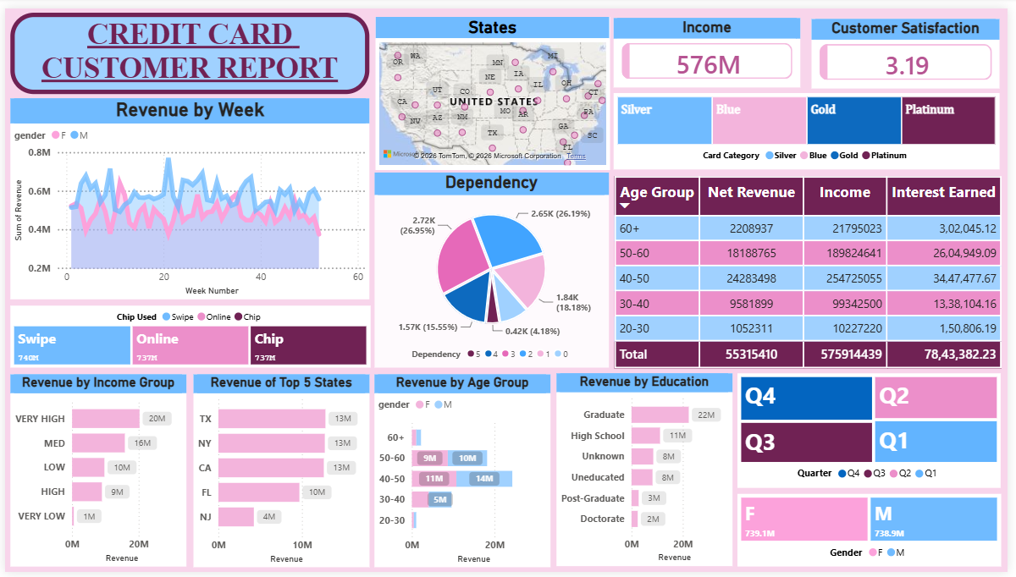
CREDIT CARD FINANCIAL DASHBOARD
End-to-End Business Intelligence Solution
POWER BI · POSTGRESQL · SQL · DAX · POWER QUERY
Satyam Anand | Business Intelligence Portfolio

Slide 2
PROJECT OVERVIEW
10,293
$56.52M
$587.6M
667K
Total Records (Week 53)
Total Revenue
Total Customer Income
Total Transactions
End-to-End BI Solution
Key Highlights
An interactive Power BI dashboard analyzing credit card customer behavior and transaction performance across 10,293 records.
Built with a production-style workflow: raw CSV data imported into PostgreSQL, connected to Power BI via a relational data model, and refreshed incrementally with new weekly data.
Two analytical dashboards provide real-time insights into revenue, demographics, spending patterns, and financial KPIs.
Real-time weekly revenue and transaction tracking
PostgreSQL database with relational data model
Incremental data refresh without rebuilding
Interactive slicers and drill-down capabilities
Geographic analysis with interactive U.S. map
02

Slide 3
ARCHITECTURE & TECH STACK
Data Pipeline
Excel
Dataset
CSV
Conversion
PostgreSQL
Database
SQL
Queries
Power BI
Desktop
Business
Insights
Customer Dashboard
Transaction Dashboard
Technology Stack
Repository Structure
Technology | Purpose
Power BI | Dashboard Development & Visualization
PostgreSQL | Database Management & Storage
SQL | Data Querying & Table Creation
Power Query | Data Cleaning & Transformation
DAX | KPI Calculations & Measures
Excel | Raw Dataset Source
CSV | Data Import Format
■ Dataset/
customer.csv, credit_card.csv
cust_add.csv, cc_add.csv
■ SQL/
Sql_Queries.sql
■ Dashboard/
Credit_Card_Financial_Dashboard.pbix
■ Images/
Dashboard screenshots & exports
03

Slide 4
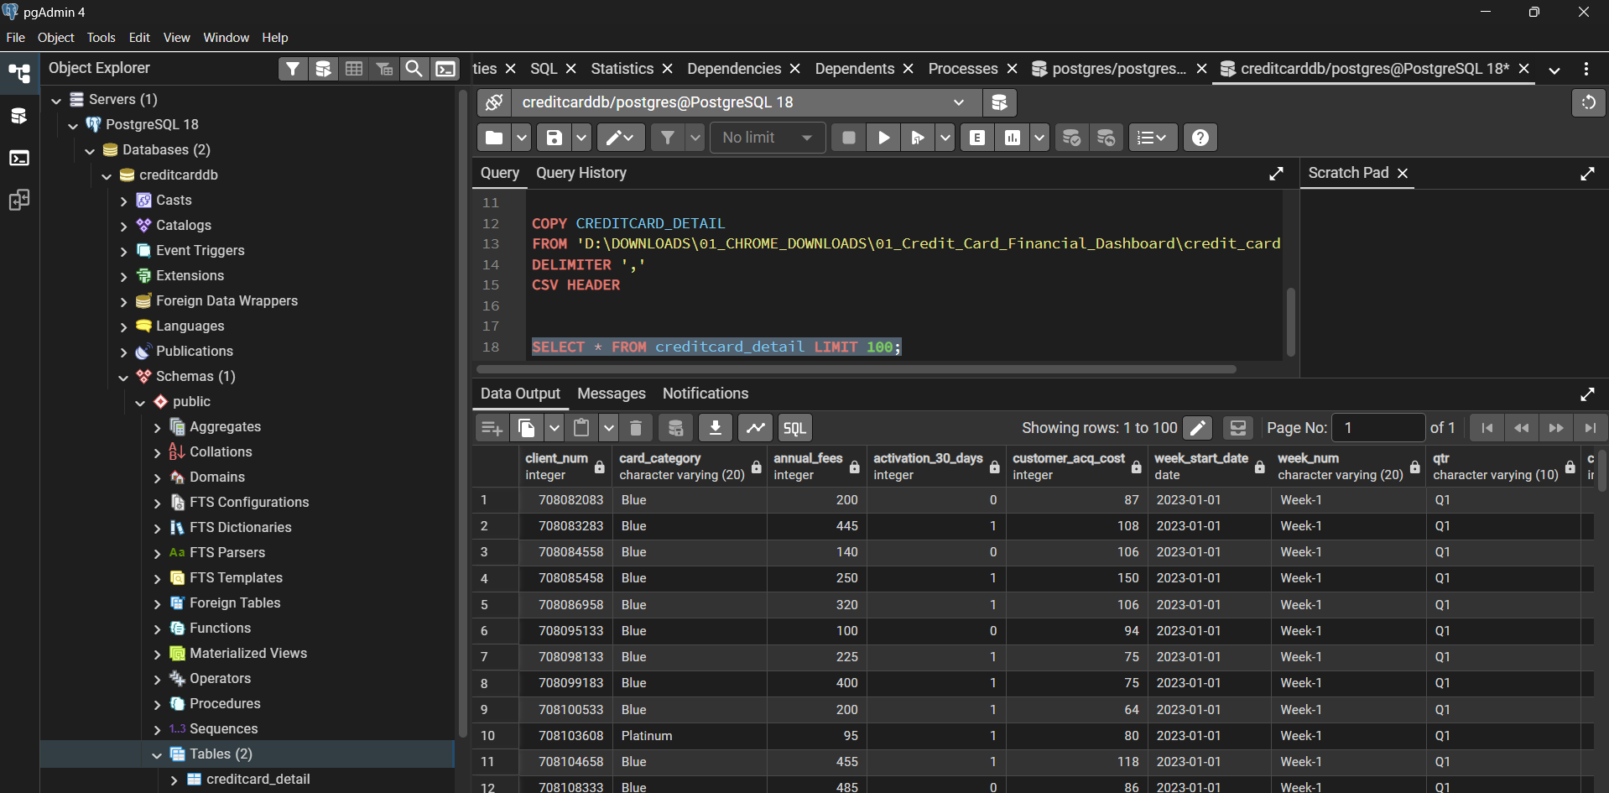
DATA PIPELINE & POSTGRESQL
PostgreSQL Integration
PostgreSQL Import (pgAdmin)
Raw Excel datasets were converted to CSV and imported into PostgreSQL using the COPY command. Two relational tables were created:
■ customer_detail — demographics, income, satisfaction
■ creditcard_detail — transactions, revenue, card data
CREATE TABLE customer_detail (...);
CREATE TABLE creditcard_detail (...);
COPY customer_detail
FROM 'customer.csv'
DELIMITER ',' CSV HEADER;
CSV data successfully imported into PostgreSQL tables using COPY commands
Workflow Steps
1. Collect raw Excel datasets 2. Convert to CSV
3. Create PostgreSQL database 4. Import CSV via COPY
5. Connect PostgreSQL to Power BI
6. Build data model 7. Create DAX measures
8. Build dashboards 9. Publish insights
CUSTOMER DATASET
CREDIT CARD DATASET
Age, Gender, Income, Education, Occupation, State, Dependents, Satisfaction
Revenue, Interest, Transaction Amount, Card Category, Expenditure, Quarter, Week
04

Slide 5
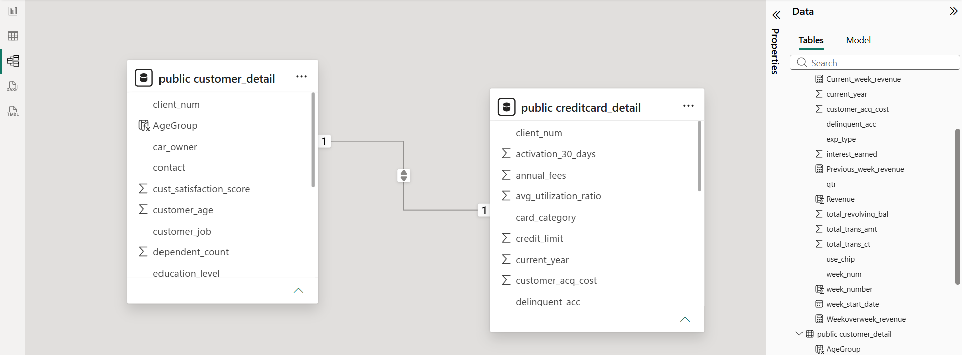
RELATIONAL DATA MODEL
Model Design
Power BI Data Model View
Two tables are connected through client_num creating a one-to-many relationship in Power BI. This enables cross-table analysis linking customer demographics with transaction behavior.
customer_detail (1) ———— (*) creditcard_detail
Joined on client_num | One Customer → Many Transactions
CUSTOMER_DETAIL
CREDITCARD_DETAIL
■ client_num (PK)
■ customer_age
■ gender
■ education_level
■ customer_job
■ income
■ state_cd
■ cust_satisfaction_score
■ client_num (FK)
■ card_category
■ revenue
■ interest_earned
■ total_trans_amt
■ total_trans_ct
■ exp_type
■ week_num / qtr
KEY DAX MEASURES
Revenue = SUM(creditcard_detail[Revenue])
Customer Income = SUM(customer_detail[income])
Satisfaction = AVERAGE(customer_detail[cust_satisfaction_score])
05

Slide 6
CUSTOMER DASHBOARD
$587M
$56.5M
$7.98M
3.19
Total Income
Net Revenue
Interest Earned
Satisfaction
DASHBOARD FEATURES
■ Weekly Revenue Trend with gender breakdown
■ Revenue by Income Group (Very High to Very Low)
■ Revenue by Age Group (20-30 through 60+)
■ Revenue by Education Level
■ Revenue by State with interactive U.S. map
■ Customer Dependency Analysis
■ Dynamic slicers: Quarter, Gender, Card Category
TOP INSIGHT
Customers aged 40-60 generate nearly 77% of total revenue. Graduate-level customers contribute 41% ($23M) of all revenue.
06

Slide 7
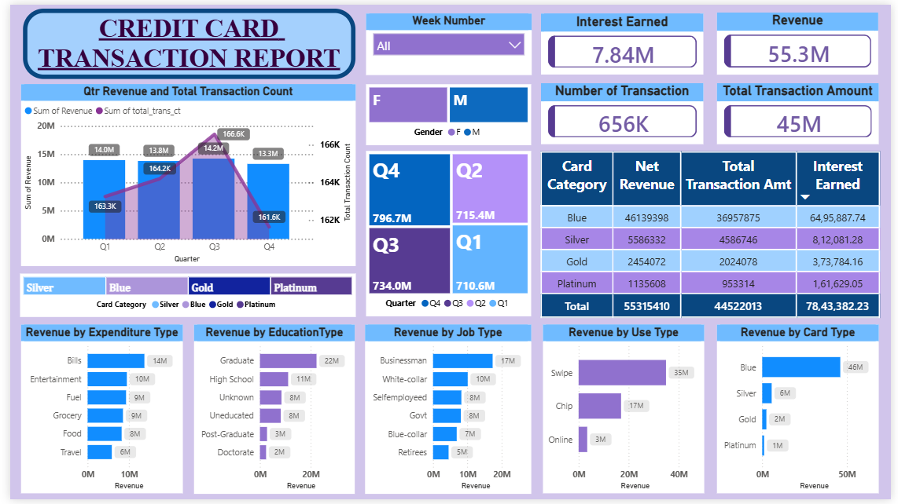
TRANSACTION DASHBOARD
$56.5M
$7.98M
$45.5M
667K
Revenue
Interest Earned
Transaction Amt
Transactions
DASHBOARD FEATURES
■ Quarterly Revenue & Transaction Count
■ Revenue by Card Category (Blue/Silver/Gold/Platinum)
■ Revenue by Expenditure Type (Bills, Entertainment, etc.)
■ Revenue by Job Type & Education
■ Revenue by Usage Type (Swipe/Chip/Online)
■ Quarterly Transaction Comparison
■ Dynamic slicers: Week, Quarter, Gender
TOP INSIGHT
Swipe transactions dominate at 62.6% of all spending. Bills account for 24.5% — the largest expenditure category. Q4 is the strongest quarter.
07

Slide 8
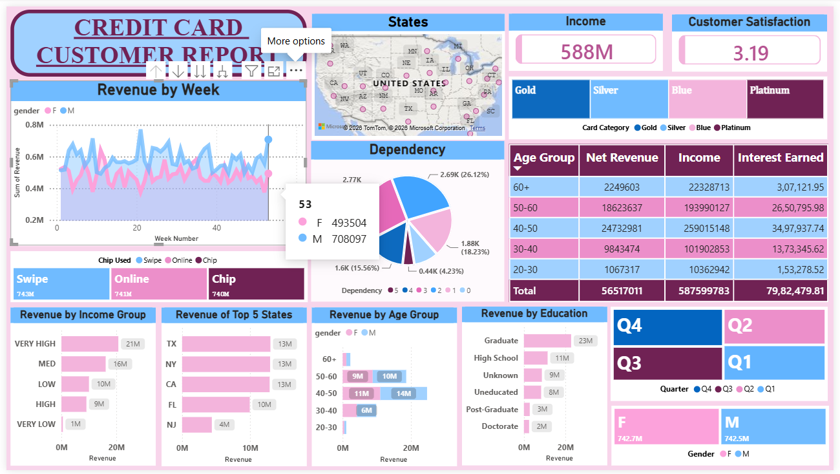
INCREMENTAL DATA REFRESH — WEEK 53
When Week 53 data became available, it was appended directly into PostgreSQL. Power BI reflected all changes automatically without modifying the data model.
UPDATED CUSTOMER DASHBOARD
Metric | Week 52 | Week 53 | Growth
Total Records | 10,108 | 10,293 | +185 (+1.83%)
Revenue | $55.32M | $56.52M | +2.17%
Income | $575.91M | $587.60M | +2.03%
Interest Earned | $7.84M | $7.98M | +1.77%
Transaction Amt | $44.52M | $45.53M | +2.27%
Transactions | 656K | 667K | +1.68%
REFRESH PROCESS
Import CSV
via COPY
185 Records
Appended
Power BI
Refresh
All KPIs
Auto-Updated
No data model changes or report redesign required. Both new files contributed primarily Blue card customer records.
08

Slide 9
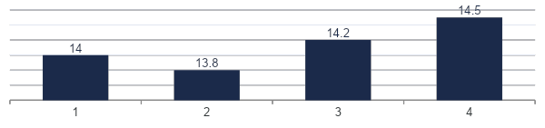
KEY BUSINESS INSIGHTS
CARD PORTFOLIO
CUSTOMER AGE
EDUCATION
83.1%
77%
41%
Blue-tier cards dominate transaction value. Opportunity to grow premium card adoption (Silver 10.2%, Gold 4.6%, Platinum 2.1%).
Customers aged 40-60 generate nearly 77% of revenue. Age 40-50 alone contributes $24.7M (43.8%).
Graduate customers contribute ~$23M (41%) of total revenue — the highest-value education segment.
TRANSACTION METHOD
SPENDING CATEGORIES
GEOGRAPHIC
62.6%
24.5%
~$13M
Swipe transactions remain dominant. Chip (31.1%) and Online (6.3%) show digital payment growth potential.
Bills are the largest spending category, followed by Entertainment, Fuel, Grocery, and Food.
Texas, New York, and California each generate ~$13M — the strongest-performing states.
QUARTERLY REVENUE PERFORMANCE
ADDITIONAL INSIGHTS
■ Businessman customers generate highest revenue at $18M
■ Female and Male revenue contributions are nearly identical
■ Very High Income segment contributes $21M (36.8%)
■ White-Collar professionals contribute $10M
09

Slide 10
SKILLS DEMONSTRATED & FUTURE ROADMAP
TECHNICAL SKILLS
Power BI
PostgreSQL
SQL & DAX
ETL Pipeline
Data Modeling
KPI Development
Data Visualization
Power Query
Dashboard Automation
Business Analytics
FUTURE ENHANCEMENTS
DEPLOYMENT
ADVANCED ANALYTICS
EXPERIENCE
■ Deploy via Power BI Service
■ Configure scheduled refresh
■ Connect to live PostgreSQL
■ Add Row-Level Security (RLS)
■ Integrate Python forecasting
■ Predictive revenue models
■ Customer churn analysis
■ Anomaly detection alerts
■ Executive dashboard layouts
■ Mobile-optimized views
■ Custom alert notifications
■ API-driven real-time feeds
THANK YOU
Satyam Anand | satyamanand9555@gmail.com | linkedin.com/in/satyam-anand-sa9555
10

