Slide 1

Basic Details of the Team and Problem Statement
Ministry/Organization Name/Student Innovation:
Ministry of Railways
PS Code: SIH1348
Problem Statement Title: Natural Language translation engine for announcements and information dissemination at station.
Team Name: Bhraman
Team Leader Name: Sankalp Borse
Institute Code (AISHE): C-41256
Institute Name: K. K. Wagh Institute of Engineering Education and Research, Nashik.
Theme Name: Smart automation

Slide 2
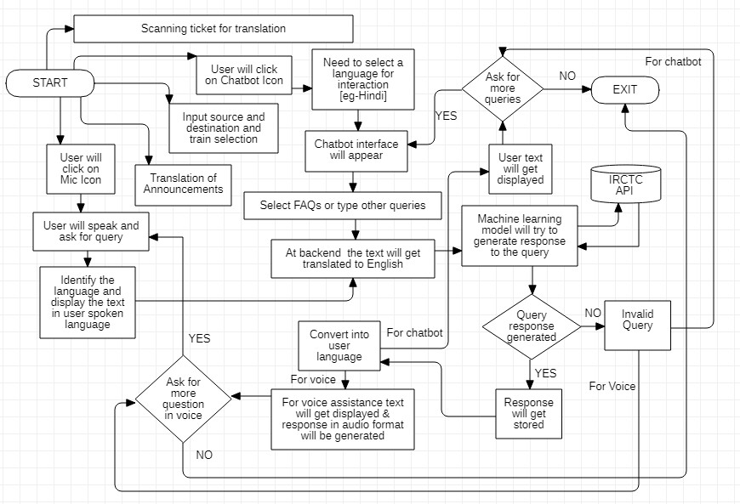
Idea/Approach Details
A one stop solution for given problem will look like this:
A language translation model which supports to multiple Indian languages, and foreign languages.
This model will be integrated with user-centered website for the real-time dissemination of information such as station announcements, railway display boards to passengers with convenience on multiple devices.
Users can get response to their relevant queries through website using natural language inputs , such as voice or text.
This web-based application will be deployed on kiosks at railway stations, providing user access to information about their desired train in one go.
Structure :
Model will take input in voice or text in user preferred language. Input voice language is identified and converted to text. The text (either by Speech-To-Text or user's input) is translated to English and treated as query.
The Machine Learning Model (Bidirectional Encoder Representations from Transformers) using IRCTC APIs will respond to the queries in English.
The response to the query is given to the user in his/her desired language in text or voice.
Technology stack :
IRCTC APIs to fetch train related data
Model training : Tensorflow, langdetect, google trans new, Google text to speech
Pytesseract for OCR, Indic and Stanford NLP library
Front-end with React, Back-end with Django
Dask for parallel computing

Slide 3
Idea/Approach Details
Features :
Integrate BERT embedding into the Chabot's natural language understanding module for context-aware responses.
Employing the lazy loading and brotli compression algorithm further optimizes database performance, ensuring streamlined data retrieval and storage for enhanced database efficiency.
Use Cases :
Case 1: Notification of emergency alerts to passengers in their preferred language.
Case 2: Passengers and customers visiting our website on mobile or desktop devices can access information, ask questions, and seek assistance in multiple Indian and foreign languages.
Case 3: Passengers at railway stations can access our website through kiosks for information and inquiries.
Case 4: Real-time updates of train display boards and announcements at stations are synchronized with the website.
Case 5: Passengers unfamiliar with the ticket’s language can use the scanner to translate the ticket in desired language.
Case 6: Sensory-deprived personal can also access the website through voice commands.
Show stopper :
A dearth of internet connectivity can precipitate suboptimal system performance.
Inaccuracies and inconsistencies in the IRCTC database can similarly affect this system, potentially causing unintended issues and discrepancies.
Dependencies :
Considering the passenger's diverse backgrounds, not all passengers will be familiar with the functioning of Kiosk devices.
Implementation of our software on kiosk will depend on Hardware of Kiosk.
Cloud Infrastructure to Host website and ML models

Slide 4
Team Member Details
Team Leader Name: Sankalp Borse
Branch : BE Stream : AI&DS Year : III
Team Member 1 Name: Ayush Bhavsar
Branch : BE Stream : AI&DS Year : III
Team Member 2 Name: Nikhil Bagul
Branch : BE Stream : AI&DS Year : III
Team Member 3 Name: Satyam Kale
Branch : BE Stream : Computer Year : IV
Team Member 4 Name: Anushka Unhale
Branch : BE Stream : Computer Year : IV
Team Member 5 Name: Maithili Dhamane
Branch : BE Stream : Computer Year : IV
Team Mentor 1 Name: Type Your Name Here
Category (Academic/Industry): Expertise (AI/ML/Blockchain etc): Domain Experience (in years):
Team Mentor 2 Name: Type Your Name Here
Category (Academic/Industry): Expertise (AI/ML/Blockchain etc): Domain Experience (in years):

