Slide 1
MediScope
Transforming Raw Patient Datasets into Actionable Healthcare Insights
Team G-17 | Newton School of Technology • Mentor: Archit Raj • April 2026

Slide 2
Context & Problem Statement
The Challenge
Three Core Findings
Hospital systems lack visibility into:
• Which patient sub-populations drive extended ICU stays
• Which lab departments generate disproportionate volume vs. diagnostic yield
Without this data-driven insight, leadership cannot:
✓ Allocate beds & staff proactively
✓ Distinguish signal from noise in test results
1
Emergency Dominance
91% emergency cases, 36% longer stays
2
Gender Disparity
Female patients flag 4–5 pts higher (p < 0.0001)
3
Hematology Drain
Highest volume + highest abnormal rate

Slide 3
Data Engineering & ETL Pipeline
SOURCE
TRANSFORM
LOAD
MIMIC-III
ICU Records
Python/Pandas
Data Cleaning
Tableau
Dashboards
→
→
Final Dataset:
76,069 laboratory event rows
Unique Patients:
100 ICU patients
Total Admissions:
129 admission records
Key Variables:
Subject ID, Admission ID, Test Type, Abnormal Flag, LOS, Admission Type, Gender
Data Quality:
99.99% retained after cleaning (5 rows with unresolvable nulls removed)

Slide 4
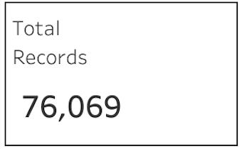
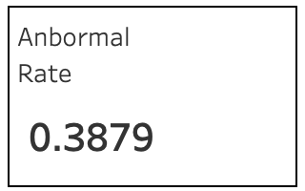
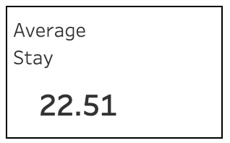
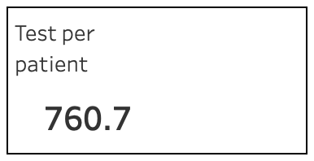
KPI & Metrics Framework
📊
⚠️
🏥
🚑
76,069
38.79%
22.5 days
760
Total Lab Tests
Abnormal Rate
Average LOS
Test Per Patient
Scale of testing activity
vs. 10-15% in outpatient
Length of stay baseline
Average Test

Slide 5
Key Insights from Exploratory Analysis
1
Emergency admission dominance: 91% of volume, 36% longer LOS than elective (28.8 vs. 21.2 days)
2
Gender disparity: Female patients consistently flag higher abnormal rates across all admission types (p < 0.0001)
3
Hematology bottleneck: Highest test volume (33,567 tests) AND highest abnormal rate (44.5%)
4
Volume-rate divergence: Test volume spikes peak at 9,200/month but abnormal rate stays flat at 39% — signature of systematic over-testing

Slide 6
Advanced Analysis & Statistical Validation
Independent T-Test
Chi-Square Test
K-Means Clustering
Emergency vs. Elective LOS
Gender vs. Abnormal Flag
Patient Risk Segmentation
Δ = 7.6 days (+36%)
Female > Male (all types)
3 clusters identified (n=60,26,14)
Result:
Result:
Result:
p < 0.0001
p < 0.0001
Cluster 2: Critical outliers
All findings are statistically significant and reproducible

Slide 7
Dashboard Architecture
3-Tier Executive Decision-Support Framework
TIER 1
Macro KPIs
C-suite (30-second overview)
Total tests, abnormal rates, patient load, LOS baseline
TIER 2
Demographic & Operational Drivers
Operations leaders (5-min deep dive)
Gender disparities, LOS by admission type, risk segments
TIER 3
Clinical Deep Dive
Department heads (bottleneck isolation)
Dept. quadrant analysis, volume spikes, test justify signals
Dashboard published at: public.tableau.com/app/profile/sambhav.kumar2781/viz/dv_p7/Dashboard1

Slide 8
Actionable Recommendations (1 of 2)
1. Optimize Emergency Triage Workflows
Fast-track discharge protocols + daily LOS review rounds (18-25 day window)
Est. Impact: 10% LOS reduction = 264 recovered bed-days per 100-patient cycle
2. Introduce Gender-Specific Laboratory Reference Ranges
Audit D_LABITEMS, recalibrate female-specific thresholds, 30-day parallel validation
Est. Impact: 5–10% reduction in false-positive alerts = ~2,083 fewer physician review events

Slide 9
Actionable Recommendations (2 of 2)
3. Implement Hematology Repeat-Testing Hard Stops in EHR
Mandatory clinical justification for 24-hr repeat panels + peer benchmarking dashboards
Est. Impact: 15% volume reduction + reagent savings + lower alert load on nursing
4. Deploy Prospective LOS Prediction Model for Critical Outliers
K-Means Cluster 2 (14 critical patients) → supervised model → admission-day flagging
Est. Impact: Early identification reduces reactive escalation (2–3x cost premium). Requires 1K+ patient dataset.

Slide 10
Quantified Impact Summary
🛏️
Emergency LOS Optimization
264 bed-days recovered per 100-patient cycle
📊
Gender Reference Ranges
~2,083 fewer false-positive alerts per cycle
🧬
Hematology Hard Stops
15% volume reduction + significant reagent savings
🤖
Predictive LOS Model
2–3x cost savings (post dataset expansion)

Slide 11
Limitations & Future Scope
Current Limitations
Phase 2 Roadmap
• Sample size (100 patients) sufficient for hypothesis testing but limiting for ML model training
→ Dataset expansion to 1,000+ patients (full MIMIC-III cohort) for robust ML training
• No direct cost data — all financial estimates use published benchmarks, not actual billing data
→ Integration of hospital billing & cost data for precise Cost-Benefit Analyses
• Single institution, specific time window — regional, seasonal, and case-mix variations not captured
→ Real-time EHR dashboard integration for prospective operational monitoring

Slide 12
Team & Contributions
Satyam Kumar
Project Lead & Data Engineer
ETL pipeline, architecture, integration
Sambhav Kumar
Visualization Specialist
Tableau dashboard design & dashboards
Shagun Singh
Statistical Analyst
T-tests, Chi-Square, K-Means clustering
Yash
Documentation Lead
Report generation & documentation
Harsh
Research & QA
Project review & presentation
Faculty Mentor: Archit Raj | Newton School of Technology | April 2026
GitHub: github.com/Satyamkumar2610/SectionD_G-17_MediScope

