Slide 1

Stock price prediction
Satyam Maravaniya (202318026)
Sreejesh Nair (202318001)
Devansh Mehta (202318053)
Notes:
Delete this slide when you finish preparing the other slides.

Slide 2



MOTIVATION / PROBLEM STATEMENT
The Stock market process is full of uncertainty and it’s affected by many factors. Hence the Stock market Prediction is one of the important exertions in business and finance.
A prediction model has been built that uses big data analytical capabilities and machine learning to predict the trend about stock markets.

Slide 3


PROJECT PIPELINE STRUCTURE

Slide 4
Data Collection
Using Random Forest and GBT to predict the stock prices change
Visualized the data with respected to the trained data
STEP - 1
STEP -2
STEP - 3
STEP - 4
STEP -5
Cleaned the data to get the required features by using data frames
Made the model more scalable using PySpark

Slide 5
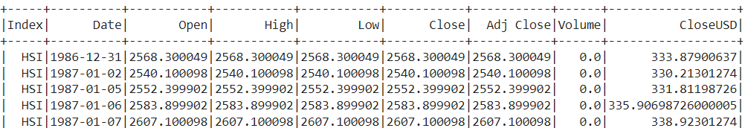
DATA SOURCE
We used spark to analyze the stock values of some companies.
In order to predict stock we decided to explore the high, low, opening value ,closing value and Adjusted closing value of stock dataset of last some year.
Rows - 104224
Columns - 9

Slide 6
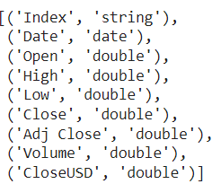
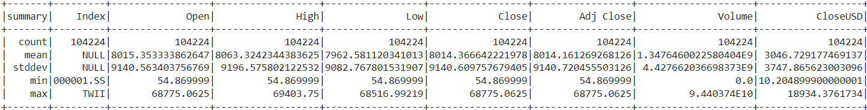
Type of data
Describe all Features

Slide 7
Feature Engineering
Window function to order by date (for features that require looking at previous rows)
Create a lagged column for the 'close' price (i.e., previous day's close)
Calculate daily return - how much did the price change in percentage from opening to closing
Calculate intra-day volatility - difference between the highest and lowest prices of the day
Calculate daily volatility - change in closing price from the previous day
Calculate a 7-day moving average for the closing prices

Slide 8
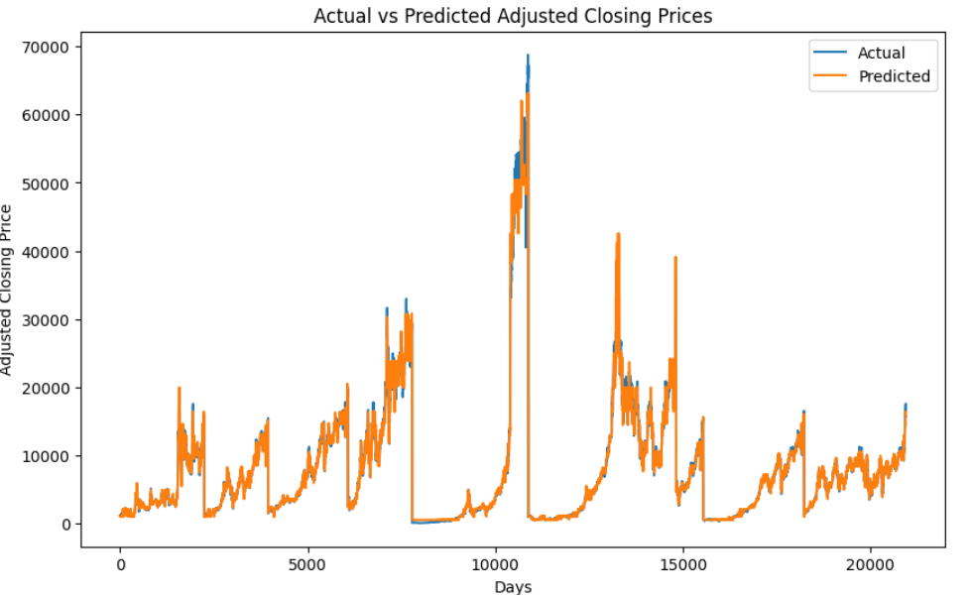
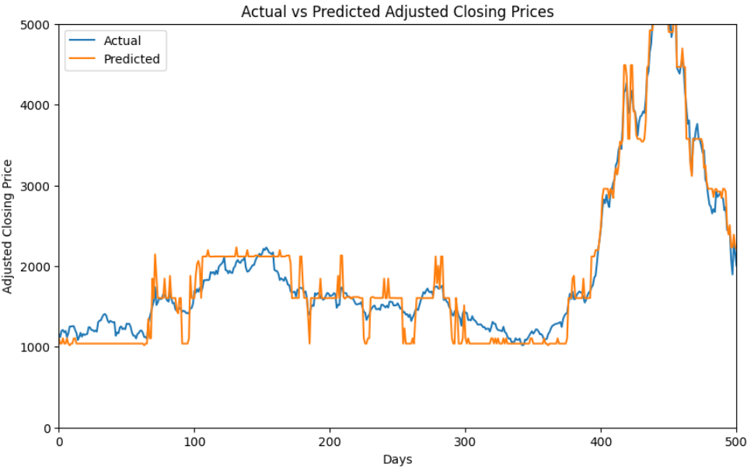
Random Forest Regression
Actual vs Predicted Adjusted Closing Prices
Results
Mean Absolute Error (MAE): 355.21904636234484
Root Mean Squared Error (RMSE): 924.0048928606751
R-squared (R2): 0.9898620134490014

Slide 9
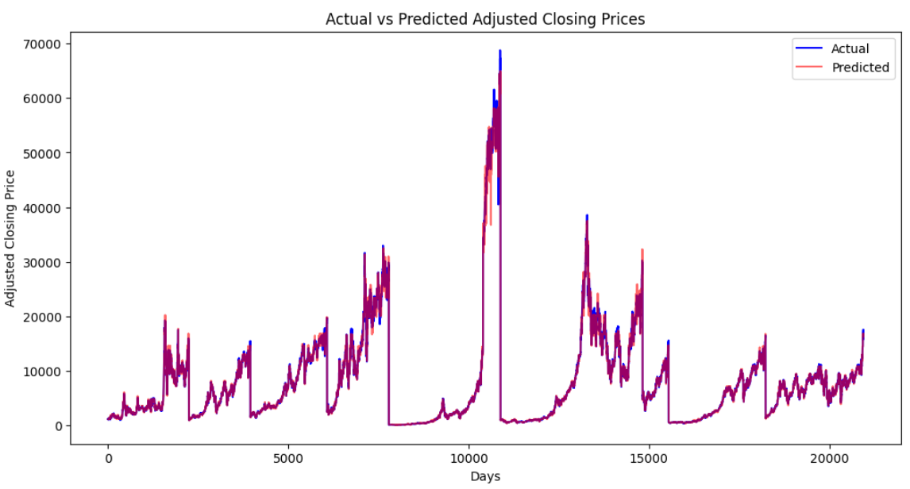
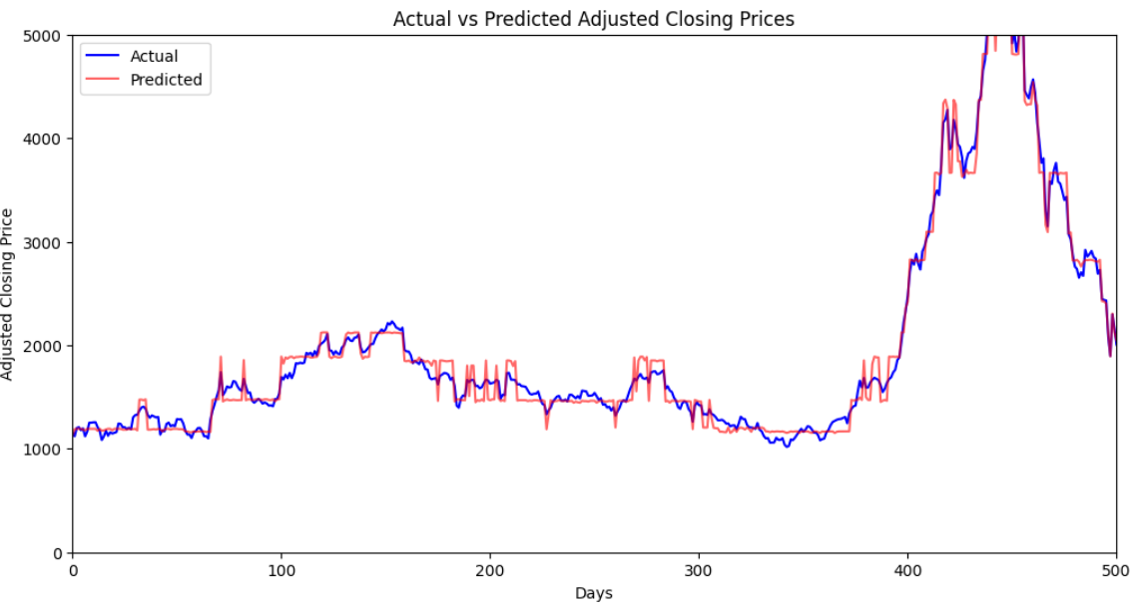
Gradient Boosted Trees
Actual vs Predicted Adjusted Closing Prices
Results
Mean Absolute Error (MAE): 216.29757735884715
Root Mean Squared Error (RMSE): 453.17744723545553
R-squared (R2): 0.9975614046223198

Slide 10
Conclusion
In this project, we determined that stock prices sparsely show similar patterns.
For prediction, we proposed a novel method based on a combination of Gradient Boosted Trees Model in order to find similar historical patterns for each stock item and build a scalable model to predict the daily stock price.

Slide 11
reference
https://www.kaggle.com/code/sanskarbhalerao/stock-market/input?select=indexProcessed.csv
https://spark.apache.org/docs/latest/api/python/reference/api/pyspark.ml.regression.GBTRegressor.html
https://spark.apache.org/docs/latest/api/python/reference/api/pyspark.ml.regression.RandomForestRegressor.html
https://spark.apache.org/docs/3.1.3/api/python/reference/api/pyspark.ml.feature.VectorAssembler.html
https://spark.apache.org/docs/latest/api/python/reference/pyspark.sql/api/pyspark.sql.Window.html

