Slide 1




INFO 617 TEXT ANALYTICS
Text Classification of Medical Conversations
Presented by :
Satyanarayan Naldiga

Slide 2




PROJECT OVERVIEW
Objective: Develop a classification model to categorize medical conversations into 15 specific intent categories based on Social Support Theory.
Emotional Support (e.g., GREET, THANK, WAIT, WISH, RECEIVE, FUTURE_SUPPORT, CONSOLE, REMIND)
Informational Support (QUESTION, DIAGNOSE, TREAT, REFERRAL, REPEAT, EXPLAIN, REQUEST_INFORMATION)
Why Care?
4,030 labeled sentences
Dataset Size
Improve clarity, patient satisfaction, and healthcare outcomes

Slide 3
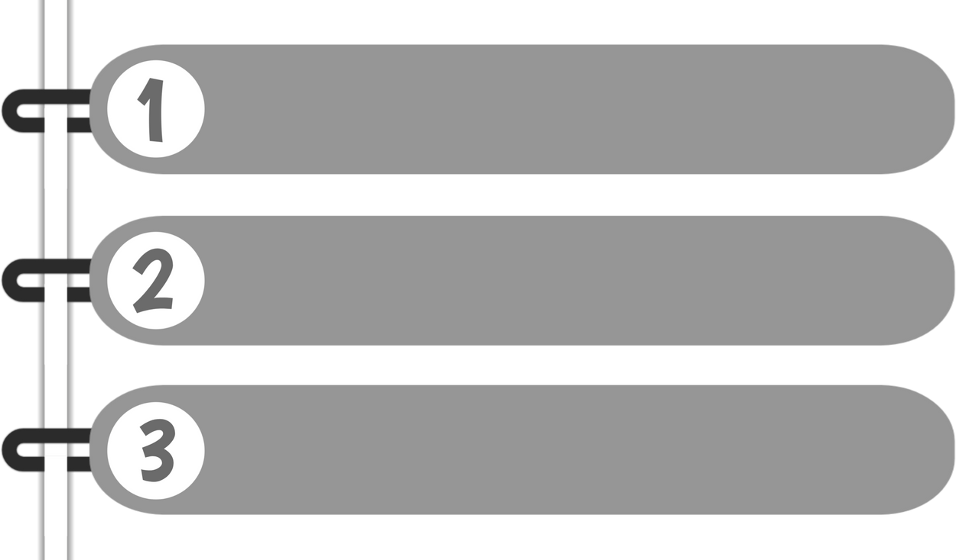
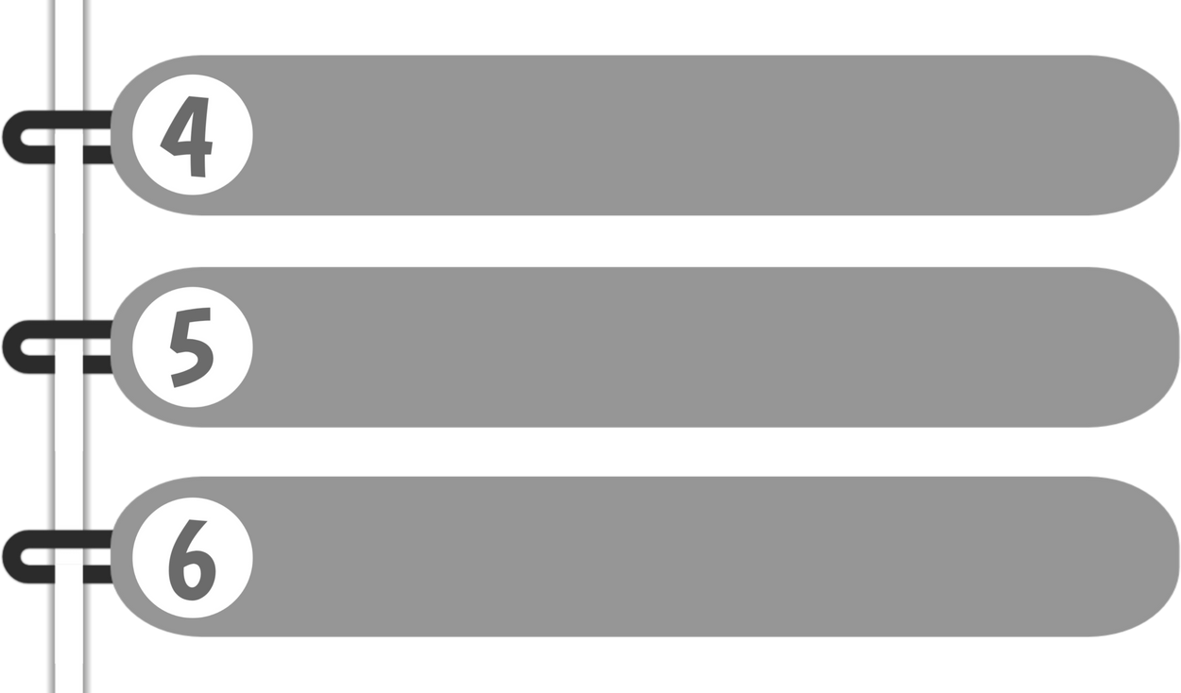
COMPREHENSIVE METHODOLOGY & WORKFLOW
Data Prep- (Preprocessing , Augmentation)
Models Built
(ML, CNN, LSTM, Transformers)
Class Imbalance Strategies
(Oversampling Techniques,Loss Functions)
Tuning & Validation
(Hyperparameters, Early Stopping)
Features & Embeddings
Static Embeddings, Contextual Embeddings
Evaluation & Selection
(Test Accuracy, Macro F1-score)

Slide 4
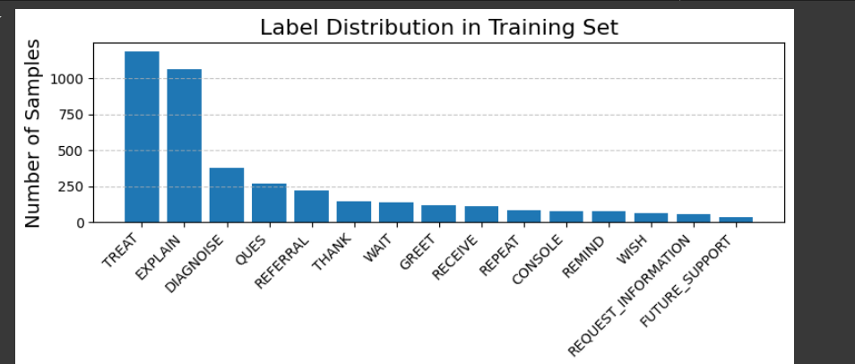
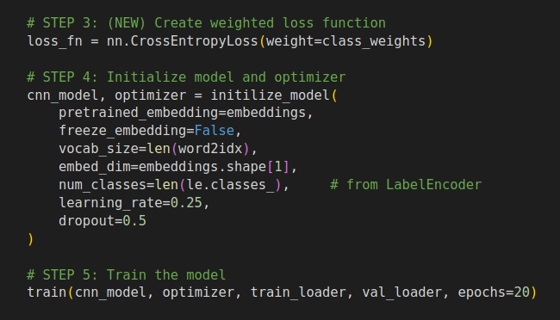
CLASS LABELS DISTRIBUTION
IMBALANCED CLASS LABELS
TACKLED IT WITH
WEIGHTED CROSS ENTROPY LOSS

Slide 5


ALGORITHMS WE EXPLORED
Traditional ML Models :
Logistic Regression
Support Vector Machine (SVM)
Random Forest Classifier
Deep Learning Models :
Convolutional Neural Network (CNN)
(Static and Non-static embeddings)
2. Long Short-Term Memory (LSTM)
(Uni- and Bi-directional)
3.Transformer-based Models:
DistilBERT
FreezeBERT
DeBERTa
BioClinicalBERT

Slide 6
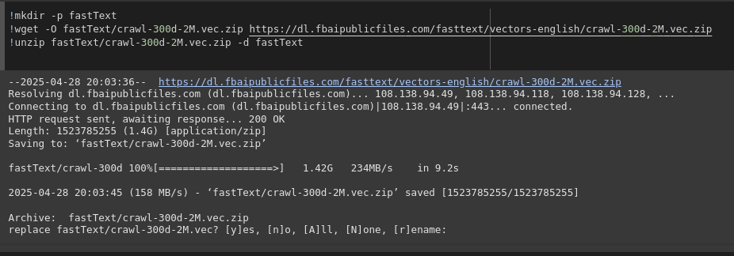
FEATURES EXTRACTED AND UTILIZED IN THE MODEL
TF-IDF Vectors used for Logistic Regression, SVM, Random Forest.
Word Embeddings (FastText) for CNN and LSTM models.
BERT Tokenizer embeddings used for BERT.
Notes:
The model extracts word-level features using pre-trained FastText word embeddings. It captures local patterns (like key phrases) through convolution filters applied on sequences of word vectors.
we need to inlude for bert

Slide 7
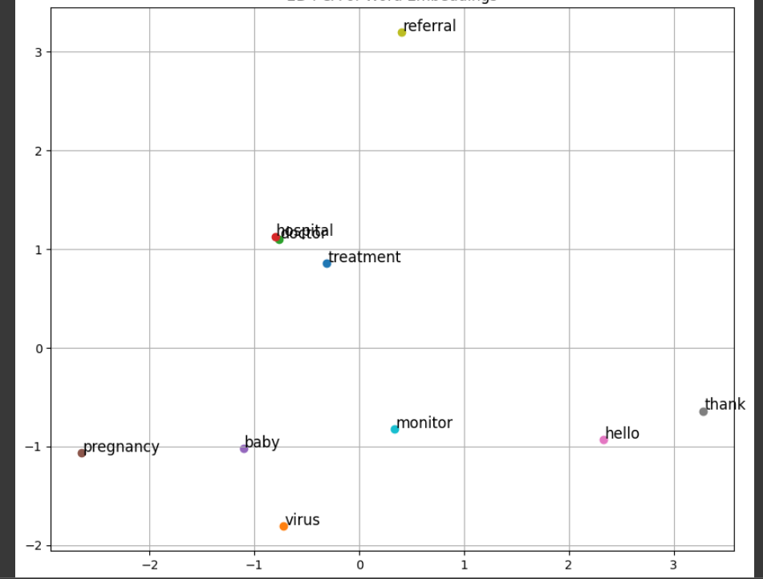
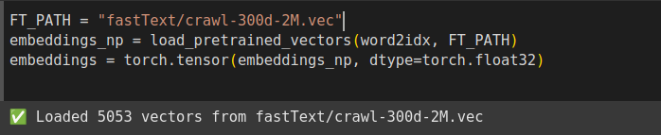
EMBEDDINGS ANALYSIS
Notes:
expliantion needed while presenting

Slide 8
HOW THESE FEATURES ARE USED IN THE MODELS
TF-IDF vectors → direct input to traditional ML models.
FastText embeddings → initialized CNN(1DCNN, Convolutional and pooling layers)
LSTM layers(Bi-Directional LSTM) - The LSTM processes embeddings sequentially, remembering important context and using the final hidden state to predict the medical label
BERT embeddings → BERT applies self-attention to embeddings, learning contextual relationships across the sentence,
Notes:
expliantion needed while presenting

Slide 9
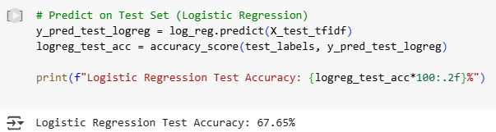
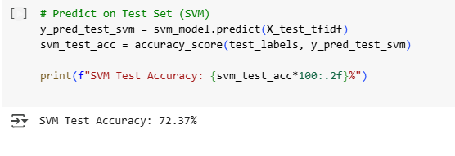
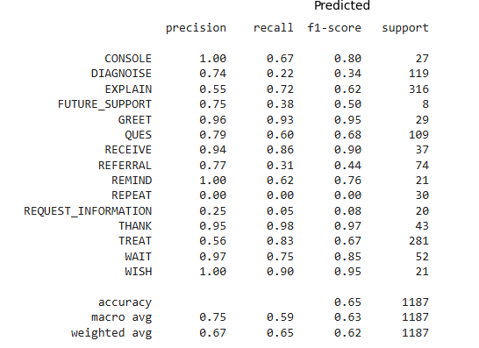
MODEL RESULTS AND COMPARISON
Traditional ML:
Logistic Regression Model Accuracy Results:
Test Accuracy: 67.65%
SVM Model Accuracy Results:
Test Accuracy: 72.37%
Random Forest Model Accuracy Results:
Test Accuracy: 64.87%
Notes:
Logistic Regression and SVM Results
Traditional ML Models:
Logistic Regression:
Test Accuracy: 67.65%
SVM:
Test Accuracy: 72.37%
TF-IDF features worked reasonably well but limited semantic understanding
CNN and LSTM Deep Learning Results
Deep Learning Models:
CNN (FastText embeddings):
Captured local n-gram patterns.
LSTM (FastText embeddings):
Captured sequential context.
LSTM Test Accuracy:
71.04%
CNN also achieved competitive results but slightly below LSTM.

Slide 10
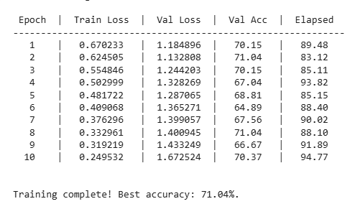
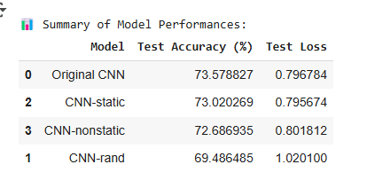
MODEL RESULTS AND COMPARISON
Deep Learning Models:
LSTM Model Accuracy Results
Test Accuracy: 71.04%
CNN Model Accuracy Results:
Test Accuracy: 73.57%
Notes:
Logistic Regression and SVM Results
Traditional ML Models:
Logistic Regression:
Test Accuracy: 67.65%
SVM:
Test Accuracy: 72.37%
TF-IDF features worked reasonably well but limited semantic understanding
CNN and LSTM Deep Learning Results
Deep Learning Models:
CNN (FastText embeddings):
Captured local n-gram patterns.
LSTM (FastText embeddings):
Captured sequential context.
LSTM Test Accuracy:
71.04%
CNN also achieved competitive results but slightly below LSTM.

Slide 11
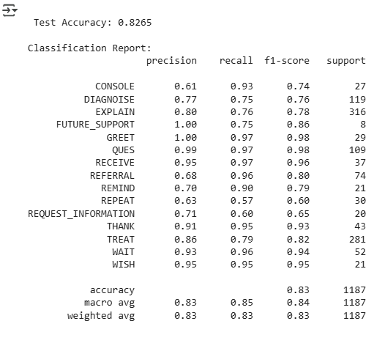
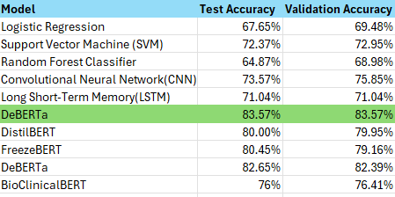
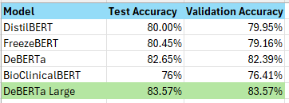
MODEL RESULTS AND COMPARISON
Transformer Model:
DeBERTa Large achieved highest performance:
Test Accuracy: 83.57%
Notes:
only bert

Slide 12



BEST MODEL PERFORMANCE
Key Results:
Test Accuracy: 83.57%
Macro F1 Score: 85%
Validation Highlights:
Stable validation accuracy (~83–84%) across epochs.
Consistent generalization with early stopping
Performance Highlights:
High F1-scores in key intents like GREET, THANK, and REQUEST_INFORMATION
Focal Loss improved class balance
DeBERTa captured deeper conversational meaning, outperforming ML and deep learning baselines
Key Takeaway:
Fine-tuned DeBERTa-v3-large captured deep contextual meaning, significantly outperforming traditional models like Logistic Regression, SVM, and even deep learning baselines (CNN, LSTM).

Slide 13
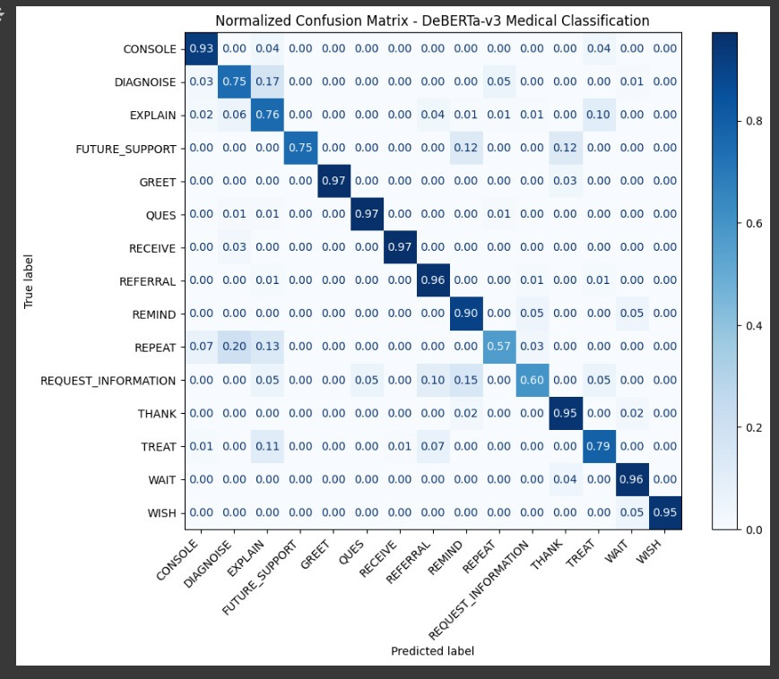
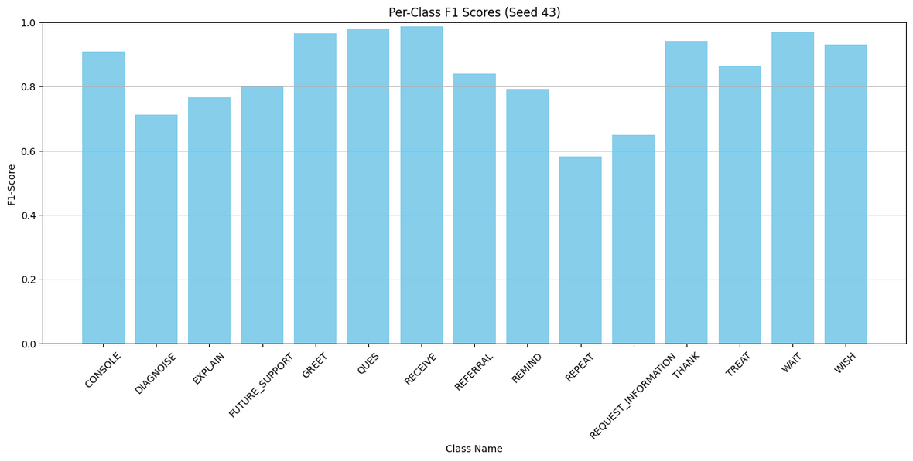
Model Performance Analysis
Model Precision Across Categories
Normalized Confusion Matrix (DeBERTa-v3)

Slide 14
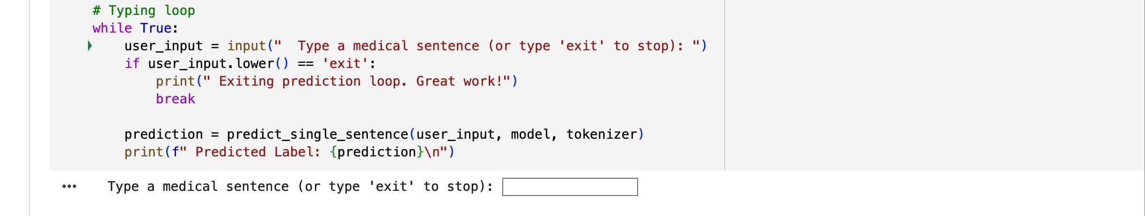
DEMO OF PREDICTING THE LABEL

Slide 15
SUMMARY AND FINAL INSIGHTS
Key Takeaways:
Explored Traditional ML, Deep Learning, and Transformer-based models for text classification.
Contextual embeddings (BERT family) captured sentence meaning far better than TF-IDF or static embeddings.
Handling class imbalance through Weighted Loss and Focal Loss was crucial for achieving balanced performance.
Conclusion:
Fine-tuned DeBERTa-v3-large achieved 83.57% Test Accuracy and 85% Macro F1 Score.
Validation accuracy remained stable (~83–84%), showing strong generalization.
Transformers outperformed traditional models by delivering deeper understanding of medical conversation intents.

Slide 16

THANK YOU

