Slide 1


Cloud Introduction with AWS
By ROHIT AMBAWADE
(Senior Software Developer)

Slide 2

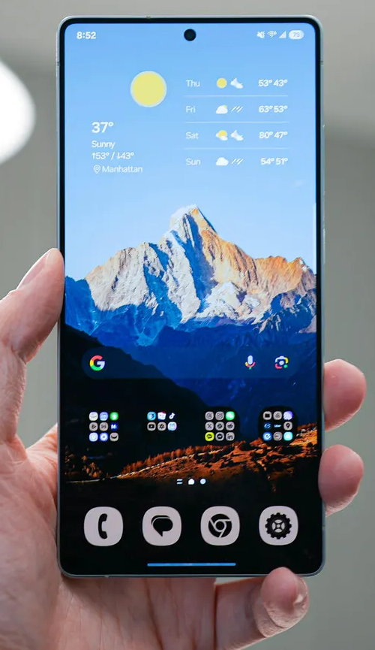
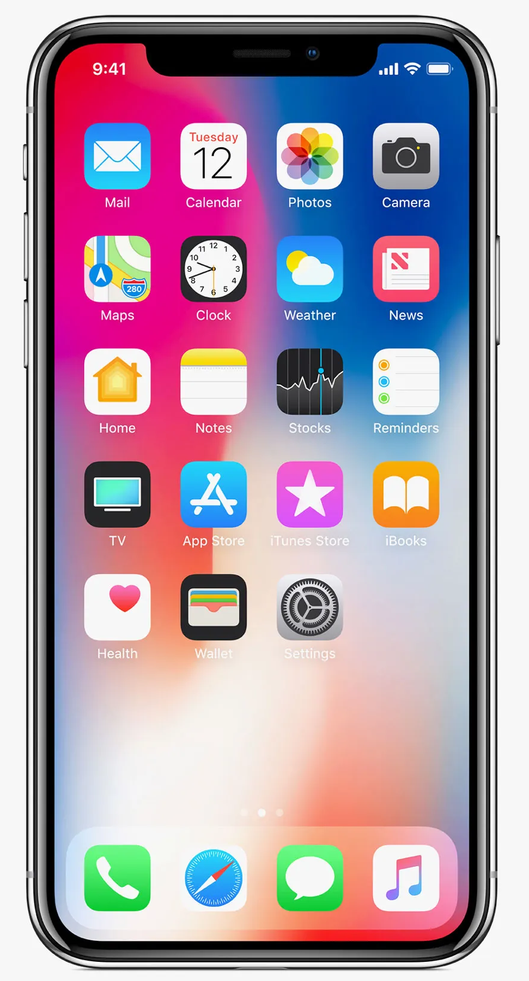
What do you mean by cloud ?
My friend here he wants to buy cloud storage to store his photos & Documents on cloud as backup.
Android (Google Drive)
Iphone (Icloud)

Slide 3
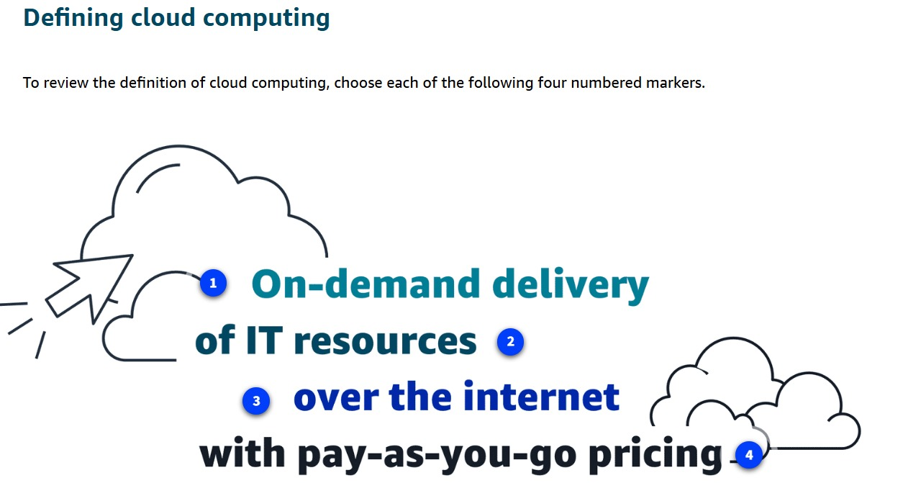
What is Cloud or Cloud Computing?
Storing and using data over the internet
Someone else’s computer you trust more than your own

Slide 4
Why Cloud?
• Scalability: Grow when needed
• Cost-effective: Pay for what you use
• High Availability: More reliable than your sleep schedule
• Security: Safer than WhatsApp backup

Slide 5
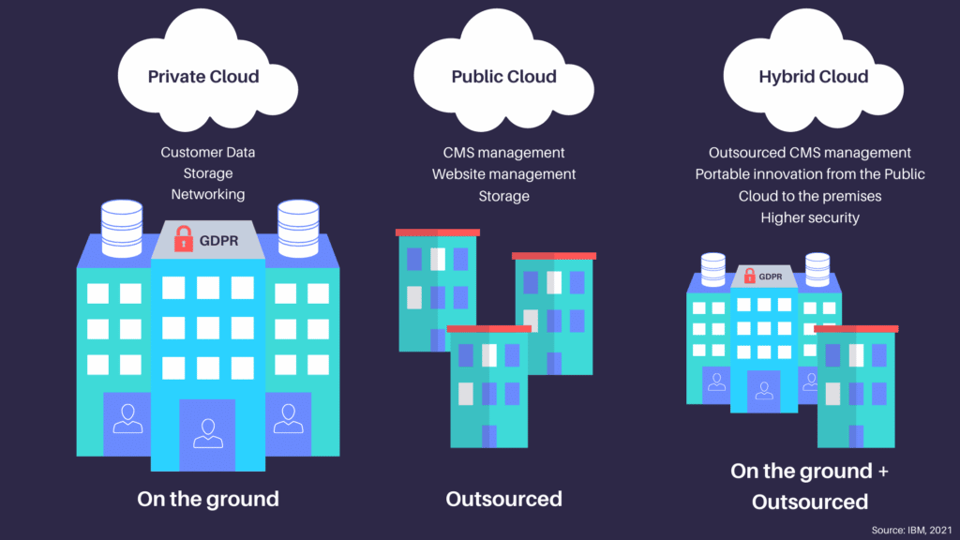
Cloud Models
Public Cloud – Like hostel Wi-Fi, but actually works
Private Cloud – Your own space, no neighbors
Hybrid Cloud – Healthy food + cheat meal combo

Slide 6
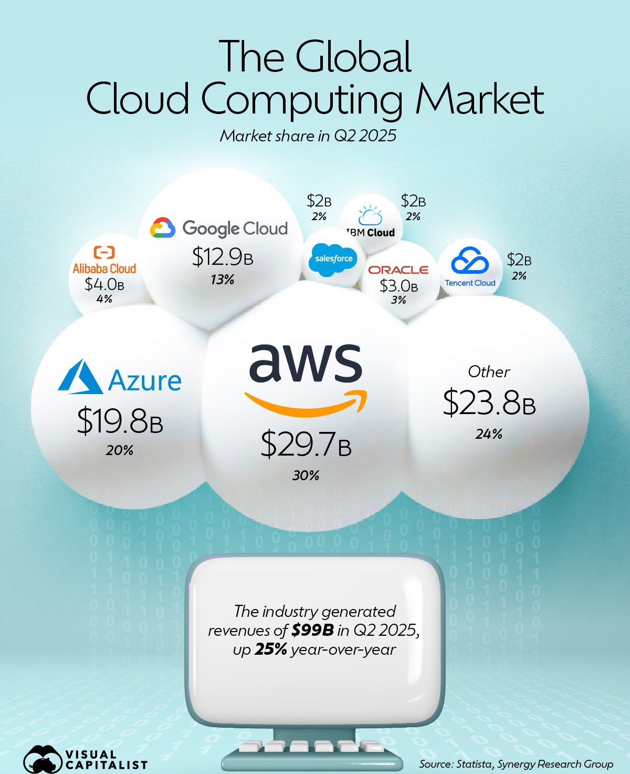




Top Cloud Providers

Slide 7
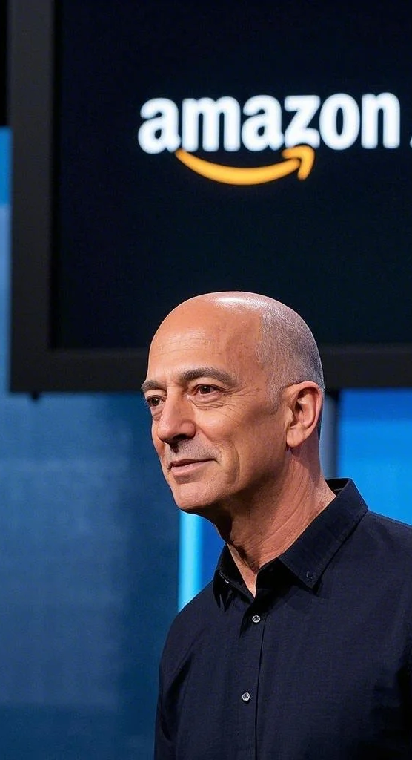
AWS History
Amazon Web Services (AWS) was officially launched in 2006 to provide IT infrastructure services over the internet, born from Amazon's own need to manage its rapidly growing e-commerce operations. It began with the launch of Amazon Simple Queue Service (SQS) and the following year, Amazon Simple Storage Service (S3) and EC2 compute services were released, creating a cloud computing platform for businesses to build, deploy, and scale applications without managing their own physical servers.

Slide 8
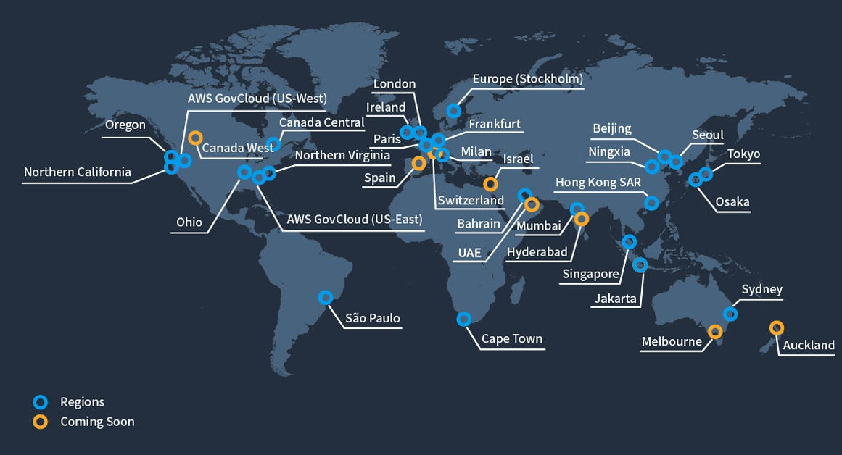
AWS Global Infrastructure

Slide 9
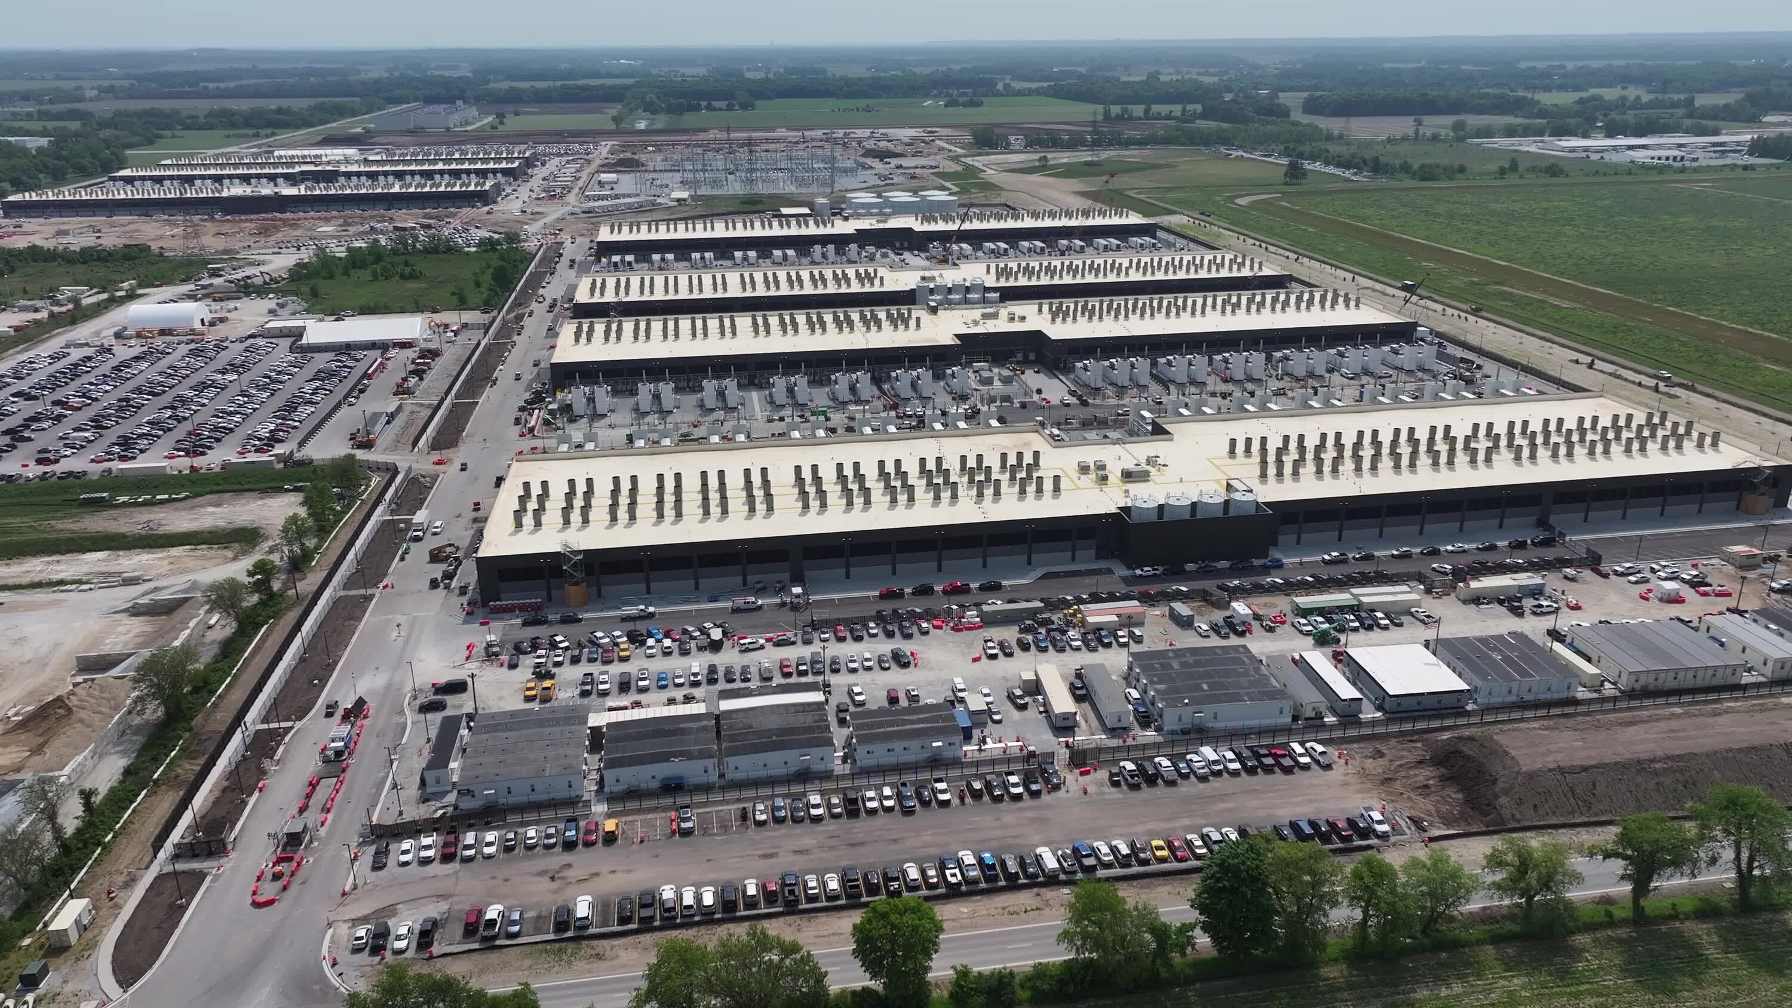

Data Centers and Servers

Slide 10
Key AWS Services
• EC2 – It allows users to rent virtual servers
• S3 – Store anything (except breakup chats)
• RDS – Database with automatic backups
• Lambda – Magic code without servers
• IAM – The bouncer of AWS

Slide 11
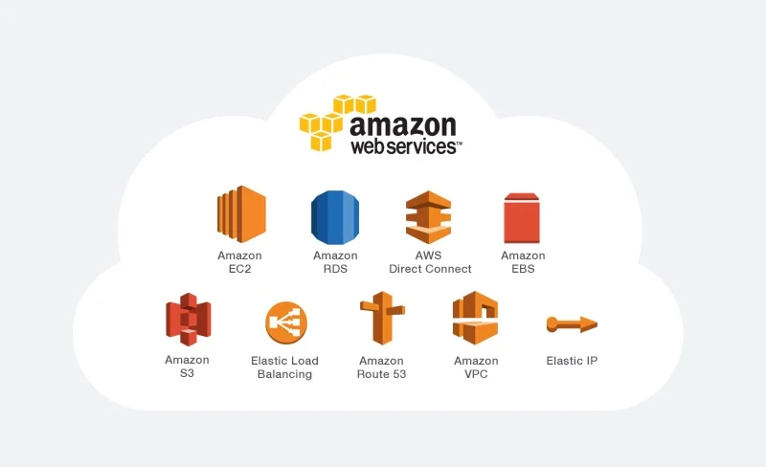
AWS Web Services

Slide 12
AWS Cost Optimization
• Turn off unused resources
• Monitor spending
• AWS bills can surprise like electricity bills

Slide 13
Real Life Examples
• Google Drive uploads
• Netflix streaming
• Office shared drives

Slide 14
Future of Cloud
AI + Cloud = Future
Jobs evolving, not disappearing

Slide 15
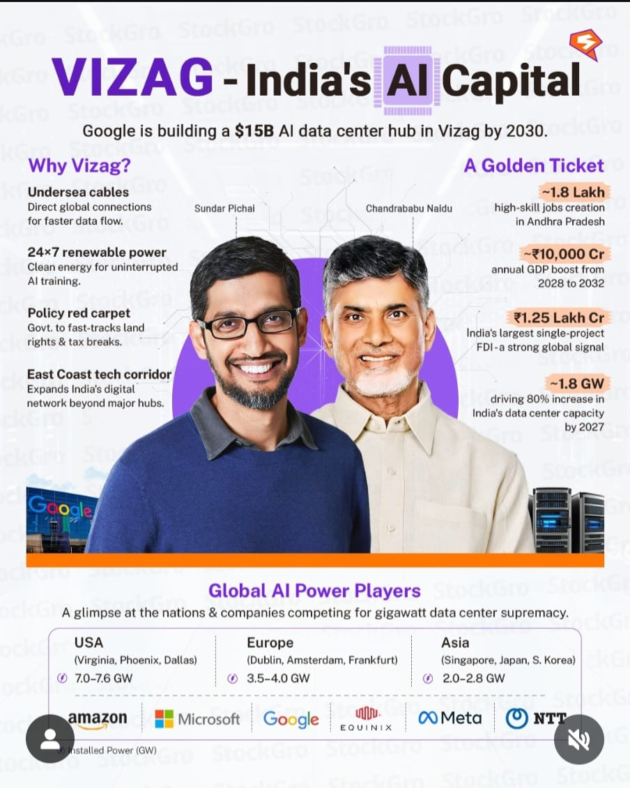

Slide 16

Thank You!

