Slide 1
File System Organization
Chapter 17

Slide 2
Key concepts in chapter 17
File system structures on disk
  free blocks
  file descriptors
  mounting file systems
  location of file blocks
  variations
Booting an OS
File system optimization
  log-structured file systems

Slide 3
File systems
File system: a data structure on a disk that holds files
  actually a file system is in a disk partition
  a technical term different from a “file system” as the part of the OS that implements files
File systems in different OSs have different internal structures

Slide 4
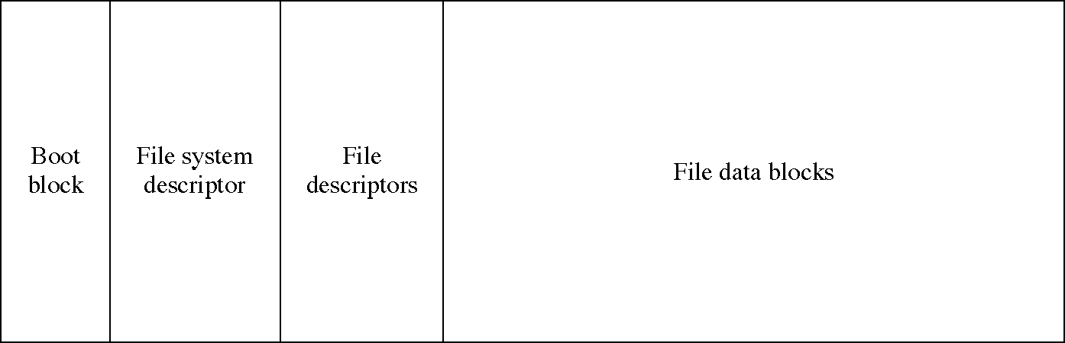
A file system layout

Slide 5
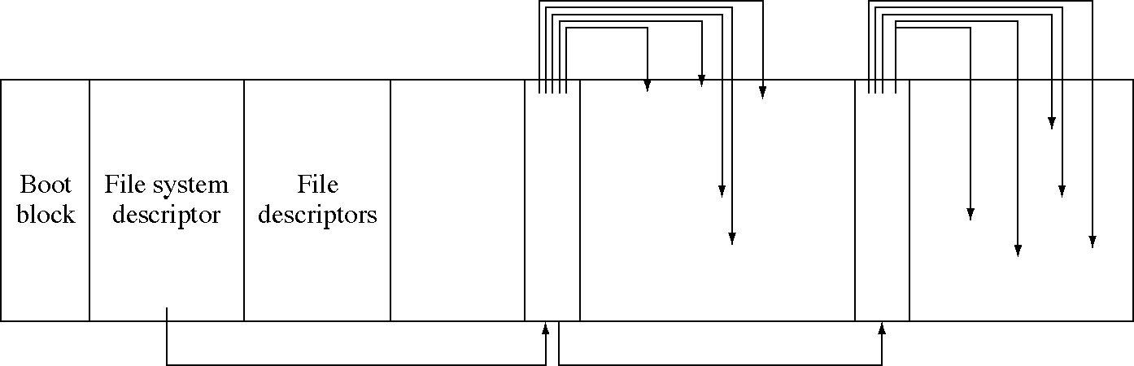
Free list organization

Slide 6
File system descriptor
The data structure that defines the file system
Typical fields
  size of the file system (in blocks)
  size of the file descriptor area
  first block in the free block list
  location of the file descriptor of the root directory of the file system
  times the file system was created, last modified, and last used

Slide 7
File system layout variations
MS/DOS uses a FAT (file allocation table) file system
  so does the Macintosh OS (although the MacOS layout is different)
New UNIX file systems use cylinder groups (mini-file systems) to achieve better locality of file data

Slide 8
Mounting file systems
Each file system has a root directory
We can combine file systems by mounting
  that is, link a directory in one file system to the root directory of another file system
This allows us to build a single tree out of several file systems
This can also be done across a network, mounting file systems on other machines

Slide 9
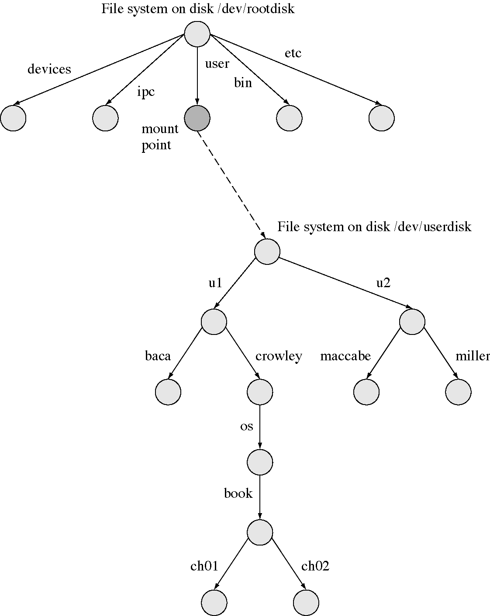
Mounting a file system

Slide 10
Locating file data
The logical file is divided into logical blocks
Each logical block is mapped to a physical disk block
The file descriptor contains data on how to perform this mapping
  there are many methods for performing this mapping
  we will look at several of them

Slide 11
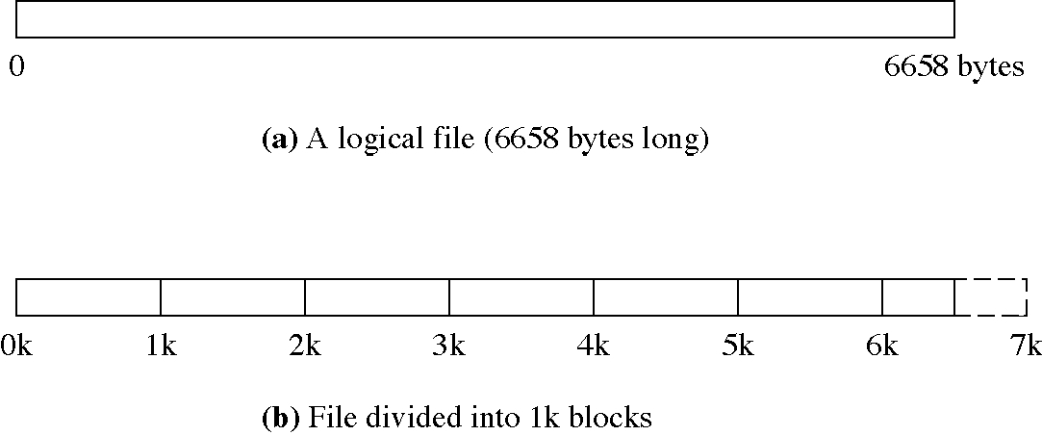
Dividing a file into blocks

Slide 12
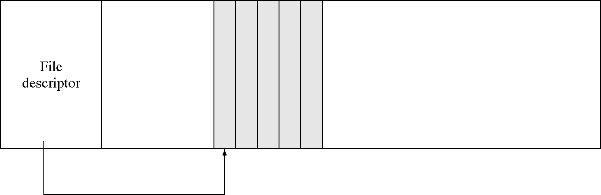
A contiguous file

Slide 13
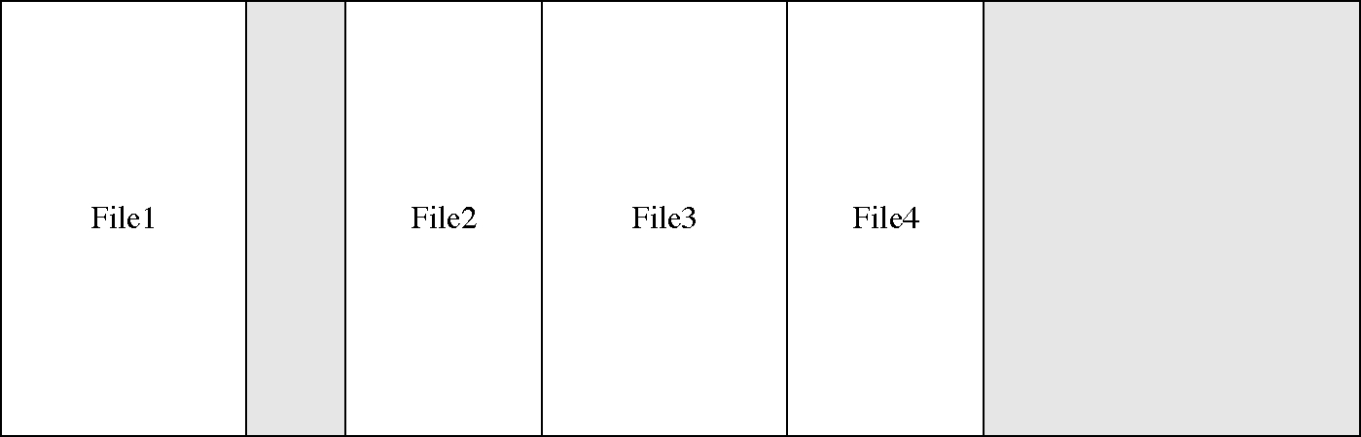
Extending contiguous files

Slide 14
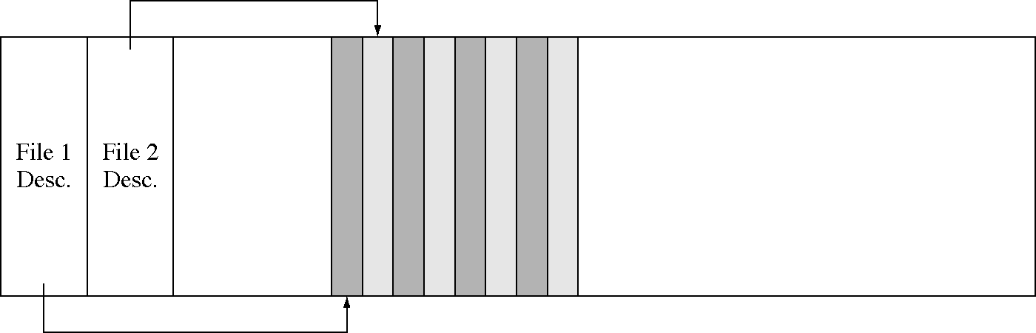
Two interleaved files

Slide 15
Keeping a file in pieces
We need a block pointer for each logical block, an array of block pointers
  block mapping indexes into this array
But where do we keep this array?
  usually it is not kept as contiguous array
  the array of disk pointers is like a second related file (that is 1/1024 as big)

Slide 16
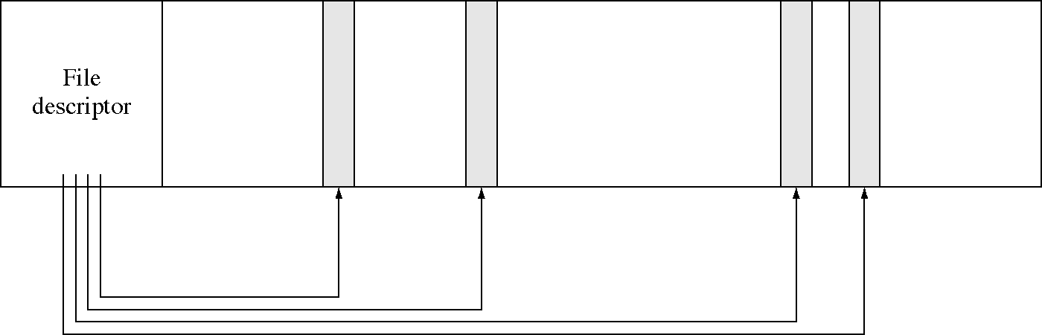
Block pointers in the file descriptor

Slide 17
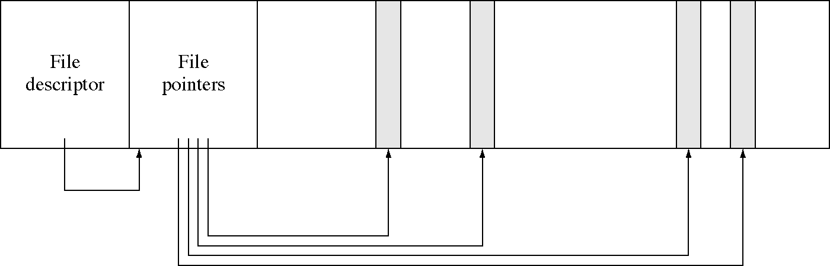
Block pointers in contiguous disk blocks

Slide 18
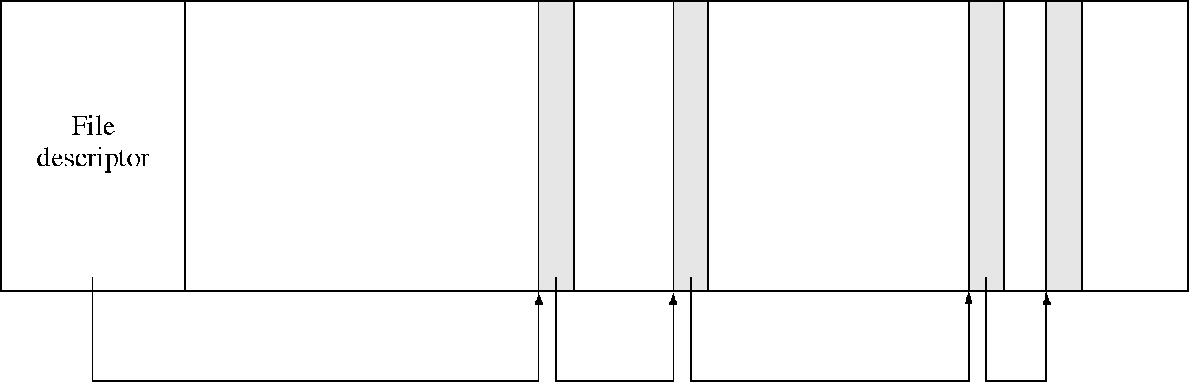
Block pointers in the blocks

Slide 19
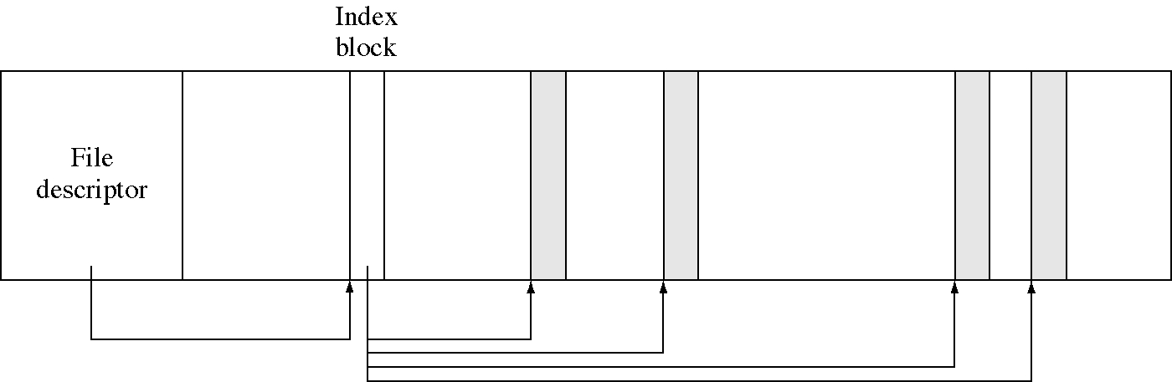
Block pointers in an index block

Slide 20
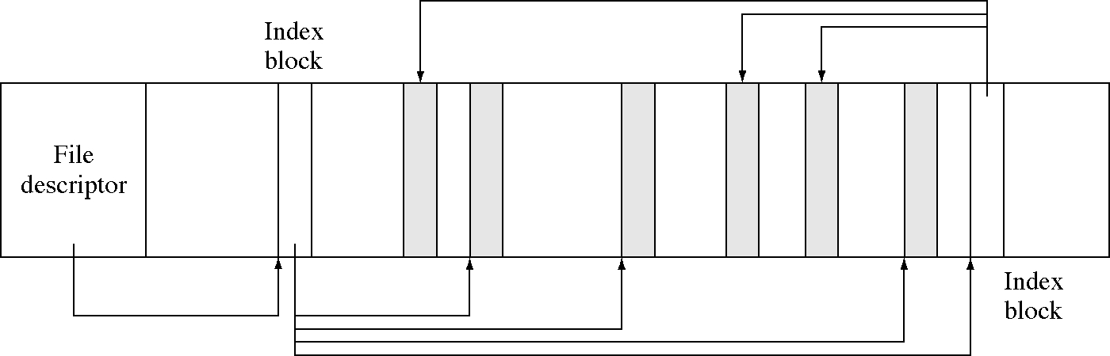
Chained index blocks

Slide 21
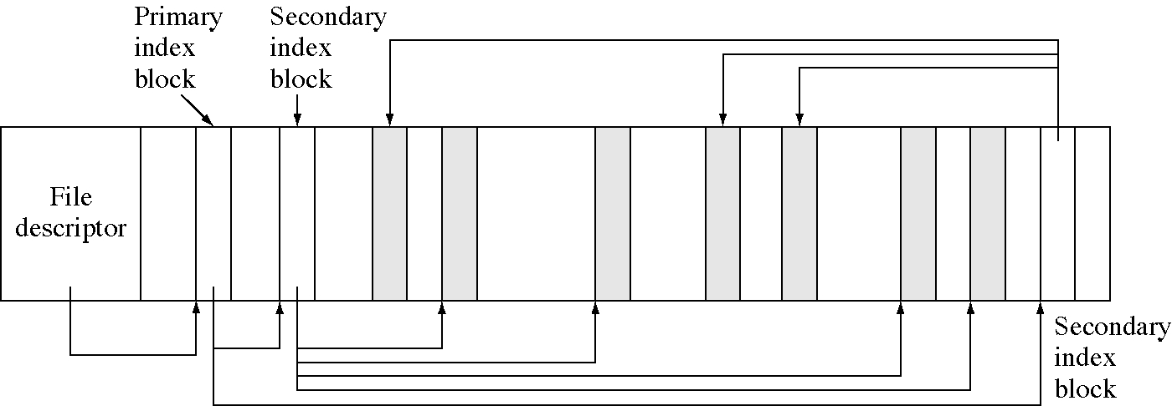
Two-level index blocks

Slide 22
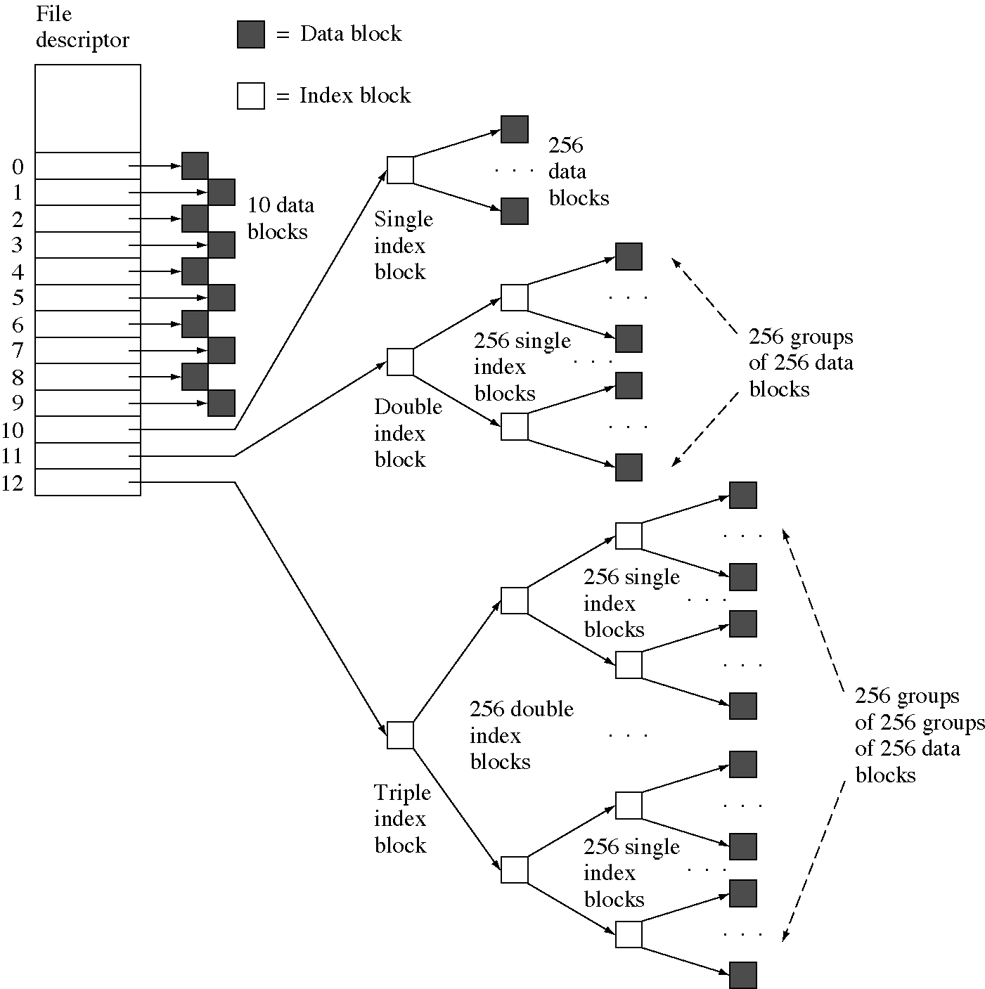
The UNIX hybrid method

Slide 23
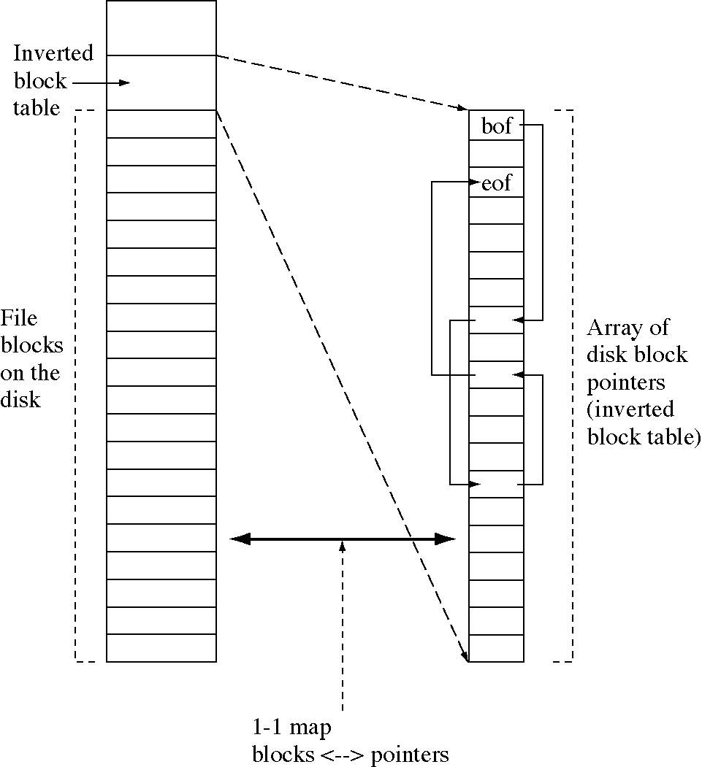
Inverted disk block index (FAT)

Slide 24
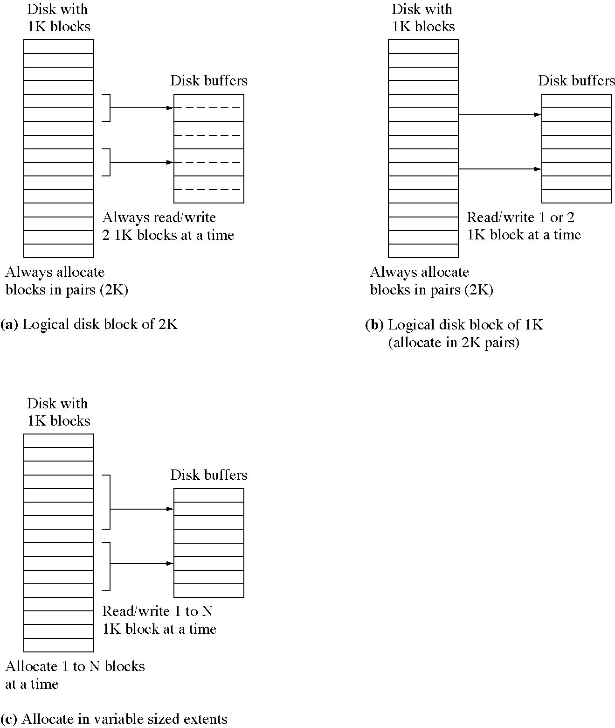
Using larger pieces

Slide 25
Fixed size extents
// Assume some maximum file size
#define MaxFileBlocks 1000
// This is the array of logical to physical blocks
DiskBlockPointer LogicalToPhysical[MaxFileBlocks];
// This is the procedure that maps a logical block
// number into a physical block number.
DiskBlockPointer
LogicalBlockToPhysicalBlock(int logicalBlock) {
// Look the physical block number up in the table.
return LogicalToPhysical[logicalBlock];
}

Slide 26
Variable sized extents
struct ExtentStruct {
DiskBlockPointer baseOfExtent;
int lengthOfExtent;};
ExtentStruct Extents[MaxFileBlocks];
DiskBlockPointer
LogicalBlockToPhysicalBlock(int logicalBlock) {
int lbOfNextBlock = 0;
int extent = 0;
while( 1 ) {
int newlb = lbOfNextBlock
+ Extents[extent].lengthOfExtent;
if( newlb > logicalBlock )
break;
lbOfNextBlock = newlb;
++extent;
}
// The physical block is an offset from the first
// physical block of the extent.
return Extents[extent].baseOfExtent
+ (logicalBlock-lbOfNextBlock);
}

Slide 27
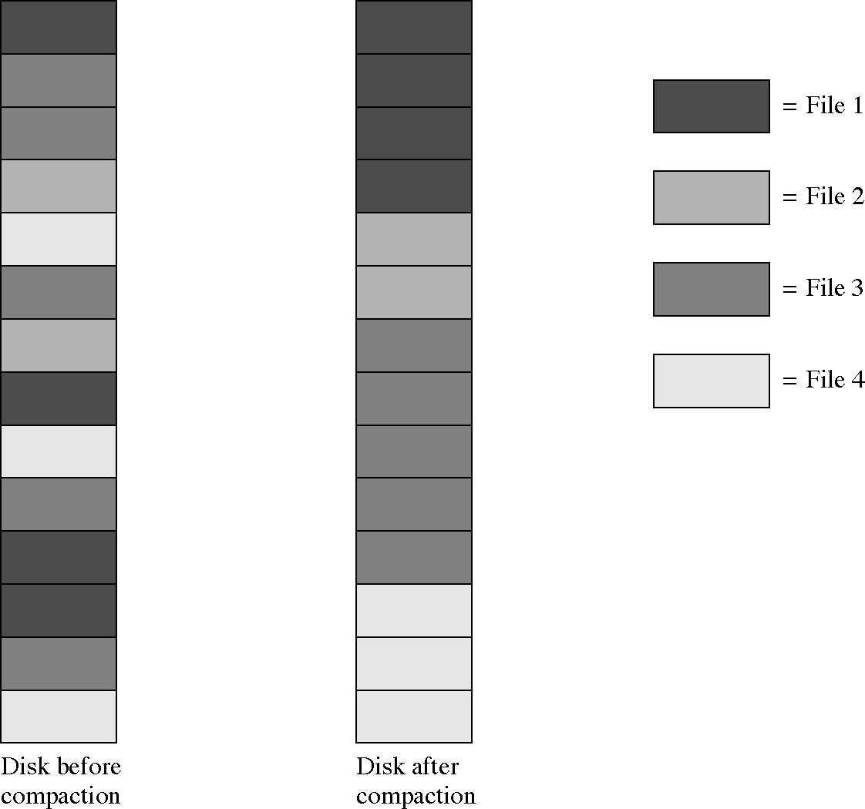
Disk compaction

Slide 28
Block mapping (1 of 2)
BlockNumber LogicalToPhysical(
BlockNumber lbn, FileDescriptor *fd) {
// lbn = logical block number
BlockBufferHeader * header;
BlockNumber pbn; // physical block number
// first see if it is in one of the direct blocks
if( lbn < DirectBlocksInFD )
// if so return it from the direct block
return fd->direct[lbn];
// subtract off the direct blocks
lbn -= DirectBlocksInFD;
if( lbn < BlocksMappedByIndirectBlock ) {
header = GetDiskBlock( DiskNumber, indirect );
if( header == 0 ) return 0; // past EOF?
// treat the block an an indirect block
pbn = ((IndirectBlock *)(header->buffer))[lbn];
FreeDiskBlock( header );
return pbn;
}
// subtract off the single level indirect blocks
lbn -= BlocksMappedByIndirectBlock;

Slide 29
Block mapping (2 of 2)
BlockNumber ibn, dibn; //indirect block numbers
// fetch the double indirect block
header = GetDiskBlock(DiskNumber, doubleIndirect);
if( header == 0 ) return 0; // past end of file?
// which indirect block in the double indirect block
ibn = lbn / BlocksMappedByIndirectBlock;
// get the number of the indirect block
dbn = ((IndirectBlock *)(header->buffer))[ibn];
// we are done with the double indirect block
FreeDiskBlock( header );
// fetch the single indirect block
header = GetDiskBlock( dbn );
if( header == 0 ) return 0; // past end of file?
// figure out the offset in this block
lbn -= ibn * BlocksMappedByIndirectBlock;
// or: lbn = ibn % BlocksMappedByIndirectBlock;
pbn = ((IndirectBlock *)(header->buffer))[lbn];
FreeDiskBlock( header );
return pbn;
}

Slide 30
Typical file sizes
Most files are small, one study showed
    24.5% <512; 52% <3K; 66.5% <11K; 95% <110K
Another study showed
    12% < 128 bytes
    23% < 256 bytes
    35% < 512 bytes
    48% < 1K bytes
    61% < 2K bytes
    74% < 4K bytes
    85% < 8K bytes
    93% < 16K bytes
    97% < 32K bytes
    99% < 64K bytes

Slide 31
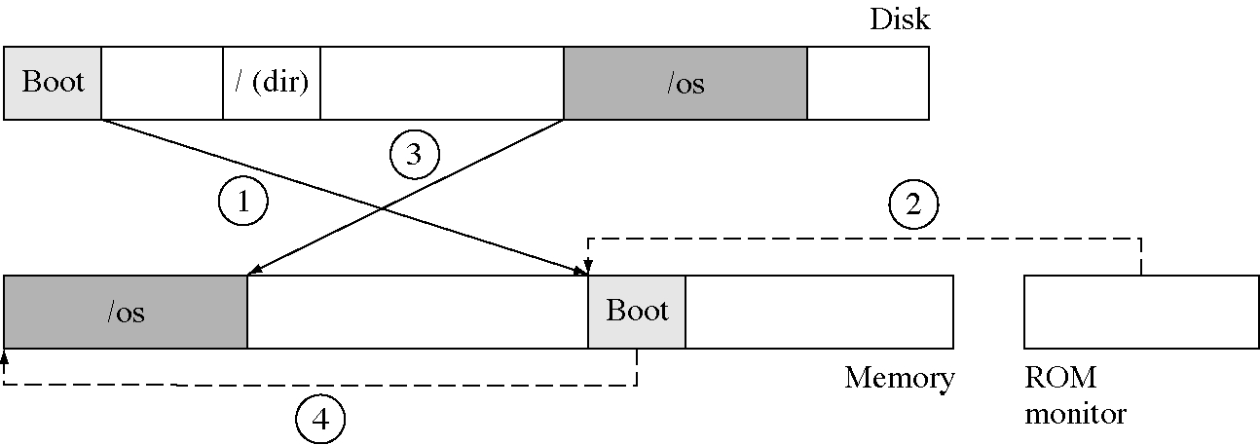
Booting an OS

Slide 32
Optimizing file system performance
Compact files to make then physically contiguous on the disk
Compress file data so it takes fewer blocks
Use larger block sizes
  but this causes more internal fragmentation
Log-structured file systems
  all writes at the end of the log

Slide 33
File system reliability
Backups
  full backup: the entire file system
  incremental backup: of files changed since the last backup
  Plan 9 does a full backup every night to a CD jukebox
Consistency checking
  use redundancy to detect and rebuild damaged file systems
  usually done on system boot

Slide 34
Multiple file systems
Most OSs now have loadable file systems and support any number of file system organizations
File system drivers are like device drivers but implement abstract file system operations
Some file systems support special needs
  the file system driver can do whatever it wants (like device drivers) and simulate various effects

Slide 35
Major file system organizations
System 5 UNIX
Berkeley UNIX
MS/DOS: FAT file system
NT file system
CD/ROM (a.k.a. high sierra)
NFS: network file system
Macintosh file system

Slide 36
Specialty file systems in SVR4
tmpfs: totally in VM, more efficient than RAM disk
/proc: information about running processes
/system/processors: information about processors
loopback: allows extending a file system with just a few new operations
fifo: for IPC
And others

