Slide 1

Building an Intelligent Industrial Product Configurator
Enhancing tool selection through advanced technology
Notes:
---

Slide 2
Industrial Tool Advisor Overview
Notes:
Core Features of the Intelligent Tool Advisor, Challenges in Accessing Industrial Tools

Slide 3

Core Features of the Intelligent Tool Advisor
Hybrid Retrieval Mechanism
  Combines semantic search with metadata filtering to accurately interpret complex technical queries in tool selection.
Real-Time Logical Decision Layers
  Parses user queries before retrieval to extract filters and constraints, ensuring precise and relevant results.
Stateful Multi-Turn Conversations
  Maintains session memory to enable users to refine queries progressively without losing context.
Structured Machine-Readable Output
  Delivers consistent JSON responses for seamless integration with automation and enterprise systems.
Notes:
The Intelligent Industrial Tool Advisor integrates a range of advanced AI-driven capabilities to streamline tool selection in complex industrial environments. It functions as a conversational product advisor that leverages hybrid retrieval mechanisms combining both semantic search and metadata filtering, enabling it to interpret technical queries with high accuracy. For instance, when a user searches for an “18V cordless tightening tool with 80 Nm,” the advisor identifies key specifications such as voltage and torque while contextualizing them within the broader tool dataset. The system also incorporates real-time logical decision layers where query parsing precedes retrieval, ensuring that each user input is analyzed for extractable filters and meaningful constraints. A significant strength lies in its ability to maintain stateful multi-turn conversations through session memory, allowing users to refine queries progressively—for example, starting with “nutrunner” and later adding “18V” without losing context. Furthermore, the advisor's structured JSON output delivers consistent and machine-readable responses suitable for downstream automation or integration with enterprise systems. By combining precise metadata-based filtering with flexible semantic understanding, the tool overcomes limitations of static catalogs and reduces dependency on human experts, thereby improving operational efficiency and accelerating product selection workflows.

Slide 4

Challenges in Accessing Industrial Tools
Complex Tool Catalogs
  Industrial tool catalogs contain hundreds of specialized tools with varied technical specifications requiring careful navigation.
Manual Search Challenges
  Manual searching through multiple formats like PDFs and spreadsheets is time-consuming and error-prone.
Ambiguous Queries
  Ambiguous search queries often lead to guesswork and irrelevant results due to poor search interfaces.
Need for AI Assistance
  An AI-assisted system can automate tool interpretation and filtering, improving accuracy and reducing effort.
Notes:
Industrial environments often contain extensive catalogs comprising over a hundred specialized tools, each with technical properties such as voltage, torque thresholds, safety ratings including IP codes, and application-specific parameters. Navigating these catalogs manually—especially when tools are distributed across PDFs, spreadsheets, or siloed internal systems—can be time‑consuming and prone to errors. Sales engineers frequently act as intermediaries, interpreting specifications and recommending appropriate tools based on experience, but this human-dependent process introduces bottlenecks. Moreover, typical search interfaces struggle with ambiguous queries such as “a tightening tool” or “a machine for assembly,” leading users to guess terminology or manually filter through irrelevant items. A common scenario illustrates the complexity: a user searching for “18V cordless tightening tool with 80 Nm” must cross‑reference torque tables, voltage compatibility charts, and model variations, all of which add cognitive load. Static PDFs exacerbate the issue by lacking interactivity, meaning users cannot apply dynamic filters or perform contextual search. These challenges collectively demonstrate the need for an intelligent, AI‑assisted approach that automates interpretation, filtering, and retrieval, while maintaining accuracy and reducing manual effort.

Slide 5
Solution and Architecture
Notes:
AI-Powered Solution Workflow, Platform Architecture Components

Slide 6

AI-Powered Solution Workflow
Natural Language Query Parsing
  User input is parsed to extract key metadata like torque, voltage, and tool categories for precise processing.
Hybrid Retrieval System
  Metadata filtering narrows down results before semantic search aligns concepts using vector embeddings.
Clarification Checkpoint
  System detects vague queries and prompts users with targeted questions to reduce ambiguity and errors.
AI Reasoning and Response Generation
  LLM consolidates filtered data, reasons, and generates structured JSON including tool recommendations.
Notes:
The Intelligent Industrial Tool Advisor follows a carefully orchestrated pipeline that ensures every user query is processed with precision and contextual understanding. The flow begins with natural language input from the user, which undergoes query parsing to extract relevant metadata such as torque ranges, battery voltage, tool category, or automation requirements. These extracted filters form the backbone of the hybrid retrieval system, where metadata filtering acts as the first layer of constraint-based narrowing. Once this filter set is applied, the refined subset passes into a semantic search mechanism powered by embeddings indexed within a FAISS vector database, enabling conceptual alignment even when user terminology differs from catalog naming conventions. Before proceeding to final reasoning, a clarification checkpoint evaluates whether the query is too vague or returns overly broad results; if so, the system proactively asks targeted questions, preventing premature LLM involvement and reducing hallucination risk. After ambiguity resolution, the Large Language Model (LLM) consolidates the filtered results, performs reasoning, and generates a structured JSON response that includes tool recommendations, metadata, and optionally images. This tightly controlled architecture ensures explainability, determinism, and accuracy in high‑stakes industrial selection tasks.

Slide 7
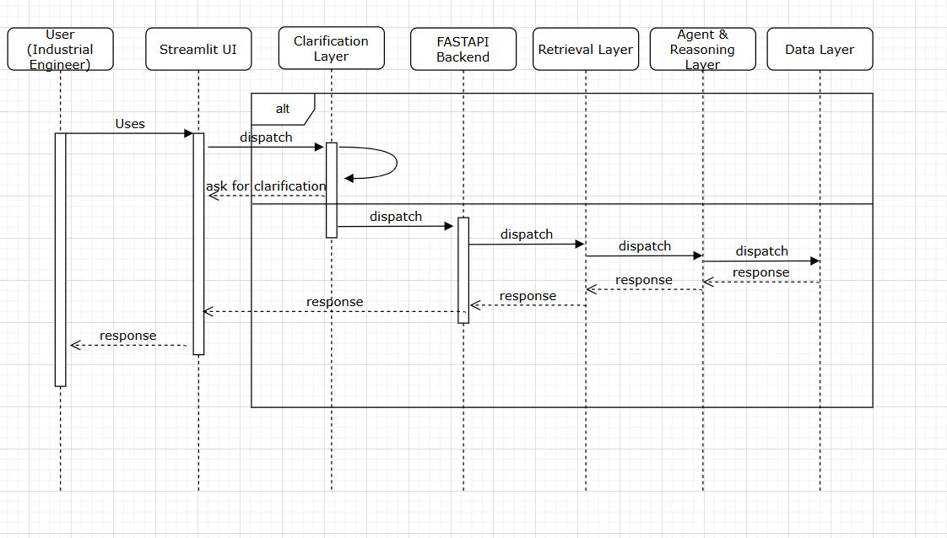
Sequence Diagram

Slide 8

Platform Architecture Components
Frontend Interface
  Streamlit offers a lightweight, interactive interface ideal for demonstrations and operator use.
Backend Engine
  FastAPI handles requests, routes data, and interfaces with vector databases and AI modules efficiently.
Agent Orchestration Framework
  CrewAI coordinates query parsing, clarification, metadata extraction, and reasoning tasks systematically.
Semantic Search and Session Management
  FAISS enables semantic search with vector indexing; a session manager maintains multi-turn conversation context.
Notes:
The system architecture integrates multiple components that collectively enable efficient querying, retrieval, and response generation. Streamlit serves as the frontend interface, offering a lightweight and interactive user experience suitable for demonstrations and operator use. FastAPI functions as the backend engine responsible for handling requests, routing data, and interfacing with both the vector database and the LLM modules. CrewAI acts as the agent orchestration framework, coordinating steps such as query parsing, clarification logic, metadata extraction, and final reasoning. The LLM powering inference—OpenAI’s GPT‑4o‑mini—executes controlled reasoning over curated data inputs rather than free‑form generative responses. Tool specifications and media assets are stored in local JSON files and image directories for rapid access and seamless updates. FAISS powers semantic search by indexing embeddings of tool descriptions, enabling similarity-based retrieval across high-dimensional vectors. A session manager maintains context throughout multi-turn conversations by storing extracted filters, previous queries, and conversation history in structured session objects. The architectural principle intentionally positions the LLM as the final step in processing to maximize determinism, accuracy, and safety while minimizing hallucination risks.

Slide 9
Innovations and Enhancements
Notes:
Hybrid Retrieval Mechanism, Clarification Loop and Query Disambiguation, Session Memory for Multi-Turn Interaction

Slide 10
Hybrid Retrieval Mechanism
Limitations of Traditional Methods
Semantic search alone may miss exact tool specifications; metadata filtering cannot handle natural language queries well.
Hybrid Retrieval Approach
Combines filter extraction from queries with semantic ranking to improve precision and contextual relevance in tool selection.
Benefits of Hybrid System
Reduces false positives, minimizes hallucination risks, and ensures robustness with precise and context-aware results.
Notes:
Hybrid retrieval is one of the most critical innovations driving the accuracy of the Intelligent Industrial Tool Advisor. Traditional RAG pipelines rely heavily on semantic search, which, while powerful, may fail to match exact industrial specifications, such as identifying tools with precise torque values or voltage levels. Conversely, metadata-only filtering lacks the ability to interpret natural language queries where users may express requirements implicitly or imprecisely. The hybrid approach combines both strengths by first extracting filters from the user's query—such as torque 80 Nm, cordless operation, or 18V power—and applying them to narrow the dataset with deterministic precision. After this filtering, a semantic search runs atop the reduced pool, ranking tools based on contextual alignment with the user’s intent. This dual-layer approach dramatically improves precision by reducing false positives and ensures the semantic model does not overpower factual requirements. Examples show improved selection quality where tools meeting exact torque constraints also align with descriptions like “compact” or “high‑speed tightening.” The system's retrieval design reduces hallucination risk and ensures robustness even in edge cases where catalog terminology differs from user phrasing. Ultimately, hybrid retrieval offers an optimized balance between rule‑based filtering and intelligent semantic understanding.

Slide 11

Clarification Loop and Query Disambiguation
Resolving Query Ambiguity
  The Clarification Loop addresses vague queries by asking targeted questions to get precise user intent before proceeding.
Reducing Hallucinations
  By verifying query parameters early, the system minimizes incorrect inferences and improves result accuracy.
Multi-turn Conversation Integration
  The system seamlessly merges new user details with previous context for continuous, coherent interactions.
Enhanced User Engagement
  Clarification questions guide users to better define their needs, boosting satisfaction and recommendation quality.
Notes:
The Clarification Loop transforms the system from a simple search engine into an interactive assistant capable of resolving ambiguity before errors occur. Many user queries—such as “tool,” “machine,” or “nutrunner”—are inherently vague and lack sufficient parameters for deterministic filtering. In traditional RAG systems, such requests often lead to hallucinations because the LLM attempts to infer missing details. The advisor instead performs a clarity check after initial metadata extraction. If no meaningful filters are found or if the filtered set is overly large, the system triggers a clarification question such as “What torque range do you need?” or “Is this for automated or manual operation?” This intervention ensures that the system only proceeds when the request is sufficiently constrained. The logic also integrates seamlessly with multi‑turn conversations; for instance, if the user later adds “18V,” the system merges this detail with prior context rather than treating it as a fresh query. The structured clarification process prevents misalignment, reduces hallucinations, and promotes user engagement by guiding them toward precise problem definition. This technique has shown significant improvement in recommendation accuracy and user satisfaction.

Slide 12

Session Memory for Multi-Turn Interaction
Contextual Query Refinement
  Session memory allows natural, incremental refinement of user queries across multiple interactions with maintained context.
Context Reset on Topic Shift
  The system detects domain changes and resets context to prevent incorrect information carryover between topics.
Structured Session Data
  Storing structured session data reduces noise and improves consistency in multi-step dialogues within industrial workflows.
Notes:
Session memory enables natural, conversational refinement of tool requirements across multiple user interactions. Without memory, each query would be treated independently, causing contextual loss; for example, a user stating “nutrunner” followed by “18V” might confuse a stateless system. The advisor instead maintains session‑level objects containing extracted filters, prior queries, and conversational history. When receiving short refinements, such as adding “cordless,” the system merges these details with existing metadata to progressively narrow down options. Conversely, if the user shifts topics entirely—such as switching from “nutrunner” to “spindle”—the system detects domain change and resets context appropriately to avoid incorrect carryover. This adaptive memory design improves both accuracy and naturalness in human‑AI interaction. It supports industrial workflows where operators typically refine queries gradually rather than specifying all constraints upfront. By storing structured session data instead of free‑form text, the system ensures predictability, reduces noise, and enhances its ability to deliver consistent results even during complex multi-step dialogues.

Slide 13
Evaluation, Lessons, and Future
Notes:
Lessons Learned from Deployment, Future Enhancements and Roadmap

Slide 14

Lessons Learned from Deployment
Clarification-First Strategy
  Clarification-first approach reduced hallucinations and improved user satisfaction by capturing missing constraints early.
Hybrid Search Advantages
  Hybrid search combined semantic and metadata searches to achieve precise specification matching and better results.
Deterministic Filtering Reliability
  Deterministic filtering before LLM involvement ensured reproducibility and minimized error propagation for industrial use.
Operational Challenges
  Issues like metadata inconsistencies, context management complexity, and FAISS index rebuilding introduced operational overhead.
Notes:
Deployment of the Intelligent Tool Advisor revealed several successful design strategies along with practical challenges. The clarification‑first approach consistently reduced hallucinations and improved user satisfaction by capturing missing constraints early. Hybrid search demonstrated clear advantages over pure semantic or pure metadata search, notably in cases requiring exact specification matching. Deterministic filtering prior to involving the LLM ensured reproducibility and minimized error propagation, making the system more reliable for industrial environments. Dynamic loading of tool data from JSON enabled fast updates without requiring major architectural changes. However, challenges emerged, such as inconsistencies or typos in metadata fields, which affected filter accuracy. Managing when to reset or preserve conversation context required nuanced logic to maintain relevance without creating confusion. Rebuilding the FAISS index after catalog updates introduced operational overhead, particularly for larger datasets. Despite these hurdles, user feedback validated that the architectural emphasis on control, determinism, and clarity aligned well with real-world needs.

Slide 15

Future Enhancements and Roadmap
Tool Comparison Features
  Future updates will enable side-by-side evaluation of tools based on torque, weight, voltage, and speed.
Enhanced Sales and Procurement
  Integrating price filtering and availability data will create a comprehensive sales and procurement advisor.
User Interaction Improvements
  Voice interface and PDF export will simplify interactions and support reporting needs.
System Architecture and Integration
  Maintaining structured intelligence and deeper ERP integration will ensure scalability and trust.
Notes:
Several future enhancements are planned to expand the system’s capabilities and improve user experience. Tool comparison features will allow users to evaluate multiple candidate tools side‑by‑side across specifications such as torque, weight, voltage, and speed. Price filtering and availability data integration will transform the advisor into a more comprehensive sales and procurement tool. PDF export functionality will support reporting needs by enabling one‑click generation of recommendation summaries. A voice interface would further simplify interaction, especially in hands‑busy environments such as assembly lines. Additional improvements include automated metadata cleaning, incremental FAISS index updates to reduce rebuild time, and deeper integration with enterprise resource planning (ERP) systems. As the system evolves, maintaining the architectural principle that “intelligence comes from structure, not model size” will ensure robustness, scalability, and trustworthiness.

