Slide 1
Springboard Project: Emerging Business Opportunities (Case-Study)
Confidential
30-08-2022
satyanath

Slide 2
Topics/Agenda
01
｜
Problem Statement
06
｜
Model Results
02
｜
Data
03
｜
Data Discovery
04
｜
Data Exploration
05
｜
Model Building

Slide 3
Problem Statement
Our client (Manufacturer A) is a leading Food & Beverage manufacturer. Client wants to understand the growth patterns of consumer preferences (themes) and evaluate positioning of their brand across different themes. Client also wants to know the sales drivers of their products.

Slide 4
Data
Sales Data – At UPC level for both Client and Competitors
Social Media Data – Mentions of theme across all Social media Platforms
Google Search Data – Search volume of the Theme
Theme Product List – Product to theme Mapping
Product Manufacturer List – Product to Manufacturer Mapping
Theme List – Theme Names
Confidential
30-08-2022
satyanath

Slide 5
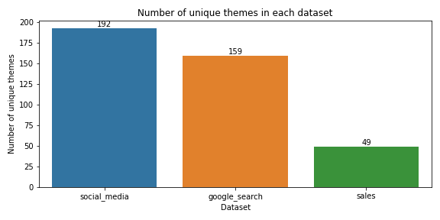
Data Discovery
Number of themes available across all data sources :
There are total of 208 themes present .
16 themes did not get publicity.
33 themes got publicity but not being searched.
Only 49 themes were contributing for sales.
Manufacture A has business in 19 themes

Slide 6
Data Discovery
consumer preference(themes) available in each data source :
Claim name | Total sales($)
Low carb | 10064350291.32
No additives preservatives | 5706705941.60
stroganoff | 5475995878.41
Apple cinnamon | 3337249869.33
salmon | 2150076179.16
Soy foods | 2041454601.01
For sales data :
Top three themes prefer by the consumers as per sales.
Low carb
No additives preservatives
stroganoff

Slide 7
Data Discovery
consumer preference(themes) available in each data source :
Theme name | Search volume | % of search volume
Ethical environment | 113502487 | 10.73
Shrimp | 77711760 | 7.34
Sugar free | 74588723 | 7.05
Honey | 73957180 | 6.99
Health | 59537486 | 5.63
Herbal | 46258132 | 4.92
diabetic | 46258132 | 4.37
For google search data :
Top three themes prefer by the consumers as per google search data
Ethical environment
Shrimp
Sugar free

Slide 8
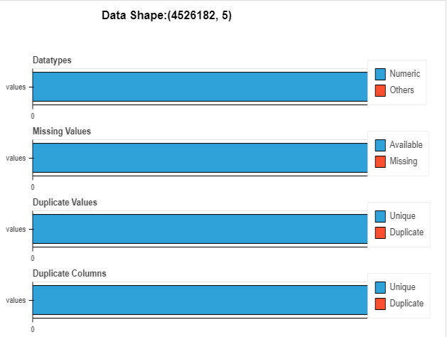
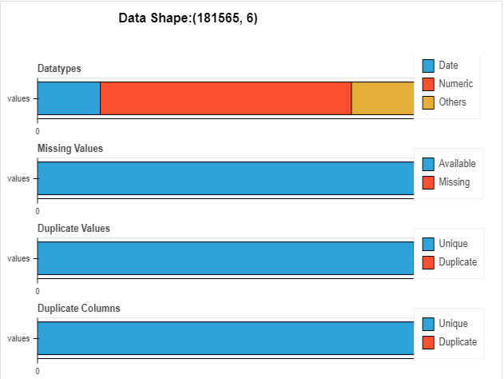
Health Analysis of Data Sources
Sales
Search

Slide 9
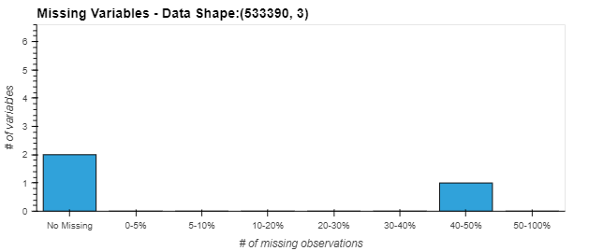
Provide a report for data sufficiency, sparsity and anomalies in each data source
Sparsity-
About 40% of the Theme ID entries in the Social Media Dataset are missing. All those were removed
Data sufficiency-
Data is not consistent through out the year .
If we aggregate data weekly, about 40-50% percent data missing for certain common themes which can not be taken for model building.
If we aggregate data monthly, November, December data missing for certain common themes

Slide 10
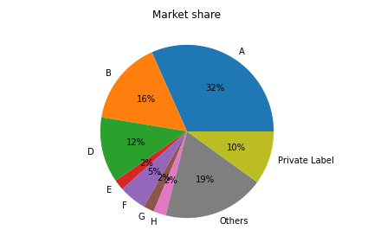
Data Exploration
The overall market share of manufacturer A:
The manufacturer A has the highest market share in the industry.
A is the leading manufacturer in terms of market share.
B has the second highest market share
The manufacturer B is the competitor of manufacturer A.

Slide 11
Potential Competitor
A threshold of 10% is taken for the competitors list
And made into a list for every Theme
A has highest competitors in Apple cinnamon, chicken theme
There are 11 themes with no competition for Client A

Slide 12
Potential Competitor of our Client A
Claim ID | Claim Name | Competitor
0 | No Claim | None
8 | Low Carb | D, Private label, F, B
15 | Beans | D, Private label (PL)
32 | Stroganoff | F, D, B,H
39 | Highsource of Protein | None
40 | No additive preservative | F, B, D, PL
58 | buckwheat | D, B, F, H
73 | Brown ale | Private label, H, B
75 | French bisque | D, B, F, Private label
81 | GMO Free | F, B, H, Private label
Claim ID | Claim Name | Competitor
120 | Crab | F, Private Label
147 | American gumbo | Private label, F, H, B
148 | Tuna | None
151 | Low Sodium | B, PL, F
152 | Low Sugar | None
158 | Chicken | PL, D, L, F, B
163 | Ethical Packaging | B, F
185 | Cookie | B, D, PL, H
186 | Pollock | B, D, PL, F, H
187 | Blueberry | Private label, F
Claim ID | Claim Name | Competitor
193 | Poultry | B
220 | Herbs | None
222 | Pizza | B, D, PL, H
224 | American Sw style | Private Label
227 | Salmon | None
287 | Tilapia | None
430 | Soyfoods | None
432 | Apple Cinnamon | B, D, F
433 | Gingerbread | B,H,F,D
437 | Vegeterian | B,H

Slide 13
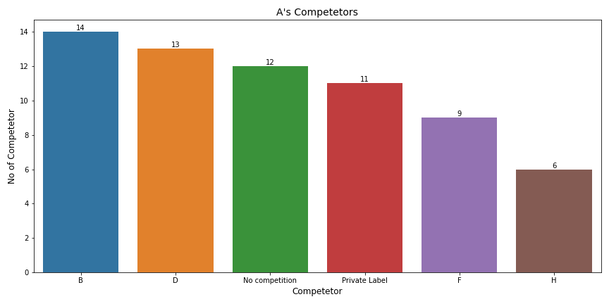
Potential Competitor
Company B is giving competition in 14 Themes
D gives competitions in 15 Themes
H is only giving competition in only 6 Themes
In 12 Themes there is no competition for client

Slide 14
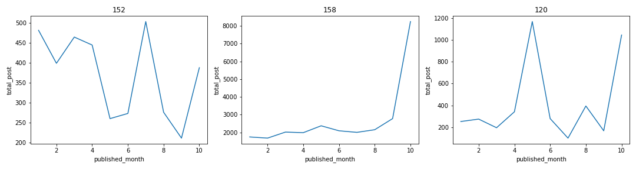
Emerging Themes in Social Media
Normalizing data between 0 and 100
Taking threshold as 60 gave 3 Themes with emerging trend
Three Themes are :
152: 'low sugar’
158: 'chicken’
120: 'crab'

Slide 15
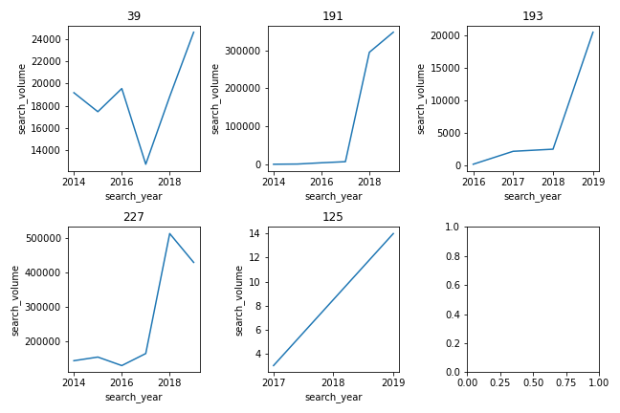
Emerging Themes in google search
Change in percentage is compared between last 3 entries of the data
If growth rate is greater that 60 between last 2nd and 3rd data is greater than 60 and growth rate between last and 2nd last data is 80 we got 5 Themes with such growth
5 Themes are :
39: 'high source of protein’
191: 'bone health’
193: 'poultry’
227: 'salmon’
125: 'nuts'

Slide 16
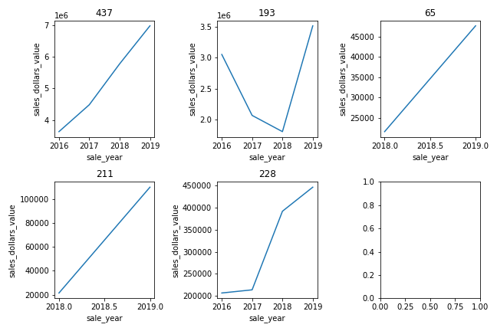
Emerging Themes in sales
Change in percentage is compared between last 3 entries of the data
If growth rate is greater that 10 between last and 2nd last data is 10 we got 5 Themes with such growth
5 Themes are:
437: 'vegetarian’
193: 'poultry’
65: 'ethical not specific’
211: 'halal’
228: 'beef hamburger'

Slide 17
Latency
Trend flows from Social -> Search -> Sales
What is the latency observed? Latency observed between Sales and Social Media data is 2 Weeks. Latency observed between Sales and Google search data is 1 Weeks. | Is the latency significantly different across themes? Yes | Pictorially represent transition between sources
Social Media
1 week
Search
1 week
Sales

Slide 18
Merging Data
Segregated the data sources based on 30 common themes .
While merging the sales data with theme product list there is one to many mapping between theme id and product id .
Fake growth of sales, unit and weight is handled by creating additional feature of length of theme and dividing with it.
Sales data, social media data, google search data, aggregated on the weekly, monthly and yearly basis.
Finally Data for only manufacturer A (our client) is segregated for the model building.
Competitors of A were made into column
A manufactures only on 19 themes

Slide 19
Final merged Data:-
Dependent Variable – Sales dollars value
Independent variable-
search volume
total post
Competitors
unit price
season

Slide 20
Model Results
OLS summary
OLS Regression Results
Dep. Variable: sales_dollars_value R-squared: 0.985
Model: OLS Adj. R-squared: 0.984
Method: Least Squares F-statistic: 7273.
Date: Tue, 30 Aug 2022 Prob (F-statistic): 0.00
Time: 11:50:26 Log-Likelihood: 1382.3
No. Observations: 2080 AIC: -2727.
Df Residuals: 2061 BIC: -2619.
Df Model: 18 Covariance Type: nonrobust

Slide 21
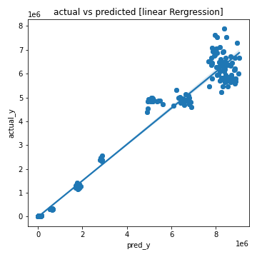
Model results
Linear regression model
Linear Regression Model
--------------------------------------------------
Test R2 0.9313
--------------------------------------------------
Train MAPE: 0.17596
Test MAPE: 6.40580
Cross Val Score of MAPE:
CV_scores: [2.335 1.089 1.137 1.914 2.223]
Bias : 1.7400822454110183
Variance: 0.5929602387157319

Slide 22
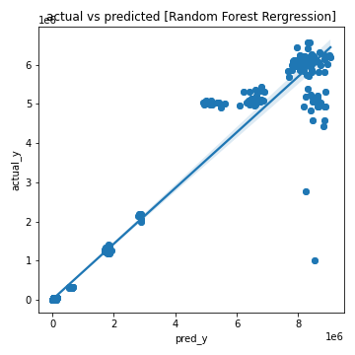
Model Results
Random Forest Regression model
Random Forest Regression Model
--------------------------------------------------
Test R2 0.8849
--------------------------------------------------
Train MAPE: 0.03161
Test MAPE: 8.66421
Cross Val Score of MAPE:
CV_scores: [1.678 1.05 1.796 1.396 1.418]
Bias : 1.4696838756712016
Variance: 0.2863812912235369

Slide 23
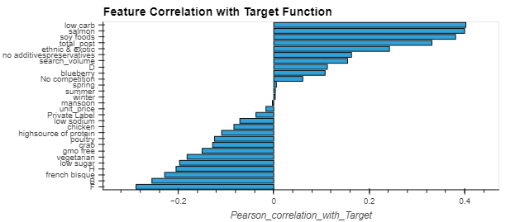
Model results
Feature Importance

Slide 24
Business intuitions
Impact on sales due to social trends, search trends, own price and competitor effects
Total post has positive impact on the sales
If we decrease the unit price sales get increase
Search volume has a positive impact
Client is performing good when there is competition with H, B, F
Themes with high business opportunity
Low carb
Soy foods
Sea foods
Salmon

Slide 25
How to achieve a 5% increase in sales overall?
By increasing the social media post across the themes will directly increases the sales.
By decreasing unit price and changing it accordingly while comparing it with competitor.
Investing in emerging themes which has significant market share (low carb, Salmon)

Slide 26
Thank You
Do you have any questions?
Name
Jitendra Kumar
Borra Venkat Satyanath Reddy

